Slide 1
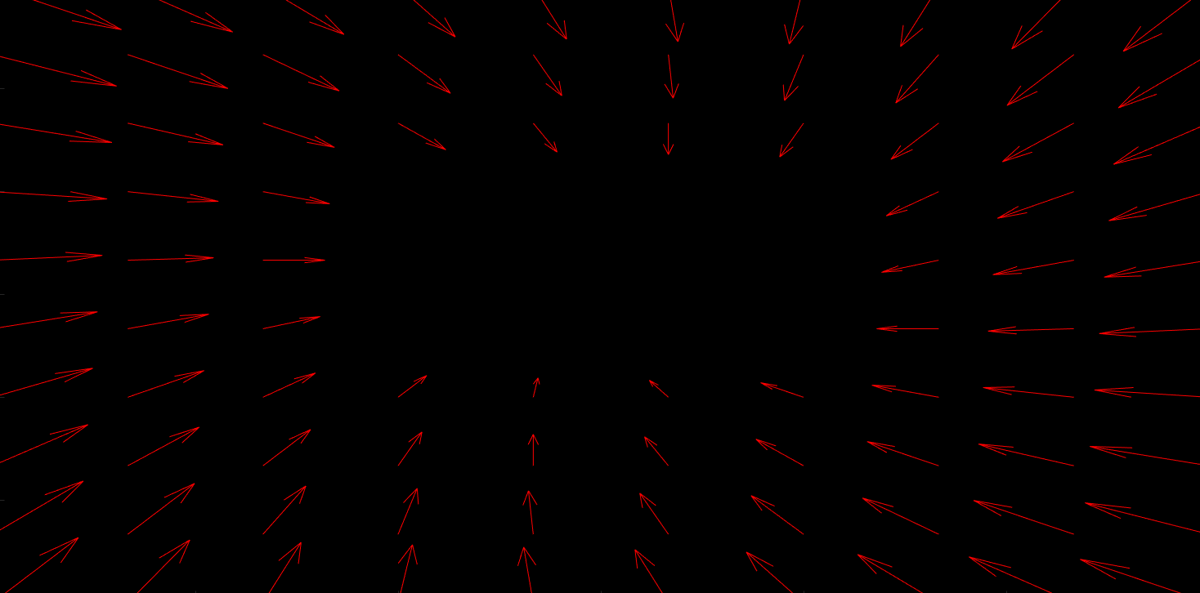
The phase plane analysis
Isocline method
Presenter : Ali Rezaei

Slide 2
Introduction
Phase plane analysis is a graphical method for studying first and second-order systems by providing motion trajectories corresponding to various initial conditions. It is used to examine the qualitative features of the trajectories and obtain information regarding the stability and other motion patterns of the system.

Slide 3
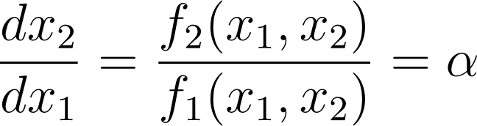
Isocline method
The basic idea in this method is that of isoclines. At a point (x1 , x2) in the phase plane, the slope of the tangent to the trajectory can be determined by following equation. An isocline is defined to be the locus of the points with a given tangent slope. An isocline with slope alpha is thus defined to be [2] :

Slide 4










Isocline pseudo code
For in the set of
Plot
Determine tangent inverse of :
Plot arrows with slope
Determine direction of arrow :
Compare and
If
Direction is increasing
If
Direction is decreasing
If
Direction is not changing

Slide 5

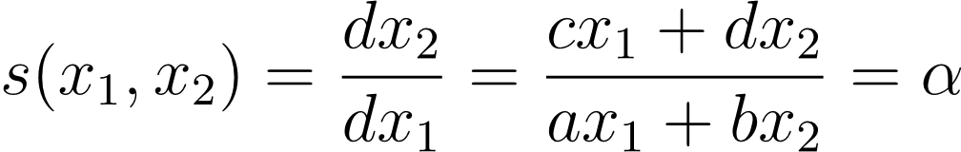
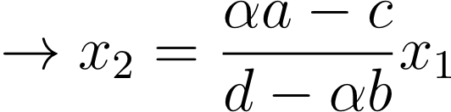

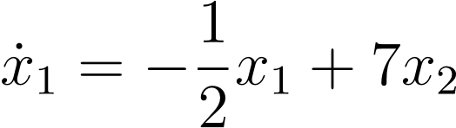
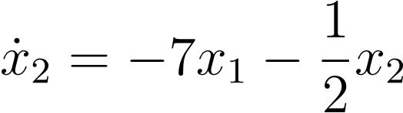
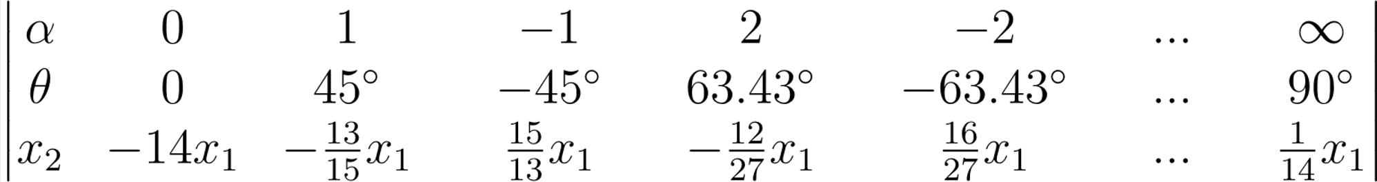
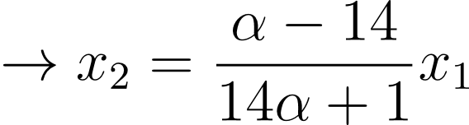
Example 1
A linear system

Slide 6
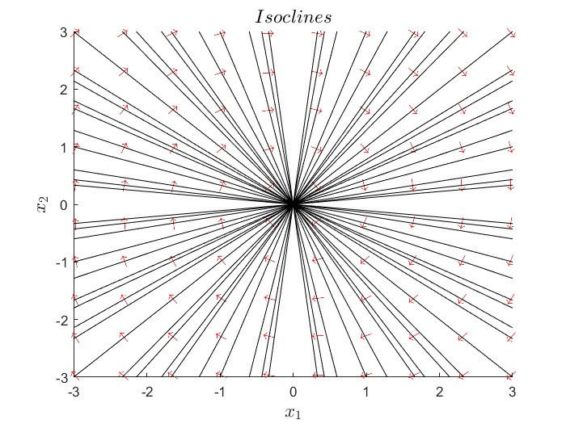
Example 1
Isoclines

Slide 7
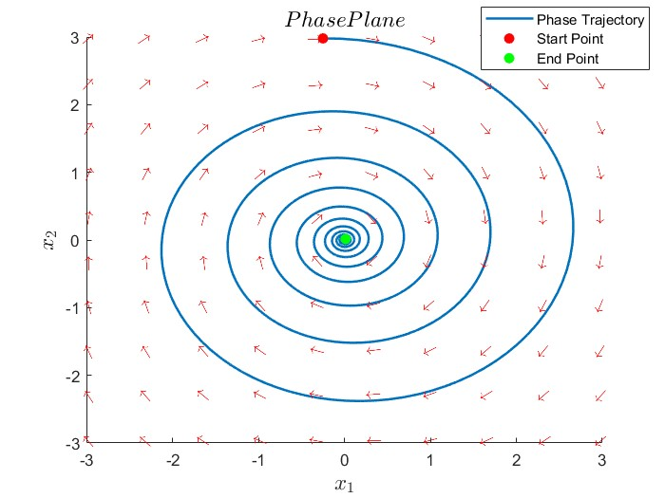
Example 1
Phase Plane

Slide 8


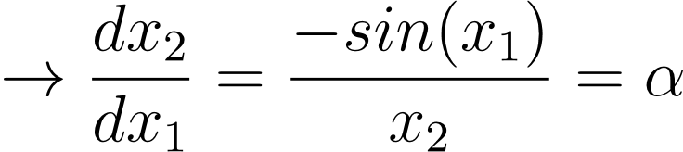
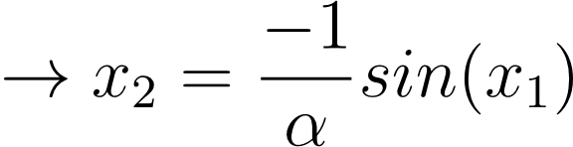
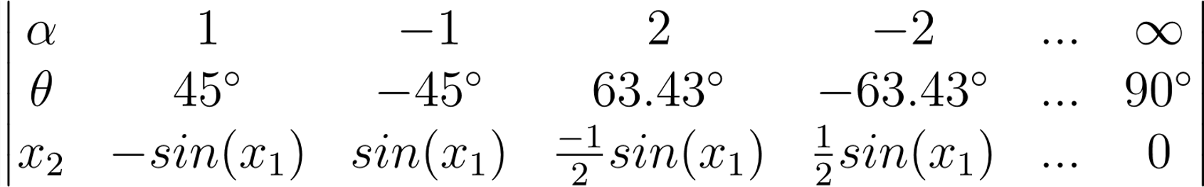
Example 2
Pendulum equation (without friction) [1],[2]

Slide 9
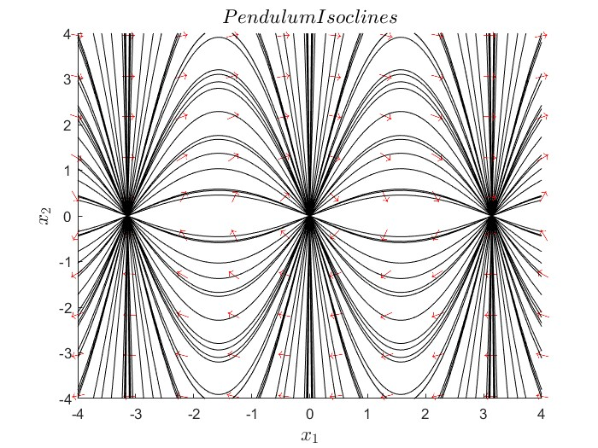
Example 2
Isoclines

Slide 10
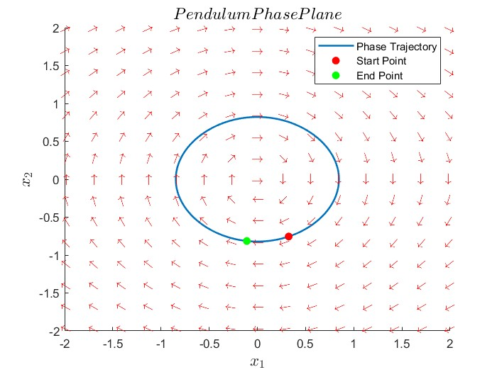
Example 2
Phase Plane

Slide 11

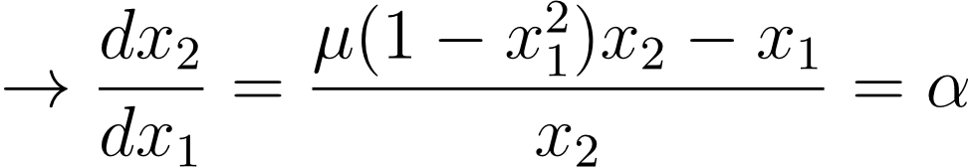
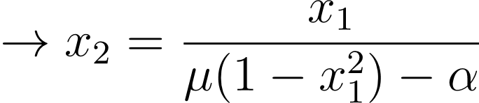
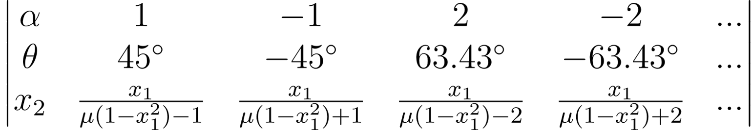
Example 3
Van der pol oscillator [1],[2]

Slide 12
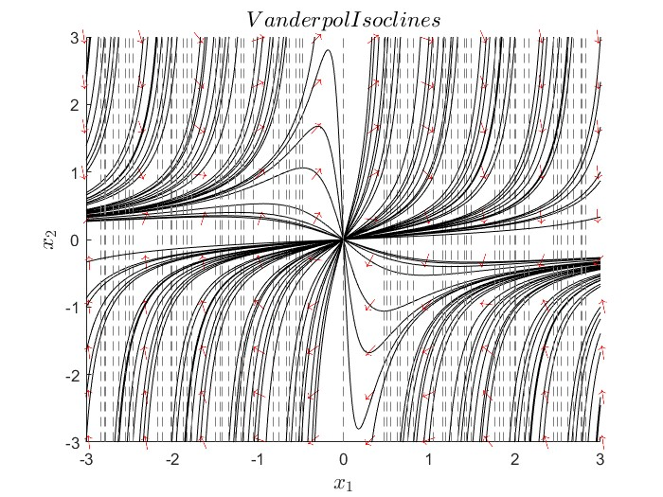

Example 3
Isoclines

Slide 13
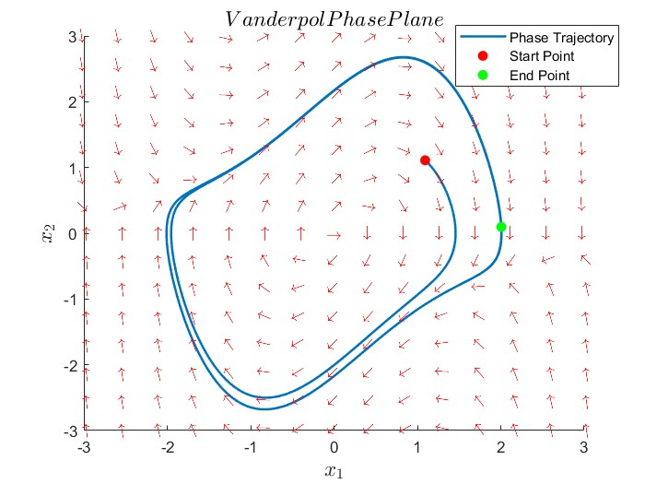
Example 3
Phase Plane

Slide 14
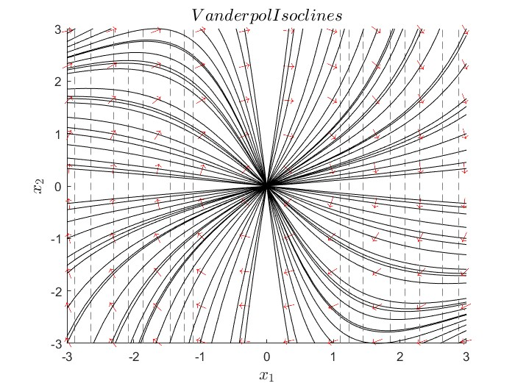

Example 3
Isoclines

Slide 15
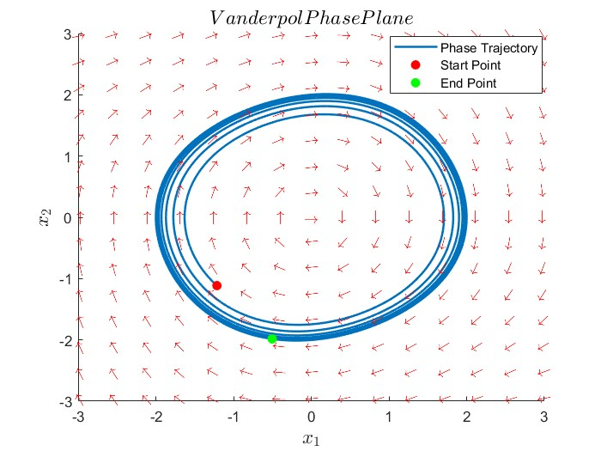
Example 3
Phase Plane

Slide 16
References
[1] M. Vidyasagar (1978). Non-linear systems analysis (1nd ed.).
[2] J. J. E. Slotin, W. Li (1991). Applied non-linear control (2nd ed.).
All Codes are available in :
https://github.com/AliiRezaei/pplane
Thank you for your attention

