Slide 1

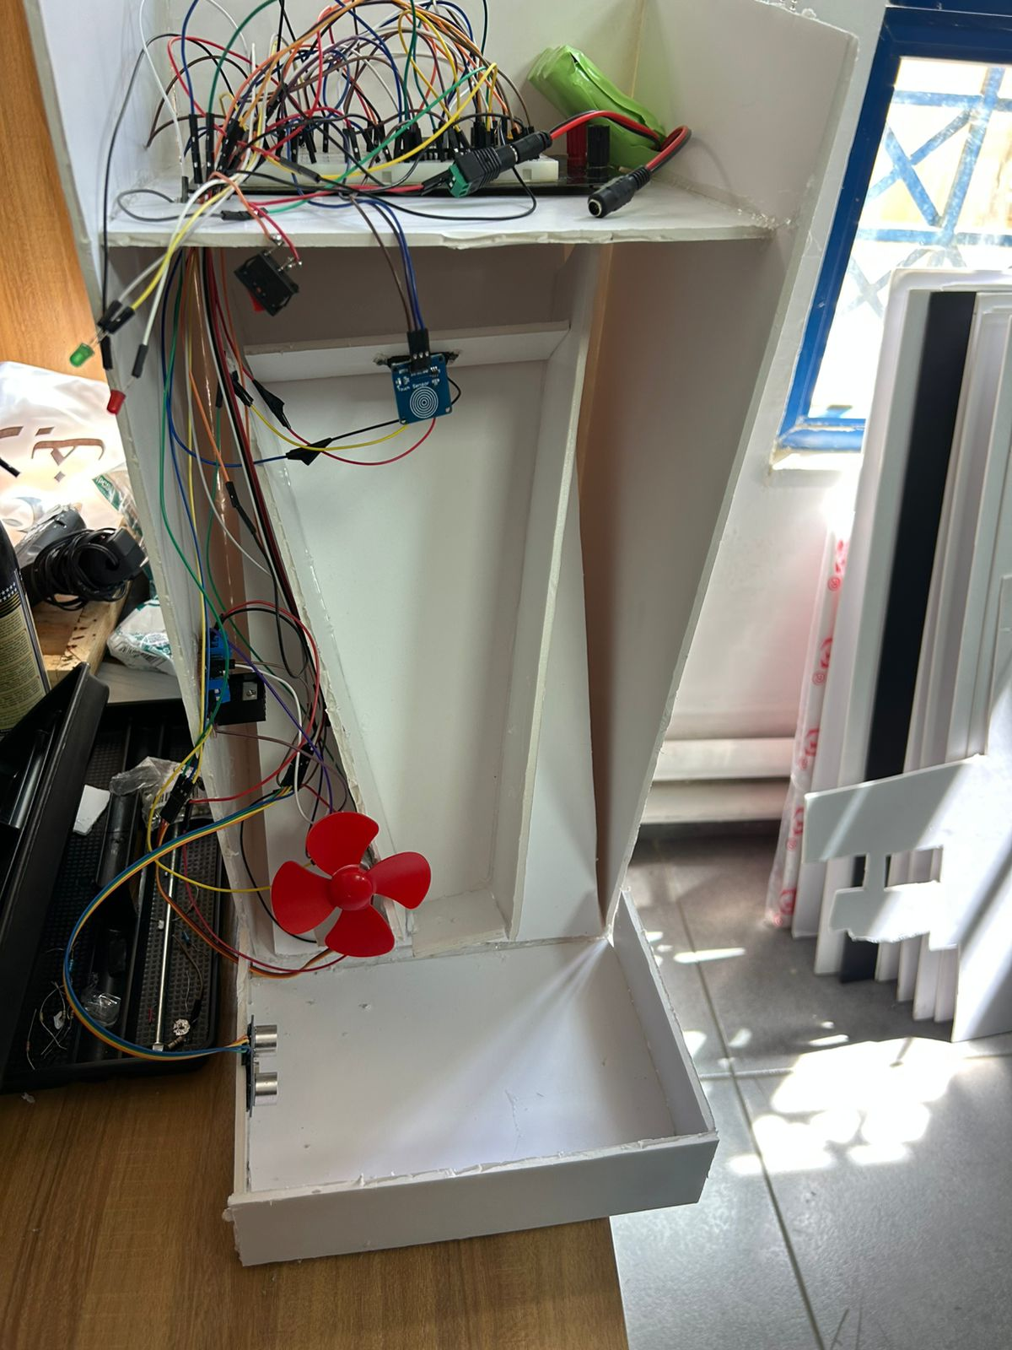
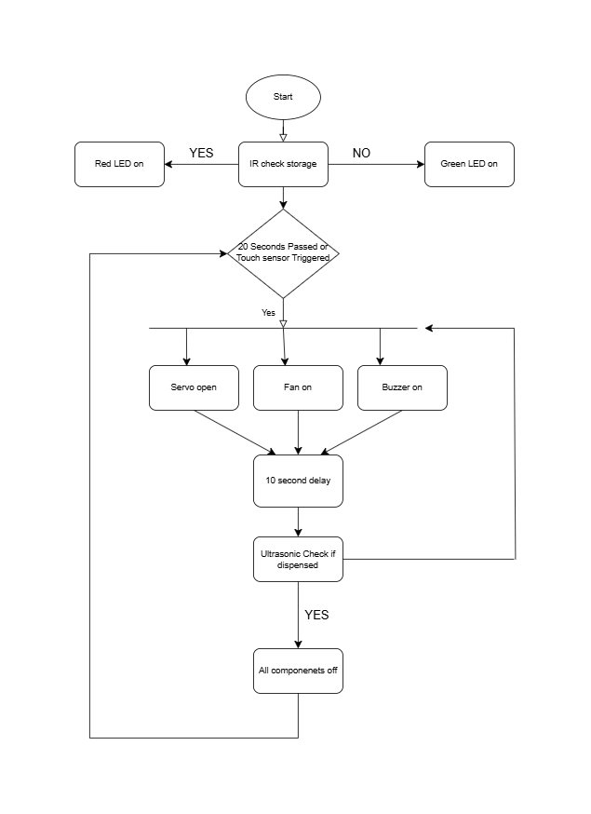
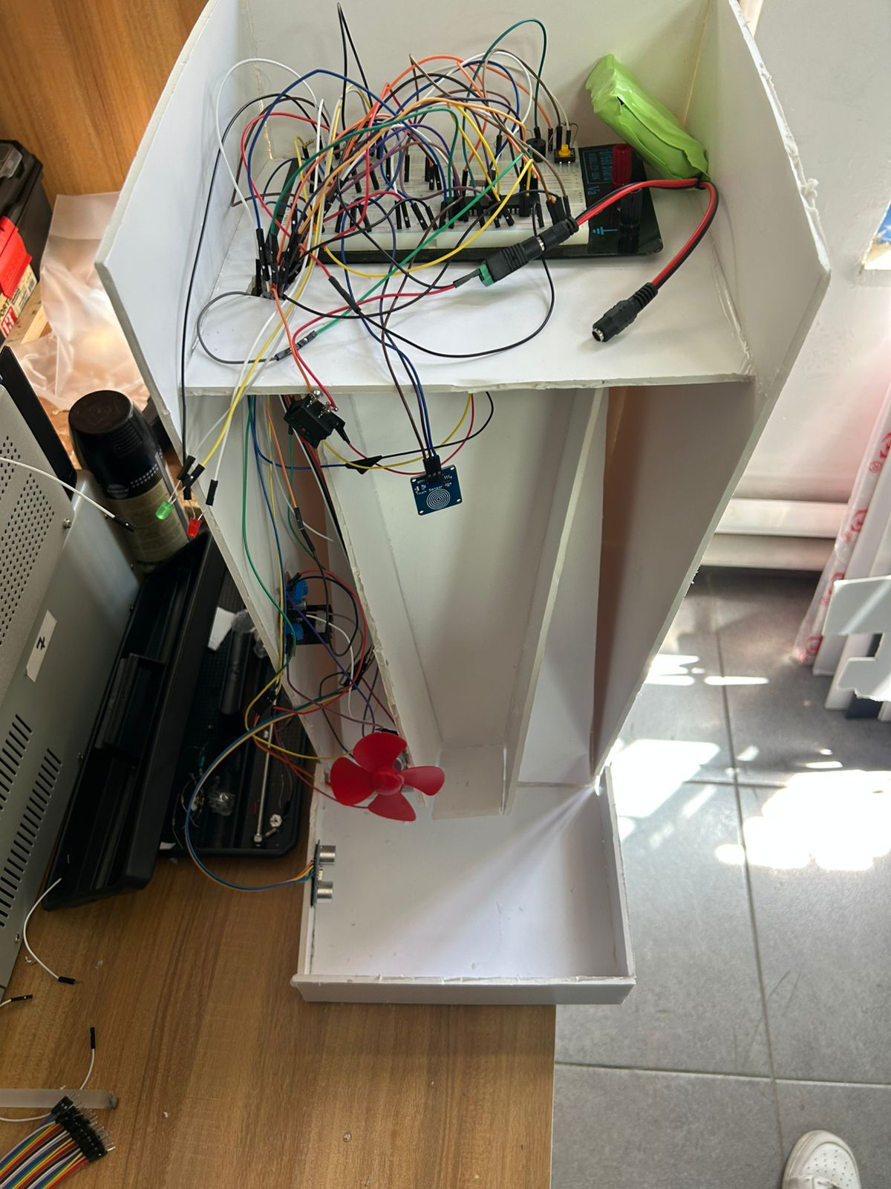
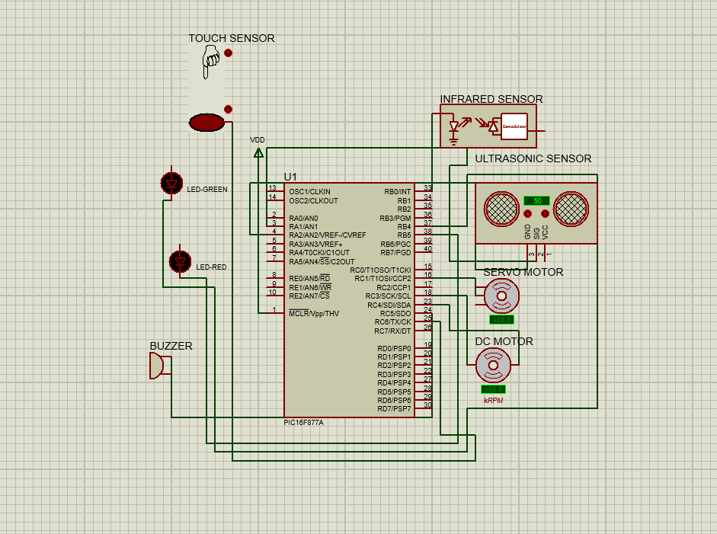
Automated Pet Feeder
A.Ziadeh, T. Ateyyeh, A. Shehadeh
Supervisor: Dr. Belal Sababha
Embedded Systems Final Design Project, Spring 2025
King Abdullah II School of Engineering
Princess Sumaya University for Technology
Introduction
Automated pet feeders are increasingly essential for ensuring timely and precise feeding of pets, especially for busy or frequently away pet owners. This project designs and implements an embedded pet feeder system based on the PIC16F877A microcontroller. The system integrates sensors and actuators including a touch sensor for user input, a servo motor for dispensing food, a DC motor for stirring or feeding mechanisms, and an ultrasonic sensor to verify successful food dispensing. The goal is to automate feeding while providing reliable feedback and control..
Results
Figure 3: Exterior View.
Figure 5:Upper View
Design
Figure 1: Flow chart
Figure 2: Electrical Circuit Simulation.
Conclusion
This project successfully developed a microcontroller-based automated pet feeder system integrating multiple sensors and actuators for reliable and autonomous feeding. The design leverages sensor feedback to verify dispensing success and provides clear user feedback through LEDs and audible alerts. The system demonstrates effective embedded system design principles and practical application for pet care automation..

