Slide 1
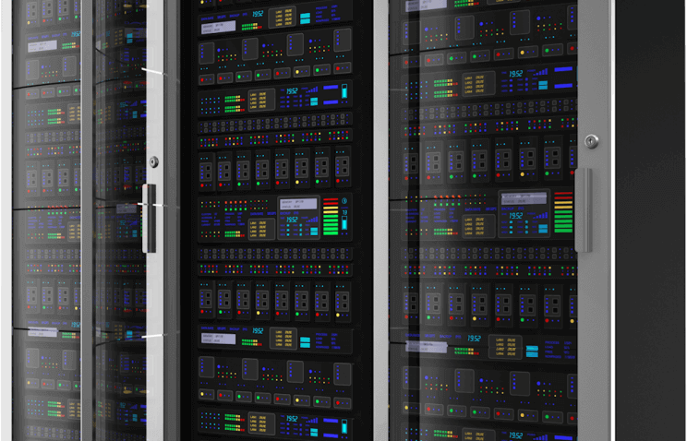

Slide 2
Entrada
Ali
Mashal
Khalid

Slide 3
Task 1
Feeding Entrada Using a Script
Send files between machines.
Task 2
Modify Entrada Code
Use the PCAP file timestamp.
Split PCAP files to 5 minutes intervals.
Name files in special format.
Upgrade the system to the new version (2.0.X)
Grafana dashboard.

Slide 4
Overview
Problem: Data sent to Grafana is not displayed with the proper packet timestamp.
Usage example: When sending April’s data in August, Grafana assumes this data was captured in August; therefore graphs are misleading.

Slide 5

Cause
Entrada 0.1.3 sends metrics to graphite in the following format: (metricName, value, timestamp); however, when inspecting the logs we noticed it’s using the current system’s time as a timestamp rather than extracting it from the packet itself.

Slide 6
Possible Solutions
Update Entrada to version 2.0.X.
Modify Entrada’s 0.1.3 java code in order to include the packet timestamp.

Slide 7
Pros and Cons of Modifying Entrada
Pros | Cons
Current Entrada is tried and tested on our cluster. | Time inefficient.
Behavior is controlled. | Requires deep understanding of the code.
Meets the client's needs. | Requires intensive testing.
Maintains current data structure.

Slide 8
Pros and Cons of Updating Entrada
Pros | Cons
Time efficient. | Requires a testing environment.
Fixed old bugs. | Behavior is uncontrolled.
Ability to use the World Map panel. | New data structure.
Increased performance while using less memory. | Does not meet the client’s needs.

Slide 9

Client’s Needs?
Client prefers modifying the current version rather than updating; to avoid risking the stability of the whole system.

Slide 10
Our plan
Split the workload equally; some will work on modifying Entrada while others work on updating it.
This ensures we meet the client’s needs and deliver a working system while also allowing us to freely work on updating it without risking the whole project.
If update fails we can always revert back to the modified old version.

Slide 11
Workload Split
Ali tries to modify the java code to use the PCAP file timestamp instead of the live timestamp.
Mashal and Khaled try to upgrade the system to the new version (2.0.X).
Khaled modifies the Grafana dashboard to meet the client's requirements.
Mashal and Ali upgrade and configure PostgreSQL to work with Entrada 2.0.X.

Slide 12
Ali’s Overview
Task: Modify Entrada’s 0.1.3 java code.
Tools used: Eclipse IDE, Apache Maven, Junit, Java Programming Language, Centos 7.
Time Taken: 7 Days.
Final Result: Timestamp changed as intended and deployment was successful.

Slide 13
Issues Faced
Setting up project workspace in Eclipse.
Diving deep into the java codes.
Implementing an accurate testing method.
Deploying executables back into the cluster.

Slide 14
Mashal’s Overview
Task: upgrading entrada to version 2.0.X
Tools used: docker, docker-compose, vim, PostgreSQL , HDFS, Centos7
Time Taken:2-3 weeks
Final Result: entrada is working with high performance (production version)

Slide 15
Issues Faced
Installing and Understanding docker
The version of PostgreSQL is not compatible with new version of entrada.
Setting up HDFS to work with entrada.

Slide 16
Khalid’s Overview
Task: Grafana dashboard customization
Tools used: Grafana Interface, JSON, Centos7 OS
Time Taken: 5 days
Final Result: A Beautiful and working dashboard that meets the client needs.

Slide 17

Issues Faced
Show data from multiple servers ( DNS1-Primary and DNS2-Primary) on one page.
Solution: modify every query in the panels to show the correct data from the analyzed packets by Entrada.
Show and compare the percentages of specific data such as : ip4 vs ip6 percentages and TCP vs UDP.
Solution: install chart plugin and write the proper query.

Slide 18
Targeted Customers: TRA, Omantel, Ooredoo, AWASR, Oman Data Park…

Slide 19

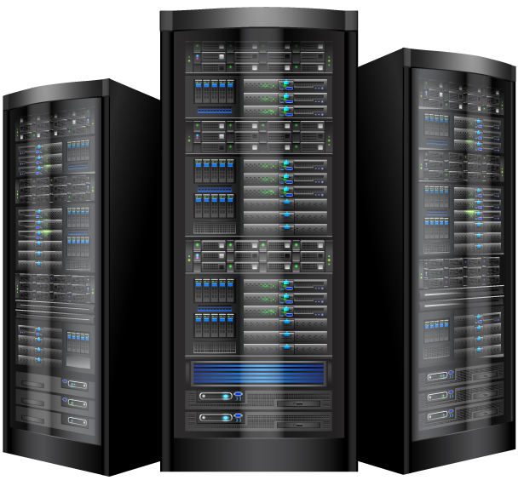

Slide 20
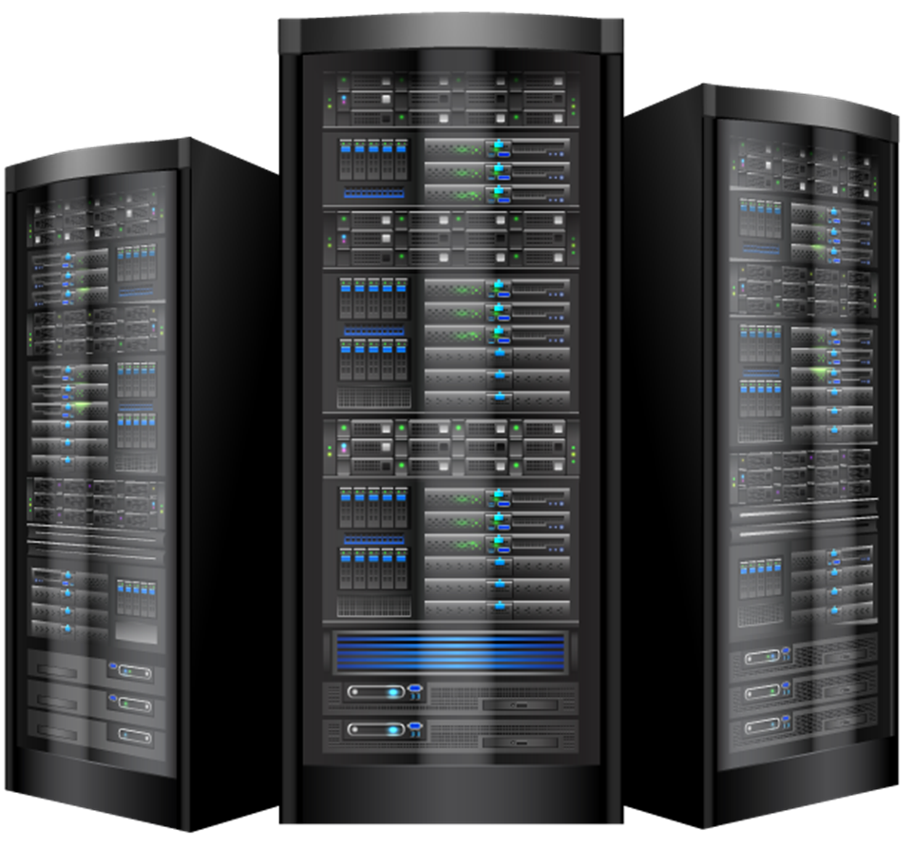
Cost Assumption
Tool | Number | Cost - OMR
Desktop Computers | 3 | 400
Server Nodes | 4 | 1,000
Steel Rack | 1 | 600
Switch | 1 | 1,500
KVM | 1 | 400
Workspace Rent | 1 | 350/month
Employee Salary | 3 | 800/month
Software Licensing | - | Free
TOTAL FIXED | - | 8,050
Annual Running Cost | - | 33,000
TOTAL + RUNNING COSTS (~ 1 Y) | - | 33,800

Slide 21
Services Provided
Service | Pricing (OMR)
Entrada Installation | 1,000
Full System Installation (Cluster + Entrada) | 3,000
Annual Contract | 6,000 per year
Plugins | 1,000– 5,000

Slide 22
First Year Scenario
Service | Number | Pricing- OMR
Annual Contracts | 3 | 6,000
Plugins | 10 | 1,000-5,000
Entrada Installation | 5 | 1,000
Full System Installation | 1 | 3,000
Total Returns | - | 41,000
Profits | - | 8,000
*Expected to turn returns into profits after the first year; as per the above scenario.

