Slide 1
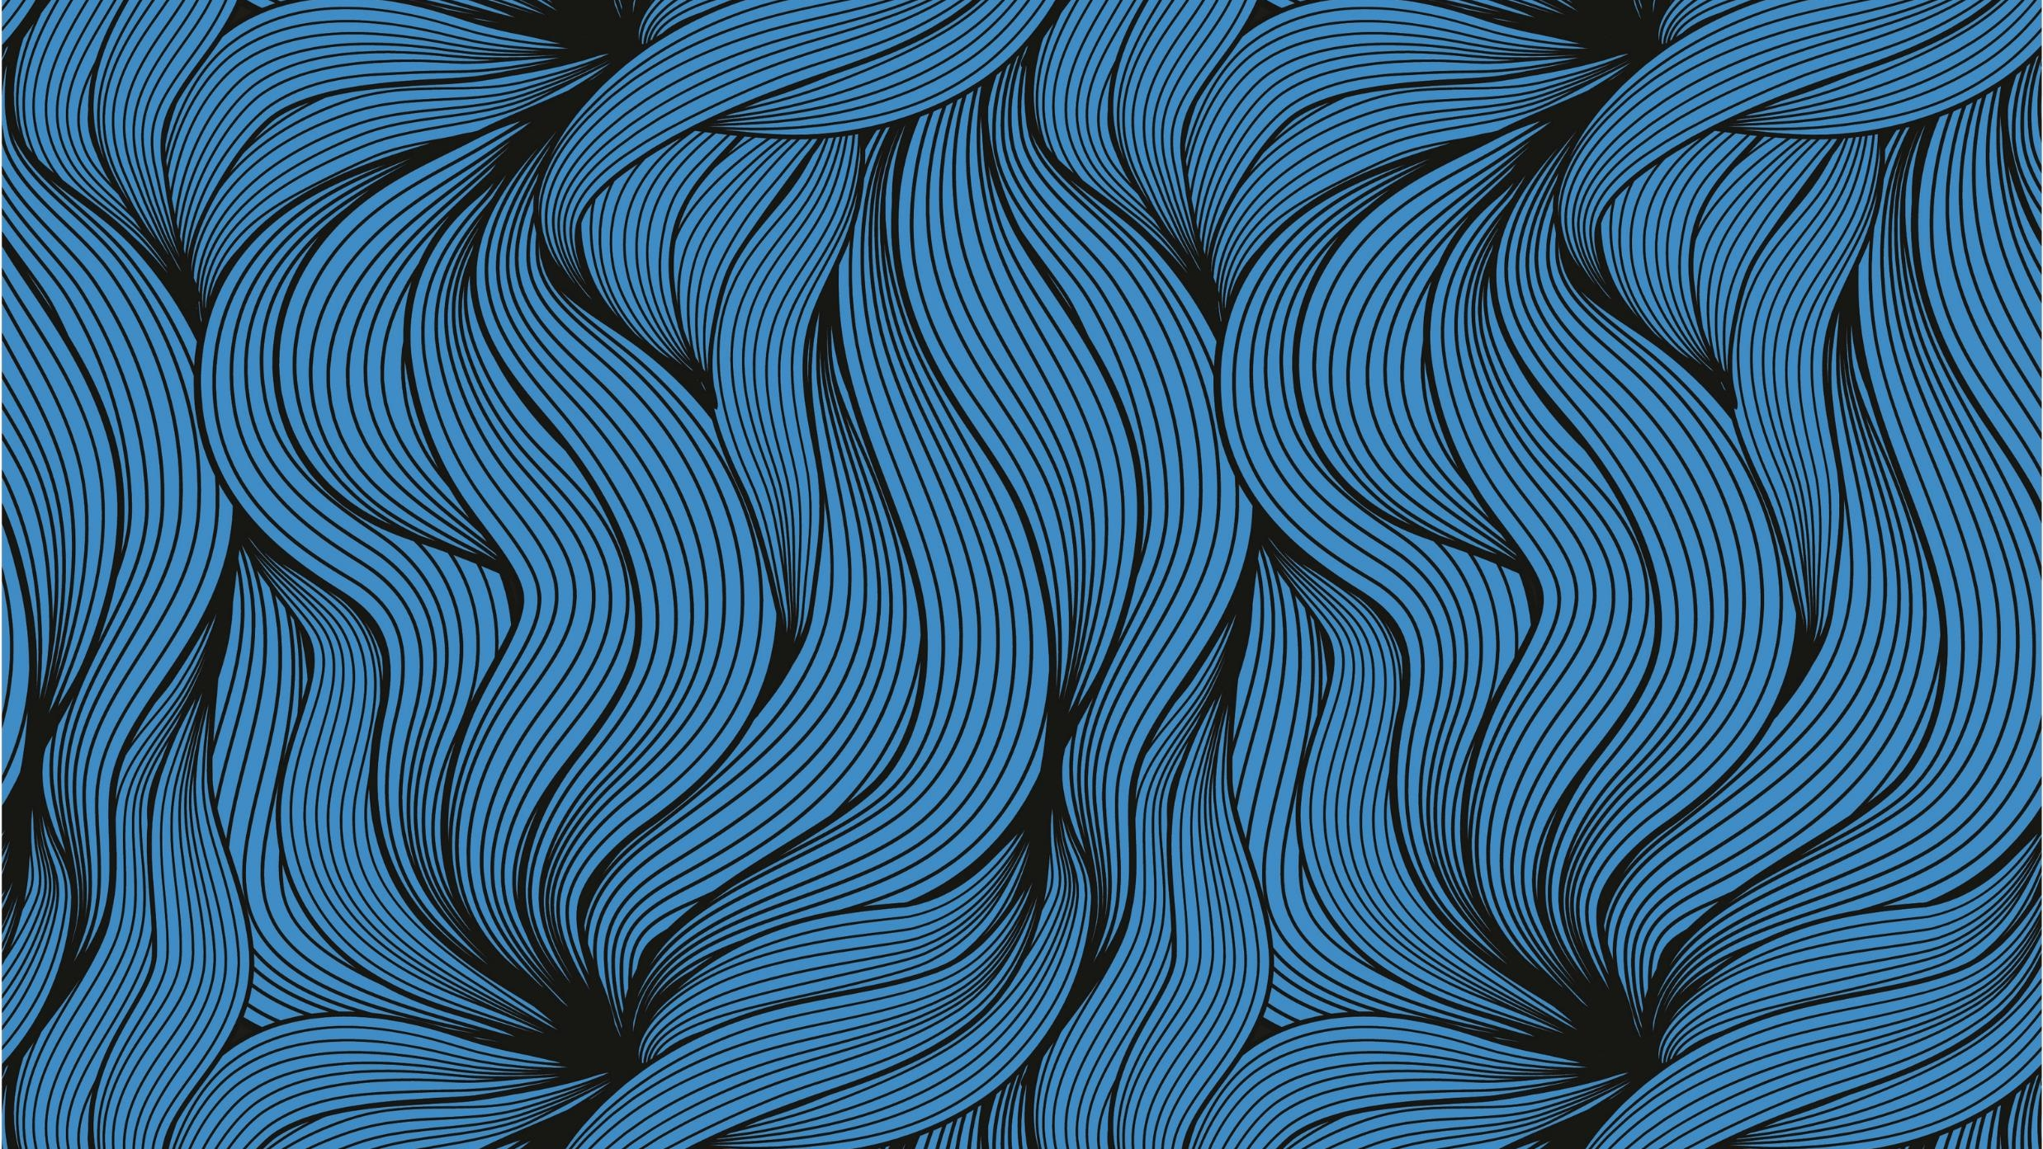
PS1: Image as function
Ali Alrasheed

Slide 2
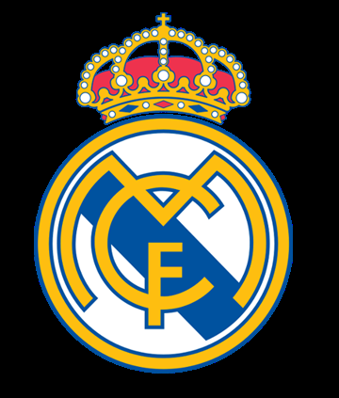

1- Input Images
ps1-1-a-1.png
ps1-1-a-2.png

Slide 3

4- Difference Image
ps1-4-d-1.png

Slide 4


5- Add noise
ps1-5-a-1.png (green channel)
ps1-5-b-1.png (Blue channel)

Slide 5
6- Discussion
A:
i. Green Channel
ii. This is because the grayscale image is converted by giving more weight for the green channel than the rest of the channels.
RGB[A] to Gray:Y←0.299⋅R+0.587⋅G+0.114⋅B (opencv website)
They are weighted according to their wavelength. Also, the human eye is more sensitive to green than red and blue.
iii: No, It doesn’t matter, the weighting for the green channel is more than the rest of the channels in all grayscale images.
B:
i: Some images’ range is between -1 and 1, some are uint8 [0,255], and some are even normalized [0,1]. There are just a pixel convention. However, in some case, they are a result of manipulating the image. For example, in the case of taking the difference between 2 images. In this case, the negative pixels means that the result image was subtracted from a brighter image.
ii: If it is not maintained, some information in the image is lost forever. Therefore, the original image cannot be recovery. Also, some images have a natural range of [-1,1].
C
i: green channel
ii: humans are more sensitive to green, also green has more weighting in the image.
iii: 10 for green, and 50 for blue

Slide 6
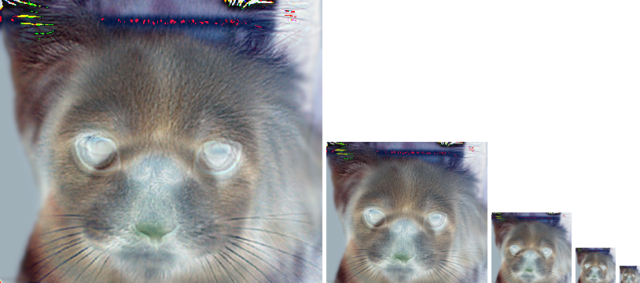
7- Hybrid Image
ps1-7-a-1.png (Hybrid Image)
A: Tune value is 3
B: Increasing the cutoff-frequency will make the cat dominate the image, whereas decreasing it will make the dog more visible.

