Slide 1
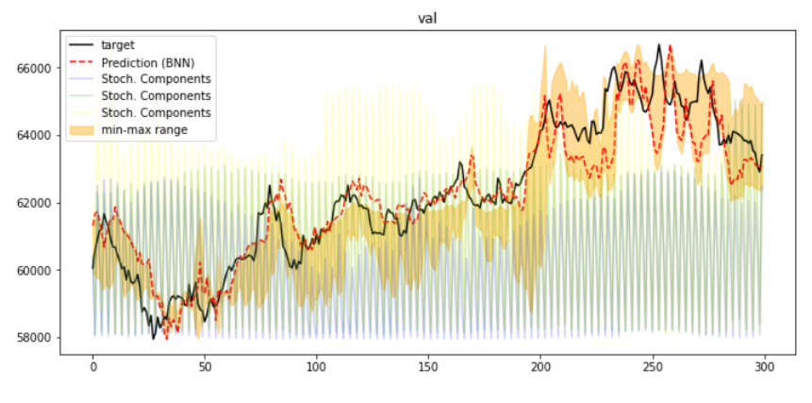
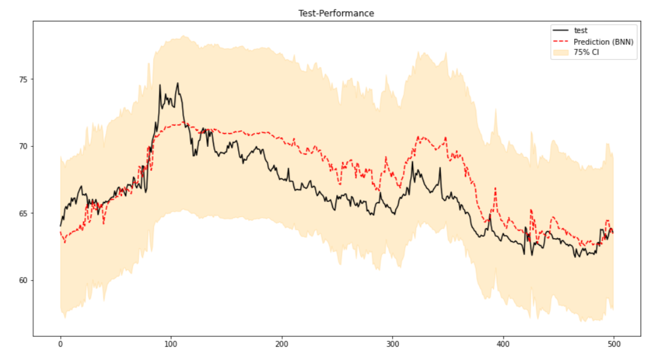
Performance (Point Estimation)
Performance (Probabilistic)

