Slide 1

WebShop AAA
Project Created by Ali . Amar . Anders

Slide 2
Plan :
The plan was that Create a Web shop with .Net Core MVC in backend
and React in frontend.
link to progress manager in Git Hub :
www.github.com/orgs/WebShopAAA/projects/2/views/1
WebShop AAA

Slide 3
Backend :
Architecture design pattern :
SOLID Principles
UOW
DIP
JWT
WebShop AAA

Slide 4
USER
IIS
WEB API
Controller
Rezor Pages VIEW(Admin)
React VIEW
Repository
Repository
Repository
Admin
UOW
Entity Framework DB Context
Microsoft SQL
WebShop AAA

Slide 5
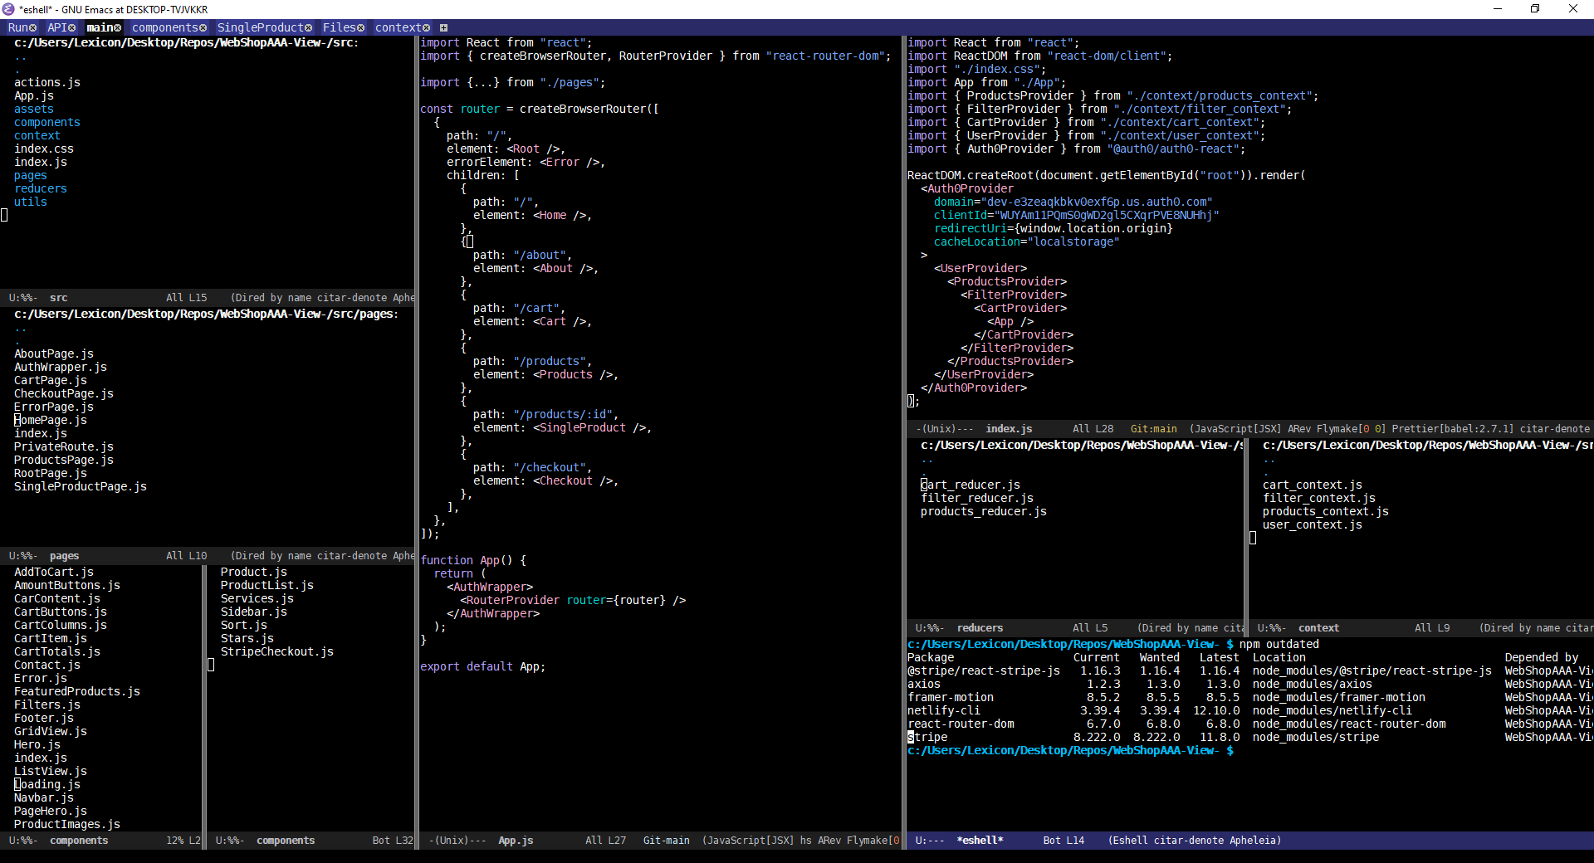
Frontend:
WebShop AAA

Slide 6
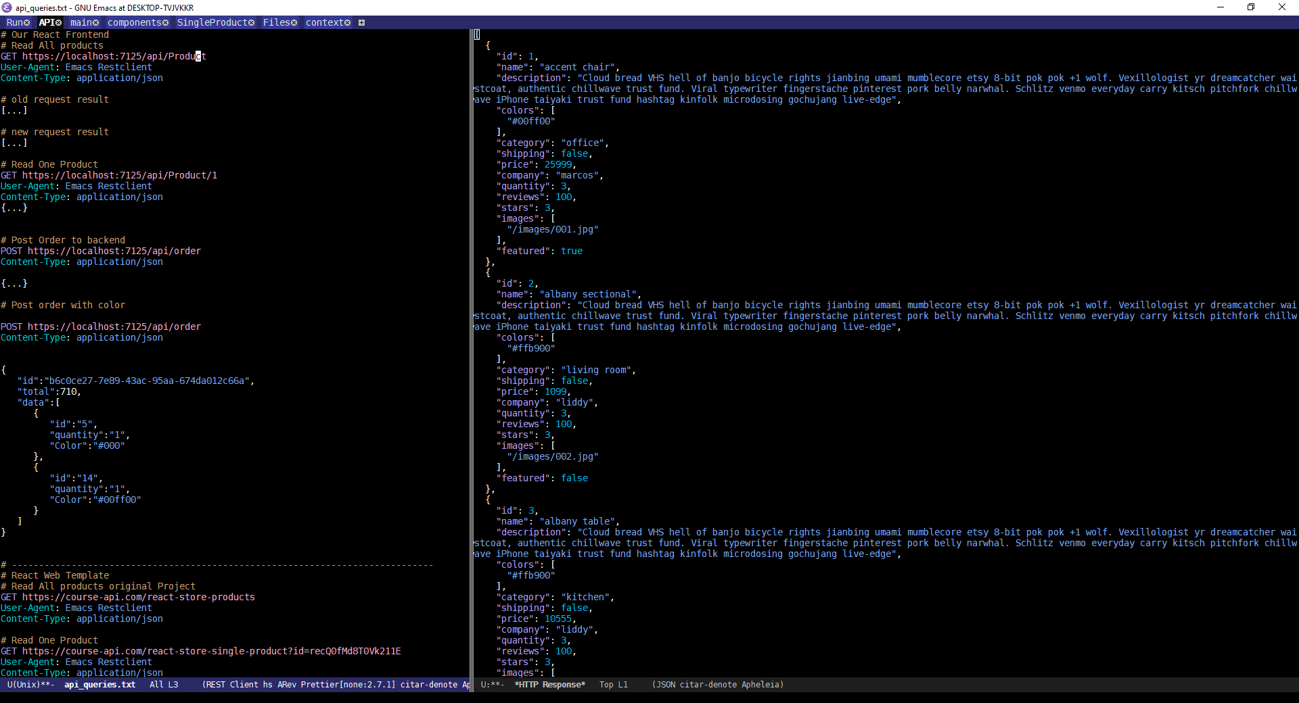
Frontend:
WebShop AAA

Slide 7
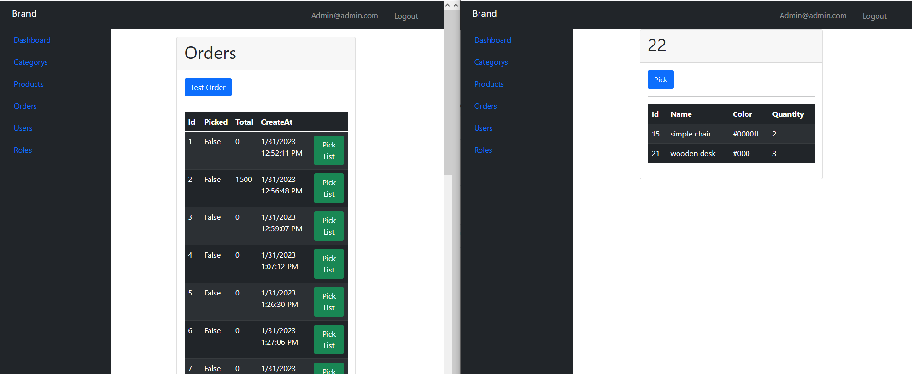
Frontend Admin :
Mvc Views
Mvc Razer pages för Login
WebShop AAA

Slide 8
END
Thank you for attention
WebShop AAA

