Slide 1


PROGRAMMING PRINCIPLES I LECTURE #3
TOPIC: What is an Array?

Slide 2

DEFINITION OF AN ARRAY
Arrays are used to store multiple values in a single variable, instead of declaring separate variables for each value.
To declare an array, define the variable type, specify the name of the array followed by square brackets and specify the number of elements it should store

Slide 3
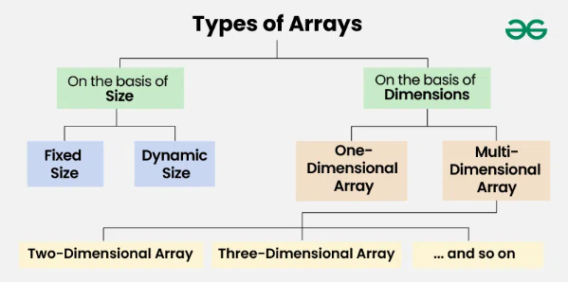
TYPES OF AN ARRAY
FIXED SIZE ARRAY
DYNAMIC SIZED ARRAY
1-DIMENSIONAL ARRAY
MULTI-DIMENSIONAL ARRAY

Slide 4
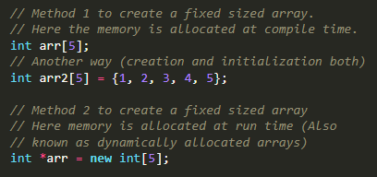
FIXED SIZE ARRAY
(!)We cannot alter or update the size of this array.
(!)Here only a fixed size (i,e. the size that is mentioned in square brackets []) of memory will be allocated for storage

Slide 5

DYNAMIC SIZE ARRAY
The size of the array changes as per user requirements during execution of code so the coders do not have to worry about sizes. They can add and removed the elements as per the need. The memory is mostly dynamically allocated and de-allocated in these arrays.

Slide 6
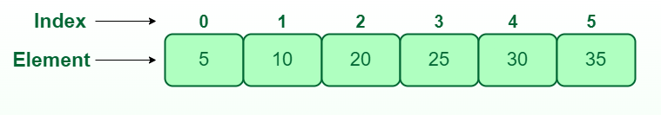


ONE-DIMENSIONAL ARRAY (1-D ARRAY)
You can imagine a 1d array as a row, where elements are stored one after another.
Syntax for Declaration of Single Dimensional Array
Below is the syntax to declare the single-dimensional array
data_type: is a type of data of each array block.
array_name: is the name of the array using which we can refer to it.
array_size: is the number of blocks of memory array going to have.

Slide 7
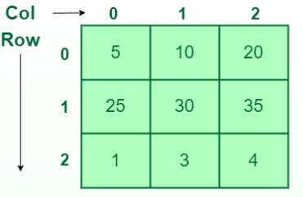

TWO-DIMENSIONAL ARRAY (2-D ARRAY)
Multidimensional arrays can be considered as an array of arrays or as a matrix consisting of rows and columns.
Syntax for Declaration of Two-Dimensional Array
Below is the syntax to declare the Two-dimensional array
data_type: is a type of data of each array block.
array_name: is the name of the array using which we can refer to it.
sizeof_dimension: is the number of blocks of memory array going to have in the corresponding dimension.

Slide 8
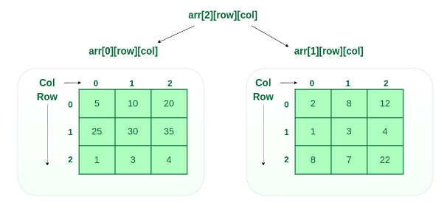

THREE-DIMENSIONAL ARRAY
A 3-D Multidimensional array contains three dimensions, so it can be considered an array of two-dimensional arrays.
data_type: is a type of data of each array block.
array_name: is the name of the array using which we can refer to it.
sizeof_dimension: is the number of blocks of memory array going to have in the corresponding dimension.

Slide 9




ARRAY DECLARATION
int foo [5];
int foo [5] = { 16, 2, 77, 40, 12071 };
int bar [5] = { 10, 20, 30 };
int baz [5] = { };

Slide 10
DECLARATION OF NEW ARRAY AND ACCESS ELEMENTS OF AN ARRAY
int foo[5]; // declaration of a new array
foo[2] = 75; // access to an element of the array.
The main difference is that the declaration is preceded by the type of the elements, while the access is not.
foo[0] = a;
foo[a] = 75;
b = foo [a+2];
foo[foo[a]] = foo[2] + 5;
A = ?
B = ?
foo[a] = ?

Slide 11
SEARCHING IN THE ARRAY
// Function to implement search operation
int findElement(int arr[], int n, int key)
{
int i;
for (i = 0; i < n; i++)
if (arr[i] == key)
return i;
// If the key is not found
return -1;
}
// Driver's Code
int main()
{
int arr[] = { 12, 34, 10, 6, 40 };
int n = sizeof(arr) / sizeof(arr[0]);
// Using a last element as search element
int key = 40;
// Function call
int position = findElement(arr, n, key);
if (position == -1)
cout << "Element not found";
else
cout << "Element Found at Position: "
<< position + 1;
return 0;
}

Slide 12

STRING IS ARRAY OF CHARS?
#include <bits/stdc++.h>
using namespace std;
int main()
{
char arr[] = { 'J', 'O', 'U', 'R', 'N', 'A', 'L', 'D', 'E', 'V' };
int size_arr = sizeof(arr) / sizeof(char);
string str = "";
for (int x = 0; x < size_arr; x++) {
str = str + arr[x];
}
cout<<"Converted char array to string:\n";
cout << str << endl;
return 0;
}
#include <bits/stdc++.h>
using namespace std;
int main()
{
string str = "";
cout<<"Enter the string:\n";
cin>>str;
char arr[str.length() + 1];
strcpy(arr, str.c_str());
cout<<"String to char array conversion:\n";
for (int i = 0; i < str.length(); i++)
cout << arr[i];
return 0;
}

Slide 13
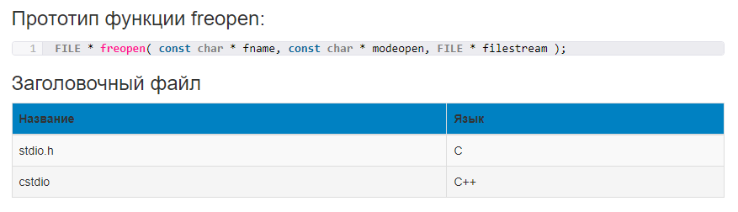
FREEOPEN (FILE EDITING)
The freopen function first attempts to close any file already associated with the stream specified by filestream. Whether the stream was successfully detached or not, freopen opens the file whose name is passed in the first parameter, fname, that is, it associates the file fname with the newly detached stream in the same way as fopen, using the access mode specified by the second parameter, mode. This function is especially useful for redirecting streams such as standard input, standard output, and standard error to specific files.

Slide 14
HOW TO USE FREEOPEN?
fname: A C string containing the name of the file to be opened. This parameter must conform to the file naming conventions of the underlying system, and may include a path if the system supports it. If this parameter is a null pointer, the function attempts to change the mode of the stream specified as the third parameter stream to the specified mode parameter, as if the file name currently associated with this stream were in use.
modeopen: A string containing the file access mode. The following is a list of modes and their descriptions. (r – read, w – write, a – edit file, r+ - editing existing file, w+ - creating empty file for read and write, a+ - editing existing file, b – using two modes for open)
#include <iostream>
#include <cstdio>
int main ()
{
freopen("file.txt", "w", stdout);
std::cout << "Это предложение будет перенаправлено в файл";
fclose (stdout);
return 0;
}

