Slide 1

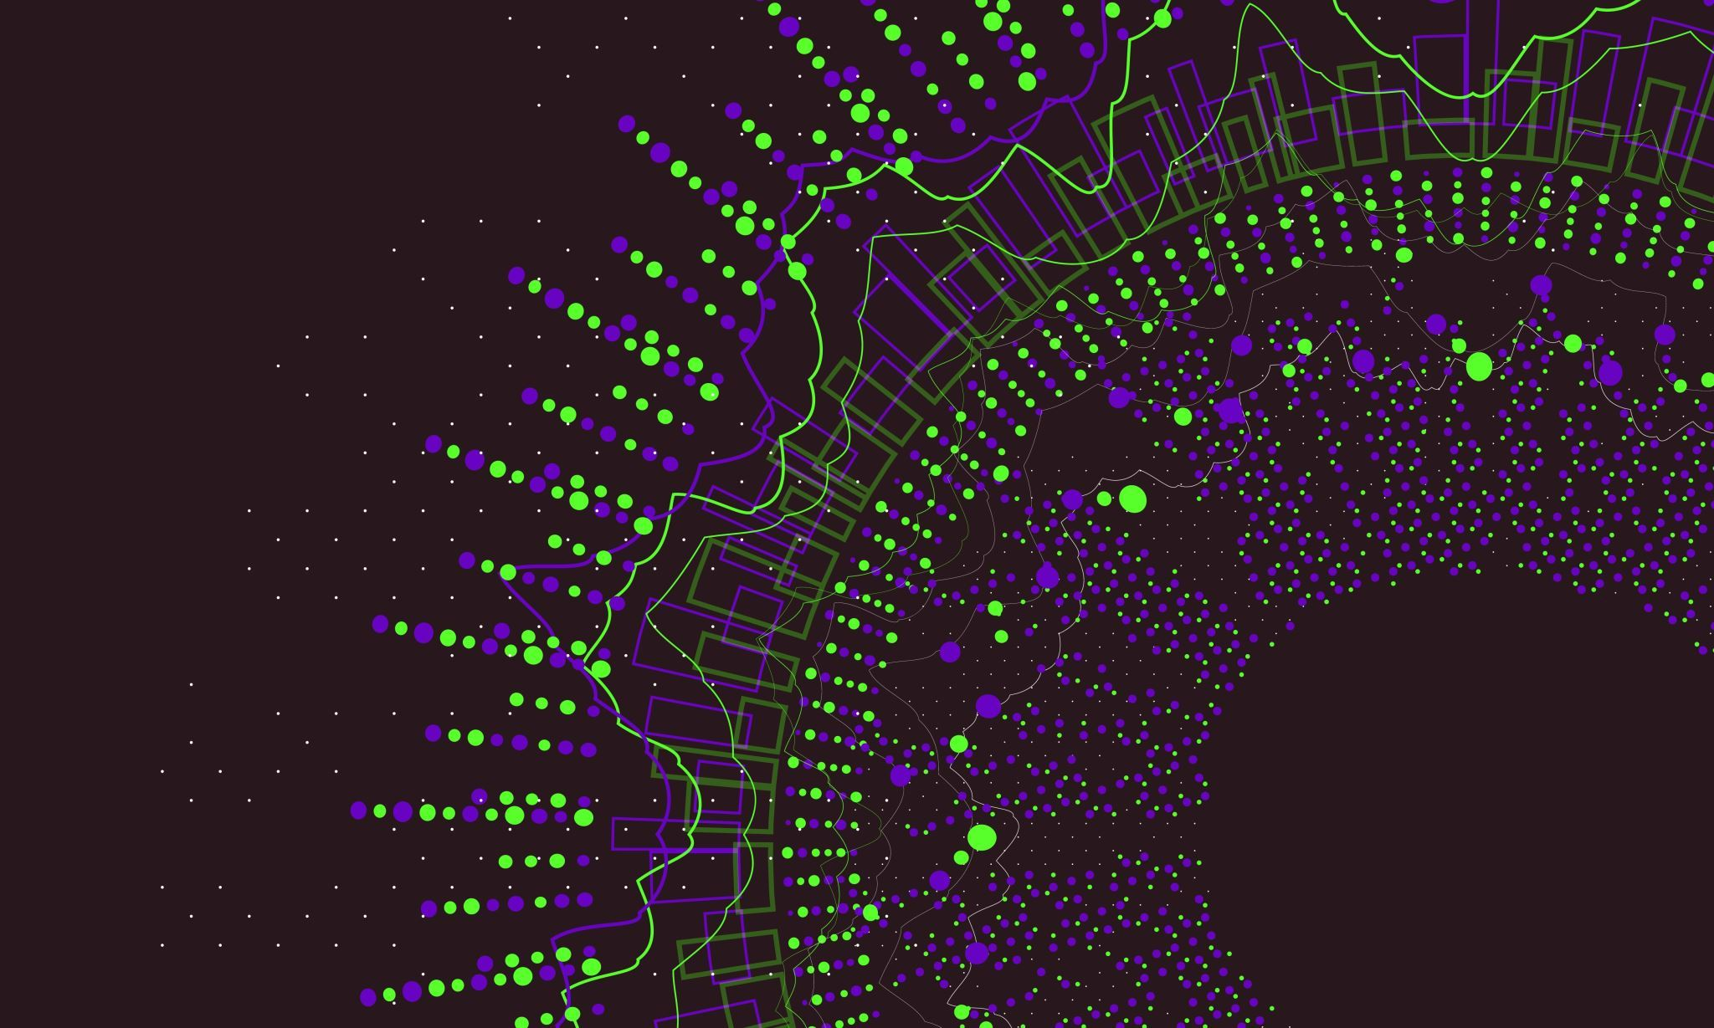

Facial Emotion Analysis using Deep Learning

Slide 2
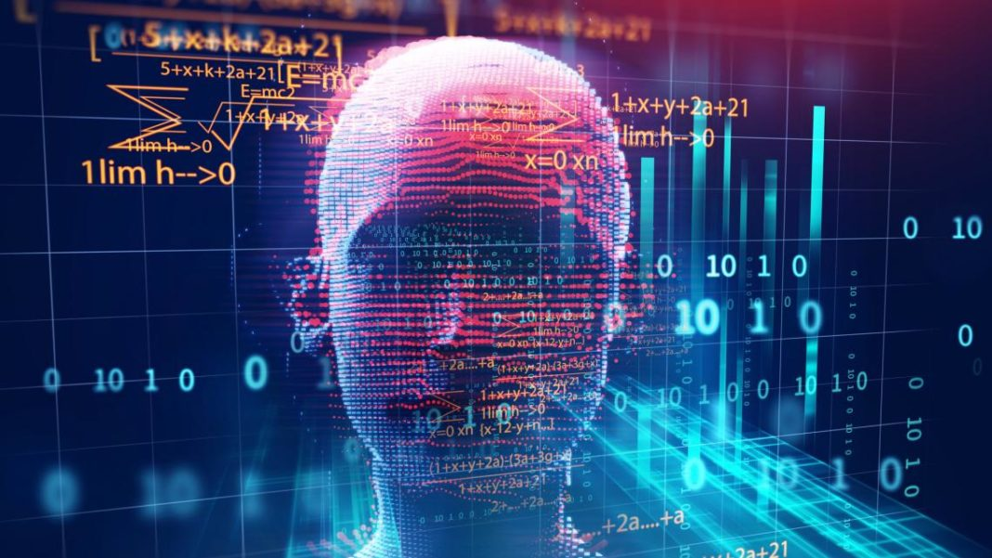
Real-world Application
Practical Use: Emotion analysis finds applications in human-computer interaction, market sentiment analysis, mental health assessment, etc.
This Photo by Unknown author is licensed under CC BY-NC-ND.

Slide 3

Project Overview:
Goal: Analyzing facial emotions using deep learning and image recognition.
Tools and Libraries:
Keras: Building and training neural networks efficiently.
OpenCV: For face detection and image preprocessing.
MobileNet: Pre-trained CNN for emotion recognition via transfer learning.
Dataset:
Included labeled facial images exhibiting emotions like anger, disgust, fear, happiness, sadness, surprise, and neutral expressions.
Consisted of diverse facial expressions, serving as training and testing data.

Slide 4
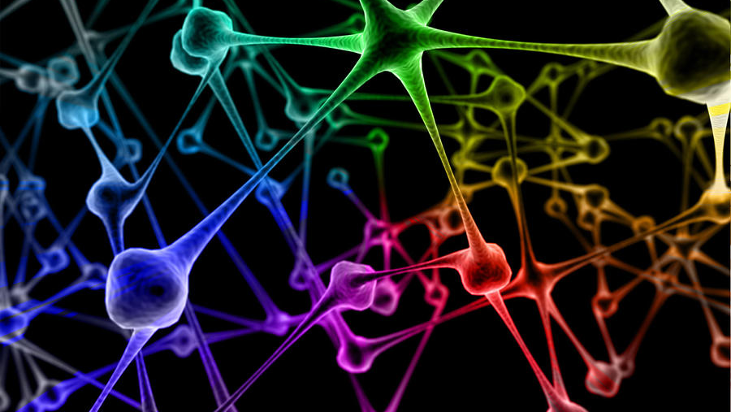
Neural Network Architecture
Base Model: MobileNet used for its efficiency in image tasks.
Transfer Learning: Adopted pre-trained MobileNet layers and froze initial layers to retain learned features.
Emotion Classification: Added specialized fully connected layers for facial emotion recognition on top of MobileNet's base.
This Photo by Unknown author is licensed under CC BY-NC-ND.

Slide 5

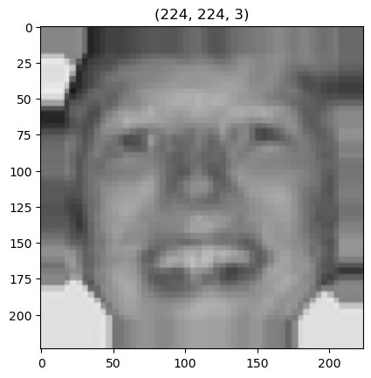

Data Preprocessing
Image Data Generator: Used for data augmentation by applying transformations like zoom, shear, and flips.
Purpose: Augmentation diversifies the dataset, enhancing model generalization.
Preprocessing Steps: Display preprocessed images scaled to the model's input size.

Slide 6

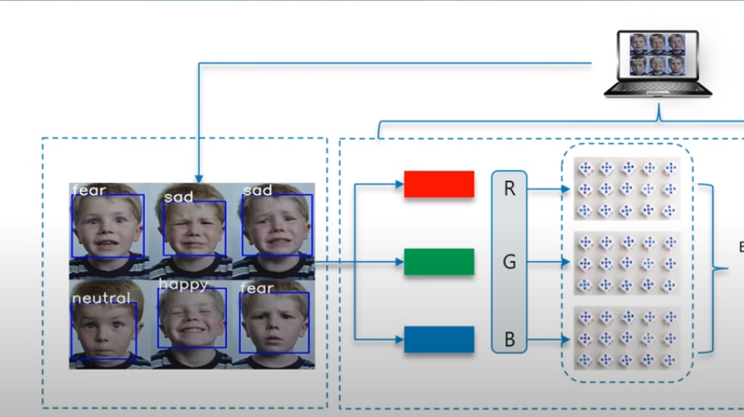
Training Process Overview
Methodology:
Utilized augmented dataset for training the model.
Employed early stopping to halt training upon validation accuracy plateau.
Implemented model checkpointing to save the best model based on validation accuracy.

Slide 7
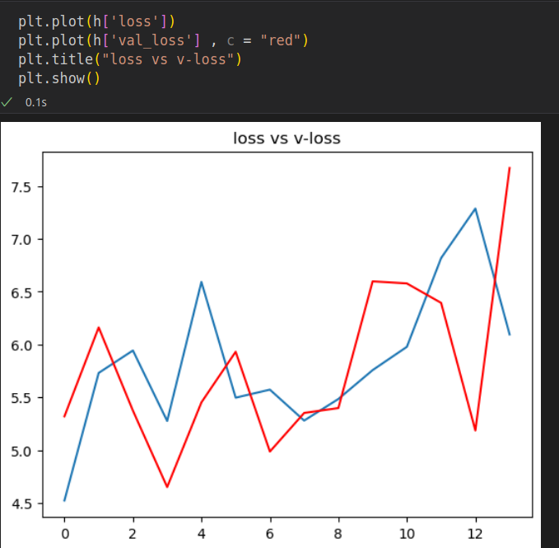
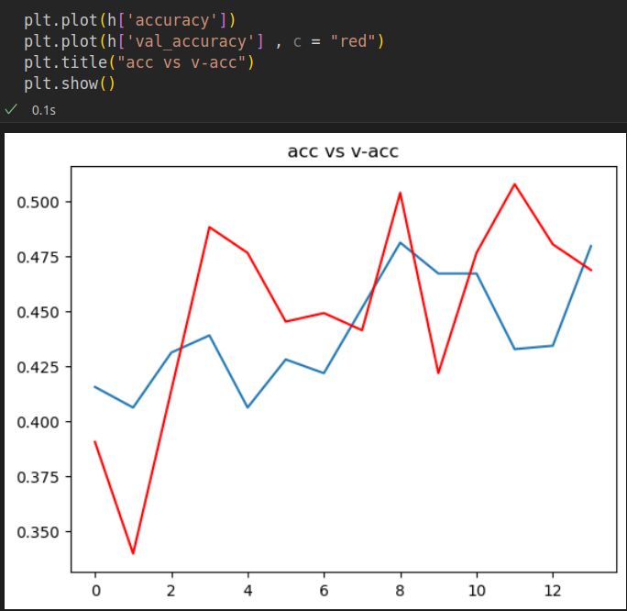
Training Progress Visualization

Slide 8
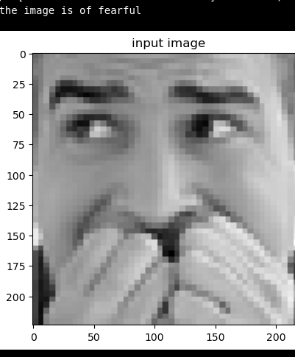
Model Evaluation:
Sample Test Image Prediction

Slide 9
Integrating Trained Emotion Recognition Model with OpenCV for Real-time Analysis
Model Loading: Load pre-trained emotion recognition model
OpenCV Setup: Initialize OpenCV for video handling.
Video Capture: Access live video feed using OpenCV.
Face Detection: Employ OpenCV's Haar Cascade Classifier for precise face detection in video frames.
Emotion Recognition:
Extract and preprocess detected facial regions.
Prepare faces to match the model's input format.
Use the loaded model to predict emotions.
Output Display: Overlay emotion labels or bounding boxes on the live video feed.
Real-time Analysis: Continuously process frames for face detection and emotion recognition.

Slide 10
Haar Cascade Classifier for Face Detection in OpenCV
Purpose: The Haar Cascade Classifier in OpenCV is a pre-trained model designed for efficient and accurate face detection in images or video frames.
Pattern Recognition: It operates by analyzing patterns resembling facial features using a series of filters called Haar-like features.
Detection Process: This classifier identifies specific patterns indicative of facial characteristics, such as edges or textures, aiding in locating faces within an image or video feed.
Role in Emotion Analysis: By accurately detecting facial regions, it forms the foundation for subsequent tasks like emotion analysis, enabling precise analysis and recognition of emotions on these detected facial areas.

Slide 11

Presented by :
Khizar Ali (22P-9269)
Kashif Sahil(22P-9005)

