Slide 1

OPERATIONS REARCH 2
KWAME NKRUMAH UNIVERSITY OF SCIENCE AND TECHNOLOGY
BRIGHT EMMANEUL OWUSU (Ph.D.)
email: bright.owusu@knust.edu.gh
contact: 0244389946

Slide 2
WAITING LINE MODELS

Slide 3
CONTENTS
STRUCTURE OF A WAITING LINE SYSTEM
SINGLE-CHANNEL WAITING LINE MODEL WITH POISSON ARRIVALS AND EXPONENTIAL SERVICE TIMES
MULTIPLE-CHANNEL WAITING LINE MODEL WITH POISSON ARRIVALS AND EXPONENTIAL SERVICE TIMES
SOME GENERAL RELATIONSHIPS FOR WAITING LINE MODELS
ECONOMIC ANALYSIS OF WAITING LINES
OTHER WAITING LINE MODELS

Slide 4
CONTENTS…
7. SINGLE-CHANNEL WAITING LINE MODEL WITH POISSON ARRIVALS AND ARBITRARY SERVICE TIMES
8. MULTIPLE-CHANNEL MODEL WITH POISSON ARRIVALS, ARBITRARY SERVICE TIMES, AND NO WAITING LINE
9. WAITING LINE MODELS WITH FINITE CALLING POPULATIONS

Slide 5
SECTION 1…
STRUCTURE OF A WAITING LINE SYSTEM

Slide 6
1. STRUCTURE OF A WAITING LINE SYSTEM
Under structure of waiting line system, we shall be looking at:
Single-Channel Waiting Line
Distribution of Arrivals
Distribution of Service
Times Queue Discipline
Steady-State Operation

Slide 7
Introduction
To illustrate the basic features of a waiting line model, we consider the waiting line at the Burger Dome fast-food restaurant. Burger Dome sells hamburgers, cheeseburgers, french fries, soft drinks, and milk shakes, as well as a limited number of specialty items and dessert selections. Although Burger Dome would like to serve each customer immediately, at times more customers arrive than can be handled by the Burger Dome food service staff.

Slide 8
Thus, customers wait in line to place and receive their orders. Burger Dome is concerned that the methods currently used to serve customers are resulting in excessive waiting times. Management wants to conduct a waiting line study to help determine the best approach to reduce waiting times and improve service.

Slide 9
Single-Channel Waiting Line
In the current Burger Dome operation, a server takes a customer’s order, determines the total cost of the order, takes the money from the customer, and then fills the order. Once the first customer’s order is filled, the server takes the order of the next customer waiting for service. This operation is an example of a single-channel waiting line. Each customer entering the Burger Dome restaurant must pass through the one channel—one order-taking and order-filling station—to place an order, pay the bill, and receive the food.

Slide 10
.
When more customers arrive than can be served immediately, they form a waiting line and wait for the order-taking and order-filling station to become available. A diagram of the Burger Dome single-channel waiting line is shown in Figure 11.1.

Slide 11
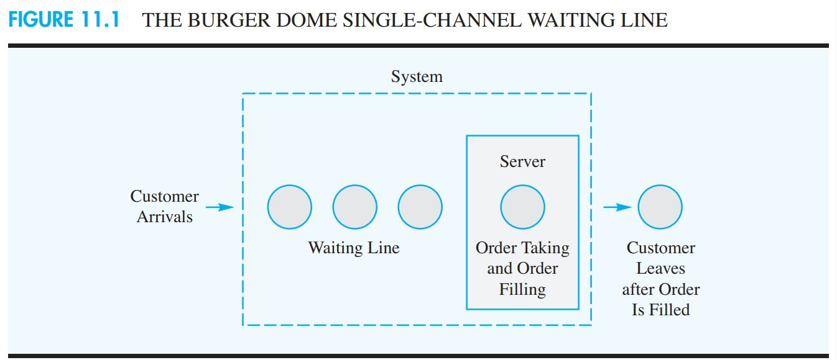

Slide 12
Distribution of Arrivals
Defining the arrival process for a waiting line involves determining the probability distribution for the number of arrivals in a given period of time. For many waiting line situations, the arrivals occur randomly and independently of other arrivals, and we cannot predict when an arrival will occur. In such cases, quantitative analysts have found that the Poisson probability distribution provides a good description of the arrival pattern.

Slide 13
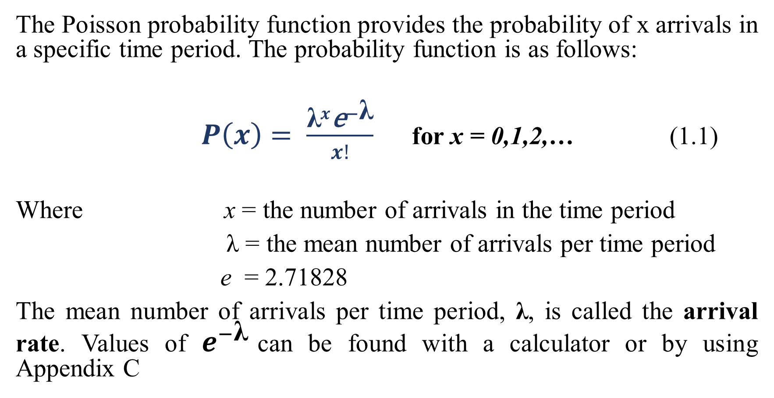
The Poisson probability function provides the probability of x arrivals in a specific time period. The probability function is as follows:
$P\left(x\right)= \frac{{\text{λ}}^{x}{\text{e}}^{−\text{λ}}}{x!}$ for x = 0,1,2,… (1.1)
Where x = the number of arrivals in the time period
λ = the mean number of arrivals per time period
e = 2.71828
The mean number of arrivals per time period, λ, is called the arrival rate. Values of $e^{−\text{λ}}$can be found with a calculator or by using Appendix C

Slide 14
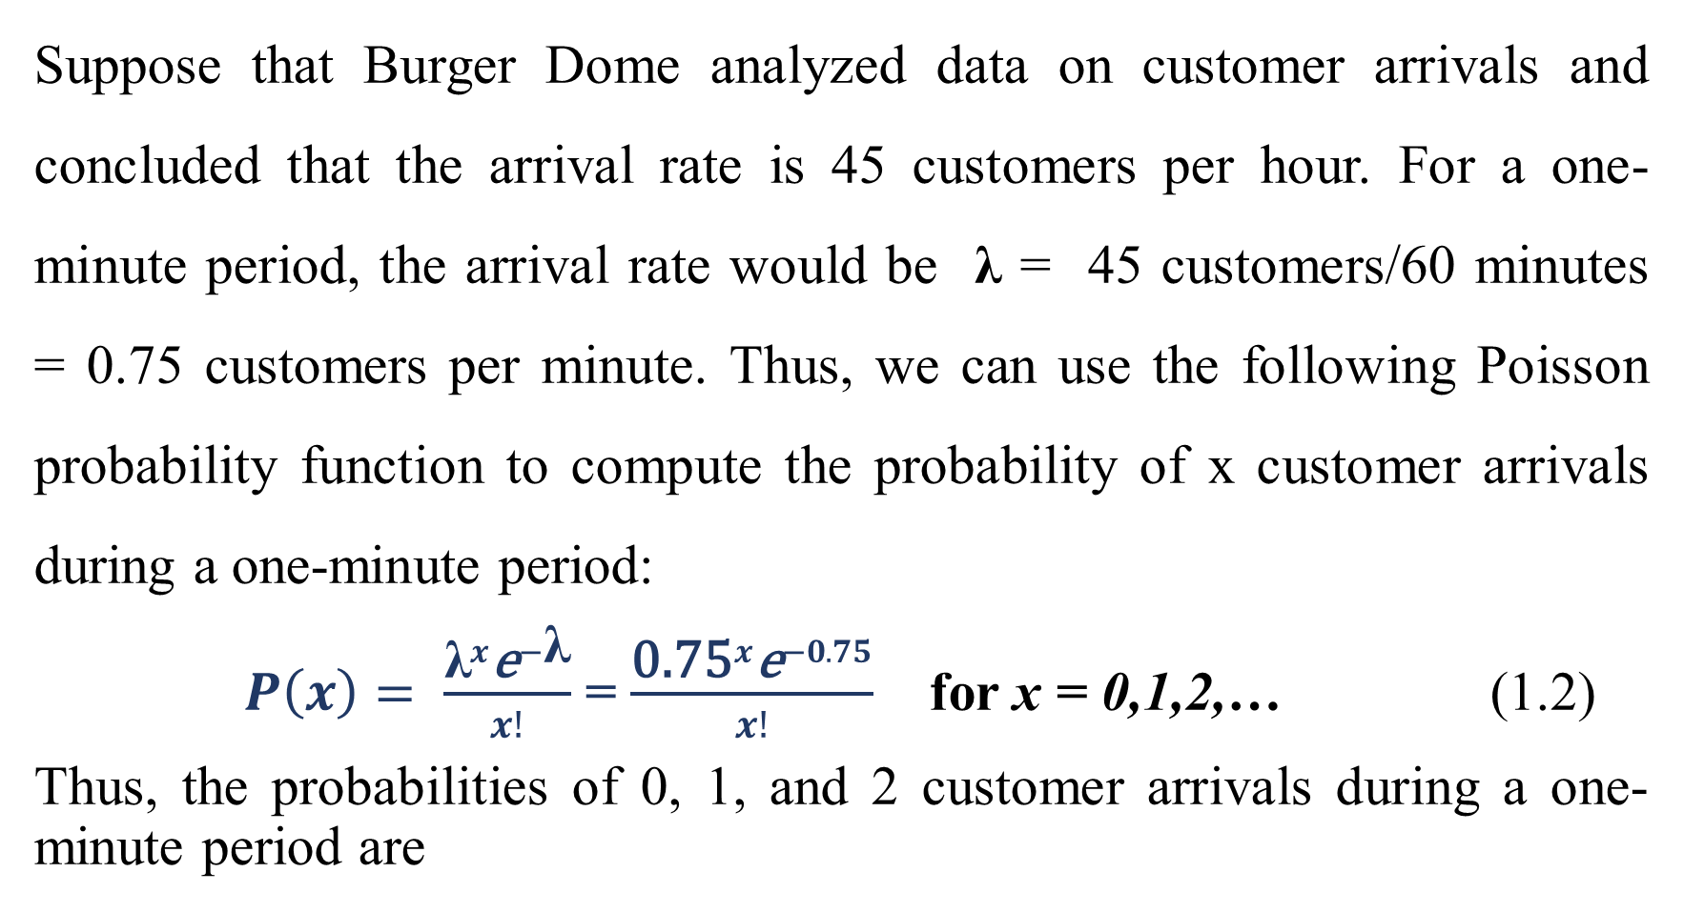
Suppose that Burger Dome analyzed data on customer arrivals and concluded that the arrival rate is 45 customers per hour. For a one-minute period, the arrival rate would be λ = 45 customers/60 minutes = 0.75 customers per minute. Thus, we can use the following Poisson probability function to compute the probability of x customer arrivals during a one-minute period:
$P\left(x\right)= \frac{{\text{λ}}^{x}{\text{e}}^{−\text{λ}}}{x!}$ = $\frac{{\text{0.75}}^{x}{\text{e}}^{−0.75}}{x!}$ for x = 0,1,2,… (1.2)
Thus, the probabilities of 0, 1, and 2 customer arrivals during a one-minute period are

Slide 15
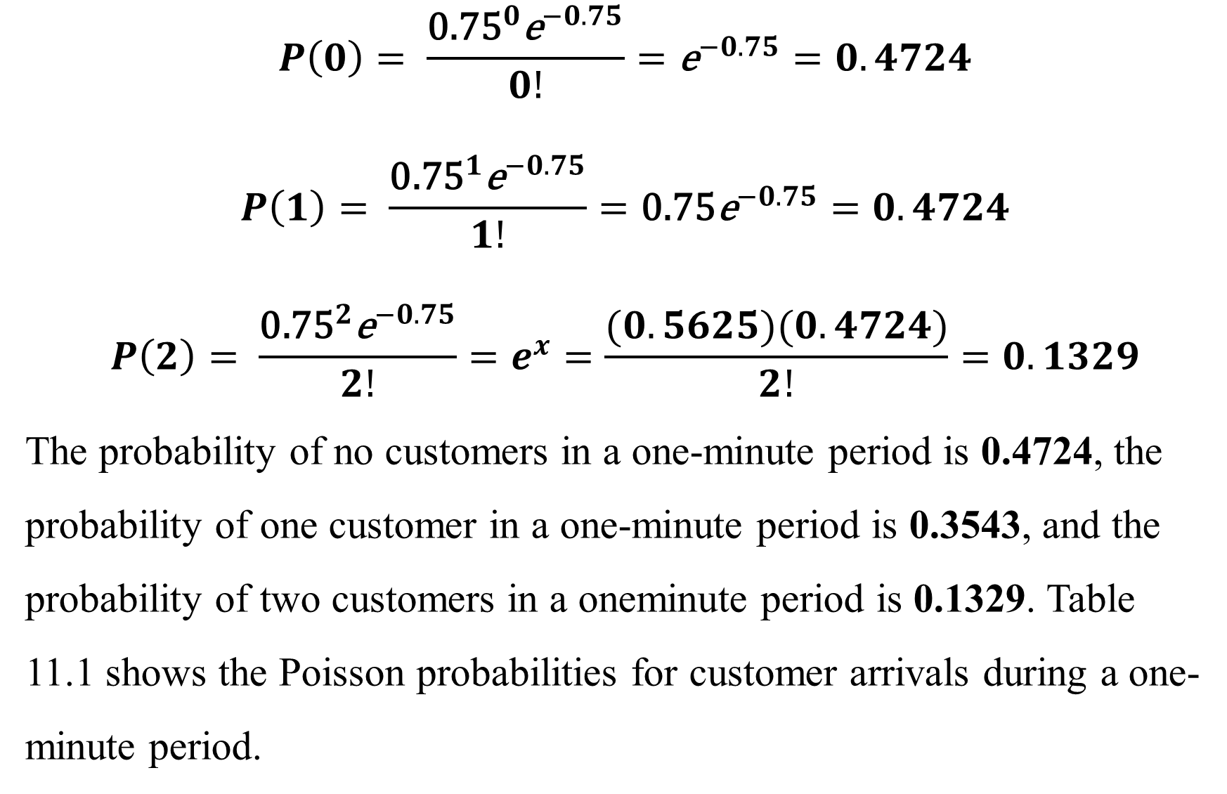
.
$$P\left(0\right)= \frac{{\text{0.75}}^{0}{\text{e}}^{−0.75}}{0!}={\text{e}}^{−0.75}=0.4724$$
$$P\left(1\right)= \frac{{\text{0.75}}^{1}{\text{e}}^{−0.75}}{1!}={\text{0.75}\text{e}}^{−0.75}=0.4724$$
$$P\left(2\right)= \frac{{\text{0.75}}^{2}{\text{e}}^{−0.75}}{2!}=e^{x}=\frac{(0.5625)(0.4724)}{2!}=0.1329$$
The probability of no customers in a one-minute period is 0.4724, the probability of one customer in a one-minute period is 0.3543, and the probability of two customers in a oneminute period is 0.1329. Table 11.1 shows the Poisson probabilities for customer arrivals during a one-minute period.

Slide 16
.
The waiting line models that will be presented in Sections 11.2 and 11.3 use the Poisson probability distribution to describe the customer arrivals at Burger Dome. In practice, you should record the actual number of arrivals per time period for several days or weeks and compare the frequency distribution of the observed number of arrivals to the Poisson probability distribution to determine whether the Poisson probability distribution provides a reasonable approximation of the arrival distribution.

Slide 17
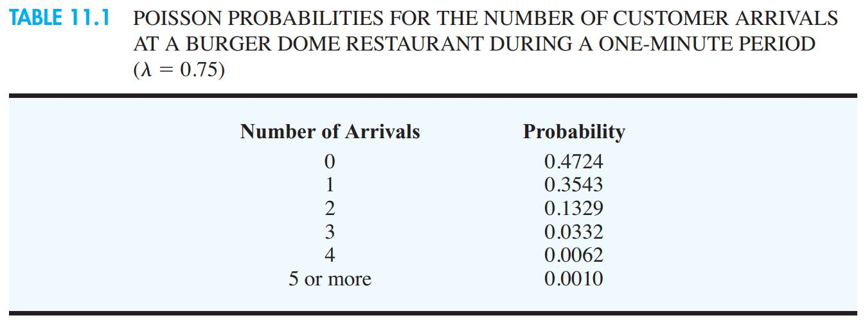
.

Slide 18
Distribution of Service Times
The service time is the time a customer spends at the service facility once the service has started. At Burger Dome, the service time starts when a customer begins to place the order with the food server and continues until the customer receives the order. Service times are rarely constant. At Burger Dome, the number of items ordered and the mix of items ordered vary considerably from one customer to the next. Small orders can be handled in a matter of seconds, but large orders may require more than two minutes.

Slide 19
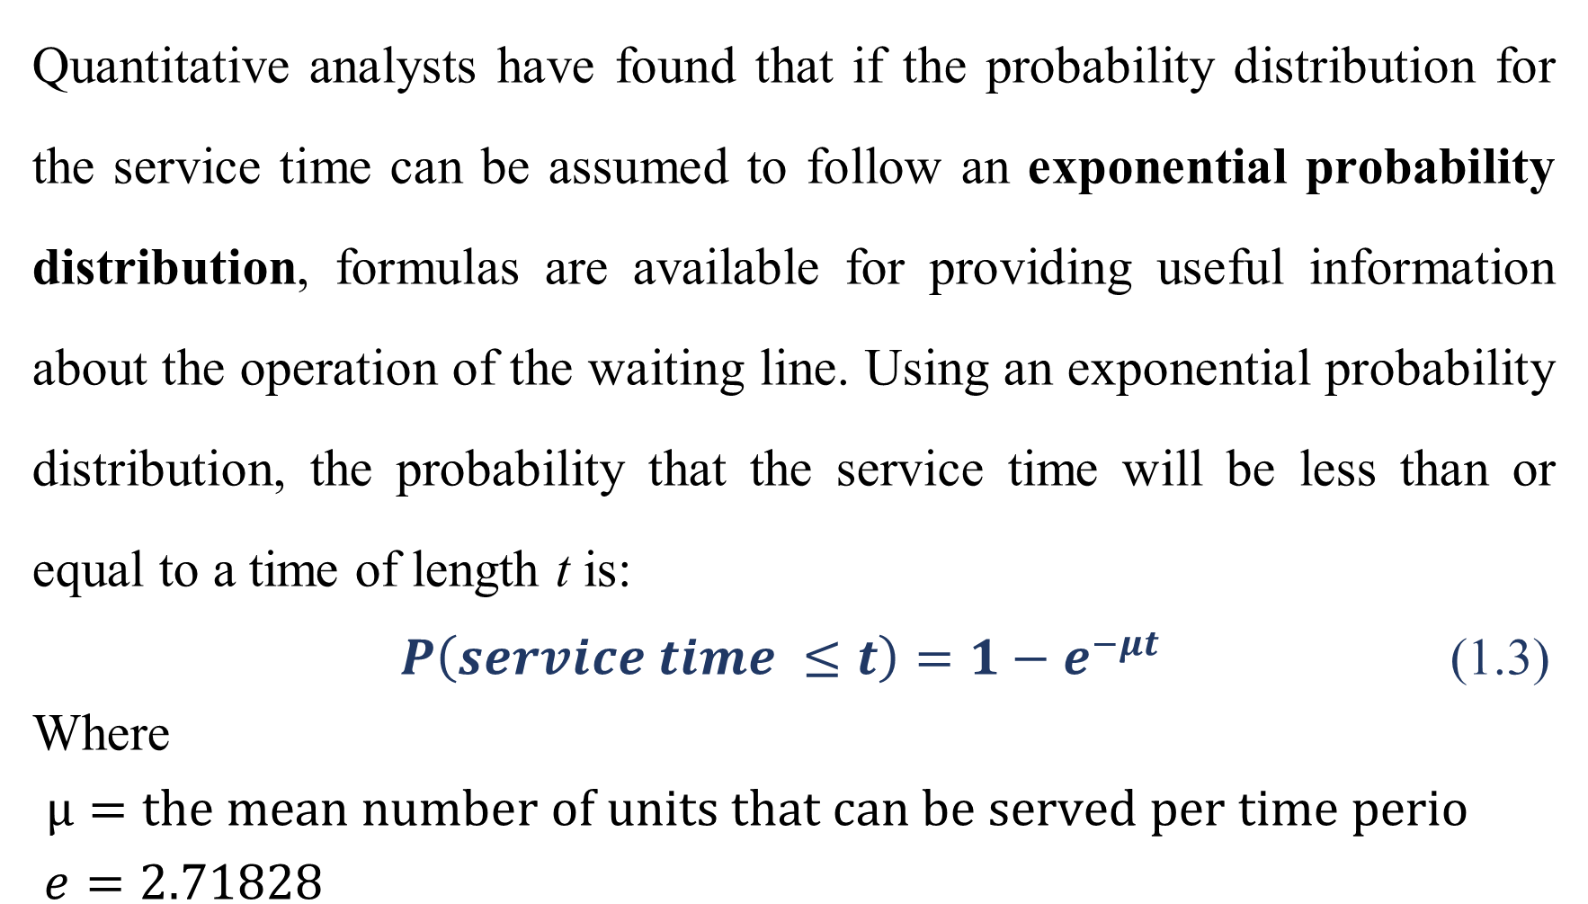
.
Quantitative analysts have found that if the probability distribution for the service time can be assumed to follow an exponential probability distribution, formulas are available for providing useful information about the operation of the waiting line. Using an exponential probability distribution, the probability that the service time will be less than or equal to a time of length t is:
$P\left(service time ≤t\right)=1−e^{−μt}$ (1.3)
Where
$μ=the mean number of units that can be served per time perio$
$e=2.71828$

Slide 20
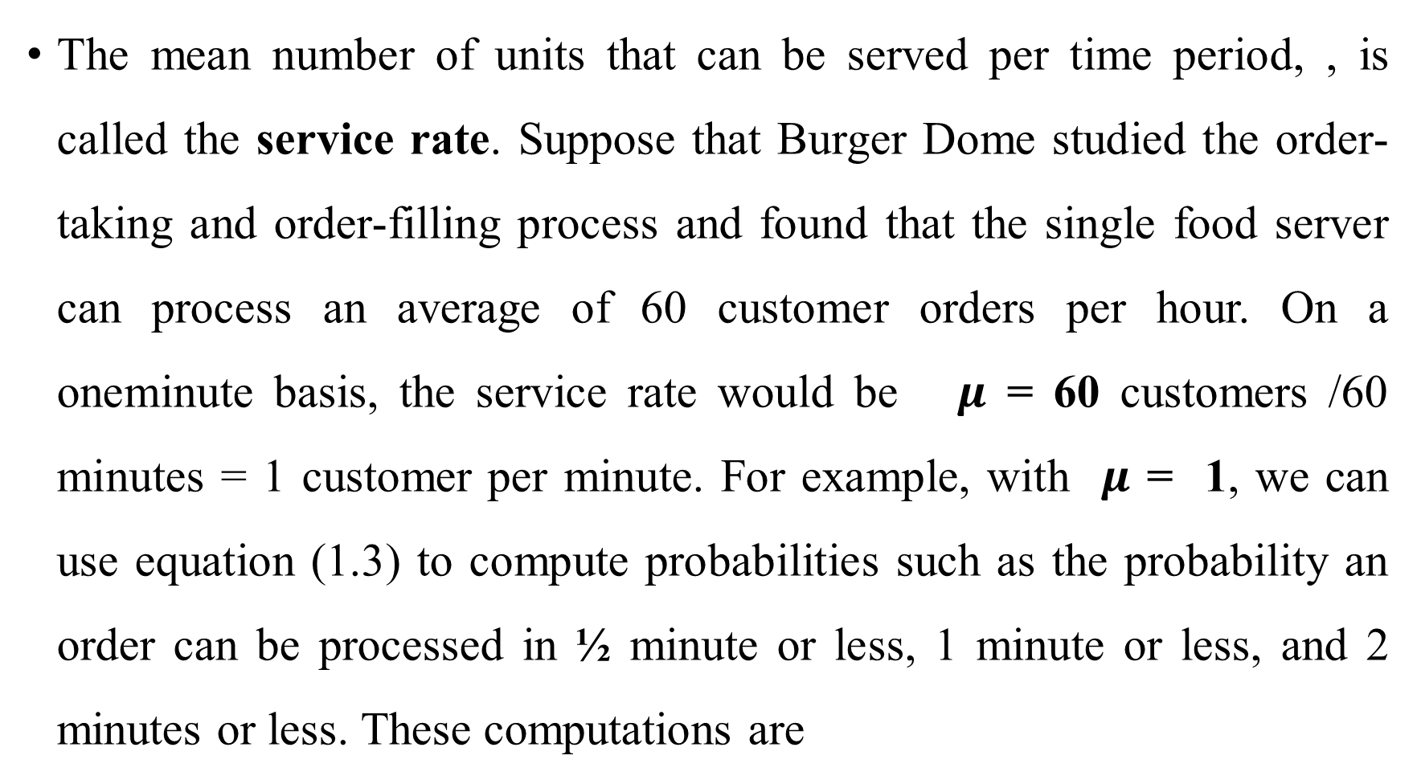
.
The mean number of units that can be served per time period, , is called the service rate. Suppose that Burger Dome studied the order-taking and order-filling process and found that the single food server can process an average of 60 customer orders per hour. On a oneminute basis, the service rate would be $μ$ = 60 customers /60 minutes = 1 customer per minute. For example, with $μ$ = 1, we can use equation (1.3) to compute probabilities such as the probability an order can be processed in ¹⁄₂ minute or less, 1 minute or less, and 2 minutes or less. These computations are

Slide 21
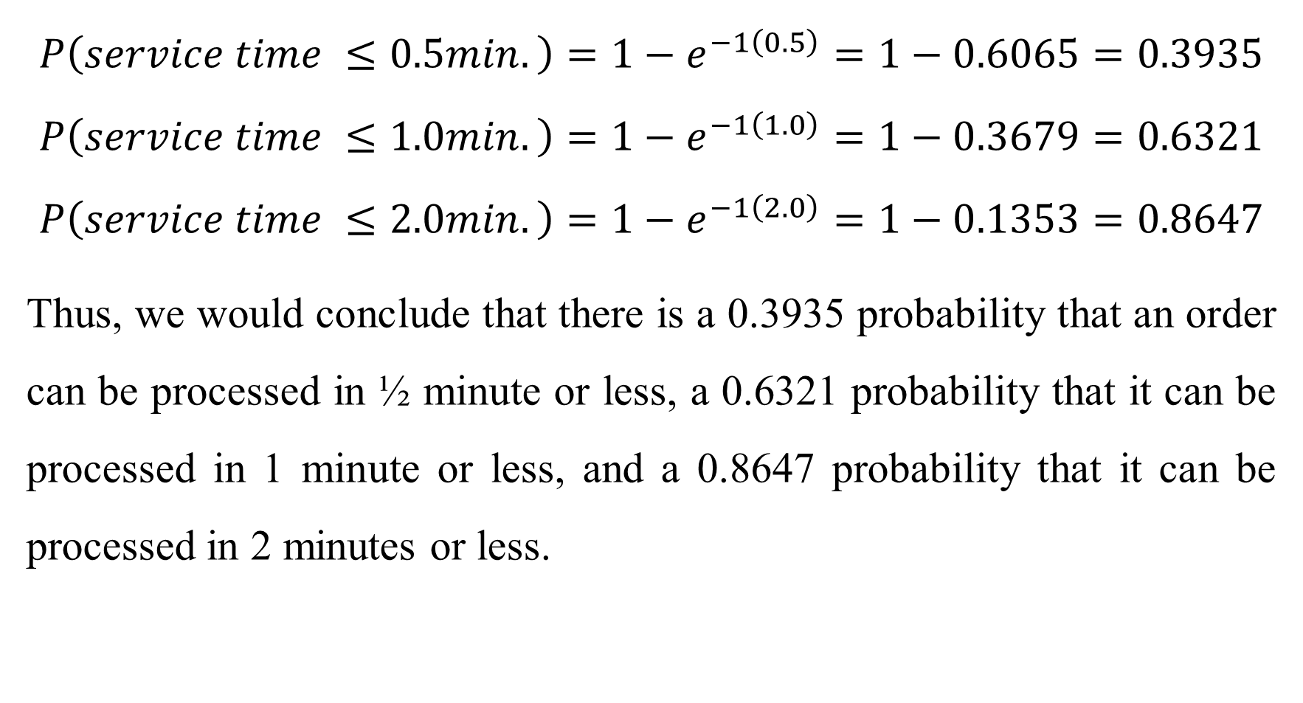
.
$$P\left(service time ≤0.5min.\right)=1−e^{−1\left(0.5\right)}=1−0.6065=0.3935$$
$$P\left(service time ≤1.0min.\right)=1−e^{−1\left(1.0\right)}=1−0.3679=0.6321$$
$$P\left(service time ≤2.0min.\right)=1−e^{−1\left(2.0\right)}=1−0.1353=0.8647$$
Thus, we would conclude that there is a 0.3935 probability that an order can be processed in ¹⁄₂ minute or less, a 0.6321 probability that it can be processed in 1 minute or less, and a 0.8647 probability that it can be processed in 2 minutes or less.

Slide 22
Queue Discipline
In describing a waiting line system, we must define the manner in which the waiting units are arranged for service. For the Burger Dome waiting line, and in general for most customer-oriented waiting lines, the units waiting for service are arranged on a first-come, first-served basis; this approach is referred to as an FCFS queue discipline. However, some situations call for different queue disciplines. For example, when people wait for an elevator, the last one on the elevator is often the first one to complete service (i.e., the first to leave the elevator).

Slide 23
.
Other types of queue disciplines assign priorities to the waiting units and then serve the unit with the highest priority first. In this chapter we consider only waiting lines based on a first-come, first-served queue discipline. The Management Science in Action, The Serpentine Line and an FCFS Queue Discipline at Whole Foods Market, describes how an FCFS queue discipline is used at a supermarket.

Slide 24
Steady-State Operation
When the Burger Dome restaurant opens in the morning, no customers are in the restaurant. Gradually, activity builds up to a normal or steady state. The beginning or start-up period is referred to as the transient period. The transient period ends when the system reaches the normal or steady-state operation. Waiting line models describe the steady-state operating characteristics of a waiting line.

Slide 25
. SECTION 2…
SINGLE-CHANNEL WAITING LINE MODEL WITH POISSON ARRIVALS AND EXPONENTIAL SERVICE TIMES

Slide 26
2. SINGLE-CHANNEL WAITING LINE MODEL WITH POISSON ARRIVALS AND EXPONENTIAL SERVICE TIMES
Under single-channel waiting line model with poisson arrivals and exponential service times, we shall be looking at:
Operating Characteristics
Operating Characteristics for the Burger Dome Problem
Managers’ Use of Waiting Line Models
Improving the Waiting Line Operation
Excel Solution of Waiting Line Model

Slide 27
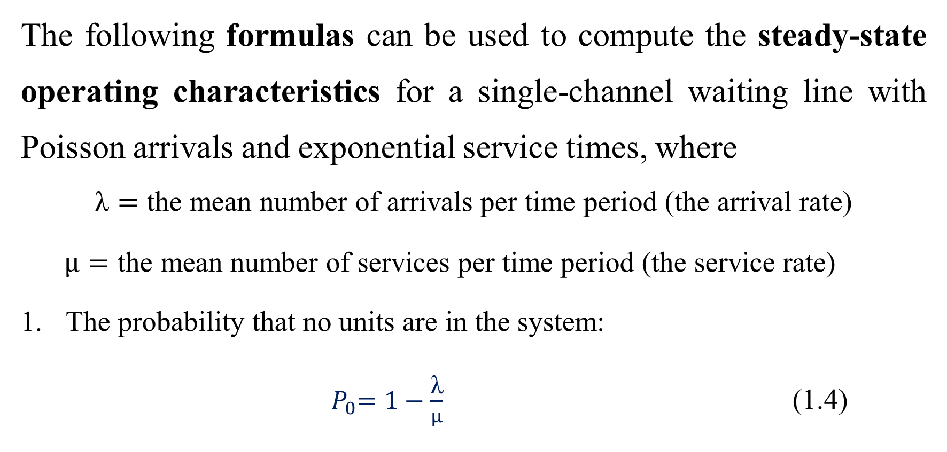
Operating Characteristics
The following formulas can be used to compute the steady-state operating characteristics for a single-channel waiting line with Poisson arrivals and exponential service times, where
$$\text{λ}=\text{the} \text{mean} \text{number} \text{of} \text{arrivals} \text{per} \text{time} \text{period}\text{ (}\text{the} \text{arrival} \text{rate}\text{)}$$
$μ=\text{the} \text{mean} \text{number} \text{of} \text{services} \text{per} \text{time} \text{period}\text{ (}\text{the} \text{service} \text{rate}\text{)}$
The probability that no units are in the system:
${ P}_{0}=1−\frac{\text{λ}}{μ}$ (1.4)

Slide 28

.
The average number of units in the waiting line: ${ L}_{q}=\frac{λ^{2}}{μ(μ−λ)}$ (1.5)
The average number of units in the system:
$L=L_{q}+\frac{λ}{μ}$ (1.6)
4. The average time a unit spends in the waiting line:
${ W}_{q}=\frac{{ L}_{q}}{λ}$ (1.7)

Slide 29
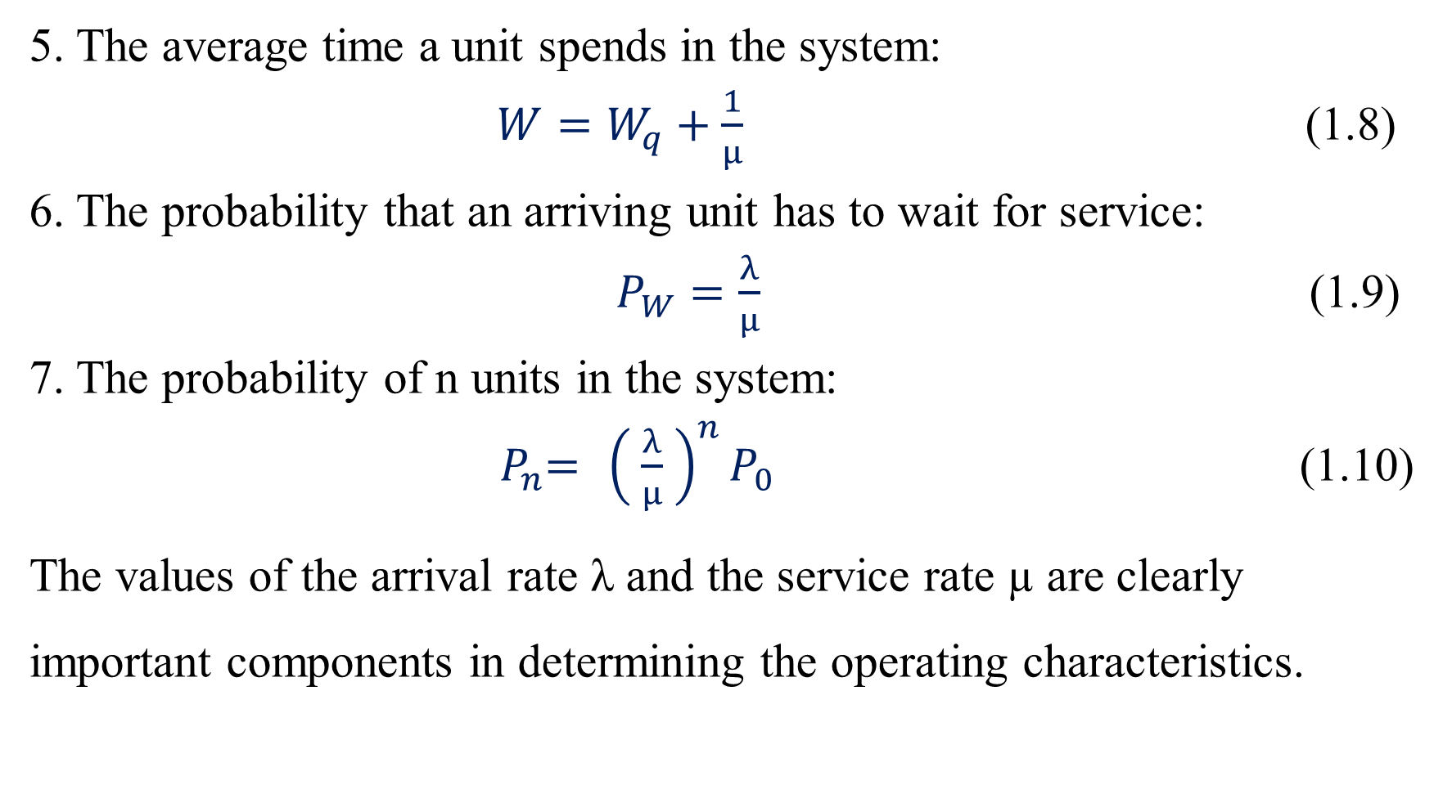
.
5. The average time a unit spends in the system:
$W=W_{q}+\frac{1}{μ}$ (1.8)
6. The probability that an arriving unit has to wait for service:
$P_{W}=\frac{λ}{μ}$ (1.9)
7. The probability of n units in the system:
${ P}_{n}={ \left( \frac{λ}{μ} \right)}^{n}P_{0}$ (1.10)
The values of the arrival rate λ and the service rate µ are clearly important components in determining the operating characteristics.

Slide 30
.
Equation (1.9) shows that the ratio of the arrival rate to the service rate, λ/μ , provides the probability that an arriving unit has to wait because the service facility is in use. Hence, λ/μ is referred to as the utilization factor for the service facility.
The operating characteristics presented in equations (1.4) through (1.10) are applicable only when the service rate μ is greater than the arrival rate λ—in other words, when λ/μ < 1.

Slide 31
.
If this condition does not exist, the waiting line will continue to grow without limit because the service facility does not have sufficient capacity to handle the arriving units. Thus, in using equations (1.4) through (1.10), we must have μ > λ

Slide 32
Operating Characteristics for the Burger Dome Problem
Recall that for the Burger Dome problem we had an arrival rate of λ = 0.75 customers per minute and a service rate of μ = 1 customer per minute. Thus, with μ > λ , equations (1.4) through (1.10) can be used to provide operating characteristics for the Burger Dome single-channel waiting line:

Slide 33

,
$P_{0}=1−\frac{\text{λ}}{μ}=1−\frac{0.75}{1}=0.25$
$L_{q}=\frac{λ^{2}}{μ(μ−λ)}=\frac{{\left(0.75\right)}^{2}}{,1\left(1−0.75\right)}=2.25 customers$
$L=L_{q}+\frac{λ}{μ}=2⋅25+\frac{0⋅75}{1}=3 customers$
$W_{q}=\frac{{ L}_{q}}{λ}=\frac{2.25}{0⋅75}=3 minutes$
$W=W_{q}+\frac{1}{μ}=3+\frac{1}{1}=4 minutes$
$P_{W}=\frac{λ}{μ}= \frac{0.75}{1}=0.75$

Slide 34
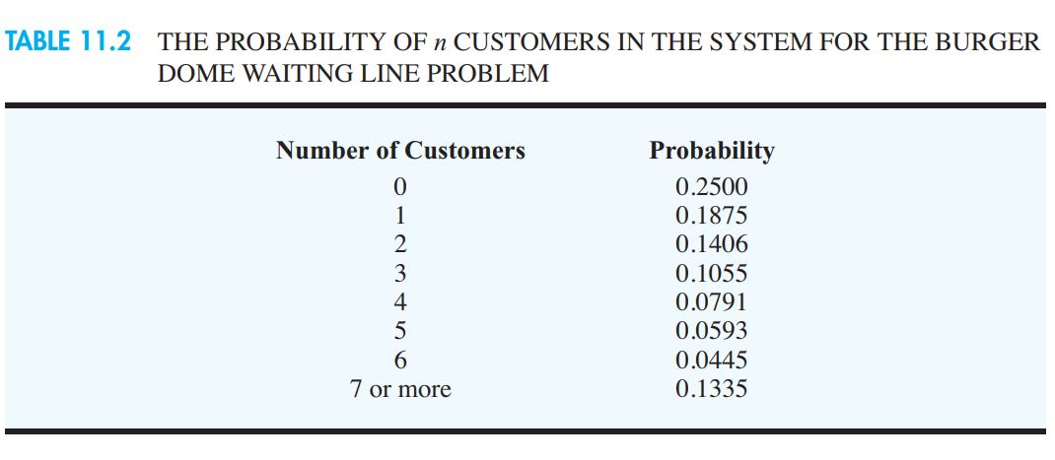

Slide 35
Managers’ Use of Waiting Line Models
The results of the single-channel waiting line for Burger Dome show several important things about the operation of the waiting line. In particular, customers wait an average of three minutes before beginning to place an order, which appears somewhat long for a business based on fast service. In addition, the facts that the average number of customers waiting in line is 2.25 and that 75% of the arriving customers have to wait for service are indicators that something should be done to improve the waiting line operation.

Slide 36
.
Table 11.2 shows a 0.1335 probability that seven or more customers are in the Burger Dome system at one time. This condition indicates a fairly high probability that Burger Dome will experience some long waiting lines if it continues to use the single-channel operation. If the operating characteristics are unsatisfactory in terms of meeting company standards for service, Burger Dome’s management should consider alternative designs or plans for improving the waiting line operation.

Slide 37
Improving the Waiting Line Operation
Waiting line models often indicate when improvements in operating characteristics are desirable. However, the decision of how to modify the waiting line configuration to improve the operating characteristics must be based on the insights and creativity of the analyst. After reviewing the operating characteristics provided by the waiting line model, Burger Dome’s management concluded that improvements designed to reduce waiting times are desirable.

Slide 38
.
To make improvements in the waiting line operation, analysts often focus on ways to improve the service rate. Generally, service rate improvements are obtained by making either or both of the following changes:
Increase the service rate by making a creative design change or by using new technology.
Add one or more service channels so that more customers can be served simultaneously.

Slide 39
.
Assume that in considering alternative 1, Burger Dome’s management decides to employ an order filler who will assist the order taker at the cash register. The customer begins the service process by placing the order with the order taker. As the order is placed, the order taker announces the order over an intercom system, and the order filler begins filling the order. When the order is completed, the order taker handles the money, while the order filler continues to fill the order.

Slide 40
.
With this design, Burger Dome’s management estimates the service rate can be increased from the current 60 customers per hour to 75 customers per hour. Thus, the service rate for the revised system is μ = 75 customers/60 minutes = 1.25 customers per minute. For λ = 0.75 customers per minute and μ = 1.25 customers per minute, equations (1.4) through (1.10) can be used to provide the new operating characteristics for the Burger Dome waiting line. These operating characteristics are summarized in Table 11.3.

Slide 41
.
The information in Table 11.3 indicates that all operating characteristics have improved because of the increased service rate. In particular, the average time a customer spends in the waiting line has been reduced from 3 to 1.2 minutes and the average time a customer spends in the system has been reduced from 4 to 2 minutes. Are any other alternatives available that Burger Dome can use to increase the service rate? If so, and if the mean service rate μ can be identified for each alternative, equations (11.4) through (11.10) can be used to determine the revised operating characteristics and any improvements in the waiting line system.

Slide 42
.
The added cost of any proposed change can be compared to the corresponding service improvements to help the manager determine whether the proposed service improvements are worthwhile. As mentioned previously, another option often available is to add one or more service channels so that more customers can be served simultaneously. The extension of the singlechannel waiting line model to the multiple-channel waiting line model is the topic of the next section.

Slide 43
. SECTION 3…
MULTIPLE-CHANNEL WAITING LINE MODEL WITH POISSON ARRIVALS AND EXPONENTIAL SERVICE TIMES

Slide 44
3.MULTIPLE-CHANNEL WAITING LINE MODEL WITH POISSON ARRIVALS AND EXPONENTIAL SERVICE TIMES
Under multiple-channel waiting line model with poisson arrivals and exponential service times, we shall be looking at:
Operating Characteristics
Operating Characteristics for the Burger Dome Problem

Slide 45
.
A multiple-channel waiting line consists of two or more service channels that are assumed to be identical in terms of service capability. In the multiple-channel system, arriving units wait in a single waiting line and then move to the first available channel to be served. The single-channel Burger Dome operation can be expanded to a two-channel system by opening a second service channel. Figure 11.3 shows a diagram of the Burger Dome two-channel waiting line.

Slide 46
.
In this section we present formulas that can be used to determine the steady-state operating characteristics for a multiple-channel waiting line. These formulas are applicable if the following conditions exist:
The arrivals follow a Poisson probability distribution.
The service time for each channel follows an exponential probability distribution.

Slide 47
.
3. The service rate μ is the same for each channel.
4. The arrivals wait in a single waiting line and then move to the first open channel for service

Slide 48
Fact…
You may be familiar with multiple-channel systems that also have multiple waiting lines. The waiting line model in this section has multiple channels but only a single waiting line. Operating characteristics for a multiplechannel system are better when a single waiting line, rather than multiple waiting lines, is used.

Slide 49
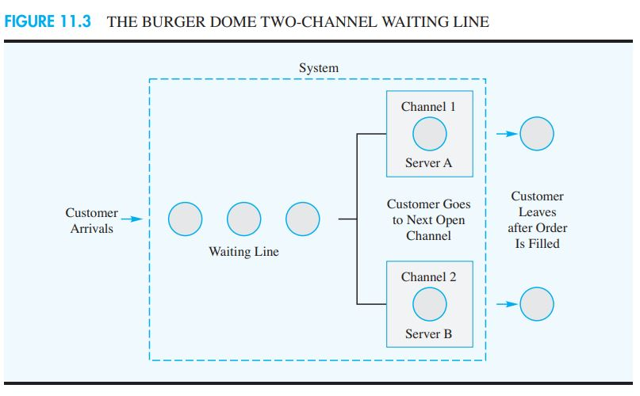
.

Slide 50
Operating Characteristics
The following formulas can be used to compute the steady-state operating characteristics for multiple-channel waiting lines, where
λ = the arrival rate for the system
μ = the service rate for each channel
κ = the number of channels

Slide 51
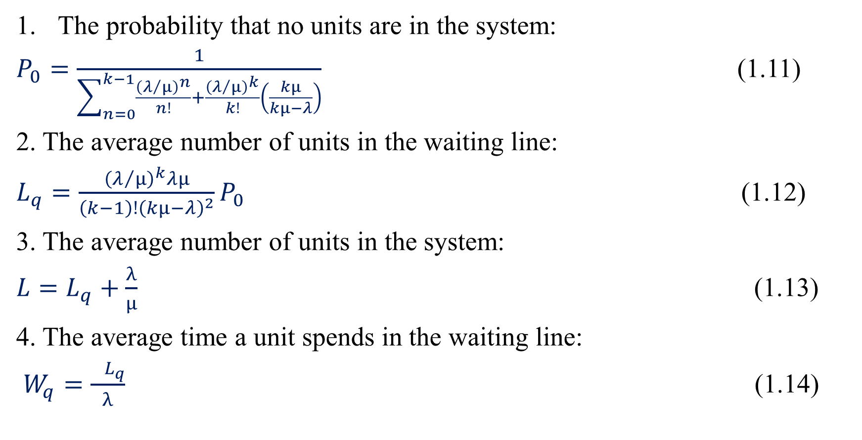
.
The probability that no units are in the system:
$P_{0}=\frac{1}{\sum_{n=0}^{k−1}{\frac{{\left(λ/μ\right)}^{n}}{n!}}+\frac{{\left(λ/μ\right)}^{k}}{k!}\left(\frac{kμ}{kμ−λ}\right)}$ (1.11)
2. The average number of units in the waiting line:
$L_{q}=\frac{{\left(λ/μ\right)}^{k}λμ}{\left(k−1\right)!{\left(kμ−λ\right)}^{2}}P_{0}$ (1.12)
3. The average number of units in the system:
$L=L_{q}+\frac{λ}{μ}$ (1.13)
4. The average time a unit spends in the waiting line:
$W_{q}=\frac{{ L}_{q}}{λ}$ (1.14)

Slide 52
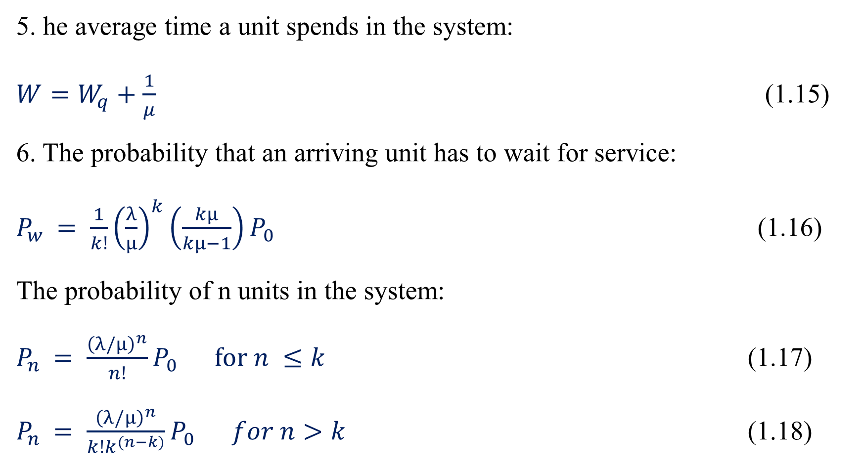
.
5. he average time a unit spends in the system:
$W=W_{q}+\frac{1}{μ}$ (1.15)
6. The probability that an arriving unit has to wait for service:
$P_{w }= \frac{1}{k!}{\left(\frac{λ}{μ}\right)}^{k}\left(\frac{kμ}{kμ−1}\right)P_{0}$ (1.16)
The probability of n units in the system:
$P_{n }= \frac{{\left(λ/μ\right)}^{n}}{n!}P_{0} for n ≤k$ (1.17)
$P_{n }= \frac{{\left(λ/μ\right)}^{n}}{k!k^{(n−k)}}P_{0} for n>k$ (1.18)

Slide 53
.
Because μ is the service rate for each channel, kμ is the service rate for the multiple-channel system. As was true for the single-channel waiting line model, the formulas for the operating characteristics of multiple-channel waiting lines can be applied only in situations where the service rate for the system is greater than the arrival rate for the system; in other words, the formulas are applicable only if kμ is greater than .

Slide 54
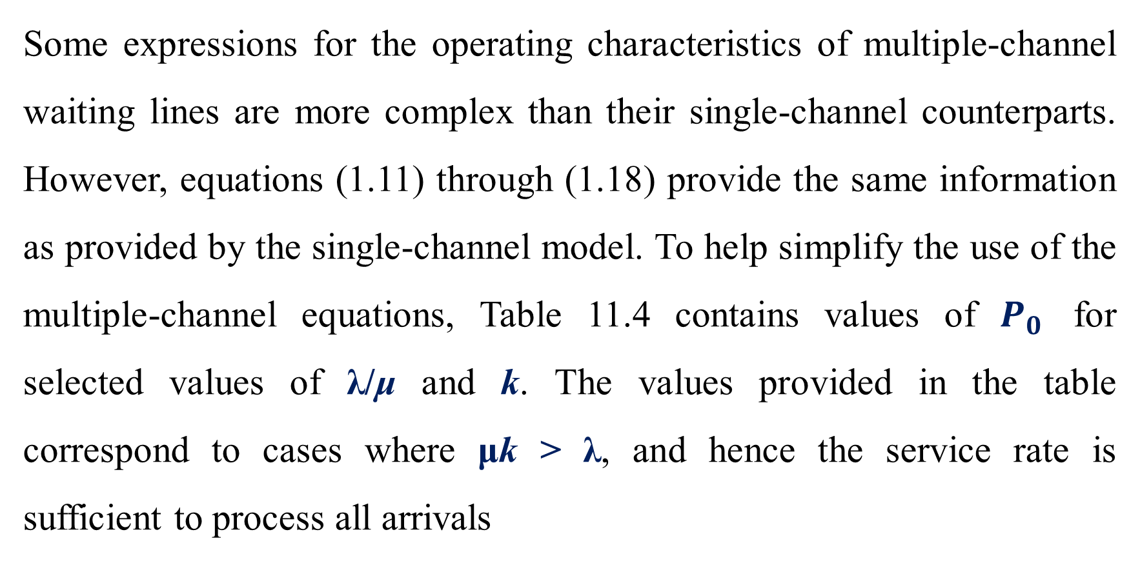
.
Some expressions for the operating characteristics of multiple-channel waiting lines are more complex than their single-channel counterparts. However, equations (1.11) through (1.18) provide the same information as provided by the single-channel model. To help simplify the use of the multiple-channel equations, Table 11.4 contains values of $P_{0}$ for selected values of λ/μ and k. The values provided in the table correspond to cases where μk > λ, and hence the service rate is sufficient to process all arrivals

Slide 55
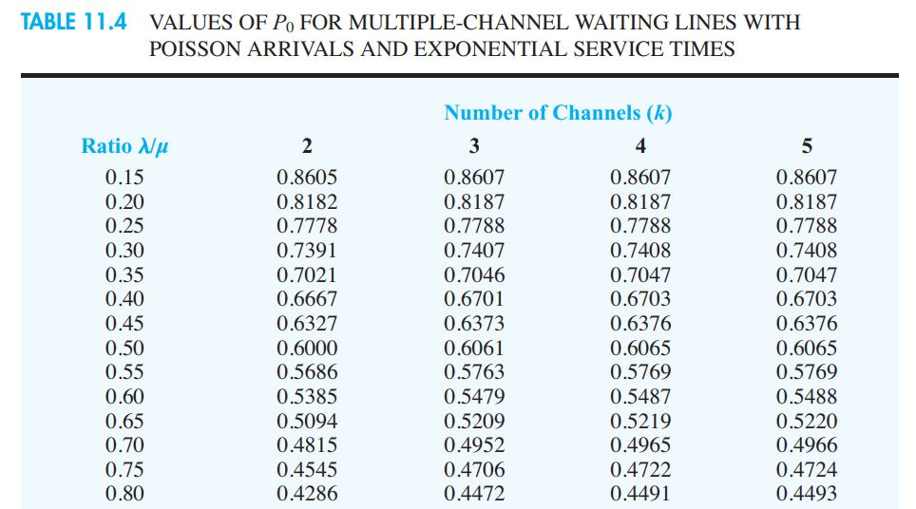
.

Slide 56
Operating Characteristics for the Burger Dome Problem
To illustrate the multiple-channel waiting line model, we return to the Burger Dome fastfood restaurant waiting line problem. Suppose that management wants to evaluate the desirability of opening a second order-processing station so that two customers can be served simultaneously. Assume a single waiting line with the first customer in line moving to the first available server. Let us evaluate the operating characteristics for this twochannel system.

Slide 57
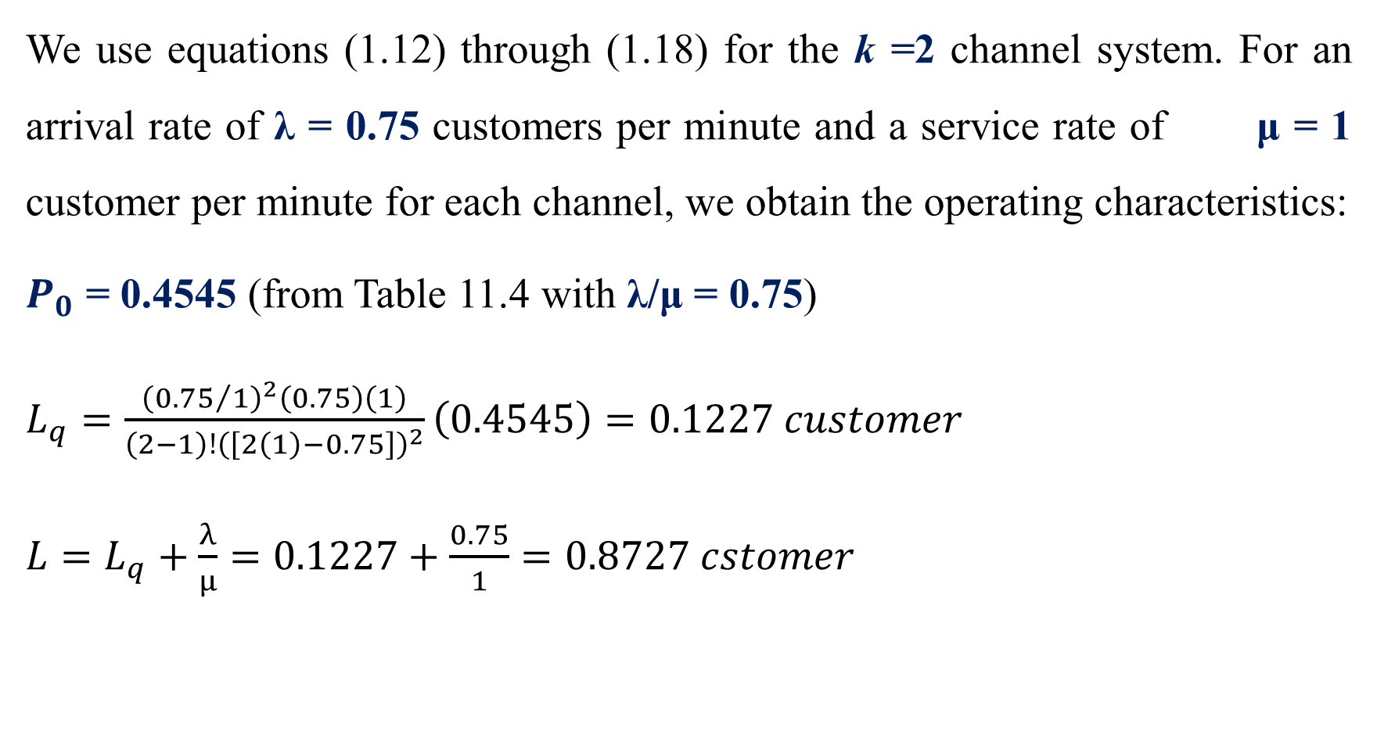
.
We use equations (1.12) through (1.18) for the k =2 channel system. For an arrival rate of λ = 0.75 customers per minute and a service rate of μ = 1 customer per minute for each channel, we obtain the operating characteristics:
$P_{0}$ = 0.4545 (from Table 11.4 with λ/μ = 0.75)
$L_{q}=\frac{{\left({0.75}/1\right)}^{2}\left(0.75\right)\left(1\right)}{\left(2−1\right)!{\left(\left[2\left(1\right)−0.75\right]\right)}^{2}}\left(0.4545\right)=0.1227 customer$
$L=L_{q}+\frac{λ}{μ}=0.1227+\frac{0.75}{1}=0.8727 cstomer$

Slide 58

.
$W_{q}=\frac{{ L}_{q}}{λ}= \frac{0.1227}{0.75}=0.1636 minute$
$W=W_{q}+\frac{1}{μ}=0.1636+\frac{1}{2}=1.1636 minutes$
$P_{w }= \frac{1}{2!}{\left(\frac{0.75}{1}\right)}^{2}\left(\frac{2\left(1\right)}{2\left(1\right)−1}\right)\left(0.4545\right)=0.2045$

Slide 59
.
Using equations (1.17) and (1.18), we can compute the probabilities of n customers in the system. The results from these computations are summarized in Table 11.5. We can now compare the steady-state operating characteristics of the two-channel system to the operating characteristics of the original single-channel system discussed in Section 11.2.
The average time a customer spends in the system (waiting time plus service time) is reduced from W = 4 minutes to W =1.1636 minutes.
The average number of customers in the waiting line is reduced from Lq = 2.25 customers to Lq = 0.1227 customer.

Slide 60
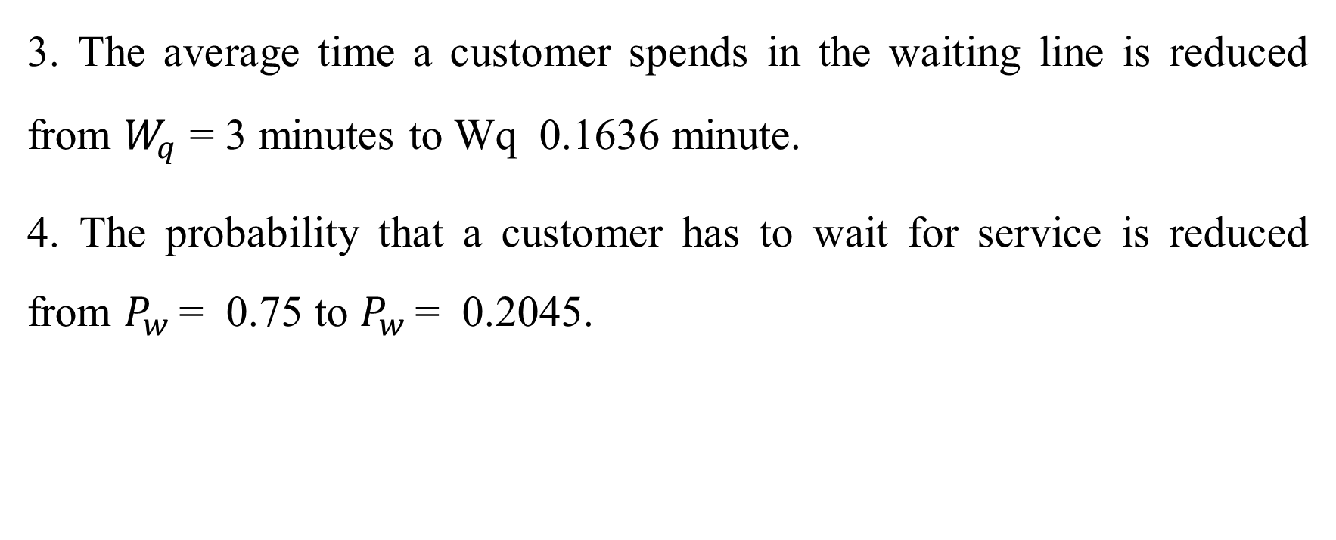
.
3. The average time a customer spends in the waiting line is reduced from $W_{q}$ = 3 minutes to Wq 0.1636 minute.
4. The probability that a customer has to wait for service is reduced from $P_{w }$= 0.75 to $P_{w }$= 0.2045.

Slide 61
.
Clearly the two-channel system will significantly improve the operating characteristics of the waiting line. However, adding an order filler at each service station would further increase the service rate and improve the operating characteristics. The final decision regarding the staffing policy at Burger Dome rests with the Burger Dome management. The waiting line study simply provides the operating characteristics that can be anticipated under three configurations: a single-channel system with one employee, a single-channel system with two employees, and a two-channel system with an employee for each channel.

Slide 62
.
After considering these results, what action would you recommend? In this case, Burger Dome adopted the following policy statement: For periods when customer arrivals are expected to average 45 customers per hour, Burger Dome will open two order-processing channels with one employee assigned to each. By changing the arrival rate λ to reflect arrival rates at different times of the day, and then computing the operating characteristics, Burger Dome’s management can establish guidelines and policies that tell the store managers when to schedule service operations with a single channel, two channels, or perhaps even three or more channels.

Slide 63
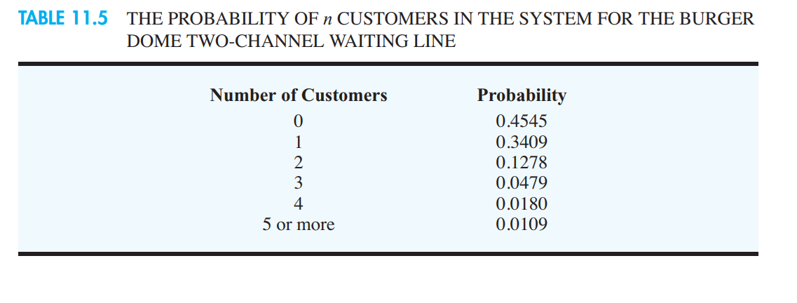
.

Slide 64
SECTION 4…
SOME GENERAL RELATIONSHIPS FOR WAITING LINE MODELS

Slide 65
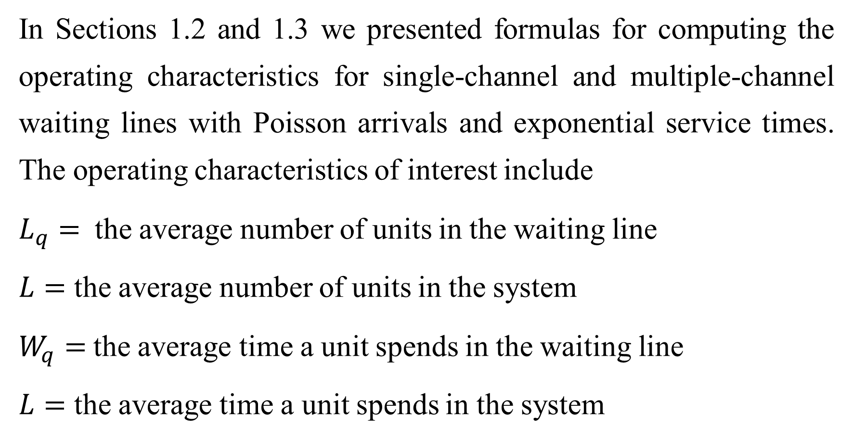
.
In Sections 1.2 and 1.3 we presented formulas for computing the operating characteristics for single-channel and multiple-channel waiting lines with Poisson arrivals and exponential service times. The operating characteristics of interest include
$L_{q}=$ the average number of units in the waiting line
$L=$ the average number of units in the system
$W_{q}=$the average time a unit spends in the waiting line
$L=$ the average time a unit spends in the system

Slide 66
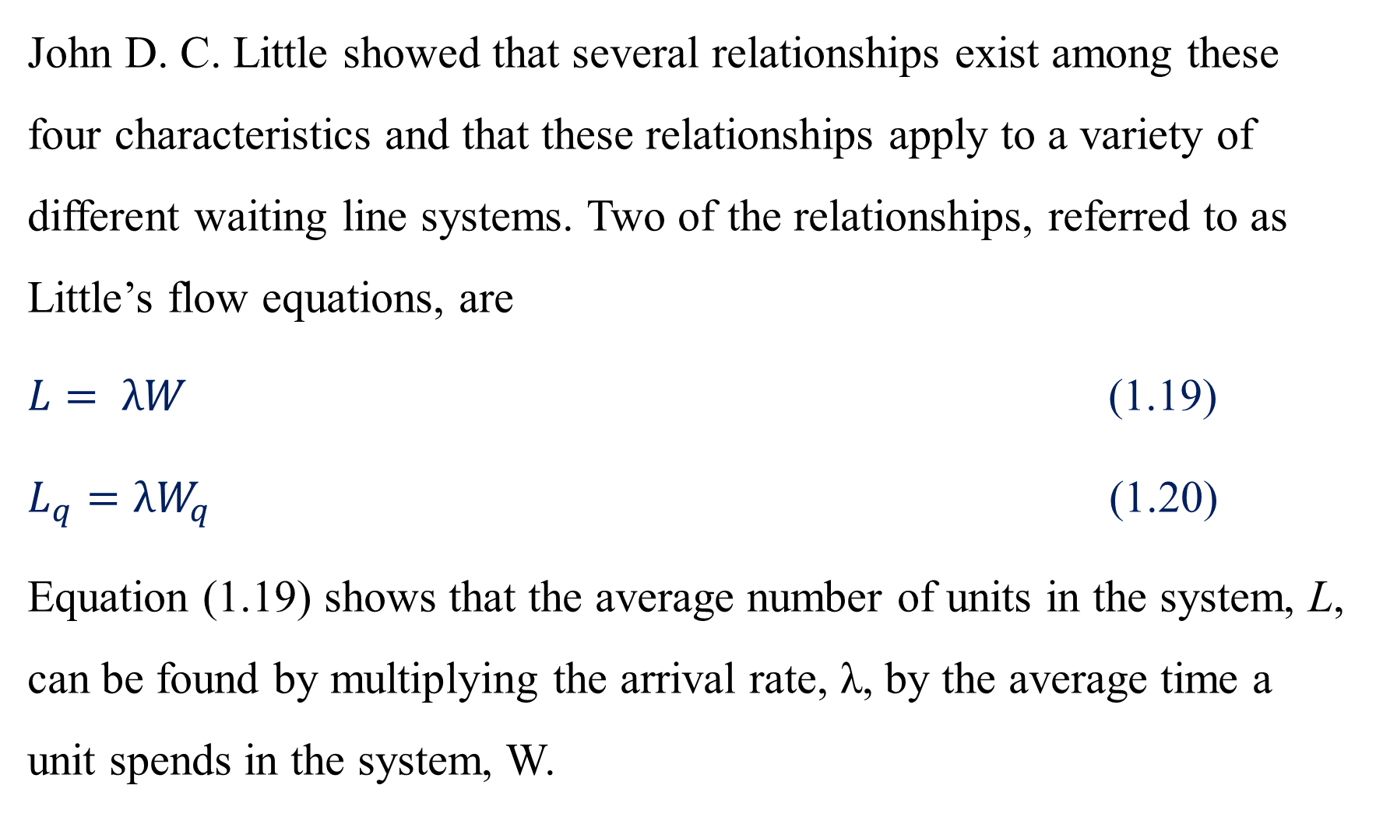
.
John D. C. Little showed that several relationships exist among these four characteristics and that these relationships apply to a variety of different waiting line systems. Two of the relationships, referred to as Little’s flow equations, are
$L= λW$ (1.19)
$L_{q}=λW_{q}$ (1.20)
Equation (1.19) shows that the average number of units in the system, L, can be found by multiplying the arrival rate, λ, by the average time a unit spends in the system, W.

Slide 67
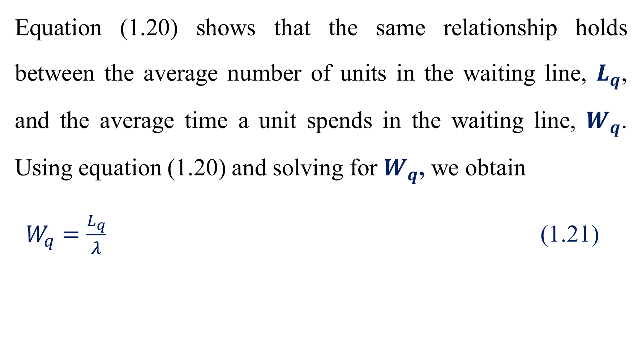
.
Equation (1.20) shows that the same relationship holds between the average number of units in the waiting line, $L_{q}$, and the average time a unit spends in the waiting line, $W_{q}$. Using equation (1.20) and solving for $W_{q}$, we obtain
$W_{q}=\frac{L_{q}}{λ}$ (1.21)

Slide 68
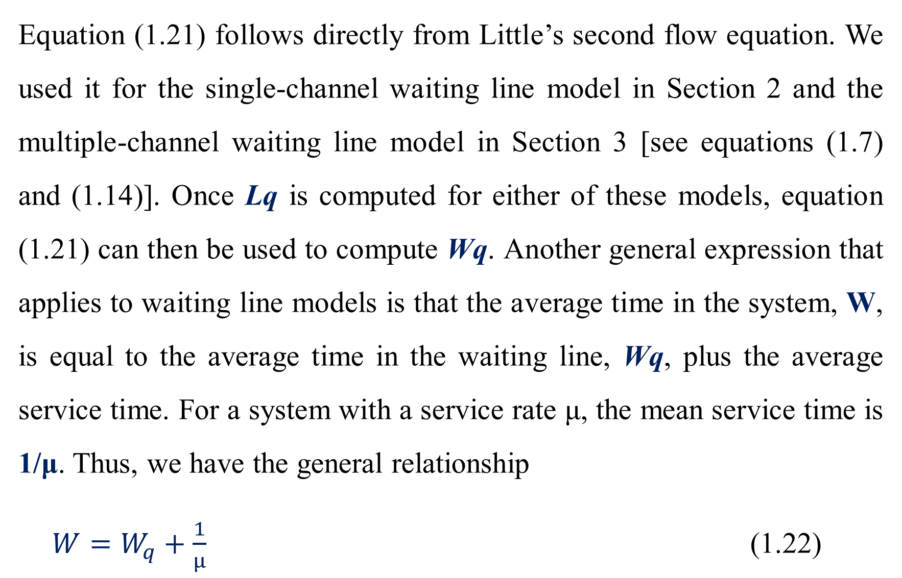
.
Equation (1.21) follows directly from Little’s second flow equation. We used it for the single-channel waiting line model in Section 2 and the multiple-channel waiting line model in Section 3 [see equations (1.7) and (1.14)]. Once Lq is computed for either of these models, equation (1.21) can then be used to compute Wq. Another general expression that applies to waiting line models is that the average time in the system, W, is equal to the average time in the waiting line, Wq, plus the average service time. For a system with a service rate μ, the mean service time is 1/μ. Thus, we have the general relationship
${W=W}_{q}+\frac{1}{μ}$ (1.22)

Slide 69
SECTION 5…
ECONOMIC ANALYSIS OF WAITING LINES

Slide 70
.
Frequently, decisions involving the design of waiting lines will be based on a subjective evaluation of the operating characteristics of the waiting line. For example, a manager may decide that an average waiting time of one minute or less and an average of two customers or fewer in the system are reasonable goals. The waiting line models presented in the preceding sections can be used to determine the number of channels that will meet the manager’s waiting line performance goals.

Slide 71
.
On the other hand, a manager may want to identify the cost of operating the waiting line system and then base the decision regarding system design on a minimum hourly or daily operating cost. Before an economic analysis of a waiting line can be conducted, a total cost model, which includes the cost of waiting and the cost of service, must be developed. To develop a total cost model for a waiting line, we begin by defining the notation to be used:

Slide 72
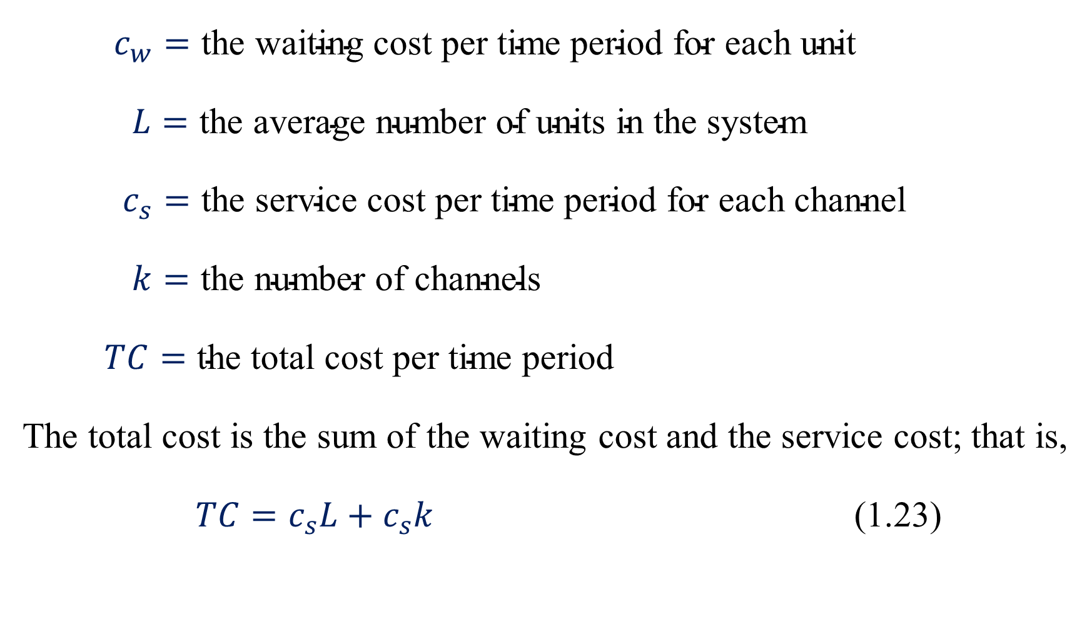
.
$c_{w}=\text{the} \text{waiting} \text{cost} \text{per} \text{time} \text{period} \text{for} \text{each} \text{unit}$
$L=\text{the} \text{average} \text{number} \text{of} \text{units} \text{in} \text{the} \text{system}$
$c_{s}=\text{the} \text{service} \text{cost} \text{per} \text{time} \text{period} \text{for} \text{each} \text{channel}$
$k=\text{the} \text{number} \text{of} \text{channels}$
$TC=\text{the} \text{total} \text{cost} \text{per} \text{time} \text{period}$
The total cost is the sum of the waiting cost and the service cost; that is,
$TC=c_{s}L+c_{s}k$ (1.23)

Slide 73
.
To conduct an economic analysis of a waiting line, we must obtain reasonable estimates of the waiting cost and the service cost. Of these two costs, the waiting cost is usually the more difficult to evaluate.
This cost is not a direct cost to Burger Dome. However, if Burger Dome ignores this cost and allows long waiting lines, customers ultimately will take their business elsewhere.

Slide 74
.
Thus, Burger Dome will experience lost sales and, in effect, incur a cost. The service cost is generally easier to determine. This cost is the relevant cost associated with operating each service channel. In the Burger Dome problem, this cost would include the server’s wages, benefits, and any other direct costs associated with operating the service channel.

Slide 75
.
At Burger Dome, this cost is estimated to be $7 per hour. To demonstrate the use of equation (1.23), we assume that Burger Dome is willing to assign a cost of $10 per hour for customer waiting time. We use the average number of units in the system, L, as computed in Sections 1.2 and 1.3 to obtain the total hourly cost for the single-channel and two-channel systems. Single-channel system (L = 3 customers)

Slide 76
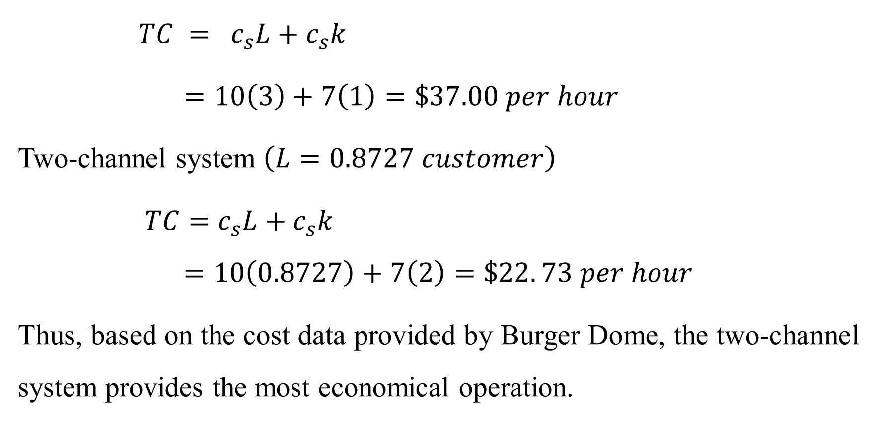
.
$TC = c_{s}L+c_{s}k$
$=10\left(3\right)+7\left(1\right)=\$37.00 per hour$
Two-channel system $\left(L=0.8727 customer\right)$
$TC=c_{s}L+c_{s}k$
$$=10\left(0.8727\right)+7\left(2\right)=\$22. 73 per hour$$
Thus, based on the cost data provided by Burger Dome, the two-channel system provides the most economical operation.

Slide 77
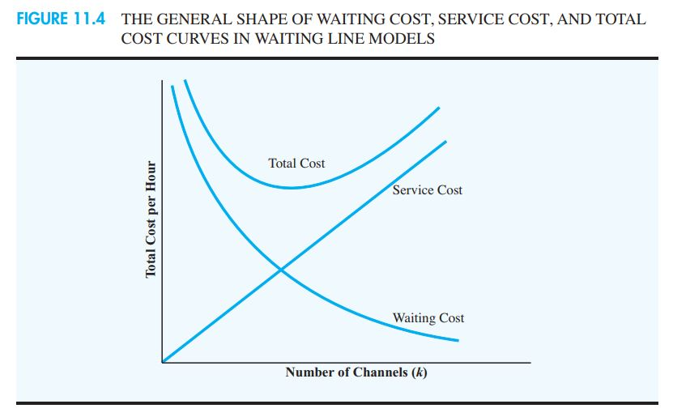
.

Slide 78
.
Figure 11.4 shows the general shape of the cost curves in the economic analysis of waiting lines. The service cost increases as the number of channels is increased. However, with more channels, the service is better. As a results, waiting time and cost decrease as the number of channels is increased. The number of channels that will provide a good approximation of the minimum total cost design can be found by evaluating the total cost for several design alternatives.

Slide 79
SECTION 6…
OTHER WAITING LINE MODELS

Slide 80
.
D. G. Kendall suggested a notation that is helpful in classifying the wide variety of different waiting line models that have been developed. The three-symbol Kendall notation is as follows:
A/B/k
Where
A = denotes the probability distribution of the arrivals
B = denotes the probability distribution for the service time
K = denotes the number of channel

Slide 81
.
Depending on the letter appearing in the A or B position, a variety of waiting line systems can be described. The letters that are commonly used are as follows:
M = designates a Poisson probability distribution for the arrivals or an exponential probability distribution for service time
D = designates that the arrivals or the service time is deterministic or constant
G = designates that the arrivals or the service time has a general probability distribution with a known mean and variance

Slide 82
.
Using the Kendall notation, the single-channel waiting line model with Poisson arrivals and exponential service times is classified as an M/M/1 model. The two-channel waiting line model with Poisson arrivals and exponential service times presented in Section 11.3 would be classified as an M/M/2 model.

Slide 83
SECTION 6…
SINGLE-CHANNEL WAITING LINE MODEL WITH POISSON ARRIVALS AND ARBITRARY SERVICE TIMES

Slide 84
7. SINGLE-CHANNEL WAITING LINE MODEL WITH POISSON ARRIVALS AND ARBITRARY SERVICE TIMES
Let us return to the single-channel waiting line model where arrivals are described by a Poisson probability distribution. However, we now assume that the probability distribution for the service times is not an exponential probability distribution. Thus, using the Kendall notation, the waiting line model that is appropriate is an M/G/1 model, where G denotes a general or unspecified probability distribution.

Slide 85
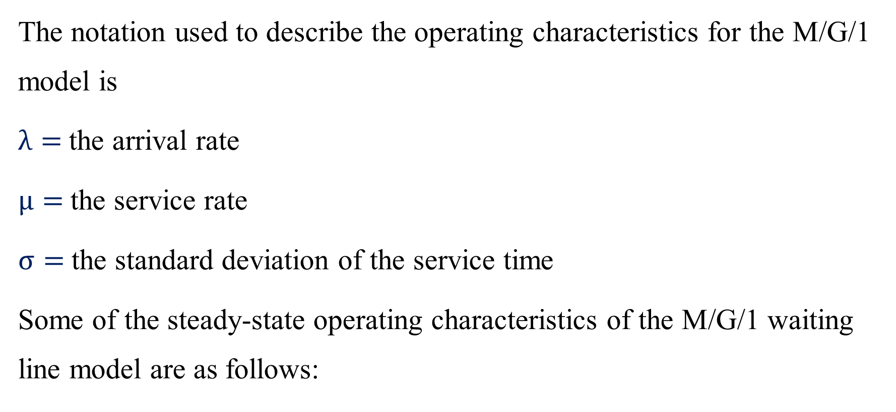
Operating Characteristics for the M/G/1 Model
The notation used to describe the operating characteristics for the M/G/1 model is
$λ=$the arrival rate
$μ=$the service rate
$σ=$the standard deviation of the service time
Some of the steady-state operating characteristics of the M/G/1 waiting line model are as follows:

Slide 86
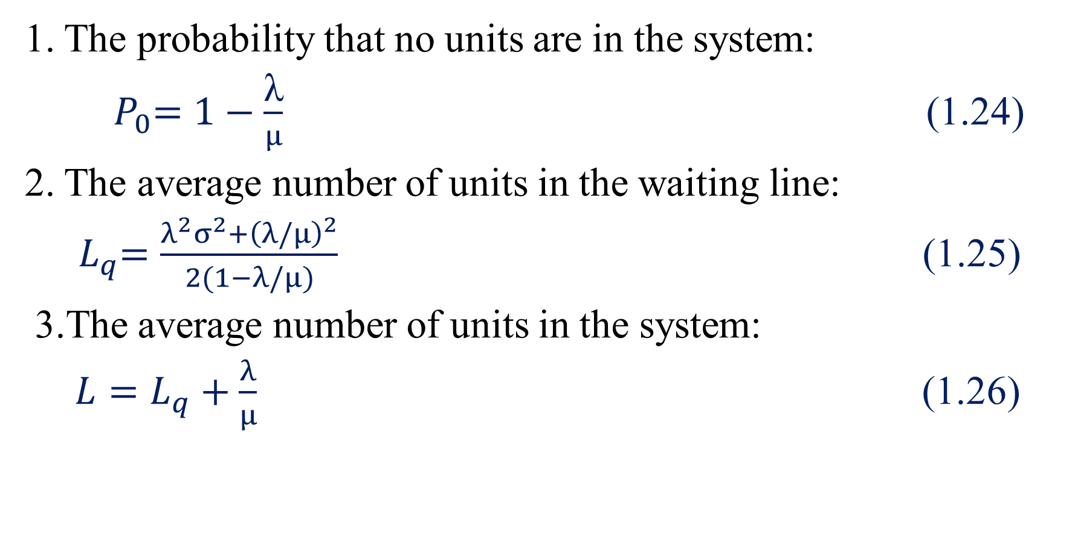
.
1. The probability that no units are in the system:
${ P}_{0}=1−\frac{\text{λ}}{μ}$ (1.24)
2. The average number of units in the waiting line:
${ L}_{q}=\frac{λ^{2}σ^{2}+{\left(λ/μ\right)}^{2}}{2(1−λ/μ)}$ (1.25)
3.The average number of units in the system:
$L=L_{q}+\frac{λ}{μ}$ (1.26)

