Slide 1
GITonik

Slide 2
(1) Git ?
DevOps Tool
Source Code Managament / Versionning
Créé par Linus Torvalds
Créé en 2005
Git est Open Source
Concurrents : SVN, …. Git (git-scm.com)

Slide 3
Pour qui ?
Developeurs et non développeurs
Petit projets – Grand projets

Slide 4
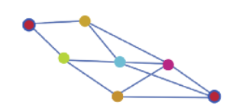
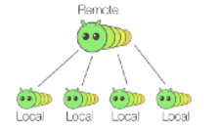

(2) Git ?

Slide 5
Getting Started
Step 1 – Installation
Git - Download s (git-scm.com)
Step 2 – Initial Configuration
Email & Unsername (put the CMD)
git config --global user.name "[nom]”
git config --global user.email "[adresse email]”
… Demo …

Slide 6
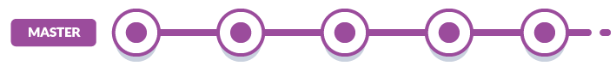
Demo 1 : Multiple version versionning
Git common commands :
Git add .
Git commit –m
Git status
Git log
Git Checkout
Git reset
Git
Git - Reference (git-scm.com)

Slide 7
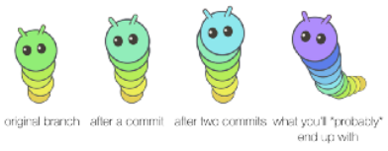
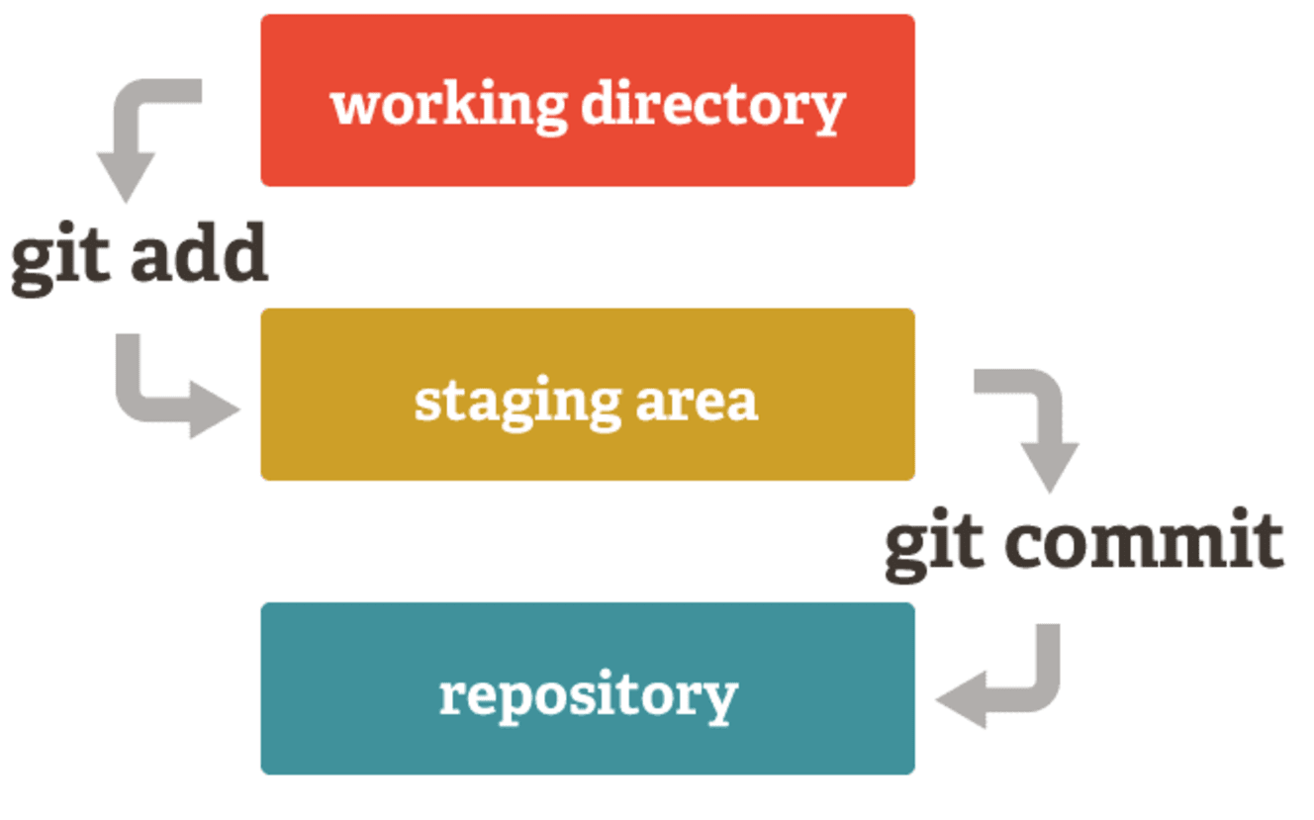
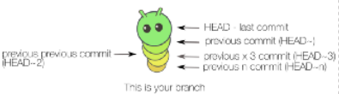
Demo 1 : Multiple version versionning
Staging area and commits

Slide 8
Demo 2 : Simple Web project Versionning
Staging area and commits
Git common commands :
Git add .
Git commit –m
Git status
Git log
Git Checkout
Git Diff

Slide 9
Gitlab, Github, Bitbucket, Azure DevOps ?
What are they ?
GitLab
Github.com
…
…
GIT ≠ (Gitlab, Github, Bitbucket, Azure DevOps)
* Let’s try one of them !

Slide 10
Gitlab, Github, Bitbucket, Azure DevOps (2)
Git common commands :
Git clone
Git pull
Git push
Git branch
Git - Reference (git-scm.com)

Slide 11
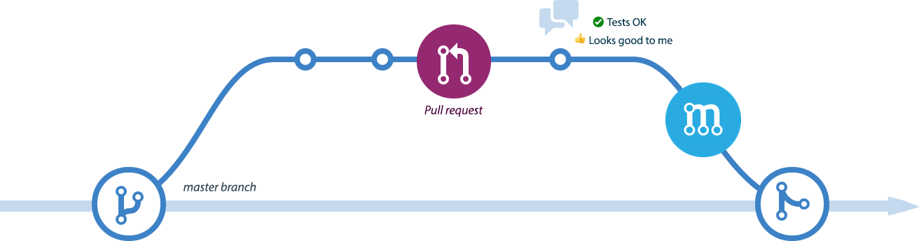
PR Review

Slide 12
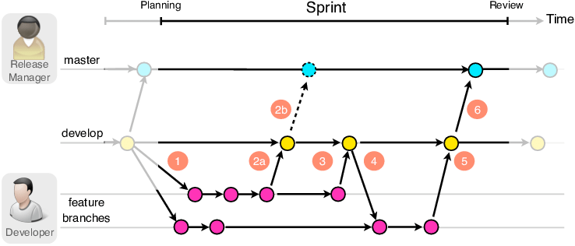
Git Branching

Slide 13
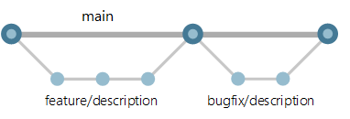
How do we do at Sonepar ?
Combo : Git , Azure DevOps
spark-dataflow-product - Repos (azure.com)
Workflow

