Slide 1
RWPSF 3305 — Web Application Development with Spring Framework
Spring Lab Library
3
site
Midterm report: laboratory works 1–7 with results and answers, and the final web application
1
5
7
4
2
6
Student: Altai Ali, group IT1-2409IS
Programme: 6B06105 Information Systems, year 3
Lecturer: Yemberdiyeva Aknur, Senior Lector
Repository: github.com/Alilishka3/spring-lab-01
IITU, Almaty — October 2026

Slide 2
One application, seven laboratory works
Every lab extended the same Spring Boot 4.1 project (spring-lab-01, package kz.iitu.springlab). Each section below shows what was built, the real output captured on 16 October 2026, the individual variant and the answers to the defence questions.
1
The first Spring Boot application
Environment, Spring Initializr, project structure, a REST controller
Var. 2 — GET /api/reverse
2
The IoC container
Beans, constructor injection, @Primary / @Qualifier / @Fallback, life cycle, scopes
Var. 2 — the "reversed" notifier
3
Application configuration
application.yml, profiles, @ConfigurationProperties with validation, Actuator
Var. 2 — app.pagination
4
Spring AOP
Logging, timing and audit aspects, @Order, the CGLIB proxy, self-invocation
Var. 1 — call counter aspect
5
Spring MVC
REST and page controllers, request parameters, status codes, model, static resources
Var. 1 — GET /api/books/search
6
Forms and validation
Thymeleaf form binding, Bean Validation, two languages, @ControllerAdvice
Var. 1 — ISBN constraint
7
REST API
DTOs and a mapper, 201/204/404/409, ProblemDetail, OpenAPI and Swagger UI
Var. 1 — paging
★
The final application
Spring Lab Library: the site that joins all seven labs, branch rk1

Slide 3
Laboratory work 1
1
3
site
1
5
7
4
2
6
The first Spring Boot application
Environment, Spring Initializr, project structure, a REST controller
Variant 2 — GET /api/reverse

Slide 4
Environment and the generated project
1
Task 1 — verification commands (PowerShell)
Spring Initializr parameters
PS> java -version
openjdk version "25.0.2" 2026-01-20
OpenJDK Runtime Environment (build 25.0.2+10-69)
OpenJDK 64-Bit Server VM (build 25.0.2+10-69, mixed mode, sharing)
PS> javac -version
javac 25.0.2
PS> .\mvnw.cmd -version
Apache Maven 3.9.16 (2bdd9fddda4b155ebf8000e807eb73fd829a51d5)
Java version: 25.0.2, vendor: Oracle Corporation
OS name: "windows 11", version: "10.0", arch: "amd64", family: "windows"
PS> git --version
git version 2.55.0.windows.5
Parameter | Value | Why
Project | Maven | build and dependency management
Spring Boot | 4.1.1 | latest stable, no SNAPSHOT/M
Group / Artifact | kz.iitu / spring-lab-01 | reverse domain; JAR name
Package | kz.iitu.springlab | root of component scanning
Packaging | Jar | executable, embedded Tomcat
Java | 25 | current LTS of the JDK
Dependencies | Spring Web, DevTools | web stack; auto-restart
Start-up log: Spring Boot/Java version, port, start-up time
SpringLab01Application Starting SpringLab01Application v0.0.1-SNAPSHOT using Java 25.0.2
TomcatWebServer Tomcat initialized with port 8080 (http)
SpringLab01Application Started SpringLab01Application in 6.844 seconds
Root path "/" answered 404 before lab 5 (no handler yet); now it serves static/index.html.

Slide 5
Project structure and pom.xml
1
Path | Purpose
pom.xml | coordinates, parent, dependencies, plugins
mvnw, mvnw.cmd, .mvn/ | Maven Wrapper — no global Maven needed
src/main/java/ | application source code
src/main/resources/application.yml | settings (properties until lab 3)
src/main/resources/static/ | CSS, JS, images, index.html
src/main/resources/templates/ | Thymeleaf views (labs 5–6)
src/test/java/ | automated tests
target/ | build output, ignored by Git
Four elements of pom.xml
<parent> spring-boot-starter-parent 4.1.1 — manages the versions of every Spring and library dependency.
<java.version>25 — compiler release used by the build.
spring-boot-starter-webmvc — the web starter (Boot 4 name of starter-web).
spring-boot-maven-plugin — repackages the JAR into an executable one with nested libraries.
Why do spring-webmvc, tomcat-embed-core and jackson-databind appear when only one dependency is declared? They are transitive dependencies of the starter: Maven downloads the whole dependency tree, with versions fixed by the parent.

Slide 6
HelloController — the first REST endpoints
1
web/HelloController.java (lab 1 part)
curl -i, run of 16 Oct 2026
@RestController
@RequestMapping("/api")
public class HelloController {
@Value("${app.owner:unknown}")
private String owner;
@GetMapping("/hello")
public Greeting hello(@RequestParam(defaultValue = "world") String name) {
return new Greeting("Hello, " + name + "!", owner,
LocalDateTime.now());
}
@GetMapping("/info")
public Info info() {
return new Info(owner,
System.getProperty("java.version"),
Runtime.getRuntime().availableProcessors());
}
public record Greeting(String message, String owner,
LocalDateTime timestamp) { }
public record Info(String owner, String javaVersion, int cpuCores) { }
}
$ curl -i http://localhost:8080/api/hello?name=IITU
HTTP/1.1 200
Content-Type: application/json
{
"message": "Hello, IITU!",
"owner": "Altai Ali",
"timestamp": "2026-10-16T19:30:23.8138368"
}
$ curl -i http://localhost:8080/api/info
HTTP/1.1 200
Content-Type: application/json
{"owner":"Altai Ali","javaVersion":"25.0.2","cpuCores":16}
$ curl -i http://localhost:8080/api/none
HTTP/1.1 404
Content-Type: application/json
{
"timestamp": "2026-10-16T14:30:24.134Z",
"status": 404,
"error": "Not Found",
"path": "/api/none"
}
java -jar … --server.port=9090
TomcatWebServer Tomcat initialized with port 9090 (http)
HTTP/1.1 200
Content-Type: application/json

Slide 7
Variant 2 — GET /api/reverse
1
web/HelloController.java
Request | Status | Response
text=Spring | 200 | "gnirpS", length 6
text=IITU 2026 | 200 | "6202 UTII", length 9
text=racecar | 200 | "racecar", length 7
(no text) | 400 | Parameter 'text' is required
@GetMapping("/reverse")
public ReverseResult reverse(@RequestParam(required = false) String text) {
if (text == null || text.isBlank()) {
throw new ResponseStatusException(
HttpStatus.BAD_REQUEST, "Parameter 'text' is required");
}
String reversed = new StringBuilder(text).reverse().toString();
return new ReverseResult(text, reversed, text.length());
}
public record ReverseResult(String original, String reversed, int length) { }
A missing or blank parameter is rejected with 400 (ResponseStatusException). Since lab 7 the answer is an RFC 9457 problem detail produced by ApiExceptionHandler.
three data sets + the error case
$ curl -i http://localhost:8080/api/reverse
HTTP/1.1 400
Content-Type: application/problem+json
{"detail":"Parameter 'text' is required","instance":"/api/reverse","status":400,"title":"Bad Request"}

Slide 8
Lab 1 — answers to the defence questions (1/2)
1
1
Which three annotations does @SpringBootApplication combine?
2
Why must all classes sit in sub-packages of the start-up class?
@SpringBootConfiguration marks the class as a source of @Bean definitions; @EnableAutoConfiguration turns on conditional auto-configuration from the classpath; @ComponentScan scans the class's package and its sub-packages for components.
@ComponentScan starts from the package of SpringLab01Application (kz.iitu.springlab). A class outside it is never found, so its endpoints answer 404 and its beans do not exist.
3
What is a starter? Why did unlisted libraries appear?
4
What is the parent element in pom.xml for?
A starter is a dependency descriptor that pulls a ready set of libraries. spring-boot-starter-webmvc brings spring-webmvc, tomcat-embed-core and Jackson as transitive dependencies; Maven resolves them automatically.
spring-boot-starter-parent supplies dependency management (tested versions of all Spring and third-party libraries), plugin configuration and defaults such as UTF-8 and the Java release, so versions are omitted in our dependencies.
5
How does @Controller differ from @RestController?
6
How does the application learn its port? Two ways to change it?
@RestController = @Controller + @ResponseBody. A @Controller method returns a view name for a template; a @RestController method's return value is written to the response body as JSON by a message converter.
From the server.port property, default 8080. Change it in application.properties/yml, or override with --server.port=9090 on the command line (also SERVER_PORT env variable or -Dserver.port).

Slide 9
Lab 1 — answers to the defence questions (2/2)
1
7
What does @Value do and what does ${app.owner:unknown} mean?
8
Why does http://localhost:8080/ return 404 while the app runs?
@Value injects a value from the Environment into a field or parameter. ${app.owner:unknown} reads the key app.owner and falls back to the default "unknown" if the key is absent.
Tomcat is up, but no handler maps "/" and there was no static index.html yet, so DispatcherServlet finds nothing and Boot's /error endpoint renders the Whitelabel page with 404.
9
How is the Greeting object turned into JSON? Which library?
10
Why is target/ added to .gitignore?
The @RestController return value goes to an HttpMessageConverter; the Jackson converter serialises the record's components to JSON (Jackson 3 in Spring Boot 4).
target/ is generated build output (classes, the JAR). It can always be rebuilt from sources, is large and machine-specific, and would only cause conflicts in the repository.
11
Difference between git add, git commit and git push?
12
What does java -jar give compared with a WAR on a server?
add stages changes in the index; commit records the staged snapshot in the local history; push sends local commits to the remote repository (GitHub).
The executable JAR embeds Tomcat, so one command starts the whole application with its own server version and settings; no external application server must be installed and configured.

Slide 10
Laboratory work 2
2
3
site
1
5
7
4
2
6
The IoC container
Beans, constructor injection, @Primary / @Qualifier / @Fallback, life cycle, scopes
Variant 2 — the "reversed" notifier

Slide 11
One interface, four beans
2
notify/Notifier.java, EmailNotifier.java
Bean name | Class | Annotations | send("IITU")
console | ConsoleNotifier | @Order(1) | console: IITU
email | EmailNotifier | @Primary @Order(2) | email: IITU
reversed | ReversedNotifier | @Order(3) — variant | UTII
noop | NoopNotifier | @Fallback @Order(99) | noop
public interface Notifier {
String send(String message); // returns what was "sent"
String channel(); // channel name for the report
}
@Component("email")
@Primary
@Order(2)
public class EmailNotifier implements Notifier {
private static final Logger log = LoggerFactory.getLogger(
EmailNotifier.class);
@Override
public String send(String message) {
log.info("EMAIL >> {}", message);
return "email: " + message;
}
@Override
public String channel() { return "email"; }
}
Packages after the lab
notify/ — Notifier and its implementations, NotificationService
config/ — FormatConfig (@Bean), ContainerReport
lifecycle/ — LifecycleDemo
scope/ — Ticket (prototype), TicketOffice
web/ — HelloController, Lab2Controller

Slide 12
Four injection points in one service
2
notify/NotificationService.java
GET /api/lab2/notify?text=IITU
@Service
public class NotificationService {
private final Notifier primary;
private final Notifier console;
private final List<Notifier> all;
private final Map<String, Notifier> byName;
public NotificationService(Notifier primary,
@Qualifier("console") Notifier console,
List<Notifier> all,
Map<String, Notifier> byName) {
this.primary = primary;
this.console = console;
this.all = all;
this.byName = byName;
}
$ curl -i …/api/lab2/notify?text=IITU
HTTP/1.1 200
Content-Type: application/json
{
"primary": "email: IITU",
"all": ["console: IITU","email: IITU","UTII","noop"],
"beanNames": ["console","email","noop","reversed"],
"console": "console: IITU"
}
Order of "all": console → email → reversed → noop. It is defined by @Order (1, 2, 3, 99): lower value first. The Map keys are bean names; primary resolved to email because of @Primary.
config/FormatConfig.java — a bean from a JDK class; its name is the method name: reportDateFormatter
@Bean public DateTimeFormatter reportDateFormatter( @Value("${app.date-pattern:dd.MM.yyyy HH:mm:ss}") String pattern) { … }

Slide 13
Experiment: commenting out @Primary
2
java -jar (EmailNotifier without @Primary)
Why @Fallback does not help
***************************
APPLICATION FAILED TO START
***************************
Description:
Parameter 0 of constructor in NotificationService required a single bean, but 4 were found:
- console: defined in ConsoleNotifier.class
- email: defined in EmailNotifier.class
- noop: defined in NoopNotifier.class
- reversed: defined in ReversedNotifier.class
This may be due to missing parameter name information
Action:
Consider marking one of the beans as @Primary, updating the consumer to accept multiple beans, or using @Qualifier to identify the bean that should be consumed
NotificationService asks for one Notifier. Without @Primary the candidates are console, email and reversed — three equal, non-fallback beans. @Fallback only would only help if exactly one non-fallback bean were left. The failure report lists all four candidates, noop included, and the context does not start.
Fix: put @Primary back on EmailNotifier (or add @Qualifier at the injection point).

Slide 14
Life cycle and scopes
2
start-up log: LIFECYCLE >> lines come before "Started"
GET /api/lab2/scopes, twice in a row
LifecycleDemo LIFECYCLE >> 2026-10-16 19:30:20 1. Constructor called
LifecycleDemo LIFECYCLE >> 2026-10-16 19:30:20 2. @PostConstruct executed
TomcatWebServer Tomcat started on port 8080 (http) with context path '/'
SpringLab01Application Started SpringLab01Application in 6.844 seconds
What is compared | First request | Second request
injectedDirectly | 0057fe04, 0057fe04 | 0057fe04, 0057fe04
viaProvider | 66f1c6b5, b3d574dc | 87db70dc, 6ca43cd8
office (singleton) | 253079246 | 253079246
The constructor runs first (the formatter bean is already injected), then @PostConstruct; both happen while the context is refreshed, so before "Started SpringLab01Application". @PreDestroy ran on a graceful stop (seen in the failed-start log of lab 3), but not after taskkill /F — a killed JVM runs no shutdown hooks.
injectedDirectly never changes: the prototype Ticket was created once, when the singleton TicketOffice was built. ObjectProvider.getObject() asks the container each time, so every call gets a new Ticket.
scope/TicketOffice.java
private final Ticket direct; // created ONCE, together with the singleton
private final ObjectProvider<Ticket> provider; // source of new prototype instances
String fresh = provider.getObject().id(); // a new Ticket on every call

Slide 15
Container report and variant 2 — the "reversed" notifier
2
CommandLineRunner ContainerReport at start-up
notify/ReversedNotifier.java
Bean definitions in total: 370
Notifier implementations: [console, email, noop, reversed]
Type of the notificationService bean: kz.iitu.springlab.notify.NotificationService
@Component("reversed")
@Order(3)
public class ReversedNotifier implements Notifier {
@PostConstruct
void init() {
log.info("ReversedNotifier initialized");
}
@Override
public String send(String message) {
return new StringBuilder(message).reverse().toString();
}
@Override
public String channel() { return "reversed"; }
}
Far more definitions than our ~25 classes: auto-configuration adds Tomcat, MVC, Jackson, Thymeleaf, Actuator, AOP and springdoc beans.
GET /api/lab2/custom?text=… | Result
Hello | olleH
Spring Framework | krowemarF gnirpS
IITU-2409 | 9042-UTII

Slide 16
Lab 2 — answers to the defence questions (1/3)
2
1
What is a bean and the two main ways to declare one?
2
Why constructor injection rather than field injection?
An object whose creation and life cycle the container manages. Declared with a stereotype annotation (@Component, @Service…) found by scanning, or by a @Bean method in a @Configuration class.
Fields can be final; the object is always fully assembled; dependencies are explicit and it can be created with plain new in a unit test. Missing dependencies fail at start-up.
3
When is @Autowired on a constructor mandatory?
4
Exception with two candidates and three ways to fix it?
Only when the class has several constructors and Spring must be told which one to use. With exactly one constructor it can be omitted.
NoUniqueBeanDefinitionException. Fix with @Qualifier("name") at the injection point, @Primary on the preferred bean, or @Fallback on the others (or inject a List/Map).
5
@Primary vs @Fallback; why did @Fallback not help?
6
How is the order in List<Notifier> defined?
@Primary picks one winner; @Fallback removes a bean from the candidates while a non-fallback one exists. Without @Primary, console and email were still two equal non-fallback candidates.
By @Order (or Ordered): lower value first — console(1), email(2), reversed(3), noop(99). Without @Order it is registration order.

Slide 17
Lab 2 — answers to the defence questions (2/3)
2
7
What does Map<String, Notifier> receive?
8
When can a class not be annotated? What then?
Every Notifier bean; the keys are bean names: console, email, reversed, noop.
When it is not our code — e.g. DateTimeFormatter from the JDK. It is declared with a @Bean method in a @Configuration class (FormatConfig).
9
Default name of a @Bean bean?
10
Order of constructor, @PostConstruct, @PreDestroy?
The method name: reportDateFormatter.
Constructor → dependency injection → @PostConstruct → bean in use → @PreDestroy on context close. In the constructor only its own parameters exist; field/setter injection is not done yet.
11
Why is @PreDestroy not executed when the process is killed?
12
singleton vs prototype; why did injectedDirectly not change?
A forced kill (taskkill /F, kill -9) stops the JVM immediately; shutdown hooks never run, so the context is not closed and no destroy callbacks are called.
Singleton: one instance per context; prototype: a new one per request to the container. Ticket was injected once into the singleton TicketOffice, so the same instance is reused.

Slide 18
Lab 2 — answers to the defence questions (3/3)
2
13
How to get a new prototype instance inside a singleton?
14
Why must a singleton not keep mutable state? LifecycleDemo?
Inject ObjectProvider<Ticket> and call getObject() each time (or use lookup method injection / a scoped proxy).
One instance serves all threads, so mutable state causes races and leaks between requests. LifecycleDemo writes its list only during start-up and shutdown and returns a copy, so it is acceptable.
15
What does getBeanDefinitionCount() show? Why so many?
The number of bean definitions in the context. Auto-configuration registers hundreds of infrastructure beans (Tomcat, MVC, Jackson, Actuator, AOP…) besides our own.

Slide 19
Laboratory work 3
3
3
site
1
5
7
4
2
6
Application configuration
application.yml, profiles, @ConfigurationProperties with validation, Actuator
Variant 2 — app.pagination

Slide 20
application.yml and two profile files
3
application.yml (shared)
application-dev.yml
application-prod.yml
spring:
application:
name: spring-lab
server:
port: 8080
app:
owner: Altai Ali
group: IT1-2409IS
mail:
from: no-reply@iitu.kz
retry-count: 3
timeout: 5s
enabled: true
date-pattern: yyyy-MM-dd HH:mm:ss
pagination:
default-size: 20
max-size: 100
logging:
level:
kz.iitu: INFO
management: # health, env, configprops, conditions
server:
port: 8081
app:
mail:
enabled: false
retry-count: 1
pagination:
default-size: 10
max-size: 50
logging:
level:
kz.iitu: DEBUG
server:
port: 8080
app:
mail:
enabled: true
retry-count: 5
logging:
level:
kz.iitu: WARN
spring.profiles.active is not set in any file: the profile is chosen at start-up (--spring.profiles.active=dev), so the same JAR runs everywhere.

Slide 21
Typed configuration with validation
3
config/AppProperties.java — Pagination is variant 2
experiment: --app.mail.retry-count=99
@Validated
@ConfigurationProperties(prefix = "app")
public record AppProperties(
@NotBlank String owner,
@NotBlank String group,
@Valid Mail mail,
@Valid Pagination pagination) {
public record Mail(
@NotBlank @Email String from,
@Min(1) @Max(10) @DefaultValue("3") int retryCount,
@DefaultValue("5s") Duration timeout,
@DefaultValue("true") boolean enabled) {
}
public record Pagination(
@Min(1) @Max(100) @DefaultValue("20") int defaultSize,
@Min(1) @Max(500) @DefaultValue("100") int maxSize) {
}
}
***************************
APPLICATION FAILED TO START
***************************
Description:
Binding to target kz.iitu.springlab.config.AppProperties failed:
Property: app.mail.retryCount
Value: "99"
Reason: must be less than or equal to 10
Action:
The wrong value is caught while the context starts: the message names the key, the value and the violated @Max(10). Restoring 3 fixes it. @ConfigurationPropertiesScan on SpringLab01Application registers the record.

Slide 22
No profile, dev and prod side by side
3
GET /api/lab3/config | no profile | dev | prod
serverPort | 8080 | 8081 | 8080
mailRetryCount | 3 | 1 | 5
mailEnabled | true | false | true
paginationDefaultSize | 20 | 10 | 20
paginationMaxSize | 100 | 50 | 100
activeProfiles | [] | [dev] | [prod]
banner | no profile is active | DEVELOPMENT: the data is test data | PRODUCTION: handle with care
config/EnvironmentBanner.java
@Component
@Profile("dev")
class DevBanner …
@Component
@Profile("prod")
class ProdBanner …
@Component
@Profile("!dev & !prod")
class DefaultBanner …
dev changes the port to 8081, switches mail off, sets retry-count 1 and the variant's page sizes 10/50; prod sets retry-count 5. Shared values (owner, group, mailFrom) come from application.yml.

Slide 23
Which property source wins
3
What is set for app.mail.retry-count | Expected | Actual
application.yml only (3) | 3 | 3
yml + environment variable APP_MAIL_RETRYCOUNT=7 | 7 | 7
yml + variable 7 + system property -D…=5 | 5 | 5
yml + variable 7 + command line argument --…=9 | 9 | 9
dev profile (1) + command line argument 9 | 9 | 9
/actuator/env/app.mail.retry-count
{
"property": {
"source": "commandLineArgs",
"value": "9"
},
"propertySources": [ commandLineArgs: 9,
… application.yml: 3 ]
}
Observed: with only the environment variable, /actuator/env/app.mail.retry-count still reports application.yml = 3 while the bound value is 7. The endpoint looks the key up literally; the binder uses relaxed binding (APP_MAIL_RETRYCOUNT).
The more external the source, the higher it stands: command-line arguments > Java system properties > OS environment variables > profile file > application.yml in the JAR. The command-line argument even beats the dev profile file.

Slide 24
Diagnostics: the --debug conditions report
3
Positive matches (excerpt)
How to read it
Positive matches:
-----------------
JacksonAutoConfiguration matched:
- @ConditionalOnClass found required class 'tools.jackson.databind.json.JsonMapper' (OnClassCondition)
ThymeleafAutoConfiguration matched:
- @ConditionalOnClass found required classes 'org.thymeleaf.templatemode.TemplateMode', 'org.thymeleaf.spring6.SpringTemplateEngine' (OnClassCondition)
Positive: the @Conditional checks passed, the auto-configuration was applied (the class was on the classpath).
Negative: skipped with the reason. JDK dynamic proxies were not configured because proxy-target-class is not false — this is why lab 4 saw a CGLIB proxy.
@ConditionalOnMissingBean lets our own bean replace the default one.
Negative matches (excerpt)
Negative matches:
-----------------
AopAutoConfiguration.AspectJAutoProxyingConfiguration.JdkDynamicAutoProxyConfiguration:
Did not match:
- @ConditionalOnBooleanProperty (spring.aop.proxy-target-class=false) did not find property 'spring.aop.proxy-target-class' (OnPropertyCondition)
AopAutoConfiguration.ClassProxyingConfiguration:
Did not match:
- @ConditionalOnMissingClass found unwanted class 'org.aspectj.weaver.Advice' (OnClassCondition)

Slide 25
Lab 3 — answers to the defence questions (1/3)
3
1
Why must settings not be kept in the code? A published password?
2
Env variable vs command-line argument? ./config vs file in JAR?
Code is the same for every environment, settings are not (twelve-factor). A password in a public repo is compromised for good — it stays in Git history and must be rotated.
A command-line argument beats an environment variable. A file in ./config beats application.yml inside the JAR: external sources win over packaged ones.
3
Why not set spring.profiles.active in application.yml?
4
With dev active: only application-dev.yml or both?
The same artefact must run in every environment; the profile is chosen at start-up. Hard-coding it would force dev or prod everywhere.
Both. application.yml is read first, application-dev.yml is applied on top and overrides only the keys it contains.
5
Four advantages of @ConfigurationProperties over @Value?
6
What is @ConfigurationPropertiesScan for?
Type-safe binding of a whole group; validation with @Validated; relaxed binding and metadata/IDE completion; immutable records, Duration/DataSize conversion and visibility in /actuator/configprops.
It finds @ConfigurationProperties classes and registers them as beans. Alternatives: @EnableConfigurationProperties(AppProperties.class) or making the class a @Component.

Slide 26
Lab 3 — answers to the defence questions (2/3)
3
7
app.mail.retry-count as an environment variable?
8
When does the @Validated check run? Why better?
APP_MAIL_RETRYCOUNT: dots become underscores, dashes are removed, upper case. This is relaxed binding.
While binding, when the context starts. A wrong value stops the application immediately with a clear message instead of failing later in production.
9
Why is @Valid needed on the nested record?
10
What does @Profile("!dev & !prod") mean?
Validation does not cascade by default; @Valid tells the validator to descend into Mail (and Pagination) and check their constraints.
The bean is active only when neither dev nor prod is active — the default banner.
11
How to find the source of a value?
12
Positive and Negative matches in --debug?
GET /actuator/env/{key} lists every property source that has the key and shows which one wins (e.g. commandLineArgs, systemEnvironment, application.yml).
The conditions evaluation report: positive matches are auto-configurations whose @Conditional checks passed and were applied; negative matches were skipped, with the reason.

Slide 27
Lab 3 — answers to the defence questions (3/3)
3
13
Role of @ConditionalOnMissingBean?
14
What is spring-boot-configuration-processor for? Why optional?
An auto-configured bean is created only if the application has not defined its own bean of that type — our bean always wins over the default.
It generates META-INF metadata at compile time for IDE completion and docs of our keys. Only needed at build time, so optional keeps it out of the runtime artefact.
15
Passing a setting to a Docker container without rebuilding?
As an environment variable (docker run -e APP_MAIL_RETRYCOUNT=7), a command argument, or a mounted config file / SPRING_APPLICATION_JSON.

Slide 28
Laboratory work 4
4
3
site
1
5
7
4
2
6
Spring AOP
Logging, timing and audit aspects, @Order, the CGLIB proxy, self-invocation
Variant 1 — call counter aspect

Slide 29
Named pointcuts and the logging aspect
4
aspect/Pointcuts.java
aspect/LoggingAspect.java
@Aspect
@Component
public class Pointcuts {
@Pointcut("within(kz.iitu.springlab.service..*)")
public void serviceLayer() { }
@Pointcut("execution(public * *(..))")
public void publicMethod() { }
@Pointcut("serviceLayer() && publicMethod()")
public void serviceOperation() { }
}
// SVC = "kz.iitu.springlab.aspect.Pointcuts.serviceOperation()"
@Aspect
@Component
@Order(2)
public class LoggingAspect {
@Before(SVC)
public void before(JoinPoint jp) {
log.info("[LOG] -> {} args={}",
jp.getSignature().toShortString(),
Arrays.toString(jp.getArgs()));
}
@AfterReturning(
pointcut = SVC,
returning = "result")
public void afterReturning(JoinPoint jp, Object result) {
log.info("[LOG] <- {} returned {}",
jp.getSignature().toShortString(), result);
}
@AfterThrowing(
pointcut = SVC,
throwing = "ex")
public void afterThrowing(JoinPoint jp, Throwable ex) {
log.error("[LOG] !! {} threw {}: {}",
jp.getSignature().toShortString(),
ex.getClass().getSimpleName(), ex.getMessage());
}
}
within(kz.iitu.springlab.service..*) — every type in service and its sub-packages ("..") ; execution(public * *(..)) — any public method, any return type, any arguments. The aspects refer only to serviceOperation(): no expression is repeated.

Slide 30
Timing with @Around and auditing with @Audited
4
aspect/TimingAspect.java, @Order(3)
aspect/AuditAspect.java, @Order(1)
// SVC = "kz.iitu.springlab.aspect.Pointcuts.serviceOperation()"
@Around(SVC)
public Object measure(ProceedingJoinPoint pjp) throws Throwable {
long started = System.nanoTime();
try {
return pjp.proceed();
} finally {
long ms = (System.nanoTime() - started) / 1_000_000;
String name = pjp.getSignature().toShortString();
if (ms > 200) {
log.warn("[TIME] SLOW: {} --- {} ms", name, ms);
} else {
log.info("[TIME] {} --- {} ms", name, ms);
}
}
}
@Around("@annotation(audited)")
public Object audit(ProceedingJoinPoint pjp,
Audited audited) throws Throwable {
if (audited.logArguments()) {
log.info("[AUDIT] start {} at {} args={}",
audited.action(), Instant.now(),
Arrays.toString(pjp.getArgs()));
} else {
log.info("[AUDIT] start {} at {}", audited.action(),
Instant.now());
}
try {
Object result = pjp.proceed();
log.info("[AUDIT] {} success at {}", audited.action(),
Instant.now());
return result;
} catch (Throwable ex) {
log.warn("[AUDIT] {} failure at {}: {}",
audited.action(), Instant.now(), ex.getMessage());
throw ex; // the exception must not be suppressed
}
}
audit/Audited.java
@Target(ElementType.METHOD)
@Retention(RetentionPolicy.RUNTIME) // read by reflection at run time
public @interface Audited { String action(); boolean logArguments(
) default false; }

Slide 31
Three aspects around one call — the order in the log
4
GET /api/lab4/items?limit=5 → CatalogService.findAll(5), @Audited(CATALOG_LIST, logArguments = true)
INFO [AUDIT] start CATALOG_LIST args=[5]
INFO [LOG] -> CatalogService.findAll(..) args=[5]
WARN [TIME] SLOW: CatalogService.findAll(..) --- 309 ms
INFO [LOG] <- CatalogService.findAll(..) returned [Item no. 1, Item no. 2, Item no. 3, Item no. 4, Item no. 5]
INFO [AUDIT] CATALOG_LIST success
Order | Record | Aspect and why
1 | [AUDIT] start CATALOG_LIST | AuditAspect @Order(1): highest precedence, first on the way in
2 | [LOG] -> CatalogService.findAll(..) | LoggingAspect @Order(2), @Before
3 | [TIME] SLOW … 3xx ms | TimingAspect @Order(3): innermost, first on the way out (> 200 ms → WARN)
4 | [LOG] <- … returned | LoggingAspect @AfterReturning
5 | [AUDIT] CATALOG_LIST success | AuditAspect closes last

Slide 32
A failing call fires @AfterThrowing
4
DELETE /api/lab4/item/0 → CatalogService.remove(0) throws
INFO [AUDIT] start CATALOG_REMOVE
INFO [LOG] -> CatalogService.remove(..) args=[0]
INFO [TIME] CatalogService.remove(..) --- 0 ms
ERROR [LOG] !! CatalogService.remove(..) threw IllegalArgumentException: Invalid identifier: 0
WARN [AUDIT] CATALOG_REMOVE failure Invalid identifier: 0
the client still gets the error
@AfterReturning did not fire: the method never returned normally.
@AfterThrowing fired with the exception bound by throwing = "ex".
The exception was not suppressed: AuditAspect logs "failure" and rethrows, so the endpoint answers 500.
$ curl -i -X DELETE http://localhost:8080/api/lab4/item/0
HTTP/1.1 500
Content-Type: application/json
{
"timestamp": "2026-10-16T14:30:27.239Z",
"status": 500,
"error": "Internal Server Error",
"path": "/api/lab4/item/0"
}

Slide 33
The proxy and self-invocation
4
GET /api/lab4/proxy
Class name CatalogService$$SpringCGLIB$$… — a CGLIB subclass generated at run time (Boot proxies classes by default). Inside the bean, this.remove() calls the target directly and skips the proxy, so no advice runs. Fix used: a lazy self-reference — calls go through the proxy again.
HTTP/1.1 200
{
"className": "kz.iitu.springlab.service.CatalogService$$SpringCGLIB$$1",
"isCglib": "true",
"isAopProxy": "true",
"superClass": "CatalogService"
}
Call | Audit expected | Audit seen: before fix | after fix
DELETE /api/lab4/item/5 (external call) | 1 start + success | 1 | 1
GET /api/lab4/remove-twice/5 | 2 (two remove calls) | 0 | 2
LoggingAspect records in the second case | — | 2 | 6
service/CatalogService.java — the fix
@Autowired
@Lazy
private CatalogService self; // the proxy, not this
public String removeTwice(long id) {
String first = self.remove(id);
String second = self.remove(id + 1);
return first + "; " + second;
}

Slide 34
Variant 1 — the call counter aspect
4
aspect/CallCounterAspect.java
after the calls on the previous slides
@Aspect
@Component
@Order(4)
public class CallCounterAspect {
private final Map<String, Long> counters = new ConcurrentHashMap<>();
@Before(SVC)
public void count(JoinPoint jp) {
counters.merge(jp.getSignature().getName(), 1L, Long::sum);
}
public Map<String, Long> getStatistics() {
return new TreeMap<>(counters);
}
}
// SVC = "kz.iitu.springlab.aspect.Pointcuts.serviceOperation()"
$ curl -i …/api/lab4/stats
HTTP/1.1 200
Content-Type: application/json
{
"findAll": 1,
"findById": 1,
"remove": 4,
"removeTwice": 1
}
@Before on serviceOperation(); counters live in a ConcurrentHashMap and merge() adds 1 atomically, so parallel requests are safe. remove = 4: item/0, item/5 and the two self-calls of removeTwice, which reach the proxy thanks to the fix.
controller/StatsController.java
@GetMapping("/api/lab4/stats")
public Map<String, Long> stats() { return callCounterAspect.getStatistics(); }

Slide 35
Lab 4 — answers to the defence questions (1/3)
4
1
What is a cross-cutting concern? Which ones are in the project?
2
Point out the pointcut and the advice.
Logic needed in many places but not part of the business: logging, timing, auditing, call counting, transactions, security. Here: LoggingAspect, TimingAspect, AuditAspect, CallCounterAspect.
Pointcuts.serviceOperation() is the pointcut — it answers WHERE. @Before/@AfterReturning/@Around methods are advice — they answer WHAT to do.
3
Read within(kz.iitu.springlab.service..*). .. vs *?
4
Why does an aspect need @Aspect and @Component?
Every type in the service package and its sub-packages. * matches one name segment; .. matches any number of packages.
@Aspect marks it for AspectJ processing, but only beans are seen by Spring's auto-proxy creator; @Component makes it a bean.
5
Order of advice of one aspect around a call?
6
What if proceed() is removed from @Around?
@Around (before proceed) → @Before → method → @AfterReturning or @AfterThrowing → @After → @Around (after proceed).
The target method never runs; the advice's return value (null) is returned and the endpoint answers an empty body.

Slide 36
Lab 4 — answers to the defence questions (2/3)
4
7
Why did @AfterReturning not fire on DELETE /item/0?
8
What is the throwing attribute for? Name mismatch?
remove(0) threw IllegalArgumentException; the method did not return normally, so @AfterThrowing fired instead.
It binds the exception to a parameter of the advice and narrows it by type. If the name does not match a parameter, Spring fails at start-up with IllegalArgumentException.
9
Why must @Retention be RUNTIME?
10
How does the @Audited instance reach the advice?
Spring reads the annotation by reflection at run time; with CLASS/SOURCE retention it is absent and @annotation(audited) matches nothing.
@Around("@annotation(audited)") binds by parameter name: the advice parameter Audited audited receives the annotation, so action() and logArguments() are read directly.
11
Which aspect runs first in, which last out?
12
Explain the /api/lab4/proxy class name.
AuditAspect @Order(1) — highest precedence: first on the way in and last on the way out; TimingAspect @Order(3) is innermost.
CatalogService$$SpringCGLIB$$0 — a runtime subclass generated by CGLIB; isAopProxy and isCglib are true; the superclass is CatalogService.

Slide 37
Lab 4 — answers to the defence questions (3/3)
4
13
Why CGLIB though an interface is possible?
14
Why no advice on self-invocation? Which fix?
Spring Boot sets spring.aop.proxy-target-class=true by default; class proxies work whether a bean is injected by interface or by class.
this.remove() goes straight to the target object, bypassing the proxy. Fix: inject a lazy self-reference (@Autowired @Lazy CatalogService self) and call self.remove().
15
Would the aspect fire on a private or static method?
16
Three Spring annotations using the same mechanism?
No. Proxies intercept only overridable, externally called methods; private and static methods cannot be overridden by the CGLIB subclass.
@Transactional, @Cacheable, @Async (also @Retryable, @PreAuthorize, @Validated method validation).

Slide 38
Laboratory work 5
5
3
site
1
5
7
4
2
6
Spring MVC
REST and page controllers, request parameters, status codes, model, static resources
Variant 1 — GET /api/books/search

Slide 39
The REST controller of lab 5
5
web/BookRestController.java (branch lab05)
Request | Status | What came back
GET /api/books | 200 | 11 books as JSON
GET /api/books?author=Bloch | 200 | 1 book (Effective Java)
GET /api/books/1 | 200 | the book
GET /api/books/999 | 404 | not found
POST /api/books | 201 | Location: /api/books/12
DELETE /api/books/2 | 204 | empty body
DELETE /api/books/2 again | 404 | already gone
@RestController
@RequestMapping("/api/books")
public class BookRestController {
// constructor injection of BookService
@GetMapping // 200
public List<Book> list(@RequestParam(required = false) String author,
@RequestParam(defaultValue = "10") int limit) {
return service.findAll(author).stream().limit(limit).toList();
}
@GetMapping("/{id}") // 200 or 404
public ResponseEntity<Book> find(@PathVariable long id) {
return service.findById(id)
.map(ResponseEntity::ok)
.orElseGet(() -> ResponseEntity.notFound().build());
}
@PostMapping // 201 + Location
public ResponseEntity<Book> create(@RequestBody Book book) {
Book saved = service.create(book);
return ResponseEntity
.created(URI.create("/api/books/" + saved.id()))
.body(saved);
}
// PUT /{id}: replace — 200 or 404 (same pattern)
@DeleteMapping("/{id}") // 204 or 404
public ResponseEntity<Void> delete(@PathVariable long id) {
return service.delete(id)
? ResponseEntity.noContent().build()
: ResponseEntity.notFound().build();
}
}
Live run on the final code: since labs 6–7 the 404 is a problem detail and the request needs a genre, the statuses are unchanged.

Slide 40
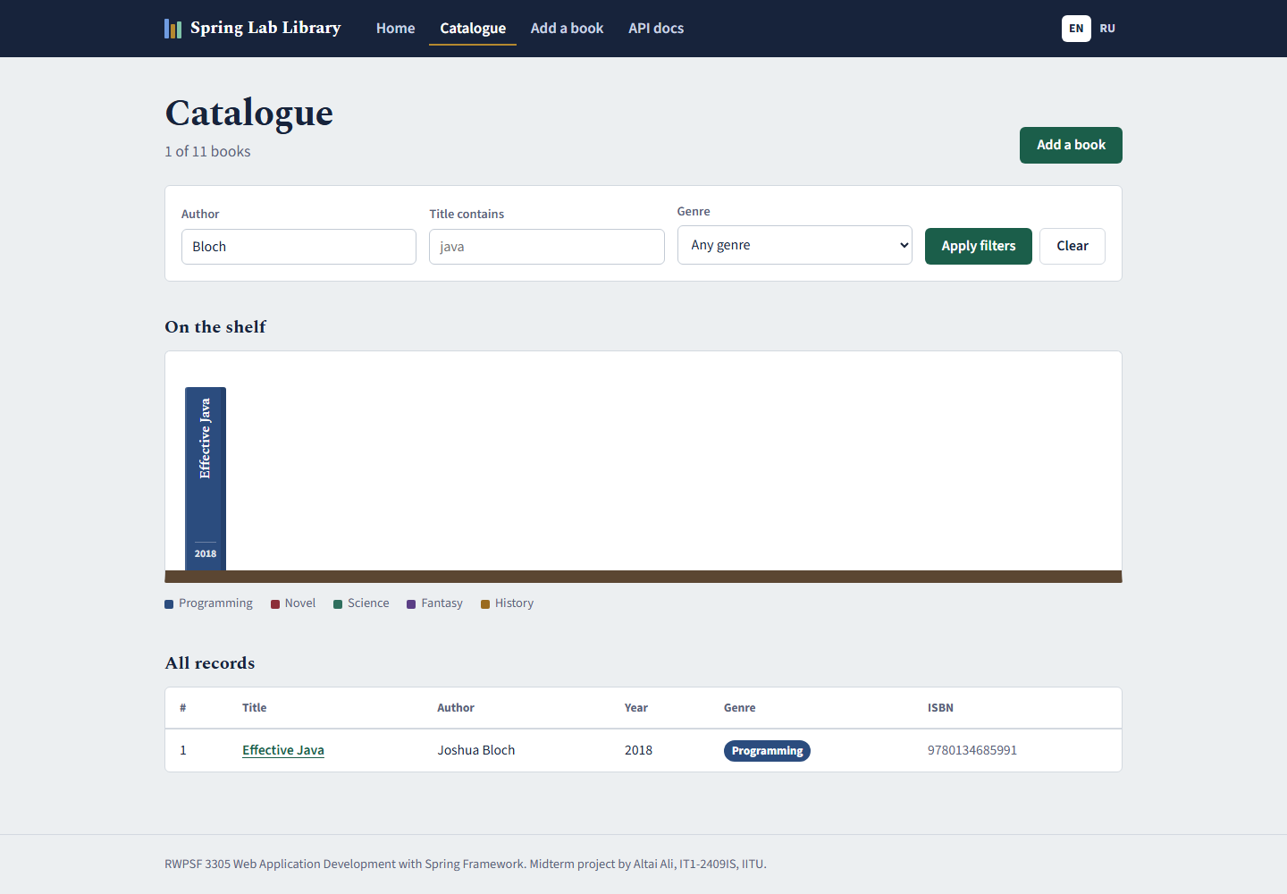
A page from a model: @Controller + Thymeleaf
5
web/BookPageController.java (lab 5)
@GetMapping
public String list(@RequestParam(required = false) String author,
Model model) {
model.addAttribute("books", service.findAll(author));
model.addAttribute("author", author);
return "books/list"; // templates/books/list.html
}
templates/books/list.html (lab 5)
<tr th:each="book : ${books}">
<td th:text="${book.id}">1</td>
<td th:text="${book.title}">Title</td>
<td th:text="${book.author}">Author</td>
<td th:text="${book.year}">2020</td>
</tr>
<link rel="stylesheet" th:href="@{/css/app.css}">
/books?author=Bloch — the model filled by the controller, read by the template

Slide 41
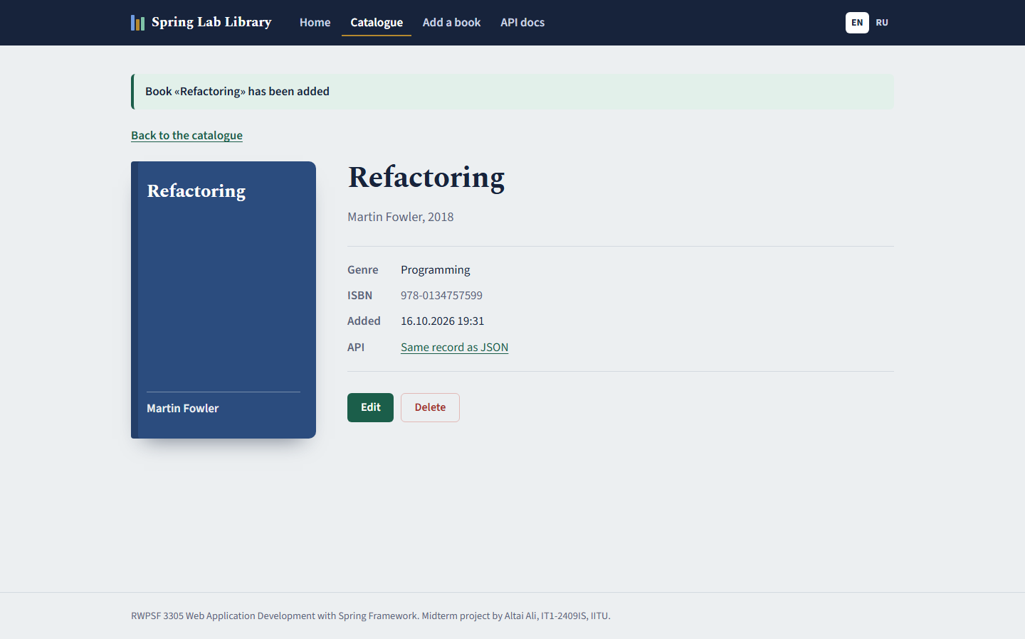
Static resources and Post/Redirect/Get
5
no controller maps this URL
$ curl -I http://localhost:8080/css/app.css
HTTP/1.1 200
Content-Type: text/css
Content-Length: 12486
Spring Boot serves everything in src/main/resources/static through ResourceHttpRequestHandler; static/index.html becomes the start page at "/".
form POST without following the redirect
$ curl -i -X POST -d "title=Java Precisely&…" …/books
HTTP/1.1 302
Location: http://localhost:8080/books/14
Two requests: POST → 302 with Location, then GET. The flash message lives in the session for exactly one request, so F5 repeats only the GET and creates no duplicate.

Slide 42
Five error statuses and what did not match
5
What was sent | Status | Which part of the mapping failed
GET /api/books/abc | 400 | "abc" cannot be converted to long id — argument binding
GET /api/nothing | 404 | the path: no handler and no static file
DELETE /api/books | 405 | the HTTP method: only GET and POST exist (Allow header)
POST, Content-Type: text/plain | 415 | consumes: no converter can read text/plain into BookRequest
GET, Accept: application/xml | 406 | produces: no converter can write XML
415 in full
$ curl -i -X POST -H "Content-Type: text/plain" -d @pro-spring.json …/api/books
HTTP/1.1 415
Accept: application/json, application/yaml, application/*+json
Content-Type: application/problem+json
{
"detail": "Content-Type 'text/plain;charset=UTF-8' is not supported.",
"instance": "/api/books",
"status": 415,
"title": "Unsupported Media Type"
}

Slide 43
Variant 1 — GET /api/books/search
5
web/BookApiController.java
?title= | Status | Found
java | 200 | Effective Java, Java Concurrency in Practice, Head First Java
SPRING (case-insensitive) | 200 | Spring in Action, Pro Spring 6
nothing matches | 200 | [] (empty array)
@GetMapping("/search") // 200, [] if nothing
public List<BookResponse> search(
@RequestParam(defaultValue = "") String title) {
return mapper.toResponseList(service.searchByTitle(title));
}
catalog/BookService.java
Both sides are lower-cased with Locale.ROOT, so "java" finds "Effective Java". An empty result is still 200 with [] — "nothing matched" is a valid answer, not a missing resource.
public List<Book> searchByTitle(String fragment) {
String needle = fragment == null ? "" : fragment.trim().toLowerCase(
Locale.ROOT);
return repository.findAll().stream()
.filter(b -> b.title().toLowerCase(Locale.ROOT).contains(
needle))
.toList();
}

Slide 44
Lab 5 — answers to the defence questions (1/3)
5
1
Trace a request from the browser to the method and back.
2
What do HandlerMapping and HandlerAdapter do?
Tomcat → DispatcherServlet → HandlerMapping finds the method → HandlerAdapter binds arguments and calls it → return value goes to a ViewResolver + Thymeleaf (page) or an HttpMessageConverter (JSON) → response.
HandlerMapping chooses the handler method for a path and HTTP method; HandlerAdapter resolves the method arguments, invokes it and processes the return value.
3
What exactly does @ResponseBody change?
4
Where does each parameter of list() come from?
The return value is written to the body by a message converter instead of being treated as a view name. It is inherited from @RestController.
author and limit are @RequestParam — query string parameters; id in other methods is a @PathVariable — a path segment; the POST body is @RequestBody.
5
What if ?limit=abc? Why is the method not called?
6
@RequestParam(required = false) vs without attributes?
Conversion to int fails during argument binding — MethodArgumentTypeMismatchException → 400 before the method is invoked.
Without attributes the parameter is mandatory: missing → 400. With required = false a missing value becomes null.

Slide 45
Lab 5 — answers to the defence questions (2/3)
5
7
Why 201 and not 200? What is in Location?
8
Why does the second DELETE return 404?
201 Created says a new resource exists; Location carries its URI (/api/books/12) so the client can fetch it without guessing.
The first call removed the record; the resource no longer exists, so the service reports it as not found.
9
What is the model in the page controller?
10
How does books/list become a file?
A map of attributes the controller fills (books, author, genres…) and the Thymeleaf template reads through ${...}.
ThymeleafViewResolver adds prefix classpath:/templates/ and suffix .html → templates/books/list.html.
11
Why is /css/app.css served without a controller?
12
How many requests in Post/Redirect/Get?
Spring Boot maps /** to static resource locations; ResourceHttpRequestHandler serves files from src/main/resources/static.
Two: POST /books → 302 with Location; the browser then sends GET to the new URL → 200. F5 repeats only the GET.

Slide 46
Lab 5 — answers to the defence questions (3/3)
5
13
Where is the flash message stored between requests?
14
Status-code table: which part of the mapping failed?
In the HTTP session by the FlashMapManager; it is copied into the model of the redirected request and removed right after.
/books/abc — type conversion of the path variable (400); /api/nothing — path (404); DELETE /api/books — method (405); text/plain — consumes (415); Accept xml — produces (406).
15
Why 415 for text/plain and 406 for application/xml?
16
What changes in the controllers if the engine is replaced?
415: no converter can READ the request body of that type. 406: no converter can WRITE the response in the type the client accepts.
Nothing: they return logical view names and a model; only templates and the starter change.

Slide 47
Laboratory work 6
6
3
site
1
5
7
4
2
6
Forms and validation
Thymeleaf form binding, Bean Validation, two languages, @ControllerAdvice
Variant 1 — ISBN constraint

Slide 48
The form object and the POST handler
6
web/BookForm.java (fields)
web/BookPageController.java
public class BookForm {
@NotBlank(message = "{book.title.required}")
@Size(max = 120, message = "{book.title.size}")
private String title;
@NotBlank(message = "{book.author.required}")
@NoDigits
private String author;
@Min(value = 1450, message = "{book.year.range}")
@Max(value = 2100, message = "{book.year.range}")
private int year;
@NotNull(message = "{book.genre.required}")
private Genre genre;
@Isbn
private String isbn;
private boolean available;
// getters and setters …
}
@PostMapping
public String create(@Valid @ModelAttribute("form") BookForm form,
BindingResult binding,
Model model,
RedirectAttributes redirect) {
if (binding.hasErrors()) {
model.addAttribute("genres", Genre.values());
return "books/form";
}
try {
Book saved = service.create(toBook(form));
flash(redirect, "flash.added", saved.title());
return "redirect:/books/" + saved.id();
} catch (DuplicateTitleException ex) {
binding.reject("book.duplicate");
model.addAttribute("genres", Genre.values());
return "books/form";
}
}

Slide 49
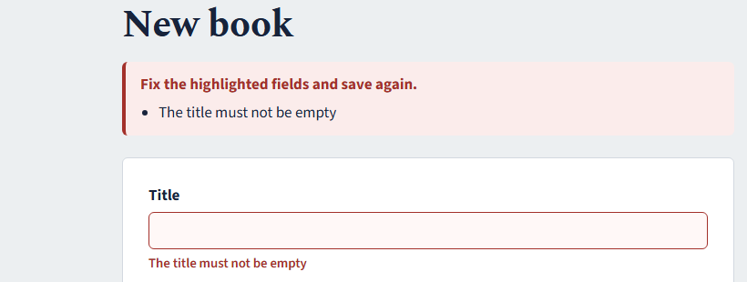
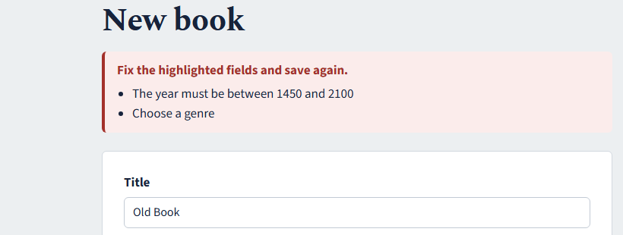
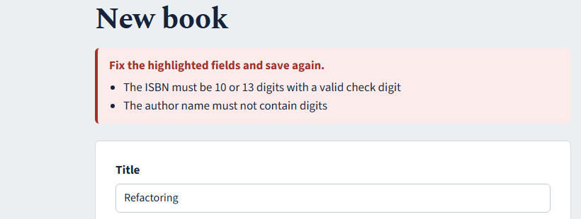
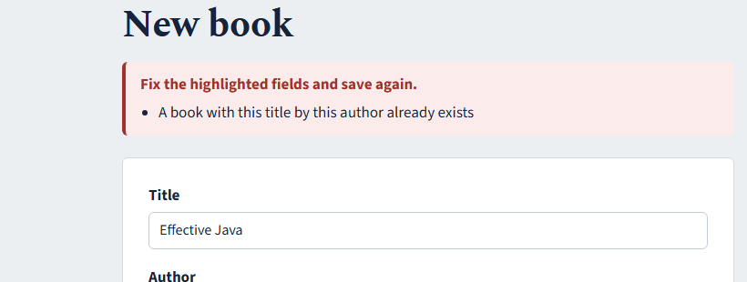
Bad input is rejected, typed values survive
6
Empty title
Year 1200 and no genre
Digits in author, wrong ISBN check digit
Duplicate book — a global error

Slide 50
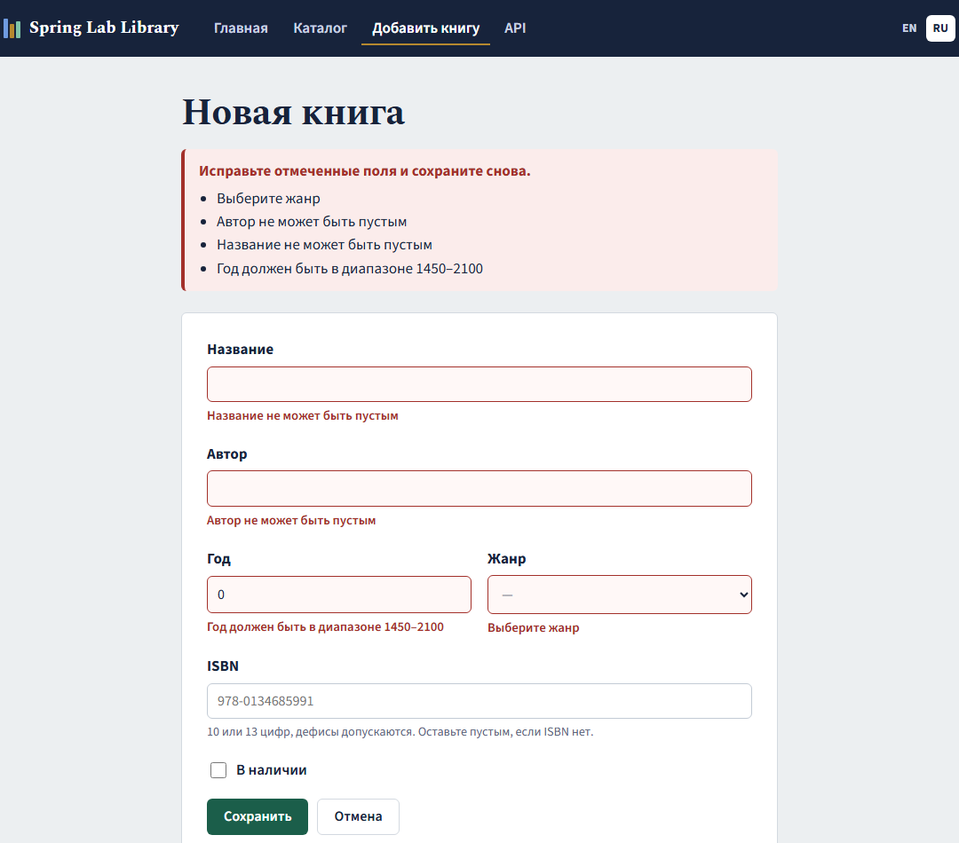
Two languages — captions and validation messages
6
messages.properties / messages_ru.properties
book.title.required=The title must not be empty
book.year.range=The year must be between 1450 and 2100
book.title.required=Название не может быть пустым
book.year.range=Год должен быть в диапазоне 1450–2100
web/LocaleConfiguration.java
SessionLocaleResolver r = new SessionLocaleResolver();
r.setDefaultLocale(Locale.ENGLISH);
LocaleChangeInterceptor i = new LocaleChangeInterceptor();
i.setParamName("lang"); // ?lang=ru | ?lang=en
Found during the run: Windows has the ru_RU locale, and Spring fell back to messages_ru for English. Fix: spring.messages.fallback-to-system-locale: false.
?lang=ru, empty form submitted: Russian errors

Slide 51

A custom constraint and two exception handlers
6
web/NoDigits.java + NoDigitsValidator.java
Request | Status and content type | Handler
GET /books/999 (browser) | 404, text/html | PageExceptionHandler → error/not-found
GET /api/books/999 (curl) | 404, application/problem+json | ApiExceptionHandler → ProblemDetail
@Constraint(validatedBy = NoDigitsValidator.class)
public @interface NoDigits {
String message() default "{book.author.nodigits}";
Class<?>[] groups() default {};
Class<? extends Payload>[] payload() default {};
}
public boolean isValid(String v, ConstraintValidatorContext c) {
if (v == null) return true; // @NotBlank's business
return v.chars().noneMatch(Character::isDigit);
}
web/PageExceptionHandler.java
@ControllerAdvice(annotations = Controller.class)
public class PageExceptionHandler {
@ExceptionHandler(BookNotFoundException.class)
@ResponseStatus(HttpStatus.NOT_FOUND)
public String handleNotFound(BookNotFoundException ex, Model model) {
model.addAttribute("message", ex.getMessage());
return "error/not-found";
}
}
@RestController carries @Controller, so the API advice gets @Order(HIGHEST_PRECEDENCE) to win for REST controllers.

Slide 52
Variant 1 — an ISBN with a valid check digit
6
web/IsbnValidator.java
Input | Result
(empty) | passes — the field is optional
978-0134757599 | valid ISBN-13 (Refactoring)
978-0134757590 | rejected: check digit
0-201-63361-2 | valid ISBN-10
12345 | rejected: length
public class IsbnValidator implements ConstraintValidator<Isbn, String> {
@Override
public boolean isValid(String value, ConstraintValidatorContext ctx) {
if (value == null || value.isBlank()) return true; // the field is optional
String isbn = value.replace("-", "").replace(" ", "").toUpperCase();
return switch (isbn.length()) {
case 10 -> isValidIsbn10(isbn);
case 13 -> isValidIsbn13(isbn);
default -> false; // wrong length
};
}
/** ISBN-13: digits weighted 1,3,1,3...; the total must be divisible by 10. */
static boolean isValidIsbn13(String isbn) {
int sum = 0;
for (int i = 0; i < 13; i++) {
char c = isbn.charAt(i);
if (!Character.isDigit(c)) return false;
sum += (c - '0') * (i % 2 == 0 ? 1 : 3);
}
return sum % 10 == 0;
}
// isValidIsbn10: weights 10..1, sum % 11 == 0, X = 10
}
ISBN-13: digits weighted 1, 3, 1, 3 …; the sum must be divisible by 10. ISBN-10: weights 10 … 1, sum divisible by 11, the last character may be X. Hyphens and spaces are ignored. The same @Isbn is reused on BookRequest in lab 7.

Slide 53
Lab 6 — answers to the defence questions (1/3)
6
1
Why is the form object separate from the entity?
2
What does th:object do and what does *{title} refer to?
It prevents mass assignment of server fields (id, createdAt), keeps form rules apart from storage rules, and can hold partial, invalid input while the page is redisplayed.
th:object selects the form-backing object; *{title} is a selection expression evaluated on that object — form.title.
3
What does th:field generate?
4
Why must GET put an empty object into the model?
id, name and value (checked/selected for boxes and options) bound to the property, so the names always match the binder.
th:object and th:field need an object to read values from; without it the template fails to render.
5
What happens if @Valid is removed?
6
What if BindingResult is moved after Model?
Binding still happens but no constraint is checked; invalid data is saved silently.
BindingResult must follow the validated parameter; otherwise Spring throws MethodArgumentNotValidException → 400 instead of redisplaying the form.

Slide 54
Lab 6 — answers to the defence questions (2/3)
6
7
Why must the error branch re-add the genre list?
8
Where do errors go? Why is nothing thrown?
The model is per request; the redisplayed form needs ${genres} again or the drop-down is empty.
Into BindingResult. Because it is declared right after the object, Spring hands the errors to the method so the controller decides what to show.
9
@NotNull vs @NotEmpty vs @NotBlank?
10
Trace the text of an error message.
@NotNull: not null. @NotEmpty: not null and length > 0. @NotBlank: not null and at least one non-whitespace character (strings only).
message = "{book.title.required}" → the validator resolves the key through Spring's MessageSource → messages_ru/en.properties for the current locale → th:errors prints it.
11
Field error vs global error? Which are yours?
12
Why must messages.properties exist?
A field error belongs to one property (title, year, isbn…); a global error to the whole object — the duplicate-book error from binding.reject().
Boot creates the MessageSource only if the default bundle exists; it is also the fallback for every other locale.

Slide 55
Lab 6 — answers to the defence questions (3/3)
6
13
How is the language chosen?
14
Three mandatory members of a constraint annotation?
SessionLocaleResolver keeps the locale in the session (default English); LocaleChangeInterceptor switches it when ?lang=ru or ?lang=en is present.
message(), groups(), payload() — required by the Bean Validation specification for every constraint.
15
Why does isValid return true for null?
16
How were the advices scoped? Without scoping?
Single responsibility: null is @NotBlank's or @NotNull's decision. The ISBN field is optional, so blank and null pass.
@ControllerAdvice(annotations = Controller.class) and @RestControllerAdvice(annotations = RestController.class) with higher @Order. Unscoped, the API would answer HTML or the pages JSON.
17
Which handler wins if two match?
18
Why is th:utext dangerous for user input?
Within one advice — the closest exception type; between advices — the one with higher @Order precedence.
It writes unescaped HTML, so a typed <script> runs in other users' browsers (XSS). th:text escapes it.

Slide 56
Laboratory work 7
7
3
site
1
5
7
4
2
6
REST API
DTOs and a mapper, 201/204/404/409, ProblemDetail, OpenAPI and Swagger UI
Variant 1 — paging

Slide 57
The contract of the /api/books resource
7
Method and URI | Request body | Success | Errors | Response body
GET /api/books?author= | — | 200 | — | BookResponse[]
GET /api/books?page=&size= (variant) | — | 200 | 400 | PageResponse<BookResponse>
GET /api/books/search?title= | — | 200 | — | BookResponse[]
GET /api/books/{id} | — | 200 | 404 | BookResponse
POST /api/books | BookRequest | 201 + Location | 400, 409 | BookResponse
PUT /api/books/{id} | BookRequest | 200 | 400, 404, 409 | BookResponse
DELETE /api/books/{id} | — | 204 | 404 | —
Every error is application/problem+json from one ApiExceptionHandler. A repeated DELETE answers 404: the resource is gone, the server state does not change, so DELETE stays idempotent.

Slide 58
DTOs and the mapper
7
web/dto/BookRequest.java
web/dto/BookMapper.java
public record BookRequest(
@NotBlank @Size(max = 120) String title,
@NotBlank String author,
@Min(1450) @Max(2100) int year,
@NotNull Genre genre,
@Isbn String isbn) { }
@Component
public class BookMapper {
public Book toDomain(BookRequest request) {
return new Book(null, request.title(), request.author(),
request.year(), request.genre(), blankToNull(request.isbn()),
Instant.now());
}
public BookResponse toResponse(Book book) {
return new BookResponse(book.id(), book.title(), book.author(),
book.year(), book.genre(), book.isbn(), book.createdAt());
}
public List<BookResponse> toResponseList(List<Book> books) {
return books.stream().map(this::toResponse).toList();
}
private static String blankToNull(String value) {
return value == null || value.isBlank() ? null : value.trim();
}
}
web/dto/BookResponse.java
public record BookResponse(
Long id,
String title,
String author,
int year,
Genre genre,
String isbn,
Instant createdAt) { }

Slide 59
Five operations in the controller
7
web/BookApiController.java (excerpt)
POST a valid book
@Operation(summary = "Find a book by its identifier")
@GetMapping("/{id}") // 200 or 404
public BookResponse find(
@Parameter(description = "Identifier of the book", example = "42")
@PathVariable long id) {
return mapper.toResponse(service.get(id));
}
@PostMapping // 201 + Location
public ResponseEntity<BookResponse> create(@Valid @RequestBody BookRequest request) {
Book saved = service.create(mapper.toDomain(request));
return ResponseEntity
.created(URI.create("/api/books/" + saved.id()))
.body(mapper.toResponse(saved));
}
@DeleteMapping("/{id}") // 204 or 404
public ResponseEntity<Void> delete(@PathVariable long id) {
service.delete(id);
return ResponseEntity.noContent().build();
}
$ curl -i -X POST -d @valid.json …
HTTP/1.1 201
Location: /api/books/15
Content-Type: application/json
{
"id": 15,
"title": "Domain-Driven Design",
"author": "Eric Evans",
"year": 2003,
"genre": "PROGRAMMING",
"isbn": "978-0321125217",
"createdAt": "2026-10-16T14:31:25.767570900Z"
}
following the Location header
$ curl -i …/api/books/15
HTTP/1.1 200
Content-Type: application/json
{
"id": 15,
"title": "Domain-Driven Design",
"author": "Eric Evans",
"year": 2003,
"genre": "PROGRAMMING",
"isbn": "978-0321125217",
"createdAt": "2026-10-16T14:31:25.767570900Z"
}

Slide 60
Six requests, six deliberate answers
7
Request | Status | What is in the response
GET /api/books | 200 | JSON array of BookResponse
GET /api/books/1 | 200 | one BookResponse
GET /api/books/999 | 404 | problem detail: Book not found
POST /api/books | 201 | Location header + the created book
DELETE /api/books/1 (first) | 204 | empty body
DELETE /api/books/1 (second) | 404 | problem detail: No book with id 1
PUT /api/books/15 | 200 | year changed to 2004, createdAt kept
second DELETE
$ curl -i -X DELETE …/api/books/1
HTTP/1.1 404
Content-Type: application/problem+json
{
"detail": "No book with id 1",
"instance": "/api/books/1",
"status": 404,
"title": "Book not found",
"type": "https://api.iitu.kz/errors/book-not-found"
}
GET is safe; GET, PUT and DELETE are idempotent; POST is neither. 201 tells the client a resource was created and Location tells it where.

Slide 61
Errors as RFC 9457 problem details
7
web/ApiExceptionHandler.java (excerpt)
Request | Status and Content-Type | Handler
GET /api/books/999 | 404, problem+json | handleNotFound (ours)
POST with an empty title | 400, problem+json | base class + our "errors" field
POST of a book that already exists | 409, problem+json | handleDuplicate (ours)
@RestControllerAdvice(annotations = RestController.class)
@Order(Ordered.HIGHEST_PRECEDENCE)
public class ApiExceptionHandler extends ResponseEntityExceptionHandler {
@ExceptionHandler(BookNotFoundException.class)
public ProblemDetail handleNotFound(BookNotFoundException ex) {
ProblemDetail problem = ProblemDetail.forStatusAndDetail(
HttpStatus.NOT_FOUND, ex.getMessage());
problem.setType(URI.create(
"https://api.iitu.kz/errors/book-not-found"));
problem.setTitle("Book not found");
return problem;
}
// + handleDuplicate → 409, handleMethodArgumentNotValid → adds "errors"
}
two bodies in full
HTTP/1.1 400
{
"detail": "Invalid request content.",
"instance": "/api/books",
"status": 400,
"title": "Bad Request",
"errors": {"title":"must not be blank"}
}
HTTP/1.1 409
{
"detail": "A book titled «Spring in Action» by this author already exists",
"instance": "/api/books",
"status": 409,
"title": "Duplicate title",
"type": "…/errors/duplicate-title",
"bookTitle": "Spring in Action"
}

Slide 62
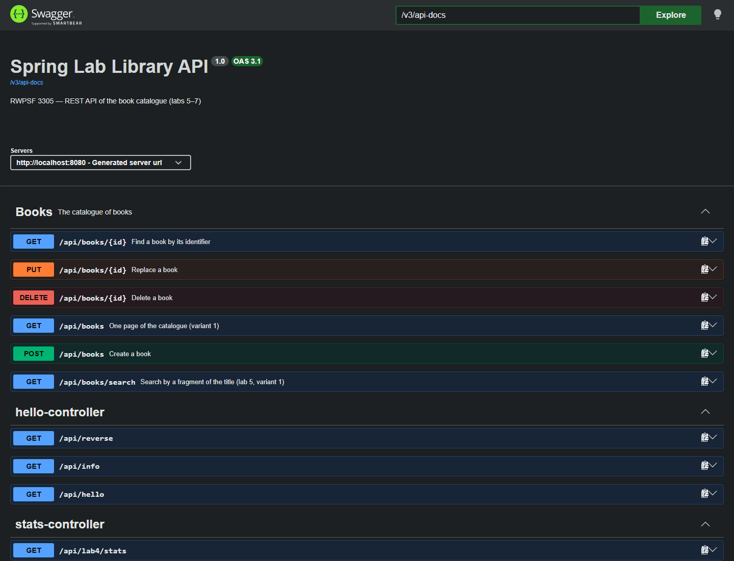
OpenAPI document and Swagger UI
7
Generated without any annotation
16 paths with their HTTP methods and parameters
BookRequest schema — required: author, genre, title
title.maxLength = 120 from @Size(max = 120)
year minimum/maximum from @Min(1450) / @Max(2100)
Added with annotations
@Tag, @Operation summaries and the "Books" group
@ApiResponse meaning of 200/201/400/404/409
@Parameter description and example = 42
/v3/api-docs and /swagger-ui.html; to be switched off in production: springdoc.swagger-ui.enabled=false

Slide 63
Variant 1 — paging of the collection
7
web/BookApiController.java
Request | Status | page | size | total | pages | items
page 0, size 5 | 200 | 0 | 5 | 13 | 3 | 5
page 2, size 5 | 200 | 2 | 5 | 13 | 3 | 3
page 0, default size, no size | 200 | 0 | 20 | 13 | 1 | 13
page -1 (invalid) | 400 | — | — | — | — | —
@GetMapping(params = "page") // 200 or 400
public PageResponse<BookResponse> page(
@RequestParam @Min(0) int page,
@RequestParam(required = false) @Min(1) @Max(500) Integer size) {
int effectiveSize = Math.min(size != null ? size : props.pagination(
).defaultSize(),
props.pagination().maxSize());
long total = service.count();
int totalPages = (int) Math.ceil((double) total / effectiveSize);
return new PageResponse<>(
mapper.toResponseList(service.findPage(page, effectiveSize)),
page, effectiveSize, total, totalPages);
}
The handler is chosen by params = "page". Without size the default comes from app.pagination.default-size — the variant setting of lab 3 — and max-size caps it. page = -1 breaks @Min(0) and gives 400 from built-in method validation.

Slide 64
Lab 7 — answers to the defence questions (1/4)
7
1
Why is the URI a noun? What is wrong with /api/getBooks?
2
Which endpoints are safe and which idempotent?
The URI names the resource; the HTTP method is the verb. /api/getBooks duplicates the verb and breaks the uniform interface.
Safe: GET (nothing changes). Idempotent: GET, PUT, DELETE. POST is neither.
3
Why 201 for creation? What does Location give?
4
Why does deletion return 204, not 200?
201 tells the client a resource was created; Location gives its URI so the client can follow it without building URLs.
Nothing meaningful is left to return; 204 No Content says success with an empty body.
5
What does a second DELETE answer and why?
6
PUT vs PATCH for a field missing from the body?
404 Not Found as a problem detail. The resource is gone; the server state stays the same, so DELETE is still idempotent.
PUT replaces the whole resource — a missing field is reset/validated as empty; PATCH would leave it unchanged.

Slide 65
Lab 7 — answers to the defence questions (2/4)
7
7
What is a DTO? Three problems with returning the entity?
8
Why separate request and response DTOs?
A boundary object for the API contract. With the entity: internal fields leak, clients could set id/createdAt (mass assignment), and renaming storage breaks clients.
The request contains only what a client may send (no id, no createdAt); the response contains what the contract promises.
9
Where does the mapper live? Why not in the controller?
10
Unparsable body vs valid JSON breaking a rule?
BookMapper, a @Component in web.dto — the one place that knows both shapes; the controller only orchestrates.
Both 400: HttpMessageNotReadableException for broken JSON, MethodArgumentNotValidException for a rule violation.
11
When 409? Why not 400?
12
Which RFC defines ProblemDetail? Five fields?
The request is valid, but conflicts with server state — the same title by the same author already exists.
RFC 9457 (replaces 7807): type, title, status, detail, instance.

Slide 66
Lab 7 — answers to the defence questions (3/4)
7
13
Media type of an error response and who sets it?
14
What does ResponseEntityExceptionHandler give?
application/problem+json, set by Spring's message converter when the body is a ProblemDetail.
Ready ProblemDetail responses for all standard MVC exceptions: 400 validation and parsing, 404, 405, 406, 415 and more.
15
How is the advice scoped? Lab 6 pages without it?
16
Why must a stack trace never be in a body?
@RestControllerAdvice(annotations = RestController.class). Without it the HTML pages would receive JSON problem details.
It reveals classes, libraries and versions to attackers and is useless to the client; it belongs in the server log.
17
What in OpenAPI was generated without annotations?
18
Where did maxLength of title come from?
Paths, HTTP methods, parameters, request/response schemas from the records, and constraints such as required and maxLength.
From @Size(max = 120) on BookRequest.title — springdoc translates Bean Validation constraints into the schema.

Slide 67
Lab 7 — answers to the defence questions (4/4)
7
19
Default URLs of the document and Swagger UI?
20
Why not leave Swagger UI on a public server?
/v3/api-docs and /swagger-ui.html (redirects to /swagger-ui/index.html).
It exposes the whole attack surface and lets anyone send requests. Disable it in prod: springdoc.swagger-ui.enabled=false and springdoc.api-docs.enabled=false, or protect it with security.

Slide 68
The final application
★
3
site
1
5
7
4
2
6
Spring Lab Library — every lab in one site
Thymeleaf pages, a validated form in two languages, a documented REST API
Branch rk1 of github.com/Alilishka3/spring-lab-01

Slide 69
How the final application is built
★
Browser
AOP (lab 4)
pages, form, start page
logging, timing, audit, call counter around service/
web — controllers
BookPageController · BookApiController · Hello/Lab2/Lab3/Catalog controllers
Configuration (lab 3)
application.yml, dev/prod, AppProperties, Actuator
web — boundary
BookForm, BookRequest/Response, BookMapper, Page/ApiExceptionHandler, LocaleConfiguration
IoC (lab 2)
catalog — domain
notifiers, life cycle, scopes, container report
Book, Genre, BookService, BookRepository (in-memory)
Spring Boot 4.1.1 · Java 25 · Thymeleaf · Bean Validation · Actuator · springdoc-openapi 3.1.1 — run with mvnw spring-boot:run, open http://localhost:8080

Slide 70
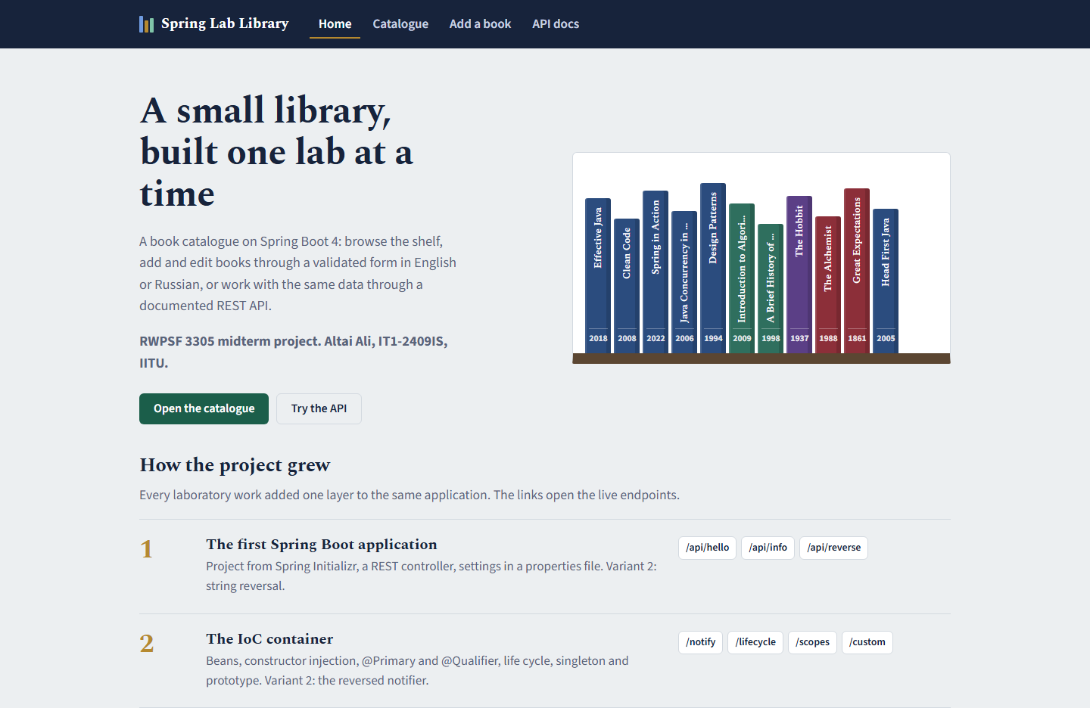
Start page: every lab is one click away
★
A static page (lab 5) served from static/index.html without a controller.
The shelf is drawn by JavaScript from GET /api/books — the REST API of lab 7.
"How the project grew" lists labs 1–7 with links to their live endpoints.

Slide 71
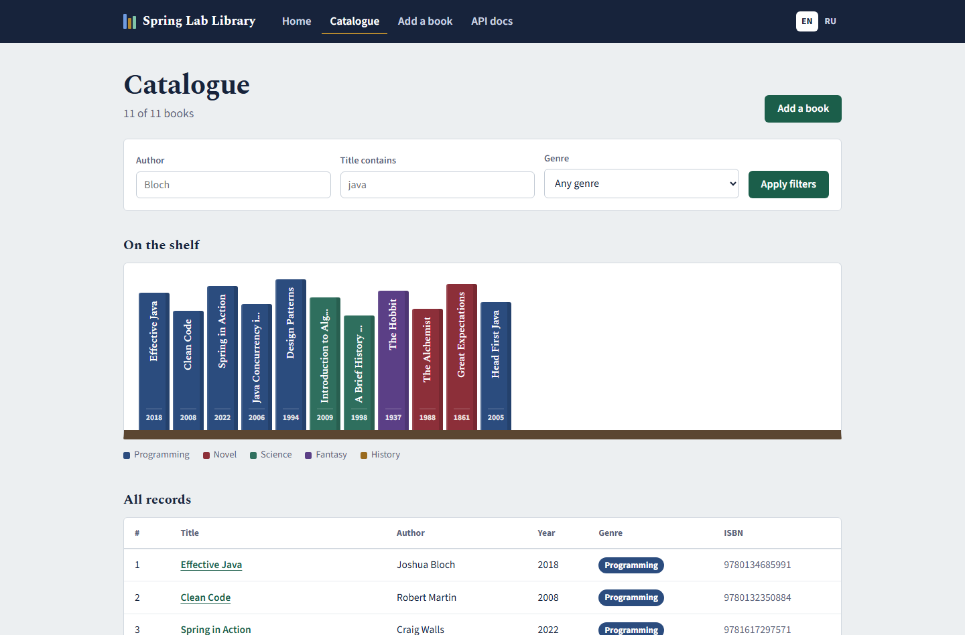
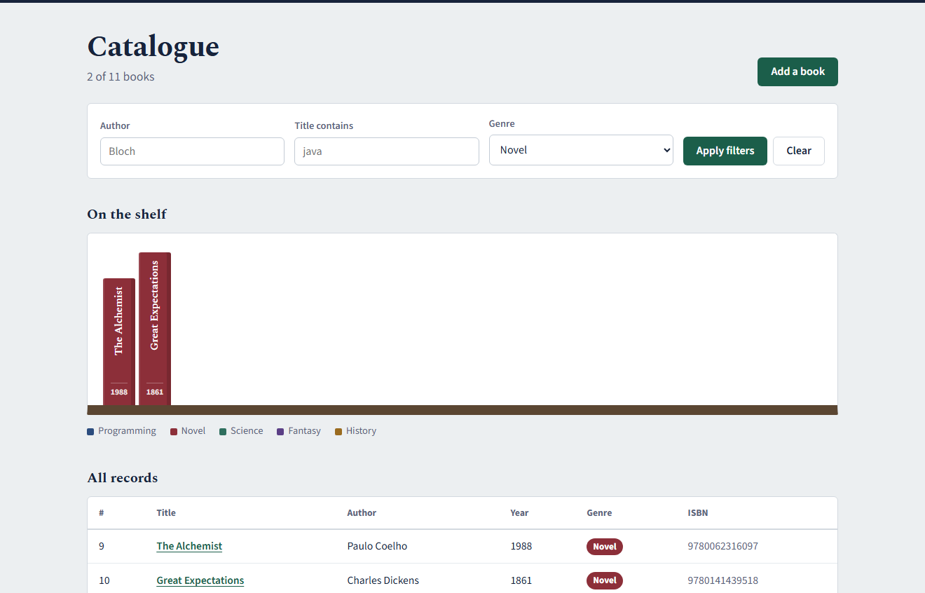
The catalogue: filters, the shelf and all records
★
?genre=NOVEL — the filters are plain GET parameters, so a filtered catalogue has its own URL.
Filters by author, title fragment and genre in one form.
The shelf: one spine per book, coloured by genre, linking to the book page.
All records: the same list as a table with ISBNs.

Slide 72
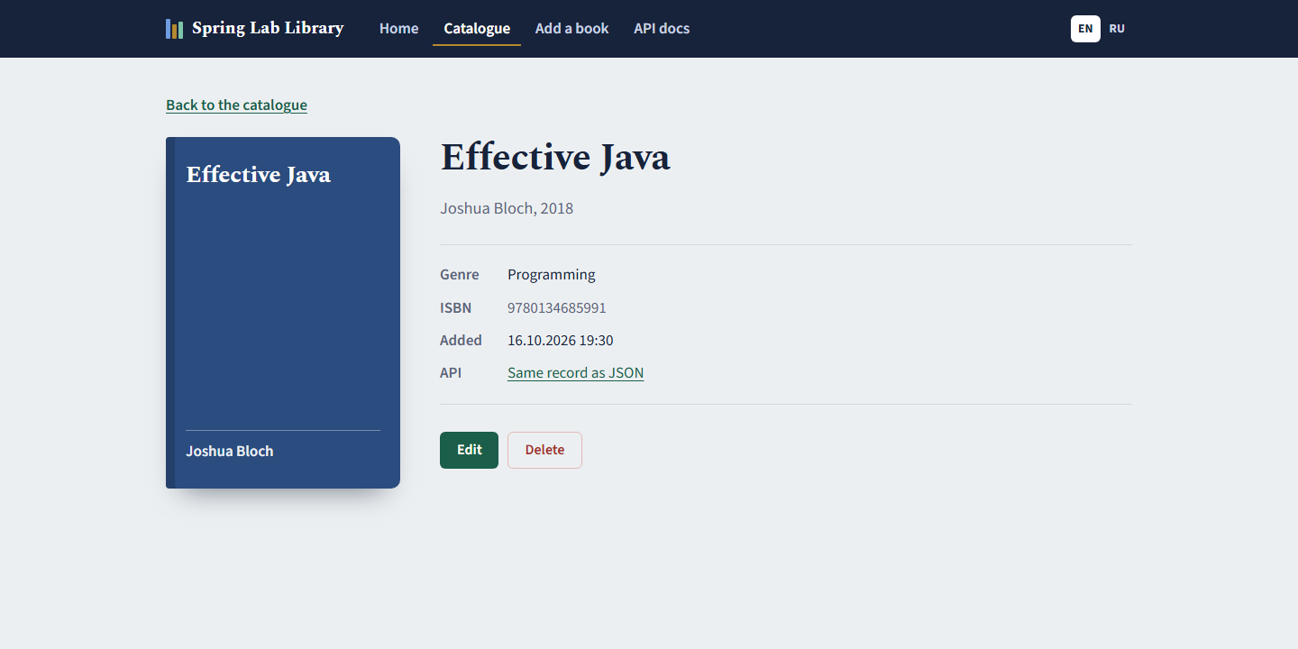
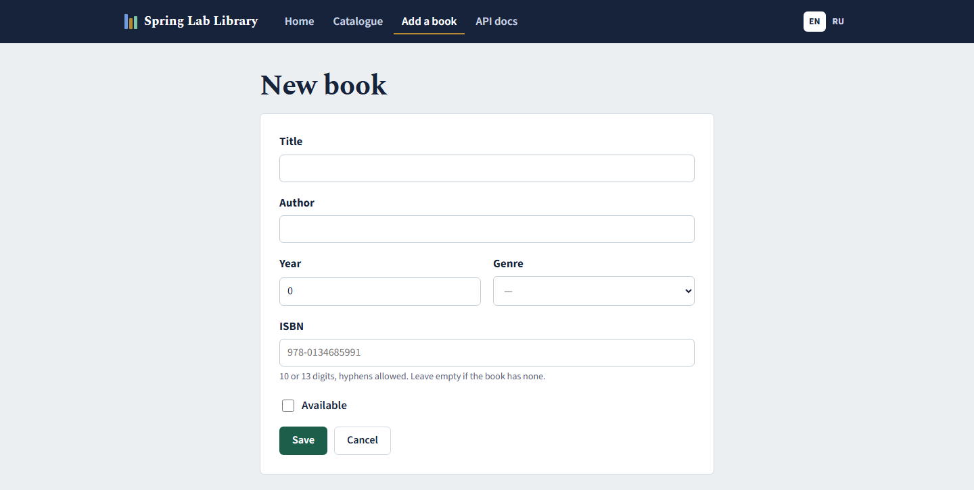
Book page, editing and the validated form
★
Book page: cover in the genre colour, ISBN, creation time, link to the same record as JSON.
Edit and Delete: the form of lab 6 is reused for editing (GET/POST /books/{id}/edit); delete is a POST followed by a redirect.
Every caption comes from messages.properties / messages_ru.properties, switched with EN / RU in the header.

Slide 73
History in Git: one branch per lab
★
git log --oneline --graph --all (excerpt)
Branch | Content
lab01 … lab04 | labs 1–4 (pushed earlier, PR #2 merged)
lab05, lab06, lab07 | labs 5–7, one commit each
rk1 | all labs + the final site
* 3c472d2 rk1: no horizontal overflow on phones
* 8f3831b rk1: form errors inside th:object, no fallback to the OS locale
* c4c1ca8 rk1: final site — layout, shelf, book page, edit/delete, i18n everywhere, st
* f10a547 (lab07) lab07: REST API with DTOs and mapper, problem details, OpenAPI/Swagger
* 2801ae4 (lab06) lab06: form binding, validation, i18n, controller advice; variant 1 IS
* 0817e41 (lab05) lab05: REST and MVC controllers, model, view, static resources; varian
* 24c04c7 merge lab02/lab03 into the main line: ReversedNotifier, YAML config, profile
|\
| * a19a89d lab03: individual assignment variant 2 (app.pagination)
| * 033d501 lab03: YAML config, profiles, typed properties, actuator
| * f0c26a9 lab02: final state
* | 5449e38 merge lab01: /api/reverse endpoint (variant 2)
|\ \
| * | 6f4f853 lab01: add /api/reverse endpoint for individual assignment (variant 2)
* | | 4477f03 (lab04) lab04: self-invocation fix and call counter aspect
* | | 936ea12 lab04: logging, timing and audit aspects
* | | 7842d69 (main) Merge pull request #2 from Alilishka3/lab02
|\ \ \
| |/ /
|/| /
| |/
| * 8811202 lab02: IoC container, DI, scopes and bean lifecycle
|/
* 30d832d lab01: generated Spring Boot project skeleton
Repository: github.com/Alilishka3/spring-lab-01
Run: mvnw.cmd spring-boot:run
Then open http://localhost:8080

Slide 74
Conclusions
The container does the wiring. Constructor injection, @Primary/@Qualifier and scopes made dependencies explicit and testable (labs 1–2).
Configuration lives outside the code. One JAR runs in dev and prod; wrong values stop the start, and Actuator shows where each value came from (lab 3).
Cross-cutting code went into aspects. Logging, timing, auditing and counting touch no business method; the proxy explains why self-calls need care (lab 4).
The web layer speaks HTTP precisely. Pages and API share one service; every outcome has its own status, validation is declarative and errors are problem details (labs 5–7).
3
site
1
5
7
4
2
6
Thank you

