Slide 1

RWPSF 3305 · Midterm
Spring Lab Library
Seven lab works on Spring Boot, built up into one book catalogue site
Altai Ali, Kalmyrza Gulim
Group IT1-2409IS, IITU
Lecturer: Yemberdiyeva Aknur
October 2026

Slide 2
One project, seven labs
Overview
We did not start a new project for every lab. The same app (spring-lab-01, Spring Boot 4.1, Java 25) got a new layer each week, and by lab 7 it had turned into a small library website with an API.
Lab | Topic | Our variant
1 | First Spring Boot app | GET /api/reverse
2 | IoC container, beans | "reversed" notifier
3 | Configuration, profiles | app.pagination
4 | Spring AOP | call counter
5 | Spring MVC | search by title
6 | Forms and validation | ISBN check digit
7 | REST API | paging
Code: github.com/Alilishka3/spring-lab-01, one branch per lab, rk1 has everything.

Slide 3
Starting the app and wiring the beans
Labs 1 and 2
Lab 1. Project from Spring Initializr and a first REST controller. Our endpoint turns a string around and returns its length; without the text parameter it answers 400.
Lab 2. Four Notifier beans for one interface. When we commented out @Primary, the app refused to start because it found four candidates. Prototype beans only change when you ask ObjectProvider for a new one.
$ curl "localhost:8080/api/reverse?text=IITU 2026"
HTTP/1.1 200
{"original":"IITU 2026","reversed":"6202 UTII","length":9}
APPLICATION FAILED TO START (EmailNotifier without @Primary)
Parameter 0 of constructor in NotificationService
required a single bean, but 4 were found:
/api/lab2/scopes | 1st call | 2nd call
injected directly | 0057fe04 | 0057fe04
via ObjectProvider | 66f1c6b5 | 87db70dc

Slide 4
Settings live outside the code
Lab 3
 | no profile | dev | prod
port | 8080 | 8081 | 8080
mail retry count | 3 | 1 | 5
mail enabled | true | false | true
page size (variant) | 20 / 100 | 10 / 50 | 20 / 100
Who wins for app.mail.retry-count
yml says 3, env variable 7, -D property 5, command line 9. The app used 9. Typed AppProperties checks the value at start-up, so --app.mail.retry-count=99 stops the app with "must be less than or equal to 10".
Property: app.mail.retryCount
Value: "99"
Reason: must be less than or equal to 10
Same JAR every time; only --spring.profiles.active changes.

Slide 5
Logging, timing and audit without touching the service
Lab 4
The catch we hit
The service is a CGLIB proxy (CatalogService$$SpringCGLIB$$1). removeTwice() called remove() through "this", and the audit aspect saw nothing: 0 records. After calling it through a lazy self-reference we got 2.
$ curl localhost:8080/api/lab4/items?limit=5
[AUDIT] start CATALOG_LIST args=[5]
[LOG] -> CatalogService.findAll(..) args=[5]
[TIME] SLOW: CatalogService.findAll(..) --- 309 ms
[LOG] <- CatalogService.findAll(..) returned [5 items]
[AUDIT] CATALOG_LIST success
Audit has @Order(1), so it opens first and closes last. Timing sits closest to the method and marks anything over 200 ms as slow.
Variant: @Before counts calls per method. After the demo: remove = 4, findAll = 1, findById = 1.

Slide 6
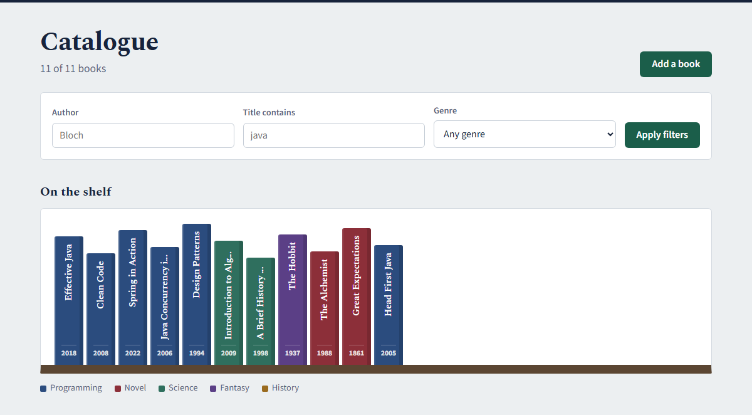
Pages and an API on the same service
Lab 5
Request | Code
GET /api/books/999 | 404
POST /api/books | 201
DELETE /api/books/2 | 204
same DELETE again | 404
GET /api/books/abc | 400
DELETE /api/books | 405
POST as text/plain | 415
Accept: application/xml | 406
/books: the controller fills the model, Thymeleaf draws the table. CSS is served from static/ with no controller. After a form POST we redirect, so F5 does not add the book twice.

Slide 7
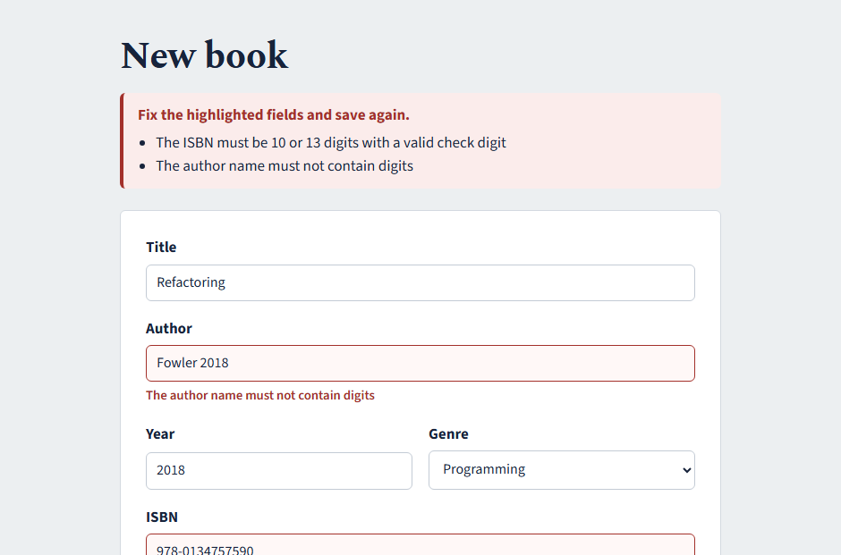
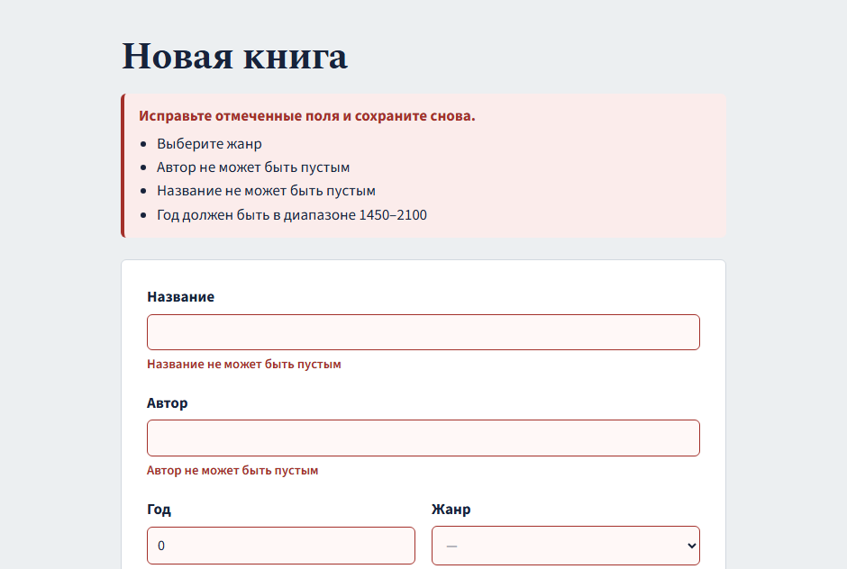
A form that keeps what you typed
Lab 6
Author with digits and a wrong ISBN (our variant checks the check digit).
Same form with ?lang=ru: the error messages switch language too.
One gotcha: Windows here runs in Russian, and Spring fell back to the Russian file even for English. spring.messages.fallback-to-system-locale: false fixed it.

Slide 8
A REST API another team could use
Lab 7
Request | Code
GET /api/books/1 | 200
POST /api/books | 201
DELETE /api/books/1 | 204
DELETE it again | 404
POST, empty title | 400
POST, book exists | 409
?page=0&size=5 | 200
?page=-1 | 400
$ curl -X POST -d @duplicate.json localhost:8080/api/books
HTTP/1.1 409
Content-Type: application/problem+json
{
"detail": "A book titled «Spring in Action» by this author already exists",
"instance": "/api/books",
"status": 409,
"title": "Duplicate title",
"type": "…/errors/duplicate-title",
"bookTitle": "Spring in Action"
}
Request and response DTOs with a mapper, so clients never touch id or createdAt. Every error is a problem detail from one @RestControllerAdvice. Paging takes its default size from the lab 3 setting. Docs at /swagger-ui.html.

Slide 9
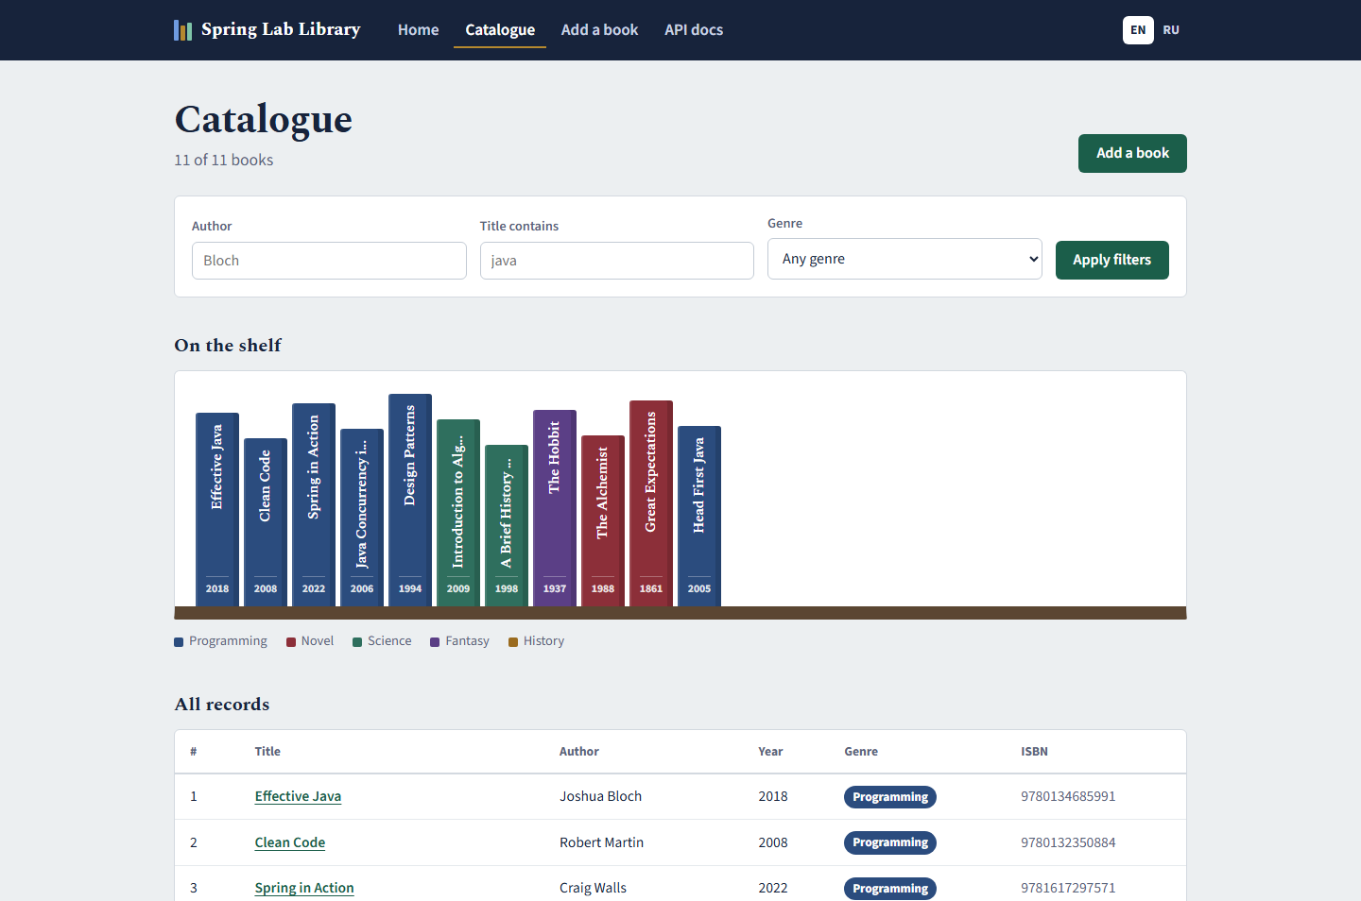
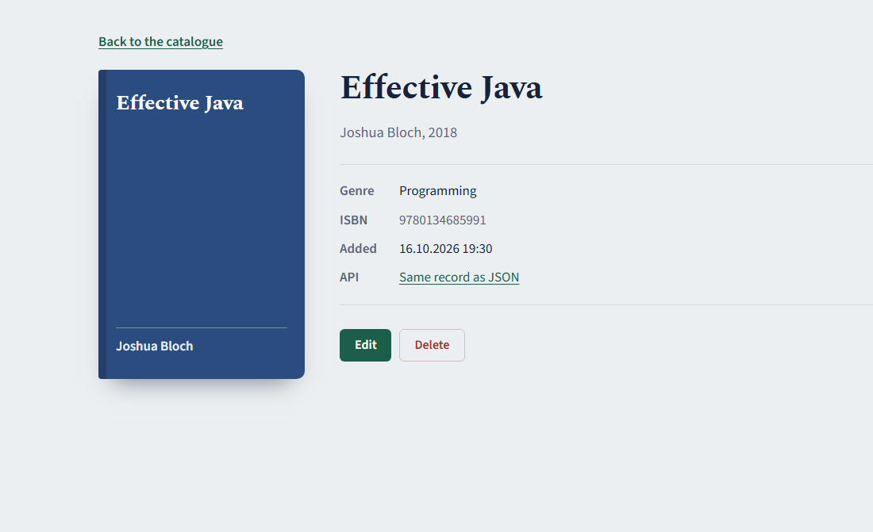
The site
Final application
localhost:8080/books
Filter by author, title or genre. Every spine on the shelf is a book and opens its page. The shelf on the start page is drawn from GET /api/books.

Slide 10
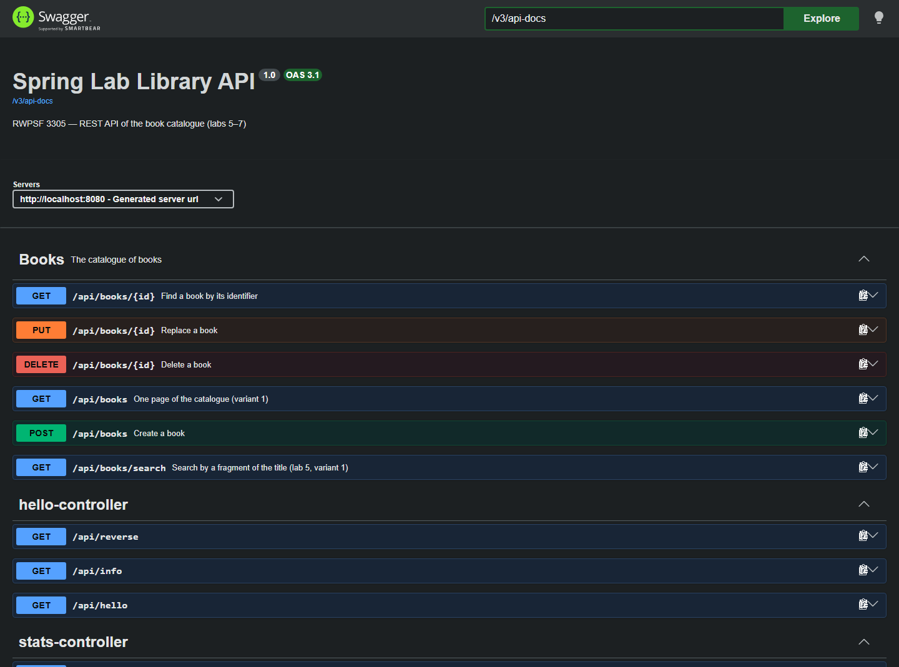

Same data through the API
Final application
A missing book gives a friendly page in the browser and a JSON problem detail in the API. Both come from the same BookNotFoundException; two scoped @ControllerAdvice classes decide the format.

Slide 11
Things that broke while we were testing
Notes
What happened | Why | Fix
Form with errors crashed with a Thymeleaf exception | The error list sat outside the element with th:object | Moved th:object to a wrapper around both
English pages showed Russian text | Spring fell back to the Windows locale (ru) | fallback-to-system-locale: false
Audit did not log removeTwice() | Call through "this" skips the proxy | Lazy self-reference
/actuator/env showed 3 while the app used 7 | The endpoint looks the key up literally, binding is relaxed (APP_MAIL_RETRYCOUNT) | Nothing to fix, worth knowing
App without @Primary did not start | Four Notifier candidates, @Fallback helps only with one left | Kept @Primary on EmailNotifier

Slide 12
What we take away
Spring creates and connects the objects; we mostly decide which bean goes where.
Settings belong in YAML and profiles, and a wrong value should stop the start.
Aspects keep logging and auditing out of the service, as long as calls go through the proxy.
A good API says what happened with the status code before you read the body.
Run it
mvnw.cmd spring-boot:run
localhost:8080
github.com/Alilishka3/spring-lab-01
Thank you. Questions?

