Slide 1
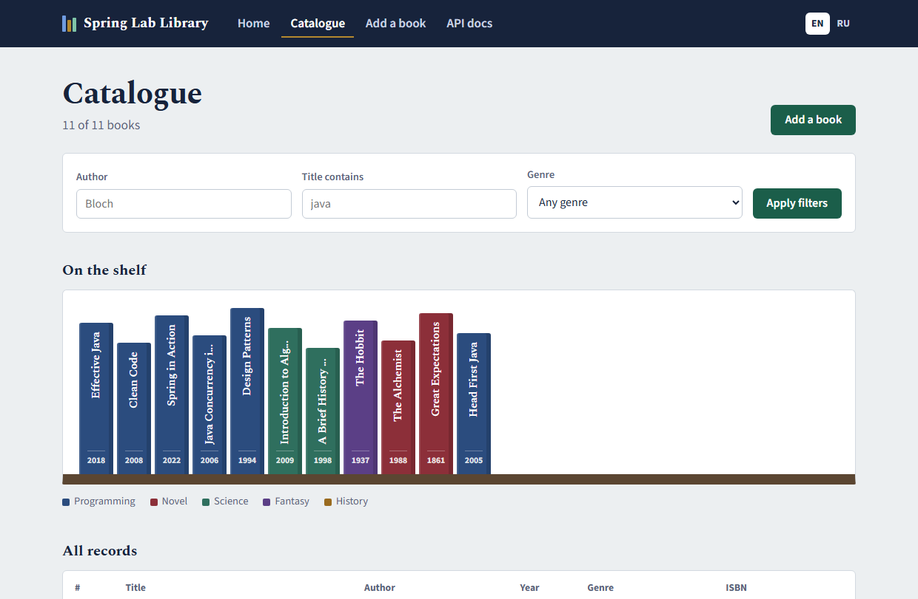
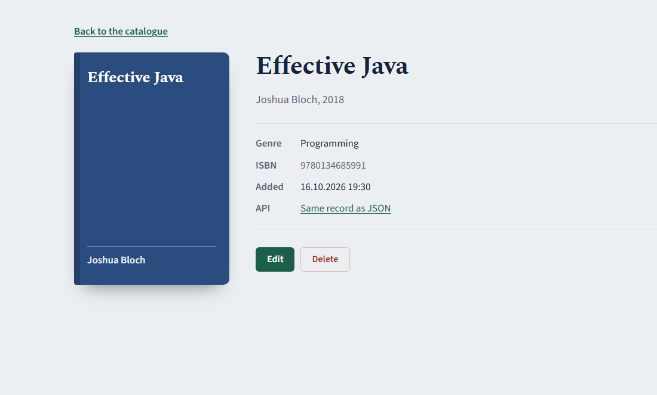
RWPSF 3305, midterm
Spring Lab Library
Seven lab works that grew into one small book catalogue, with a website and a REST API.
Altai Ali, Kalmyrza Gulim
IT1-2409IS, IITU
Lecturer: Yemberdiyeva Aknur

Slide 2
One project, seven steps
Overview
Every lab added a layer to the same app (spring-lab-01, Spring Boot 4.1, Java 25) instead of starting over.
1
2
3
4
5
6
7
First app
IoC, beans
Config, profiles
AOP
MVC
Forms
REST API
GET /api/reverse
"reversed" notifier
app.pagination
call counter
search by title
ISBN check
paging
Second line under each step is our individual variant. Code: github.com/Alilishka3/spring-lab-01, one branch per lab, branch rk1 has all of it.

Slide 3
First app, then four beans
Labs 1 and 2
Lab 1
Spring Initializr project and our first controller. The variant endpoint turns a string around and says how long it is; without text it answers 400.
Lab 2
Console, email, reversed and noop all implement Notifier. With @Primary removed the app would not start:
$ curl "…/api/reverse?text=IITU 2026"
HTTP/1.1 200
{"original":"IITU 2026","reversed":"6202 UTII","length":9}
APPLICATION FAILED TO START
NotificationService
required a single bean, but 4 were found:
Ticket id | 1st request | 2nd request
injected once | 0057fe04 | 0057fe04
ObjectProvider | 66f1c6b5 | 87db70dc
A prototype injected into a singleton stays the same; ask the provider and you get a new one.

Slide 4
Same JAR, different settings
Lab 3
/api/lab3/config | no profile | dev | prod
port | 8080 | 8081 | 8080
mail retry count | 3 | 1 | 5
mail enabled | true | false | true
page size, default / max | 20 / 100 | 10 / 50 | 20 / 100
Who wins for app.mail.retry-count?
command line
9
-D system property
5
environment variable
7
application.yml
3
The last row is our variant, app.pagination. Lab 7 uses it for paging.
With all four set, the app used 9. Higher in the list beats lower.
--app.mail.retry-count=99
Value: "99"
Reason: must be less than or equal to 10

Slide 5
Three aspects wrapped around one method
Lab 4
AuditAspect @Order(1)
[AUDIT] start CATALOG_LIST args=[5]
[LOG] -> findAll(..) args=[5]
[TIME] SLOW: findAll(..) --- 309 ms
[LOG] <- findAll(..) returned 5 items
[AUDIT] CATALOG_LIST success
LoggingAspect @Order(2)
TimingAspect @Order(3)
findAll(5)
The log reads from the outside in and back out, exactly in @Order.
Where it bit us. Spring hands out a CGLIB proxy, not the real service. removeTwice() called remove() on "this", so the audit saw 0 calls. Through a lazy self-reference it saw 2.
Our variant counts calls per method: remove 4, findAll 1, findById 1.

Slide 6
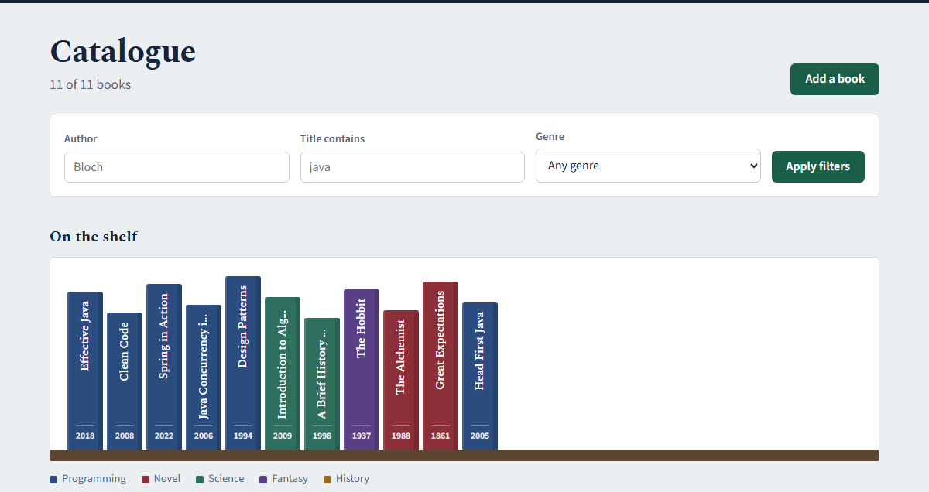
Every mistake gets its own status code
Lab 5
400
404
405
415
406
/api/books/abc
/api/nothing
DELETE /api/books
POST text/plain
Accept: xml
id is not a number
no such path
no id, wrong method
cannot read the body
cannot write xml
The page side. @Controller fills the model, Thymeleaf renders /books. app.css comes straight from static/, no controller. After a form POST we redirect, so F5 does not add the book twice.
Variant: GET /api/books/search?title=java found 3 books; no match is 200 with [].

Slide 7
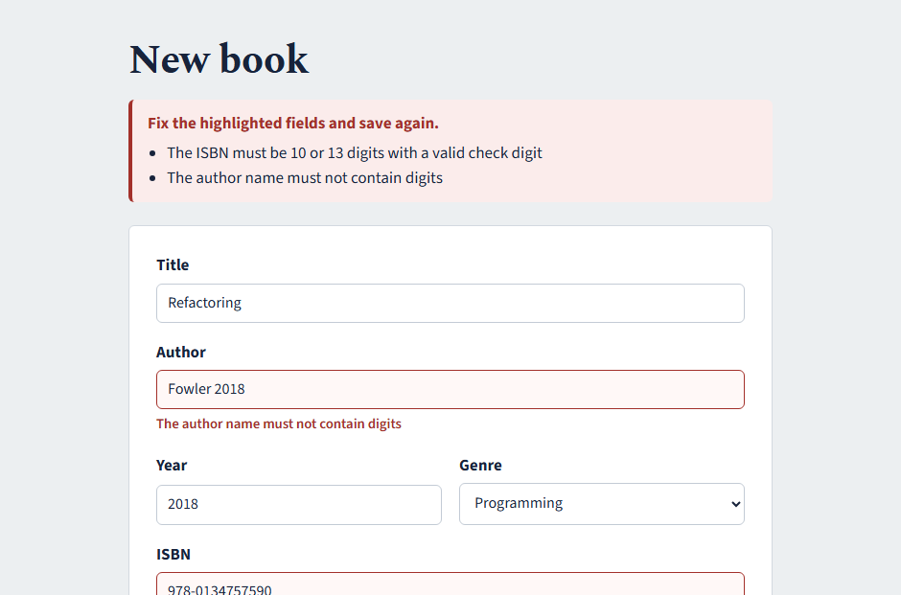
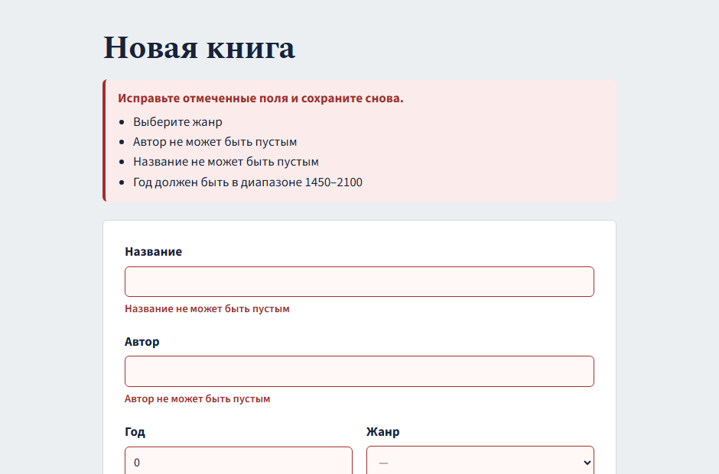
A form that keeps what you typed
Lab 6
Digits in the author and a bad ISBN check digit (our variant).
?lang=ru: labels and error messages switch together.
Windows here runs in Russian, and Spring showed Russian even on the English page. fallback-to-system-locale: false fixed it.

Slide 8
An API another team could use
Lab 7
Request | Code
GET /api/books/1 | 200
POST /api/books | 201
DELETE /api/books/1 | 204
the same DELETE again | 404
POST with empty title | 400
POST a book that exists | 409
?page=0&size=5 | 200
?page=-1 | 400
$ curl -X POST -d @duplicate.json …/api/books
HTTP/1.1 409
Content-Type: application/problem+json
{
"detail": "A book titled «Spring in Action» by this author already exists",
"instance": "/api/books",
"status": 409,
"title": "Duplicate title",
"type": "…/errors/duplicate-title",
"bookTitle": "Spring in Action"
}
Clients send BookRequest and get BookResponse, so they never set id or createdAt. Errors come back as problem details from one place. Paging (our variant) takes its default size from the lab 3 setting.

Slide 9
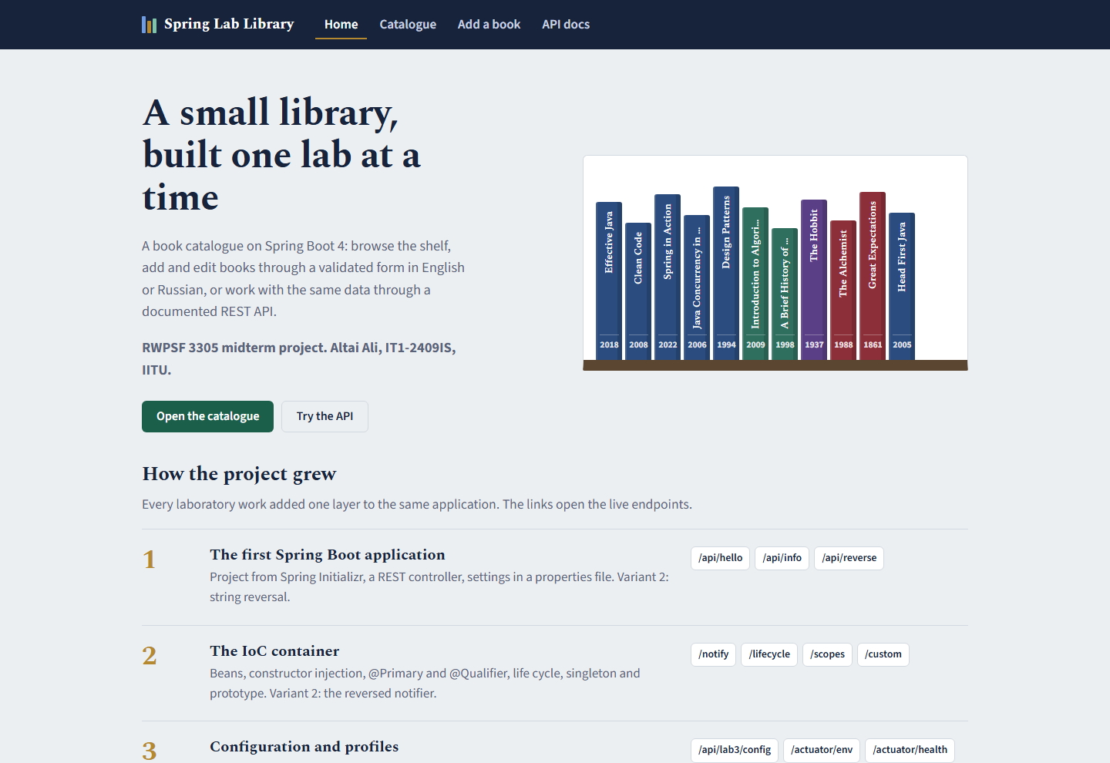
The site
Final app
localhost:8080
The start page lists the seven labs with links to their endpoints. The shelf on the right is drawn from GET /api/books.
/books
Catalogue with filters by author, title and genre. Each spine opens the book page with edit and delete.

Slide 10
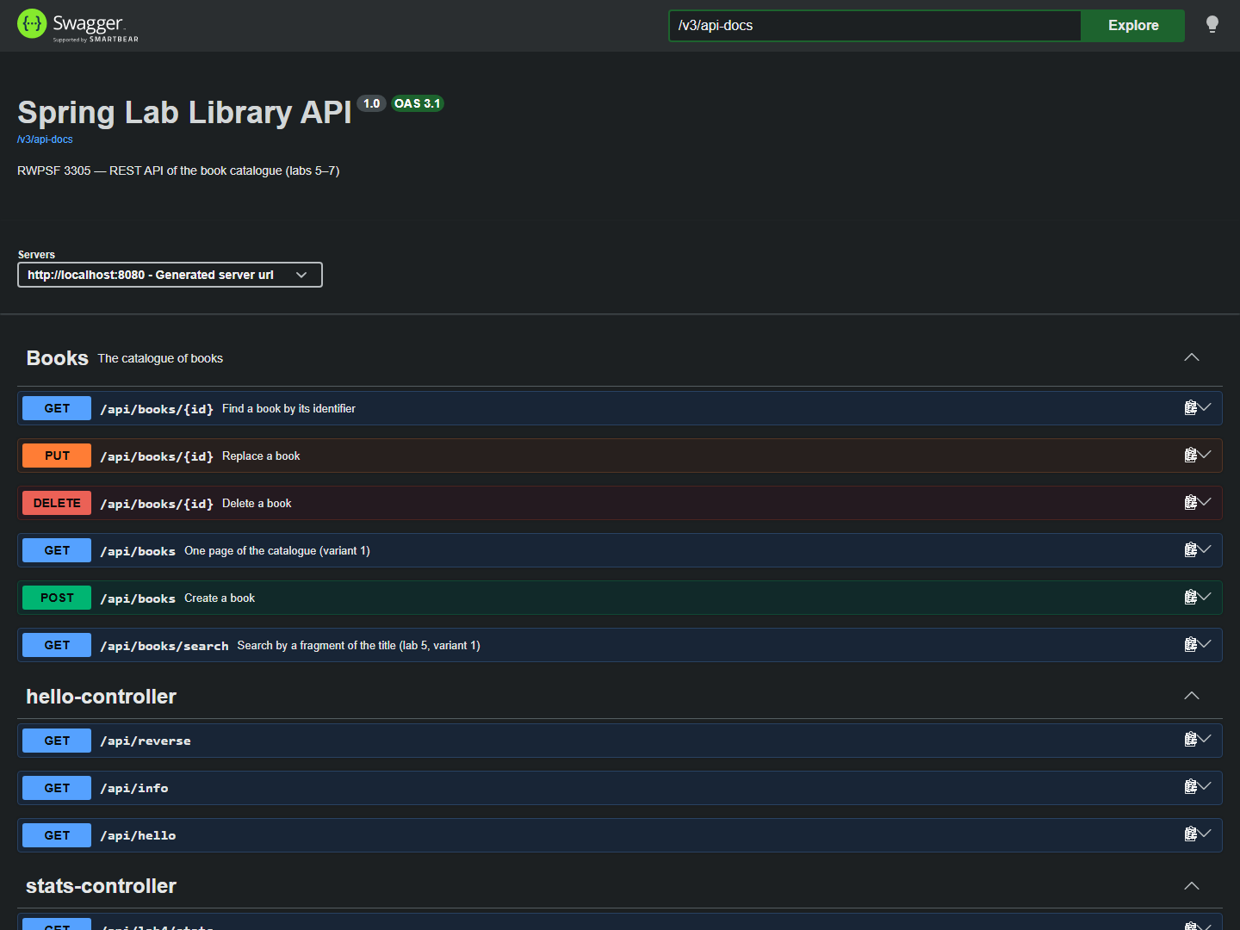

The same books through the API
Final app
Ask for book 999 in the browser and you get this page. Ask the API and you get JSON with status 404. Same exception, two scoped @ControllerAdvice classes.

Slide 11
What broke while we tested it
Notes
1
The form with errors crashed
2
English pages showed Russian
The error list sat outside th:object. We wrapped both in one element.
Spring used the Windows locale. Turned off fallback-to-system-locale.
3
Audit missed removeTwice()
4
/actuator/env said 3, app used 7
Calls through "this" skip the proxy. Fixed with a lazy self-reference.
The endpoint looks the key up literally; binding is relaxed. Not a bug.
5
No start without @Primary
Four candidates. @Fallback only helps when one bean is left.

Slide 12
What we take from it
Spring builds and connects the objects; our job is to say which bean goes where.
Settings belong outside the code, and a wrong value should stop the start.
Aspects keep logging and audit out of the service, if calls go through the proxy.
A good API tells you what happened with the status code first.
Try it
mvnw.cmd spring-boot:run
localhost:8080
github.com/Alilishka3/spring-lab-01
Thank you. Questions?

