Slide 1
The Processor: Datapath and Control
Chapter - 5

Slide 2
Introduction
A subset of the core MIPS instruction set:
The memory-reference instruction – lw, sw
The arithmetic-logical instruction – add, sub, and, or, slt
The branch instructions - branch equal (beq), jump (j)

Slide 3
An overview of the implementation
For every instruction, the first two steps are identical:
Sent the PC to the memory that contains the code and fetch the instruction from that memory.
Read one or two registers, using fields of the instruction to select the registers to read.

Slide 4
An overview of the implementation (Cont.)
Even across different instruction classes there are some similarities: Example
All instruction classes use the ALU after reading the registers.
  Memory-reference – address calculation
  Arithmetic-logic – operation execution
  Branch – comparison.
After using the ALU, the actions differ.

Slide 5
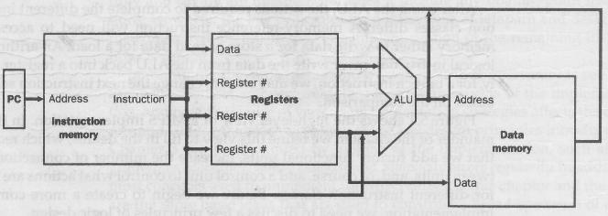
An overview of the implementation (Cont.)
Fig. – 5.1 An abstract view of the implementation.

Slide 6
A word about Logic Convention and Clocking
The functional unites in the MIPS implementation consist of two different types of logic elements.
  Combinational - ALU
  State Element / Sequential – Instruction and Data Memory, Registers
  State element has at least two inputs and one output.

Slide 7
Clocking Methodology
A clocking methodology defines when signal can be read and when they can be written.
We assume edge-triggered clocking.
This means that a register (or flip-flop) captures or updates its stored value only at a specific moment — when the clock signal changes from 0 to 1 (rising edge) or from 1 to 0 (falling edge).

Slide 8
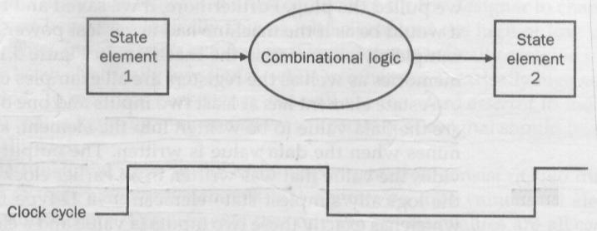
Clocking Methodology (Cont.)
Combinational logic, which operate in a single clock cycle.

Slide 9
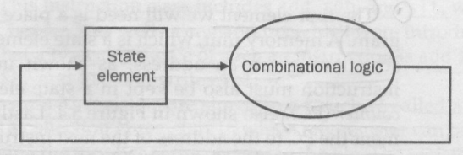
Clocking Methodology (Cont.)
An edge triggered methodology allows us to read the contents of a register, send the value through some combinational logic, and write the register in the same clock cycle.

Slide 10
The MIPS Subset Implementation
Uses a single long clock cycle for every instruction.
Begins execution on one clock edge and completes execution on the next clock edge.

Slide 11
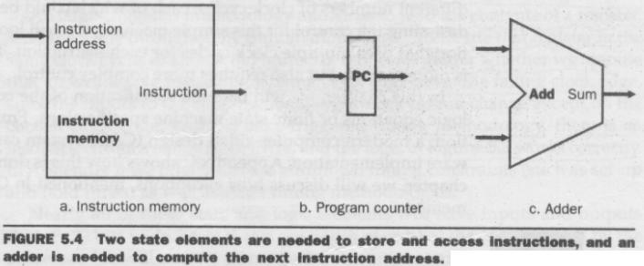
Building a Datapath
Datapath elements:

Slide 12
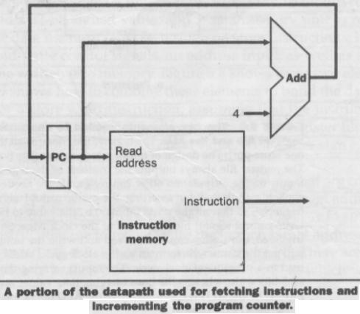
Building a Datapath
For fetching instructions:

Slide 13
Building a Datapath
Name | Fields
Field Size | 6 bits | 5 bits | 5 bits | 5 bits | 5 bits | 6 bits
R-format | op | rs | rt | rd | shamt | funct
I-format | op | rs | rt | address/immediate
J-format | op | target address

Slide 14
Building a Datapath
R-format:
add $t1, $t2, $t3
Register file: is a collection of registers in which any resister can be read or written by specifying the number of the register in the file.

Slide 15
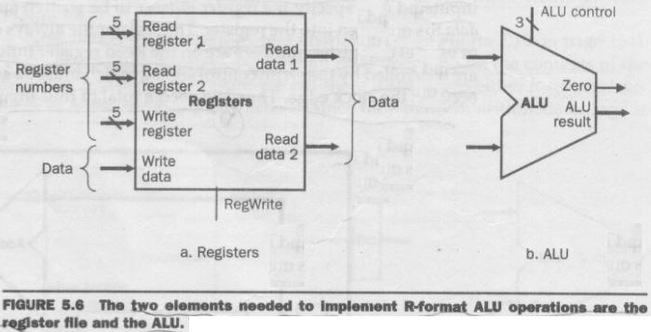
Building a Datapath
Two elements needed for R-type instruction.

Slide 16
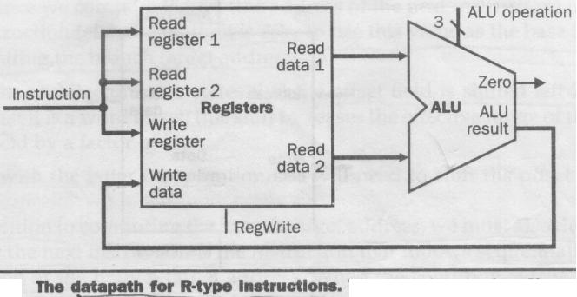
Building a Datapath
Datapath for R-type instruction.

Slide 17
Building a Datapath
Name | Fields
Field Size | 6 bits | 5 bits | 5 bits | 5 bits | 5 bits | 6 bits
R-format | op | rs | rt | rd | shamt | funct
I-format | op | rs | rt | address/immediate
J-format | op | target address

Slide 18
Building a Datapath
I-format:
lw $t1, offset_value ($t2)
sw $t1, offset_value ($t2)
compute a memory address by adding the base register ($t2) to the 16 bit signed offset field.

Slide 19
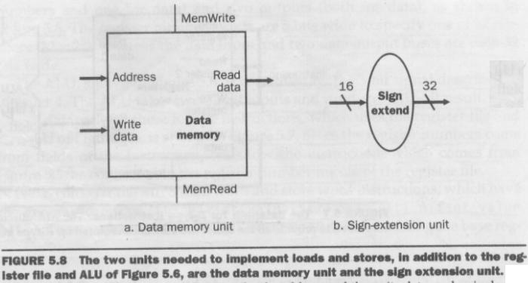
Building a Datapath
Two elements needed for lw & sw instructions.

Slide 20
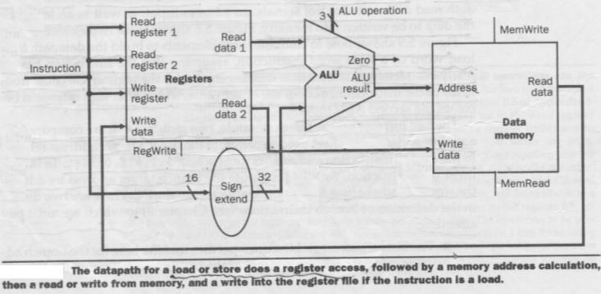
Building a Datapath
Datapath for lw or sw instructions.

Slide 21
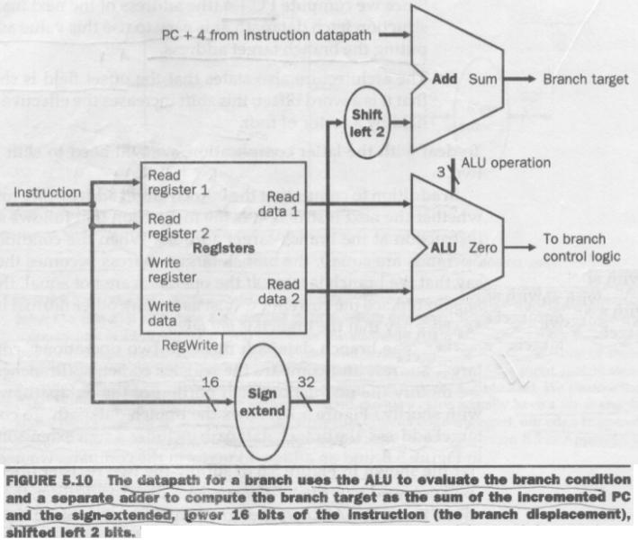
Building a Datapath
Datapath for beq instruction.

Slide 22
Building a Datapath
Name | Fields
Field Size | 6 bits | 5 bits | 5 bits | 5 bits | 5 bits | 6 bits
R-format | op | rs | rt | rd | shamt | funct
I-format | op | rs | rt | address/immediate
J-format | op | target address

Slide 23
A simple Implementation Scheme
This implementation covers:
lw, sw, beq, add, sub, and, or, and slt.
Later enhanced for j.

Slide 24
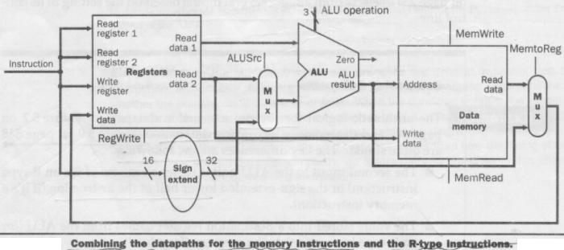
Creating a Single Datapath

Slide 25
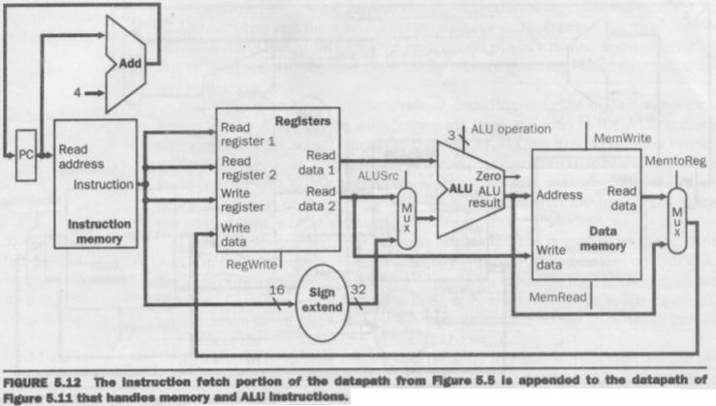
Creating a Single Datapath

Slide 26
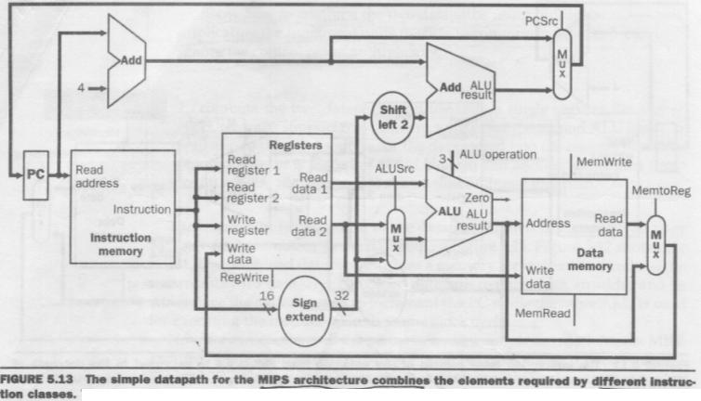
Creating a Single Datapath
Used for load and store word

Slide 27
Designing the Main Control Unit
Name | Fields
Field Size | 6 bits | 5 bits | 5 bits | 5 bits | 5 bits | 6 bits
R-format | op (0) | rs | rt | rd | shamt | funct
I-format | op (35/43/4) | rs | rt | address/immediate
I-format : lw, sw, beq

Slide 28
Designing the Main Control Unit
Major observations:
op field always contained in bits 31-26
Two registers to be read are always specified at positions 25-21 and 20-16.
Base register for lw and sw is always in position 25-21.
16-bit offset for beq, lw and sw is always in position 15-0.
Destination register is in one of two places. 20-16 for lw and 15-11 for R-type.

Slide 29
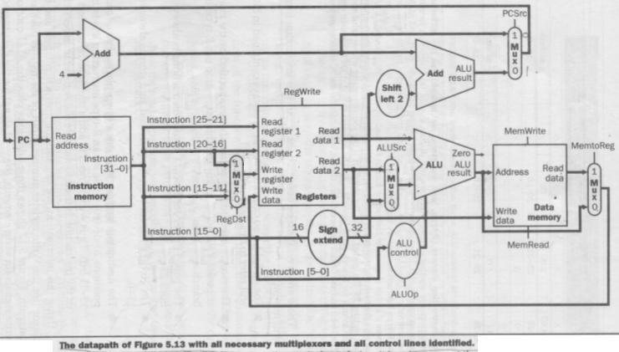
Designing the Main Control Unit
7-single bit control lines
2-bit ALUOp control signal

Slide 30
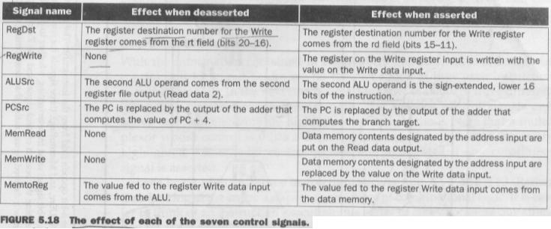
Designing the Main Control Unit
7-single bit control lines
2-bit ALUOp control signal

Slide 31
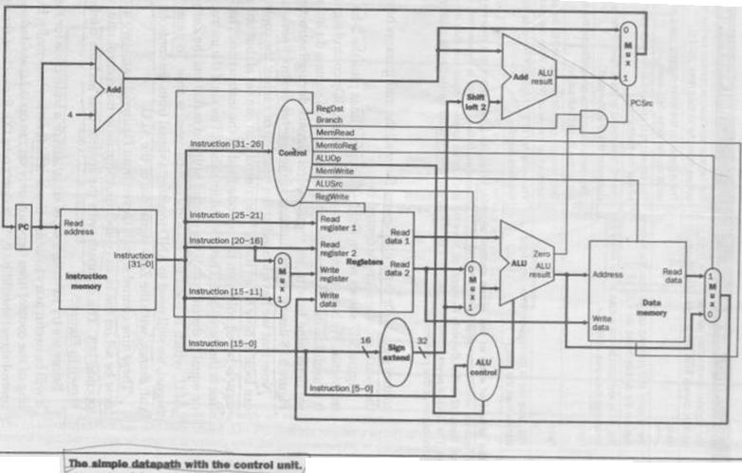
Designing the Main Control Unit
9 control signals can be set on the basis of six opcode bits.

Slide 32
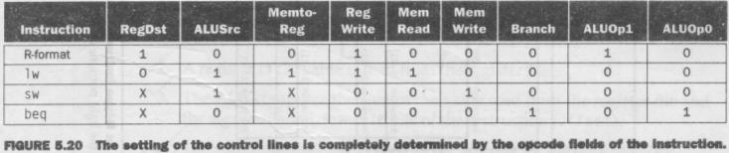
Designing the Main Control Unit
Defines how the control signals should be set for each opcode.

Slide 33

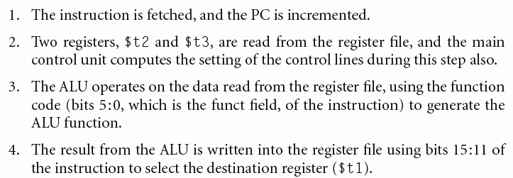
Operation of the Datapath

Slide 34
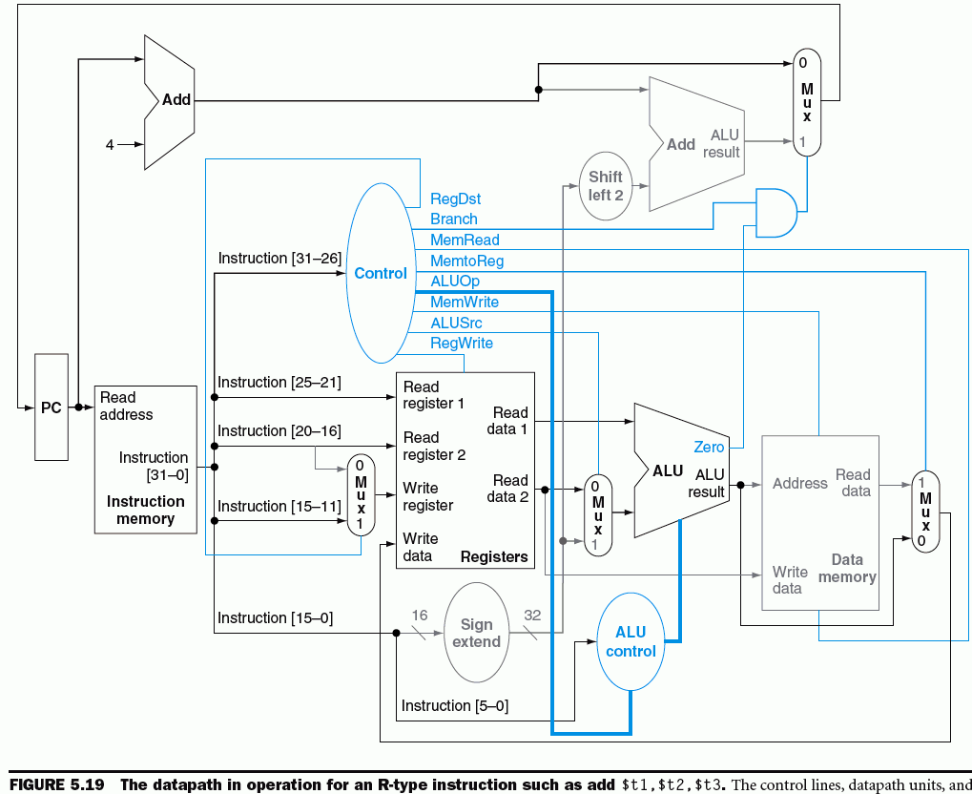
Operation of the Datapath

Slide 35
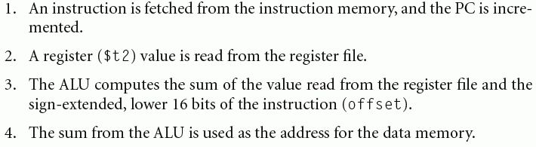
Operation of the Datapath

Slide 36
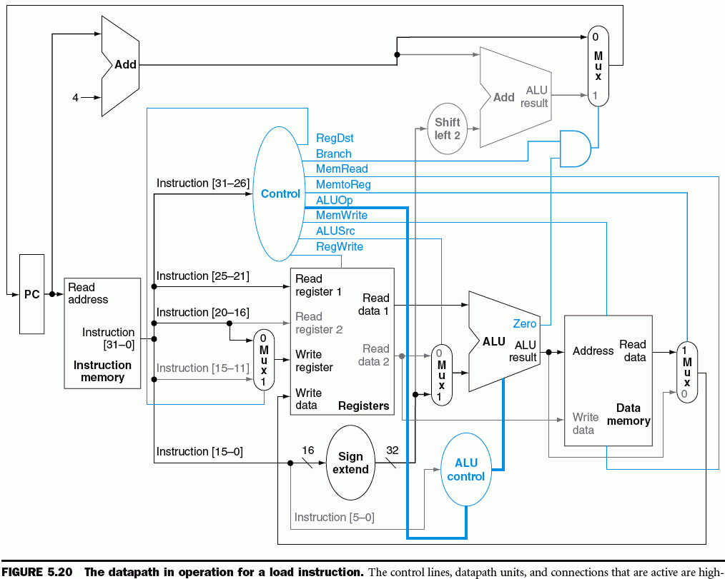
Operation of the Datapath

Slide 37
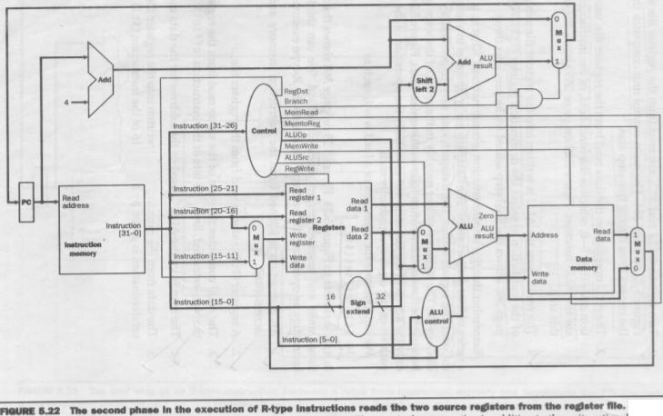
Operation of the Datapath
aa

Slide 38
Implementing Jumps
2 | address
31-26 | 25-0

Slide 39
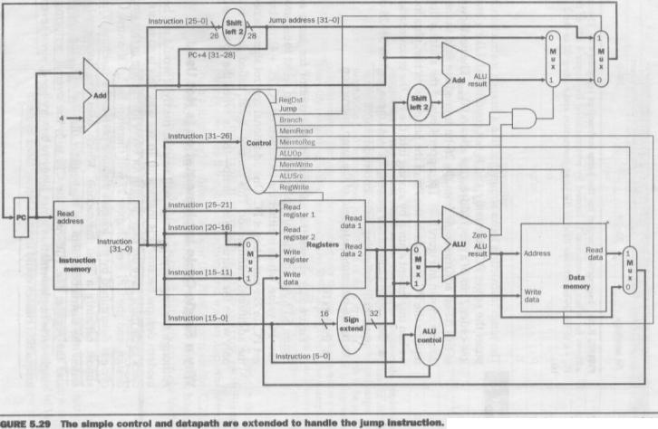
Implementing Jumps

Slide 40

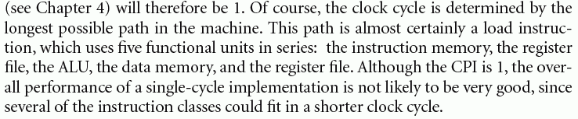
Why a single-cycle implementation is not used?

Slide 41
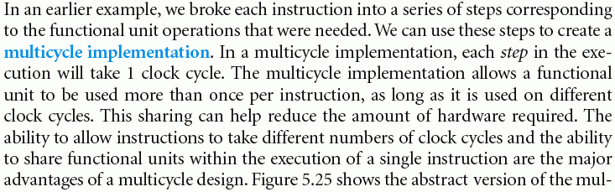
A Multicycle Implementation
Advantages?

Slide 42
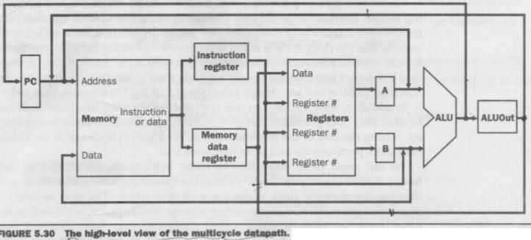
A Multicycle Implementation
Why the temporary registers are used?

Slide 43
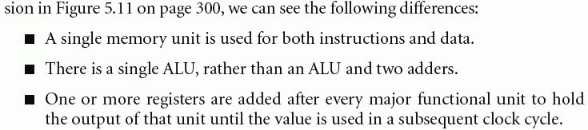
A Multicycle Implementation
Comparison with single-cycle implementation.

Slide 44
A Multicycle Implementation
Why the temporary registers are used?

Slide 45
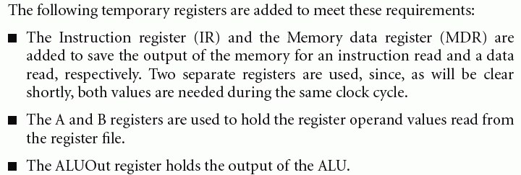
A Multicycle Implementation

Slide 46
A Multicycle Implementation
Why the temporary registers are used?

Slide 47
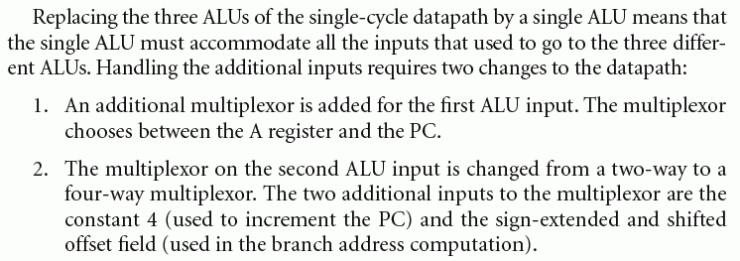
A Multicycle Implementation

Slide 48
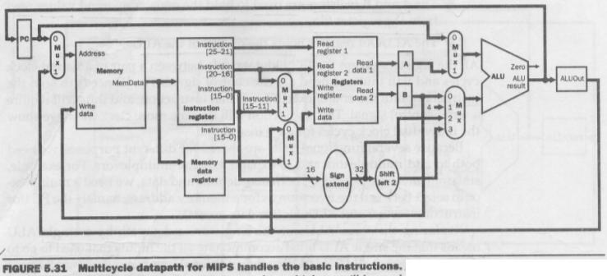
A Multicycle Implementation
With the additional multiplexers.

Slide 49
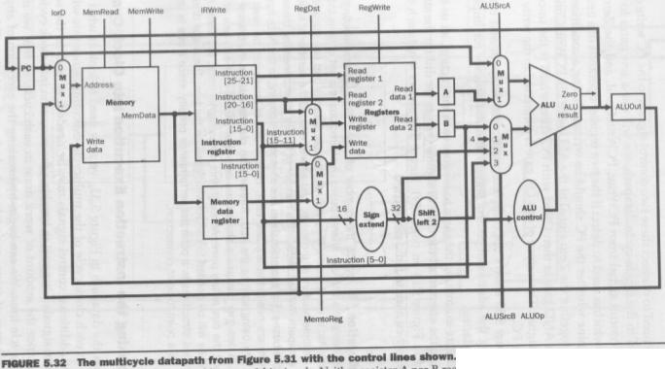
A Multicycle Implementation
With the control lines added.

Slide 50
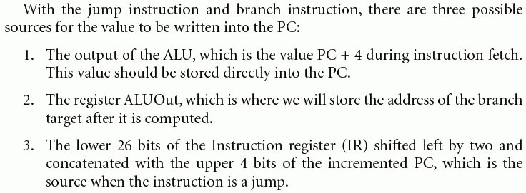
A Multicycle Implementation

Slide 51
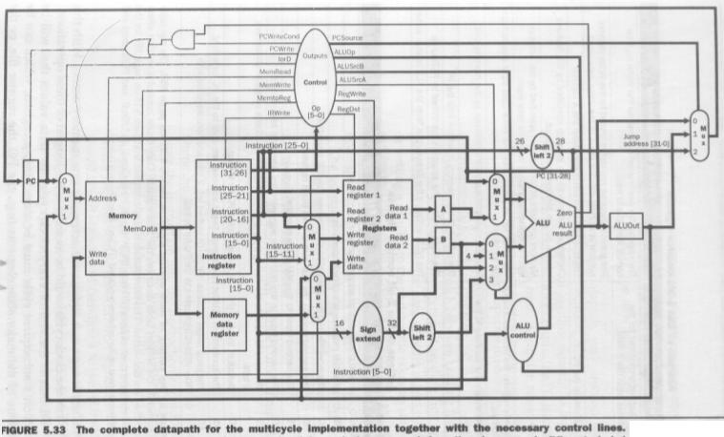
A Multicycle Implementation

Slide 52
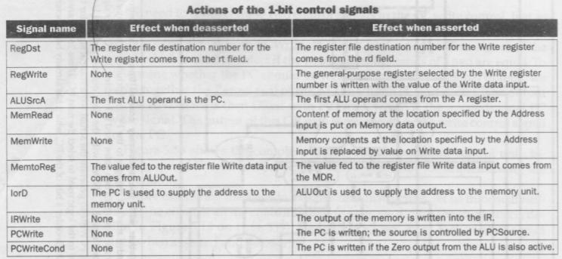
A Multicycle Implementation

Slide 53
Exceptions
An exception is an unexpected event from within the processor.
Types: due to an undefined instruction and an arithmetic overflow.
Interrupt
Examples: Page-411

Slide 54
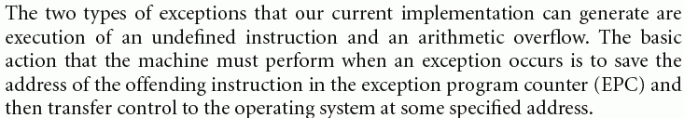
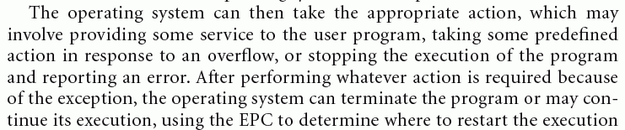
How Exceptions are Handled

Slide 55
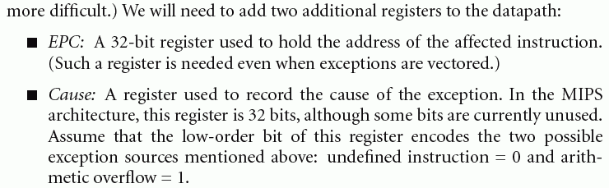
How Exceptions are Handled

Slide 56
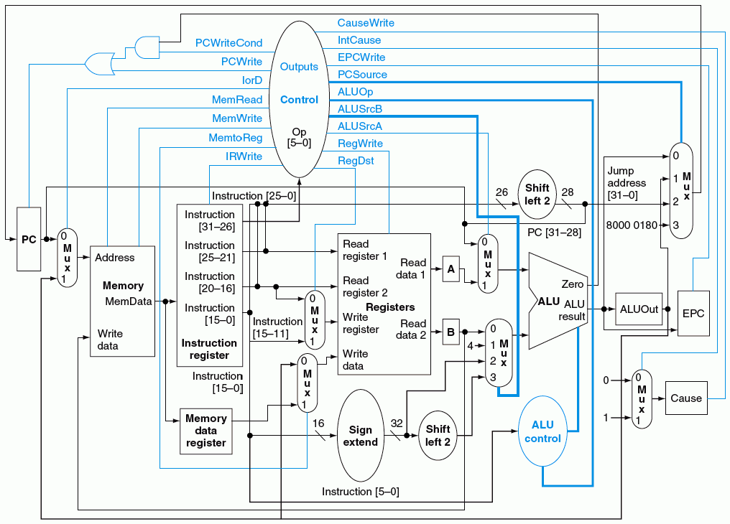
How Exceptions are Handled

