Slide 1
The Processor: Datapath and Control
Chapter - 5

Slide 2
Introduction
A subset of the core MIPS instruction set:
The memory-reference instruction – lw, sw
The arithmetic-logical instruction – add, sub, and, or, slt
The branch instructions - branch equal (beq), jump (j)

Slide 3
An overview of the implementation
For every instruction, the first two steps are identical:
Sent the PC to the memory that contains the code and fetch the instruction from that memory.
Read one or two registers, using fields of the instruction to select the registers to read.

Slide 4
An overview of the implementation (Cont.)
Even across different instruction classes there are some similarities: Example
All instruction classes use the ALU after reading the registers.
  Memory-reference – address calculation
  Arithmetic-logic – operation execution
  Branch – comparison.
After using the ALU, the actions differ.

Slide 5
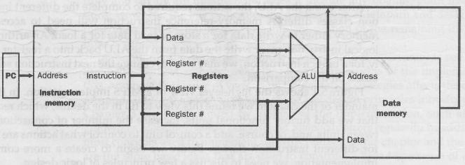
An overview of the implementation (Cont.)
Fig. – 5.1 An abstract view of the implementation.

Slide 6
A word about Logic Convention and Clocking
The functional unites in the MIPS implementation consist of two different types of logic elements.
  Combinational - ALU
  State Element / Sequential – Instruction and Data Memory, Registers
  State element has at least two inputs and one output.

Slide 7
Clocking Methodology
A clocking methodology defines when signal can be read and when they can be written.
We assume edge-triggered clocking.

Slide 8
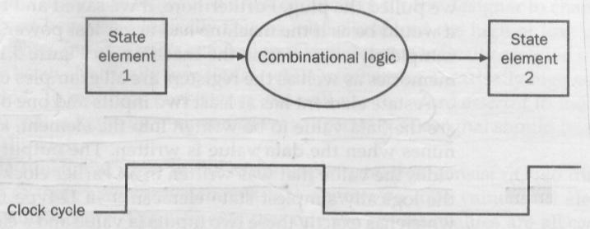
Clocking Methodology (Cont.)
Combinational logic, which operate in a single clock cycle.

Slide 9
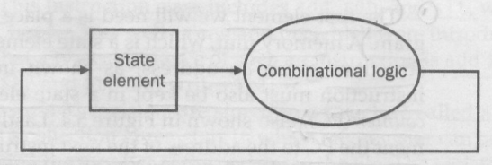
Clocking Methodology (Cont.)
An edge triggered methodology allows us to read the contents of a register, send the value through some combinational logic, and write the register in the same clock cycle.

Slide 10
The MIPS Subset Implementation
Uses a single long clock cycle for every instruction.
Begins execution on one clock edge and completes execution on the next clock edge.

Slide 11
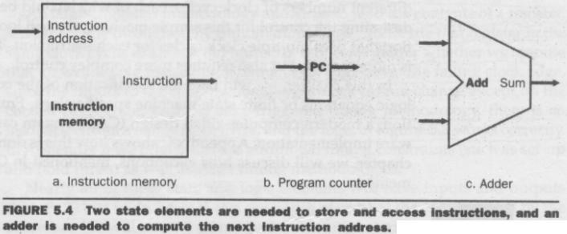
Building a Datapath
Datapath elements:

Slide 12
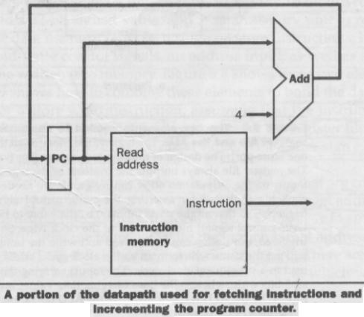
Building a Datapath
For fetching instructions:

Slide 13
Building a Datapath
Name | Fields
Field Size | 6 bits | 5 bits | 5 bits | 5 bits | 5 bits | 6 bits
R-format | op | rs | rt | rd | shamt | funct
I-format | op | rs | rt | address/immediate
J-format | op | target address

Slide 14
Building a Datapath
R-format:
add $t1, $t2, $t3
Register file: is a collection of registers in which any resister can be read or written by specifying the number of the register in the file.

Slide 15
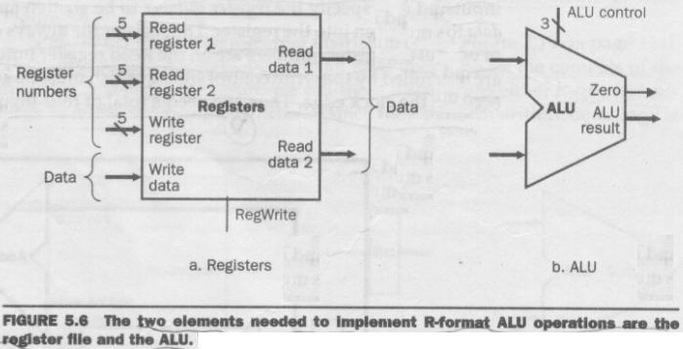
Building a Datapath
Two elements needed for R-type instruction.

Slide 16
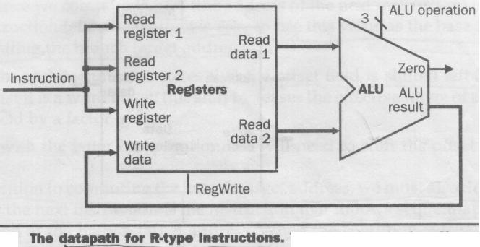
Building a Datapath
Datapath for R-type instruction.

Slide 17
Building a Datapath
Name | Fields
Field Size | 6 bits | 5 bits | 5 bits | 5 bits | 5 bits | 6 bits
R-format | op | rs | rt | rd | shamt | funct
I-format | op | rs | rt | address/immediate
J-format | op | target address

Slide 18
Building a Datapath
I-format:
lw $t1, offset_value ($t2)
sw $t1, offset_value ($t2)
compute a memory address by adding the base register ($t2) to the 16 bit signed offset field.

Slide 19
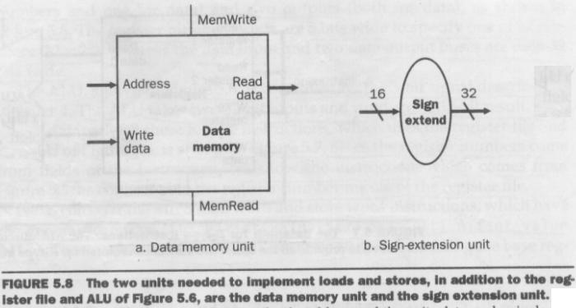
Building a Datapath
Two elements needed for lw & sw instructions.

Slide 20
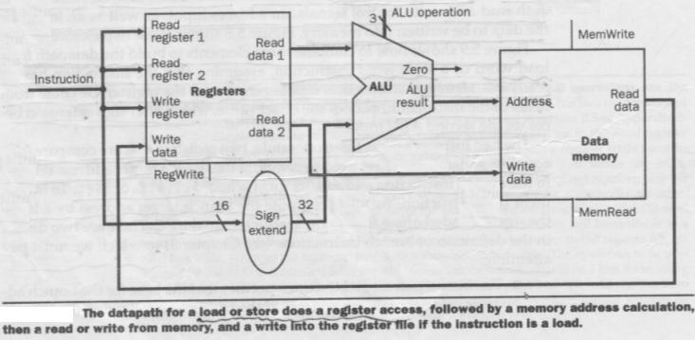
Building a Datapath
Datapath for lw or sw instructions.

Slide 21
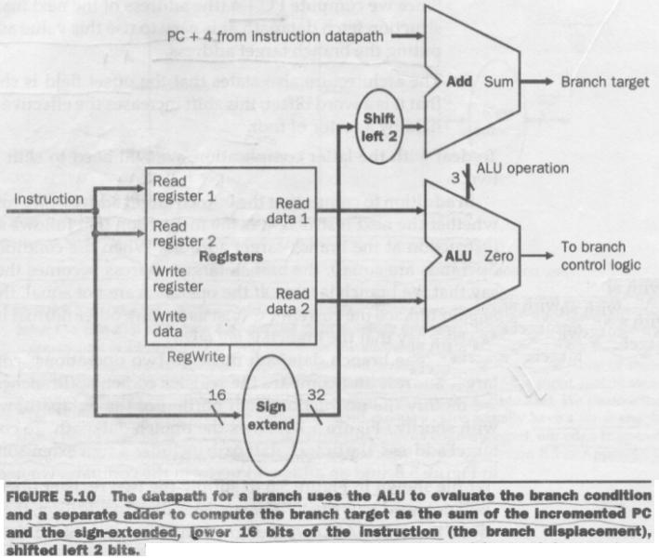
Building a Datapath
Datapath for beq instruction.

Slide 22
Building a Datapath
Name | Fields
Field Size | 6 bits | 5 bits | 5 bits | 5 bits | 5 bits | 6 bits
R-format | op | rs | rt | rd | shamt | funct
I-format | op | rs | rt | address/immediate
J-format | op | target address

Slide 23
Building a Datapath
J-format:
J 2500 ; Go to 10000
Operates by replacing the lower 28 bits of the PC with lower 26 bits of the instruction shifted left by 2 bits.

Slide 24
A simple Implementation Scheme
This implementation covers:
lw, sw, beq, add, sub, and, or, and slt.
Later enhanced for j.

Slide 25
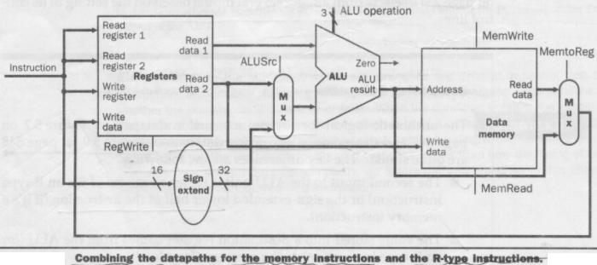
Creating a Single Datapath

Slide 26
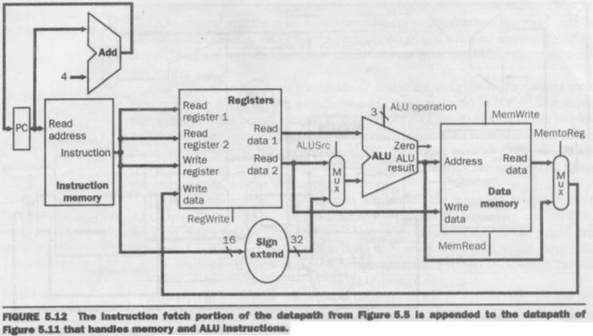
Creating a Single Datapath

Slide 27
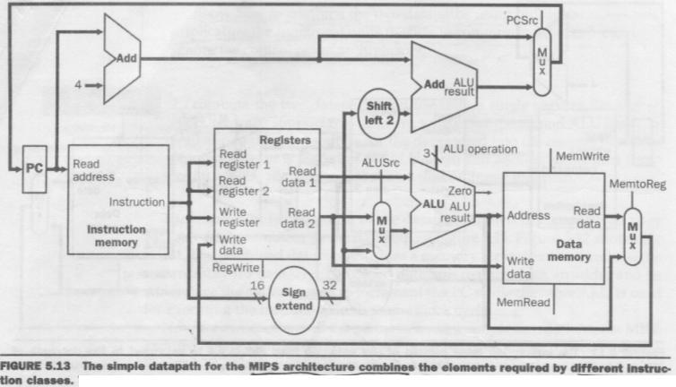
Creating a Single Datapath

Slide 28
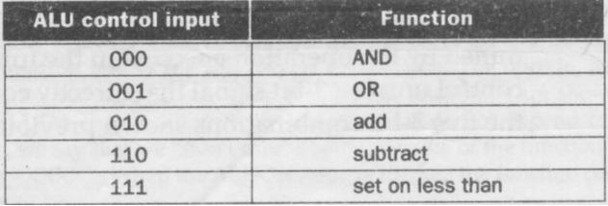
The ALU Control
ALU has three control inputs.

Slide 29
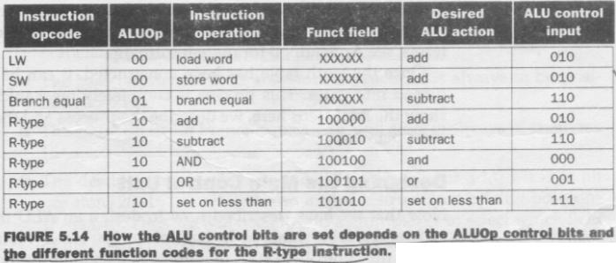
The ALU Control

Slide 30
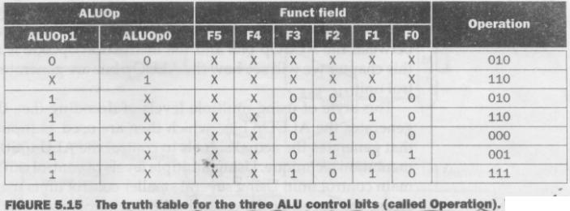
The ALU Control
Truth table

Slide 31
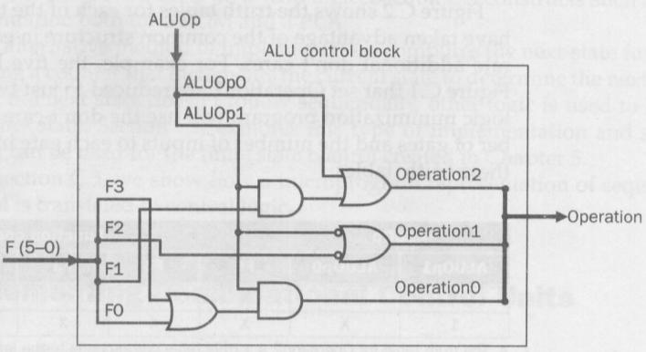
The ALU Control
Appendix C - Section C.2

Slide 32
Designing the Main Control Unit
Name | Fields
Field Size | 6 bits | 5 bits | 5 bits | 5 bits | 5 bits | 6 bits
R-format | op (0) | rs | rt | rd | shamt | funct
I-format | op (35/43/4) | rs | rt | address/immediate
I-format : lw, sw, beq

Slide 33
Designing the Main Control Unit
Major observations:
op field always contained in bits 31-26
Two registers to be read are always specified at positions 25-21 and 20-16.
Base register for lw and sw is always in position 25-21.
16-bit offset for beq, lw and sw is always in position 15-0.
Destination register is in one of two places. 20-16 for lw and 15-11 for R-type.

Slide 34
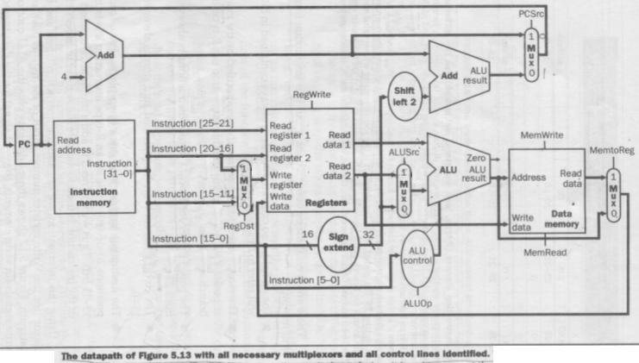
Designing the Main Control Unit
7-single bit control lines
2-bit ALUOp control signal

Slide 35
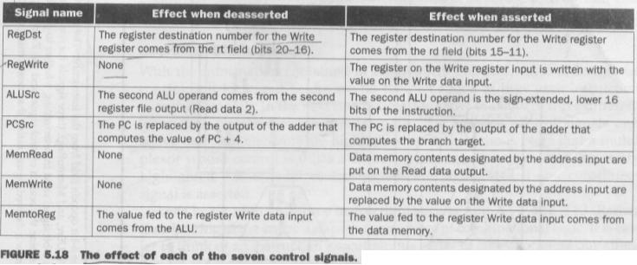
Designing the Main Control Unit
7-single bit control lines
2-bit ALUOp control signal

Slide 36
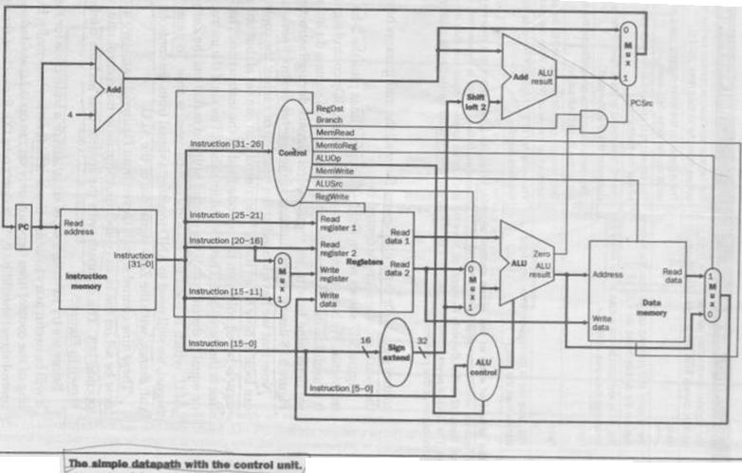
Designing the Main Control Unit
9 control signals can be set on the basis of six opcode bits.

Slide 37
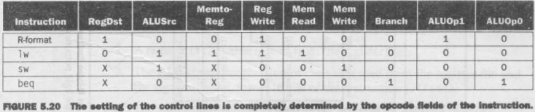
Designing the Main Control Unit
Defines how the control signals should be set for each opcode.

Slide 38

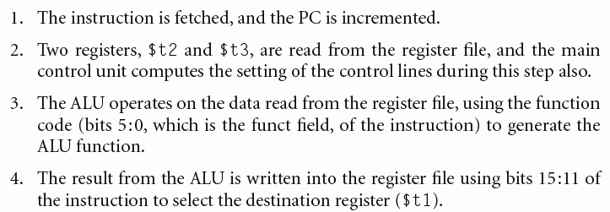
Operation of the Datapath

Slide 39
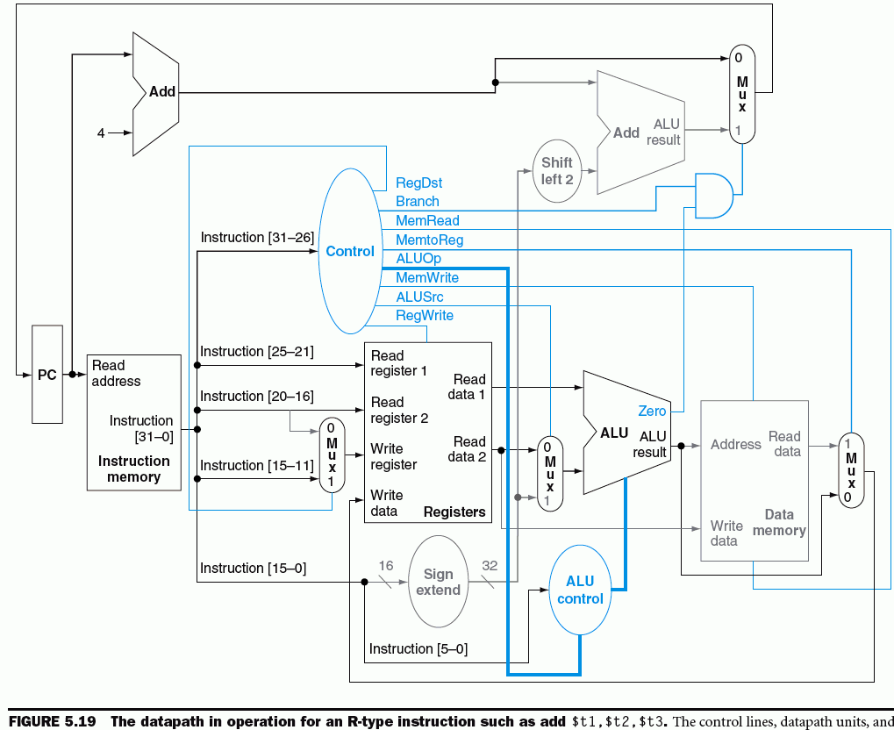
Operation of the Datapath

Slide 40
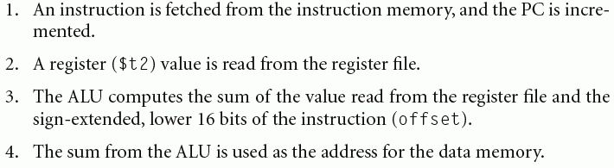
Operation of the Datapath

Slide 41
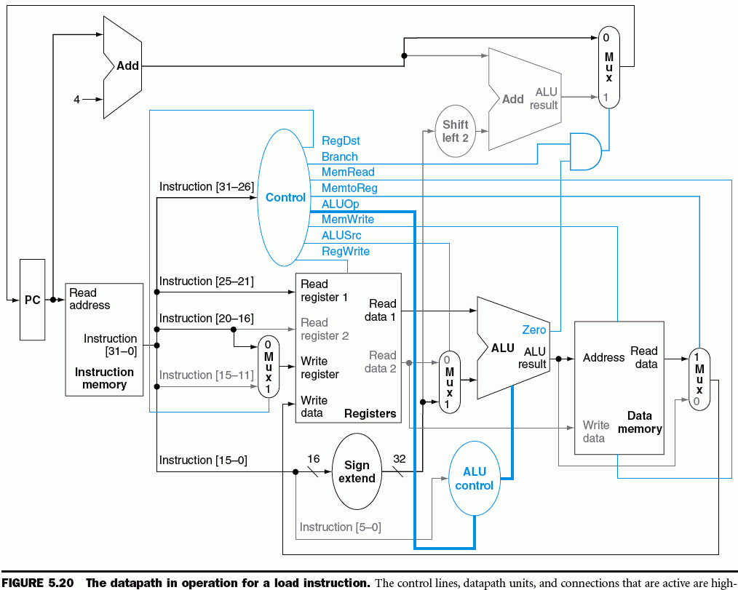
Operation of the Datapath

Slide 42
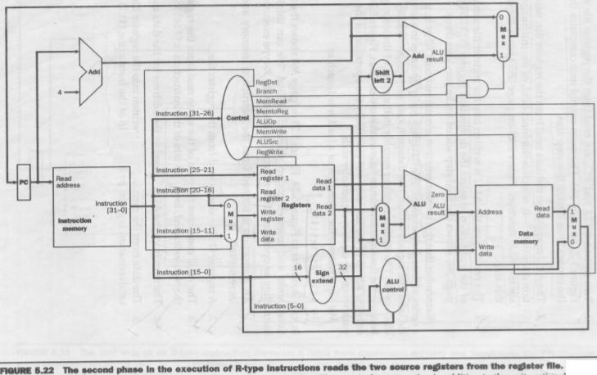
Operation of the Datapath
aa

Slide 43
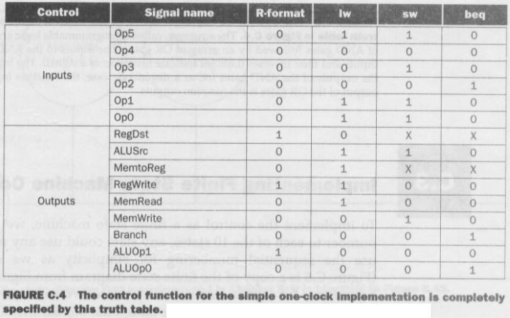
Finalizing the Control
aa

Slide 44
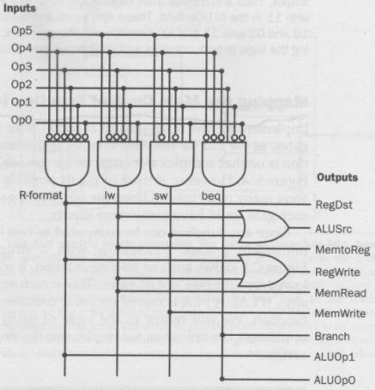
Finalizing the Control

Slide 45
Implementing Jumps
2 | address
31-26 | 25-0

Slide 46
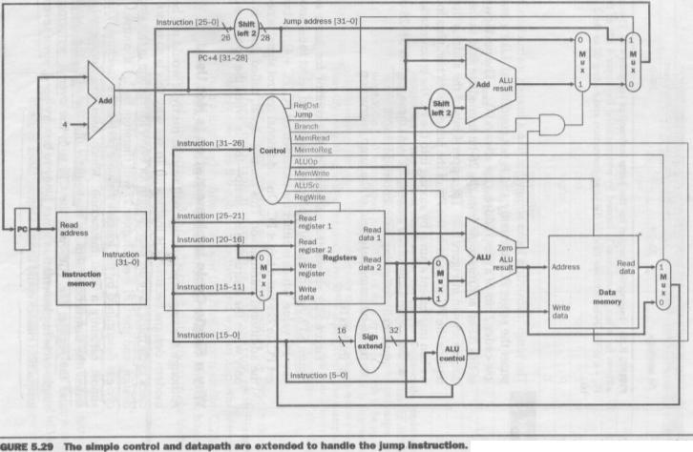
Implementing Jumps

Slide 47

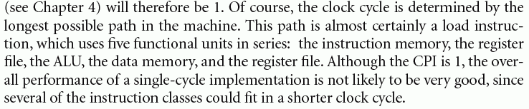
Why a single-cycle implementation is not used?

Slide 48
A Multicycle Implementation
Advantages:
The ability to allow instructions to take different numbers of clock cycles
The ability to share functional units within the execution of a single instruction

Slide 49
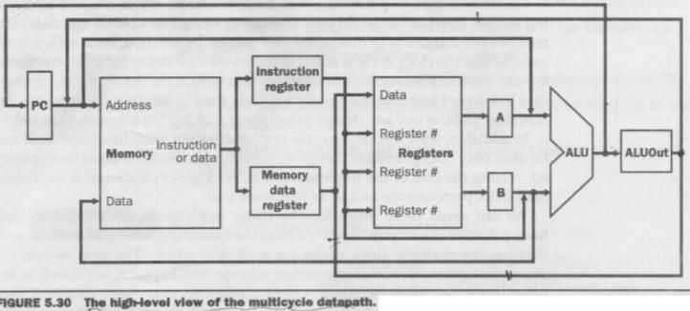
A Multicycle Implementation
Why the temporary registers are used?

Slide 50
A Multicycle Implementation
Comparison with single-cycle implementation.
  A single memory unit is used for both instructions and data.
  There is a single ALU, rather than an ALU and two adders.
  One or more registers are added after every major functional unit to hold the output of that unit until the value is used in a subsequent clock cycle.

Slide 51
A Multicycle Implementation
Why the temporary registers are used?

Slide 52
A Multicycle Implementation
Following temporary registers are added:
  The Instruction register (IR) and the Memory data register (MDR) are added to save the output of the memory for an instruction read and a data read, respectively.
  The A and B registers are used to hold the register operand values read from the register file.
  The ALUOut register holds the output of ALU.

Slide 53
A Multicycle Implementation
Why the temporary registers are used?

Slide 54
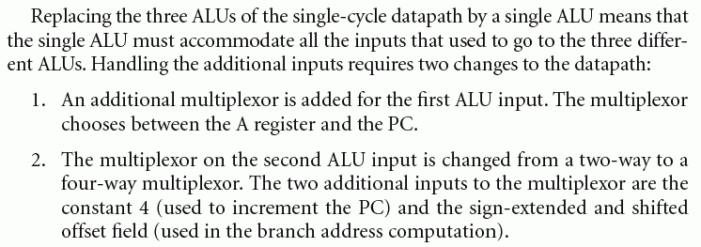
A Multicycle Implementation

Slide 55
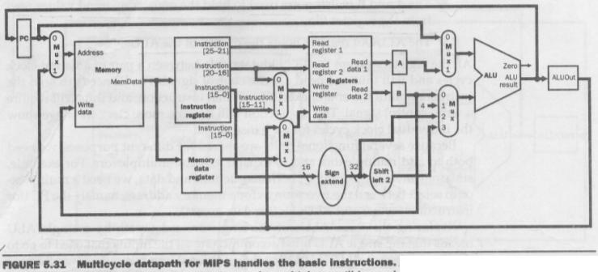
A Multicycle Implementation
With the additional multiplexers.

Slide 56
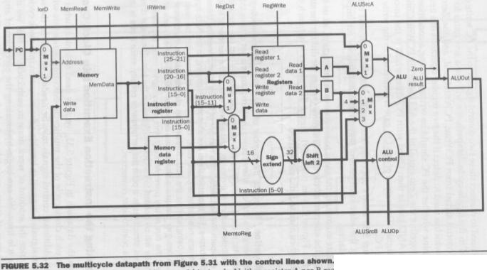
A Multicycle Implementation
With the control lines added.

Slide 57
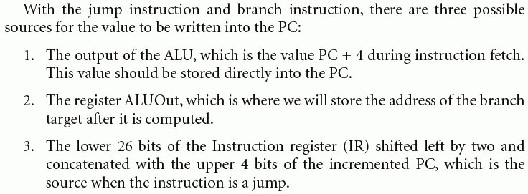
A Multicycle Implementation

Slide 58
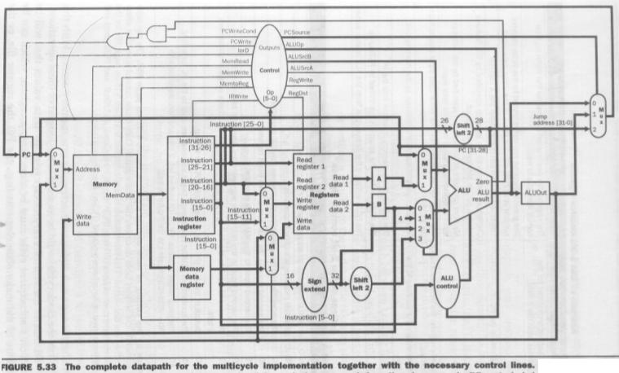
A Multicycle Implementation

Slide 59
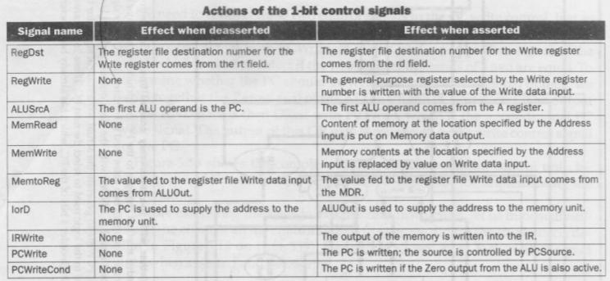
A Multicycle Implementation

Slide 60
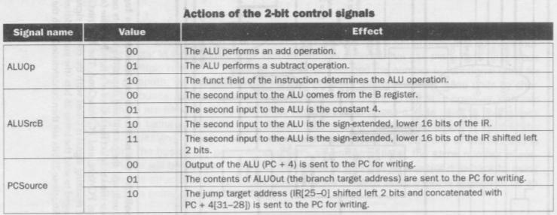
A Multicycle Implementation

Slide 61
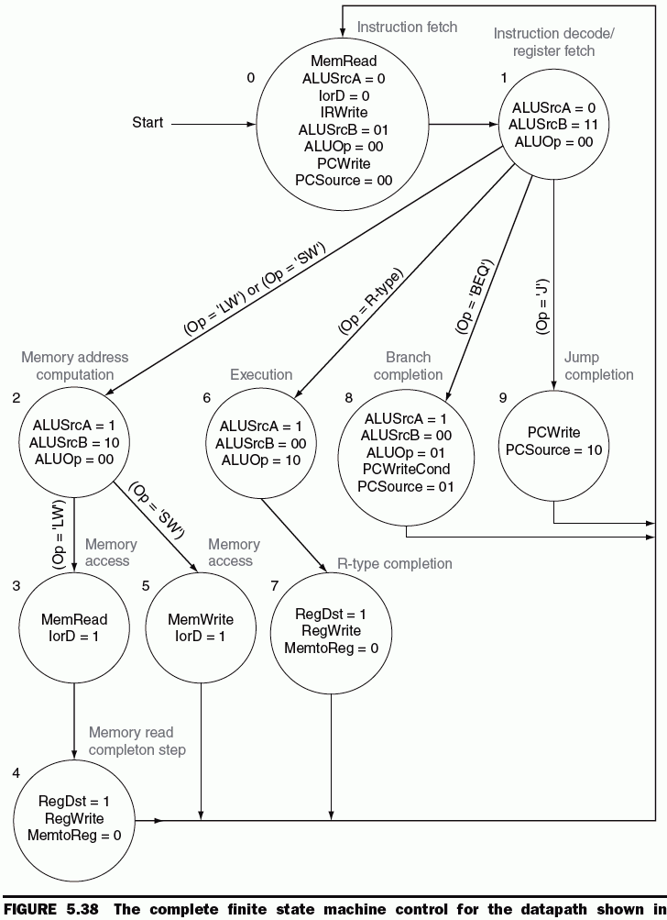

Defining the Control

Slide 62
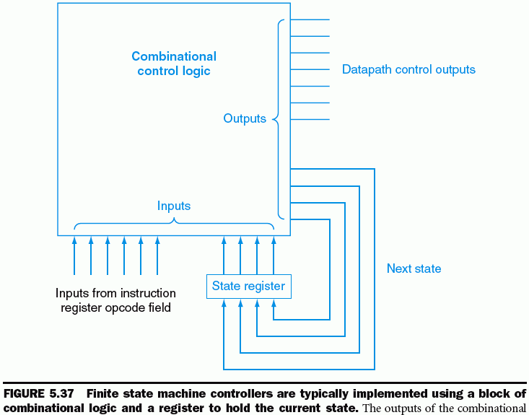
Defining the Control

Slide 63
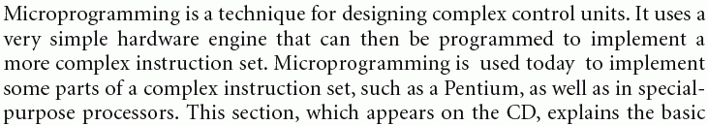
Microprogramming:
Simplifying Control Design
Each microinstruction defines the set of datapath control signals that must be asserted in a given state.
Designing the control as a program that implements the machine instructions in terms of simple microinstructions is called microprogramming.

Slide 64
Implementing the Microprogram

Slide 65
Exceptions
An exception is an unexpected event from within the processor.
Two Types:
  due to an undefined instruction
  an arithmetic overflow.
An Interrupt is an event that also causes an unexpected change in control flow but comes from outside of the processor.

Slide 66

Exceptions
Examples of exceptions and interrupts:

Slide 67
How Exceptions are Handled
Basic actions:
  Save the address of the offending instruction in the exception program counter (EPC)
  Transfer control to the operating system at some specific address.
  OS takes appropriate action: providing some services to the user program, taking some predefined action in response to an overflow, or stopping the execution of the program and report an error.
  OS can terminate the program or may continue its execution, using the EPC to determine where to restart the execution of the program

Slide 68
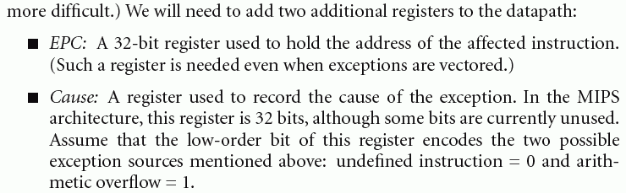
How Exceptions are Handled

Slide 69
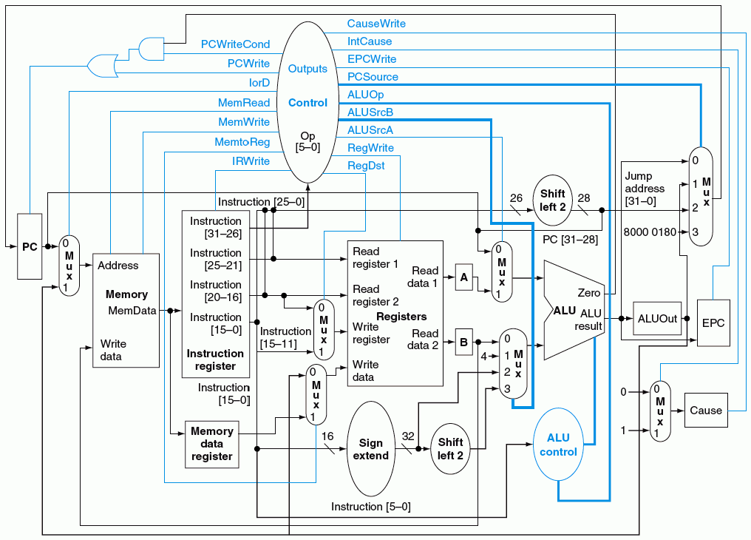
How Exceptions are Handled

Slide 70


Slide 71
Thank You !!!

