Slide 1
Classification of Sber Avtopodpiska website visitors

Slide 2
Task
1.

Slide 3
About project
an alternative to carsharing and buying on credit
long-term car rental service for individuals with a monthly payment
insurance and repair
additional services

Slide 4
Main tasks
Develop binary classification model of users' actions
ROC AUC ≥ 0.65
Use only utm, device and geo features
Deploy as API
Scalable
Response time < 3s

Slide 5
EDA
2.

Slide 6
Data format
hits.csv
sessions.csv
 | session_id | … | event_label
0 | 1 | … | quiz_show
1 | 1 | … | view_card
2 | 1 | … | sub_submit_success
… | … | … | …
100 | 1 | … | view_card
101 | 1 | … | sub_car_claim_click
102 | 1 | … | sub_landing
 | geo_city | … | visit_date | session_id
0 | Moscow | … | 2021-12-09 | 1
1 | None | … | 2021-12-15 | 2
… | … | … | … | …
100000 | Moscow | … | 2021-12-28 | 100000
100001 | Omsk | … | 2021-12-16 | 100001

Slide 7
Data format
column | non-null count | percentage % | dtype | nunique
utm_source | 1732190 | 100 | object | 281
utm_medium | 1732266 | 100 | object | 55
utm_campaign | 1536979 | 88.73 | object | 407
utm_adcontent | 1428129 | 82.44 | object | 281
utm_keyword | 711514 | 41.07 | object | 1193
device_category | 1732266 | 100 | object | 3
device_os | 718302 | 41.47 | object | 14
device_brand | 1385070 | 79.96 | object | 201
device_model | 15062 | 0.87 | object | 105
device_screen_resolution | 1732266 | 100 | object | 4947
device_browser | 1732266 | 100 | object | 55
geo_country | 1732266 | 100 | object | 159
geo_city | 1732266 | 100 | object | 2389

Slide 8
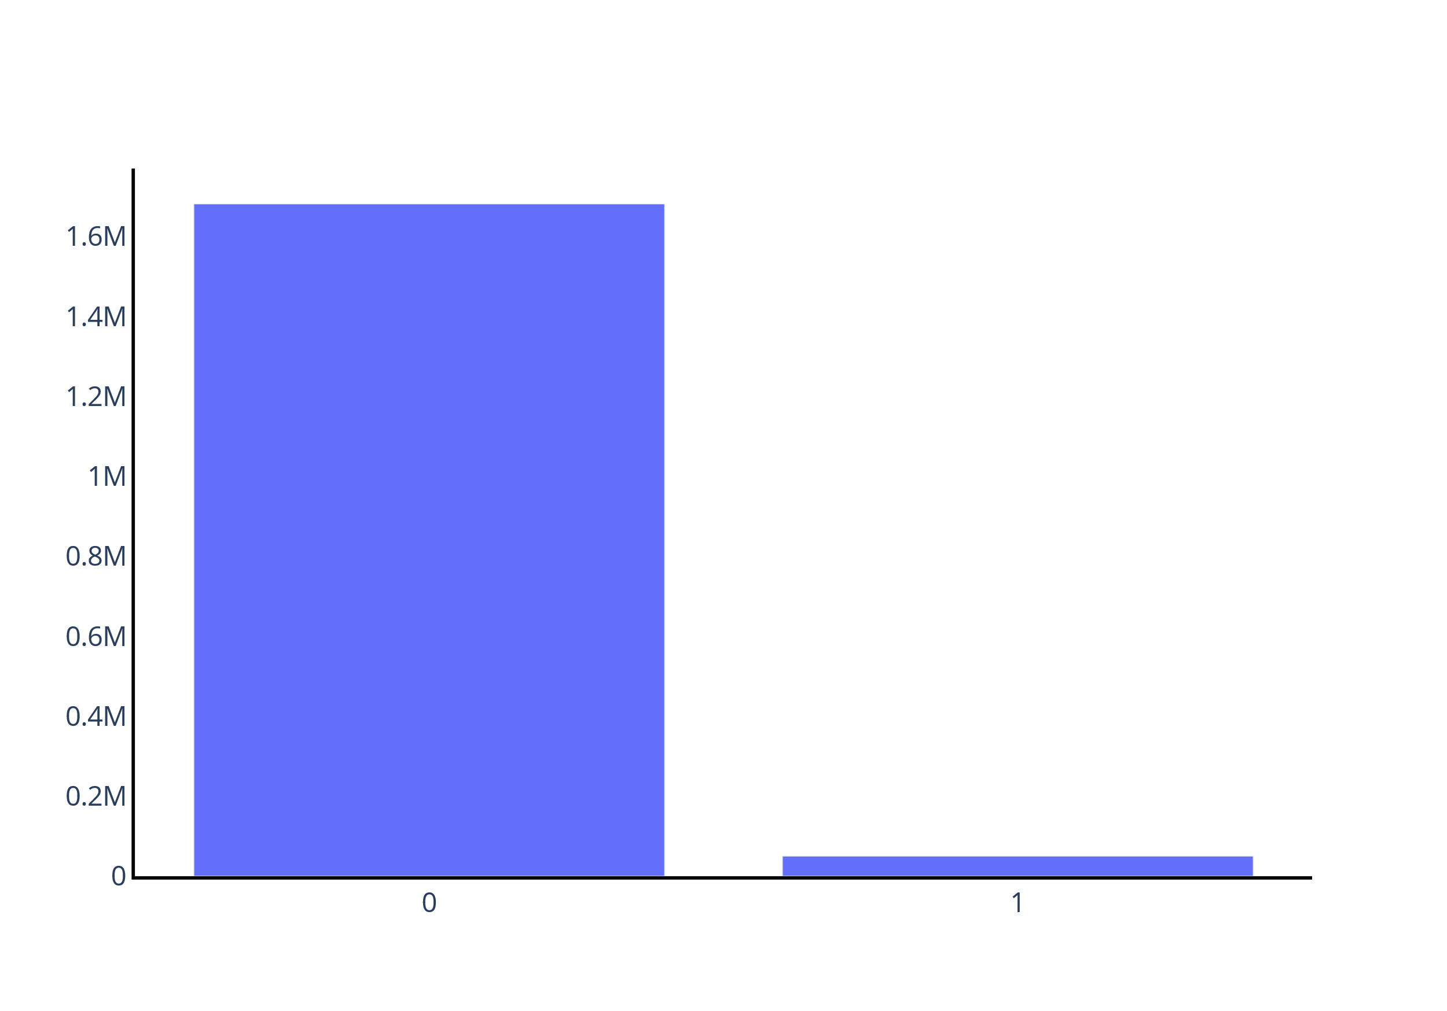
Target
0 – 97.1%
1 – 2.9%

Slide 9
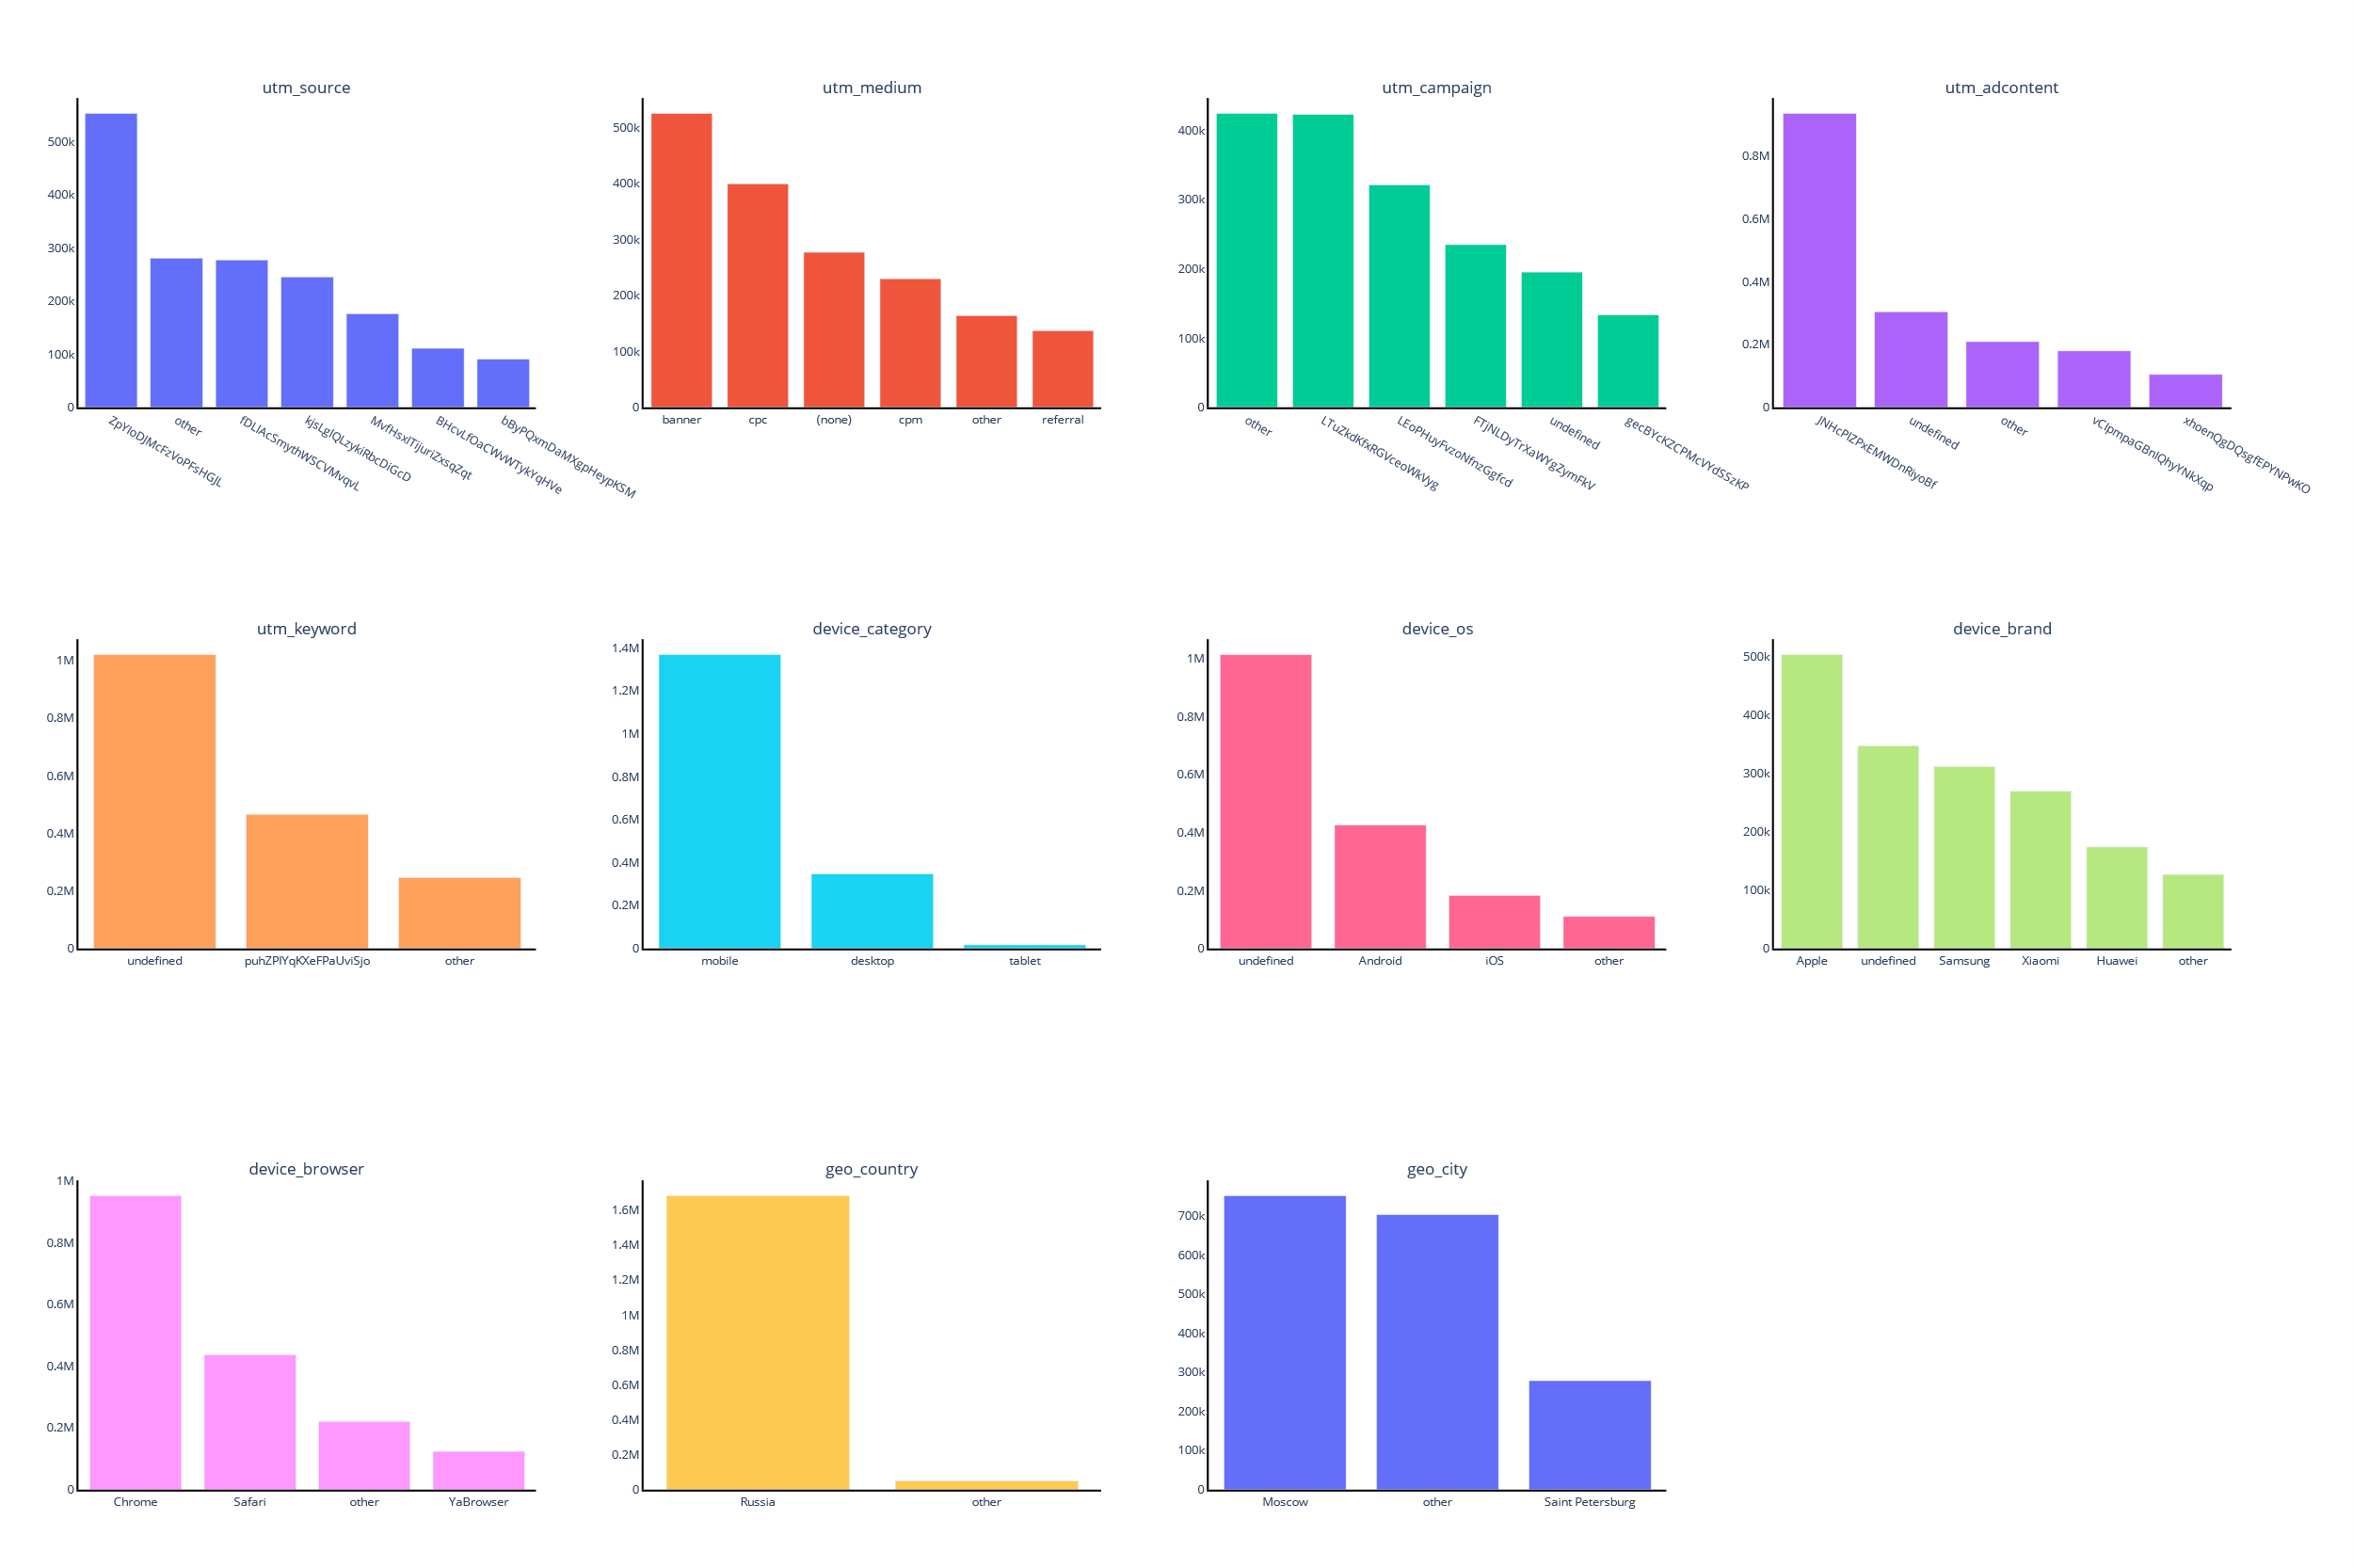
Distributions

Slide 10
Distributions

Slide 11
Distributions

Slide 12
Feature Engineering
3.

Slide 13
Basic transformation
combine os & keyword
extract device_screen_height from device_screen_size

Slide 14


RU Cities
Geonames ru cities data ^{[1]}
RU cities by population ^{[2]}
 | city | population | timezone
0 | Moscow | 10381222 | Europe/Moscow
1 | None | 5351935 | Europe/Moscow
… | … | … | …
100000 | Trakow | 0 | Europe/Moscow
100001 | Akatnov | 0 | Europe/Moscow
 | city | federal_subject | federal_district
0 | Moscow | Moscow (federal city) | Central
1 | Saint Petersburg | Saint Petersburg (federal city) | Northwest
… | … | … | …
308 | Snezhinsk | Chelyabinsk Oblast | Ural
309 | Zhigulyovsk | Samara Oblast | Volga
cities.csv

Slide 15
Preprocessing
4.

Slide 16
Preprocessing I
dev/train/query.sql
CONVERT
event_action to binary target_action
MAX
target_action groped by session_id
JOIN
with sessions on session_id

Slide 17
Preprocessing II
pandas_preprocess() at dev/train/train.py
Assign*
Merge
with cities.csv on city name
Drop
device_model device_screen_resolution
device_os
utm_keyword

Slide 18
Assign
column | action
utm_campaing | fillna
utm_adcontent | fillna
utm_keyword | fillna
device_category | merge tablet & mobile
device_os | fillna convert to Windows/Macintosh/Linux
device_brand | fillna
device_screen_resolution | new column device_screen_height
device_browser | merge Safari & Safari (in-app)
os_keyword | combine os & keyword columns

Slide 19
Preprocessing III
preprocess variable at dev/train/train.py
Rare Label Encoder
One Hot Encoder
Mean Median Imputer
Cat Boost Encoder ^{[3]}
Winsorizer
Standard Scaler

Slide 20
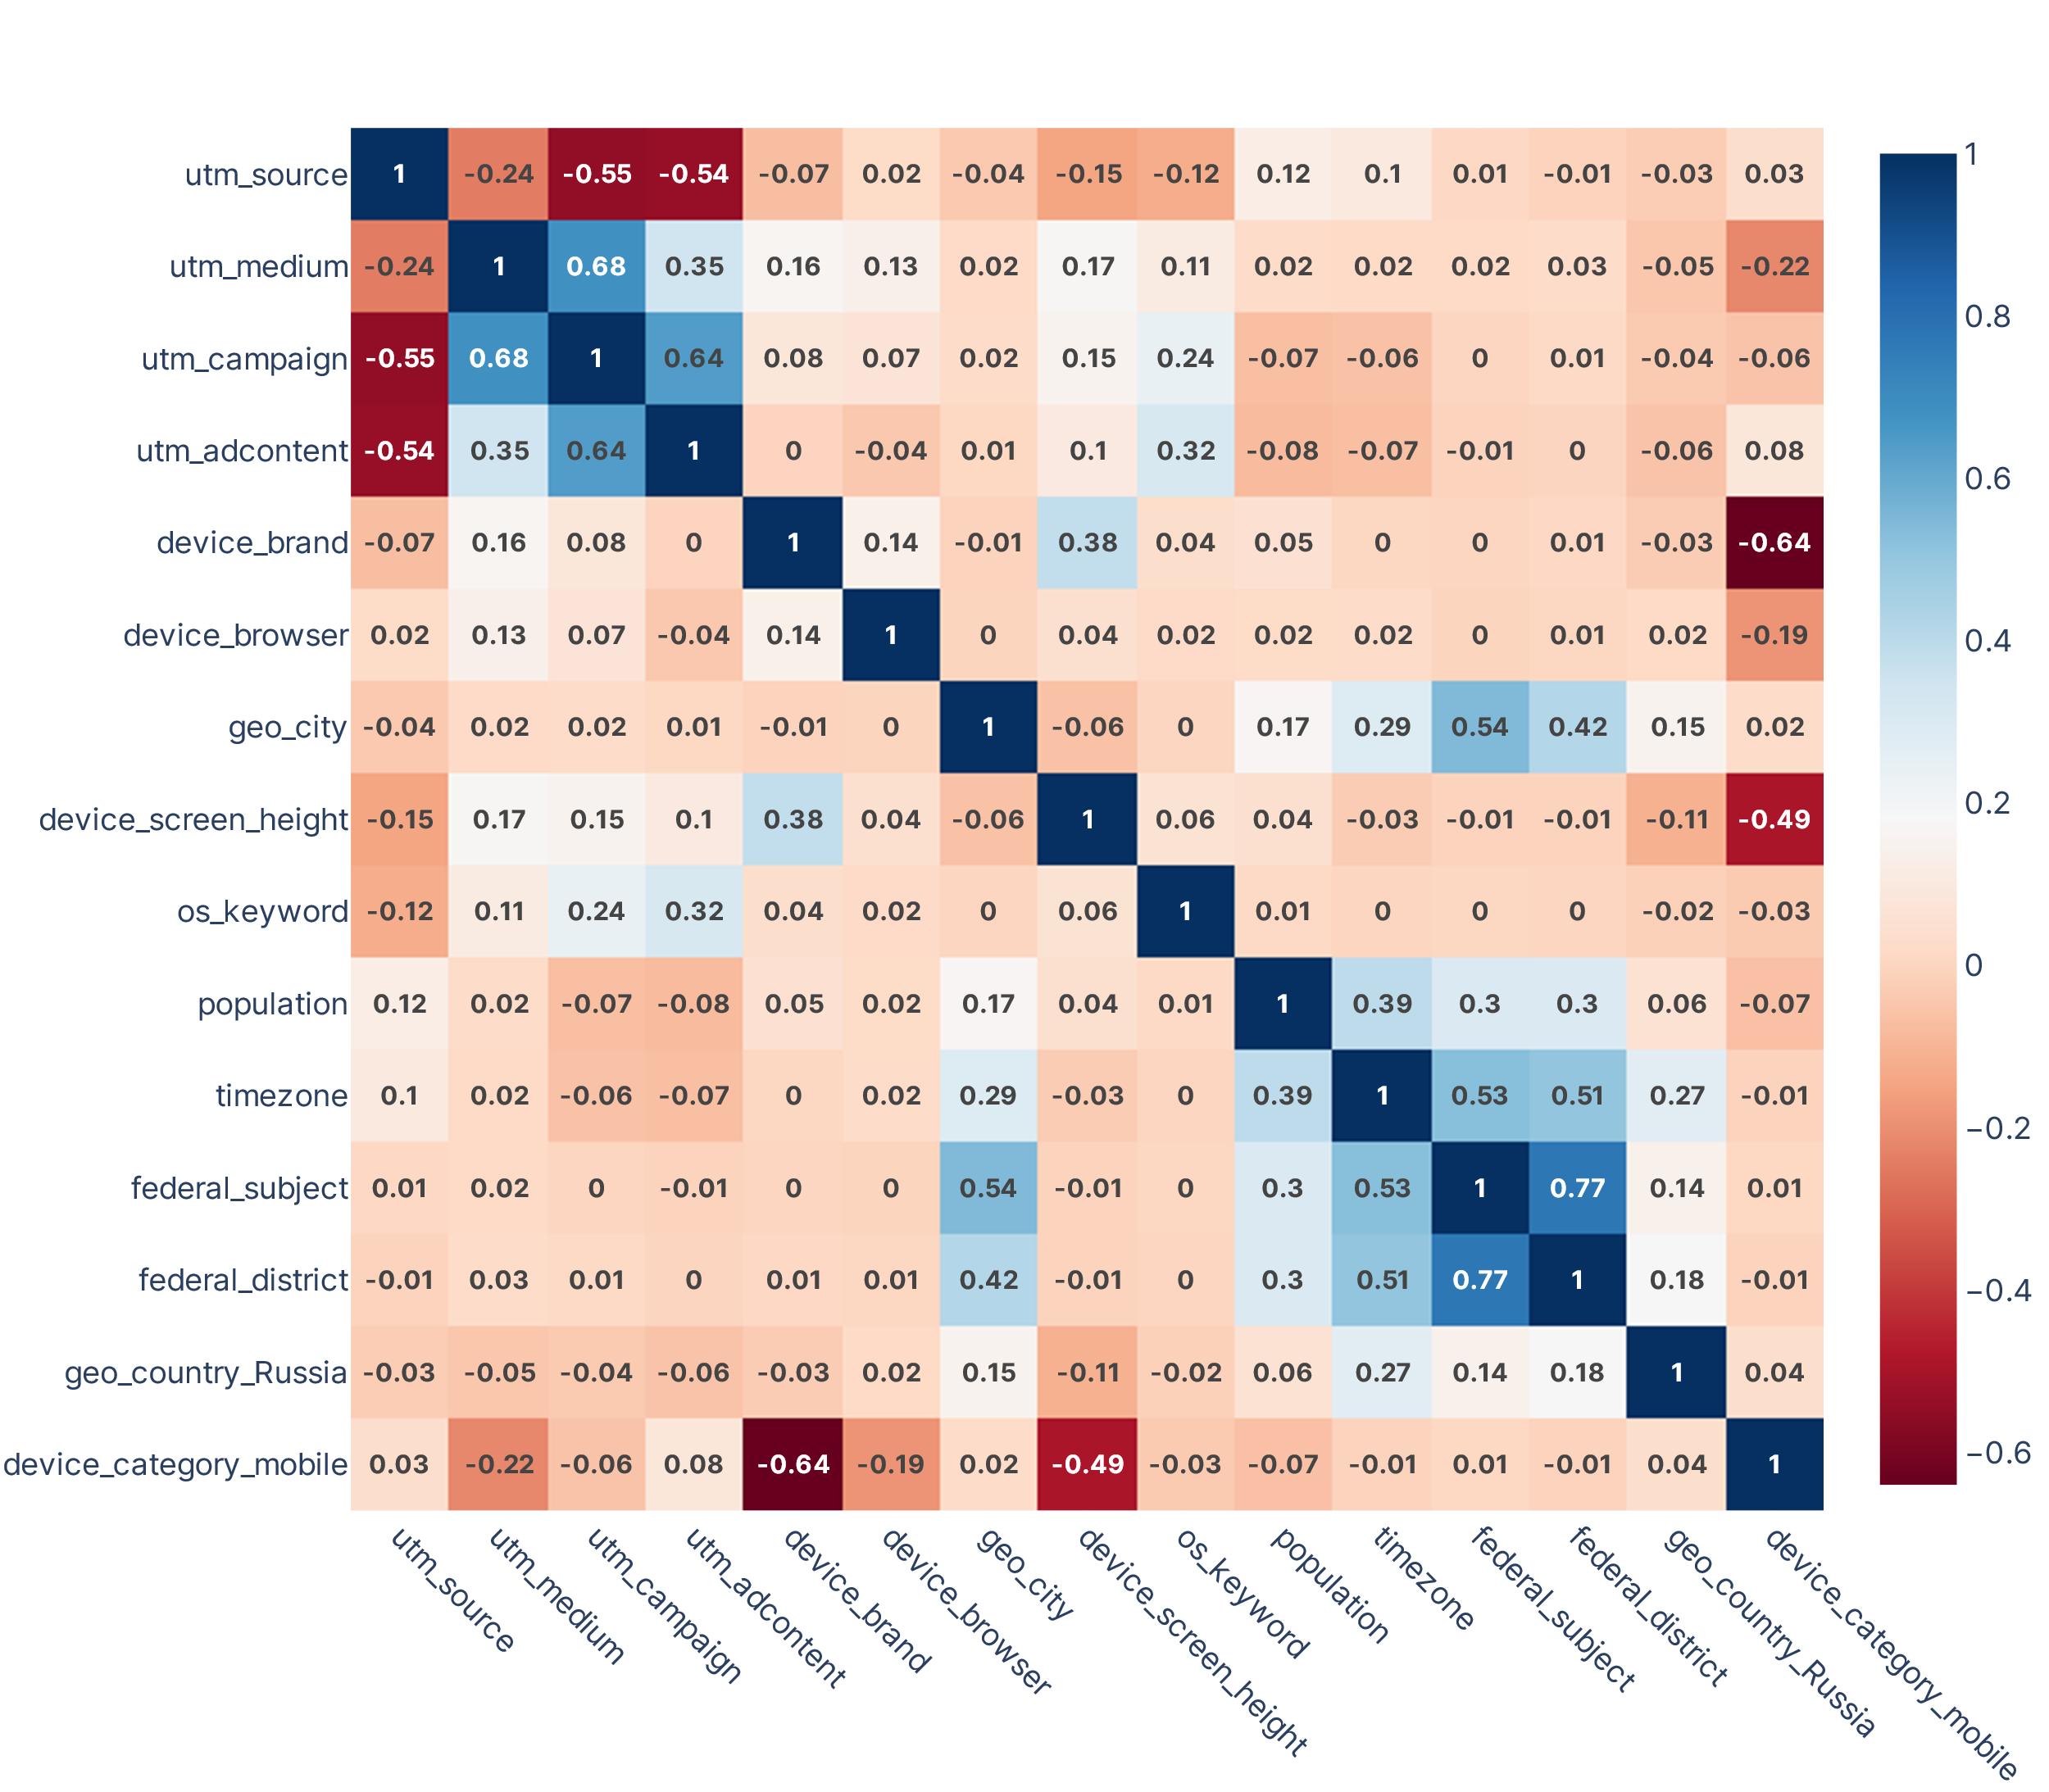
Correlation

Slide 21
Model Selection
5.

Slide 22
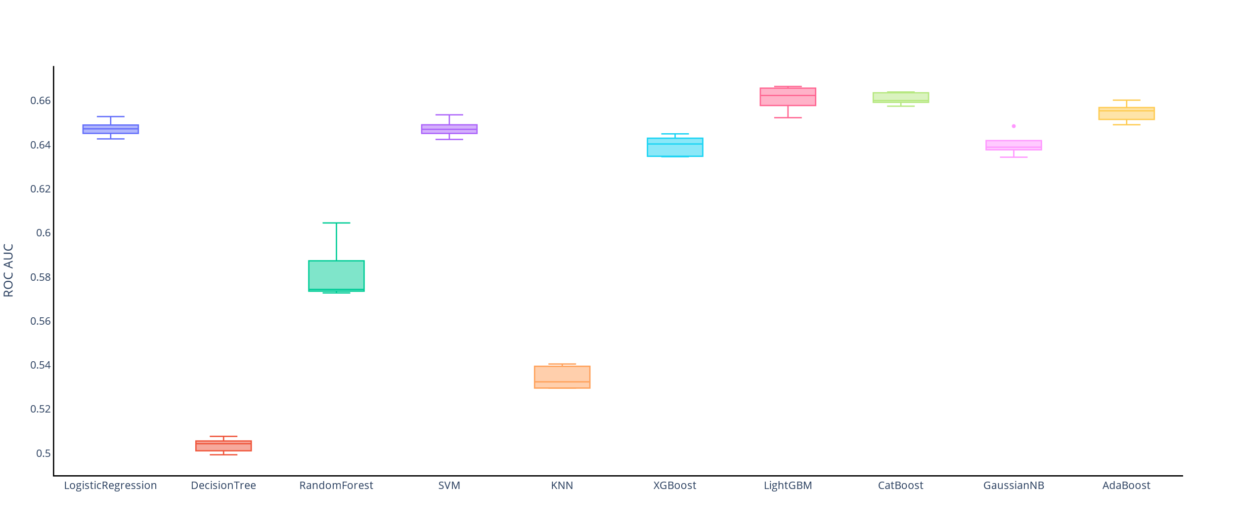
Baseline

Slide 23
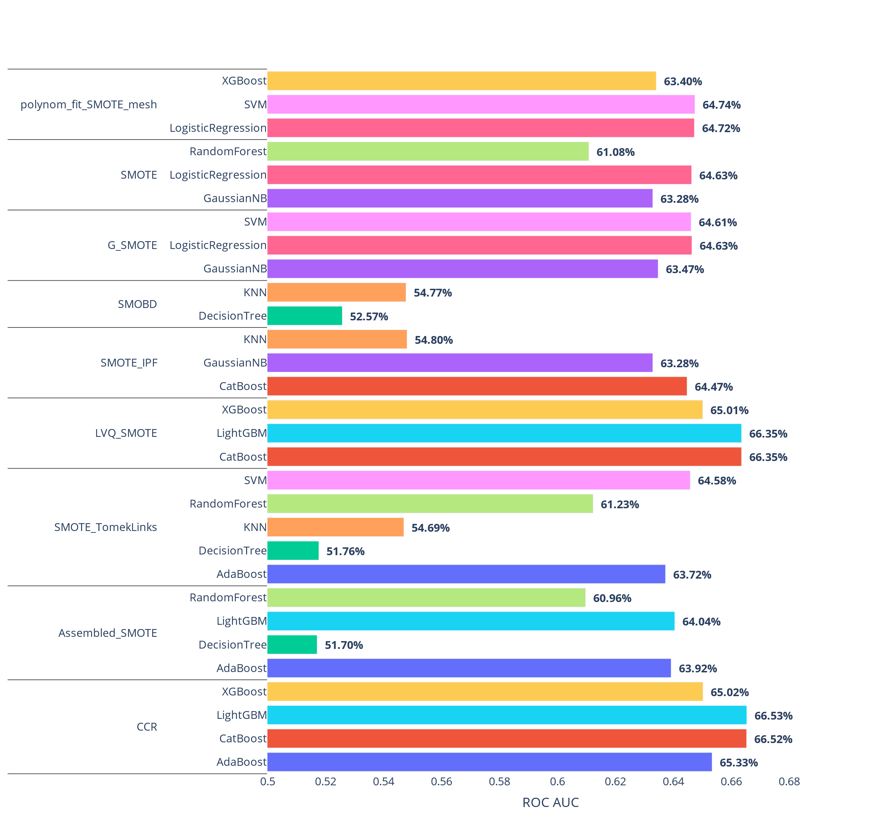
Resampling ^{[4]}

Slide 24
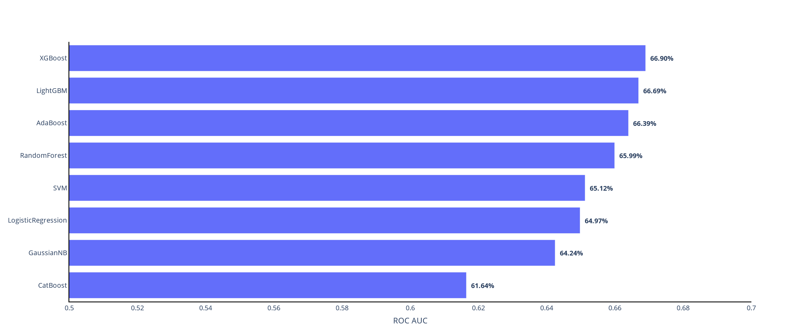
Tuned models

Slide 25
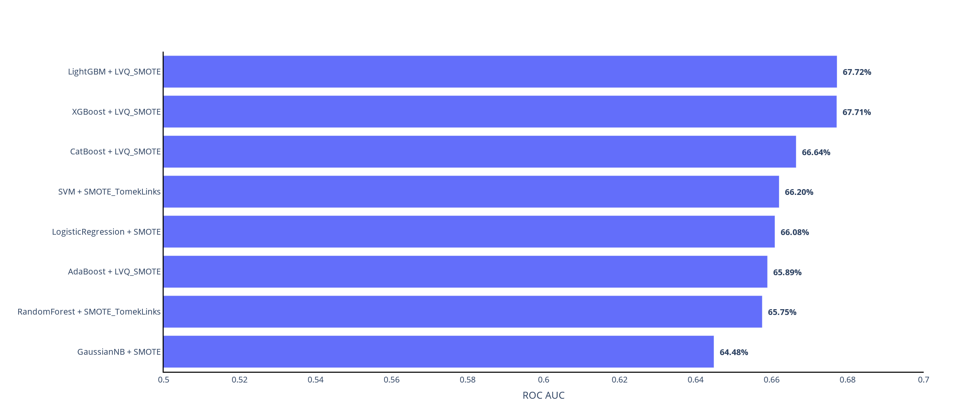
Tuned with Resampling

Slide 26
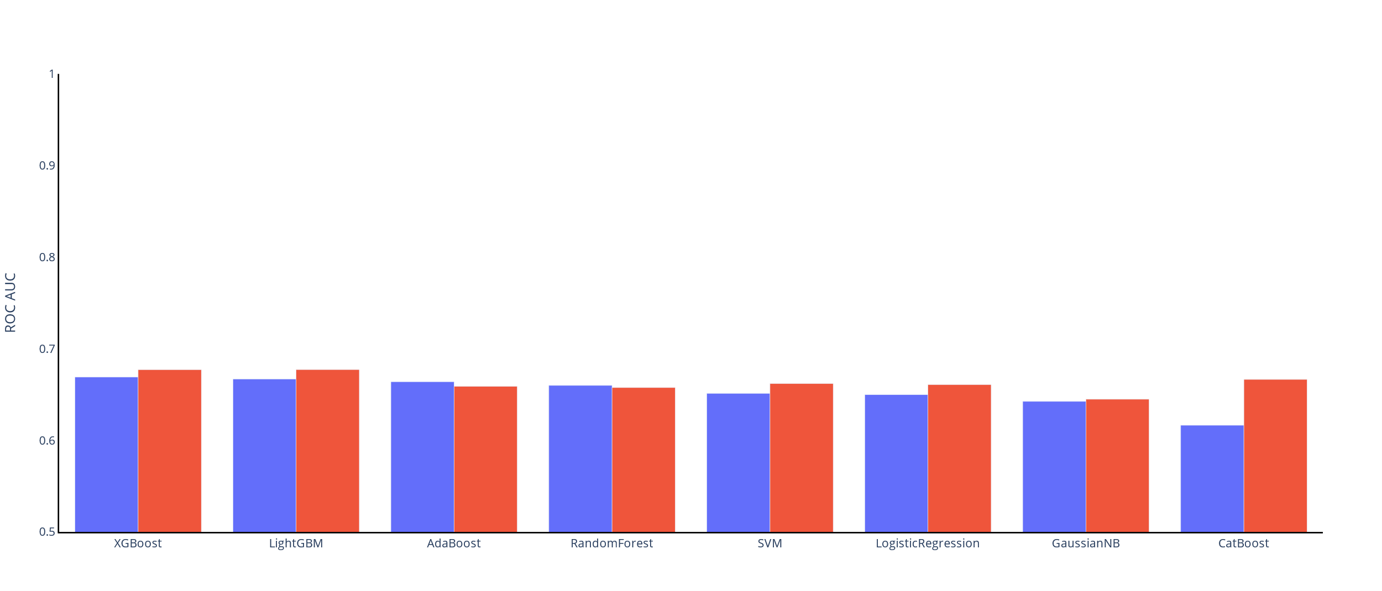
Weighted vs Resampled

Slide 27
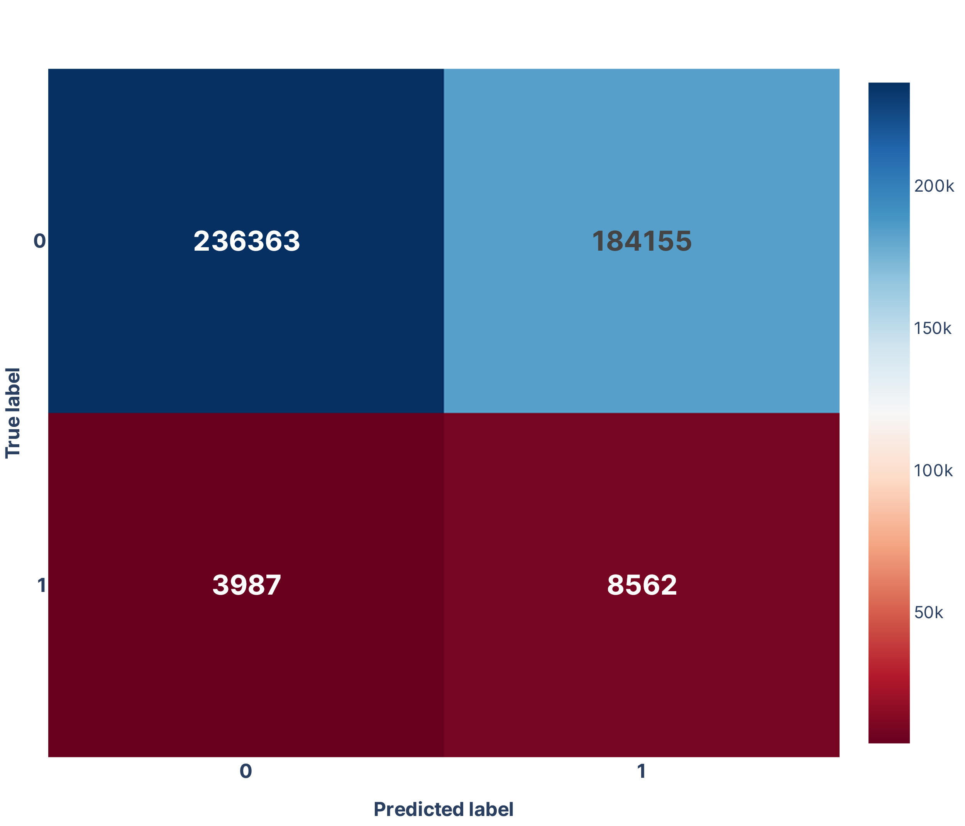
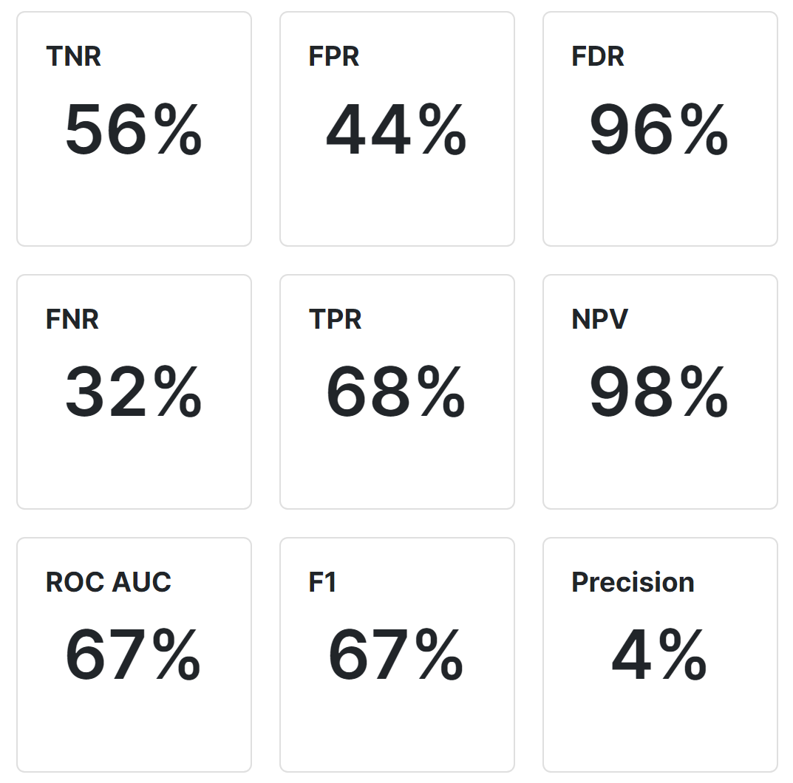
Model
XGBoost
Tuned
Weighted

Slide 28
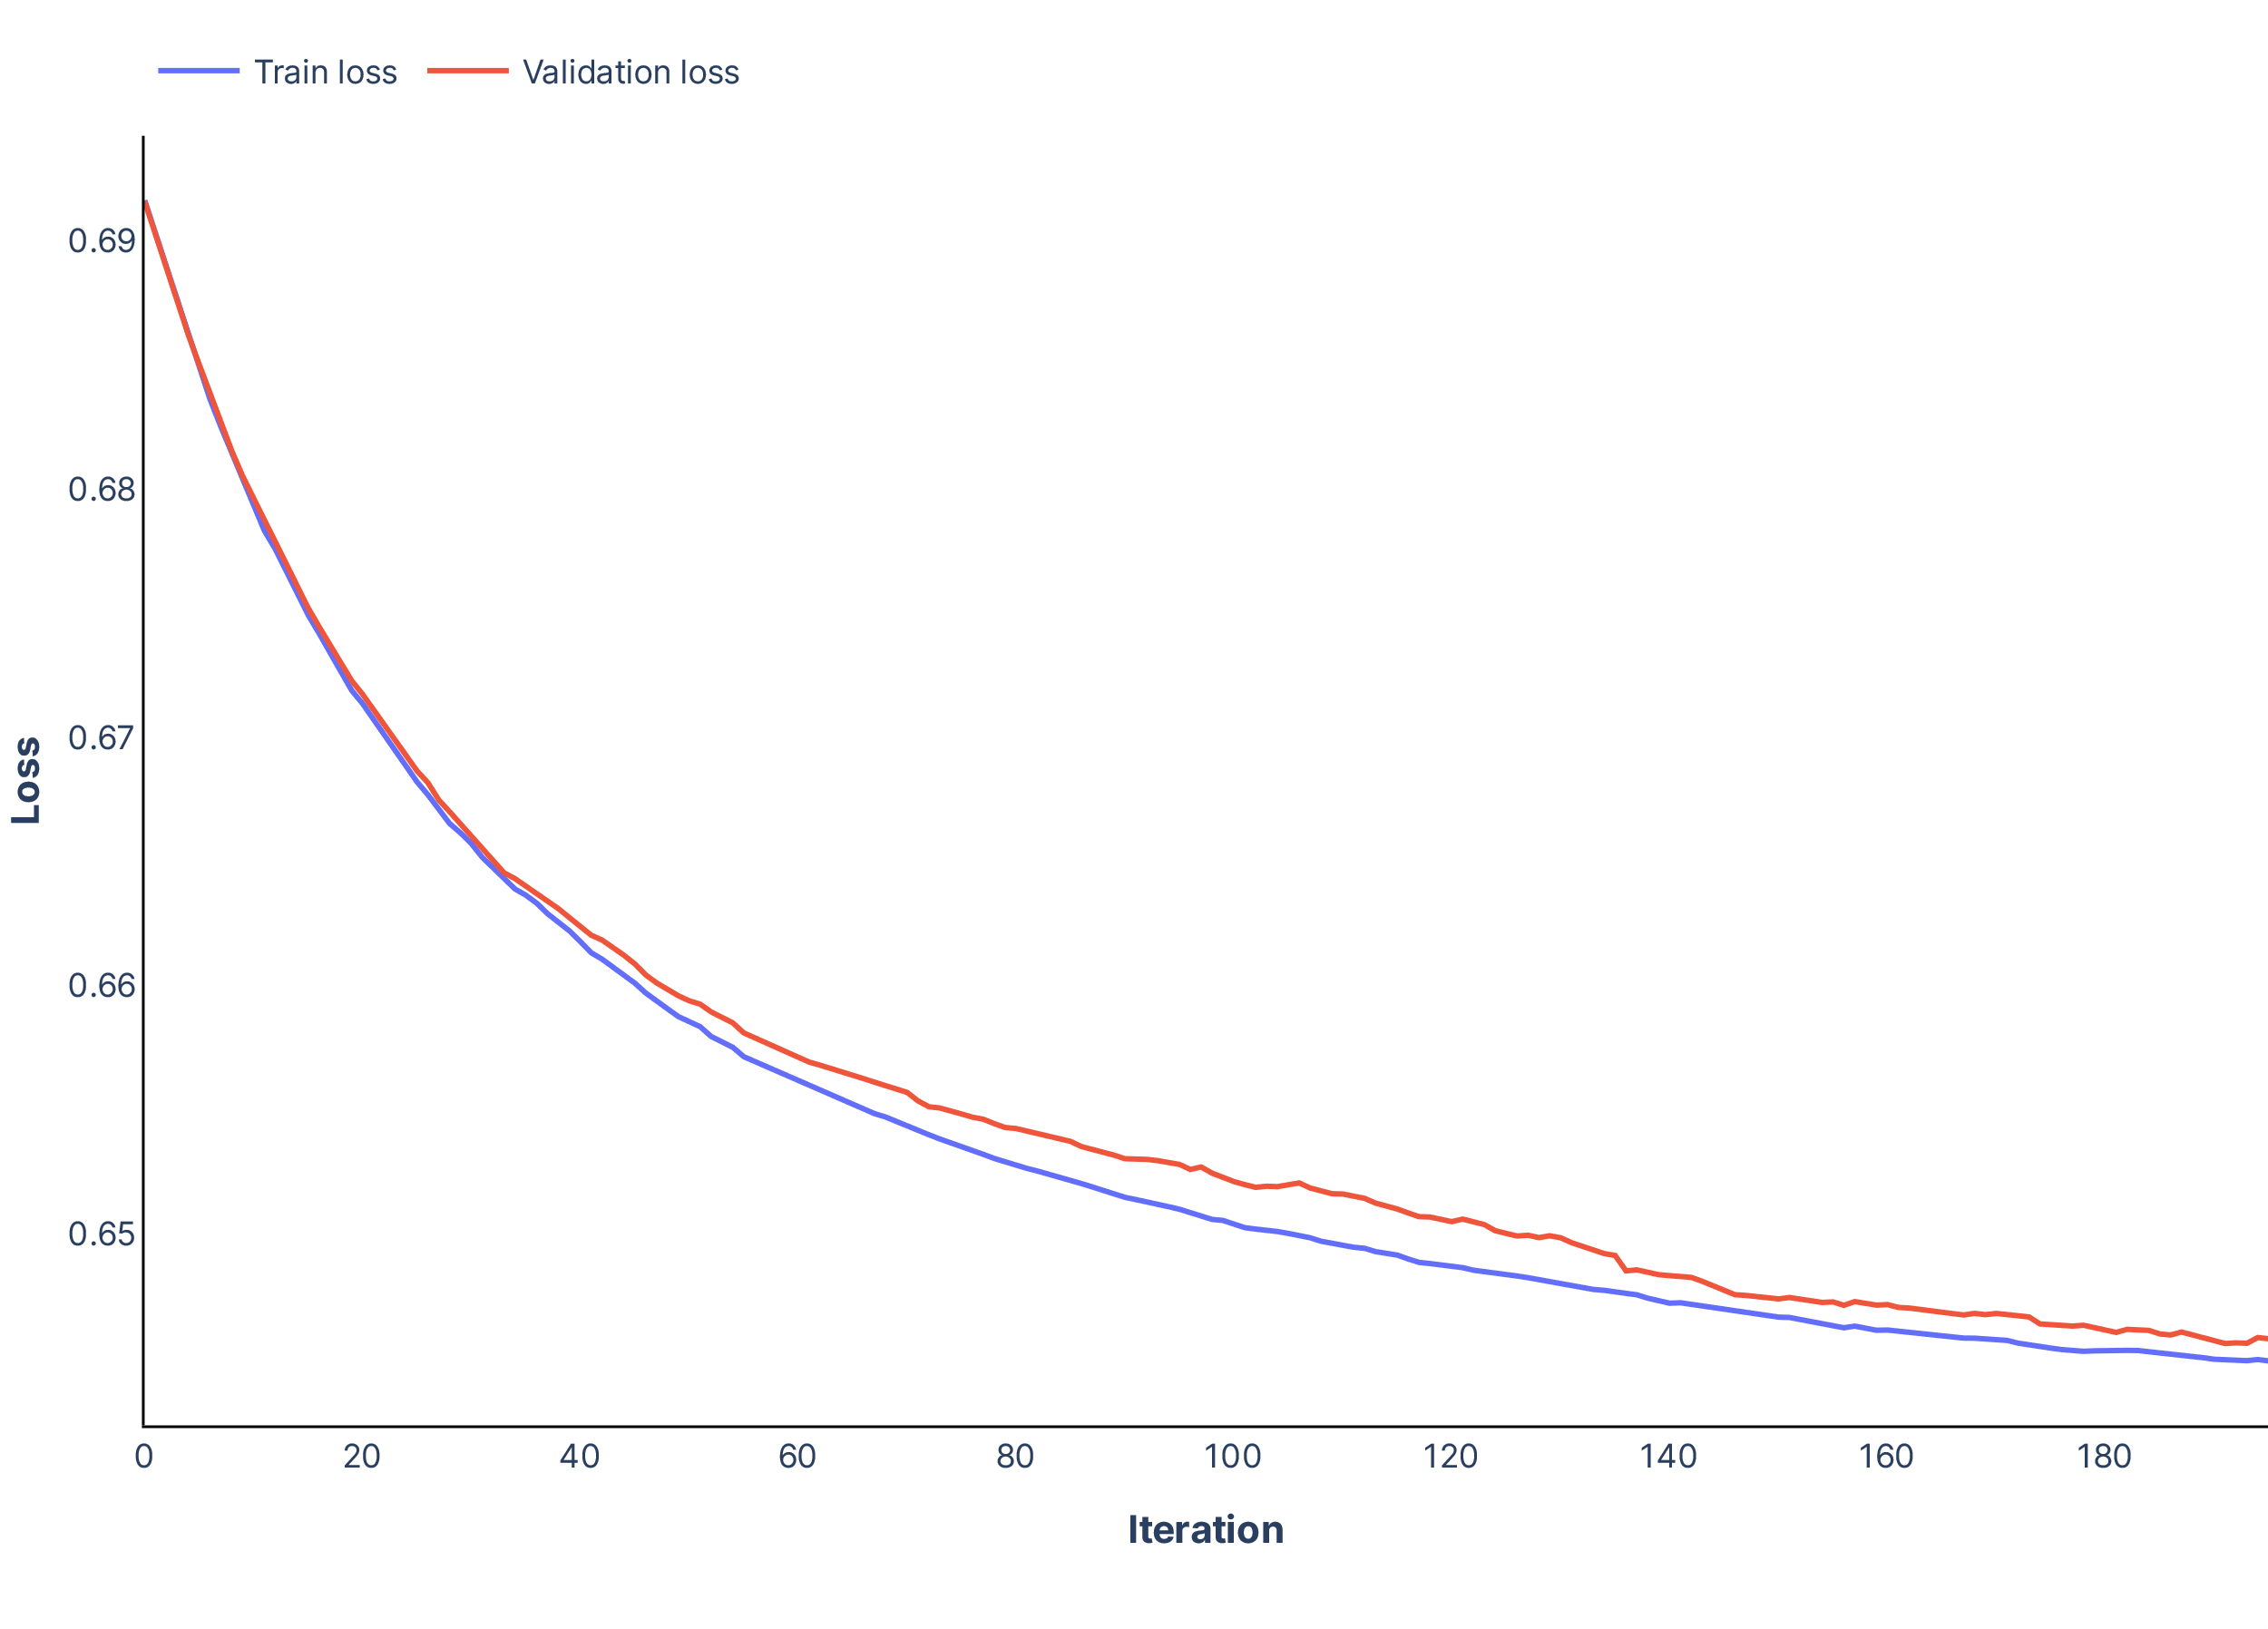
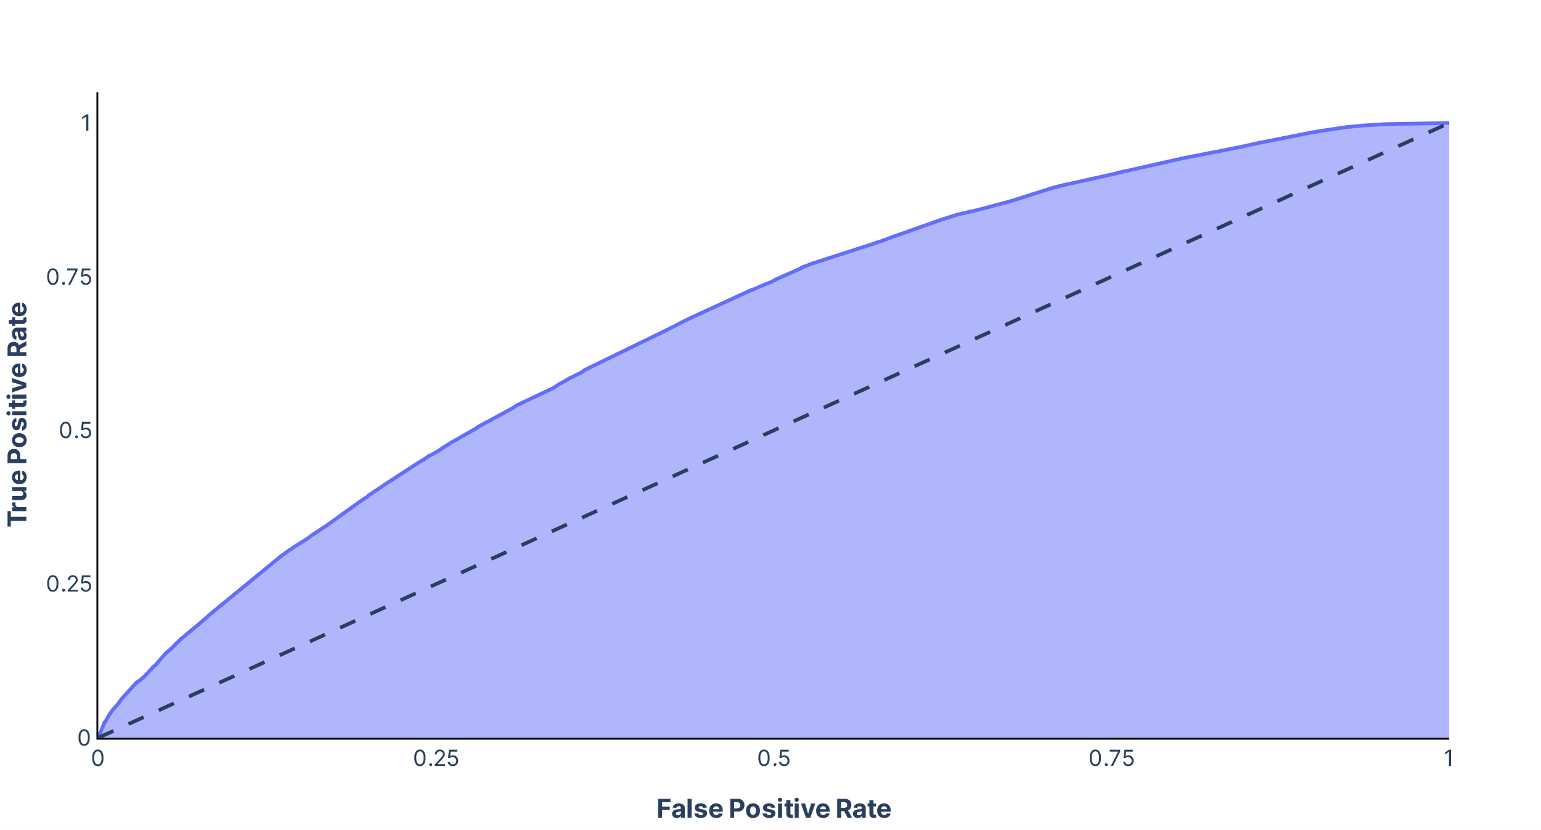
Model

Slide 29
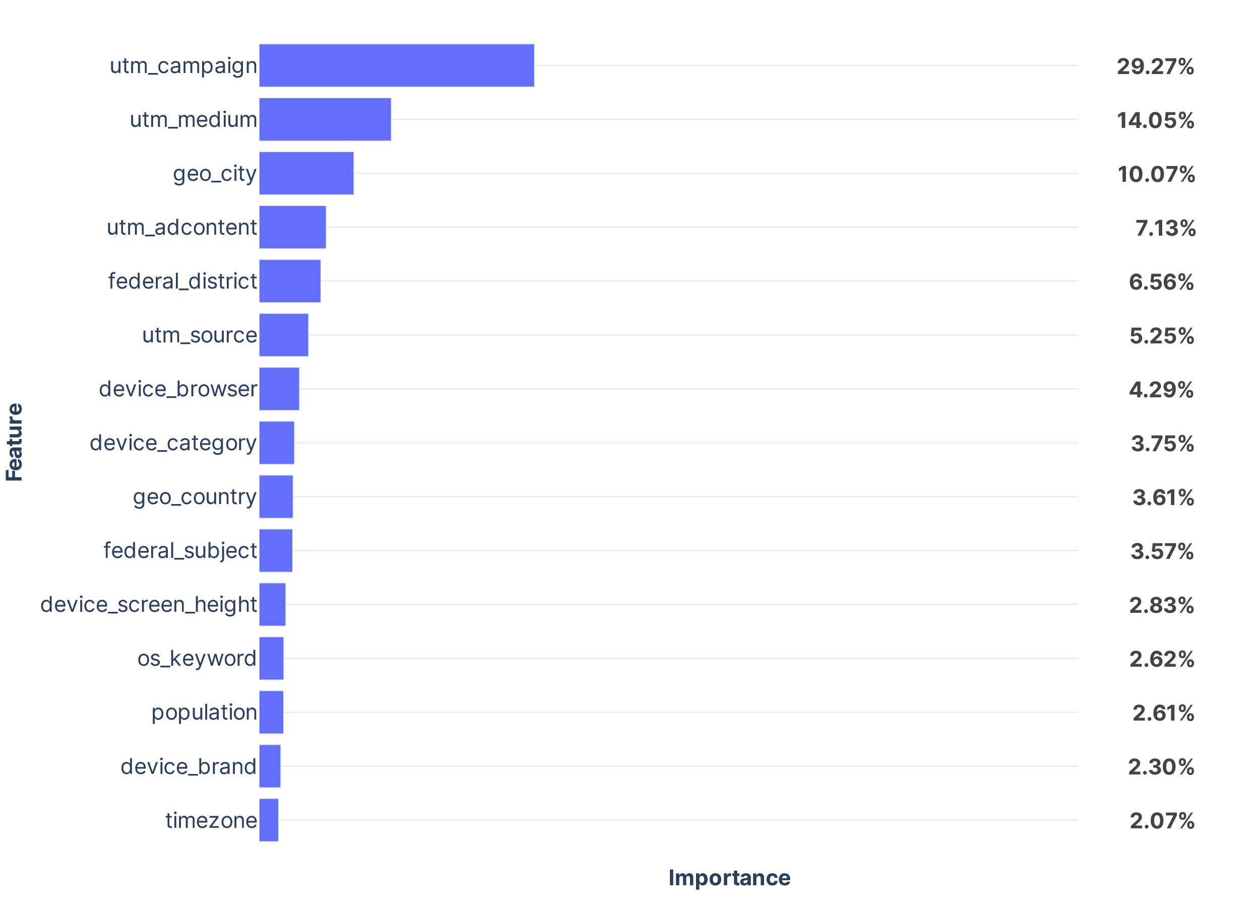
Feature importance
utm features cumulatively made the most impact

Slide 30
Deployment
6.

Slide 31

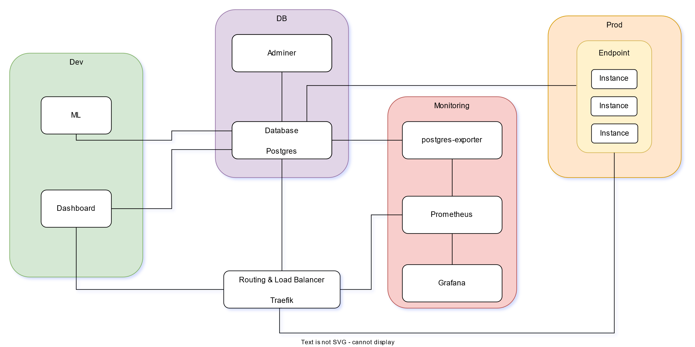
Services architecture

Slide 32

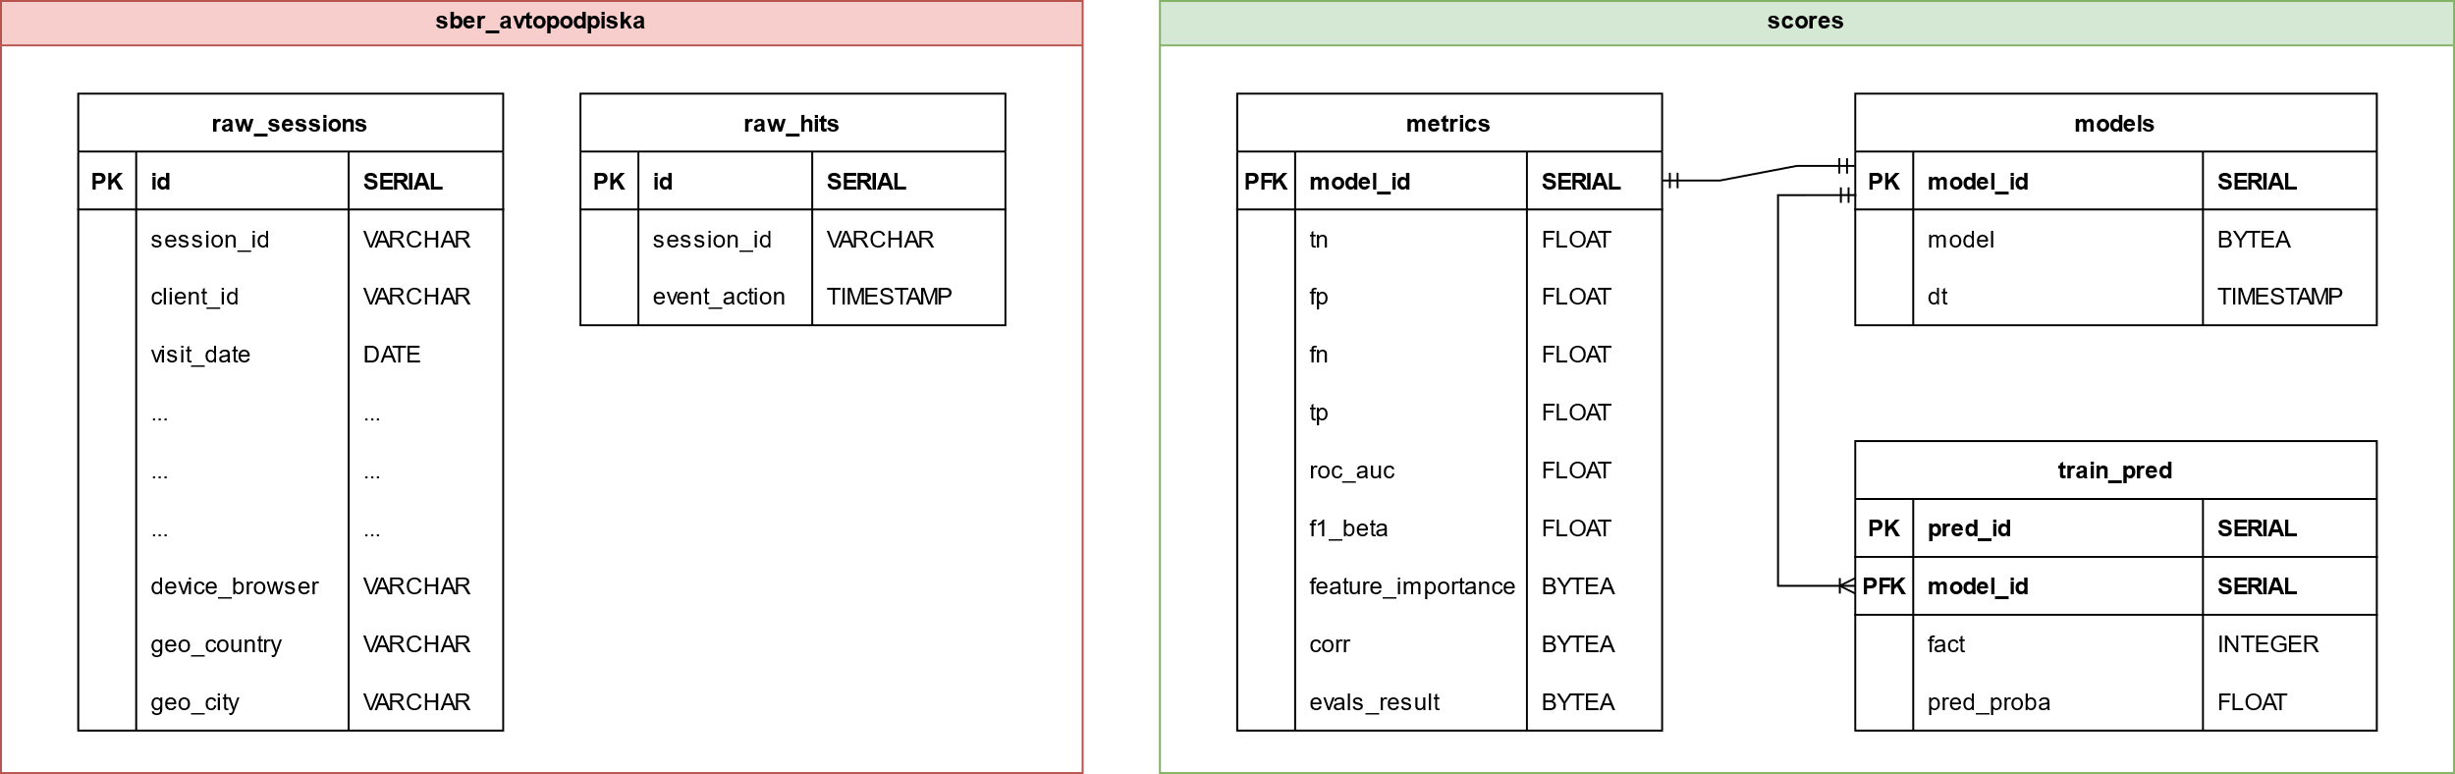
Database architecture

Slide 33
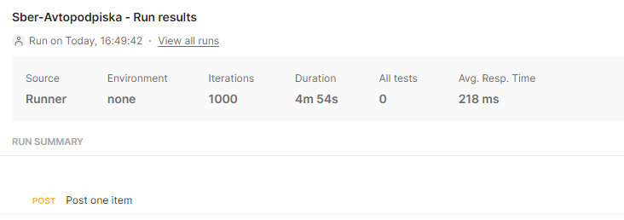
API
{
"items": [
{
"utm_source": false,
"utm_medium": false,
"utm_campaign": "isYoUwVPnRHJ",
"utm_adcontent": "JNHcPlZPxEM",
"utm_keyword": null,
"device_category": "mobile",
"device_os": null,
"device_brand": "Nokia",
"device_model": null,
"device_screen_resolution": "412x823",
"device_browser": "Chrome",
"geo_country": "Russia",
"geo_city": "Stavropol"
}
]
}

Slide 34
Results
Model with ROC AUC ≈ 0.67
Deployed with response time ≈ 200 ms

Slide 35
Thanks
[0] Source code – https://github.com/AlimU11/Sber-Avtopodpiska
[1] “GeoNames Russian Cities Data.” download.geonames.org, https://download.geonames.org/export/dump/
[2] Wikipedia Contributors. “Federal Subjects of Russia.” Wikipedia, Wikimedia Foundation, 6 Oct. 2019, https://en.wikipedia.org/wiki/Federal_subjects_of_Russia
[3] Vorotyntsev, Denis. Benchmarking Categorical Encoders. 14 July 2019, https://towardsdatascience.com/benchmarking-categorical-encoders-9c322bd77ee8
[4] Kovács, György. “An Empirical Comparison and Evaluation of Minority Oversampling Techniques on a Large Number of Imbalanced Datasets.” Applied Soft Computing, vol. 83, Oct. 2019, p. 105662, https://www.sciencedirect.com/science/article/abs/pii/S1568494619304429, 10.1016/j.asoc.2019.105662.

