Slide 1


























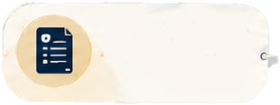








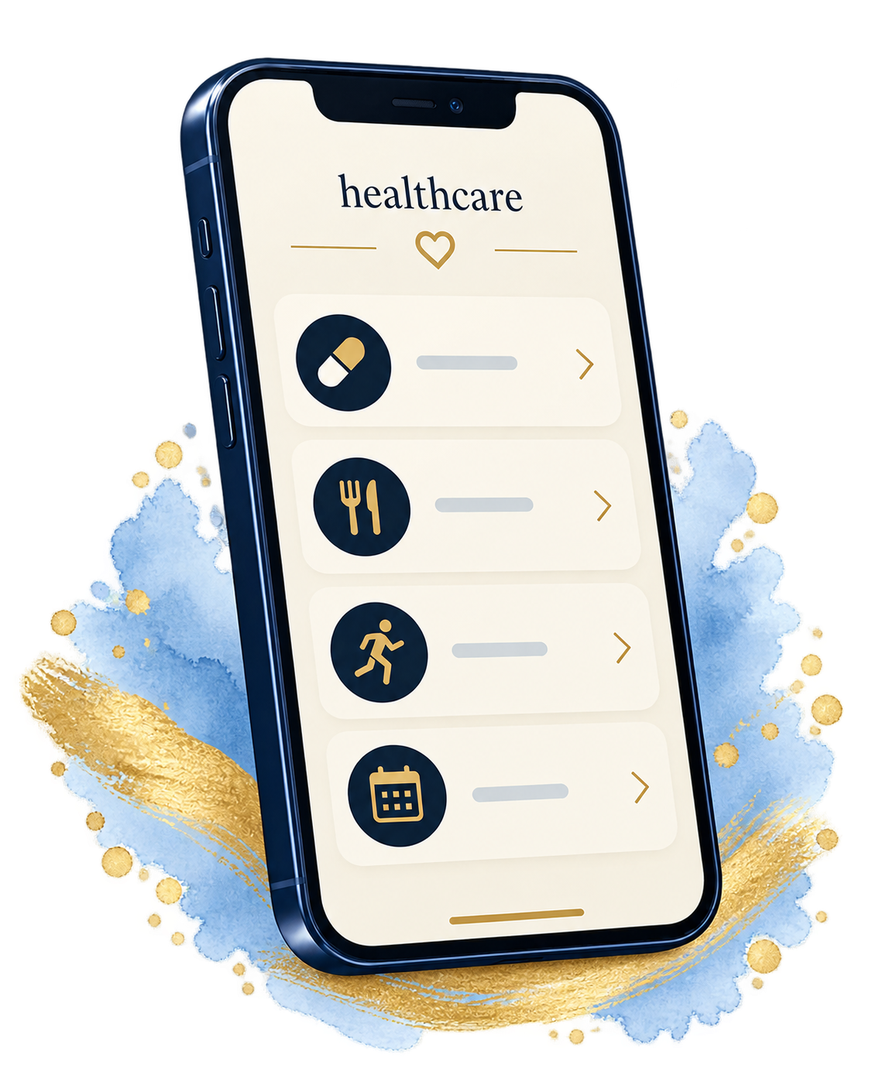

healthcare
THE INTELLIGENT CARE ECOSYSTEM
Together for better health
Connected care. Intelligence at every step
Healthier people. Stronger communities. A brighter future
Patient 360
Health Risk Prediction
Medical Treatment
Eligibility
Administration & Governance
• Registration and records
• History and allergies
• Vitals, medicines and labs
• Documents and visits
Early signals of disease
risk and deterioration
Does the patient meet the
medicine's criteria?
• Dashboards and reports
• Safety and supply alerts
• Activity and audit trails
• Role-based permissions
Dispensing Eligibility
Personalised Care
Last dispense and timing
Duplicate prevention
Plans informed by
patient data
Clinical Care & Clinics
Care Network & Inventory
• Assessments and prescriptions
• Automatic and exception routes
• Combined or rehab-only plans
• Appointments and follow-up
• Centres and clinical teams
• Services, capacity and contracts
• Stock receipts and supply requests
• Batches, expiry and transfers
Demand & Stock Forecasting
Intelligence that
supports care
Medication Safety
Anticipate shortages and plan supply
Flag interactions and
contraindications
Pharmacy & Safe Dispensing
Clinical Records Assistant
Adherence Risk Prediction
Assistant & Analytics
• Verification and valid stock
• Refill and duplicate controls
• Cash / card collection records
• Coverage and printable receipts
Summarize records and support decisions
Clinical decisions approved
by professionals
Identify patients needing
earlier follow-up
• Chatbot with source links
• Contextual follow-up
• Health and adherence trends
• Demand and stock forecasts
Intelligence supports people. It does not replace them
Unified Health Data Platform
Connected data. Better decisions
Patient
Pharmacist
Reviewer
Doctor
Administrator
Expansion Vision:
Patient Mobile App
Product vision: current capabilities and future integrations • Medical decisions remain with qualified professionals

Slide 2




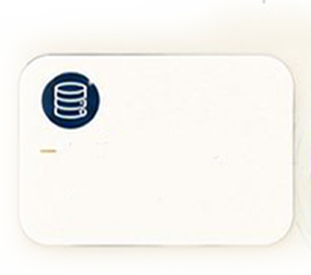








The Intelligent Care Ecosystem
A Connected Healthcare Ecosystem
Five connected workspaces share patient, treatment and supply records.
Each care action carries its updates into the next stage of the journey.
Shared patient records
Five workspaces
Identity and clinical intake
Vitals and laboratory evidence
Treatment and dispensing
Appointments and progress
Admin and governance
Doctor and medical reviewer
Pharmacist and patient
Permissions for each role
Connected workflows
Programme monitoring
Eligible requests to pharmacy
Exceptions to reviewers
Stock and coverage updates
Patient notifications
Patient and treatment status
Adherence and follow-up
Supply and safety indicators
Reports and source records

Slide 3










AI-Enabled Care Support
AI That Supports Care and Decision-Making
Eight data-informed capabilities supporting risk detection,
treatment and dispensing eligibility, planning and follow-up.
Clinical decisions remain with qualified professionals.
Health Risk Prediction
Dispensing Eligibility
Spot risks using vitals, BMI
and clinical evidence.
Verify identity, prescription,
refill timing and usable stock.
Demand & Stock
Forecasting
Clinical Records
Assistant
Anticipate stock gaps and
plan medication supply.
Summarise records and
link to supporting evidence.
Medical Treatment
Eligibility
Personalised Care
Suggest care using patient
history and plan checks.
Check clinical criteria and
route exceptions for review.
Medication Safety
Adherence Risk
Prediction
Flag interactions and
contraindications.
Track adherence and flag
patients needing follow-up.

Slide 4




1. Patient 360
The complete patient record, daily care and progress
Registration & care team
Medical history
Patient identity, residency and intake.
Assigned doctor and treatment centre.
Linked clinical and treatment records.
Previous illnesses, chronic conditions,
procedures, allergies and clinical notes.
Current and completed treatment courses.
Vitals & laboratory evidence
Documents & reports
Weight, height, BMI, blood pressure
and heart rate, with laboratory results.
Review values beside their source reports.
Upload clinical files and lab evidence.
Preview original reports and attachments.
Download laboratory results as PDFs.
Patient statistics
Weight and BMI history
Dose adherence and rehab progress
Follow-up and attendance
Medication & adherence
Visits & patient updates
Prescribed doses, dispensing history
and recorded doses taken by the patient.
Adherence follows the treatment schedule.
Appointments and linked care plans.
Approval, information and dispensing
notifications open the related records.
Activity & continuity
Log home activity and duration.
Keep progress and completed
treatment in the same record.

Slide 5




2. Clinical Care & Clinics
Assessment, treatment decisions and continuing care
Assessment & treatment drafts
Detailed prescriptions
Record symptoms, findings and diagnosis.
Save assessments and treatment drafts.
Review vitals, labs and eligibility evidence.
Set medication, strength and frequency,
duration, dates and instructions.
Document monitoring and follow-up.
Automatic or exception routing
Independent clinical review
Eligible submitted requests go directly
to the pharmacy verification queue.
Exceptions require a doctor’s rationale.
Approve, reject or request more evidence
with a documented reason. Clinicians
complete information and resubmit.
Rehabilitation delivery
Programme, centre and sessions.
Record completion and progress.
Keep notes linked to the care plan.
Integrated care plans
Appointments & completion
Combine medication, rehabilitation
and prescribed home exercises.
Support rehabilitation-only plans too.
Schedule, confirm, cancel and reschedule.
Track attendance and prevent conflicts.
Close treatment with a follow-up summary.
Plan review
Check evidence and capacity.
Review completeness and guidance.
Record doctor confirmation.

Slide 6



3. Pharmacy & Safe Dispensing
Prescription checks, stock allocation and patient collection
Verification before dispensing
Refill and duplicate controls
Confirm patient identity, prescription,
approval validity, medication and dose.
Check required clinical evidence.
Check the last and next eligible dispense.
Block duplicate or early dispensing
unless a documented exception applies.
Valid stock allocation
Coverage & patient contribution
Reserve stock for ready requests.
Exclude expired batches and prioritise
the earliest valid expiry for dispensing.
Calculate support by patient category.
Separate medication collection from
rehabilitation costs in the care estimate.
Prescription details
Strength, frequency and duration
Start, end and follow-up dates
Instructions and monitoring
Checkout & collection records
Connected dispensing updates
Record cash, card or covered collection.
Link the amount to the dispensing record
and prevent duplicate collection entries.
Update treatment, patient medication
and batch stock together. Record the
movement, notification and audit trail.
Patient documents
Print or download prescriptions
and receipts with coverage
and the patient contribution.
Collection receipts preserve the amount, coverage, method and dispensing reference.

Slide 7




4. Administration & Governance
Programme statistics, operational control and accountable decisions
Programme statistics
Safety & operational alerts
Enrolled and active patients, requests
awaiting review, upcoming appointments
and medication availability indicators.
Prioritise safety and supply signals.
Create alerts, open related records and
mark selected alerts read or handled.
Misuse review
Live activity & system audit
Review duplicate requests, refill patterns,
identity mismatches and invalid approvals.
Keep evidence and resolution status.
Follow clinical and dispensing activity.
Trace the actor, record, time and reason,
with previous and updated state.
17 report views
Patients, care plans, rehabilitation,
requests, reviews, approvals, rejections
and missing information.
Reports & saved snapshots
Role-based governance
Filter by date, location and patient group.
Preview results, save a fixed snapshot
and export the selected records.
Separate Admin, Doctor, Reviewer,
Pharmacist and Patient responsibilities.
Limit records and actions to each role.
Operational reporting
Dispensing, inventory, low stock,
expiry, adherence, appointments,
finance, audit and activity.

Slide 8



5. Care Network & Inventory
Care access, organisation records and medication supply
Geographic care network
Rehabilitation matching
Locate treatment centres, pharmacies
and rehabilitation services by emirate.
Explore map layers and facility details.
Compare nearby centres by distance,
programme support and available slots.
Link the chosen service to the care plan.
Clinician management
Centre administration
Add and edit doctor profiles, licences,
specialties, contacts and qualifications.
Manage assignments and contract status.
Maintain manager and contact details,
services, location and contract dates.
Track active, pending or suspended status.
Availability & planning
Compare on-hand, reserved
and available stock. Monitor
low, empty and expiring supplies.
Batch receipts & movements
Replenishment requests
Record quantities, source and expiry.
Trace stock receipts and dispensing
by batch, strength and centre.
Identify low-stock strengths and centres.
Create supply requests from the dashboard
and prevent duplicate open requests.
Network supply vision
Combine demand outlook,
batch visibility and transfers
across the care network.

Slide 9




6. Assistant, Chatbot & Analytics
Questions, source records and programme outlook in one workspace
Conversational record search
Context across follow-up questions
Ask about a patient or request by name
or identifier, including laboratory results,
appointments and care plans.
Keep the selected patient or request
through the conversation. Refine questions
without repeating the full context.
Answers with source links
Clinical & care insights
Show facts from programme records
and open the relevant patient, request
or care record for further review.
Review treatment status, lab evidence,
recorded adherence and rehabilitation.
Connect trends to the patient history.
Patient outlook
Obesity and weight-change outlook.
Expected treatment completions.
Patients needing earlier follow-up.
Operational questions
Data scope by role
Explore dispensing, stock, open alerts,
programme counts and financial records
within the user’s permitted workspace.
Use records available to the current role.
Keep source links inside that scope.
Support Arabic and English questions.
Programme outlook
Expected enrolment and dispensing,
upcoming visits and stock shortfalls
for the selected planning horizon.
Patient and programme outlooks use the selected planning horizon and available evidence.

Slide 10

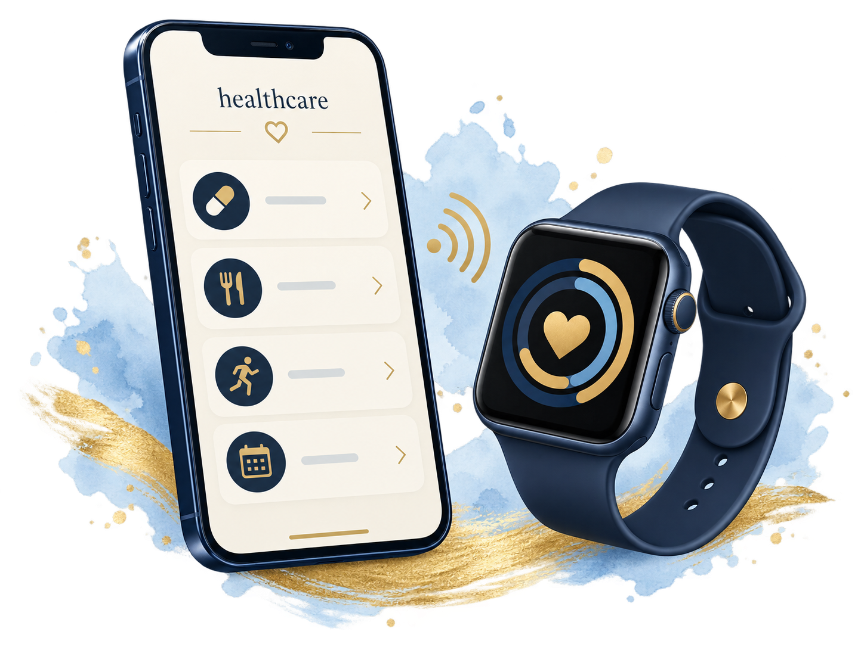
7. Mobile App
Daily care and programme work through a shared mobile experience
Medication & injections
Nutrition & daily routine
View the prescribed medicine, strength,
schedule and instructions. Receive dose
reminders and record medication taken.
Follow nutrition guidance and meal plans
alongside prescribed exercise routines.
Keep daily care linked to treatment goals.
Physiotherapy & home exercise
Health records & patient statistics
Access lessons and exercise instructions.
Follow planned rehabilitation sessions
and record activity, duration and progress.
Review medical history, laboratory results
and documents. Follow weight, BMI,
adherence and treatment progress.
Four mobile workspaces
Appointments & care updates
In-app assistant
Patient: daily care and progress
Doctor: patients and care plans
Pharmacy: dispensing and inventory
Admin: oversight and reports
View visits and follow-up dates.
Receive treatment and dispensing updates.
Open linked requests and receipts.
Ask about permitted care records,
continue questions in the same context
and open the supporting sources.
Mobile expansion vision with shared records, healthcare branding and a consistent experience across portals.

