Slide 1
Image Acquisition & Mounting

Slide 2
Image Acquisition

Slide 3
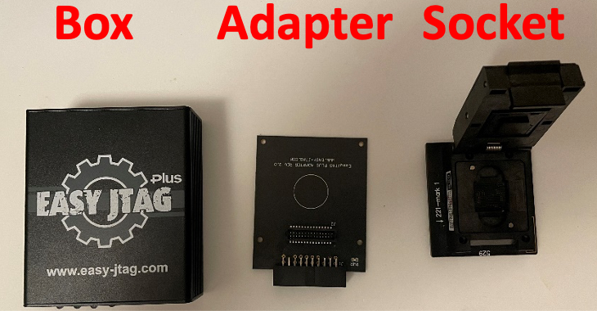
Image Acquisition Steps
Place the eMMC in the socket
Connect the socket to adapter on BGA 153 slot
Connect adapter to the box
Plug the box cable to laptop’s USB port
Open Easy JTAG Tool

Slide 4
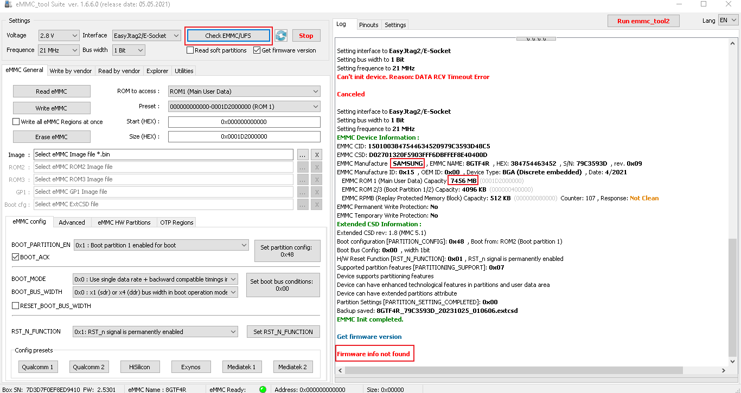
1. Click to check eMMC
eMMC is not readable
Probably needs cleaning
To remove glue on pins

Slide 5
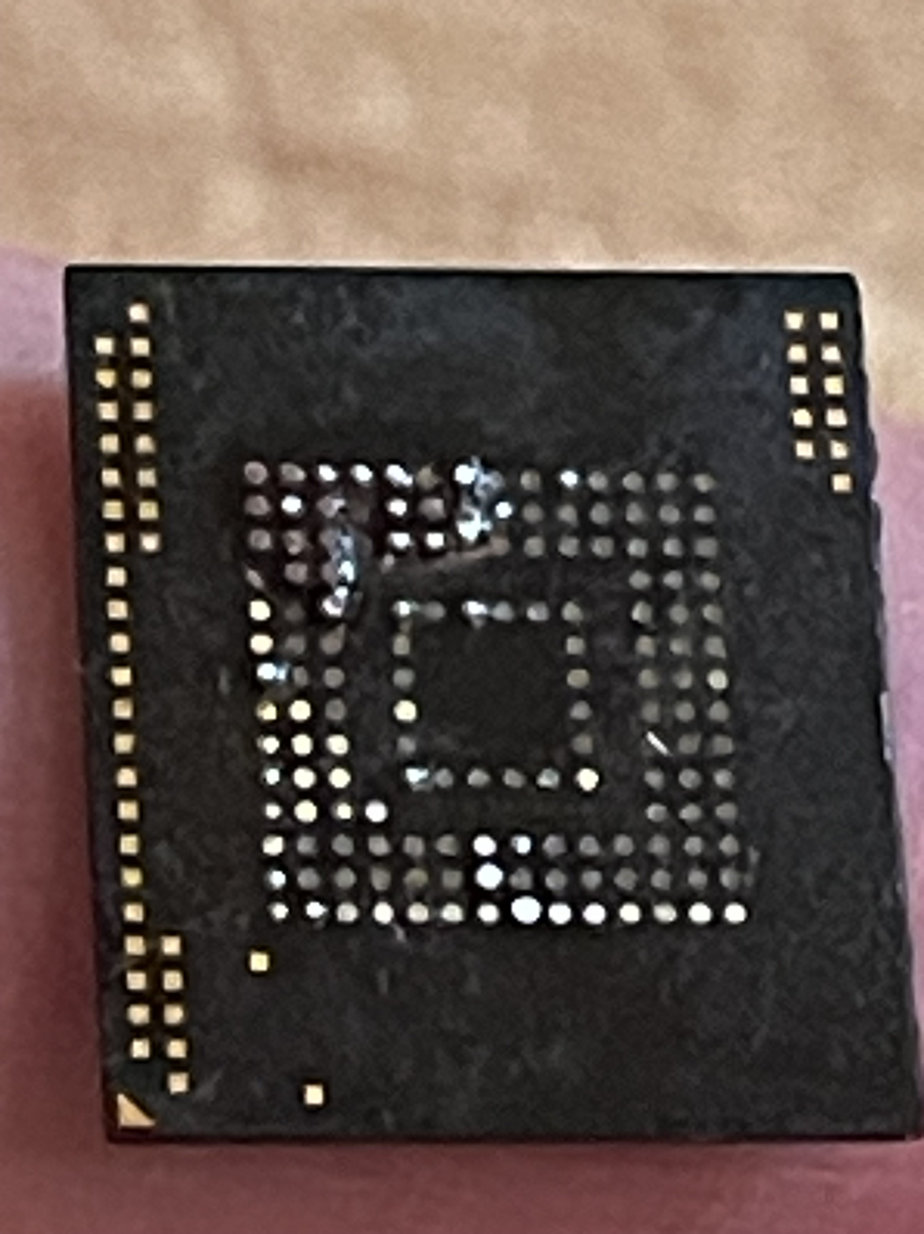
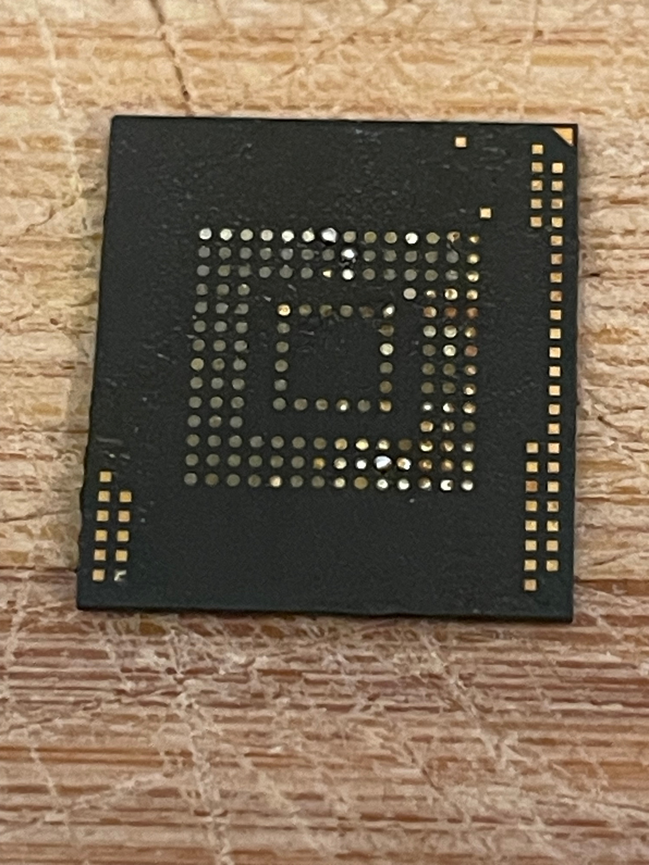
eMMC Needs Cleaning
Pins on eMMC are not readable due to glue so needs cleaning
Apply flux and clean with solder iron at 200 Celsius
After
Cleaning

Slide 6
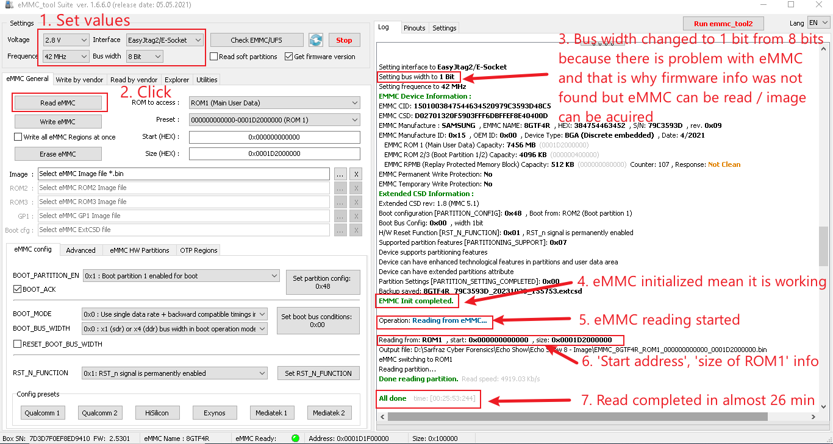
Image Acquisition After Cleaning
Image Acquisition from Device eMMC using East JTAG

Slide 7
Image Downloading

Slide 8
Download Image from Link
miya.teracloud.jp/share/11d151b81341ff61

Slide 9
Image Verification

Slide 10
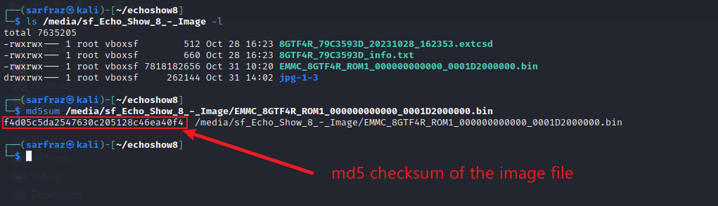
Image File Verification
Verification of file hash (checking file integrity)

Slide 11
Image Mounting

Slide 12
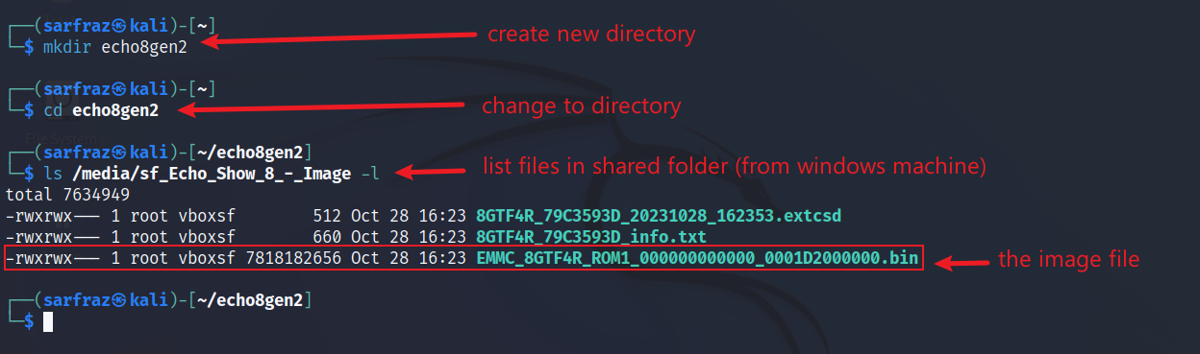
Create Workspace
Create a new directory, go to it and list image file

Slide 13
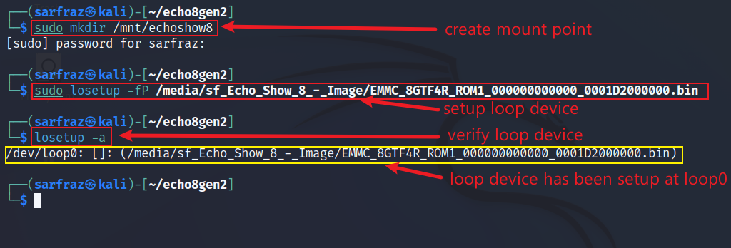
Setup Loop Device
Create mount point, setup loop device, verify, list loop devices

Slide 14
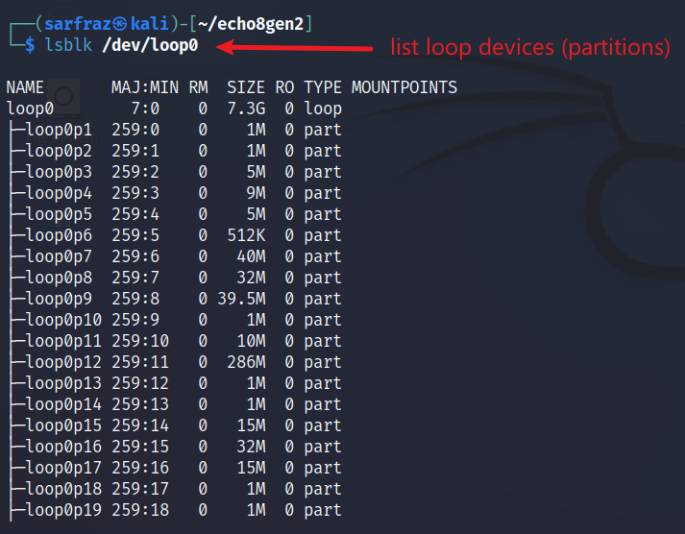
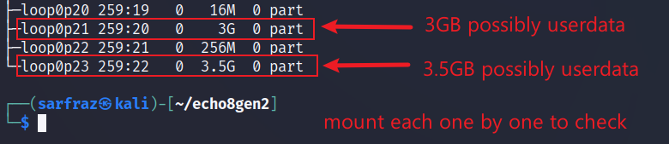
Check Partition Numbers of Block Devices
List loop devices

Slide 15
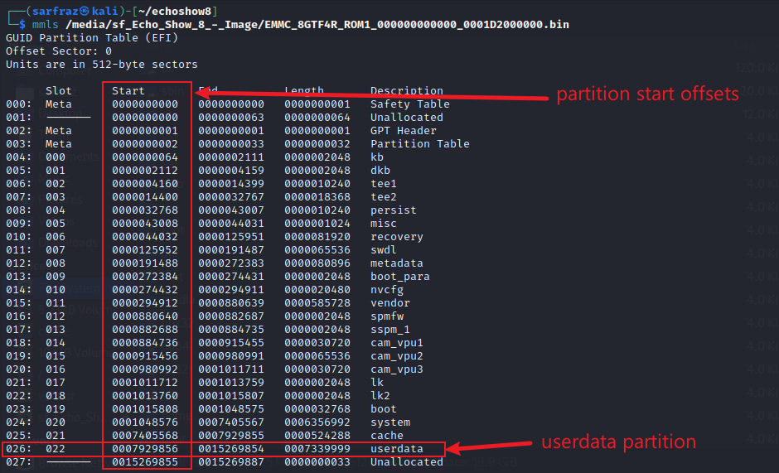
Check Partitions Layout of Image
List partitions of Image
(mmls (lsblk (Partition
output) output) Name)
020 p21 System Partition
022 p23 Userdata Partition

Slide 16
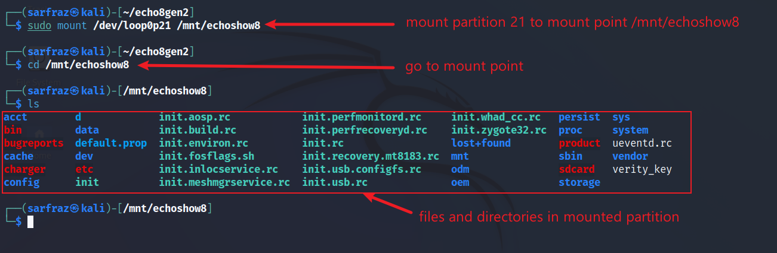
Mount System Partition (p21)
Mount loop device, go to mount point

Slide 17
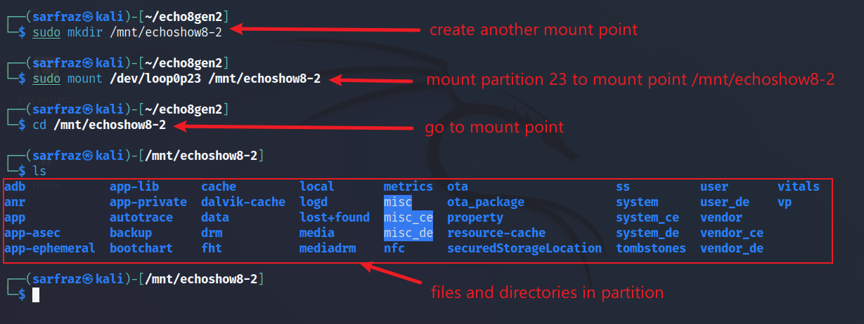
Mount Userdata Partition (p23)
Mount loop device, go to mount point

