Slide 1
Network Info

Slide 2

Wifi Info

Slide 3
/misc/wifi
The misc/wifi directory contains:
Files related to the Wi-Fi settings and configuration of the device
SSID and password of the Wi-Fi networks that device is connected to or saved on the device
Preferred network

Slide 4
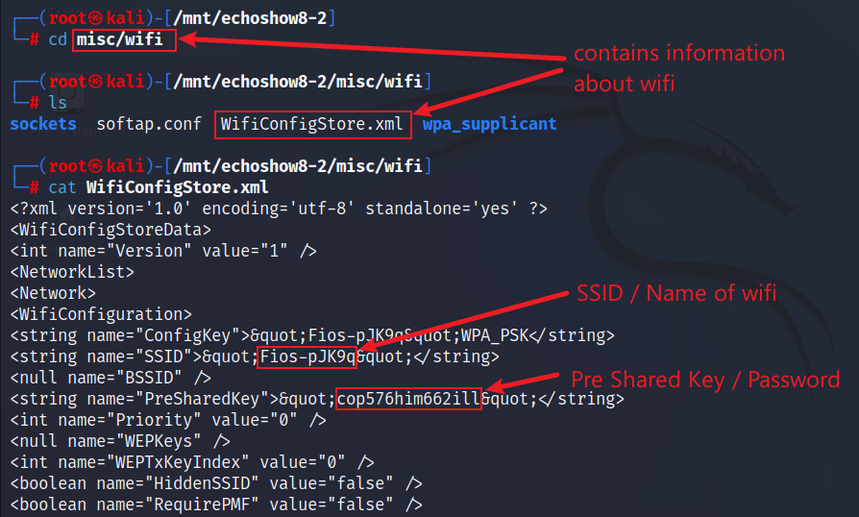
Wifi SSID and Password
List files in /misc/wifi and display contents of WifiConfigStore.xml file
SSID and Password of the Current/Connect Network

Slide 5
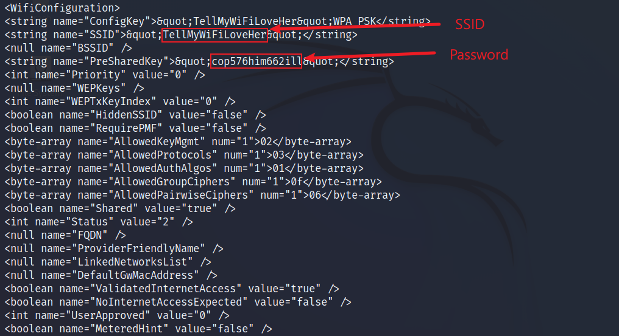
Wifi SSID and Password
Display contents of WifiConfigStore.xml file (contd.)
SSID and Password of the Previous/Saved Network

Slide 6

Bluetooth Info

Slide 7
com.android.bluetooth
A system app that is part of the Android Bluetooth stack
Responsible for managing the Bluetooth functionality on device
Functions include scanning, pairing, connecting, and transferring data with other Bluetooth devices

Slide 8
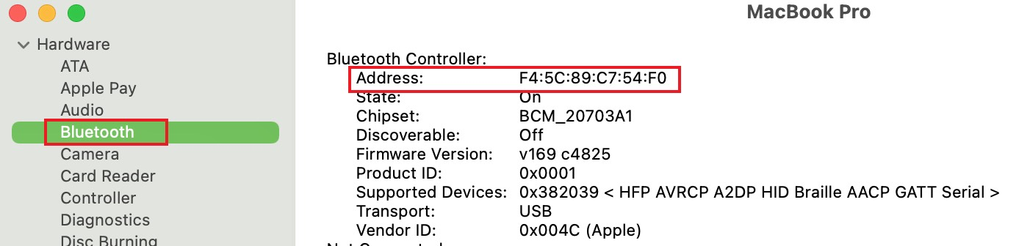
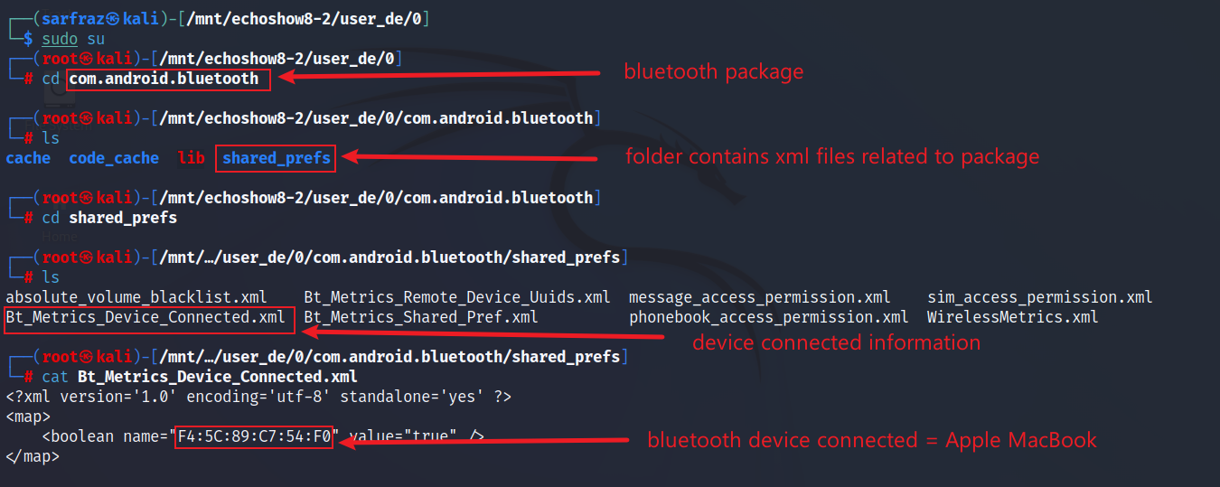
Bluetooth (Connected Devices)
Display contents of Bt_Metrics_Device_Connected.xml file

Slide 9
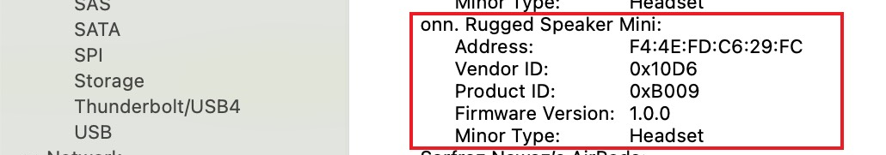
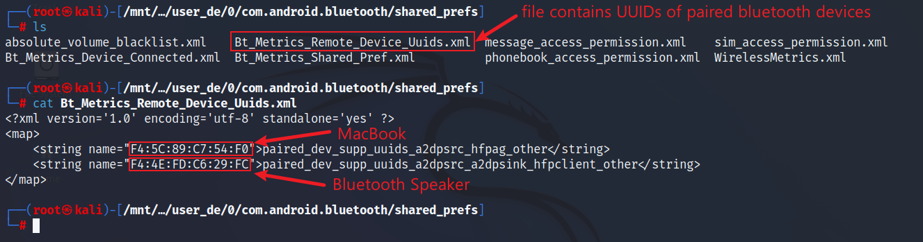
Bluetooth (Paired Devices)
Display contents of Bt_Metrics_Remote_Device_Uuids.xml file

Slide 10
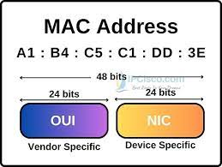
MAC Addresses

Slide 11
/misc/blurdroid
A system directory that contains files related to the Bluetooth functionality on the device.
The bt_config.conf file in this directory stores the Bluetooth configuration data, such as the device name, MAC address, class, etc.
Name: Device name
DevClass: It is a 6-digit hexadecimal number that indicates the type and capabilities of your device, such as phone, computer, audio, etc.
ScanMode: It is a 1-digit decimal number that indicates whether your device is discoverable and connectable by other devices, such as 3 for both, 2 for connectable only, 1 for discoverable only, or 0 for neither.

Slide 12
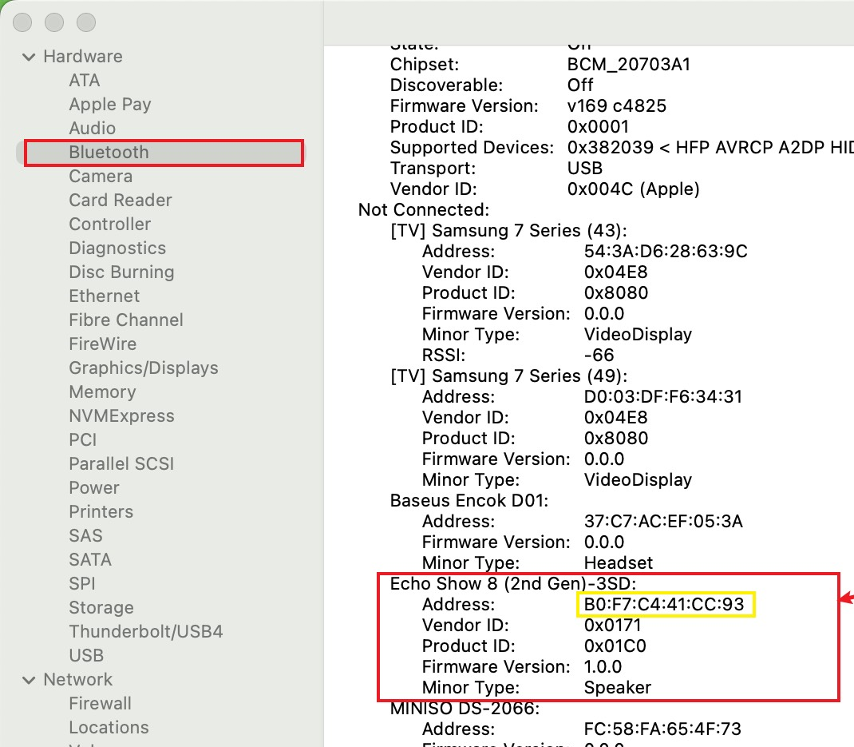
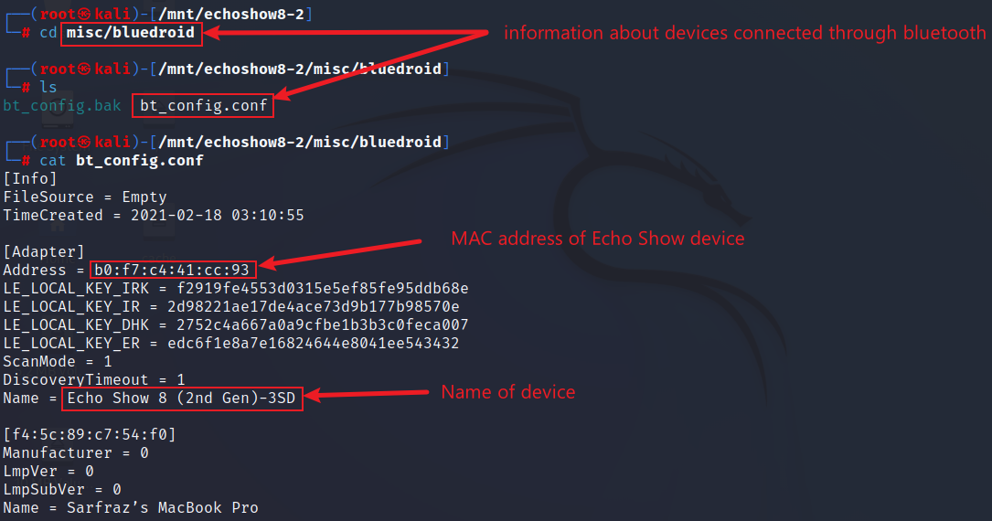
MAC Address and Name of Echo Show Device
Go to directory misc/bluedroid and display bt_config.conf file

Slide 13
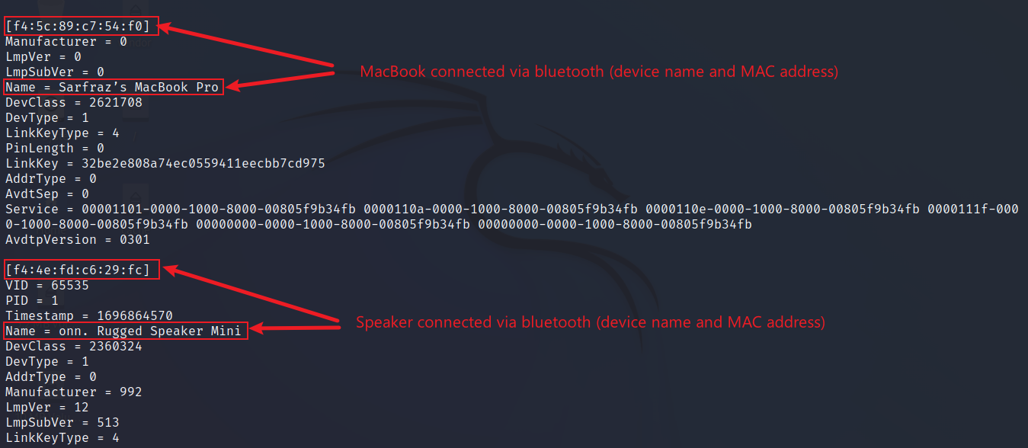
MAC Addresses and Names of Connected Bluetooth Devices
Browse display bt_config.conf file

