Slide 1
Web Activity

Slide 2
Database File ‘History’ Contains all Web Browsing Data
Location: ﻿data/com.amazon.cloud9/app_amazon_webview/amazon_webview
Important Tables
urls: contains browsing history
Keyword_search_terms: contains web search keywords
visits: details of all web visits like url id, time of visit, duration of visit etc.

Slide 3
Web Browsing

Slide 4
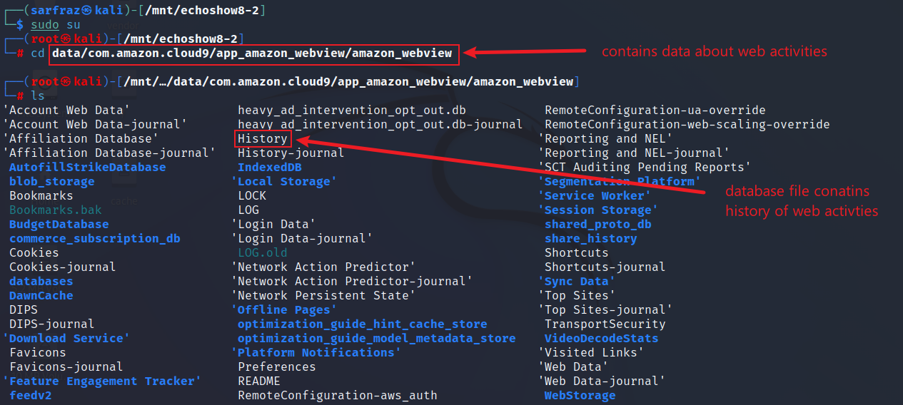
History - Web Browsing and Search History
Go to amazon webview

Slide 5
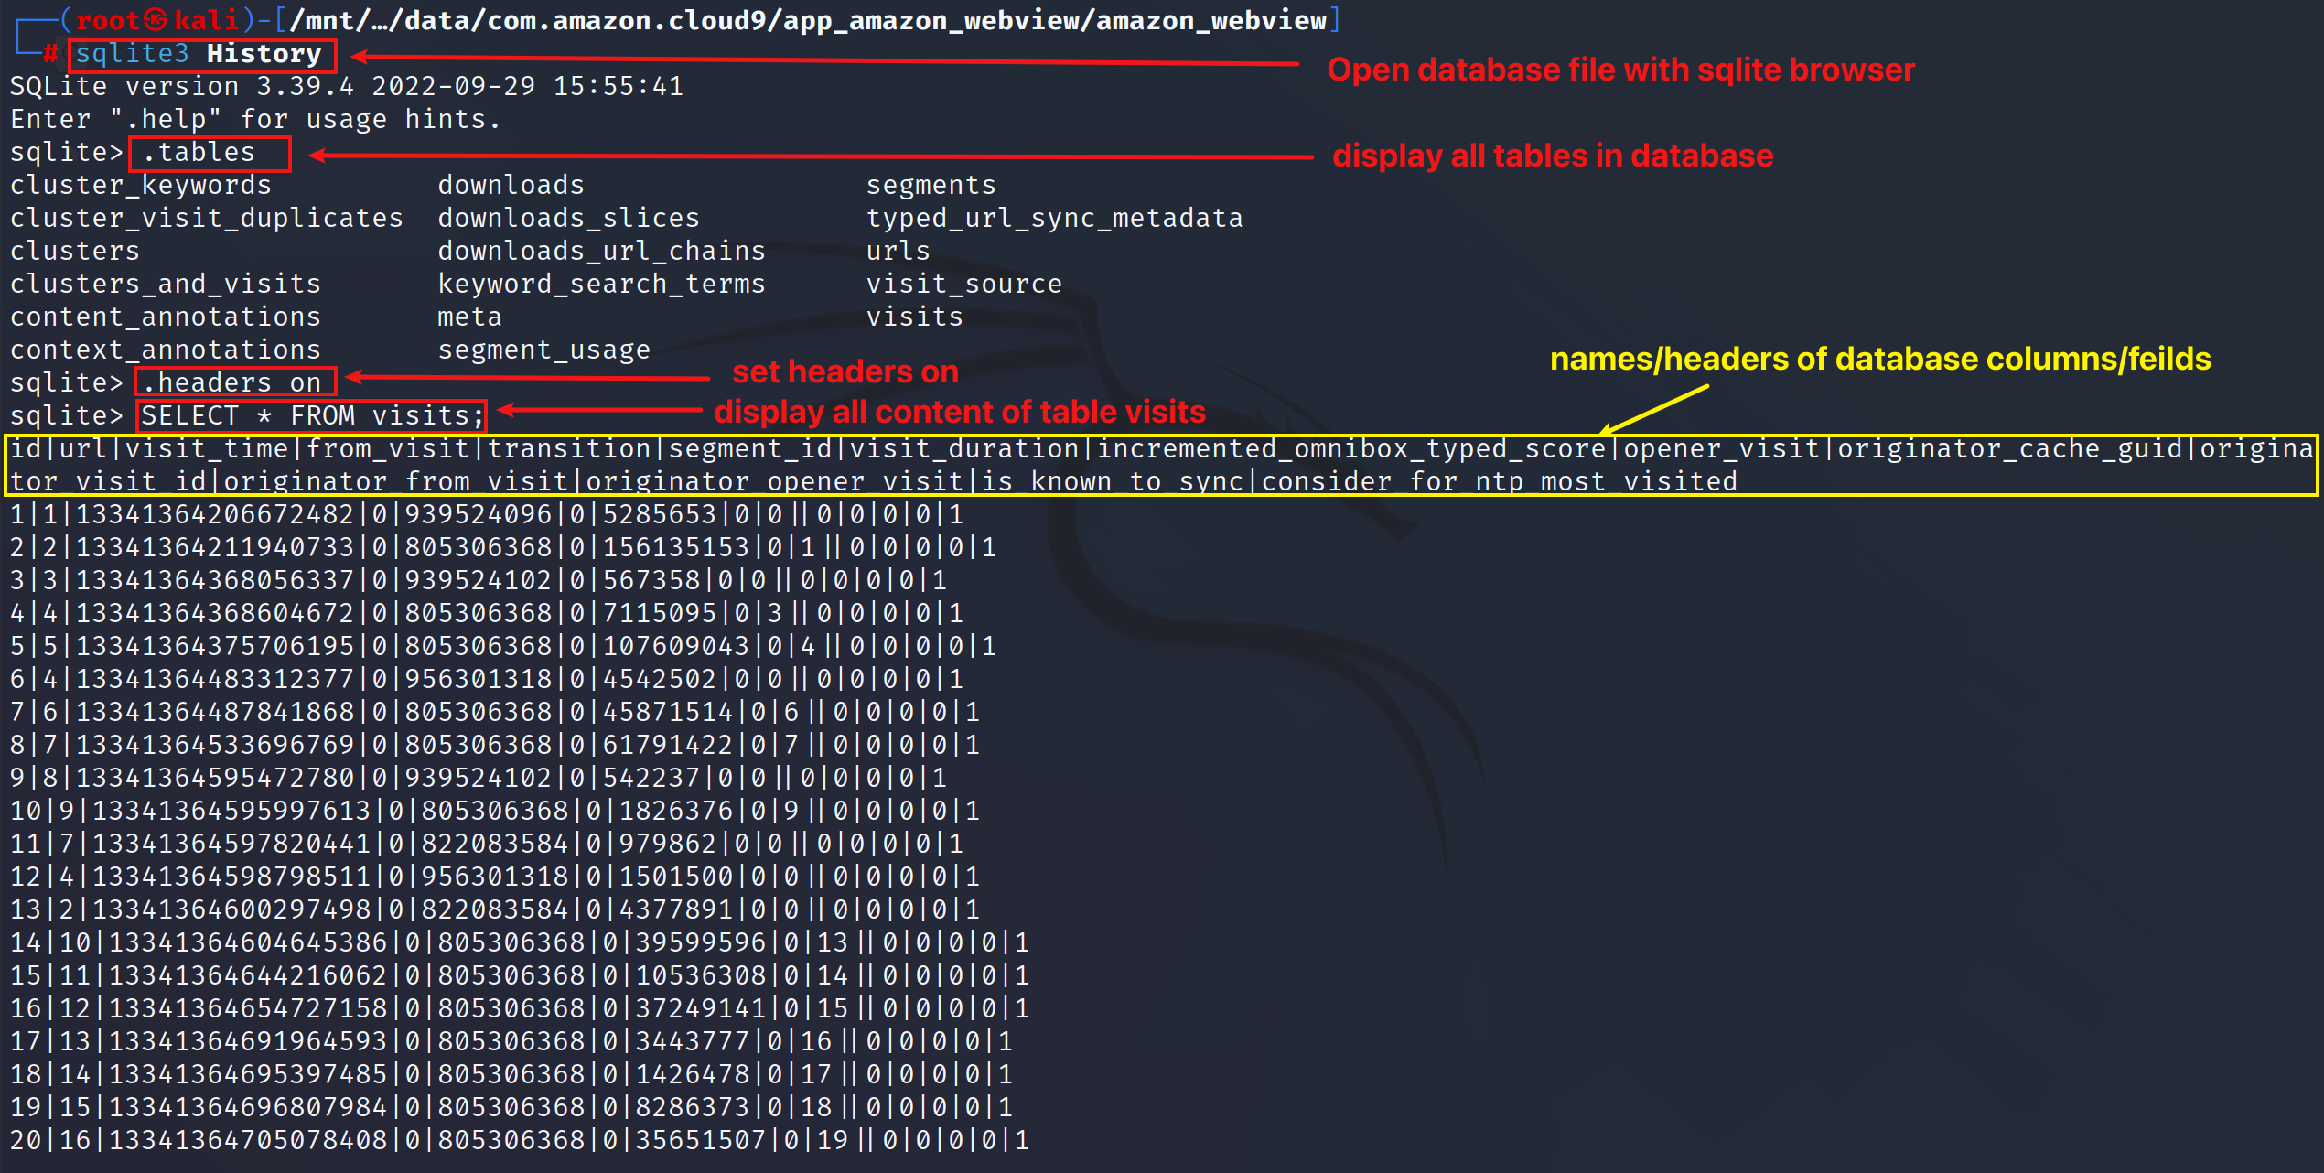
History – Web Browsing (Visits)
Browse ‘visits’ table

Slide 6
Web Searches

Slide 7
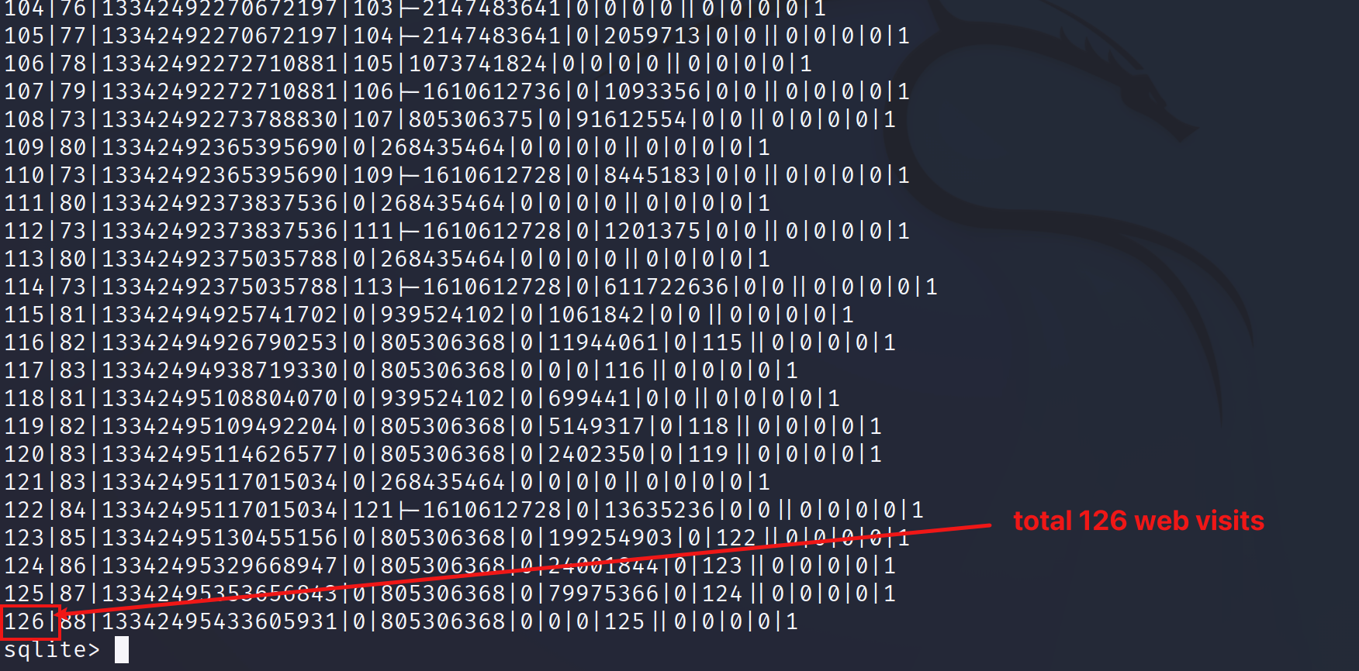
History – Total Web Browsing (Visits)
Browse ‘visits’ table

Slide 8
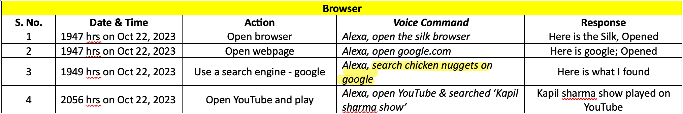
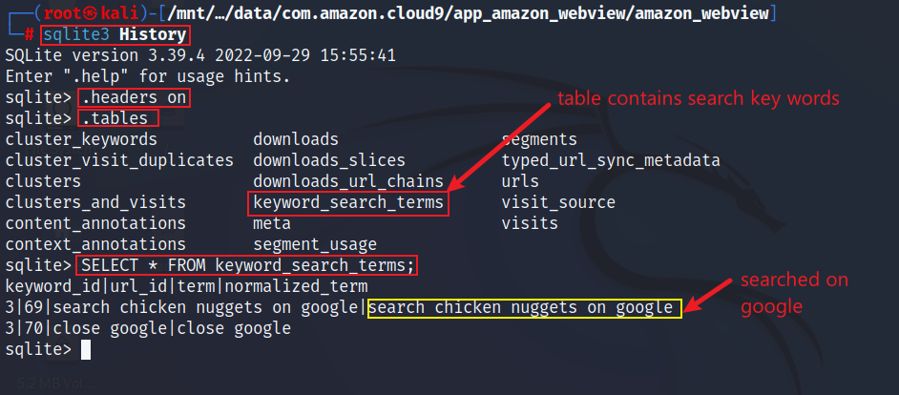
Web Search History – Keyword Searches
Browse the table ‘keyword_search_terms’

Slide 9
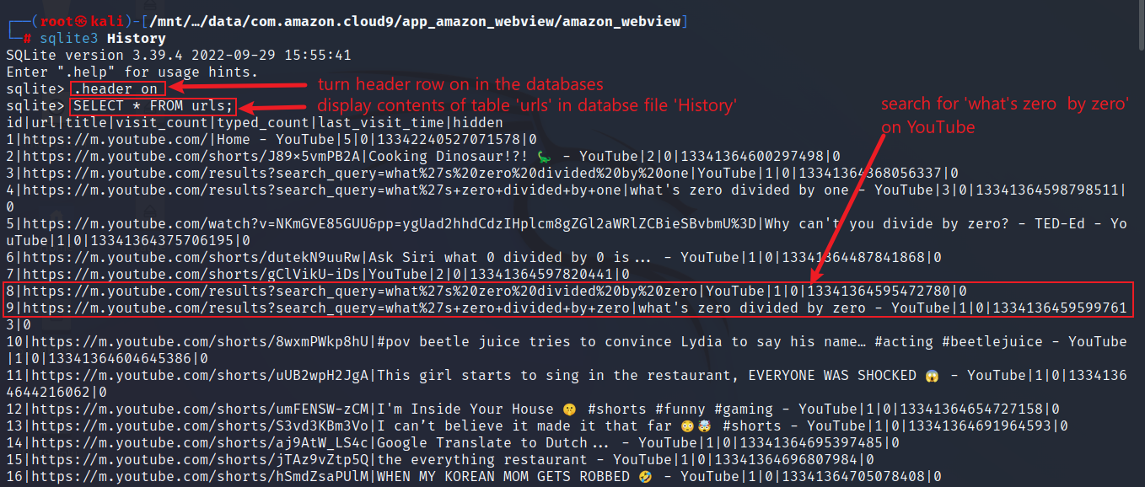
Web Search History – YouTube Searches
Open the table ‘urls’

Slide 10
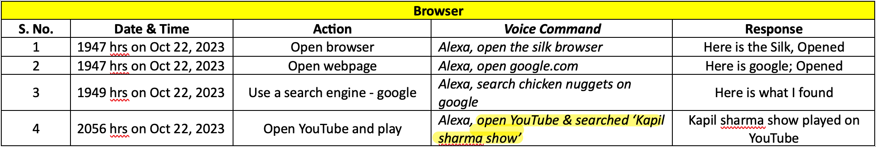
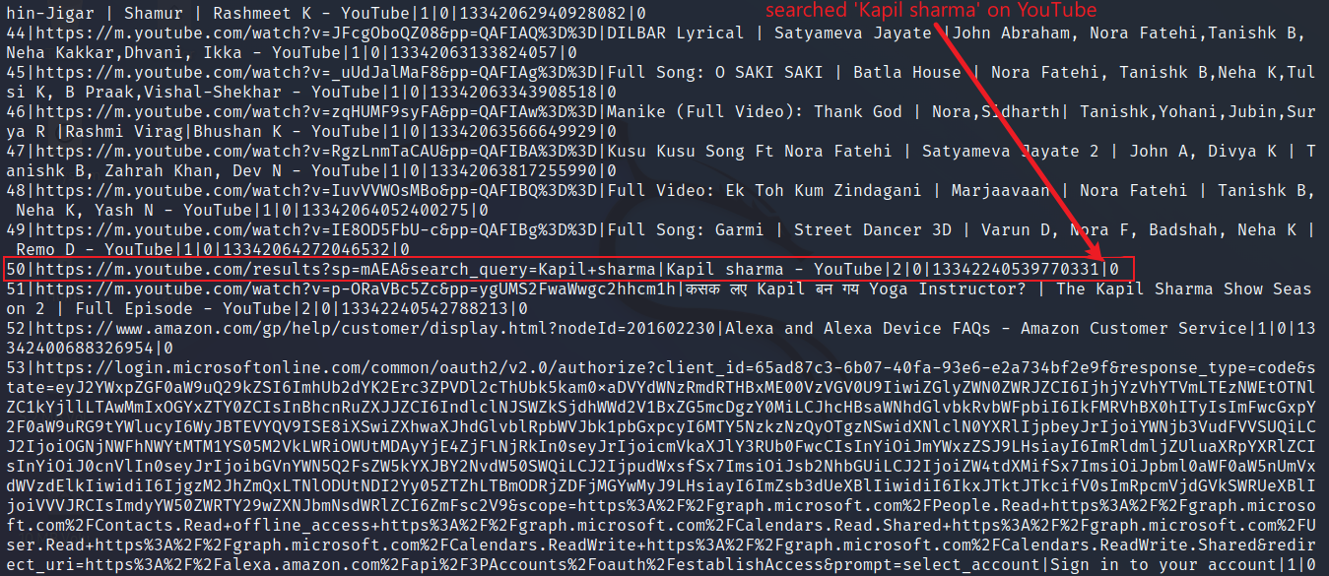
Web Search History – YouTube Searches
Browse the table ‘urls’

Slide 11
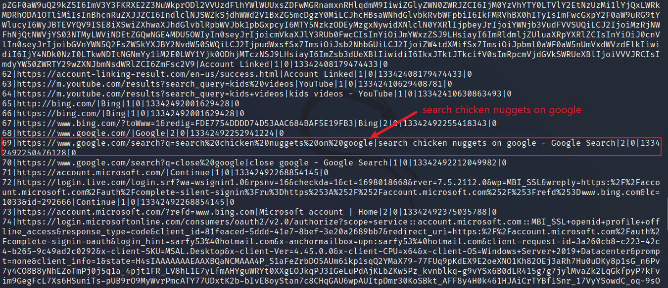
Web Search History – Google Searches
Browse the table ‘urls’

Slide 12
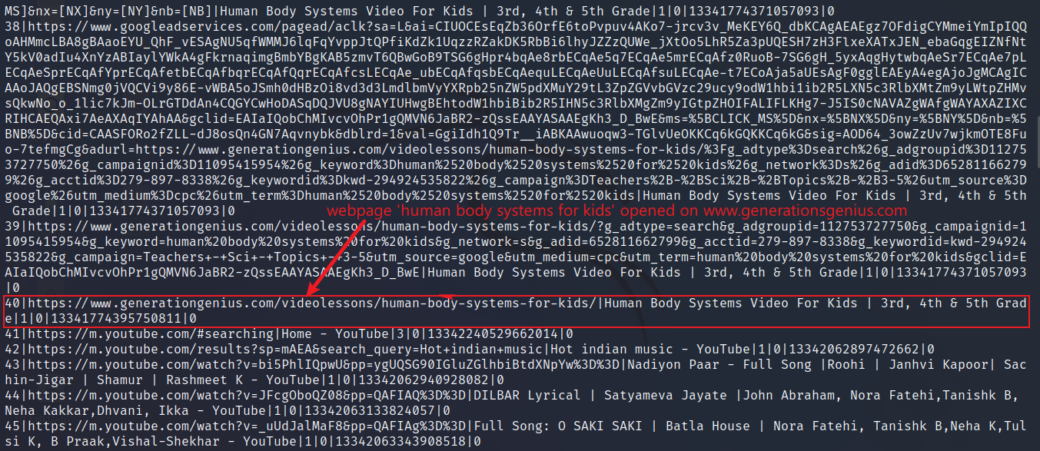
Web Search History – Web Searches
Browse the table ‘urls’

Slide 13
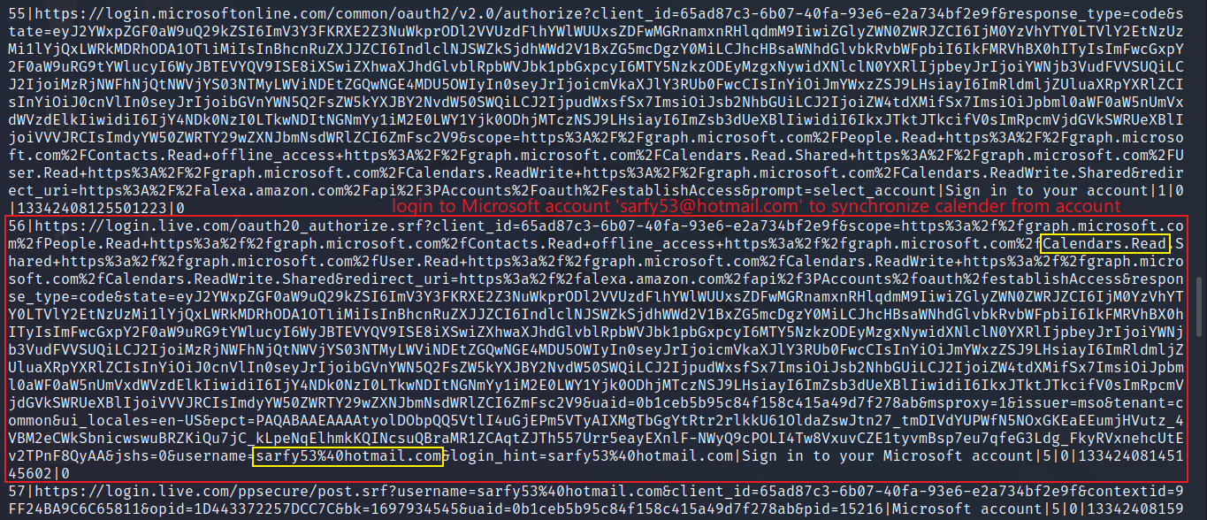
Web Search History – Calendar Syn & Microsoft Live Login (email address)
Browse the table ‘urls’

