Slide 1
Phone Communication

Slide 2
Linux Commands Used in This Lab
Command | Purpose | Command Syntax Used | Explanation
dd | It is used for copying and converting files | dd if=/dev/sdb of=my_backup.img bs=512, skip=7929256, count=7339999 | if=/dev/sdb: Specifies the input file of=my_backup.img: Specifies the output file bs=block_size: Specifies the block size for copying data. skip=num_blocks: Specifies the number of blocks to skip before starting the copy operation. count=num_blocks: Specifies the number of blocks to copy.
scalpel | It is a file carving and data recovery tool. It is used to recover files based on their headers & footers. | scalpel -o output_directory disk-image.img | -o output_directory: Specifies the directory where recovered files should be saved. disk-image.img: Specifies the input device from which scalpel will recover files.

Slide 3
Linux Commands Used in This Lab
Command | Purpose | Command Syntax Used | Explanation
grep | It is used for searching text patterns in files | Grep -Eril | -E : Enables extended regular expressions -r : Recursively searches through directories and subdirectories. -i : Makes the search case-insensitive -l : Prints only the names of files that contain the matched pattern, rather than displaying the actual matching lines.
jq | It is used for parsing, manipulating, and formatting JSON data | jq '.' file.json | (“.”): represents the top-level of the JSON structure, effectively selecting the entire JSON object file.json: The JSON file from which jq will read data.

Slide 4
Phone Communication Logs in Echo Show
Phone communication logs are saved in XML files.
However, these XML files are deleted by the operating system (OS).
As a result, these files cannot be found in the file system.
Fortunately, they can be carved from the unallocated space.
A popular file-carving tool in Linux for this purpose is the 'scalpel.'
To use scalpel effectively, we need to specify the the type of files we want to carve by editing its configuration file.

Slide 5
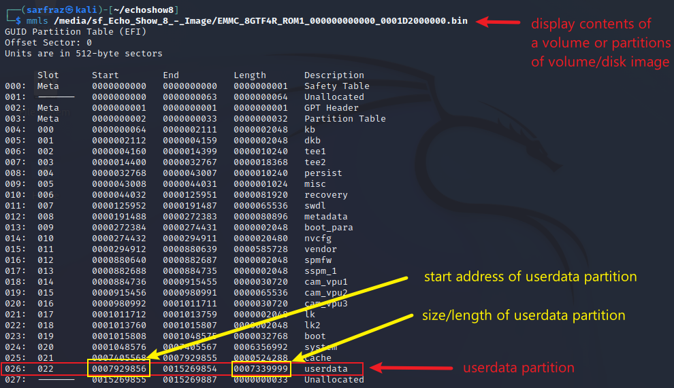
Isolating Userdata Partition from Disk Image
Display partitions in the disk image
The disk image size is 7.3 GB, whereas the userdata partition is 3.5 GB.
Working with the userdata partition is more efficient for file recovery or carving due to its smaller size.

Slide 6
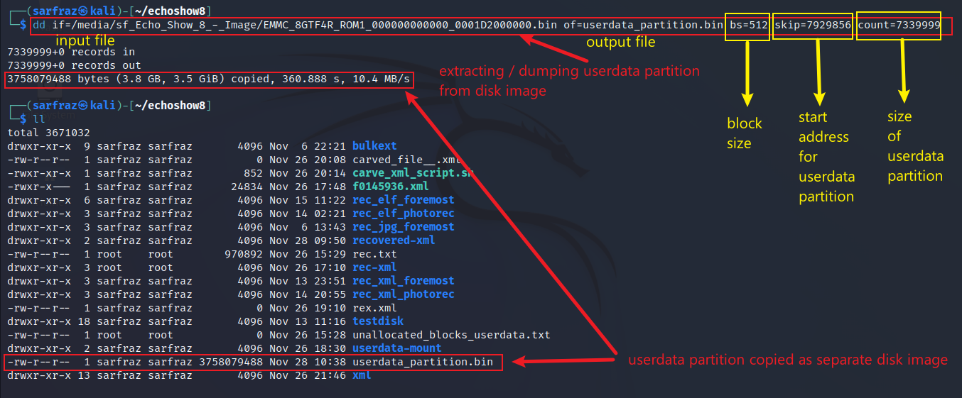
Isolating Userdata Partition from Disk Image
Use dd command to isolate / extract userdata partition

Slide 7
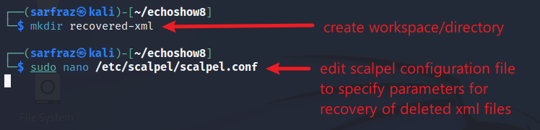
Carving XML Files – Open Conf. File
Create output directory and edit configuration file

Slide 8
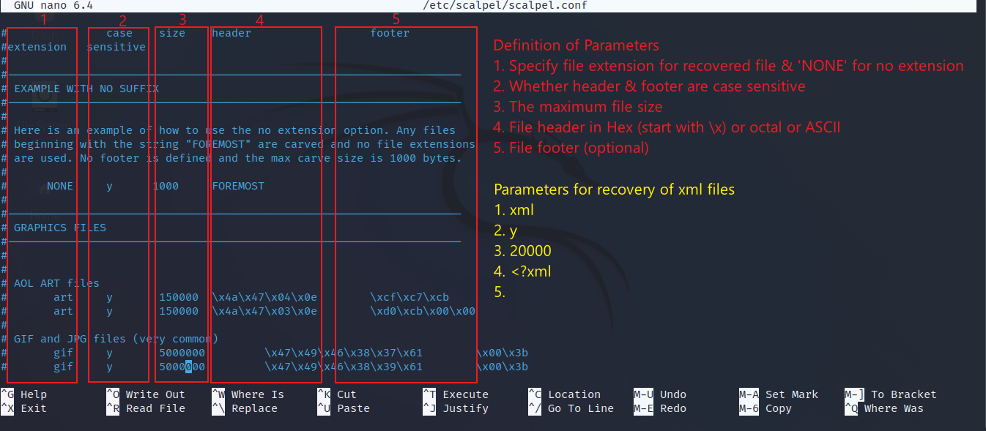
Carving XML Files – Conf. File Parameters
Parameters of the scalpel.conf file

Slide 9

Carving XML Files – Edit & Save Conf. File
Add the line at the end of the scalpel.conf file
Save the changes in the file by pressing Ctrl + X
Confirm filename and press Enter

Slide 10
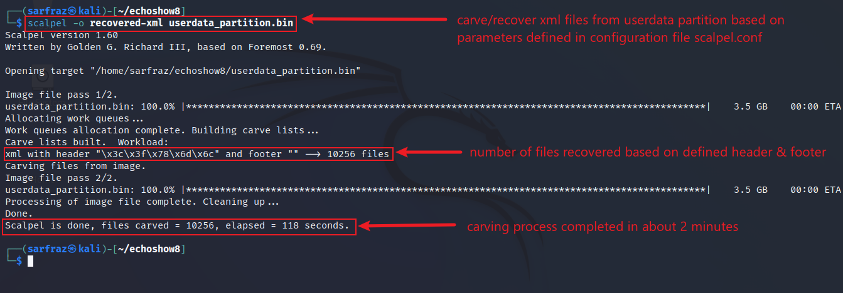
Carving XML Files – Carving Files
Run scalpel command (specify output directory & input file)

Slide 11
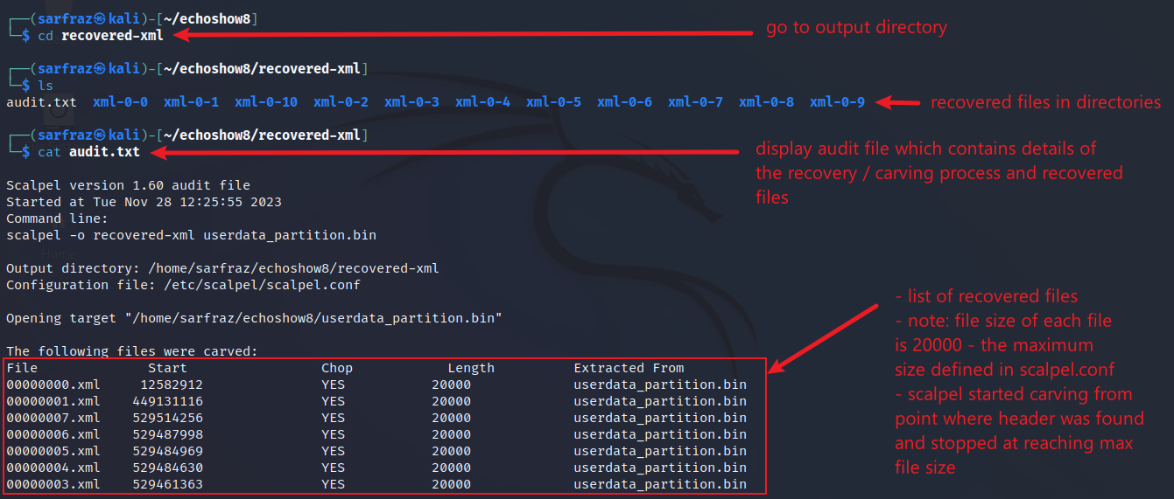
Carving XML Files – View Carved Files
Go the output directory and view the recovered file

Slide 12
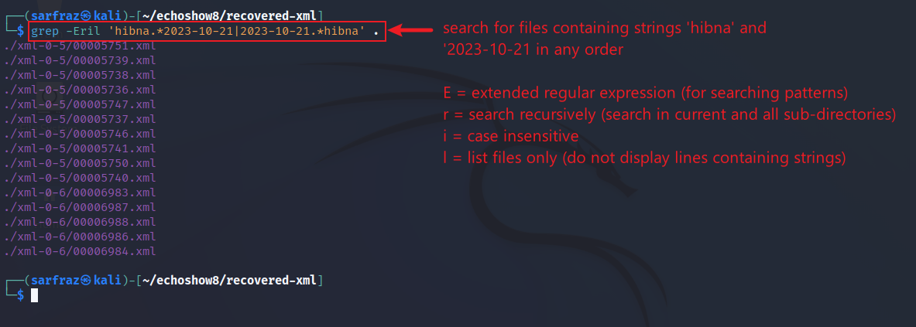
Searching for Callee Name ‘hibna’ in carved XML Files
Use grep command to search for string/words in files
15 files are found to have strings ‘hibna’ and ‘2023-10-21’ in any order

Slide 13
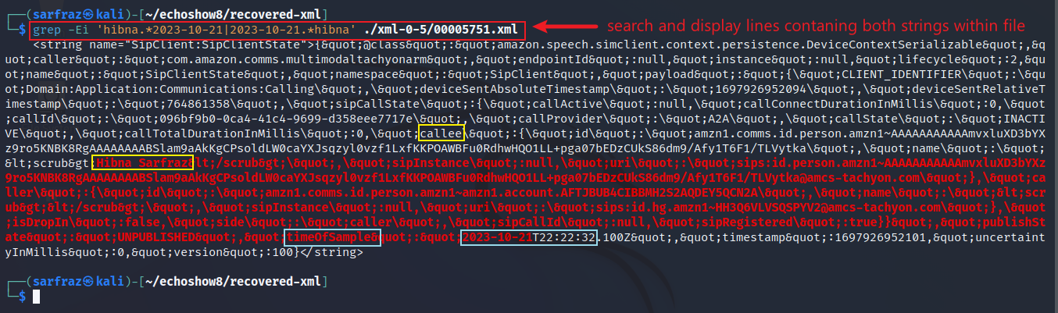
View Files Containing the Callee Name ‘hibna’
Display/print the file containing the callee name
Viewing first file out of the 15 files

Slide 14
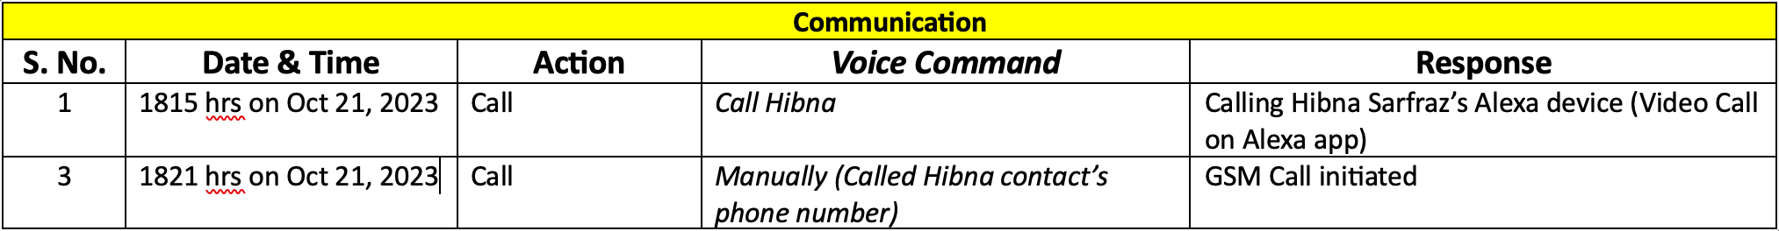
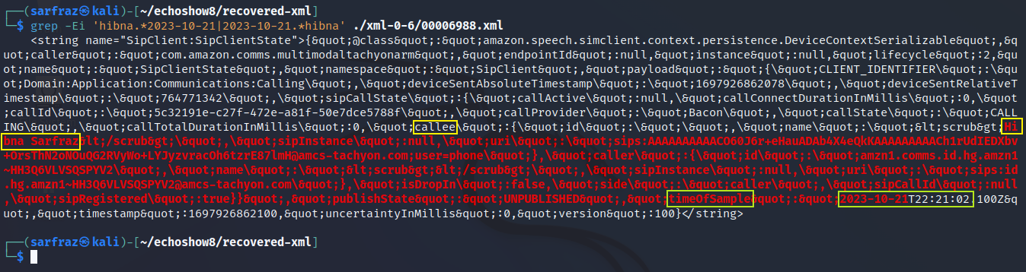
Phone Log Found!
View all files until the file containing time 22:21 Is found
The timestamp of the phone call found matches the populated data

Slide 15
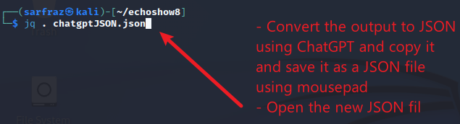
Convert Excerpt from XML File to JSON
Convert excerpt of xml file containing the phone log to JSON
We may convert the excerpt from XML file to JSON to view the file in a better way

Slide 16
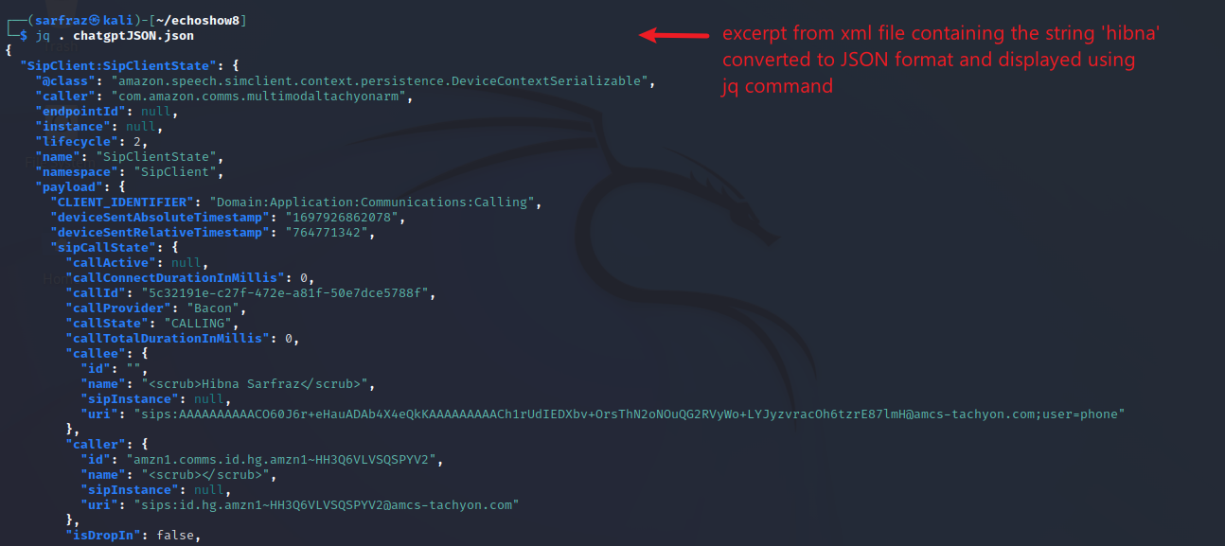
Viewing XML Phone Log Excerpt in JSON
Display/print JSON file using jq command

Slide 17
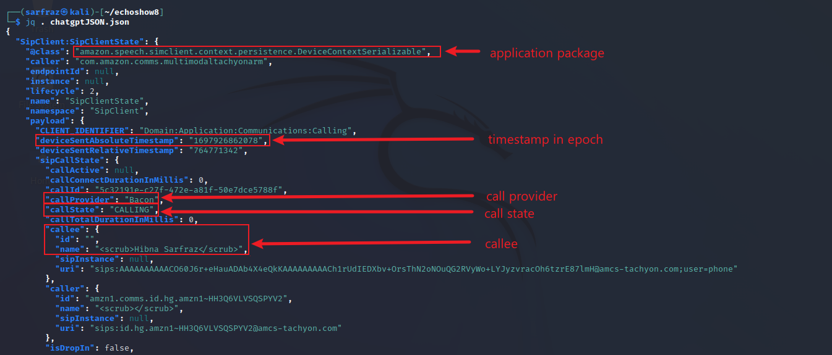
Phone Call Parameters
View the phone call parameters

Slide 18
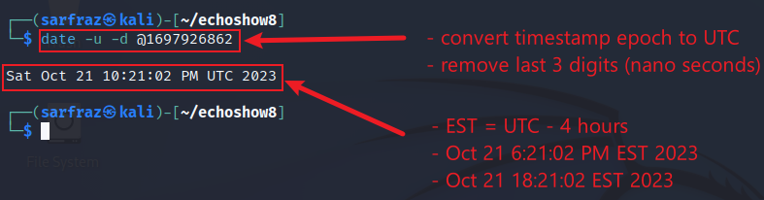
Convert the Epoch Time to UTC and EST
Use date command to convert epoch to UTC

