Slide 1
Videos Played on Device

Slide 2
Application Package com.amazon.avod
It is an Amazon Video On Demand app
To watch movies and TV shows on Prime Video
Contains various files and sub-directories containing information about movies/videos played
avod stands for advertising-based video-on-demand

Slide 3
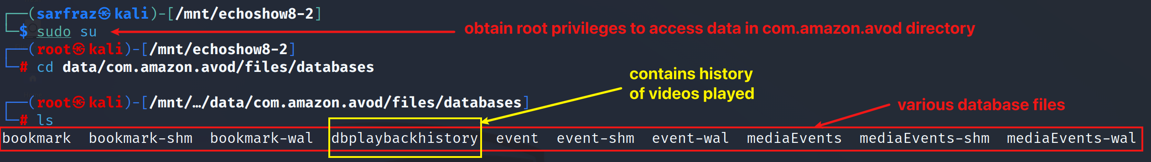
Database File dbplaybackhistory.db Contain Information
File dbplaybackhistory.db contains information related to videos played
File is in package com.amazon.avod
Exact location is data/com.amazon.avod/files/databases/dbplaybackhistory
Go to the directory containing dbplaybackhistory file

Slide 4
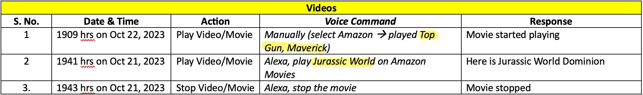
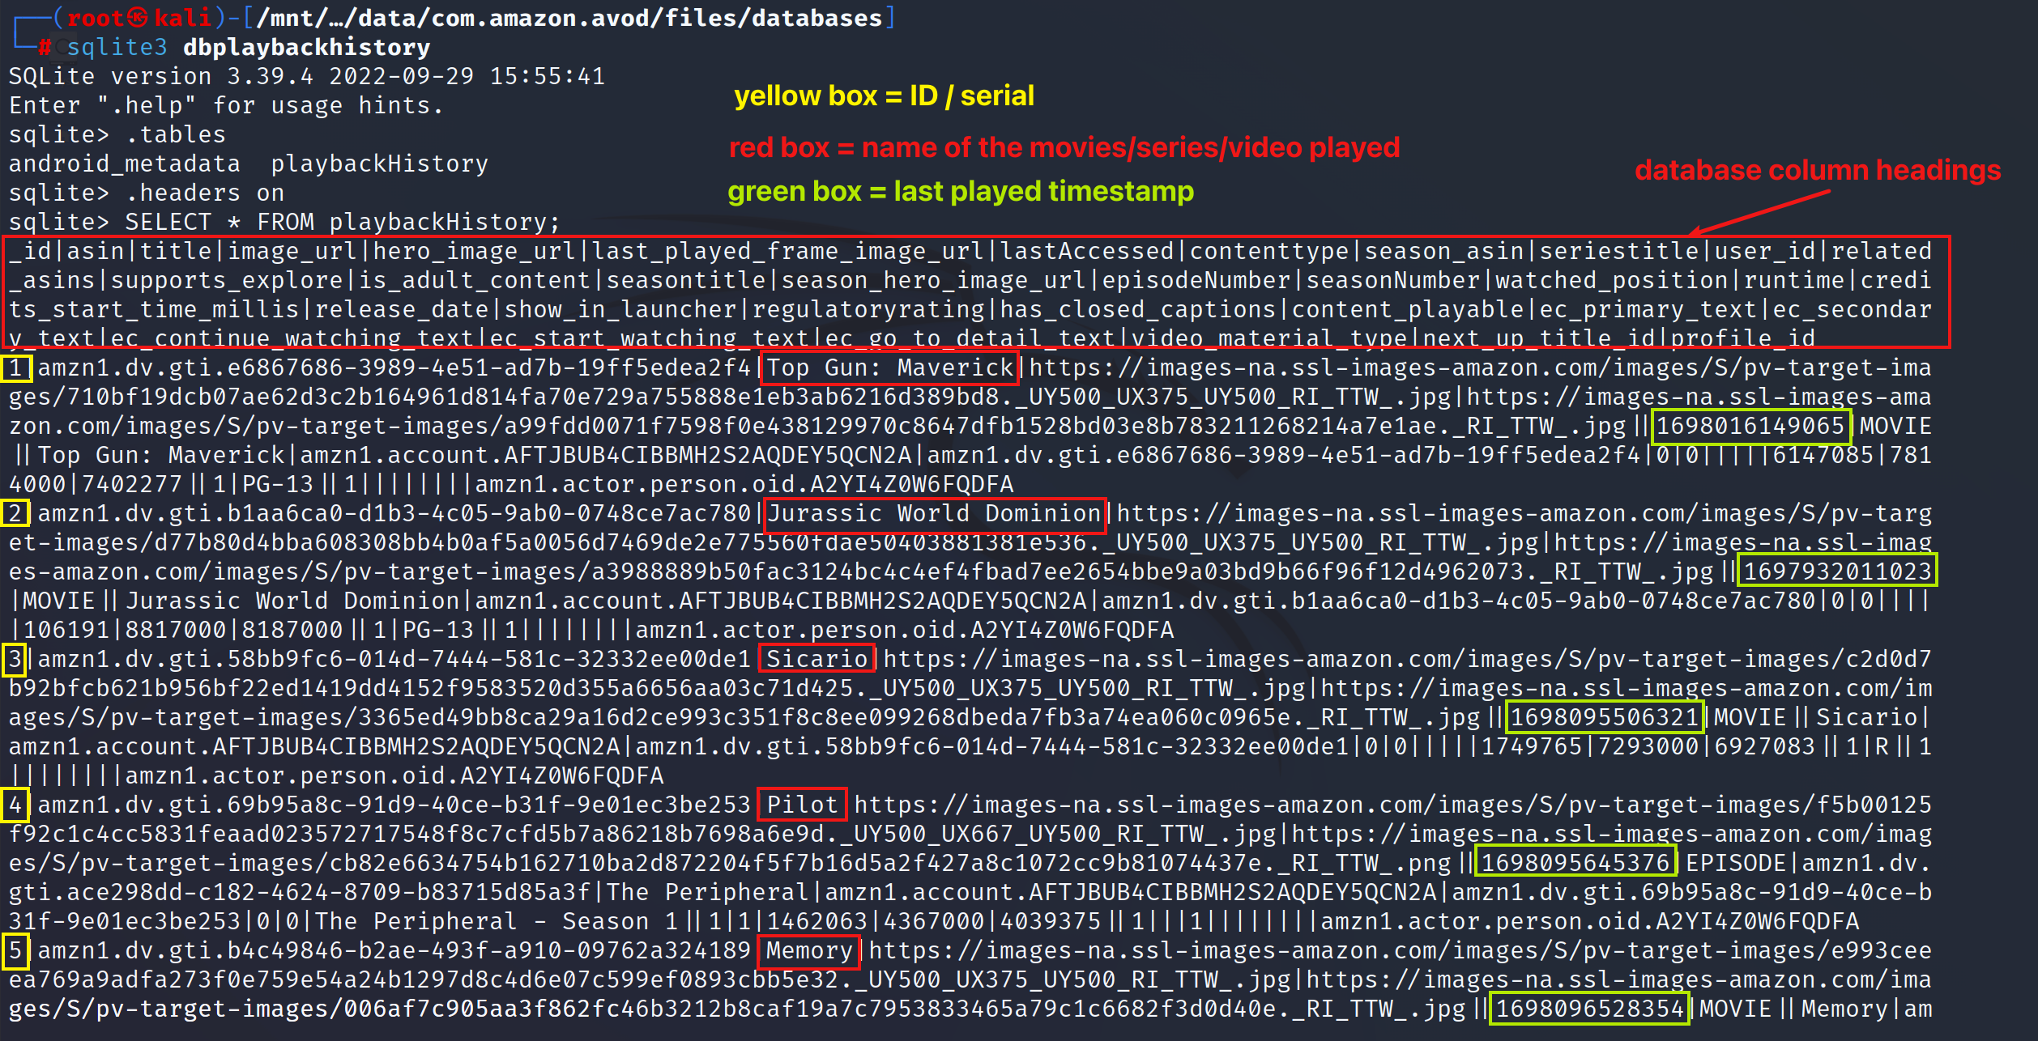
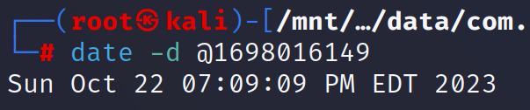
Movies Played
View playbackHistory table in dbplaybackhistory file
Convert epoch time to EDT and it matches with the evidence

Slide 5
User Profile (Amazon Prime)

Slide 6
Package com.amazon.avod
One sub-directory ‘Profiles’ in com.amazon.avod contains user profiles
These are user profiles associated with Amazon Video App on Echo Show and all other devices
Gives information about profiles created by user on their Amazon Prime app

Slide 7
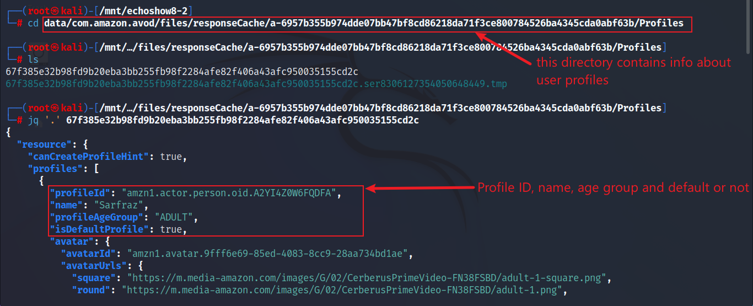
User Profiles
List files and display contents of json file

Slide 8
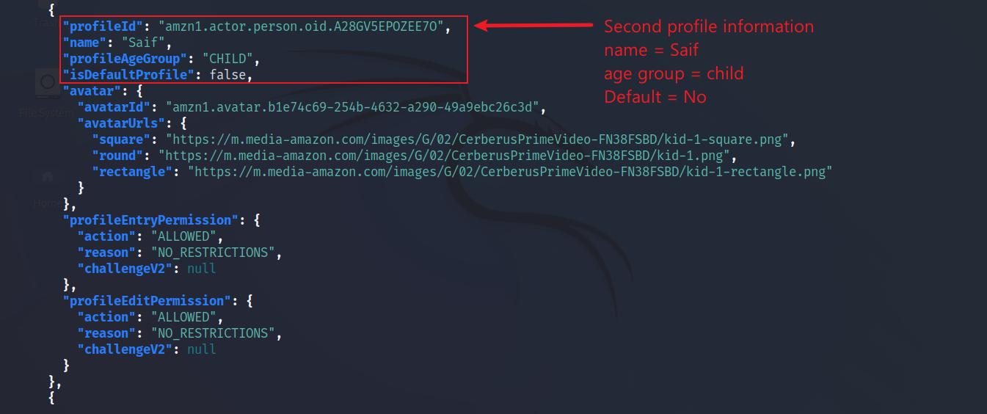
User Profiles
List files and display contents of json file

Slide 9
Photos & Videos Captured by Device

Slide 10
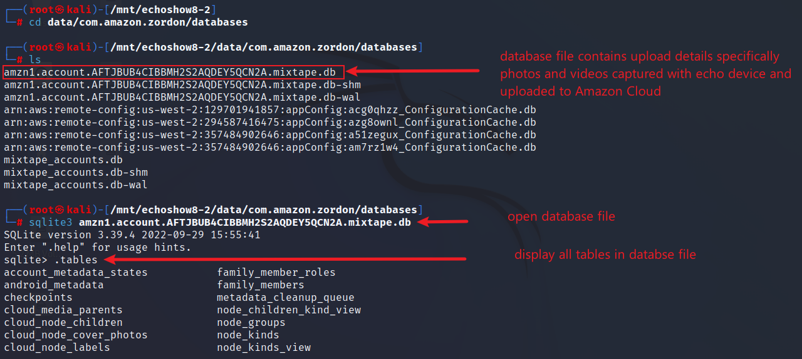
Uploading Data of Photos and Videos Captured by Device
Application com.amazon.zordon contains information related to media upload to Amazon Photos
Go to package com.amazon.zordon

Slide 11
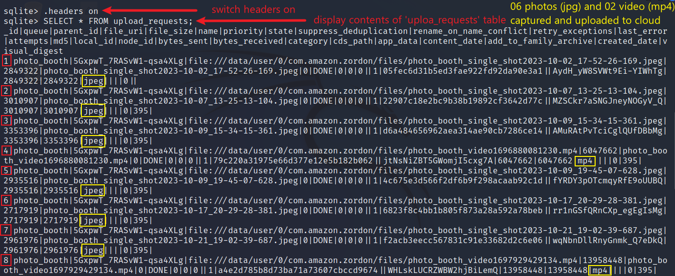
Uploading Data of Photos and Videos Captured by Device – 06 photos & 02 videos uploaded
Display table ‘upload_requests’ from the database file

Slide 12
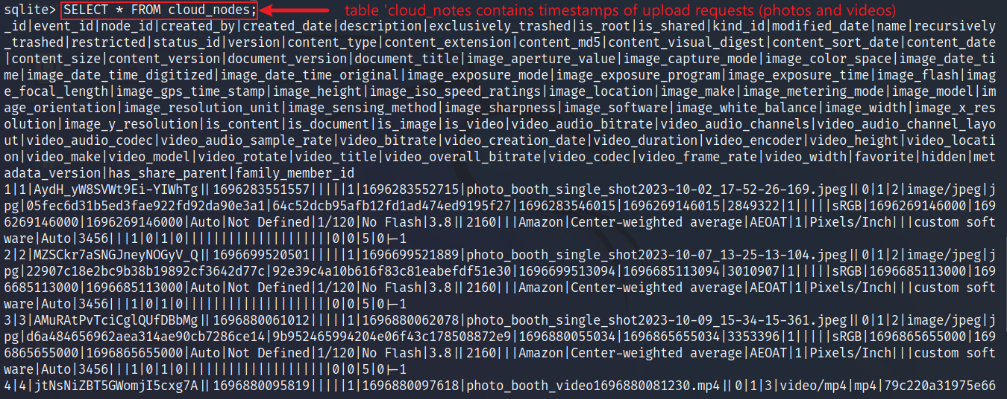
Uploading Data of Photos and Videos Captured by Device – Find Upload Timestamp
Display table ‘cloud_nodes’ from the database file

Slide 13
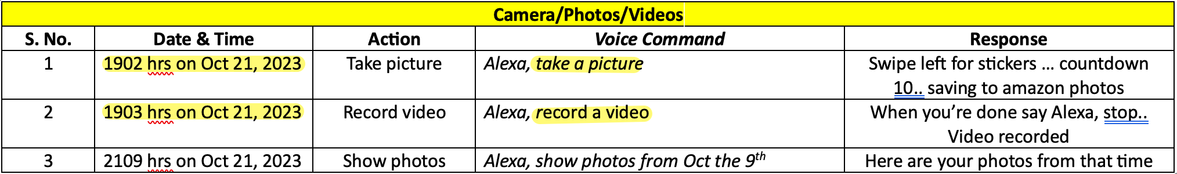
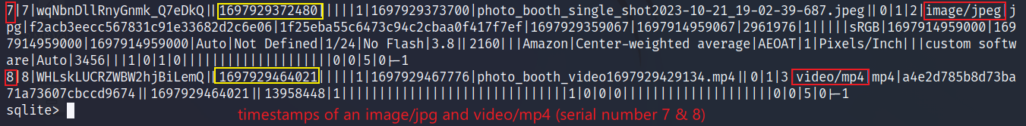
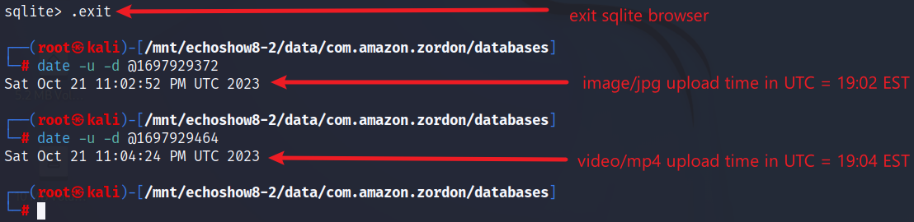
Upload Timestamp
Browse table ‘cloud_nodes’ from the database file
Convert Epoch time to UTC

Slide 14
Videos Saved on Device

Slide 15
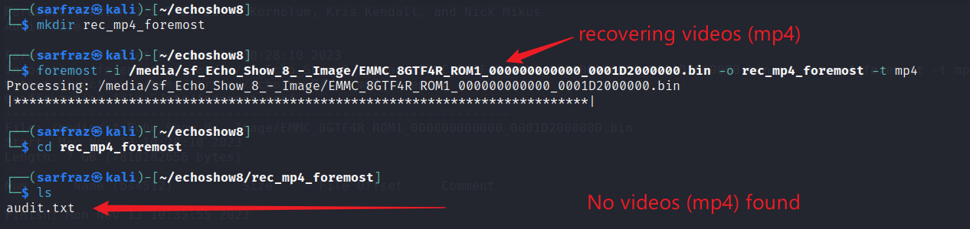
Search Videos by Carving mp4 files
Create a directory and run foremost
No videos were found even in unallocated space

Slide 16
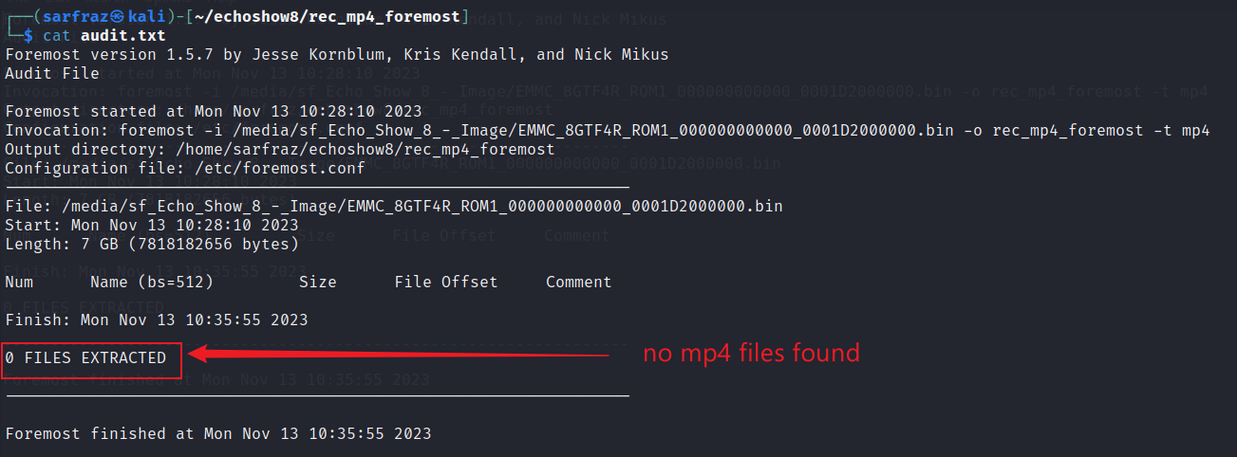
Search Videos by Carving mp4 files
View contents of audit.txt file

