Slide 1
Planting Evidence / Data Population

Slide 2
Why, How & What Evidence Has Been Planted
Evidence Planting: Evidence has been intentionally planted on the device by using various features of device.
Examples of Planted Evidence: Features such as making calls, capturing videos and photos, playing music, watching movies, changing device names, setting up alarms and reminders, browsing the internet, checking weather and traffic conditions, connecting devices through Bluetooth, and controlling smart home devices were utilized for planting evidence.
Evidence Storage: Some of this evidence has been stored locally on the device, while other data resides in the cloud.

Slide 3
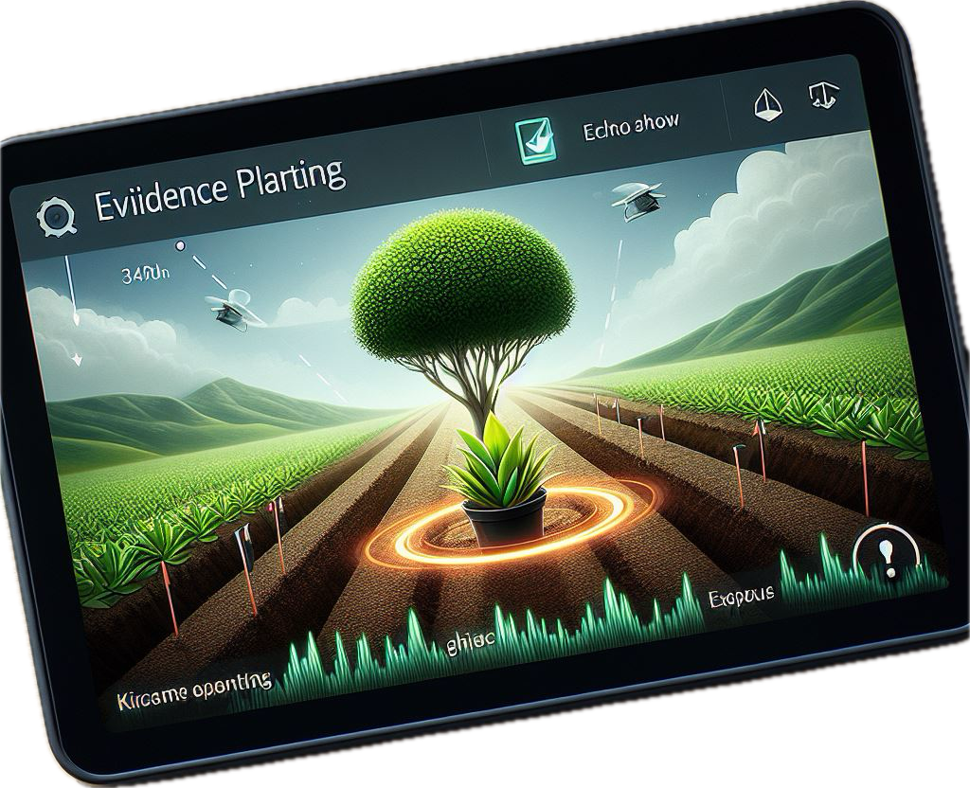
Objective & Learning Outcomes
Objective: The primary objective is to examine the disk image of the internal storage (eMMC) of the Echo Show device and search for evidence using Linux tools and commands.
Key Learning Outcomes:
Practical application of digital forensics in a simulated scenario.
Utilization of forensic tools to extract evidence from an Echo Show device image.

Slide 4
Details of Planted Evidence

Slide 5
What potential evidence to look for?
Following slides shows the evidence which has been planted on device
Potential evidence to be looked for has been highlighted in red
Moreover, timestamp of each activity is also a significant evidence
Timestamp is very important in reconstructing the scenario

Slide 6
Device Details
S. No. | Date & Time | Action | Voice Command | Response
1 | 1302 hrs on Oct 21, 2023 | Change name of device | Manually ( Changed Name from ‘Sarfraz Shaikh’ to ‘John Miller’) | Name Changed
2 | 1305 hrs on Oct 21, 2023 | Asked owner’s name | Alexa, Say my name | You are John, and this is Sarfraz’s account
3 | 1308 hrs on Oct 21, 2023 | Take to home screen | Alexa, Go to home screen | Home screen displayed
4 | 1309 hrs on Oct 21, 2023 | Ask name of the device | Alexa, what is the name of this device | It’s called Amazing Assistant
5 | 1317 hrs on Oct 21, 2023 | Add new profile | Manually (A new profile ‘William Wordsworth’ added with audio and video profile) | Added
Note: The text in highlighted in red is potential evidence to be searched in Echo Show Device Image

Slide 7
Phone Communication
S. No. | Date & Time | Action | Voice Command | Response
1 | 1809 hrs on Oct 21, 2023 | Send text message | Manually (to wife, what’s for dinner) | Done (On Alexa app)
2 | 1815 hrs on Oct 21, 2023 | Call | Call Hibna | Calling Hibna Sarfraz’s Alexa device (Video Call on Alexa app)
3 | 1821 hrs on Oct 21, 2023 | Call | Manually (Called Hibna contact’s phone number) | Regular call on Hibna Sarfraz’s phone
4 | 1833 hrs on Oct 21, 2023 | Send Voice Message | Alexa send a message to wife .. followed by voice message (I want baby potatoes) in response to what’s message from Alexa | Voice and text message sent on Alexa app
5 | 1837 hrs on Oct 21, 2023 | Send Text Message | Manually (text message to Hibna, You’re awesome) | Text message sent on Alexa app
Note: The text in highlighted in red is potential evidence to be searched in Echo Show Device Image

Slide 8
To Do & Reminders
S. No. | Date & Time | Action | Voice Command | Response
1 | 1850 hrs on Oct 21, 2023 | Add to To do list | Alexa, add submit the ITNG paper to my to do list | Submit the i.t.n.g paper added to your to do list
2 | 1851 hrs on Oct 21, 2023 | Show To do list | Alexa, show my to do list | To do list opened
3 | 1853 hrs on Oct 21, 2023 | Reminder | Alexa, set a reminder for William to exercise every day at 7pm | Okay John, I will remind John every day at & pm to exercise
4 | 1900 hrs on Oct 21, 2023 | Reminder |  | William here is your reminder from John Exercise
Note: The text in highlighted in red is potential evidence to be searched in Echo Show Device Image

Slide 9
Capture Photos and Videos
S. No. | Date & Time | Action | Voice Command | Response
1 | 1902 hrs on Oct 21, 2023 | Take picture | Alexa, take a picture | Swipe left for stickers … countdown 10.. saving to amazon photos
2 | 1903 hrs on Oct 21, 2023 | Record video | Alexa, record a video | When you’re done say Alexa, stop.. Video recorded
3 | 2109 hrs on Oct 21, 2023 | Show photos | Alexa, show photos from Oct the 9th | Here are your photos from that time
Note: The text in highlighted in red is potential evidence to be searched in Echo Show Device Image

Slide 10
Playing Videos / Movies
S. No. | Date & Time | Action | Voice Command | Response
1 | 1909 hrs on Oct 22, 2023 | Play Video/Movie | Manually (select Amazon → played Top Gun, Maverick) | Movie started playing
2 | 1941 hrs on Oct 21, 2023 | Play Video/Movie | Alexa, play Jurassic World on Amazon Movies | Here is Jurassic World Dominion
3 | 1943 hrs on Oct 21, 2023 | Stop Video/Movie | Alexa, stop the movie | Movie stopped
Note: The text in highlighted in red is potential evidence to be searched in Echo Show Device Image

Slide 11
Bluetooth Connectivity
S. No. | Date & Time | Action | Voice Command | Response
1 | 2051 hrs on Oct 21, 2023 | Connect | Alexa, connect to Sarfraz’s MacBook Pro | Searching… Connected to Sarfraz’s MacBook Pro
2 | 2052 hrs on Oct 21, 2023 | Play | Manually (played YouTube from MacBook) | Audio streaming)
Note: The text in highlighted in red is potential evidence to be searched in Echo Show Device Image

Slide 12
Playing Audio / Music
S. No. | Date & Time | Action | Voice Command | Response
1 | 2104 hrs on Oct 21, 2023 | Play music | Alexa, play centuries | Here is centuries by Fallout boys on Amazon Music
2 | 2106 hrs on Oct 21, 2023 | Play music | Alexa, play money heist theme song | Here is money heist theme song Bella Ciao…
Note: The text in highlighted in red is potential evidence to be searched in Echo Show Device Image

Slide 13
Web Browsing
S. No. | Date & Time | Action | Voice Command | Response
1 | 1947 hrs on Oct 22, 2023 | Open browser | Alexa, open the silk browser | Here is the Silk, Opened
2 | 1947 hrs on Oct 22, 2023 | Open webpage | Alexa, open google.com | Here is google; Opened
3 | 1949 hrs on Oct 22, 2023 | Use a search engine - google | Alexa, search chicken nuggets on google | Here is what I found
4 | 2056 hrs on Oct 22, 2023 | Open YouTube and play | Alexa, open YouTube & searched ‘Kapil sharma show’ | Kapil sharma show played on YouTube
Note: The text in highlighted in red is potential evidence to be searched in Echo Show Device Image

Slide 14
Summary of Evidence Implanted

Slide 15
Summary of Data/Evidence Planted
S. No. | Evidence Category / Device Function | Evidence Planted
1 | Device Details | User1 = John Miller, User2 = William Wirdsworth, Device = Amazing Assistant
2 | Change 'Language' | Language = English (U.S 1), English (Indian 1)
3 | Change 'Wake Word' | Wake words = ‘Alexa’, ‘Ziggy’
4 | Smart Home Devices – Smart Wifi Light Bulb | Smart device name = ‘magic’, device on/off information
5 | Bluetooth Connection | Bluetooth devices = Sarfraz’s Macbook
6 | Communication | Contacts = Hassan Nawaz, Hibna Sarfraz, Calls = Hibna Sarfraz, Messages = Hibna You’re awesome
7 | Calendar | Entry = every Wednesday weekly meeting with Dr. Xu

Slide 16
Summary of Data/Evidence Planted
S. No. | Evidence Category / Device Function | Evidence Planted
8 | Directions | Home = 3362 N Chatham Rd, Apt C, Ellicott City, Maryland Work = 1420 N Charles
9 | Weather | Weather = 55 cloudy sky in & out low 48
10 | Reminder & To-do Lists | To-do = Submit the i.t.n.g paper, Reminders = William to exercise every day at 7pm
11 | Shopping list | Shopping list = milk, eggs, New list = Forensic Jobs
12 | Alarm & Timer | Alarm = 1:28 pm, 7:55 am weekday & timer = 15 seconds
13 | Camera | Took a picture, recorded a video & show pic from Oct 9
14 | Play videos | Movies = Top Gun, Maverick, Jussaric World

Slide 17
Summary of Data/Evidence Planted
S. No. | Evidence Category / Device Function | Evidence Planted
15 | Play audio/music | Music = centuries, money heist theme
16 | Display photos | Photos = Displayed photos, from = September 27, 2023
17 | View Camera | Camera viewing = Camera streamed on phone
18 | Browser | Website = google.com, web search = chicken nuggets
19 | Theme | Theme = Space theme
20 | Routines | Routine = Routine (weather, traffic, news, daily morning)
21 | Game | Game = Played ‘Trivia’ game

