Slide 1

Duplex House 3D Modelling by Auto-Cad
Submitted To Dr. Nazib Abdun Nasir
Assistant Professor
Green University of Bangladesh
Submitted By Abdul Alim Monshi | ID: 212002073 Zabia Ferdusi | ID: 212002077

Slide 2
Table of Content
Progress status
Progress samples
Conclusion

Slide 3


Progress status
We have build the 3d design of the ground floor and 2d design of the 1st floor. In the next steps we will convert the 1st floor design to 3d and attach it with the ground floor design. Than we will work on the outer look of the entire house.

Slide 4
Design Samples of Progress
Notes:
Thank you zabia ferdusi for welcoming me to continue the presentation. I am abdul alim monshi. My Id is 212002073.
Now I will talk about Windiw fundamental

Slide 5
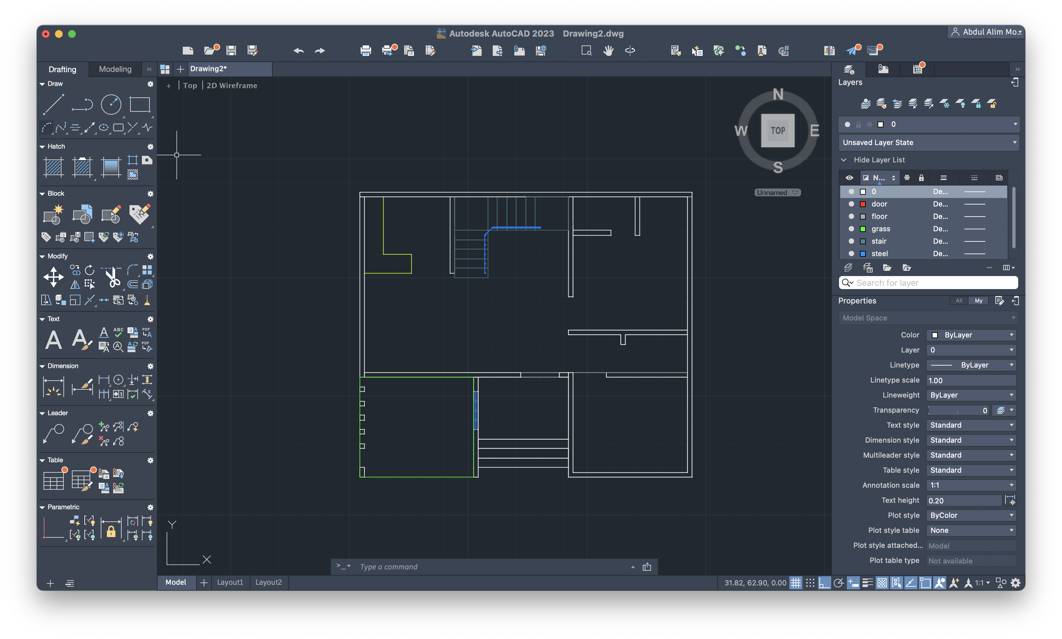
2D Structure of the building

Slide 6
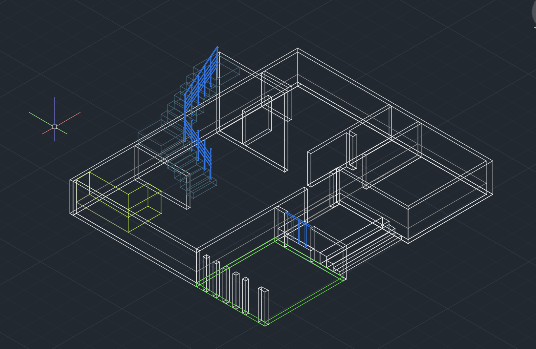
3D Wireframe

Slide 7
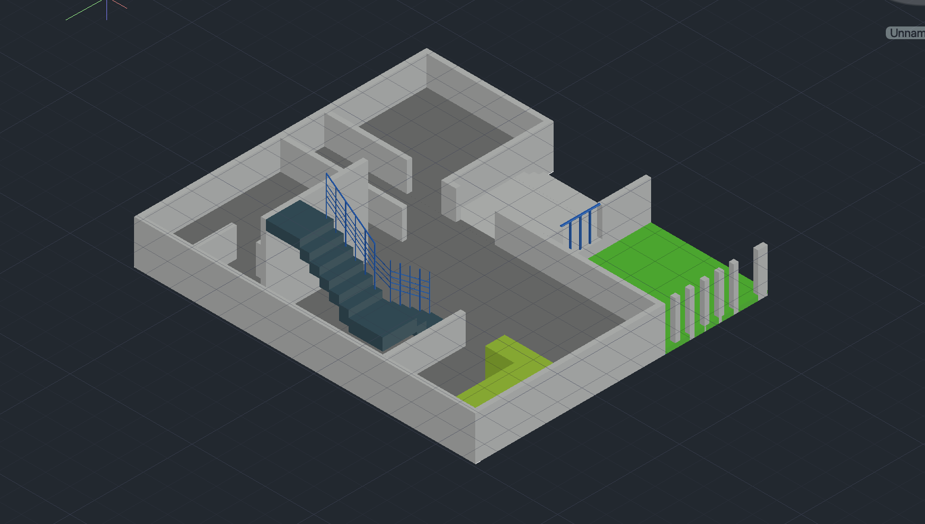
3D Design of ground floor

Slide 8
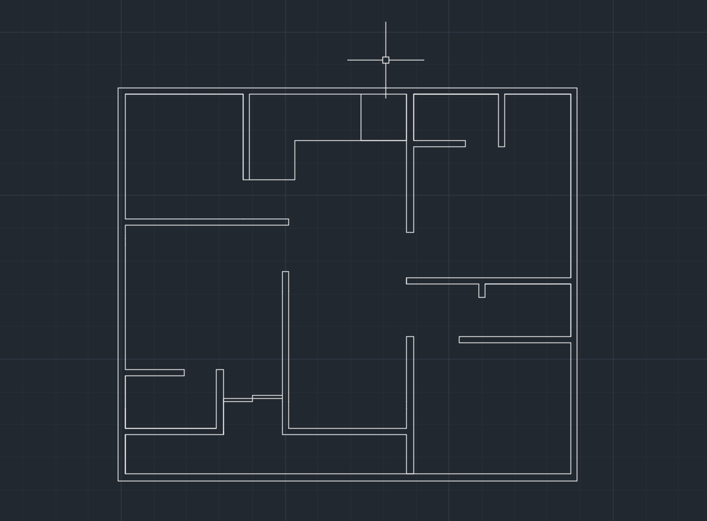
2D Design of the 1st floor

Slide 9
Conclusion
It was really very difficult to design the stairs in 3d. Specially the measurement of the steps of stairs. We are expecting to complete the project before deadline.

Slide 10
Thank you

