Slide 1

AWT Abstract Window Toolkit
Submitted By Abdul Alim Monshi | ID: 212002073 Khalid Bin Walid | ID: 212002075 Zabia Ferdusi | ID: 212002077

Slide 2
Table of Content
What is AWT
Application of AWT
Window Fundamental
Components
Implementation
Event Handling
Complexity

Slide 3


Introduction
The Abstract Window Toolkit (AWT) is Java's original platform-dependent windowing, graphics, and user-interface widget toolkit, preceding Swing. The AWT is part of the Java Foundation Classes (JFC) — the standard API for providing a graphical user interface (GUI) for a Java program

Slide 4
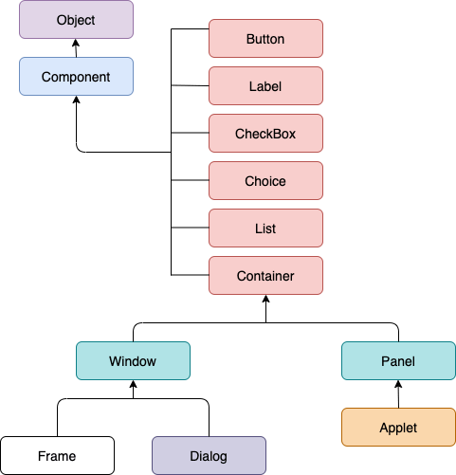
Application of AWT
AWT provides various components like button, label, checkbox, etc. used as objects inside a Java Program. AWT components use the resources of the operating system. The classes for AWT are provided by the Java.awt package for various AWT components.

Slide 5
Window Fundamental

Slide 6
Components
Container
Button
Text Fields
Label
Canvas
Scroll Bar
List
Checkbox

Slide 7
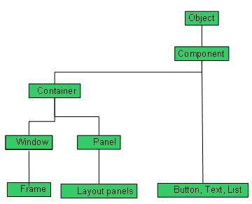
Container
Containers are integral part of AWT GUI components. A container provides a space where a component can be located. A Container in AWT is a component itself and it adds the capability to add component to itself.

Slide 8
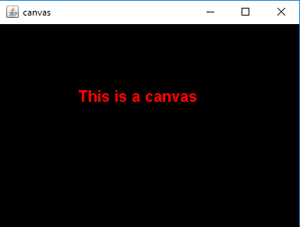
Canvas
Canvas class is a part of Java AWT. Canvas is a blank rectangular area where the user can draw or trap input from the user. Canvas class inherits the Component class.

Slide 9
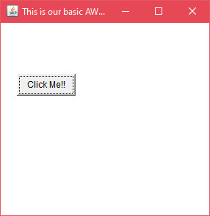
Implementation
import java.awt.*;
public class AWTExample1 extends Frame {
AWTExample1() {
Button b = new Button("Click Me!!");
b.setBounds(30,100,80,30);
add(b);
setSize(300,300);
setTitle("This is our basic AWT example");
setLayout(null);
setVisible(true);
}
public static void main(String args[]) {
AWTExample1 f = new AWTExample1();
}
}

Slide 10
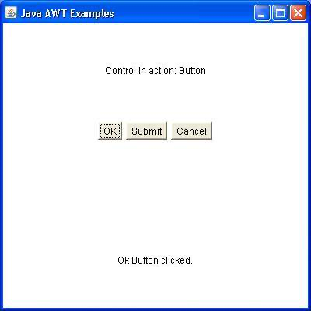
Event Handling
Event Handling is the mechanism that controls the event and decides what should happen if an event occurs. This mechanism have the code which is known as event handler that is executed when an event occurs. Java Uses the Delegation Event Model to handle the events.

Slide 11
Complexity
The components of Java AWT are heavy weighted.
Java AWT has comparatively less functionality as compared to Swing.
The execution time of AWT is more than Swing.
MVC pattern is not supported by AWT.
AWT provides comparatively less powerful components.

Slide 12
Thank you

