Slide 1


E-Health Care Management System
Title: Algorithms Lab
Code: CSE-206
Semester: Fall
Presented To
Tanoy Debnath Lecturer at Green University of Bangladesh
Presented by
Abdul Alim Monshi ID: 212002073 Section: D1

Slide 2
Table of Contents
Introduction
Related Works
Objectives
Project Architecture
Implementation
Limitations & Future Scope
Conclusion

Slide 3
Introduction
The E-Health Care Management System is a comprehensive system designed to manage the entire patient healthcare experience.
It provides a single, unified platform for scheduling appointments.
The system is designed to enable healthcare providers to provide better care to their patients, while also reducing administrative costs and increasing efficiency.

Slide 4
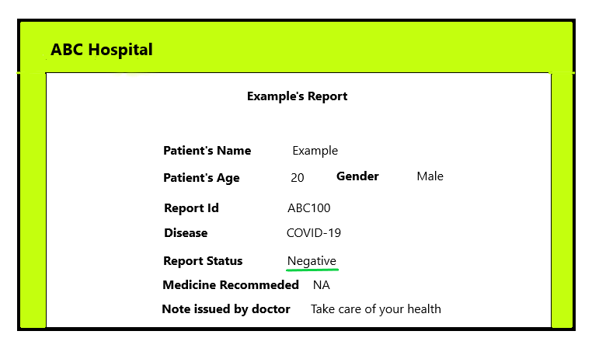
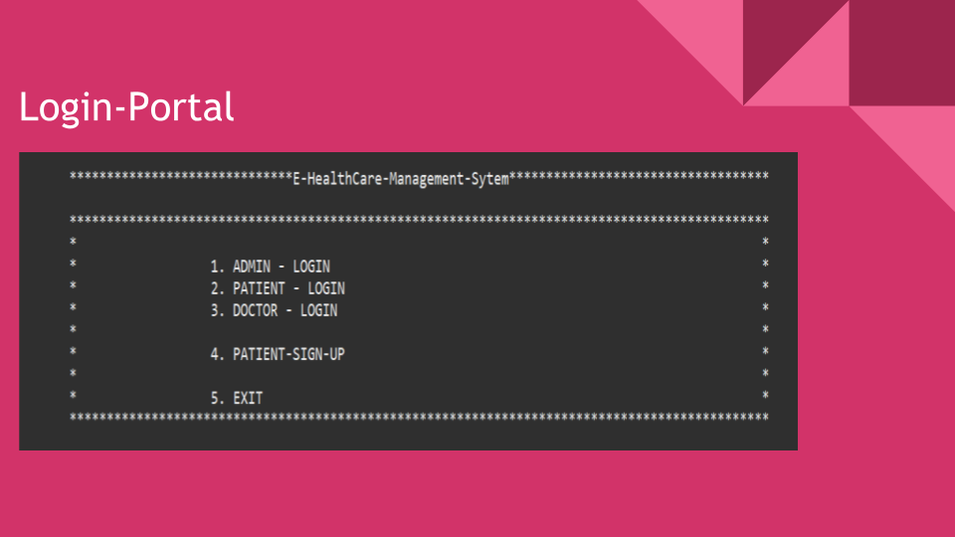
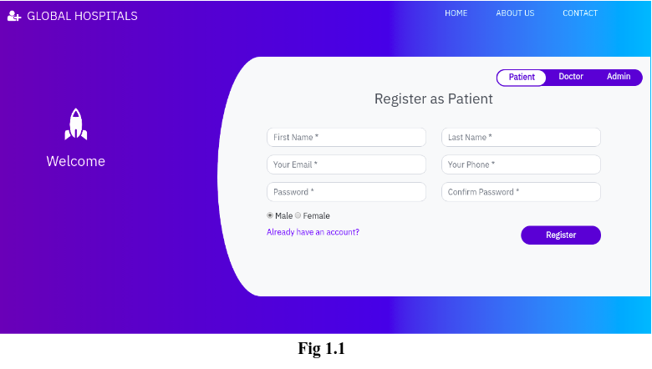
Related Works
Open Reference
Open Reference
Open Reference
4

Slide 5
Objectives
To enable healthcare providers to easily access patient records, medical history, and medical reports.
To help healthcare providers monitor and analyze patient data for better decision-making.
To enable healthcare providers to customize the system to meet their specific needs.
To provide user-friendly and cost-effective solutions.

Slide 6
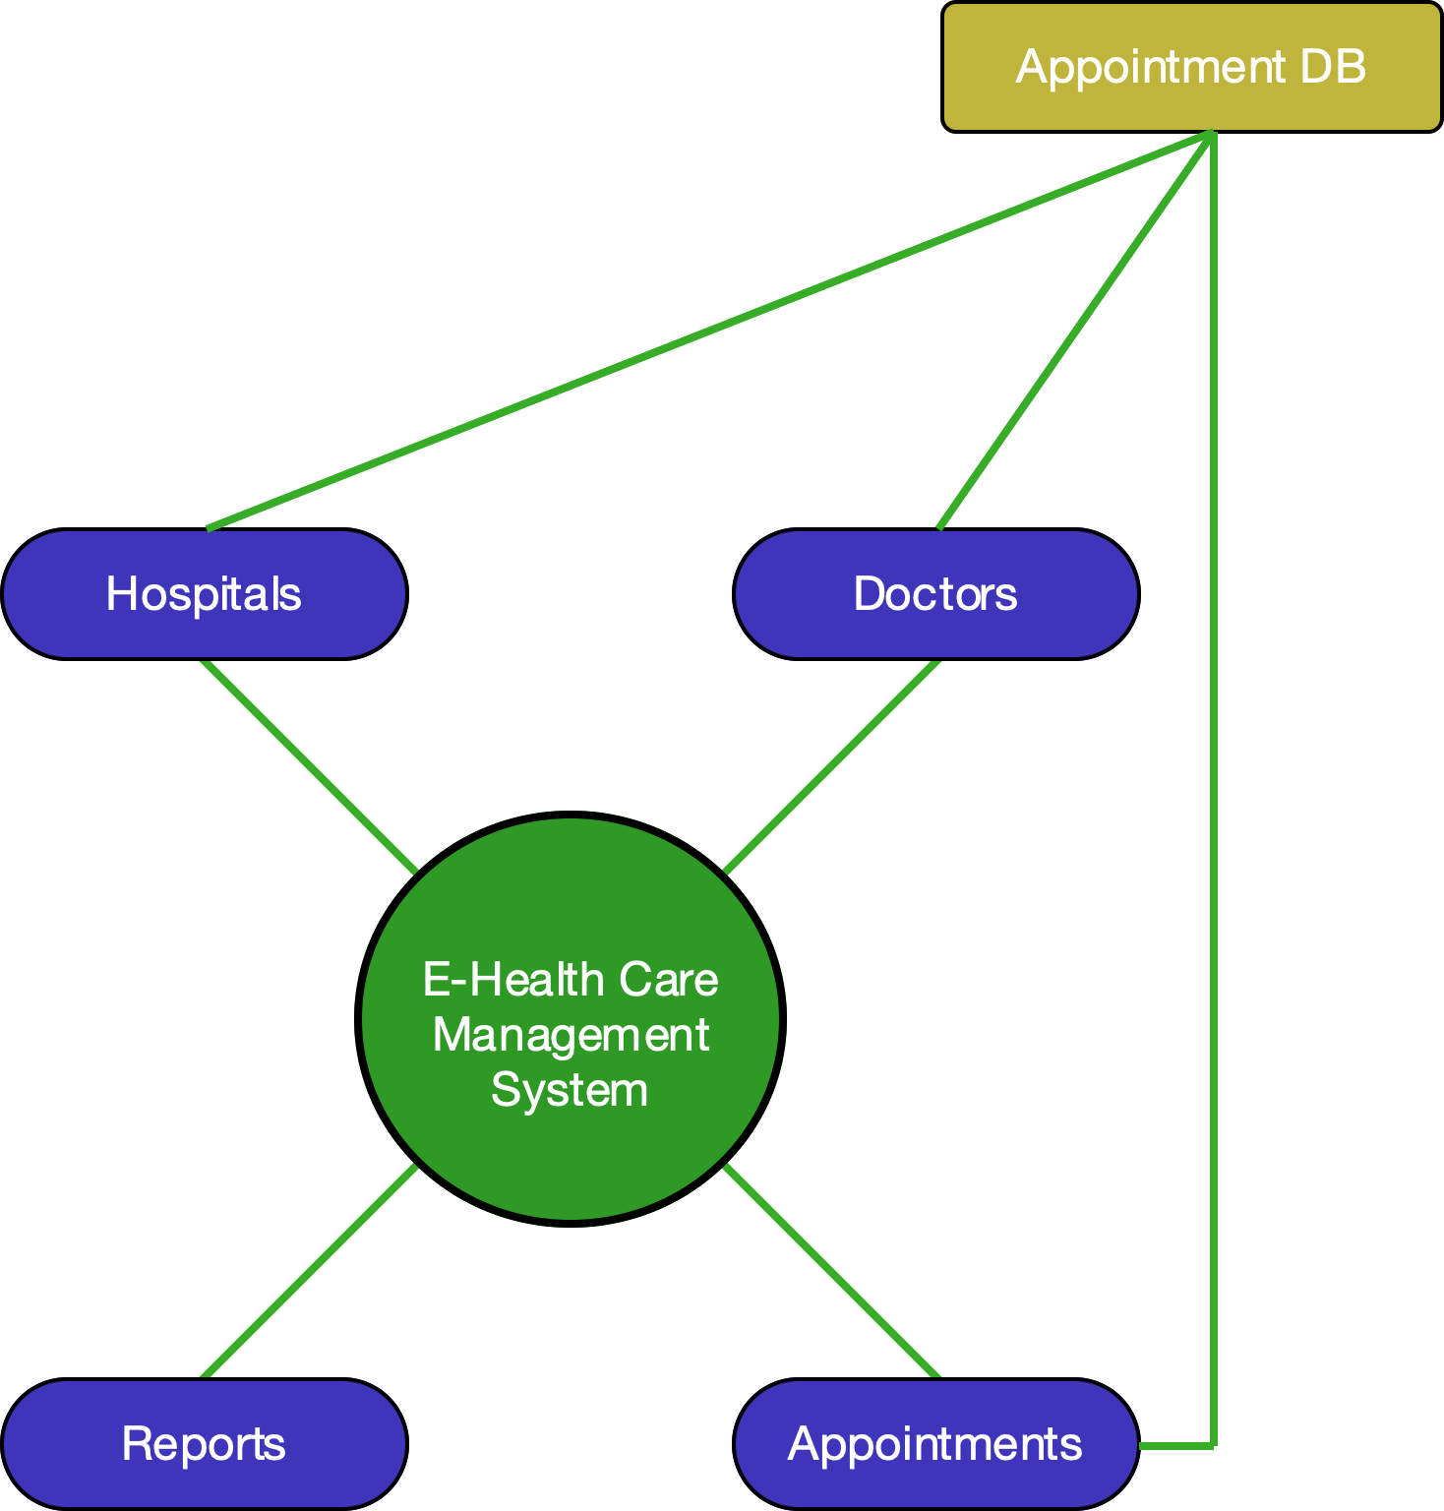
Project Architecture

Slide 7
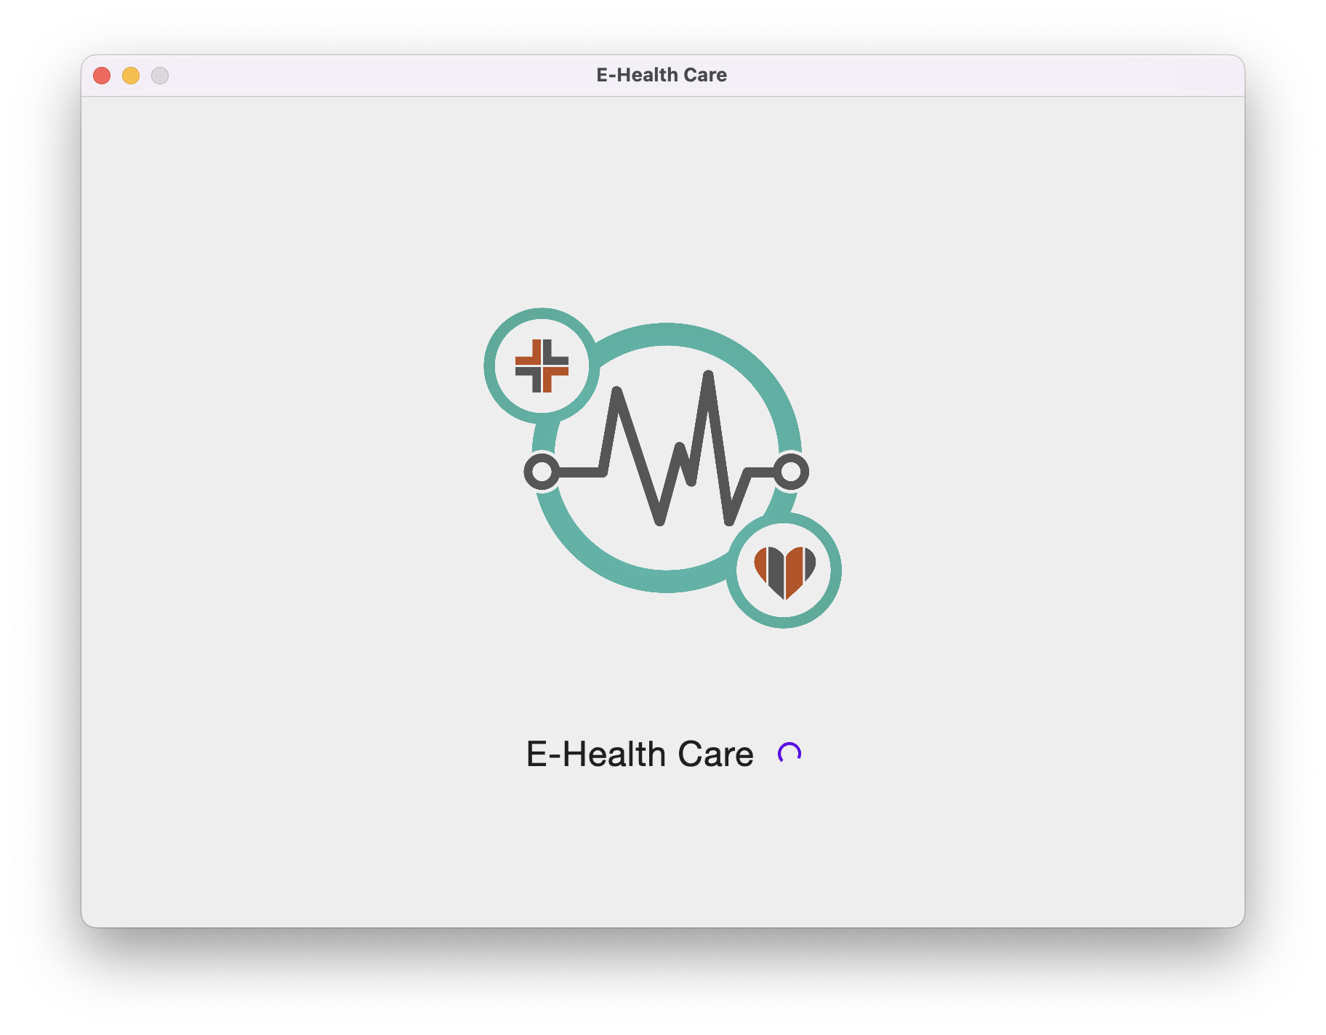
Implementation
This Splash Screen with check if the user is Authenticated or not.
If user is already logged in, it will open the main screen
Else it will ask the user to login

Slide 8
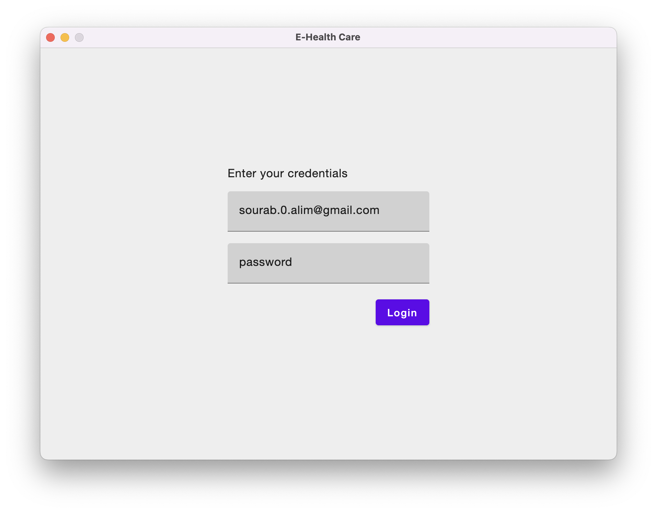
Implementation (Cont.)
User should put their login credentials to start using the software.

Slide 9
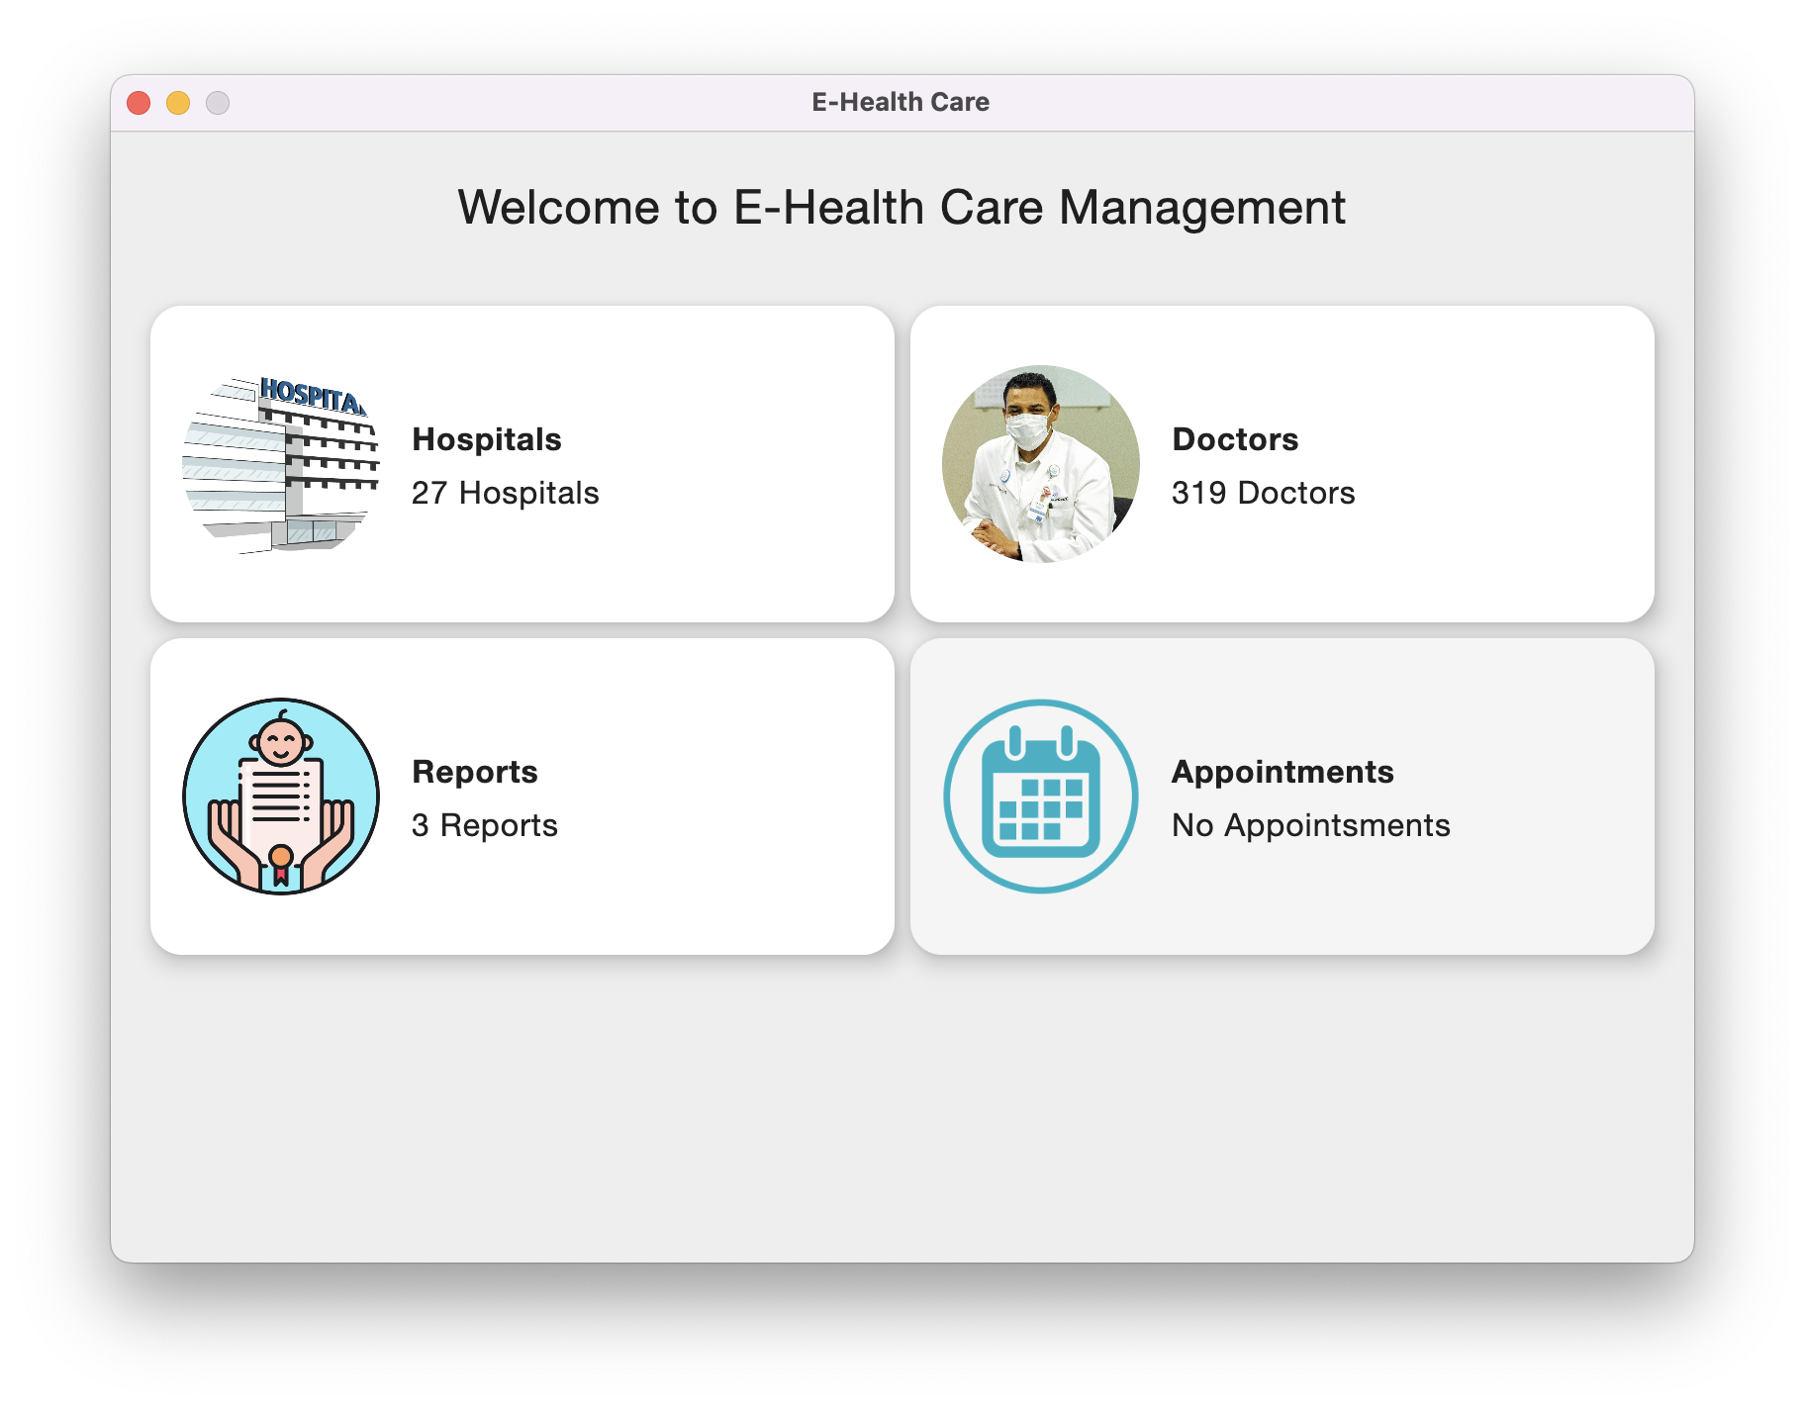
Implementation (Cont.)
This is the Main Screen, where user can get appointments of doctor by choosing hospital or doctor.

Slide 10
Limitation & Future Scope
Limitation
Future Scope
Lack of proper integration among different components of the system.
Limited scalability and customization options.
Lack of remote monitoring capabilities.
Limited access to real-time data.
Limited data security measures.
Improved integration of different components of the system.
Improved scalability and customization options.
Remote monitoring capabilities.
Improved data security measures.
Automated patient reminders and appointment scheduling.

Slide 11
Conclusion
The E-Health Care Management System provides a comprehensive and efficient way to manage patient information.
It provides an integrated platform to streamline and improve the delivery of healthcare services.
The system can be used to manage patient information, track appointments, monitor vital signs, and provide electronic prescriptions.
Additionally, it can help reduce the cost of healthcare delivery and improve the overall quality of care.

Slide 12


Thank you

