Slide 1
BoxAI : Real-Time AI Form & Technique Coach for shadowBoxing and Calisthenics
Munshi Alimushwan
300383063
CSIS 4260 (Winter 2026)
Course Faculty : Nikhil Bhardwaj

Slide 2
The Challenge
Athletes and coaches lack technology for immediate, objective feedback on form and technique
Training is subjective and delayed
No affordable, portable alternative for real-time coaching
Self-learning and performance tracking is manual and inconsistent

Slide 3
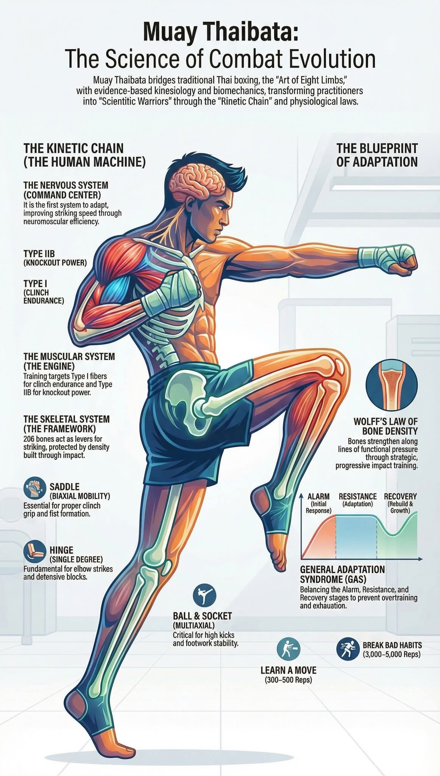
Kinetic Chain Analysis
The Kinetic Chain Sequential transfer of force and motion through connected body segments
Why It Matters
Generates maximum power and efficiency in punches and exercises
Correct chain = better performance + lower injury risk
Broken chain = weak technique, energy leaks, shoulder/elbow strain
How BoxAI Coach Analyzes It
Uses 33 MediaPipe landmarks to track joint angles and segment coordination in real time
Monitors key kinetic chain checkpoints:
Ground reaction (footwork & stance)
Hip & core rotation
Shoulder stability & sequencing
Elbow extension & wrist snap (boxing)
Core-to-limb transfer (pushups, squats, situps)

Slide 4
Project Objective
Develop a smart AI coach that:
Works with only a laptop webcam (no extra hardware)
Supports 6 movements (3 boxing + 3 calisthenics)
Provides real-time intelligent guidance (angle, distance, form)
Acts like a real coach with dynamic instructions
Saves joint data for self-learning
Generates detailed performance analytics

Slide 5
Literature review
Liang, J. (2022). Human Boxing Motion Prediction Using Neural Networks.
Bulun, S., & Berg, M. K. (2024). Real-Time Boxing Feedback Using Human Pose Estimation and Machine Learning. KTH Royal Institute of Technology.
Quinn, E., & Corcoran, N. (2024). The Automation of Computer Vision Applications for Real-Time Combat Sports Video Analysis.
Prymak, I. (2025). Using Artificial Intelligence Technologies to Analyze Technical and Tactical Actions in Boxing.
Li, T. et al. (2026). Integrating Psychological Profiling with Deep Learning for Enhanced Boxing Action Recognition.
Cizmić, D. (2022). Development of a machine learning based classification system for electronic martial arts equipment.
This project was heavily inspired by and built upon these research papers in AI, computer vision, and sports performance analysis.

Slide 6
System Architecture
System Architecture
Hardware: Laptop webcam only
Computer Vision: MediaPipe Pose (33 landmarks)
Real-time Processing: OpenCV + Python
Configuration: External JSON files (one per movement)
Self-Learning: Saved 3D joint data per session
Analytics: Pandas + Matplotlib post-session report

Slide 7
Key Features
Drill selection for 6 movements
Intelligent Director (real-time angle, distance, guard/form feedback)
Dynamic coach-style instructions with random pauses
Movement-specific rules (guard check only for boxing)
Automatic session data saving for self-learning
Full post-session analytics with graphs

Slide 8
Computer Vision Pipeline (MediaPipe + OpenCV)
MediaPipe Pose:
Model complexity = 1 (balanced speed vs accuracy).
Outputs 33 3D landmarks (normalized x, y, z + visibility score).
Key landmarks used:
Shoulders (11, 12) → facing angle
Nose (0) + heels (27, 28) → body distance
Wrists (15, 16) + chin approx ((0+7)/2) → guard check (boxing only)
Real-time loop:
cv2.VideoCapture(0)
pose.process(rgb_frame)
mp_drawing.draw_landmarks() for skeleton overlay
Custom calculations for angle, distance, guard
OpenCV putText() for all feedback and coach commands

Slide 9
Configuration System (External JSON)
Each movement has its own config file (config/movements/{key}.json):
name, commands list, optimal_angle_range, guard_threshold (boxing only), good_distance_min/max, color
Example for hooks:
Commands: Left Hook, Right Hook, Left Hook Right Hook, etc.
Angle tolerance tighter (25°) because hooks are best seen from side 3/4 view.
This makes the system easily extendable to calisthenics or new sports (no hard-coded values).

Slide 10
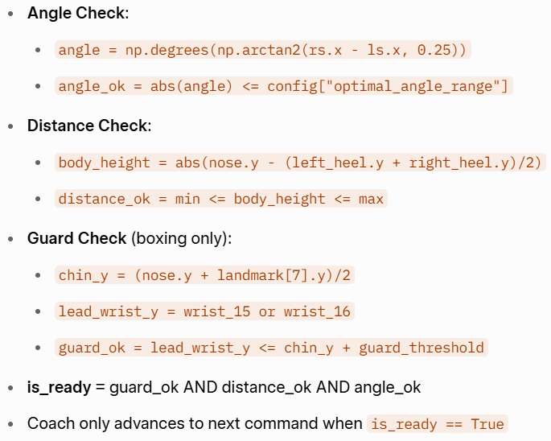
Intelligent Director
Continuously monitors facing angle, distance, and form
Only gives commands when position is correct
Gives clear, immediate instructions to fix issues
Boxing: Guard height check
Calisthenics: General form check

Slide 11
Dynamic Coach Instructions
Realistic boxing combos (Jab, 1-2, Left Hook–Right Hook, etc.)
Calisthenics commands (Pushup, Slow Squat, etc.)
Random pauses between commands (like a real coach)
Coach waits until user fixes position before continuing

Slide 12
Dynamic Coach Instructions(CONTINUED)
Commands are stored in the movement’s config.
Only advances when user is in correct position.
Random pause between commands: random.uniform(2.0, 5.0) seconds.
When not ready → shows “Fix position first” (no command given).
Boxing uses left/right specific combos (more realistic).
Calisthenics uses simple exercise-specific commands.

Slide 13
Data Saving & Self-Learning Foundation
Every frame saves full 33-landmark data:
JSON
{"x": ..., "y": ..., "z": ..., "visibility": ...}
Saved to data/sessions/final_capstone_YYYYMMDD_HHMMSS.json
This data can be used later for:
Custom ML model fine-tuning (LoRA)
User-specific form correction
Long-term progress tracking

Slide 14
Post-Session Analytics
Guard Compliance %
Distance Compliance %
Angle Compliance %
Coach Following Score % (how well user followed instructions)
Overall Form Score %
Graph of guard height, distance, and angle over time

Slide 15
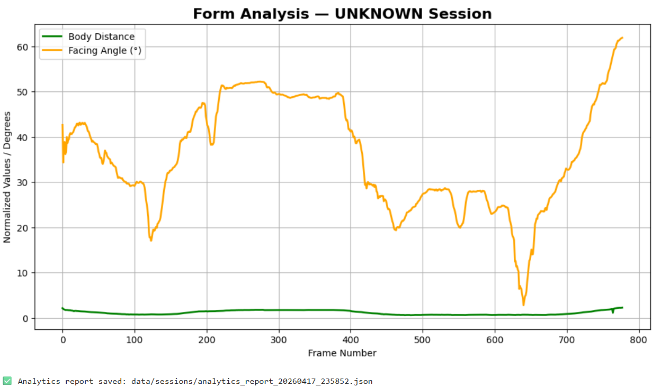
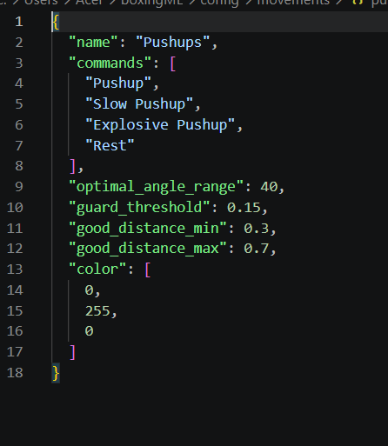
Demonstrations

Slide 16
What I Learned
Real-time computer vision is powerful but sensitive to lighting and camera angle
Boxing and calisthenics need completely different analysis logic
External JSON config makes the system very easy to extend
Saving raw landmark data creates a strong foundation for future ML

Slide 17
Limitations of the Models
- Rule-based (not trained ML) → less adaptive than deep learning models
Single webcam only → can lose accuracy at extreme angles or poor lighting
No rep counting yet
No voice feedback yet
Analytics currently session-based (no long-term progress tracking)

Slide 18
Conclusion & Future Work
Conclusion
Successfully built a practical, low-cost AI coach
Demonstrates real-time computer vision and data analytics in sports training
Future Work
Add voice feedback (TTS)
Mobile app version
Advanced ML for automatic form correction
Cloud storage for long-term progress tracking

