Slide 1
Threading
Learning group

Slide 2
Notes
This should be fun
Learn together or recap threading
Mention: Thank you for helping me to finish the courses on Threading! ^_^

Slide 3
Agenda
Basic (Low level concepts) – 30 min
Threads
Tasks
Synchronization concepts
Advanced (High level concepts) – 20 min
TPL – Task parallel library
PLINQ – Parallel LINQ
TAP – Task async pattern

Slide 4
Basic (Low level concepts)
Threads
Tasks
Synchronization concepts

Slide 5
Synchronization concepts
Locks vs Mutex
???
Mutex vs Semaphore
???
Semaphore vs SemaphoreSlim
???

Slide 6
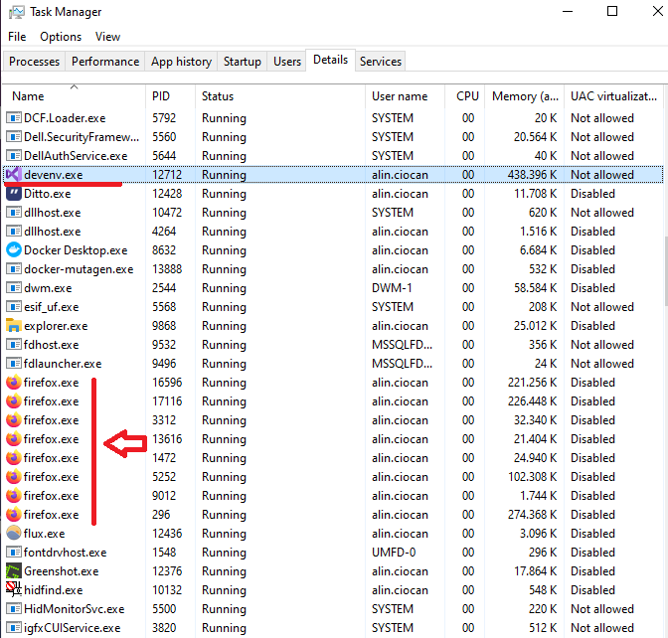
Synchronization concepts
Locks vs Mutex
???
Mutex vs Semaphore
???
Semaphore vs SemaphoreSlim
???

Slide 7
Advanced (High level concepts)
Parallel code:
TPL - Parallel.ForEach()
PLINQ - .asParallel()
Asynchronous code:
TAP (async/await pattern)

Slide 8
Thank you AGAIN

