Slide 1
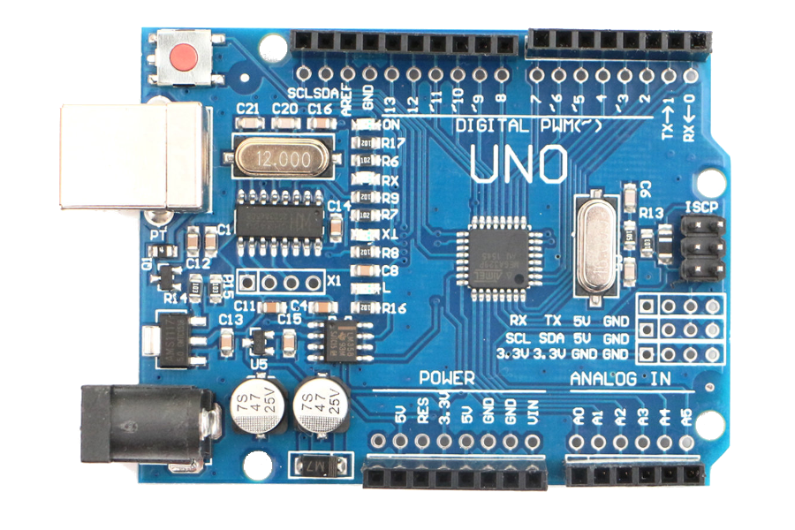
Microcontroller
Reset button
Digital pins
USB connector
Clock
USB Driver
CH340
Voltage regulator
Power connector
Power pins
Analog pins

Slide 2
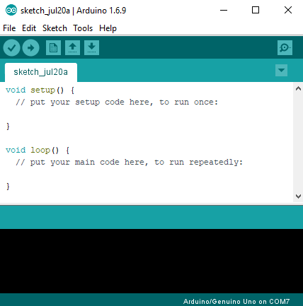
New, open, save
Menu bar
File name
Menu bar
Verify code
Upload code
Arduino code: setup
Arduino code: loop
Compilation output
MCU and serial port

