Slide 1
Online Retail II - Sales Analysis Report
Auto-generated using Python (pandas, matplotlib, pptx)

Slide 2
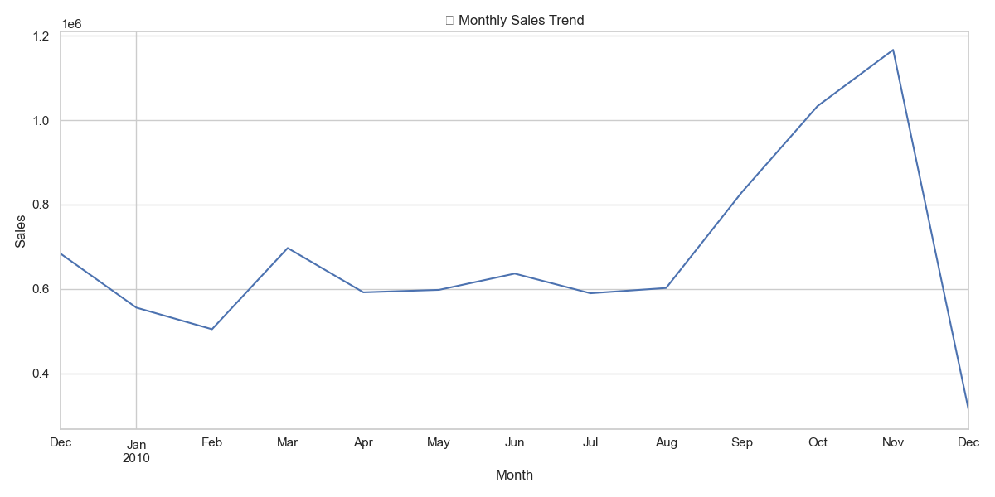
Monthly Sales Trend

Slide 3
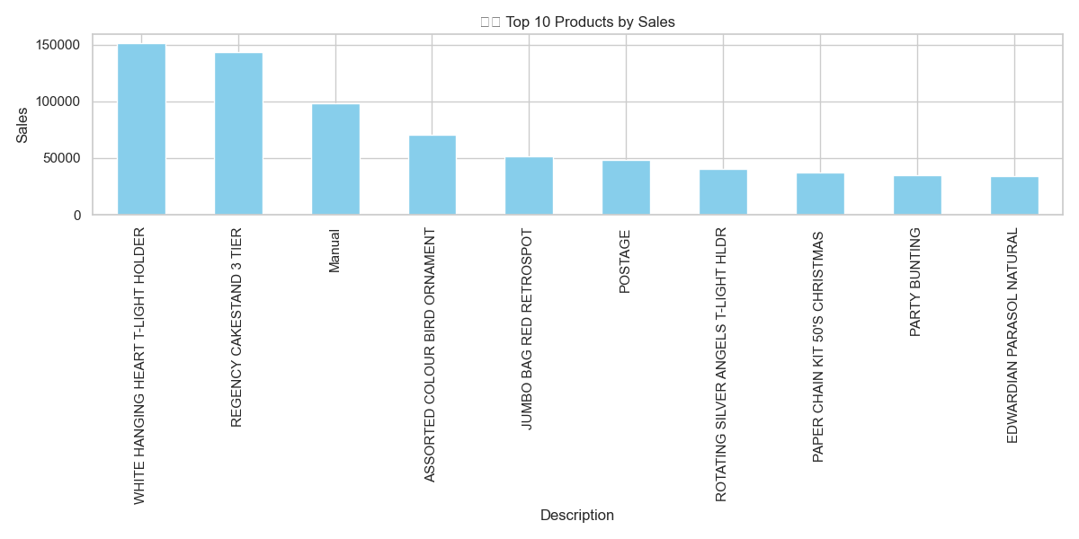
Top Products

Slide 4
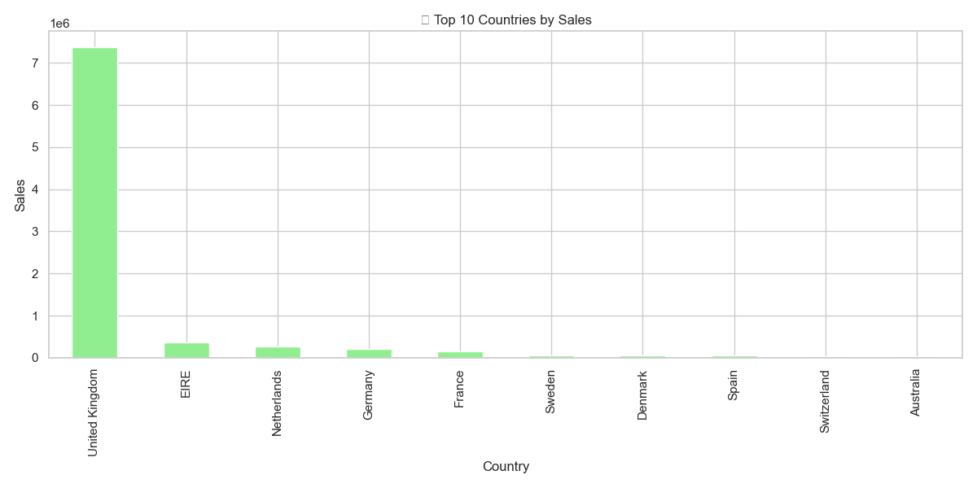
Top Countries

Slide 5
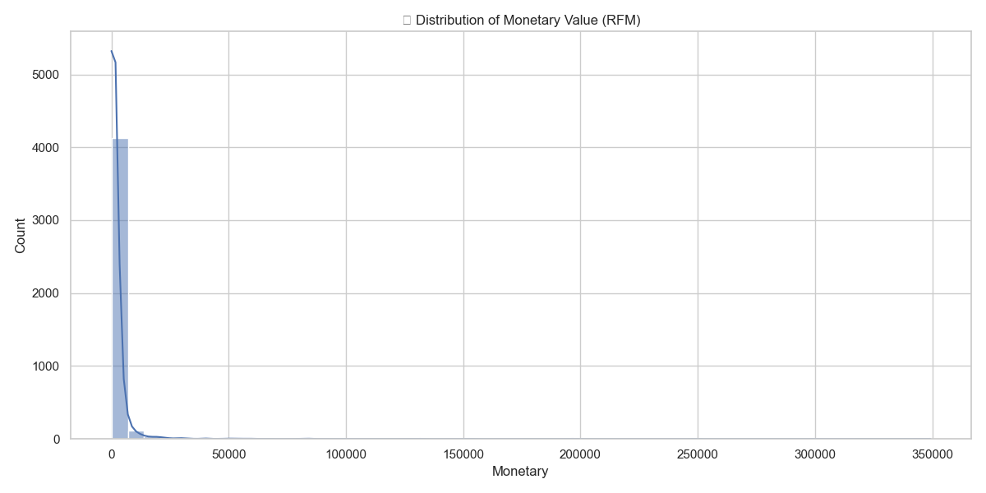
RFM - Monetary Distribution

