Slide 1
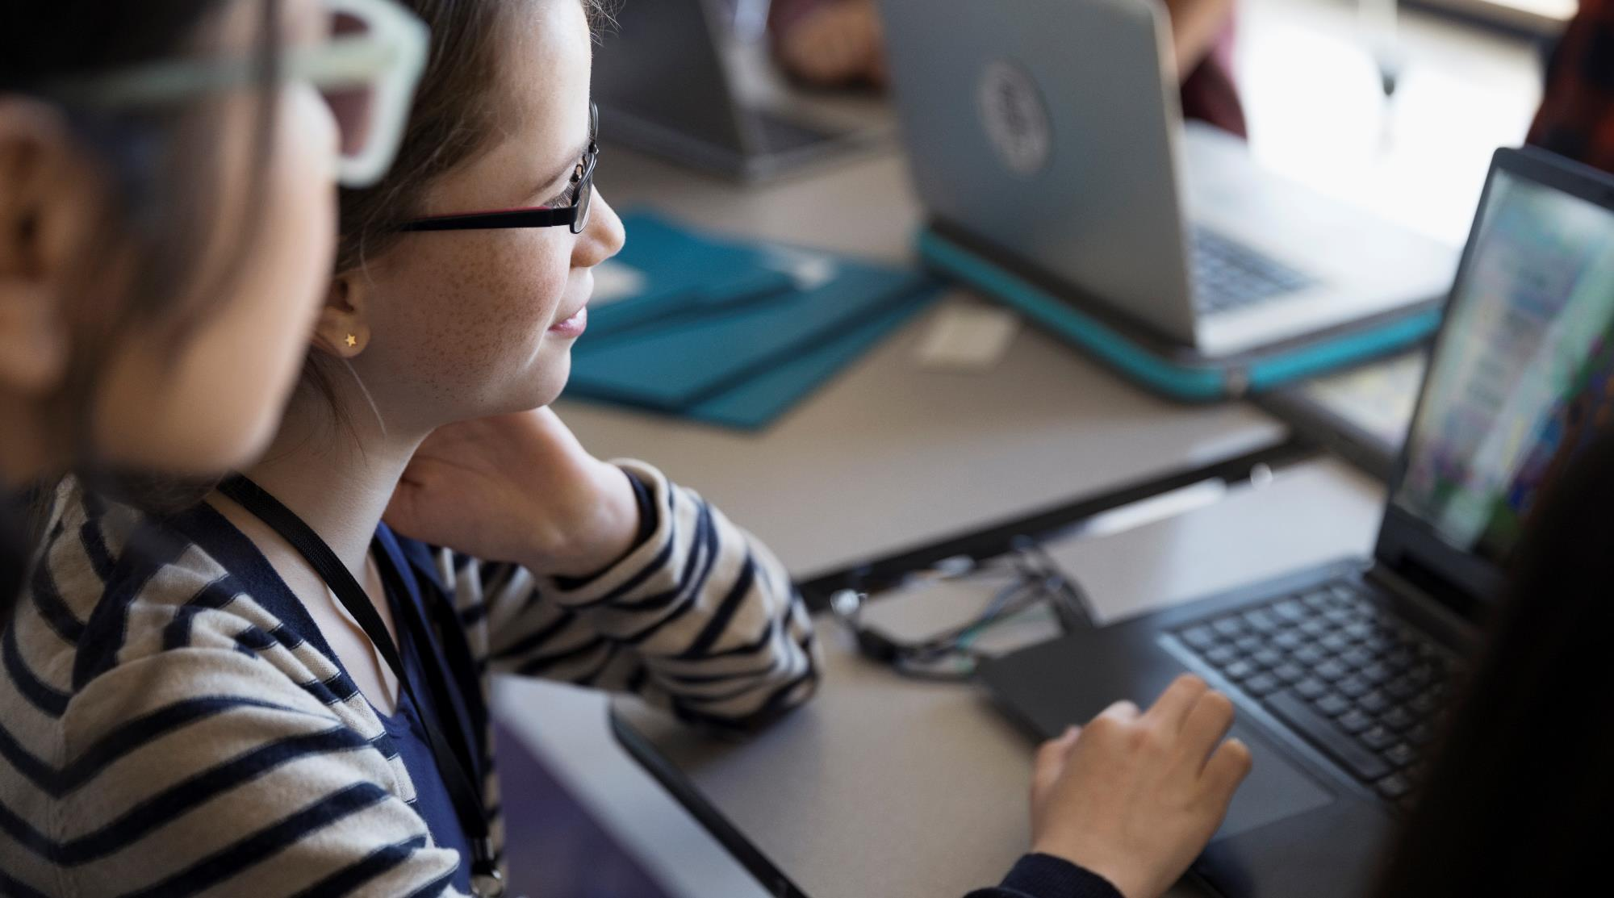
Hi everyone, I'm Alina Afzaal, and I'm thrilled to connect with you through this video.
Alina Afzaal.

Slide 2
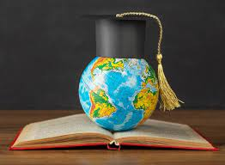
Academic Background
I pursued my Bachelor's in Computer Science from the Gujrat Institute of Management Science, affiliated with Arid Agriculture University. I'm proud to say that I graduated as the topper of my batch with a remarkable 3.9 CGPA. I have created PHP website in my in year project.
I was also working on mobile applications and developed some basic app.
Now enhancing my app development using flutter.
BSCS-Bachelors of Computer Science 2023

Slide 3
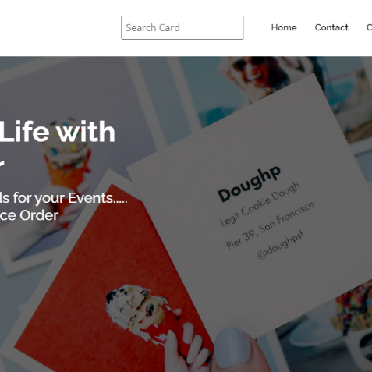
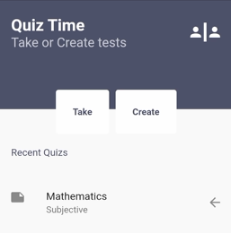

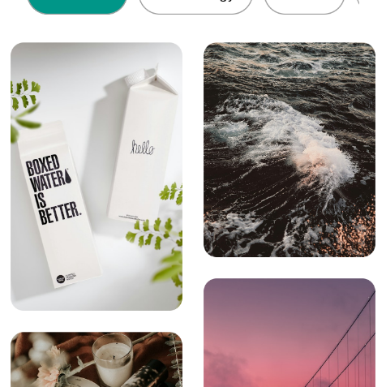
My work
Online Cardmaker
Quiz App
Todo App
Wallpaper
PHP website having cards template that can be edit and order
Flutter App for subjective an d objective quizes
Flutter Simple todo app with SQLite
Flutter Wallpaper App using Unsplash

Slide 4
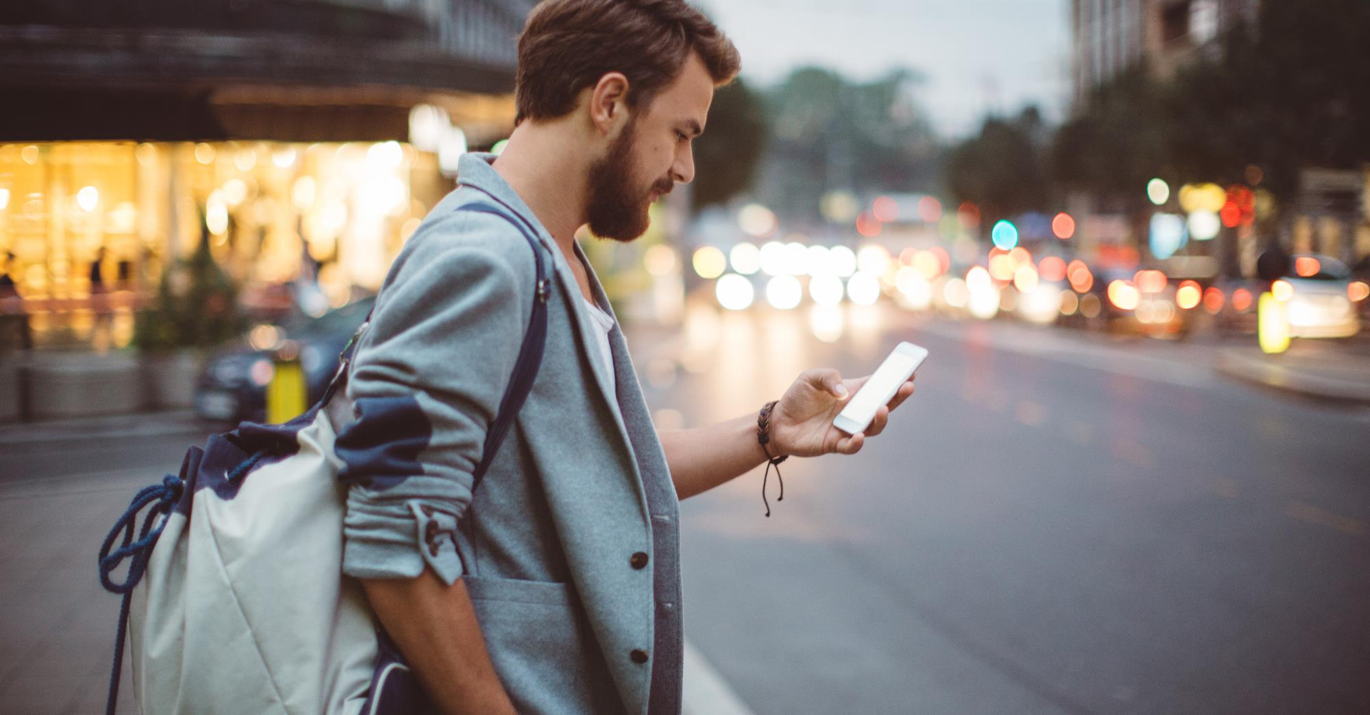
hobbies
Beyond the binary world of coding, I find joy in poetry, capturing moments through traveling, and of course, indulging in the art of pics and selfies.

Slide 5
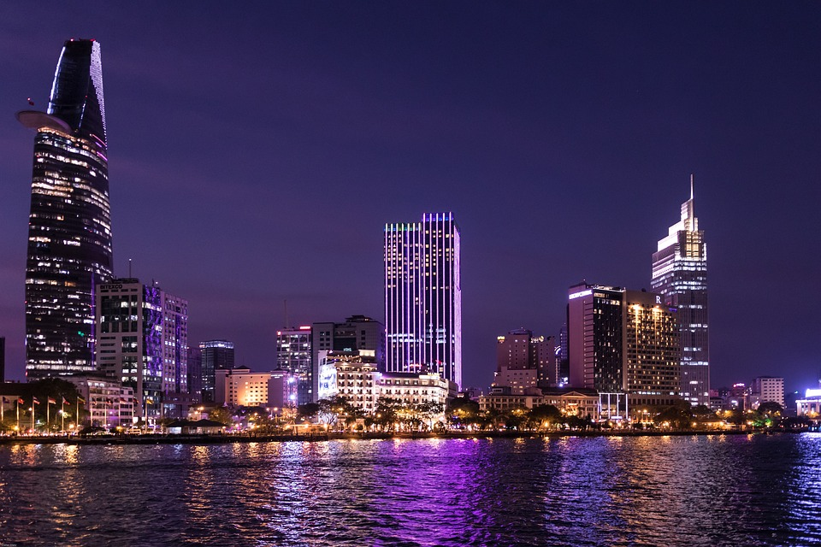
goals
Explore Mobile App Development
Work on Real-world Projects
Apply Strategically

Slide 6
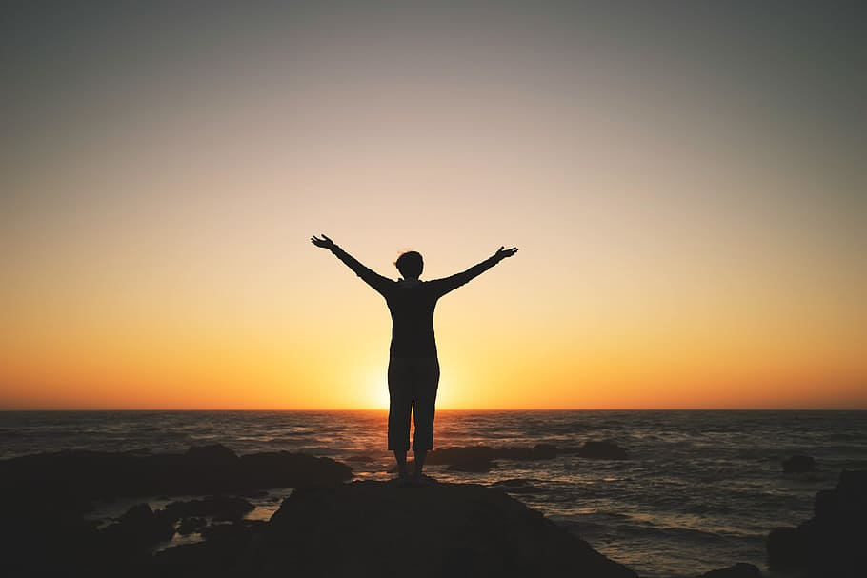


Thank You internee.pk for the great opportunity
Alina Afzaal
alinaafzaalhussain@email.com

