Slide 1


M.Tech Program
Advanced Industry Integrated Programs
Jointly offered by University and LTIMindTree
Review III
GraphRAG - Based Smart Additive Manufacturing for Process Parameter
Optimization
BY ALINA NASIR AGA
VIT CHENNAI
Knowledge partner | Implementation partner

Slide 2
Introduction
Laser Powder Bed Fusion (LPBF) is an advanced additive manufacturing process for producing complex metal components.
Process parameters such as laser power, scan speed, hatch spacing, and layer thickness strongly affect product quality.
Selecting optimal parameters is challenging due to the complex relationship between process parameters, porosity, and tensile strength.
This project combines Machine Learning, Neo4j Knowledge Graph, GraphRAG, and Llama 3.1 8B for intelligent process optimization.
The system recommends parameters to minimize porosity while maintaining high tensile strength.

Slide 3
Objective
Build a Manufacturing Knowledge Graph.
Retrieve domain knowledge using GraphRAG.
Predict manufacturing outcomes using ML models.
Optimize process parameters for quality and defect reduction.
Generate explainable recommendations using Llama.

Slide 4
Module name
Subtopic
Dataset & Preprocessing - Dataset Understanding, Data Cleaning, EDA, Feature Engineering
Machine Learning - Porosity Prediction, UTS Prediction, Model Training, Model Validation
Knowledge Graph - Neo4j Aura, Graph Construction, Material–Process–Sample Relationships
GraphRAG & Generative AI - Query Understanding, Graph Retrieval, Llama 3.1 8B, AI-based Explanation
Optimization & Application - Parameter Recommendation, FastAPI Backend, Streamlit Dashboard, History & Analytics

Slide 5
Problem Statement
Engineers in additive manufacturing face challenges in selecting optimal process parameters such as laser power, scan speed, layer thickness, and hatch spacing.
Incorrect settings can cause defects such as porosity, cracks, lack of fusion, and poor surface quality.
Traditional trial-and-error approaches are costly, time-consuming, and lack explainability.

Slide 6
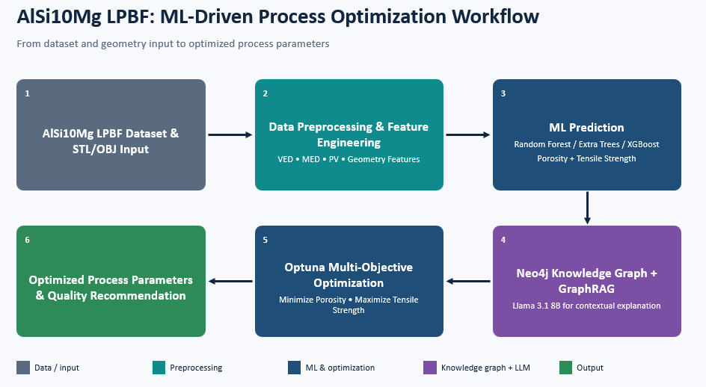
Methodology

Slide 7
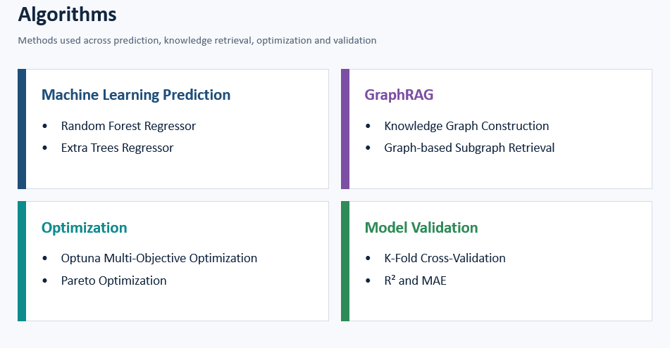
Approach/Algorithms/Tools

Slide 8
Approach/Algorithms/Tools
Tools
Programming – Python
ML - Scikit-learn
Deep/GenAI - Llama 3.1 8B
Graph Database - Neo4j AuraDB
GraphRAG - Neo4j + GraphRAG pipeline
Optimization - Optuna 5.0.0
Web Application – Streamlit
3D Input - STL / OBJ
Backend/APIPython / FastAPI

Slide 9
Findings and Results
EXTRA TREES – POROSITY
R² : 0.9543
MAE : 0.2757 %
RANDOM FOREST – UTS
R² : 0.9532
MAE : 7.1925 MPa

Slide 10
Conclusion
The proposed framework combines ML, GraphRAG, and multi-objective optimization to enable accurate, explainable, and optimized AlSi10Mg LPBF process parameter selection.
The ML models predict key manufacturing outcomes such as porosity and tensile strength using process and derived features including VED, MED, PV, and geometry-related parameters. The Knowledge Graph and GraphRAG components provide context-aware and explainable recommendations, while Optuna identifies process parameters that simultaneously minimize porosity and maximize tensile strength.
Overall, the framework provides a data-driven, explainable, and optimization-oriented approach for improving LPBF process quality and supporting intelligent manufacturing decisions.

Slide 11
Acknowledgement
I would like to express my sincere gratitude to my project guide, Dr. Ganesa Ramachandran Arunachalam, for his valuable guidance, continuous support, and constructive feedback throughout the development of this project. His expertise, encouragement, and suggestions were instrumental in successfully completing this work.
I would also like to extend my sincere thanks to the faculty members and staff of Vellore Institute of Technology (VIT), Chennai, for providing the necessary facilities, resources, and academic support required to carry out this project.

Slide 12
Reference
DebRoy, T., Wei, H. L., Zuback, J. S., et al. (2018). Additive manufacturing of metallic components – Process, structure and properties. Progress in Materials Science, 92, 112–224.
Neo4j. Neo4j Graph Database and GraphRAG Documentation.
Scikit-learn Documentation. Machine learning algorithms and model evaluation.
Optuna Documentation. Hyperparameter and multi-objective optimization framework.

Slide 13
M.Tech Program
Advanced Industry Integrated Programs
Jointly offered by University and LTIMindTree
Review III
MacroStress - GAN: Multi-Agent GenAI Framework for Indian Financial Market
BY ALINA NASIR AGA
Knowledge partner | Implementation partner

Slide 14
Introduction
Financial institutions perform stress testing manually by creating crisis scenarios, simulating outcomes, and calculating portfolio risk.
Challenges:
Time consuming
Difficult to test multiple crisis events
Limited scalability and automation

Slide 15
Objective
Understand crisis scenarios using Llama LLM.
Analyze historical market data.
Generate stress scenarios using TimeGAN.
Calculate VaR, ES, Expected loss, MDD.
Use a multi-agent AI framework.
Generate explainable risk reports.

Slide 16
Module name
Subtopic
Data Collection & Preprocessing
Exploratory Data Analysis
Synthetic Data Generation
Stress Scenario Generation
Financial Risk Analysis
Multi-Agent Analysis
Visualization & Report Generation

Slide 17
Problem Statement
To develop a Multi-Agent Generative AI framework that generates realistic macroeconomic stress scenarios, quantifies portfolio risk, optimizes asset allocation, and independently validates financial resilience under extreme market conditions

Slide 18
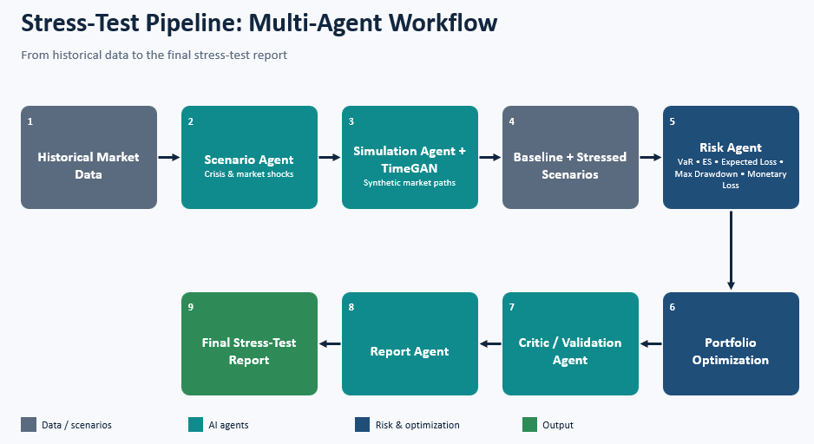
Methodology

Slide 19
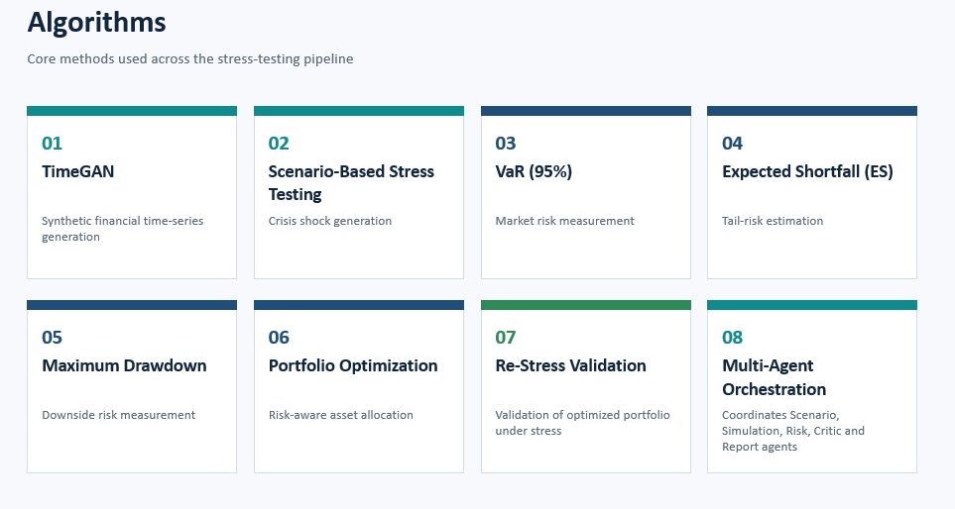
Approach/Algorithms/Tools

Slide 20
Approach/Algorithms/Tools
Tools
Programming – Python
Generative AI - TimeGAN, Llama 3.1 8B
Agent Framework – LangGraph
Database – PostgreSQL
Backend – FastAPI
Dashboard - Streamlit

Slide 21
Findings and Results
TIMEGAN EVALUATION
Discriminative Score : 0.4250
Predictive Score : 0.2494
Correlation Similarity : 0.9801
Wasserstein Distance : 0.0084

Slide 22
Conclusion
MacroStress-GAN combines Multi-Agent AI, TimeGAN, financial risk analytics, and portfolio optimization to enable automated and validated financial stress testing.
The system generates synthetic market scenarios, applies crisis-specific shocks, evaluates VaR, Expected Shortfall, Expected Loss, and Maximum Drawdown, and optimizes portfolio allocation.
Critic-based validation and re-stress testing further verify the effectiveness of the optimized portfolio, enabling comprehensive and data-driven financial risk assessment.

Slide 23
Acknowledgement
I would like to express my sincere gratitude to my project guide, Dr. Ganesa Ramachandran Arunachalam, for his valuable guidance, continuous support, and constructive feedback throughout the development of this project. His expertise, encouragement, and suggestions were instrumental in successfully completing this work.
I would also like to extend my sincere thanks to the faculty members and staff of Vellore Institute of Technology (VIT), Chennai, for providing the necessary facilities, resources, and academic support required to carry out this project.

Slide 24
Reference
Yoon, J., Jarrett, D., & van der Schaar, M. (2019). “Time-series Generative Adversarial Networks.” Advances in Neural Information Processing Systems (NeurIPS). NeurIPS Proceedings
Meta AI. (2024). “Introducing Llama 3.1.” Meta AI. Meta AI
LangGraph Documentation – Framework for stateful and multi-agent workflows. LangChain Reference Docs
PyTorch Documentation – Deep learning and tensor computation framework.

