Slide 1

FutureFrame: Smart chatbot assistant for Human Design
Alina Hyk & Samuel Jamieson

Slide 2

What is Human Design?

Slide 3


AI-Driven Assistance for Human-Design Consulting

Slide 4

What problems are we solving?
Bridging Knowledge and Accessibility
Transforming Static Information into an Interactive Resource
Reducing Cognitive Overload for Consultants and Clients
Preserving and Systematizing Expertise

Slide 5
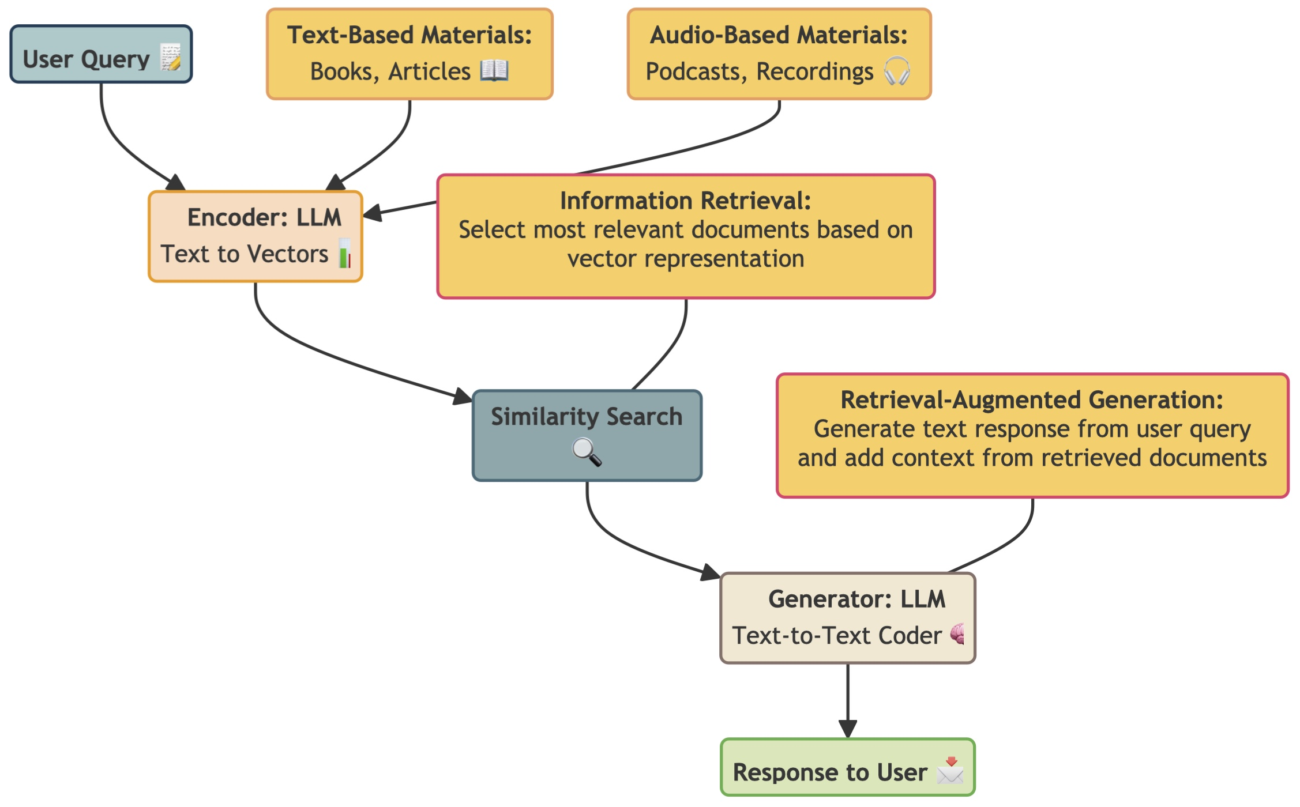
High-level overview:

Slide 6

Main tools that will be used:
Python as a main language of the project
PDF processing python library (High Efficiency & Accuracy/No API Costs)
Whisper OpenAI API (State-of-the-Art Accuracy/Robustness and Multilingual Support)
OpenAI embeddings generator models (High Semantic Fidelity: 1,536-dimensional vectors/Cost Efficiency at Scale)
OpenAI GPT-4o APIs (Advanced Reasoning and Understanding/Larger Context Window)
Qdrant Vector Database (Open-Source & Self-Hostable/Scalability & Durability)
LangChain software framework (Streamlined RAG Pipeline/Modular and Reusable Components)

Slide 7
Let’s take a step-by-step overview…

Slide 8

Data integration tools:
PDF text extrications: PyMuPDF Python library
PDF visuals extrications (stretch goal): Optical Character Recognition (OCR), Keras-OCR or Doctr Python library
Audio file processing/text extrications: Whisper (OpenAI) API
Raw text data storage: JSON or Python dictionary: {type (pdf”/audio), source, full text , stretch goal (key-words)}

Slide 9
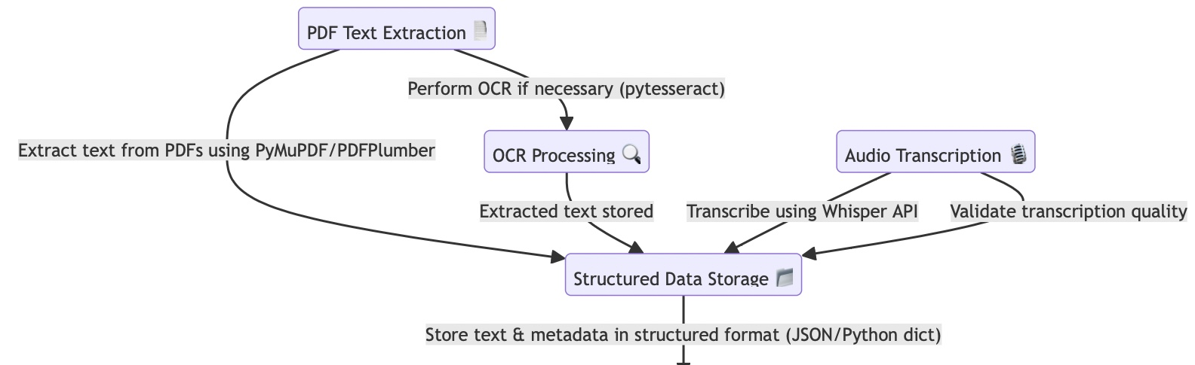
Data integration workflow

Slide 10
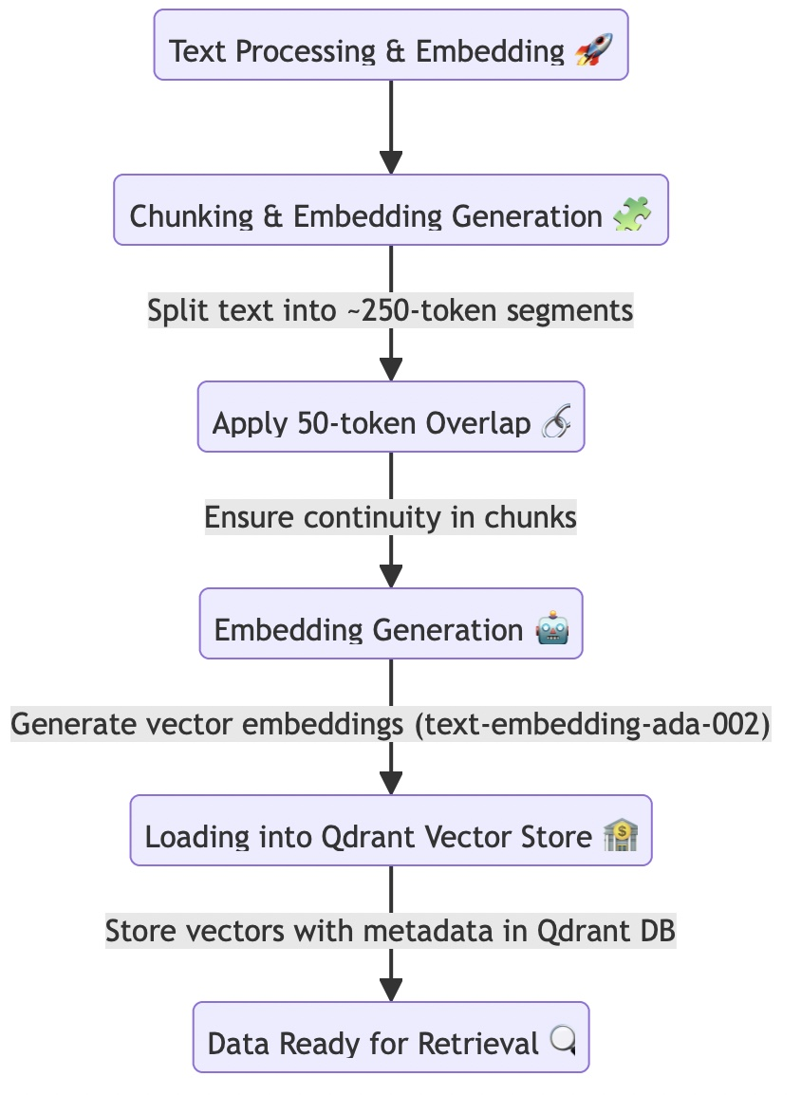
Embeddings generation
Purpose: Converts text into numerical vectors, enabling semantic search and retrieval of relevant information based on meaning.
Tool Used: OpenAI’s text-embedding-ada-002 – fast, cost-effective, and optimized for retrieval tasks.
Storage: Qdrant Vector Database – a high-performance vector search engine that indexes and retrieves relevant document chunks efficiently.

Slide 11
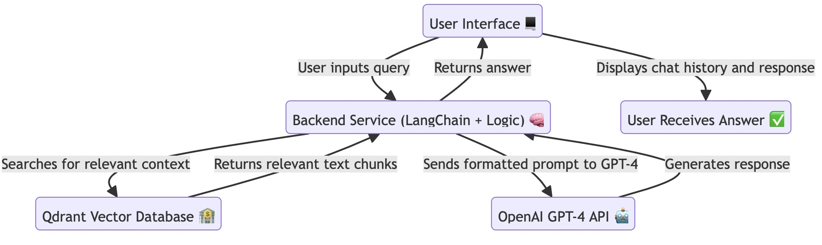
Implementation:

Slide 12

How will it look like?

Slide 13
Potential Risks
Data-Related Risks:
Transcription Errors
Inconsistent Formatting
AI Hallucination & Accuracy Risks/User Experience Risks:
Hallucinated Responses
Over-Reliance on LLMs
Inconsistent Responses
Long wait time
System Reliability Risks:
Retrieval Failure
Server Downtime
Security & Privacy Risks:
Unauthorized Access

Slide 14
What testing will be performed?

Slide 15
Functional Testing
Minimizes Data-Related Risks
Unit Tests:
Verify text preprocessing (e.g., chunking PDFs correctly)
Validate Qdrant retrieval (ensuring that relevant documents are returned).
Integration Tests:
Ensuring query → embedding → retrieval → GPT-4 response → UI rendering happens correctly
Verify the web UI correctly displays conversation history
Ensure authentication works and blocks unauthorized access.
Minimizes System Reliability Risks/ Security & Privacy Risks

Slide 16
Performance Testing
Minimizes System Reliability Risks/User Experience Risks
Load Testing:
Simulate multiple concurrent users querying at the same time.
Analyze EC2 server CPU & memory usage under heavy traffic.
Measure Qdrant search speed and OpenAI API response times (e.g., retrieving embeddings within milliseconds)
Stress Testing
Send high query volumes to check if the chatbot crashes.
Measure API rate limits—ensure OpenAI calls don’t exceed quota (especially in embeddings generation)
Minimizes System Reliability Risks/Data-Related Risks

Slide 17
Usability Testing
User Experience (UX) Testing:
Test chat layout on desktop and mobile for responsiveness.
Verify chat history is easy to scroll and navigate.
A/B Testing:
Comparing different prompts, and different top-k retrievals

Slide 18
Human-subject tests
In-class testing during the final presentation
Testing and post-testing quality assessment interviews with our clients and their user-experience

Slide 19
What is our timeline?
Week 7: Development & Integration:
Finalize data integration workflow
Implement embeddings generation pipeline using OpenAI’s
Initial LLM integration with OpenAI GPT-4o for response generation
Week 8: Testing & Optimization:
Conduct performance testing
Address system reliability risks
Implement security measures
Week 9: Final Adjustments & Presentation Prep:
Finalize testing results & risk mitigation strategies
Prepare presentation/demo materials
Conduct final internal review before project submission/presentation

Slide 20

Thank you!

