Slide 1
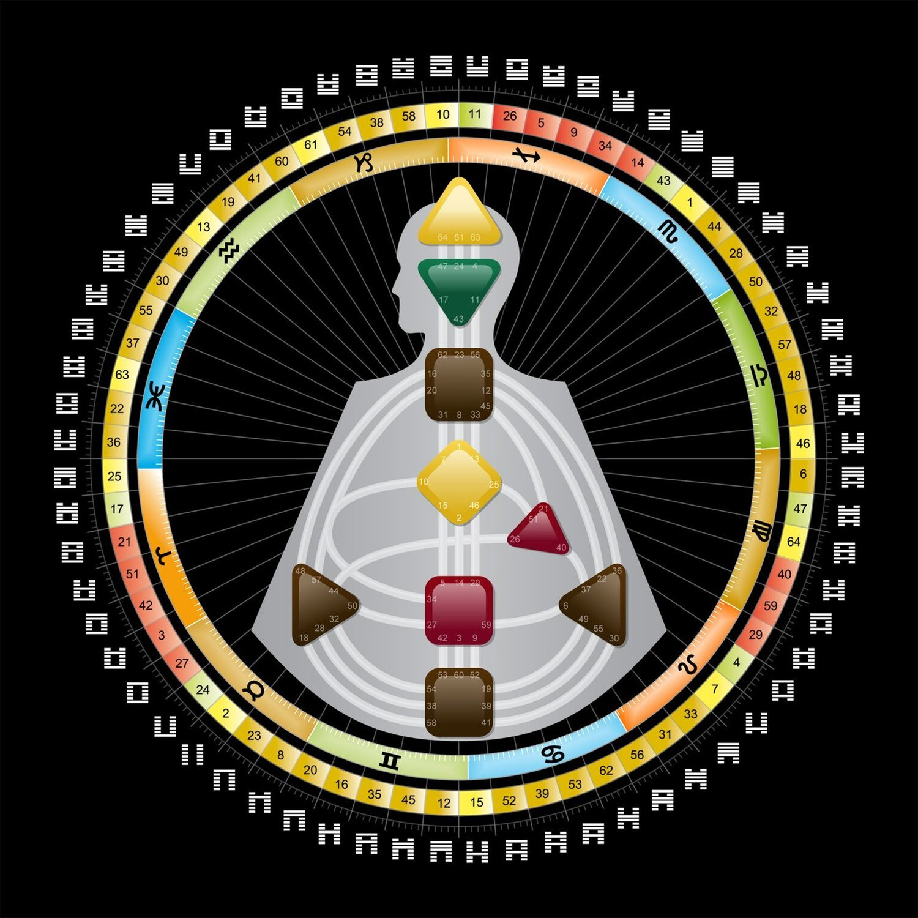
FutureFrame: AI-Driven Assistance for Human-Design Consulting
Alina Hyk and, hopefully, six more highly motivated students…)

Slide 2
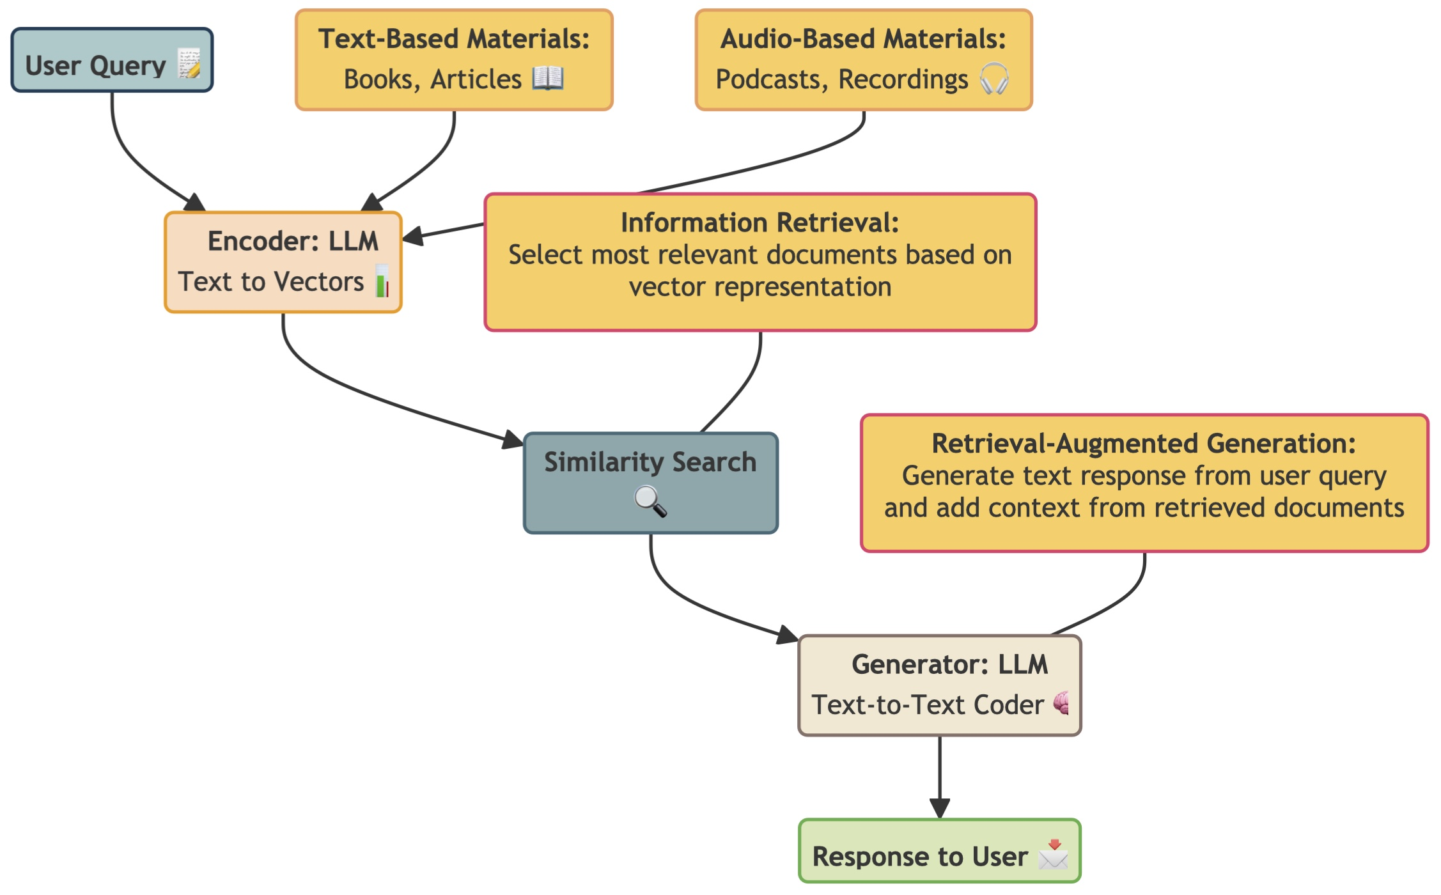
What is the project about?
In terms of philosophy: Human Design is a system blending ancient wisdom and modern science to reveal your unique energy, strengths, and decision-making style. It categorizes people into five types and helps you live authentically and with purpose.
In technical perspective:

Slide 3
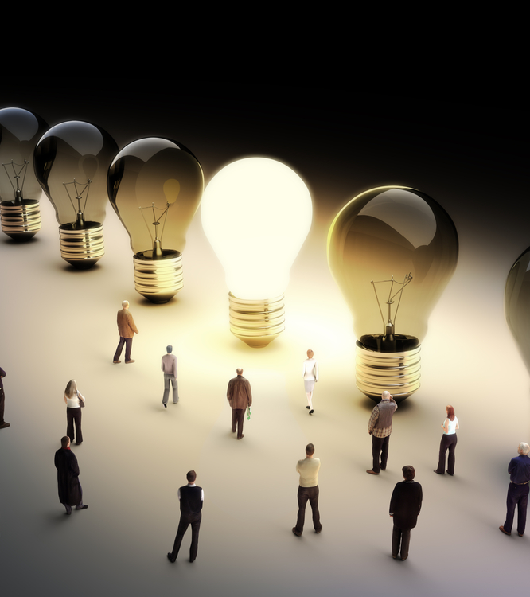
Why this project (employees)?
Unique application of tools previously unavailable on the market.
Access to unique information and philosophy in the process of development and testing.
Potential for further full-time employment on the project.
Application of high-level skills and a clear demonstration of expertise in topics such as information retrieval, Natural Language Processing (NLP), and AI.
Real-world client project launched at the company, with research showing:
Improvements in final grades by nearly 20%.
A 45% increase in hiring rates.
Enhanced professional skills by more than 10%.

Slide 4
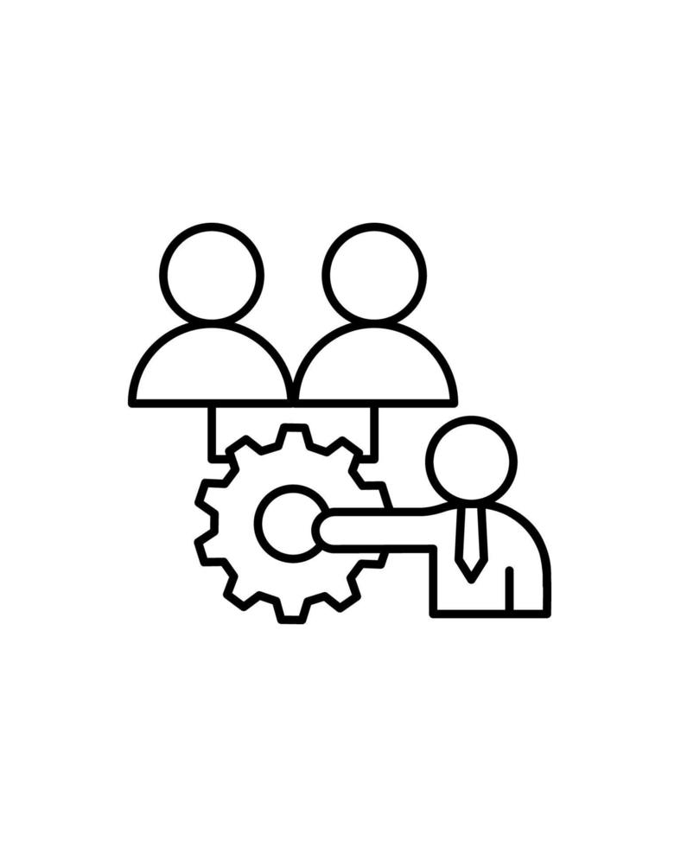
Why this project (venture capitalists)?
Unique product with no competitors.
Adherence to in-demand techniques and practices in AI tool application, relevant for both improvement and research (grad school).
Since the project is for an actual client:
Rigorous requirements for team management, deadline tracking, and structured processes.
One-to-one modeling of company workflows.
Alignment with industry standards.

