Slide 1

THANK YOU!
#EuroTestConf

Slide 2
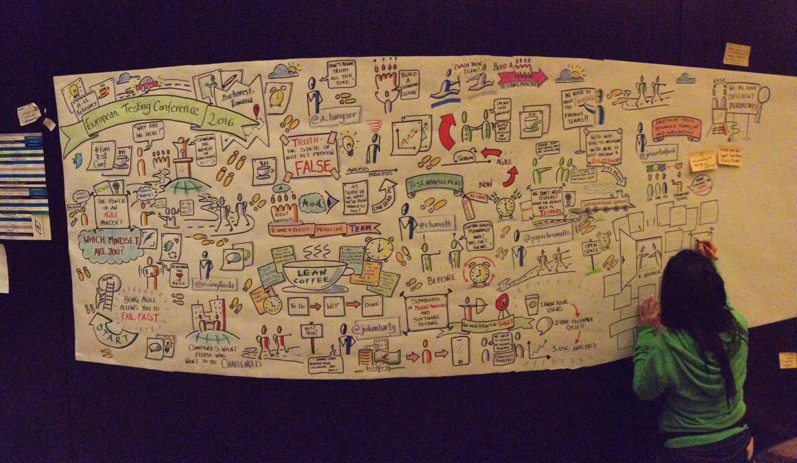

Slide 3






Our Sponsors
PLATINUM
GOLD

Slide 4


Slide 5
SEE YOU NEXT YEAR!
#EuroTestConf goes Finland

