Slide 1

Wifi: RadissonGuest / Key: restaurant
WELCOME!
#EuroTestConf

Slide 2
CHANGING THE WORLD OF CONFERENCES
Notes:
Practical, about practitioners sharing the craft
Testing, not testers. As performance and as artifact creation
Not making speakers pay to speak and eventually paying for speaking to create the best contents year after year

Slide 3
4 KEYNOTES 6 WORKSHOPS 15 TALKS LEAN COFFEE –DISCUSSION OPEN SPACE

Slide 4
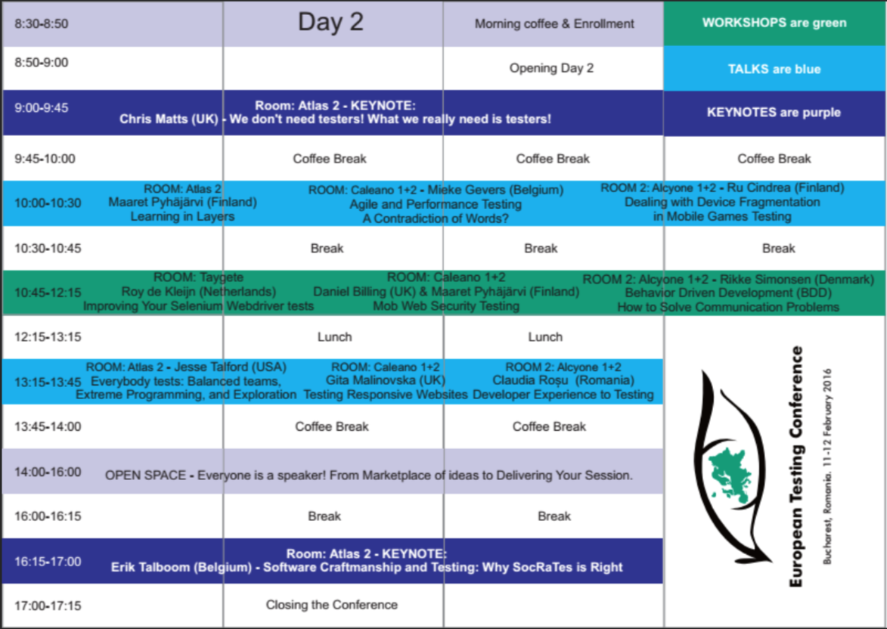
Atlas 2
Thomas, Richard & Llewellyn

Slide 5
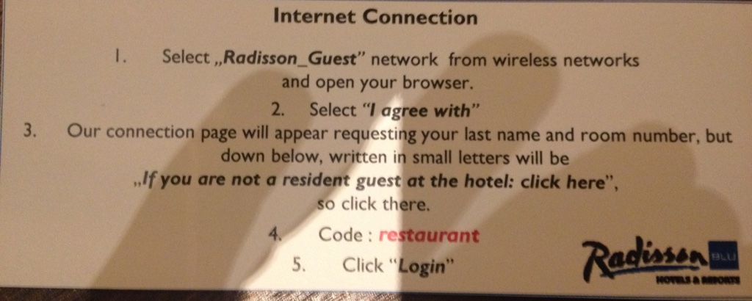
Wi-Fi Code: restaurant

Slide 6
TWITTER: #EuroTestConf

Slide 7

You Have Been Invited!

Slide 8
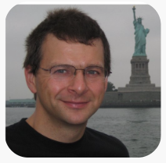
A Conference Gift from Julian Harty

Slide 9
OTHER PRACTICALITIES

Slide 10






Our Sponsors
PLATINUM
GOLD

