Slide 1
Folder structure with python files per folder
home
bmat.py
gmx2qmmm.py
readInput.py
operations
atoms_from_xyz.py
bmat.py (similiar to file in home folder)
expansion_check.py
generate_top.py
geo_from_hes.py
geo_from_xyz.py
geo_xyz_g09RevA_02_log.py
hes_xyz_g09RevD_01_fchk.py
hessian_from_hes.py
mass_from_hes.py
nma_3N_6dof.py
nma_helper.py
nma_stuff.py
qmmm.py
qmmm_helper.py
qmmm_job.py
xyz_zmat_g16RevA_02.py
gmx2qmmm
_helper.py
tools
pointcharges
create_droplet.py
generate_charge_shift.py
generate_pcf_from_top.py
prepare_pcf_for_shift.py
sum_pcf_tm.py
overview done

Slide 2
special variables
qmmmtop:
self.qmmmtop = str(self.qmmmparams.jobname + ".qmmm.top")
(I don‘t know how this file looks, maybe make a list with examples of such files?)

Slide 3
README
All content in this file should be in English now. If you find German text, feel free to change it to English or leave a comment.
The string „XX“ marks parts that are to be discussed or questions. Feel free to leave you thoughts as a comment.
The file is created by Alina Jansen. If you leave a comment, please leave your initials with it to avoid confusion.

Slide 4
gmx2qmmm.py

Slide 5
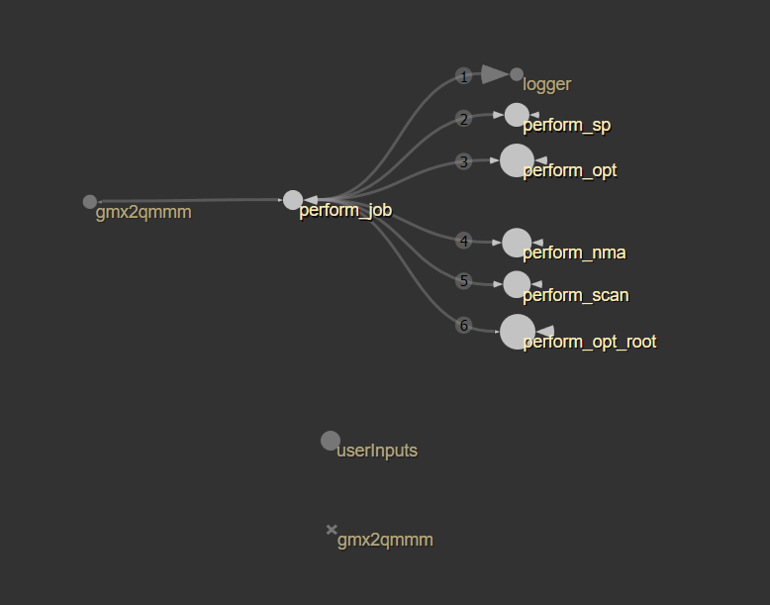
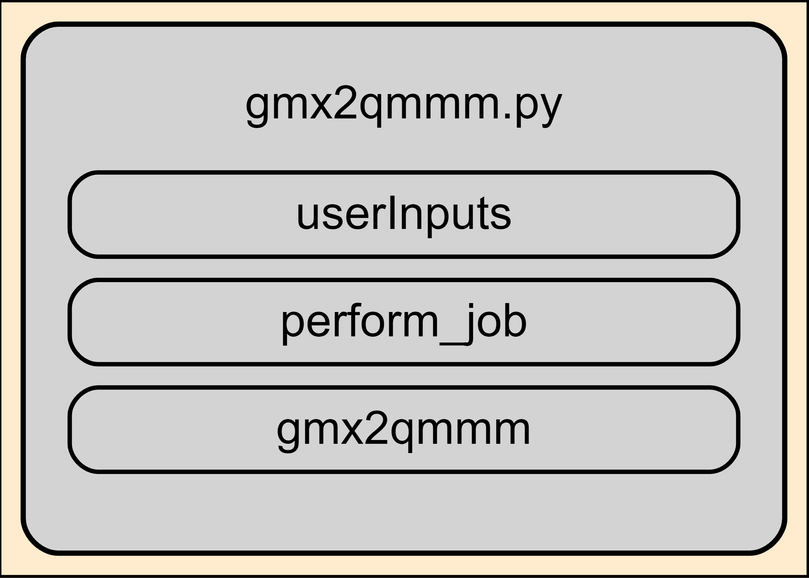
gmx2qmmm.py
Saves user inputs with function „userInputs“
Calls gmx2qmmm with inputs
Instantiates the QMMMInput class with input files
Calls perform_job
calls the job with the jobtype defined in the input
qmmm.py

Slide 6
qmmm.py

Slide 7
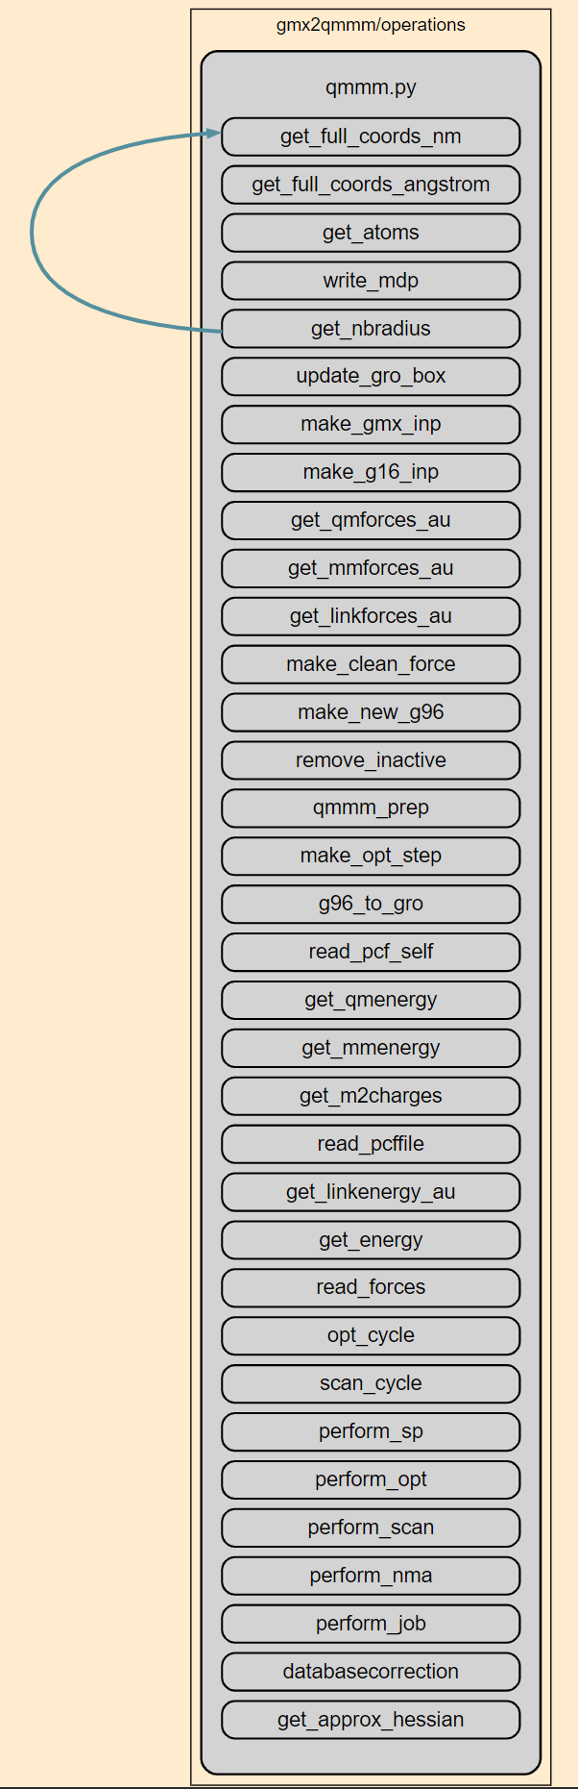
qmmm.py
databasecorrection
g96_to_gro
get_approx_hessian
get_atoms
get_energy
get_full_coords_angstrom
get_full_coords_nm
get_linkenergy_au
get_linkforces_au
get_m2charges
get_mmenergy
get_mmforces_au
get_nbradius
get_qmenergy
get_qmforces_au
make_clean_force
make_g16_inp
make_gmx_inp
make_new_g96
make_opt_step
opt_cycle
perform_job
perform_nma (skipped for now)
perform_opt
perform_scan
perform_sp
qmmm_prep
read_forces
read_pcf_self
read_pcffile
remove_inactive
scan_cycle
update_gro_box
write_mdp
List of all functions
- left: sorted alphabetically
- right: sorted chronologically as appearing in the script
minor functions
medium?
major functions
due to importance or size of function

Slide 8
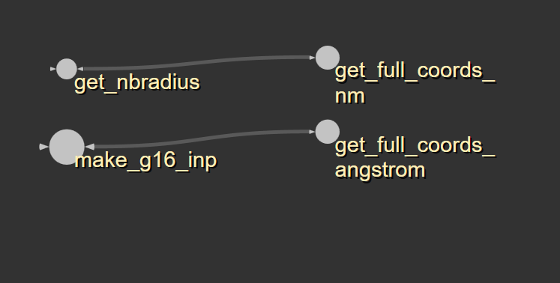
qmmm.py
get_full_coords_angstrom
get_full_coords_nm
both read the coordinates of all atoms from g96 files and return them as a list
Both functions seem to do exactly the same thing, only the output of the coordinates has a different unit -> combine functions?

Slide 9
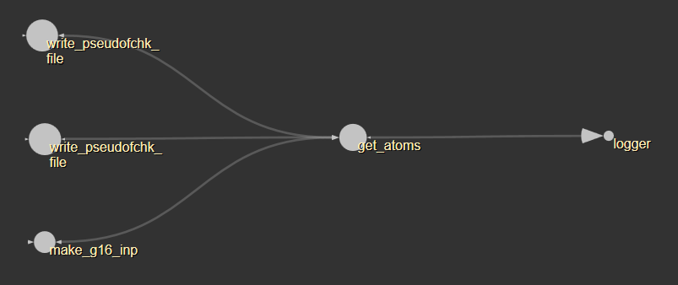
qmmm.py
get_atoms
'''
input: qmmmtop (some sort of topology file?) and logfile
return: list of atom names
-----------------
apparently looks for atom masses in qmmmtop file and translates them to a list of atom names
'''

Slide 10
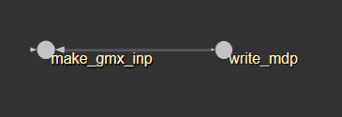
qmmm.py
write_mdp
'''
input: mdpname;
nbradius: maximum distance between two atoms in nm, for coulomb and vdw cutoff if none given;
mminfo: user defined coulomb and vdw cutoff radius
returns: none
---------------
writes the mdp file for gmx
'''

Slide 11
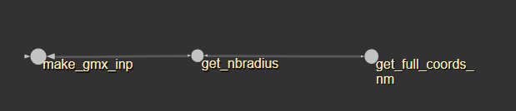
qmmm.py
get_nbradius
calculates and returns the maximum distance between any two atoms in nm

Slide 12
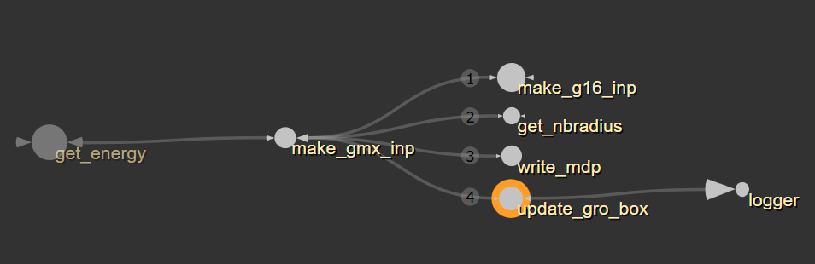
qmmm.py
update_gro_box
'''
input:
gro: g96 file
groname: name of new g96 file
nbradius: maximum radius between two atoms
logfile
returns: none
-----------------
writes a new g96 file with increased box size, margin 10*nbradius
'''

Slide 13
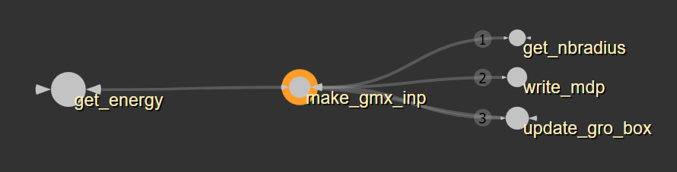
qmmm.py
make_gmx_inp
'''
input:
realprefix: gmx command for calling subprocess
returns: name of new tpr
--------------------------
calls functions to write new mdp and g96 file
creates new tpr file with gmx subprocess
'''

Slide 14
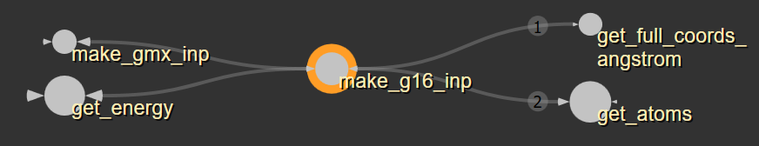
qmmm.py
make_g16_inp
'''
input:
gro: g96 file
qmmmtop, qmatomlist, qminfo, qmmminfo
pcffile
linkatoms
nmaflag
returns: name of gaussian input file
-----------------------
creates the gaussian input file with QM atoms, link atoms and pcf
'''

Slide 15
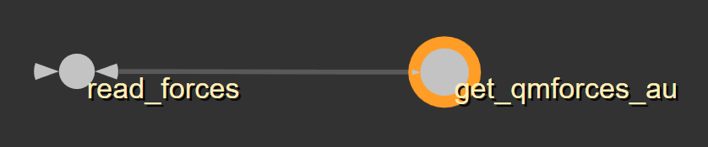
qmmm.py
get_qmforces_au
creates list of force vectors for each QM atom and the m1 atoms in atomic units

Slide 16
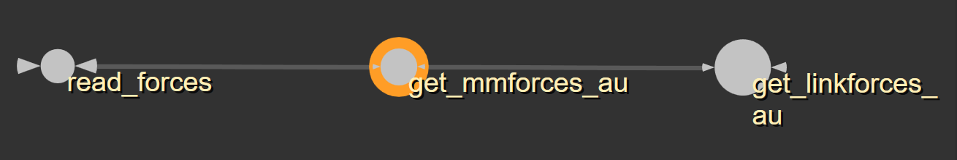
qmmm.py
get_mmforces_au
creates list of force vectors for all atoms in atomic units extracted from the gromacs trr file

Slide 17
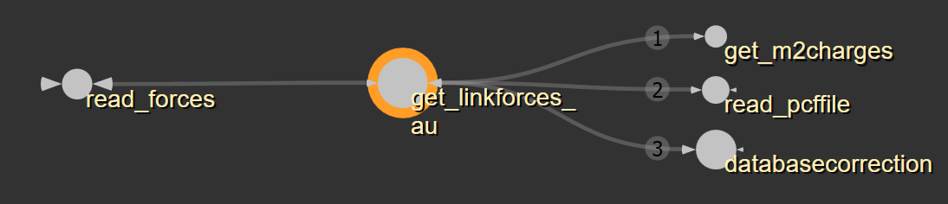
qmmm.py
get_linkforces_au
creates list of force vectors on link atoms in au

Slide 18
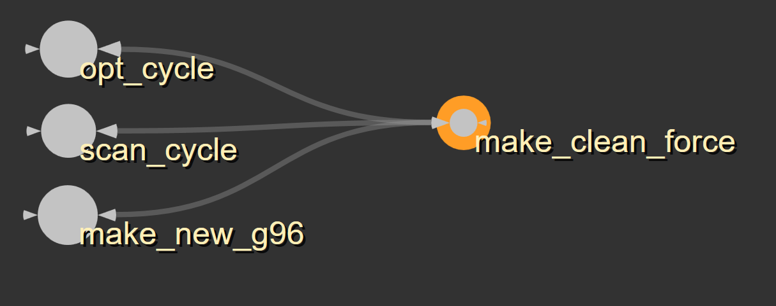
qmmm.py
make_clean_force
just converts whatever type of forces are in the input list to floats (?)
Why not append them as floats in the first place?

Slide 19
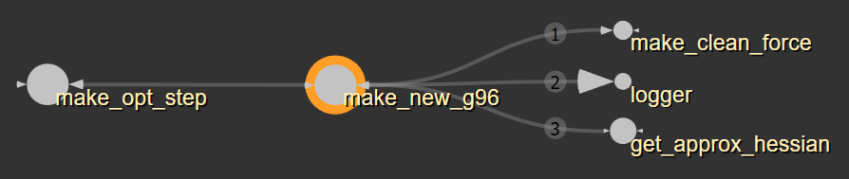
qmmm.py
make_new_g96
'''
Input:
propagator: user chosen propagator algorithm, steepest
descent, conjugate gradient or bfgs
total_force
last_forces
initstep: current step size I guess
Return: None
----------------------
Writes new g96 file with updated atom positions based on forces and propagator
'''

Slide 20
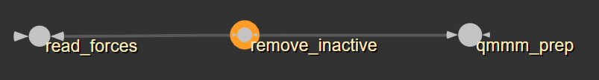
qmmm.py
remove_inactive
sets all forces on inactive atoms to zero

Slide 21
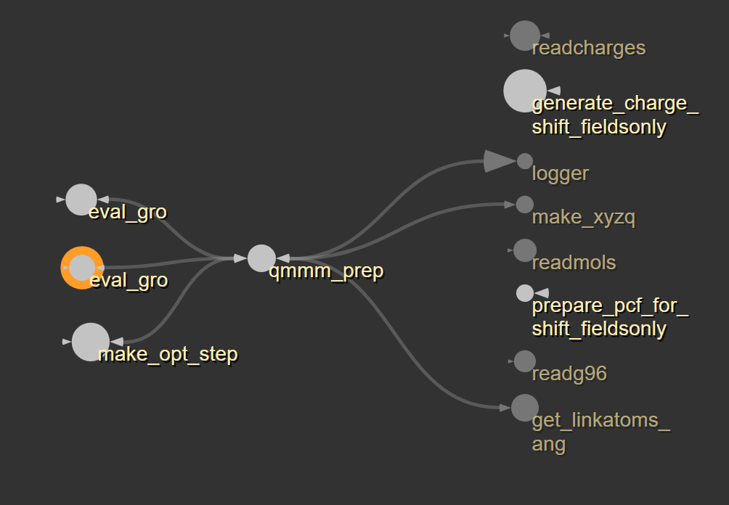
qmmm.py
qmmm_prep
'''
input:
new_gro, top, jobname, curr_step, qminfo, qmatomlist
connlist, linkatoms, basedir, logfile
pathinfo: path information for gmx, Grolib and g16
returns:
new_xyzq: new xyzq matrix
m1list: updated m1 atoms
(positions or indices?)
m2list: updated m2 atoms
new_links: updated link atoms
-----------------
I don't quite understand this
function, a lot of pcf stuff that I
haven't looked into yet
'''
graph not working properly when functions from other files are called, qmmm_prep should call all functions on the right;
two different functions called „eval_gro“ in nma_stuff.py and nma_helper.py

Slide 22
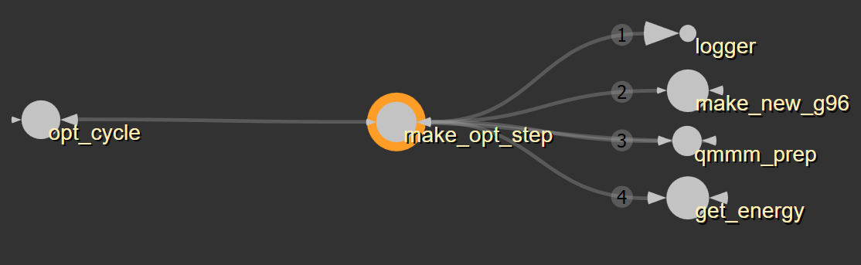
qmmm.py
make_opt_step
makes new step based on the forces and checks if new energy is better or worse, if worse step size is adapted until too small

Slide 23
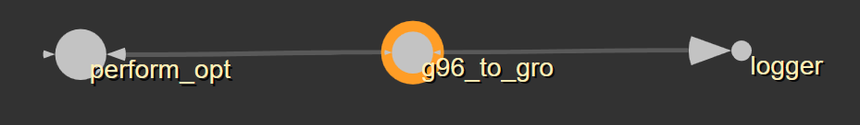
qmmm.py
g96_to_gro
writes the final geometry to a gro file

Slide 24
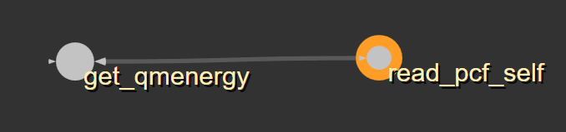
qmmm.py
read_pcf_self
reads and returns the energy of the point charges

Slide 25
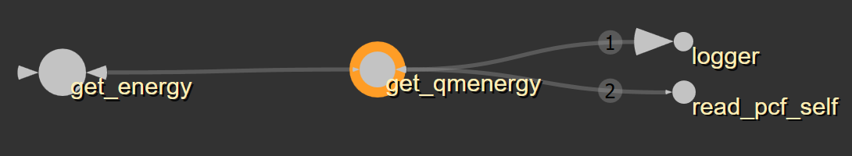
qmmm.py
get_qmenergy
reads qm energy from qm output and corrects energy with energy of pcf

Slide 26
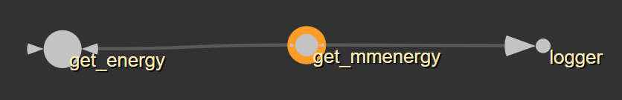
qmmm.py
get_mmenergy
calls gmx via subprocess to obtain mm energy, converts and returns mm energy in au

Slide 27
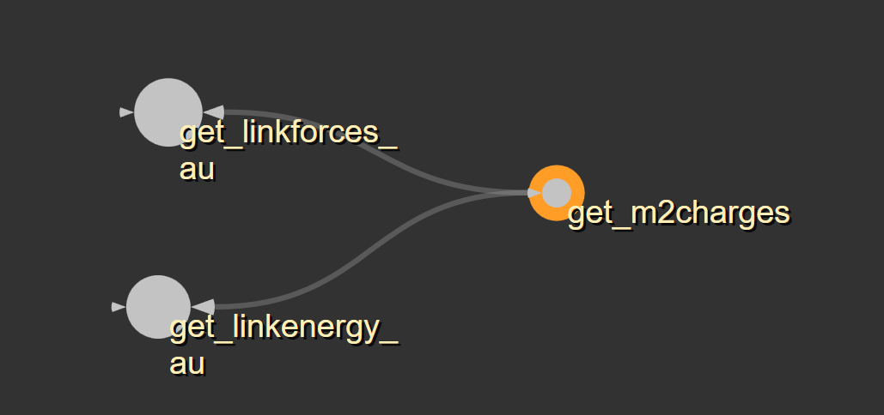
qmmm.py
get_m2charges
reads and returns m2 charges from xyzq matrix

Slide 28
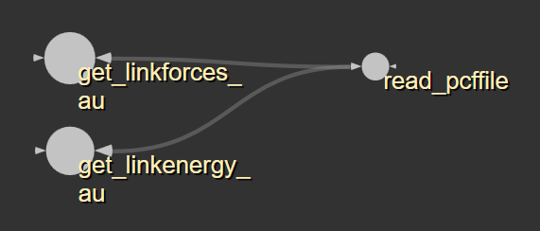
qmmm.py
read_pcffile
reads the pcf file and returns a list with coordinates and charges (? for which atoms?)

Slide 29
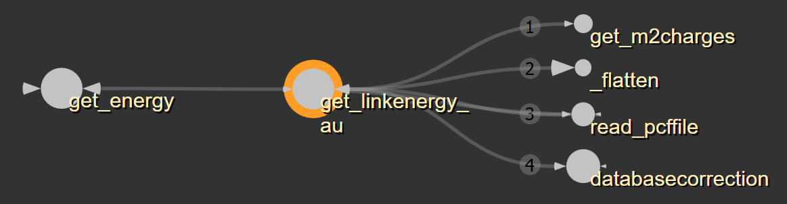
qmmm.py
get_linkenergy_au
calculates (coulomb) and corrects (?) the energy of the link atoms, returns energy

Slide 30
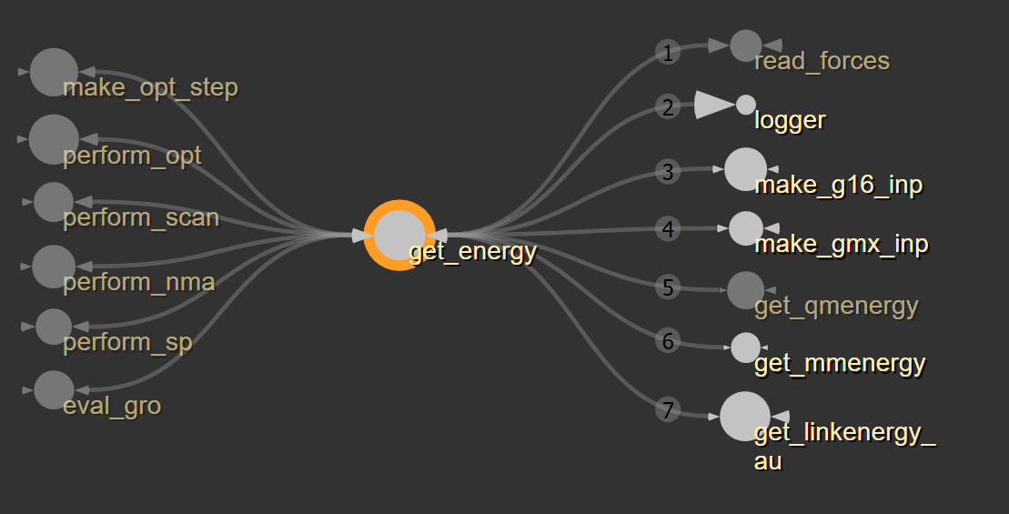
qmmm.py
get_energy
makes G16 input file
makes gmx input file
runs qm input file (unless there already is an output)
runs gmx input file (mdrun)
get qm energy
get mm energy
get corrected link energy
writing energy to oenergy.txt
return qm energy, mm energy and qm_corrdata (?)

Slide 31
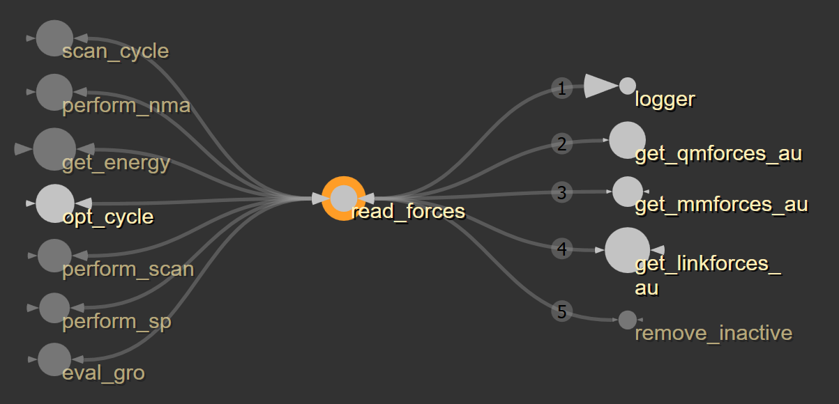
qmmm.py
read_forces
reads all types of forces and calculates and returns total force

Slide 32
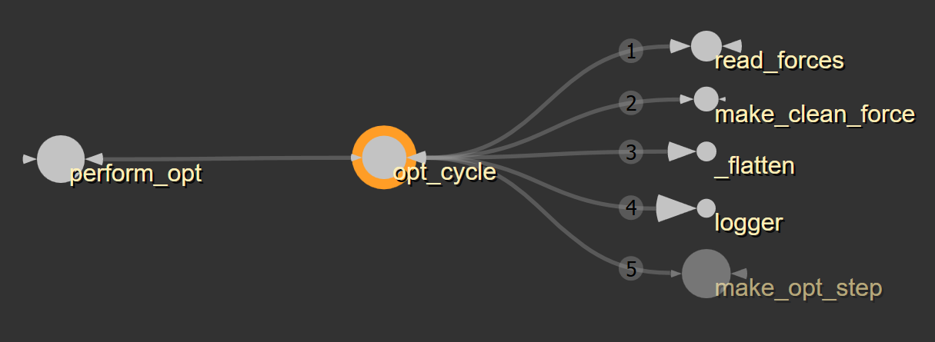
qmmm.py
opt_cycle
'''
checks if the maximum force on any atom is below the user chosen force threshold, if not it calls another opt step until one of the ending criteria is met
'''

Slide 33
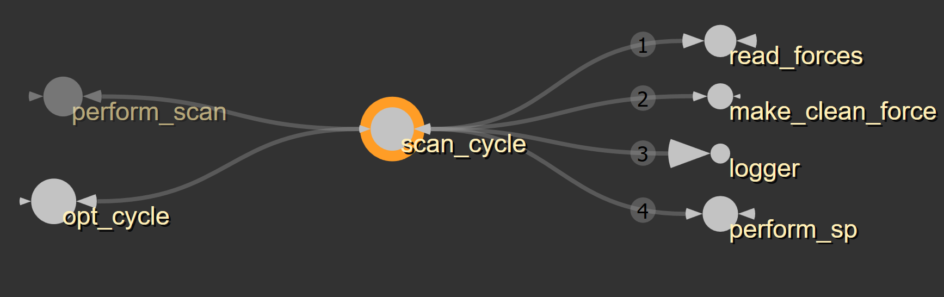
qmmm.py
scan_cycle
'''
creates new g96 file with new coordinates for scan atoms and calls a singlepoint
'''

Slide 34
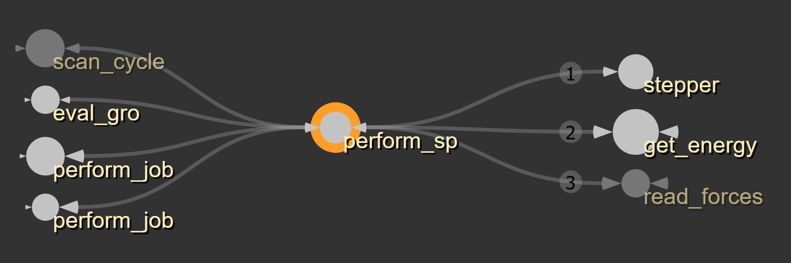
qmmm.py
perform_sp
'''
gets energy and forces of current info and writes forces to output file (where are the subprocesses called though?)
'''

Slide 35
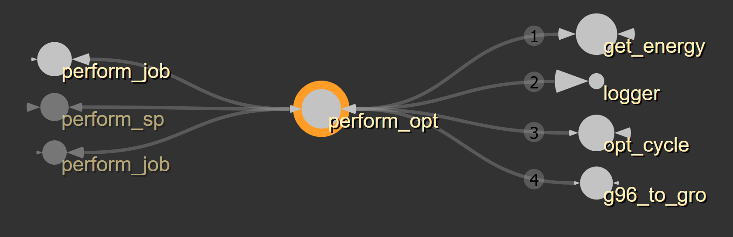
qmmm.py
perform_opt
'''
gets last energy, runs loop of optimization cycles until one ending criterion is met
'''

Slide 36
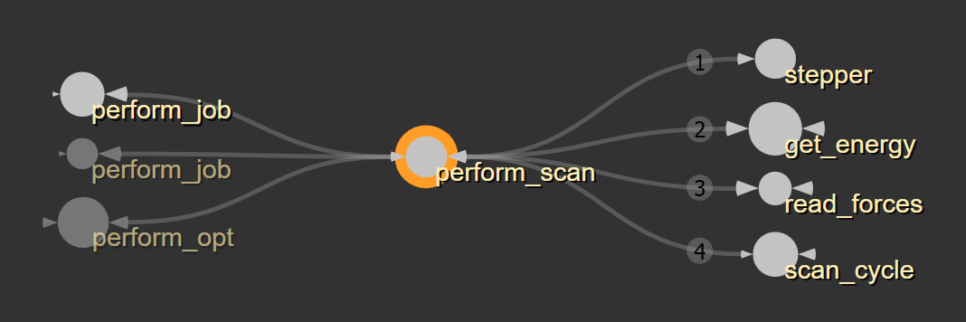
qmmm.py
perform_scan
'''
gets energy and forces, reads scan data (from scan.txt), calls scan cycle
'''

Slide 37
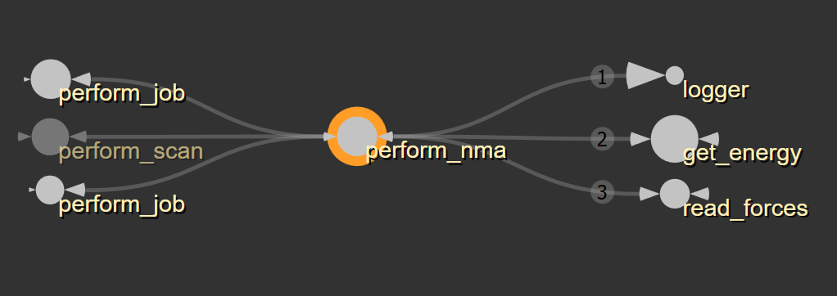
qmmm.py
perform_nma
'''
gets energy and forces, ... later (:
‘’’
Function skipped, as not relevant for "general" gmx2qmmm process (e.g. optimizations) for now, will be summarized later or ask Florian (:

Slide 38
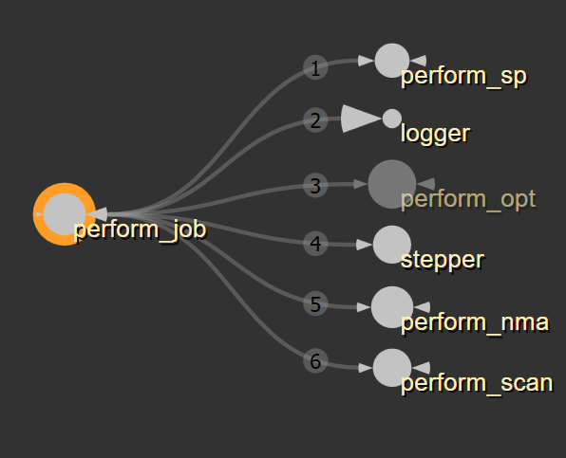
qmmm.py
perform_job
'''
reads jobtype and calls perform_* based on jobtype, passes all arguments to the job
‘‘’
there’s a function in gmx2qmmm.py that is called the same and also calls perform_*, is this function ever called??

Slide 39
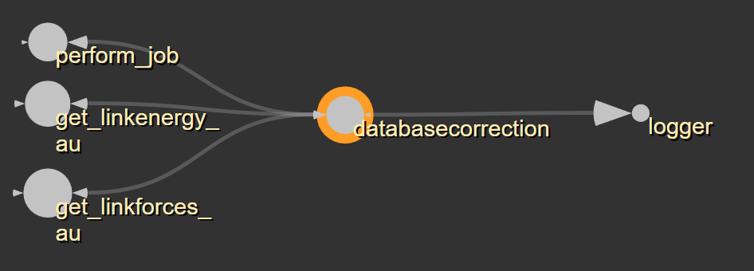
qmmm.py
databasecorrection
'''
seems to be correcting some values based on some database
‘‘’
XX does Florian know more??

Slide 40
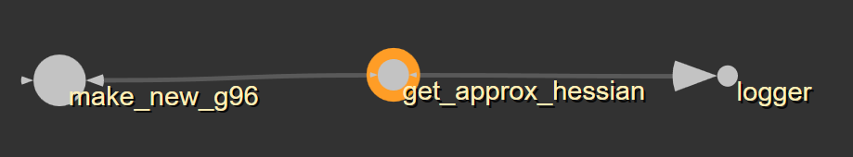
qmmm.py
get_approx_hessian
'''
calculates and returns a new hessian matrix and it's smalles eigenvalue (?)
'''

Slide 41
Pointcharges
Files:
generate_charge_shift.py
generate_pcf_from_top.py
prepare_pcf_for_shift.py
sum_pcf_tm.py

Slide 42
Pointcharges
generate_charge_shift.py
generate_pcf_from_top.py
prepare_pcf_for_shift.py
sum_pcf_tm.py
uvec
create_corr_charges
write_disp_charges
make_new_field
write_new_pcf
write_new_field_to_disk_listsonly
write_new_field_to_disk
read_xyzq
get_qmlist
get_m2vec
get_m2vec_fieldsonly
make_droplist
generate_charge_shift_fieldsonly
generate_charge_shift
checkformol
getincludelist
readcharges
readg96
readgeo
readmols
read_numatoms
makeout
generate_pcf_from_top
get_bondpartners
identify_m2
identify_m1
read_conn_list
read_qmatom_list
read_inner_list
read_outer_list
get_qmcoords
read_charge_list
eliminate_and_shift_to_m1
prepare_pcf_for_shift_fieldsonly
prepare_pcf_for_shift
sum_pcf_tm
sum_pcf_tm_nofile
sum_pcf_tm_red
minor functions
medium?
major functions
due to importance or size of function

Slide 43
generate_charge_shift.py
#This will take a point charge field (turbomole style, without a leading "$point_charges" line) and shift the charges such that the M1 atom charge is replaced by a distribution of charge on the neighbouring atoms.
#Will also generate a corrected dipole field at all Q atoms by setting pairs of displaced dipoles next to the M2 atoms and numerically optimizing them.
#Requires input point_charge field, M1 atom list, file containing the XYZ coordinates of all QM atoms (one per row), M2 atoms list(format see below), output file
#format for M2 file: each row corresponds to M1 file rows, each row contains all M2 atom indices separated by a space/tab whatever

Slide 44
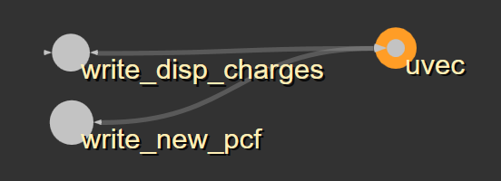
generate_charge_shift.py
uvec
'''
------------------------------ \\
EFFECT: \\
normalizing a vector \\
--------------- \\
NONE \\
------------------------------ \\
INPUT: \\
vec: 1d list or np.array
--------------- \\
NONE \\
------------------------------ \\
RETURN: \\
np.array -> normalized vector \\
--------------- \\
NONE \\
------------------------------ \\
'''

Slide 45
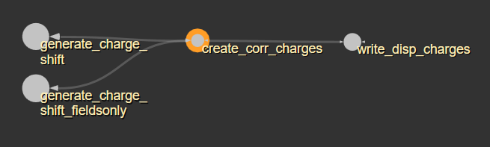
generate_charge_shift.py
create_corr_charges

Slide 46
generate_charge_shift.py
write_disp_charges

Slide 47
generate_charge_shift.py
make_new_field

Slide 48
generate_charge_shift.py
write_new_pcf

Slide 49
generate_charge_shift.py
write_new_field_to_disk_listsonly
'''
------------------------------
EFFECT: \\
---------------
write point charge fiel file
------------------------------
INPUT: \\
---------------
inp: list, list, xyzq for all atoms, ‘QM’ for qm atoms
ofilename: string, name for pcf file
new_field: 2d array, xyzq of new charges
getlist: list, m1 atoms
m2_nolist: list, m2 atoms
------------------------------
RETURN: \\
---------------
None
------------------------------
'''

Slide 50
generate_charge_shift.py
write_new_field_to_disk

Slide 51
generate_charge_shift.py
read_xyzq

Slide 52
generate_charge_shift.py
get_qmlist

Slide 53
generate_charge_shift.py
get_m2vec

Slide 54
generate_charge_shift.py
get_m2vec_fieldsonly

Slide 55
generate_charge_shift.py
make_droplist

Slide 56
generate_charge_shift.py
generate_charge_shift_fieldsonly
'''
------------------------------
EFFECT: \\
---------------
create new pcf
------------------------------
INPUT: \\
---------------
pcf: list, xyzq for all atoms, ‘QM’ for qm atoms
m1list: list of m1 atom indices
qmcoords: list, xyzq for qm atoms
m2list: list of m2 atom indices
jobname: string, jobname
basedir: directory
------------------------------
RETURN: \\
---------------
None
------------------------------
'''

Slide 57
generate_charge_shift.py
generate_charge_shift

Slide 58
generate_pcf_from_top.py
# This will take a gro and top file, and take the point charges from there.
# THIS IS NOT YET IMPLEMENTED#This list of charges and coordinates will then be trimmed by a set of point charges which then will be concatenated to a charge shift model, like in a QM/MM approach.
# THIS IS NOT YET IMPLEMENTED#The trimming is optional.
# will print output list as x y z charge in Angstrom
# THIS IS NOT YET TRUE#needs input pdb, file containing groups/atoms to trim (format: <number of groups>\n<for each group:><amount of atoms in group>\n<indices of atoms, one per line>
# needs input .gro file, input .top file, PCF output file

Slide 59
generate_pcf_from_top.py
checkformol
'''
------------------------------
EFFECT: \\
---------------
function checks if the molecule (molname) is listed in the topology file
------------------------------
INPUT: \\
---------------
molname: string, name of molecule
inp: string, name of topology file
------------------------------
RETURN: \\
---------------
correct: -> bool
------------------------------
'''

Slide 60
generate_pcf_from_top.py
getincludelist
'''
------------------------------
EFFECT: \\
---------------
reads charges for all atoms in a molecule type
------------------------------
INPUT: \\
---------------
molvecentry: list with molecule name and amount of this molecule
top: string, name of topology file
gmxtop_path: string, path to grolib
------------------------------
RETURN: \\
---------------
finalvec: list of charges for every atom in these molecule types
------------------------------
'''

Slide 61
generate_pcf_from_top.py
readg96
'''
------------------------------
EFFECT: \\
---------------
reads coordinates of all atoms from a g96 file
------------------------------
INPUT: \\
---------------
inp: string, name of g96 file
------------------------------
RETURN: \\
---------------
coords: list of coordinates
------------------------------
'''

Slide 62
generate_pcf_from_top.py
read_numatoms
'''
------------------------------
EFFECT: \\
---------------
reads and returns the number of atoms in the system
------------------------------
INPUT: \\
---------------
inp: string, name of structure file
------------------------------
RETURN: \\
---------------
int, number of atoms
------------------------------
'''

Slide 63
generate_pcf_from_top.py
readmols
'''
------------------------------
EFFECT: \\
---------------
reads list of molecules from the topology file
------------------------------
INPUT: \\
---------------
top: string, name of topology file
------------------------------
RETURN: \\
---------------
mollist: list of molecules and their amount in the system
------------------------------
'''

Slide 64
generate_pcf_from_top.py
dupli
'''
------------------------------
EFFECT: \\
---------------
XX
------------------------------
INPUT: \\
---------------
------------------------------
RETURN: \\
---------------
------------------------------
'''

Slide 65
prepare_pcf_for_shift.py
read_qmatom_list
'''
------------------------------
EFFECT: \\
---------------
reads and sorts qm atom indices
------------------------------
INPUT: \\
---------------
inp: string, name of qm atoms index file
------------------------------
RETURN: \\
---------------
sortedlist: list of sorted qm atom indices
------------------------------
'''

Slide 66
prepare_pcf_for_shift.py
identify_m2
'''
------------------------------
EFFECT: \\
---------------
reads out all m2 atoms
------------------------------
INPUT: \\
---------------
qmlist: list of qm atom indices
m1list: list of m1 atom indices
connlist: list of atom connection
------------------------------
RETURN: \\
---------------
m2list: list of m2 atom indices
------------------------------
'''

Slide 67
prepare_pcf_for_shift.py
identify_m1
'''
------------------------------
EFFECT: \\
---------------
reads out all m1 atoms
------------------------------
INPUT: \\
---------------
qmlist: list of qm atom indices
connlist: list of atom connection
------------------------------
RETURN: \\
---------------
m1list: list of m1 atom indices
------------------------------
'''

Slide 68
prepare_pcf_for_shift.py
get_bondpartners
'''
------------------------------
EFFECT: \\
---------------
reads all m1 atoms for a specific qm atom
------------------------------
INPUT: \\
---------------
connlist: list of atom connection
target: int, index of specific qm atom
------------------------------
RETURN: \\
---------------
partnerlist: list of m1 atoms for this specific qm atom
------------------------------
'''

Slide 69
prepare_pcf_for_shift.py
prepare_pcf_for_shift_fieldsonly
'''
------------------------------
EFFECT: \\
---------------
prepares m1 and m2 atom lists and returns correct charges
------------------------------
INPUT: \\
---------------
charges: list, xyzq
qmatomlist: list of qm atom indices
qmcharge: int, total qm charge
connlist: list of atom connection
------------------------------
RETURN: \\
---------------
qmcoordlist: list of xyzq coordinates for all qm atoms
m1list: list of m1 atom indices
m2list: list of m2 atom indices
updated_chargelist: list of new xyzq coordinates updated for qm region and charge shifts
------------------------------
'''

Slide 70
prepare_pcf_for_shift.py
get_qmcoords
'''
------------------------------
EFFECT: \\
---------------
reads xyzq of qm atoms
------------------------------
INPUT: \\
---------------
qmatoms: list of qm atom indices
charges: list, xyzq
------------------------------
RETURN: \\
---------------
qmcoordlist: list of xyzq for qm atoms
------------------------------
'''

Slide 71
prepare_pcf_for_shift.py
eliminate_and_shift_to_m1
'''
------------------------------
EFFECT: \\
---------------
removes qm charges and shifts them to m1 atoms
------------------------------
INPUT: \\
---------------
qmatoms: list of qm atom indices
charges: list, xyzq
m1list: list of m1 atom indices
qmcharge: int, total qm charge
qmcoordsq: list of xyzq for qm atoms
------------------------------
RETURN: \\
---------------
updated_chargelist: shifts m1 charges
------------------------------
'''

Slide 72
prepare_pcf_for_shift.py
dupli
'''
------------------------------
EFFECT: \\
---------------
XX
------------------------------
INPUT: \\
---------------
------------------------------
RETURN: \\
---------------
------------------------------
'''

