Slide 1
Folder structure with python files per folder
home
bmat.py
gmx2qmmm.py
readInput.py
operations
atoms_from_xyz.py
bmat.py (similiar to file in home folder)
expansion_check.py
generate_top.py
geo_from_hes.py
geo_from_xyz.py
geo_xyz_g09RevA_02_log.py
hes_xyz_g09RevD_01_fchk.py
hessian_from_hes.py
mass_from_hes.py
nma_3N_6dof.py
nma_helper.py
nma_stuff.py
qmmm.py
qmmm_helper.py
qmmm_job.py
xyz_zmat_g16RevA_02.py
gmx2qmmm
_helper.py
tools
pointcharges
create_droplet.py
generate_charge_shift.py
generate_pcf_from_top.py
prepare_pcf_for_shift.py
sum_pcf_tm.py

Slide 2
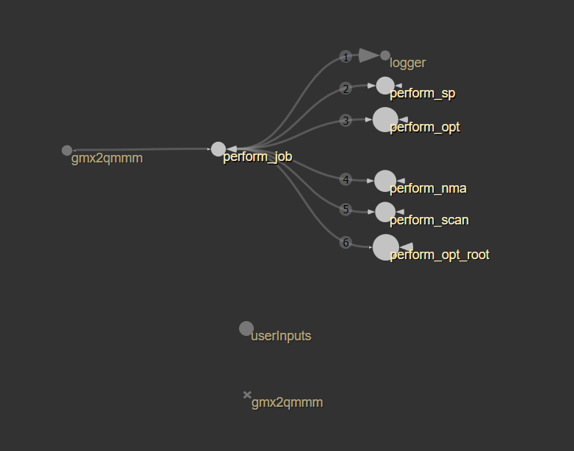
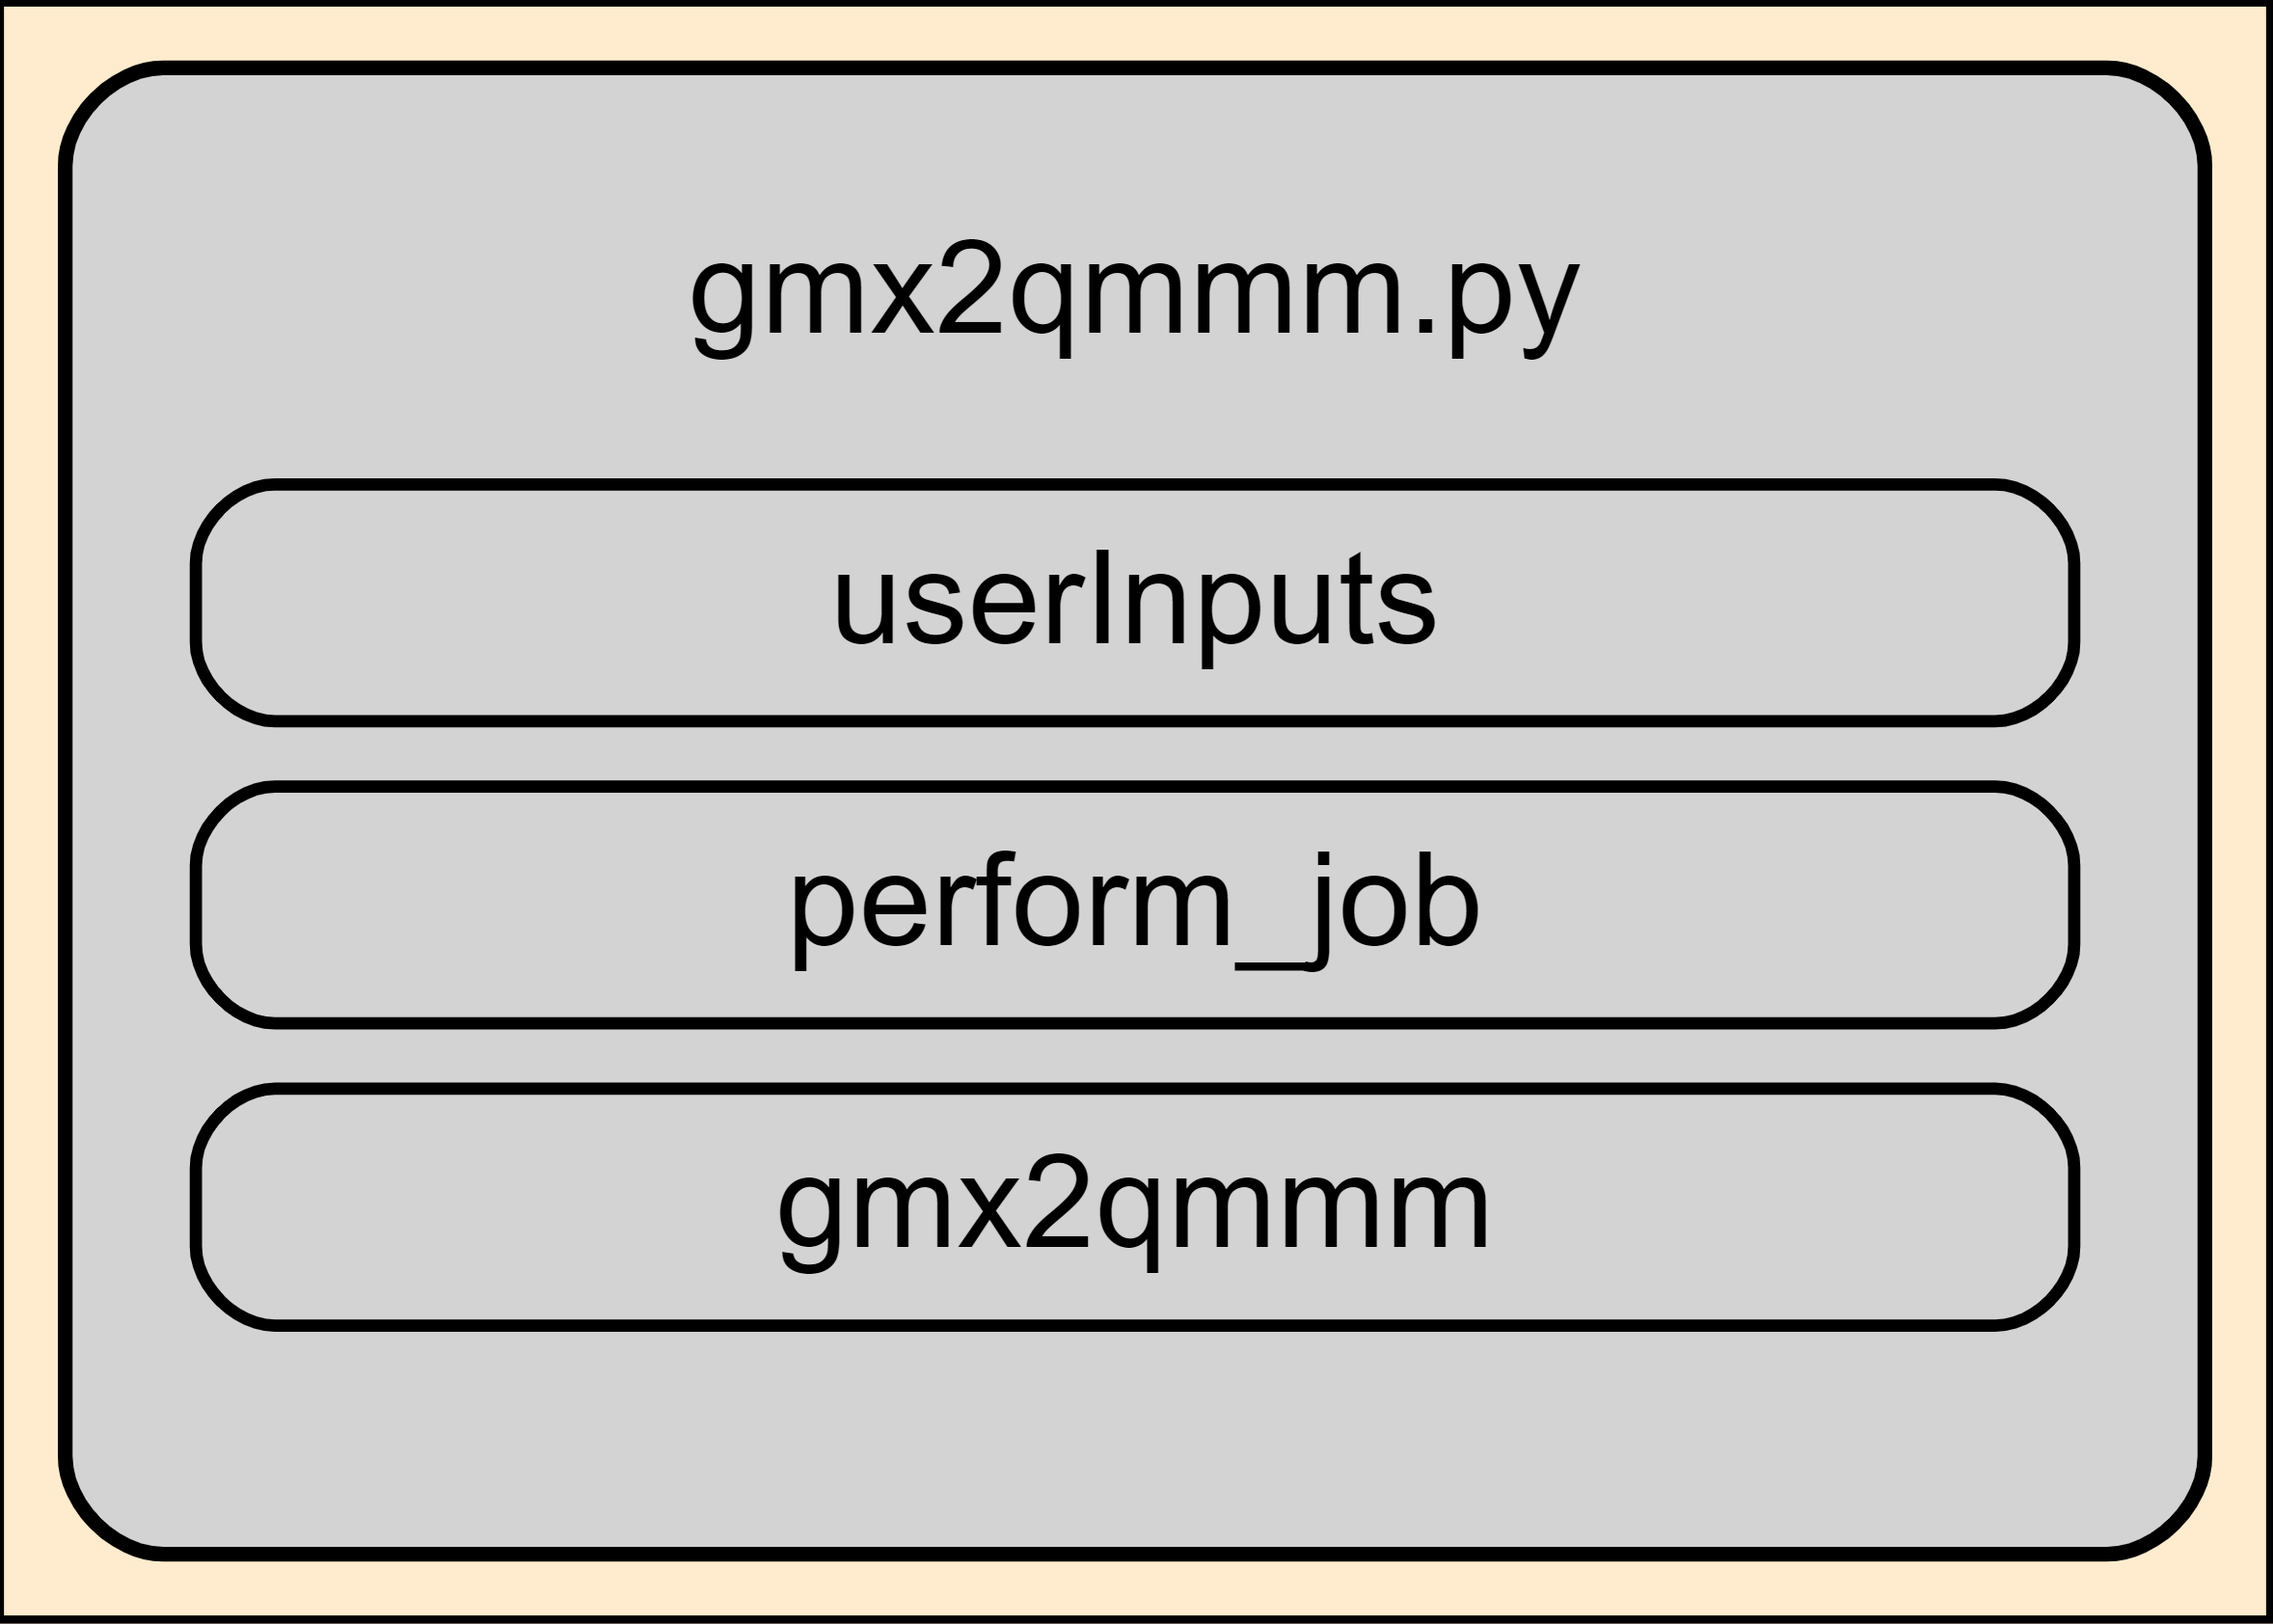
gmx2qmmm.py
Saves user inputs with function „userInputs“
Calls gmx2qmmm with inputs
Instantiates the QMMMInput class with input files
Calls perform_job
calls the job with the jobtype defined in the input
qmmm.py

Slide 3
qmmm.py

Slide 4
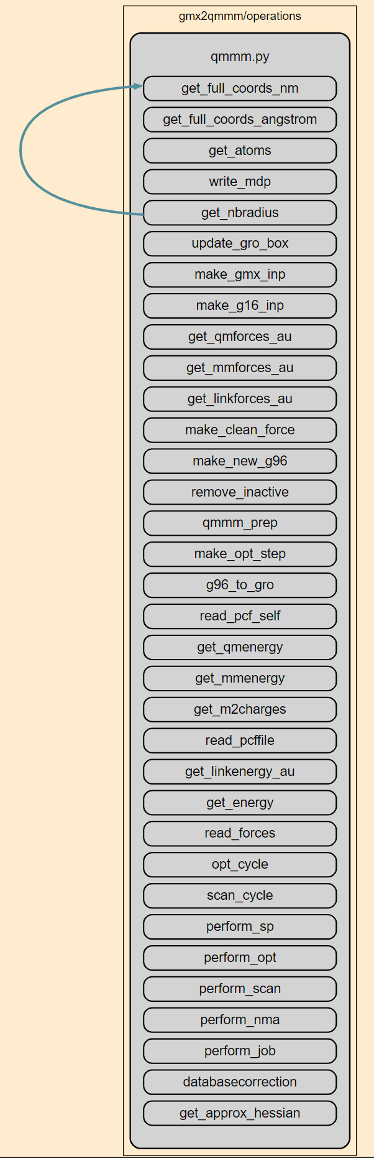
qmmm.py
databasecorrection
g96_to_gro
get_approx_hessian
get_atoms
get_energy
get_full_coords_angstrom
get_full_coords_nm
get_linkenergy_au
get_linkforces_au
get_m2charges
get_mmenergy
get_mmforces_au
get_nbradius
get_qmenergy
get_qmforces_au
make_clean_force
make_g16_inp
make_gmx_inp
make_new_g96
make_opt_step
opt_cycle
perform_job
perform_nma (skipped for now)
perform_opt
perform_scan
perform_sp
qmmm_prep
read_forces
read_pcf_self
read_pcffile
remove_inactive
scan_cycle
update_gro_box
write_mdp
Liste aller Funktionen
- links nach Alphabet
- rechts chronologisch im Skript
minor functions
medium?
major functions
due to importance or size of function

Slide 5
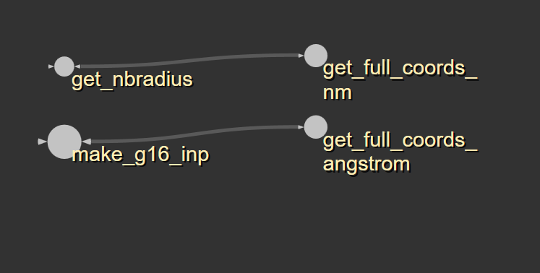
qmmm.py
get_full_coords_angstrom
get_full_coords_nm
beide lesen aus g96 Dateien die Koordinaten aller Atome aus und geben diese als Liste zurück
beide Funktionen scheinen exakt das Gleiche zu tun, nur das output der Koordinaten hat eine andere Einheit -> Funktionen vereinen?

Slide 6
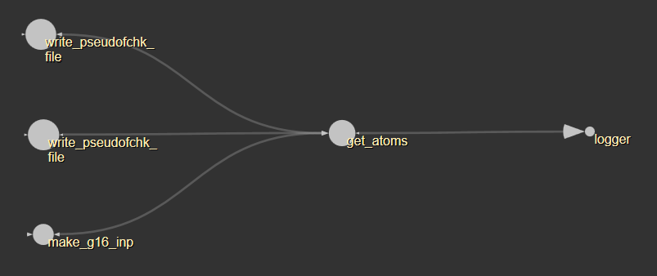
qmmm.py
get_atoms
'''
input: qmmmtop (some sort of topology file?) and logfile
return: list of atom names
-----------------
apparently looks for atom masses in qmmmtop file and translates them to a list of atom names
'''

Slide 7
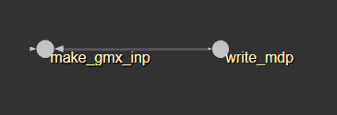
qmmm.py
write_mdp
'''
input: mdpname;
nbradius: maximum distance between two atoms in nm, for coulomb and vdw cutoff if none given;
mminfo: user defined coulomb and vdw cutoff radius
returns: none
---------------
writes the mdp file for gmx
'''

Slide 8
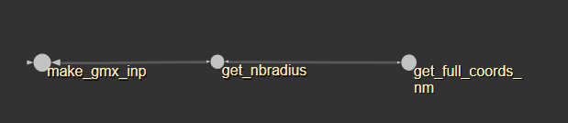
qmmm.py
get_nbradius
calculates and returns the maximum distance between any two atoms in nm

Slide 9
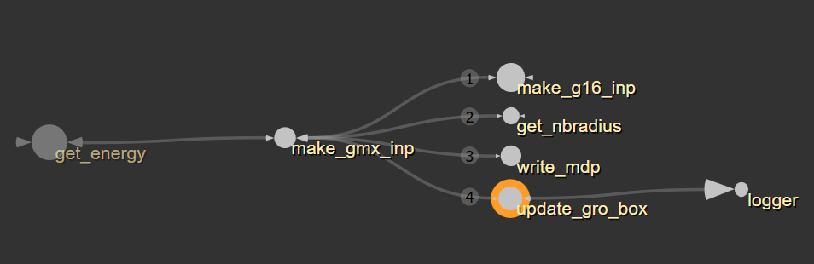
qmmm.py
update_gro_box
'''
input:
gro: g96 file
groname: name of new g96 file
nbradius: maximum radius between two atoms
logfile
returns: none
-----------------
writes a new g96 file with increased box size, margin 10*nbradius
'''

Slide 10
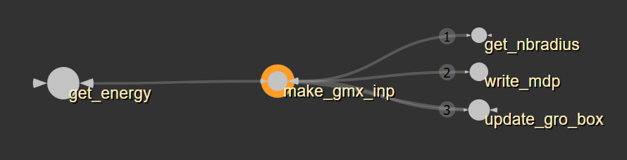
qmmm.py
make_gmx_inp
'''
input:
realprefix: gmx command for calling subprocess
returns: name of new tpr
--------------------------
calls functions to write new mdp and g96 file
creates new tpr file with gmx subprocess
'''

Slide 11
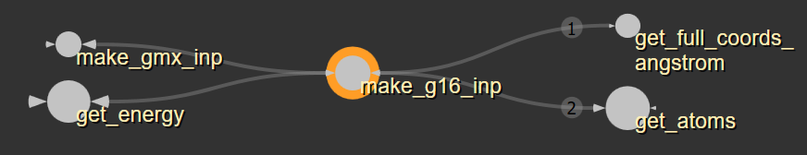
qmmm.py
make_g16_inp
'''
input:
gro: g96 file
qmmmtop, qmatomlist, qminfo, qmmminfo
pcffile
linkatoms
nmaflag
returns: name of gaussian input file
-----------------------
creates the gaussian input file with QM atoms, link atoms and pcf
'''

Slide 12
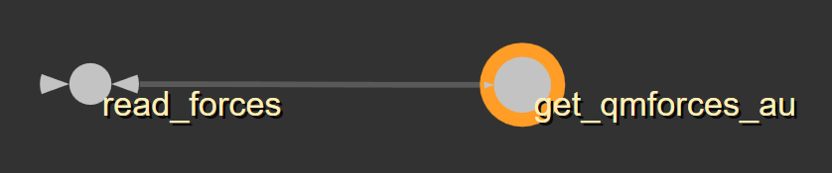
qmmm.py
get_qmforces_au
creates list of force vectors for each QM atom and the m1 atoms in atomic units

Slide 13
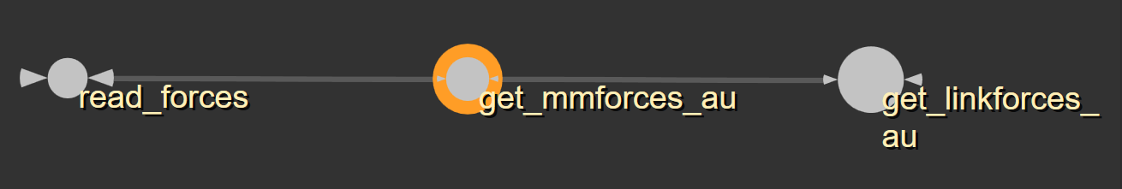
qmmm.py
get_mmforces_au
creates list of force vectors for all atoms in atomic units extracted from the gromacs trr file

Slide 14
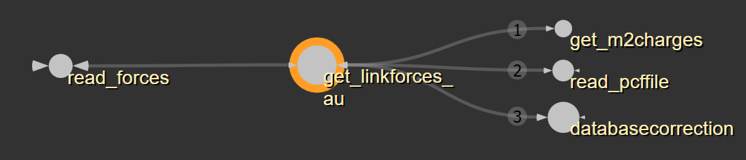
qmmm.py
get_linkforces_au
creates list of force vectors on link atoms in au

Slide 15
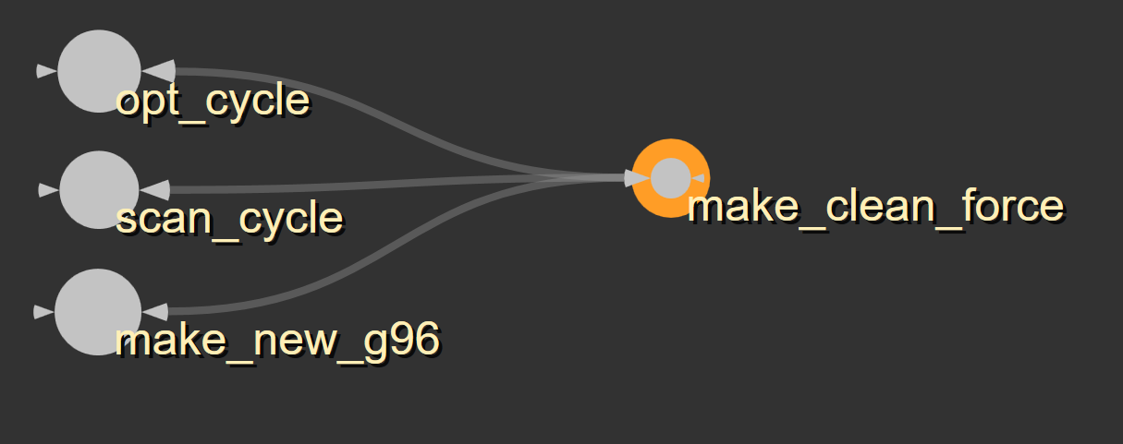
qmmm.py
make_clean_force
just converts whatever type of forces are in the input list to floats (?)
Why not append them as floats in the first place?

Slide 16
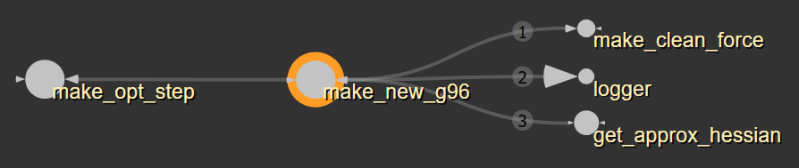
qmmm.py
make_new_g96
'''
Input:
propagator: user chosen propagator algorithm, steepest
descent, conjugate gradient or bfgs
total_force
last_forces
initstep: current step size I guess
Return: None
----------------------
Writes new g96 file with updated atom positions based on forces and propagator
'''

Slide 17
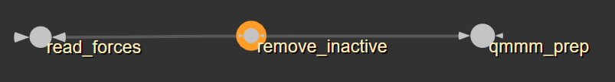
qmmm.py
remove_inactive
sets all forces on inactive atoms to zero

Slide 18
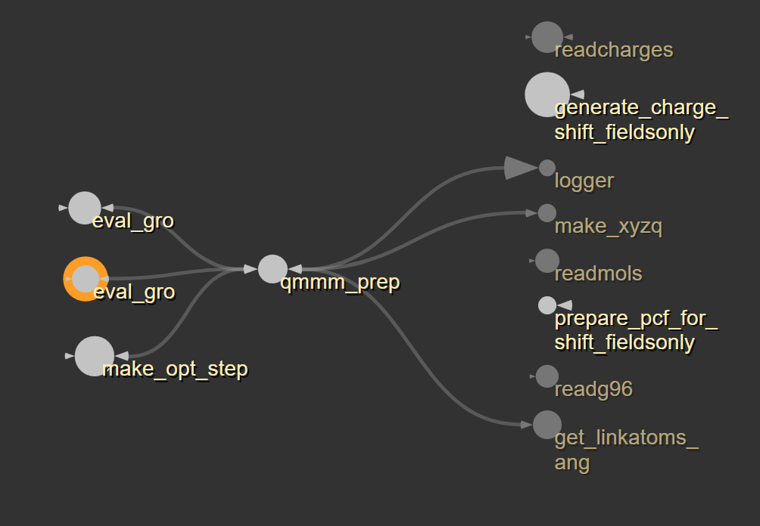
qmmm.py
qmmm_prep
'''
input:
new_gro, top, jobname, curr_step, qminfo, qmatomlist
connlist, linkatoms, basedir, logfile
pathinfo: path information for gmx, Grolib and g16
returns:
new_xyzq: new xyzq matrix
m1list: updated m1 atoms
(positions or indices?)
m2list: updated m2 atoms
new_links: updated link atoms
-----------------
I don't quite understand this
function, a lot of pcf stuff that I
haven't looked into yet
'''
graph not working properly when functions from other files are called, qmmm_prep should call all functions on the right;
two different functions called „eval_gro“ in nma_stuff.py and nma_helper.py

Slide 19
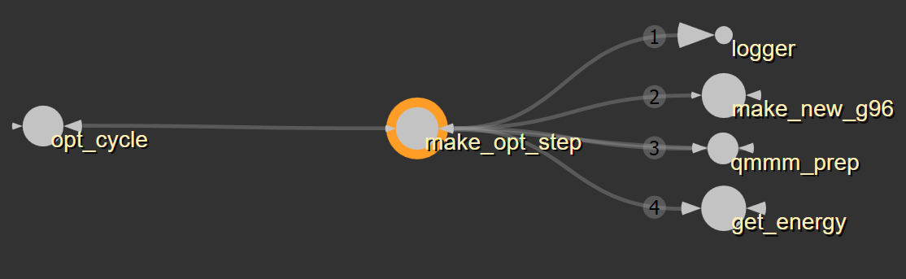
qmmm.py
make_opt_step
makes new step based on the forces and checks if new energy is better or worse, if worse step size is adapted until too small

Slide 20
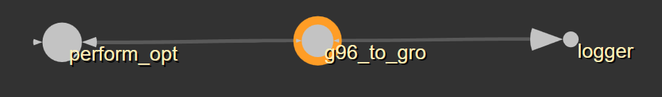
qmmm.py
g96_to_gro
writes the final geometry to a gro file

Slide 21
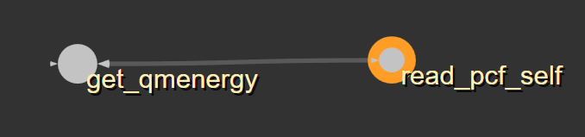
qmmm.py
read_pcf_self
reads and returns the energy of the point charges

Slide 22
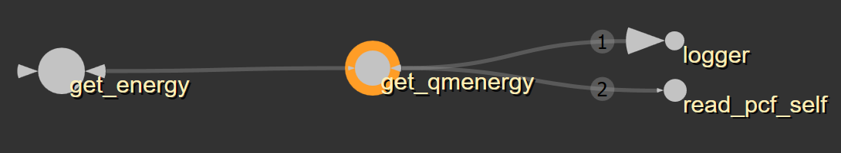
qmmm.py
get_qmenergy
reads qm energy from qm output and corrects energy with energy of pcf

Slide 23
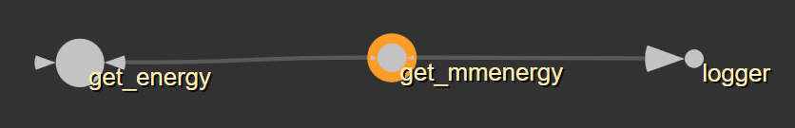
qmmm.py
get_mmenergy
calls gmx via subprocess to obtain mm energy, converts and returns mm energy in au

Slide 24
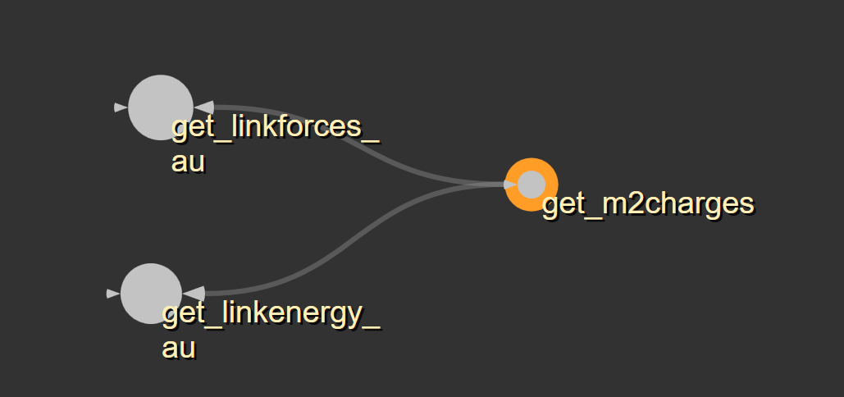
qmmm.py
get_m2charges
reads and returns m2 charges from xyzq matrix

Slide 25
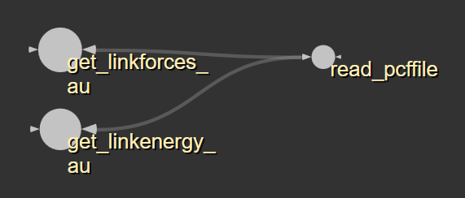
qmmm.py
read_pcffile
reads the pcf file and returns a list with coordinates and charges (? for which atoms?)

Slide 26
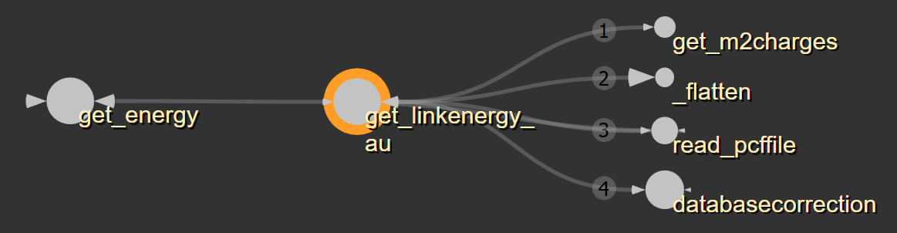
qmmm.py
get_linkenergy_au
calculates (coulomb) and corrects (?) the energy of the link atoms, returns energy

Slide 27
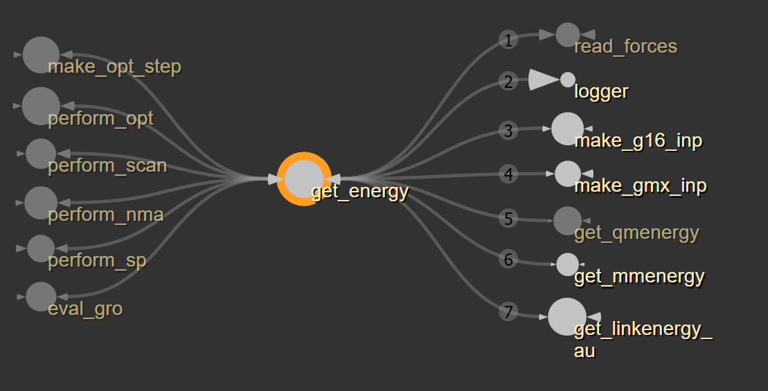
qmmm.py
get_energy
makes G16 input file
makes gmx input file
runs qm input file (unless there already is an output)
runs gmx input file (mdrun)
get qm energy
get mm energy
get corrected link energy
writing energy to oenergy.txt
return qm energy, mm energy and qm_corrdata (?)

Slide 28
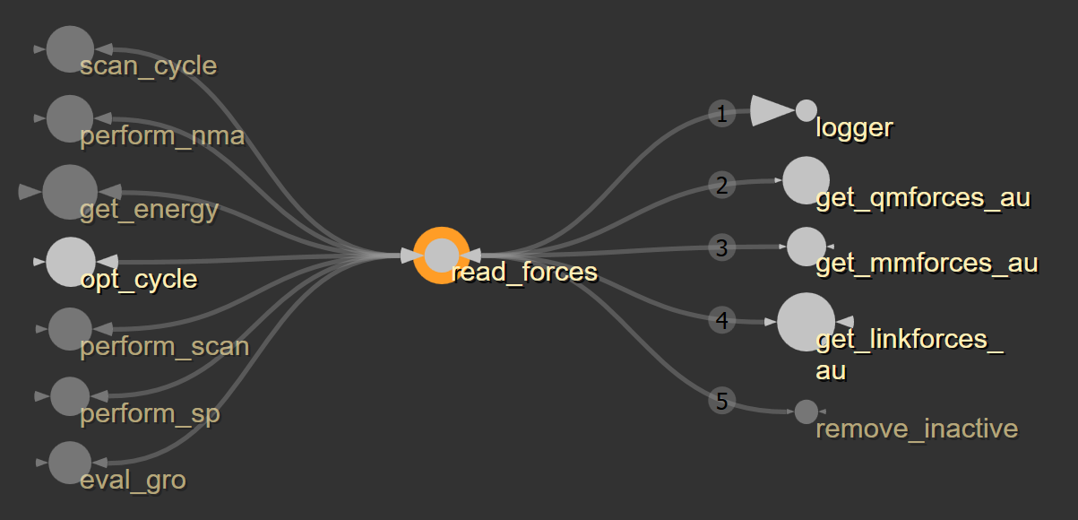
qmmm.py
read_forces
reads all types of forces and calculates and returns total force

Slide 29
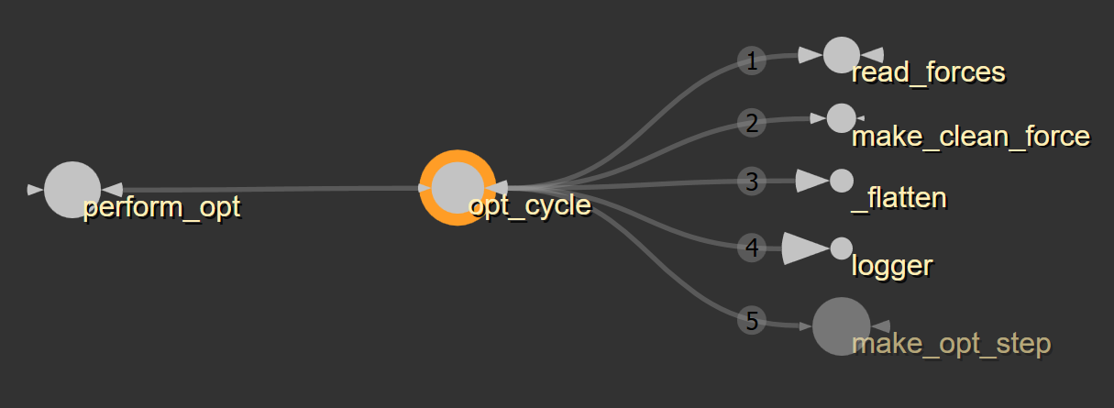
qmmm.py
opt_cycle
'''
checks if the maximum force on any atom is below the user chosen force threshold, if not it calls another opt step until one of the ending criteria is met
'''

Slide 30
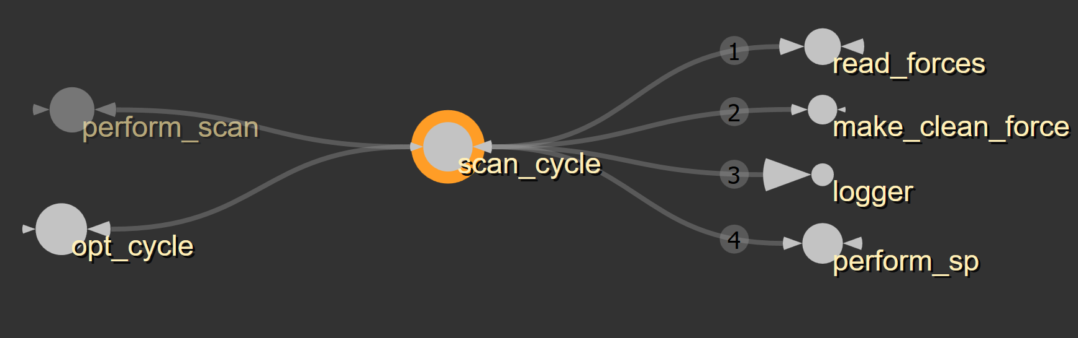
qmmm.py
scan_cycle
'''
creates new g96 file with new coordinates for scan atoms and calls a singlepoint
'''

Slide 31
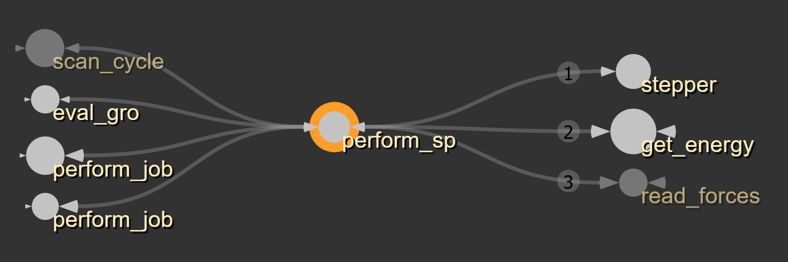
qmmm.py
perform_sp
'''
gets energy and forces of current info and writes forces to output file (where are the subprocesses called though?)
'''

Slide 32
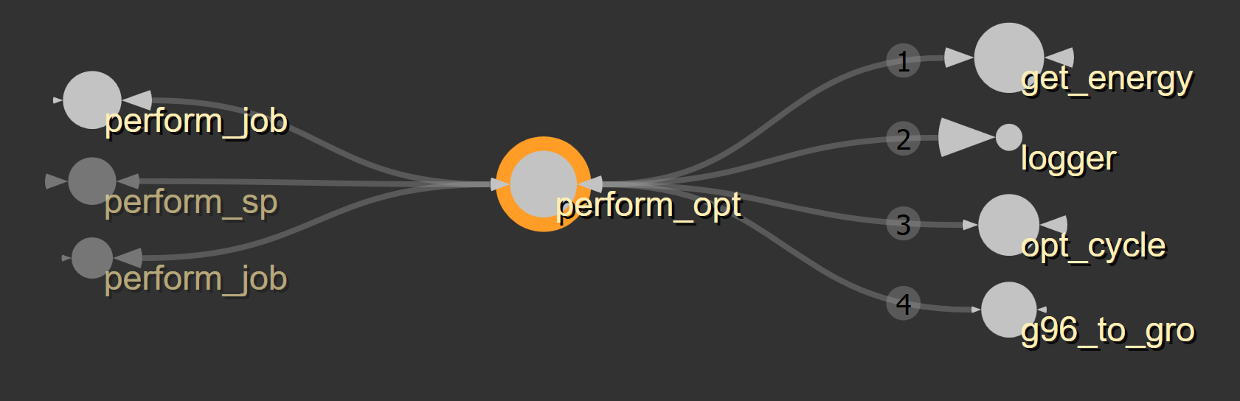
qmmm.py
perform_opt
'''
gets last energy, runs loop of optimization cycles until one ending criterion is met
'''

Slide 33
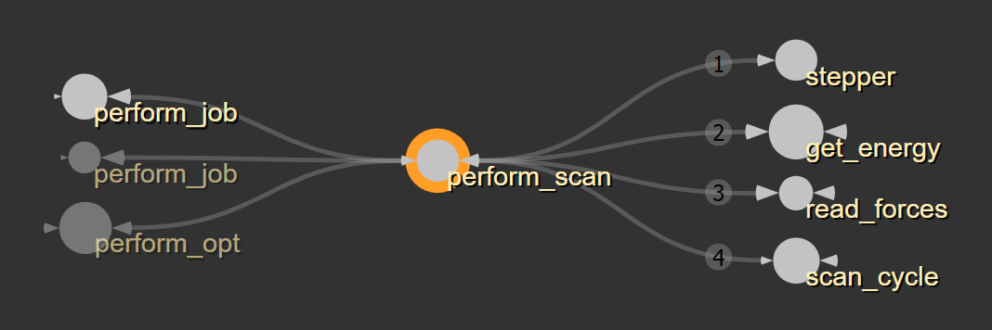
qmmm.py
perform_scan
'''
gets energy and forces, reads scan data (from scan.txt), calls scan cycle
'''

Slide 34
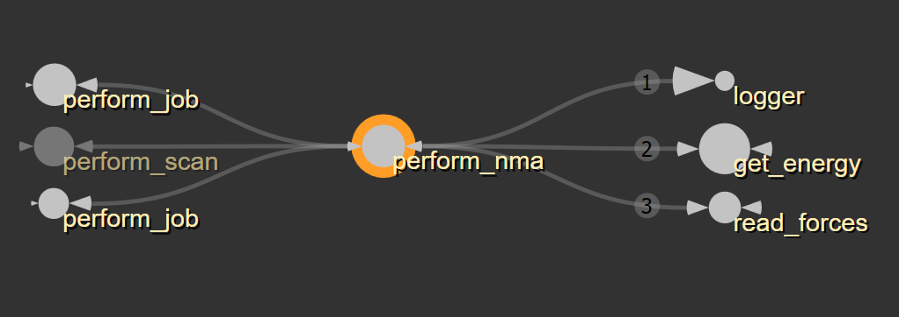
qmmm.py
perform_nma
'''
gets energy and forces, ... later (:
‘’’
Funktion übersprungen, da vorerst nicht relevant für “allgemeinen” gmx2qmmm Ablauf (z.B. Optimierungen), wird später zusammengefasst oder Florian fragen (:

Slide 35
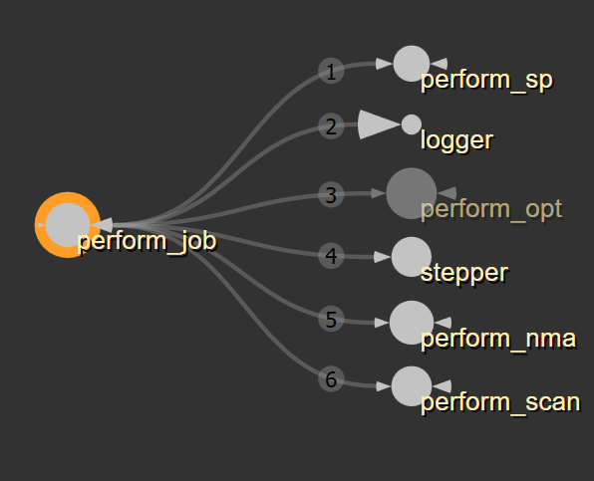
qmmm.py
perform_job
'''
reads jobtype and calls perform_* based on jobtype, passes all arguments to the job
‘‘’
there’s a function in gmx2qmmm.py that is called the same and also calls perform_*, is this function ever called??

Slide 36
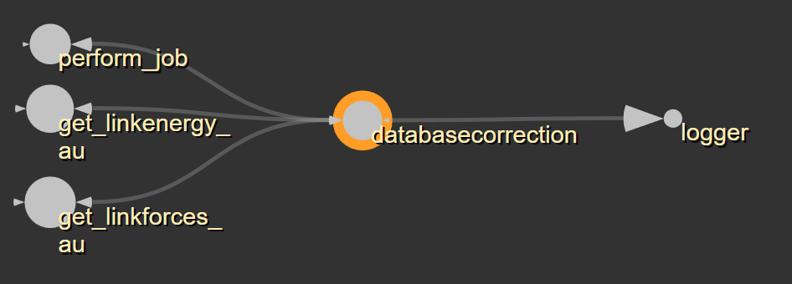
qmmm.py
databasecorrection
'''
seems to be correcting some values based on some database
‘‘’
XX does Florian know more??

Slide 37
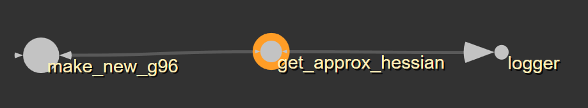
qmmm.py
get_approx_hessian
'''
calculates and returns a new hessian matrix and it's smalles eigenvalue (?)
'''

Slide 38
variables
qmmmtop:
self.qmmmtop = str(self.qmmmparams.jobname + ".qmmm.top")
(I don‘t know how this file looks, maybe make a list with examples of such files?)

