Slide 1

Human Factor
Hstepanalytics 31/05/2020,

Slide 2
Table of Content
Data Loading
Exploration of available data
Visualization of dependencies between variables
(EU countries and characterizing them parameters)
Intermediate findings
Preprocessing
SVM modeling
GridSearchCV
Conclusion

Slide 3
Loading Data
NASA.gov_NO2 Data in Giovanni NO2_concentrations_over_Europe
IATA_mediakit_2019
ESA_NO2_concentrations_over_Europe_JAN_20
ESA_NO2_concentrations_over_Europe_MAY_20
ECDS_CODIV-19_distribution_worldwide
data.europa.eu
WHO
Population_prb.org
Woldometrs
European_Center_of_desease_prevention_and_control

Slide 4
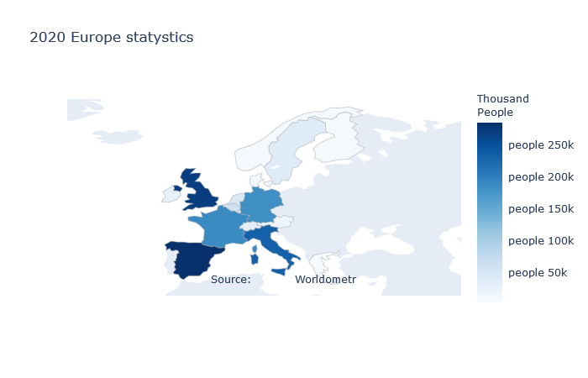
2020 Westen Europe statystics

Slide 5
Conclusion
Were used:
Visualization based on collected data
Applicable model of ML for identification of tendencies
Provided analytical con clusion based on research
Let us express hope that thans for fundamental work of NASA, ESA, JAXA, CNES, and CS and provided dataset the researchers will find solution to ovewcome this disease.

