Slide 1

CIS2601 · INTRODUCTION TO DATA SCIENCE · 2025–2026
Internet Addiction across
Gender × Exercise groups
Does psychological distress is correlated to perceived internet addiction differently across groups of adolescents and can we forecast who is at risk?
819
4
0.76
adolescents · ages 13–19
gender × exercise groups
AUC risk forecast
AUTHORS Noam Avizmil · Tomer Golshani · May Mandalaoui · Alina Kozitsyna
Data: Mahmud et al. (2024), Mendeley Data V2 (CC BY 4.0) · Analysis in R 4.5.1

Slide 2






BACKGROUND & MOTIVATION
Why this question matters
Adolescent internet addiction is rising worldwide and travels with depression, poor sleep and suicidal ideation. If distress is what turns ordinary use into compulsive, out-of-control use, then the lever is mental-health support - not just screen-time limits.
WHAT PRIOR WORK TELLS US
Depression ↔ addiction
Loneliness ↔ addiction
Exercise protects
Males score higher
Meta-analysis of 33 studies (303,243 teens): internet addiction correlates with depression, pooled r⁺ = 0.318.
32 effect sizes: loneliness linked to addiction (r = 0.291); the link weakens as the share of males rises.
9 RCTs: exercise interventions reduced internet-addiction scores (SMD = −1.11) - causal, not just correlational.
34 jurisdictions: males more likely to be addicted (g = 0.145); the gap is largest in Asia.
Soriano-Molina et al. 2025
Wang & Zeng 2024
Wang et al. 2025
Su et al. 2019
* ↔ stands for correlation
THE GAP - AND OUR CONTRIBUTION
We run the first single-sample interaction test of whether distress→addiction differs by gender × exercise, using perceived addiction rather than raw hours
Group 2 · CIS2601 - Internet Addiction across gender × Exercise groups

Slide 3


WHAT WE SET OUT TO TEST
Research questions & hypotheses
Q1
EXPLORATORY
PRE-REGISTERED HYPOTHESES
Within each of the four gender × exercise groups do depression and loneliness positively correlated with higher internet-addiction scores (IAT)? And is that link stronger in some groups?
The Groups:
girls who exercise
girls who don’t
boys who exercise
boys who don’t
H1a
Higher depression → higher IAT, in every group
H1b
Higher loneliness → higher IAT, in every group
H2
Exercise buffers the distress→addiction link (flatter slope in exercisers)
H3
Males have higher addiction prevalence than females
Q2
FORECAST
Given a student’s distress and group, can we forecast the chance they are internet-addicted (IAT ≥ 31, the Young cutoff)?
Depression → P(IAT)
H4
Perceived addiction (IAT) tracks distress better than raw screen-time hours
H5
Distress + group + controls forecast addiction better than chance
Stated before modelling, grounded in the literature above. Verdicts on slide 10.
Group 2 · CIS2601 - Internet Addiction across gender × Exercise groups

Slide 4


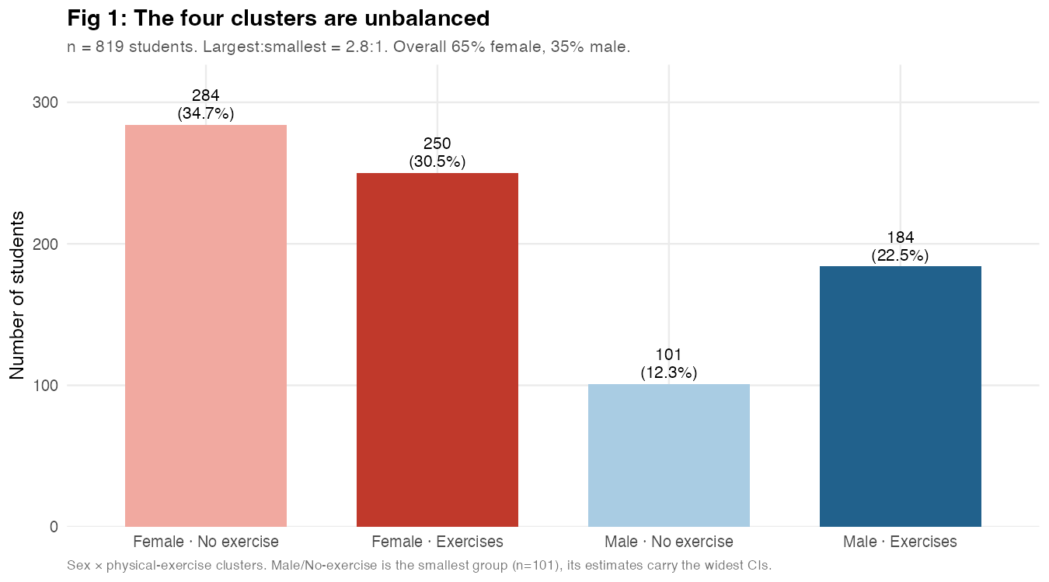



DATA OVERVIEW
819 Bangladeshi adolescents
n = 819 students, ages 13–19 (mean ≈ 15.8); one row per student.
Sylhet, Bangladesh - collected by Google Forms behind an informed-consent gate.
Cross-sectional · zero missing values across all 91 columns.
Convenience (non-probability) sample · 65% female, concentrated at ages 14–16.
THREE VALIDATED INSTRUMENTS
Internet Addiction Test OUTCOME · perceived addiction
Young, 1998 - TotalIA (0–94)
PHQ-9 depression
THE FOUR GROUPS = gender × EXERCISE
Kroenke et al., 2001 - totalphq (0–27)
Unbalanced by design (largest:smallest ≈ 2.8:1). Non-exercising boys are the smallest group (n = 101) and carry the widest confidence intervals - flagged throughout.
UCLA Loneliness Scale v3 loneliness
Russell, 1996 - score 29–75
Source: Mahmud et al. (2024), Mendeley Data V2, doi:10.17632/yzcwfyrxy2.2 (CC BY 4.0).
Group 2 · CIS2601 - Internet Addiction across gender × Exercise groups

Slide 5




HOW WE SET IT UP
Two decisions that shaped the analysis
1
Outcome = perceived addiction, not “hours online”
2
Forecast = the chance of being addicted (logistic)
Hours pile up at the floor - 62% of students sit in the lowest social-media bucket (84% for internet), leaving little variance to model.
Hours barely track distress (r = 0.27 with depression), while the IAT score tracks it at r = 0.53.
The IAT measures loss of control - the construct that actually moves with mental health.
We model P(addicted) rather than the raw score, with addicted = IAT ≥ 31 - the standard Young cutoff (25% of students).
Well distributed across groups, so the target is balanced enough to model.
Everything re-checked against a stricter cutoff (IAT ≥ 50; 10% of students) as a robustness lens.
Confounded Variables
Assumptions - course level
Reproducibility
Age
Bullied
Checked visually: Residuals-vs-Fitted and Normal Q–Q. Collinearity via the predictor correlation (r = 0.37).
set.seed(42), including right before the train/test split - every coefficient, figure and metric reproduces exactly.
Group 2 · CIS2601 - Internet Addiction across gender × Exercise groups

Slide 6

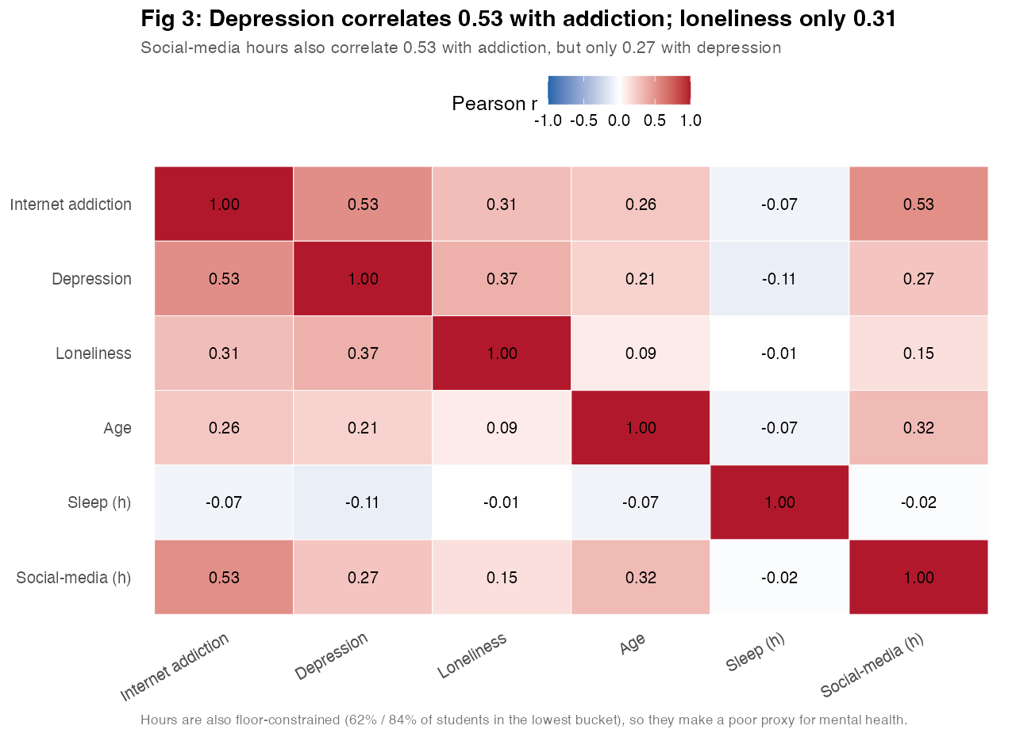
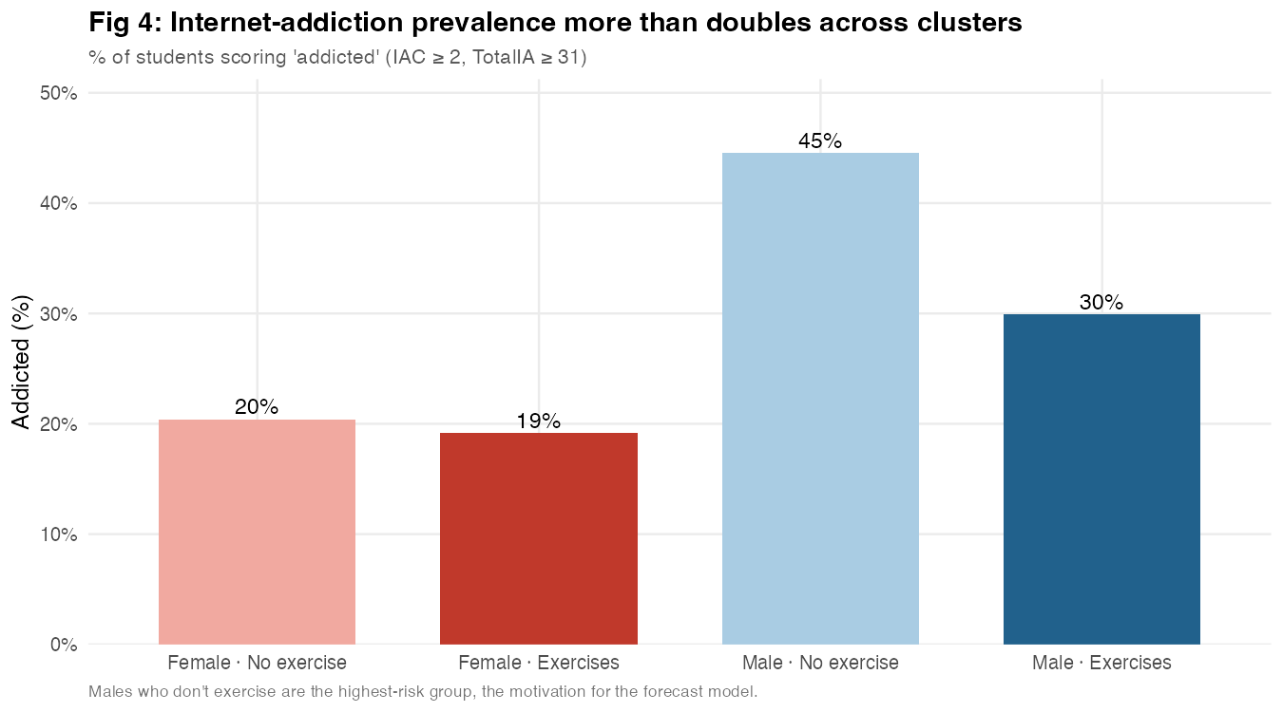
EXPLORATORY DATA ANALYSIS
What the data shows before modelling
r = 0.53
0.27
19% → 45%
Depression–addiction correlation - far ahead of loneliness (0.31).
Screen-time tracks addiction (0.53) but distress only 0.27 - a poor mental-health proxy.
Addiction prevalence more than doubles, girls to non-exercising boys.
IAT is heavily right-skewed (≈75% of students below the addiction cutoff) - which is why the forecast uses a binary outcome.
Group 2 · CIS2601 - Internet Addiction across gender × Exercise groups

Slide 7

METHODS
Four models, one job each
A continuous score calls for linear regression; a yes/no outcome calls for logistic regression. Everything stays within the course syllabus.
2
Pooled interaction model
Do the distress slopes differ across groups?
The falsifiable test of H2 - whether exercise buffers the distress→addiction link, and whether that differs by gender.
3
Two whole-sample models
Model A: distress only · Model B: global additive
Fit once the interaction comes back null - Model B adds gender, exercise, bullied and age across all 819 students.
Group 2 · CIS2601 - Internet Addiction across gender × Exercise groups
07 / 11

Slide 8

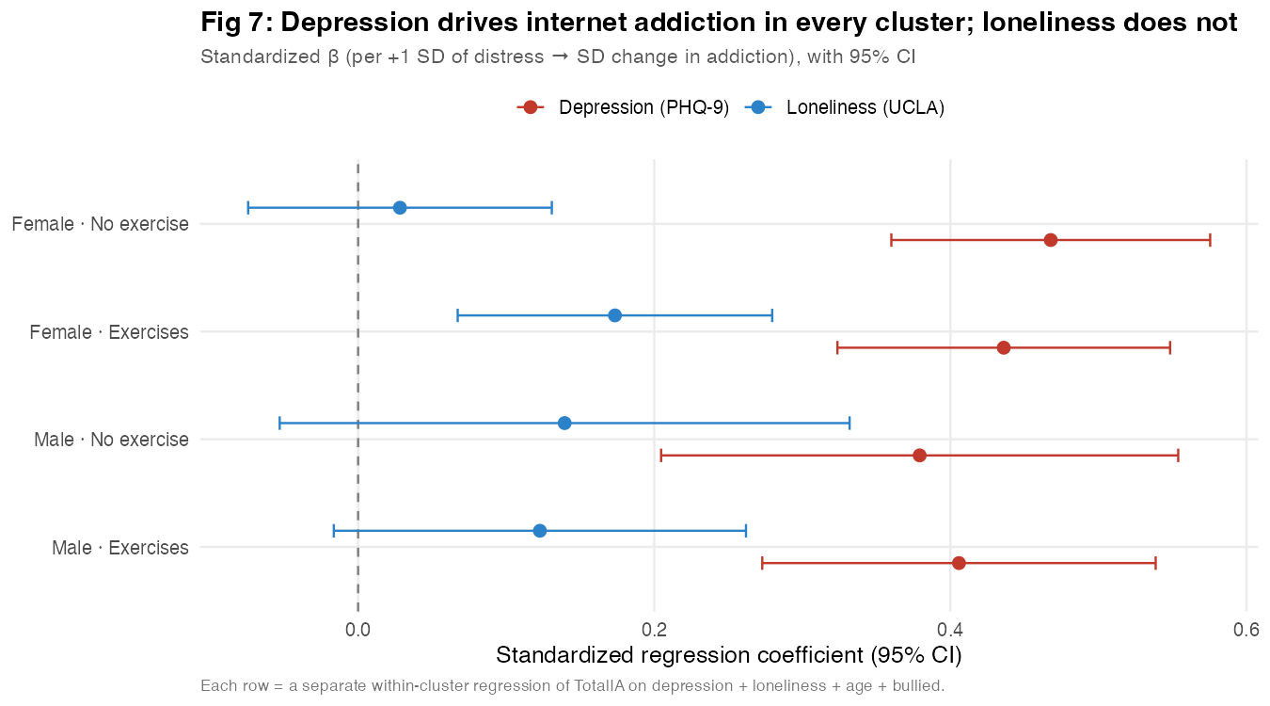

RESULTS · THE GROUP REGRESSIONS
On the models – Exploratory and Predictor
*
Four linear regressions - one per group
TotalIA ~ depression + loneliness + age + bullied
Estimates the distress slope inside each gender × exercise subgroup, holding the group fixed by stratification.
**
Logistic forecast of P(addicted)
~ depression + loneliness + gender + exercise + age + bullied
β = 0.38–0.47
DO THE SLOPES DIFFER ACROSS GROUPS?
70/30 stratified split: fit on train, score on the held-out test. ROC / AUC + confusion matrix; odds ratios on the full sample.
standardized depression slope, all p < .001
No. Interaction F(6, 805) = 0.65, p = 0.69.
Depression is associated with addiction just as hard for non-exercising boys as for exercising girls. This contradicts H2 (exercise buffering).
Group 2 · CIS2601 - Internet Addiction across gender × Exercise groups

Slide 9

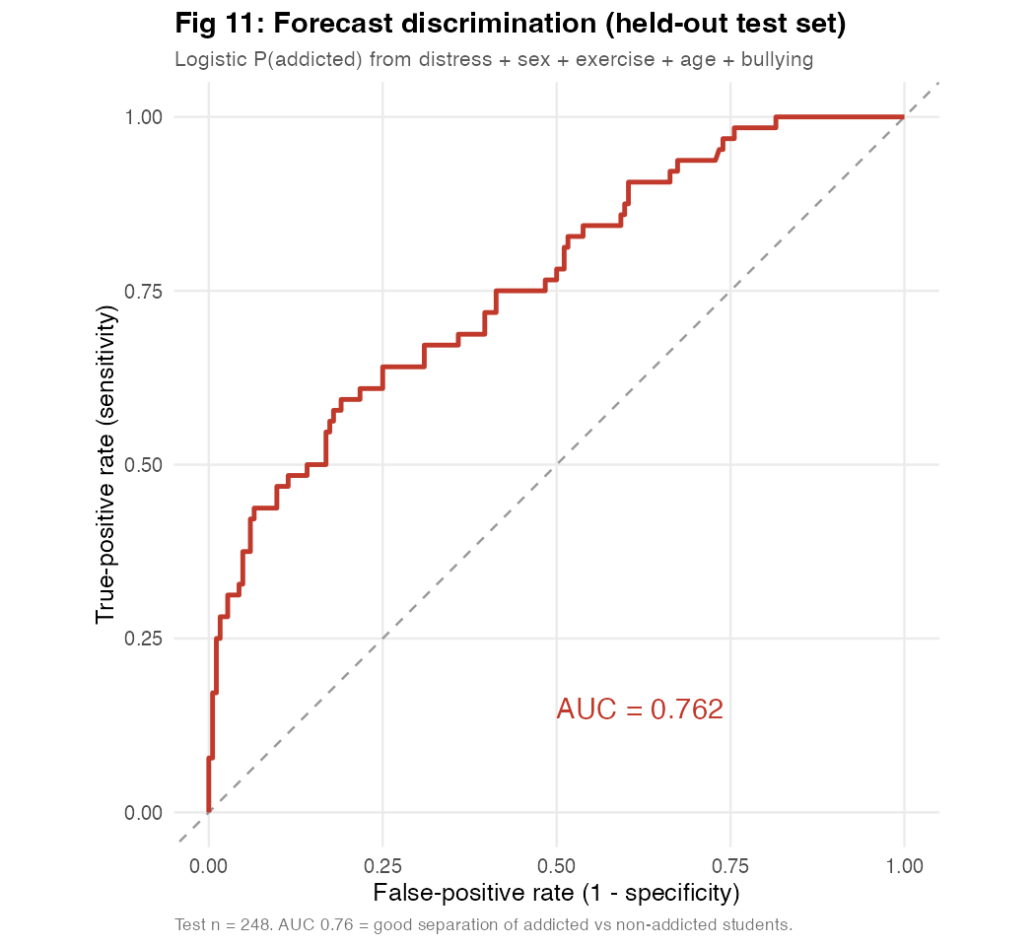
RESULTS · THE FORECAST
Forecasting who is at risk
WHO IS AT HIGHER RISK – SLOPES (FULL SAMPLE)
+1 PHQ-9 point (depression) - main question
1.18
p < .001
Associated variables that helped main question
Bullied (vs not)
1.98
p = .002
Male (vs female)
1.60
p = .023
+1 year of age
1.26
p < .001
+1 UCLA point (loneliness)
1.04
p < .001
Exercises (vs not)
0.84
n.s. (p = .383)
AUC
Accuracy 0.78
vs 0.74 baseline
Spec 0.89 · Sens 0.47
0.76
Each extra PHQ-9 point is associated with the odds of addiction by ~18%. Being bullied, male, and older all raise the odds; exercise points protective but isn’t significant once distress and gender are in.
Group 2 · CIS2601 - Internet Addiction across gender × Exercise groups

Slide 10

THE SCORECARD
What we found
#
HYPOTHESIS
VERDICT
EVIDENCE
H1a
Higher depression → higher IAT (every group)
CONFIRMED
std β 0.38–0.47, all p < .001
H1b
Higher loneliness → higher IAT (every group)
PARTIAL
β 0.11–0.13 pooled; ≈ 0 in 3 of 4 groups
H2
Exercise buffers the distress→addiction link
CONTRADICTED
interaction F(6,805) = 0.65, p = 0.69
H3
Males have higher prevalence than females
CONFIRMED
45% vs 19%; male OR = 1.60
H4
IAT tracks distress better than screen-time hours
CONFIRMED
IAT r = 0.53 vs hours r = 0.27 (w/ depression)
H5
Distress + group forecast addiction > chance
PARTIAL
AUC 0.76, accuracy 0.78 > 0.74 baseline
★
Emergent: groups differ in level, not slope
SUPPORTED
parallel slopes (Fig 7) + different heights (Fig 4)
Bottom line: depression is the main predictor of perceived addiction, well ahead of loneliness, and it works at about the same rate in every subgroup - what changes from group to group is the starting point.
Group 2 · CIS2601 - Internet Addiction across gender × Exercise groups

Slide 11



CONCLUSIONS
Takeaways
1
2
3
Depression - not loneliness - is the driver.
Groups differ in level, not slope.
The lever is mental-health support.
It is the main predictor of perceived internet addiction, and it bites about equally hard in every subgroup.
Non-exercising boys cross into addiction far more often because they start with more distress and a higher male baseline.
Target the high-baseline subgroup - but the mechanism, distress, is shared by everyone, not just screen-time limits.
LIMITATIONS
FUTURE WORK
Cross-sectional single questionnaire - association, not causation (common-method bias).
Convenience sample: 65% female, ages 14–16, Bangladesh - limited generalizability.
Small, unbalanced groups (non-exercising boys n = 101) · coarse self-reported exposure.
Longitudinal cross-lagged waves to test the depression ⇄ addiction direction.
Objective screen-time logs + an exercise dose (frequency, intensity).
Representative multi-country, multilevel models · mediation (distress → sleep → addiction).
Group 2 · CIS2601 - Internet Addiction across gender × Exercise groups · Association, not causation.

