Slide 1
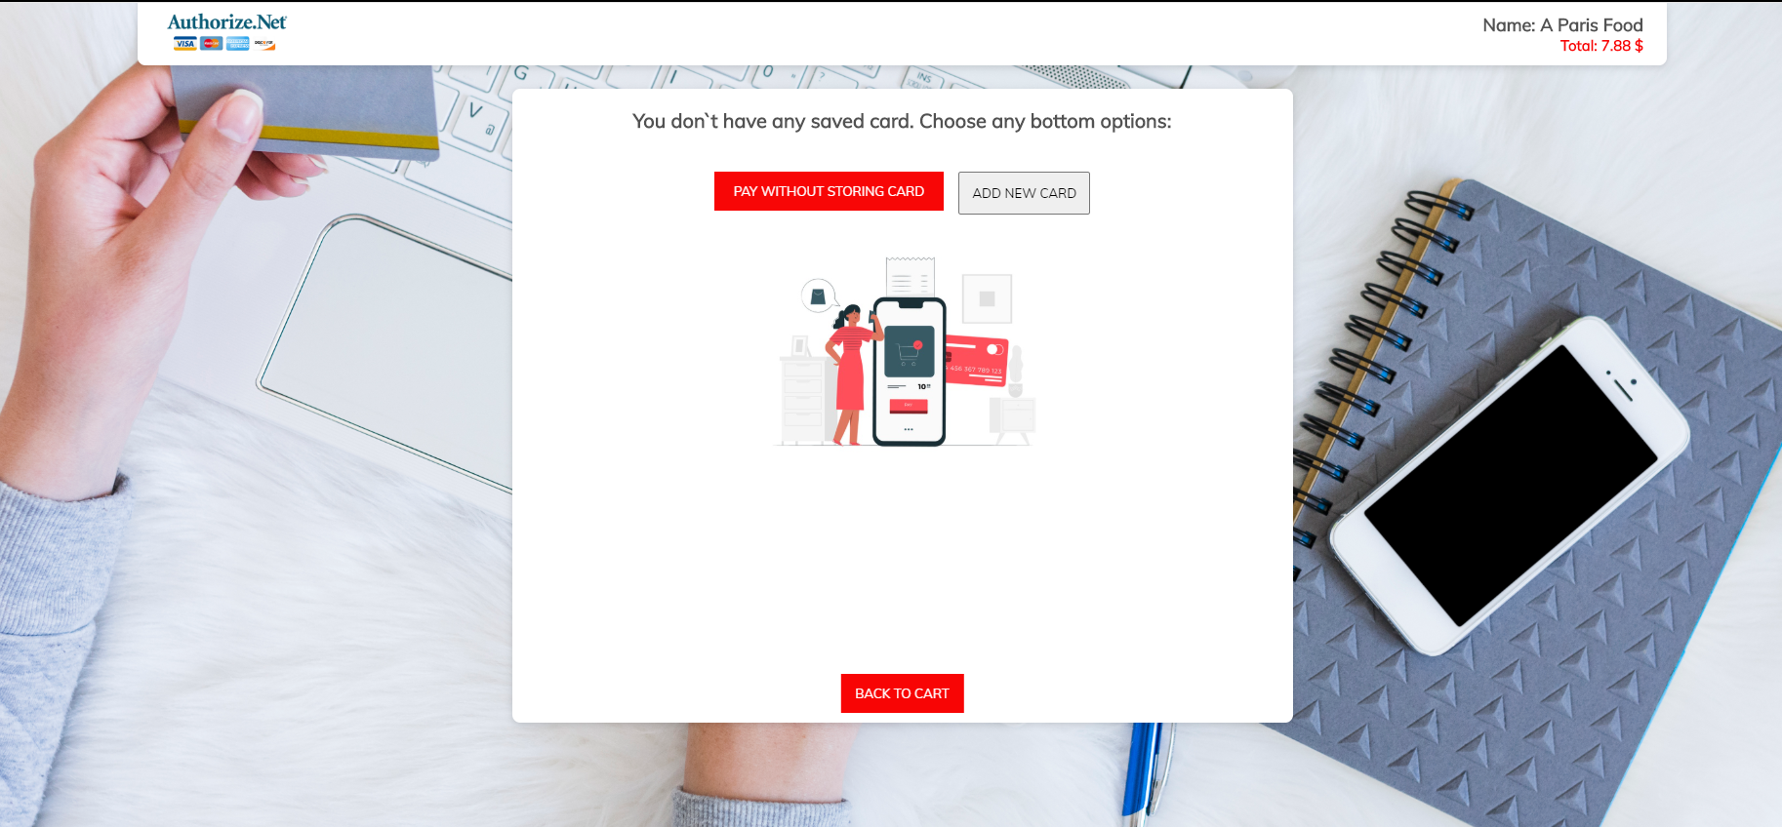
Main view without stored cards
Image can easily be changed from custom form

Slide 2
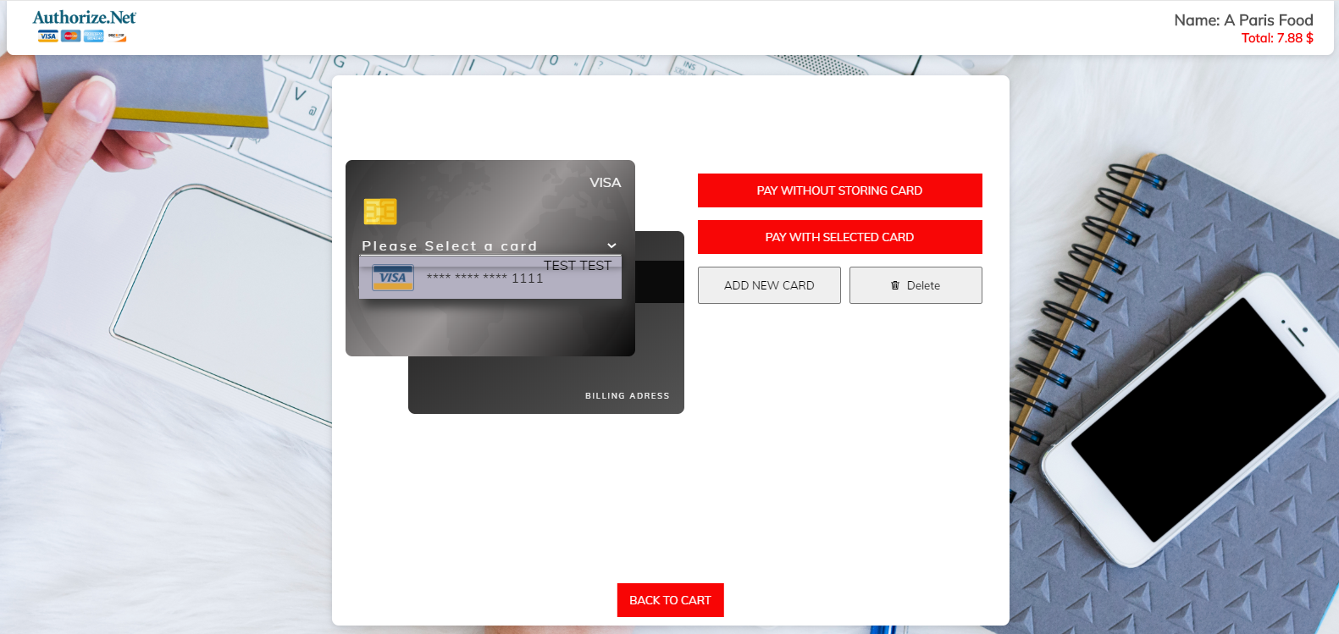
Main view with stored cards

Slide 3
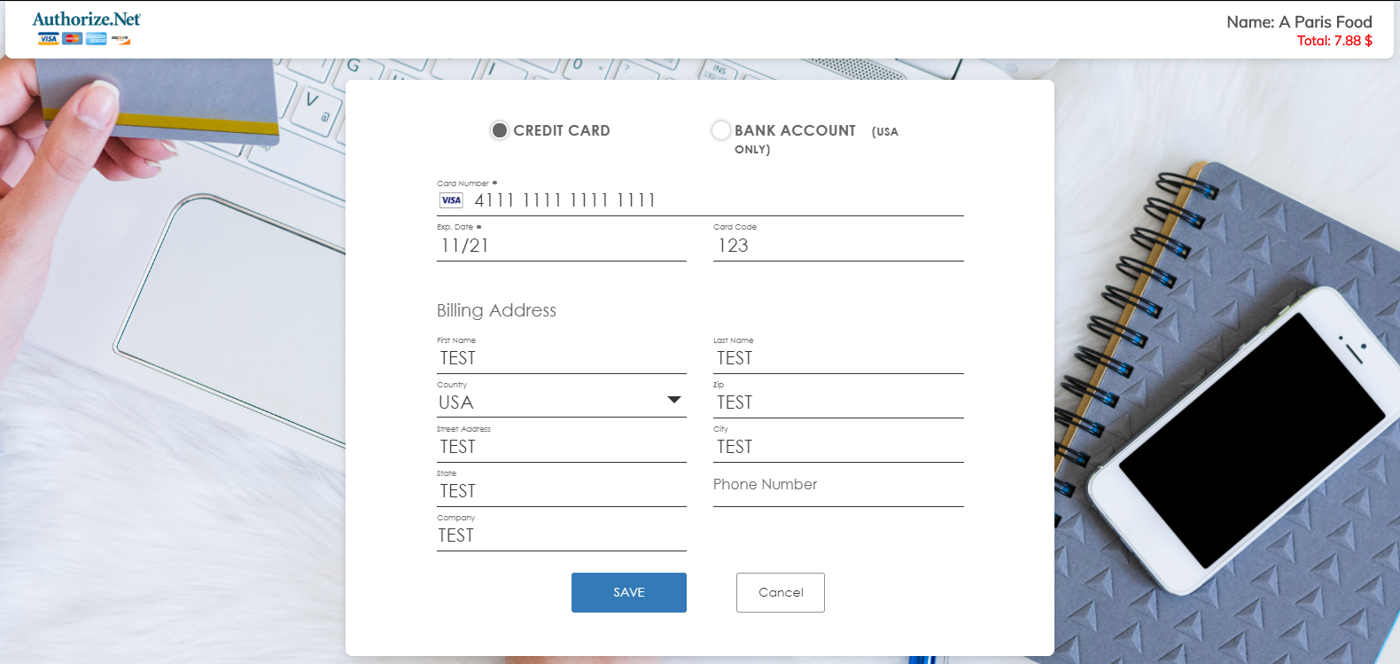
New Card adding view

Slide 4
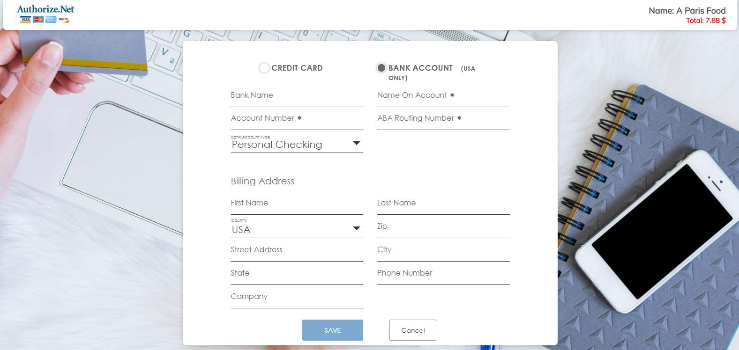
New Card (Bank Account) adding view

Slide 5
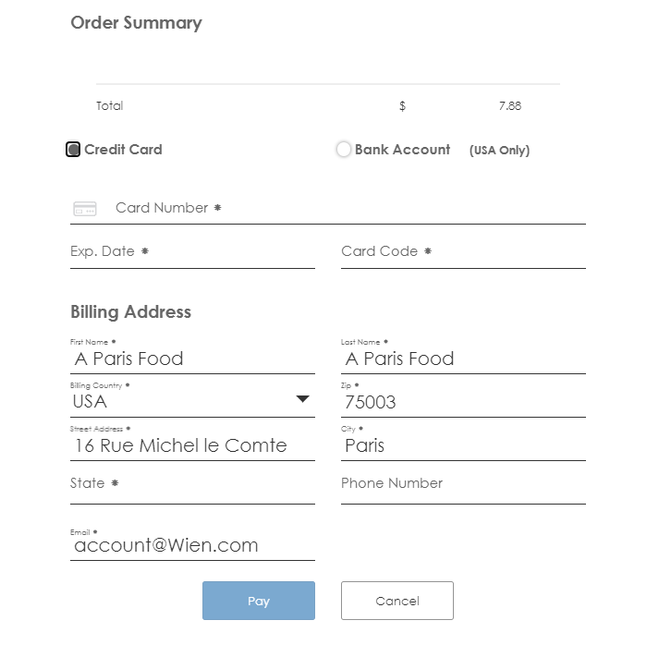
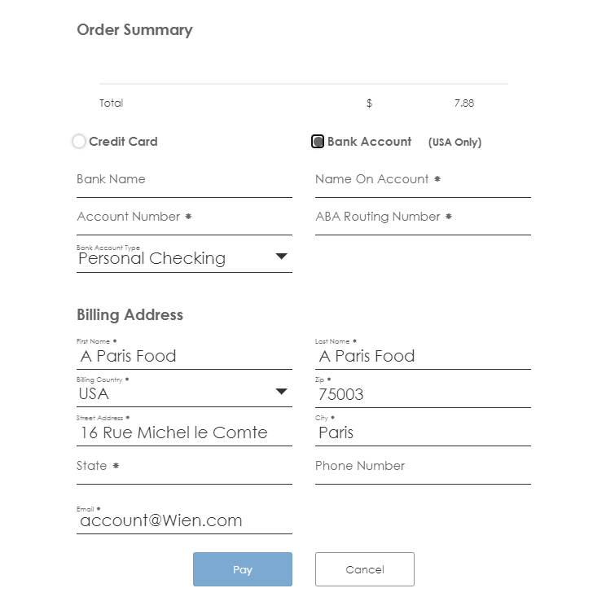
Paying without stored cards forms

Slide 6
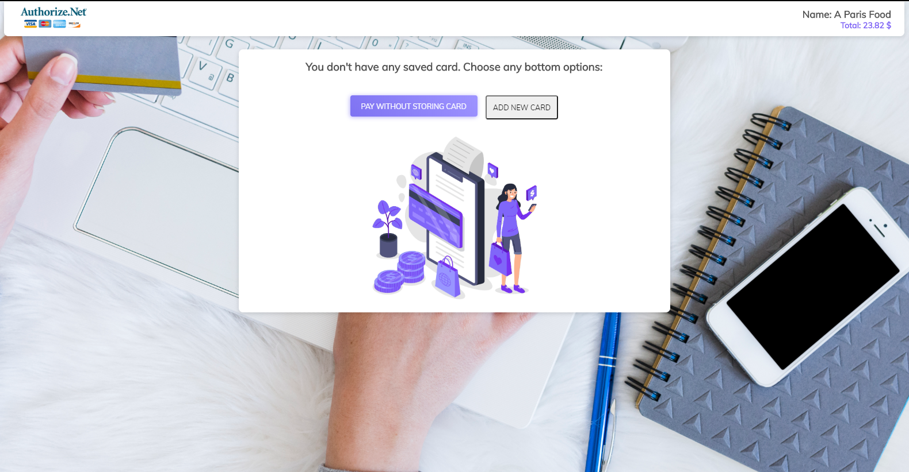
Main view without stored cards of second version

