Slide 1
Trading Strategy for Foreign Exchange Rates
Data Engineering Final Project
MG-GY_8411
Alina Wang

Slide 2
Data Collection Workflow
Main purpose: Implementing a trading strategy, utilizing historical FX data and exogenous economic indicators, to generate buy/sell signals and calculate Profit and Loss (P&L) for various currency pairs.
1. Data Source: FX rates data sourced from the Polygon API for specific currency pairs (tickers: USDEUR, USDGBP, etc.).
2. Data Collection & Temporary Storage in SQLite:
Real-time FX rates ( timestamp, ticker, exchange rate, N, and entry timestamp) stored in SQLite database (final_fx_rates.db).
3. Features calculation and Transferring to MongoDB:
Additional features (VWAP, liquidity, volatility, Keltner bands, fd) calculated for each currency pair. Data vectors are transferred to MongoDB (final_database) in real-time.
4. Data Cleaning and Deletion:
Periodic cleaning of temporary SQLite data to remove outdated entries.
1. Data Source: Economic indicators data (GDP, Unemployment, CPI, Core CPI) is obtained from the FRED API.
2. Data Processing:
2.1 The data is resampled to daily frequency using the 'ffill' (forward fill) method to fill missing values.
2.2 Upscaling with Spline-A spline of degree 3 is used to fit the original time series, and the resulting curve is evaluated at more finely spaced points.
2.3 Weekend Exclusion-Weekends (Saturday and Sunday) are excluded to match the FX market's weekdays-only nature.
3. Data Storage in MongoDB:
The upscaled data is stored in a MongoDB collection named 'upscaled_data' within the 'final_database'.

Slide 3
TradingStrategy Class
Regression Modeling
Correlation Calculation
Signal Generation
1. Data Loading:
Connects to MongoDB to fetch historical FX data for the specified ticker.
Loads the data into a DataFrame.
2. Regression Model Training:
Trains a regression model using PyCaret's automated model selection.
Saves the trained model with a unique name based on the ticker.
3. Data Merging:
Concatenates the historical FX data with exogenous data
Drops rows with missing timestamp values.
4. Correlation Calculation:
Calculates the correlation matrix between relevant columns in the extended data.
5. Signal Generation:
Utilizes the trained regression model to predict future values.
Generates buy/sell signals based on a trading strategy.
Generative models can assist in creating new features or representations of the data, potentially capturing complex patterns that traditional methods might overlook, thereby improving the effectiveness of predictive models.

Slide 4
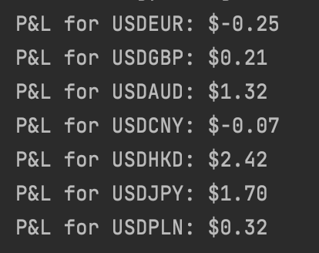
P A R T 0 3
Profit and Loss Calculation
1. Function `calculate_pnl`:
Takes a CSV file containing buy/sell signals for a specific currency pair as input and reads the signals into a DataFrame.
Iterates through the signals, keeping track of the trading position and calculating the P&L.
Closes any open position at the end using the last available price.
2. Loop for Multiple Currency Pairs:
Iterates through a list of currency pairs: 'USDEUR', 'USDGBP', 'USDAUD', 'USDCNY', 'USDHKD', 'USDJPY', 'USDPLN'.
Calls the `calculate_pnl` function for each currency pair, passing the corresponding signals CSV file.
Final_P&L.py calculates the Profit and Loss (P&L) for different currency pairs based on buy/sell signals generated from historical FX data.

