Slide 1
Cryptocurrency Prices (CoinGecko API)
Retrieve daily price history for Bitcoin and Ethereum in USD over the past 365 days.
Draw insights from your data and present the visuals.
presented by: Consolee MUSANABERA & Aline MUHAWENIMANA

Slide 2
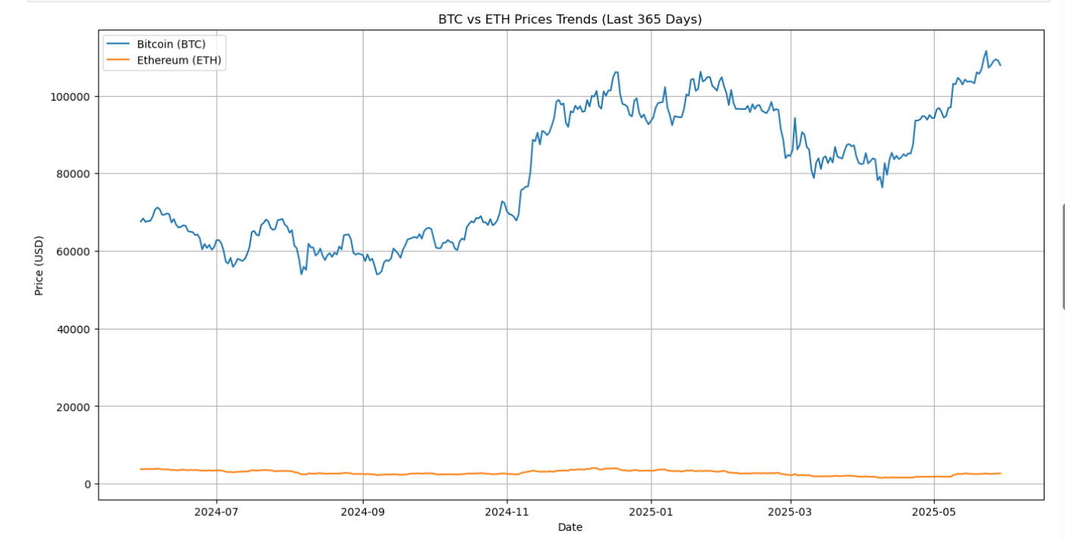
.

Slide 3
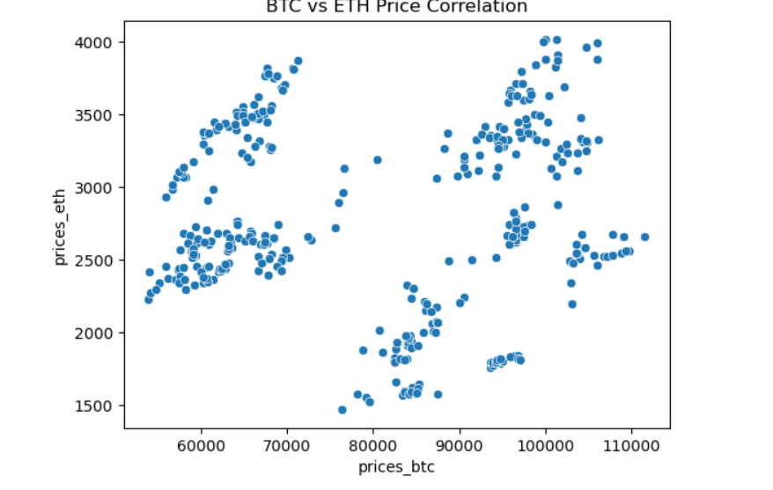
.

Slide 4



