Slide 1
Mental Health Analysis in the Healthcare Workforce
MBABAZI Jane and MUHAWENIMANA Aline

Slide 2
Introduction
This project performs a comprehensive analysis of the UCI Healthcare Workforce Mental Health Dataset. It explores stress levels, job satisfaction, mental health absences, and burnout across departments and roles. The goal is to identify areas for improvement and propose evidence-based strategies.

Slide 3
Load Required Libraries

Slide 4
Load the Dataset
 | Employee ID | Employee Type | Department | Workplace Factor | Stress Level | Burnout Frequency | Job Satisfaction | Access to EAPs | Mental Health Absences | Turnover Intention
0 | HCP-00001 | Pediatric Nurse | Pediatrics | Heavy Workload | 8 | Often | 2 | Yes | 6 | No
1 | HCP-00002 | Laboratory Technician | Laboratory | Safety Concerns | 8 | Often | 1 | Yes | 12 | No
2 | HCP-00003 | Nursing Assistant | Assisted Living | Poor Work Environment | 6 | Occasionally | 2 | Yes | 9 | Yes
3 | HCP-00004 | Medical Assistant | Outpatient Services | Poor Work Environment | 7 | Never | 4 | No | 11 | No
4 | HCP-00005 | Registered Nurse | General Medicine | Work-Life Imbalance | 8 | Occasionally | 2 | Yes | 7 | No

Slide 5
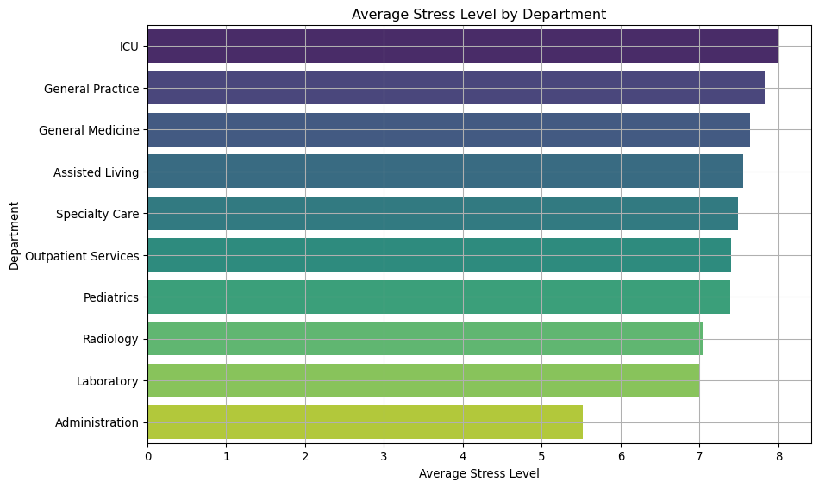
Average Stress Level by Department

Slide 6
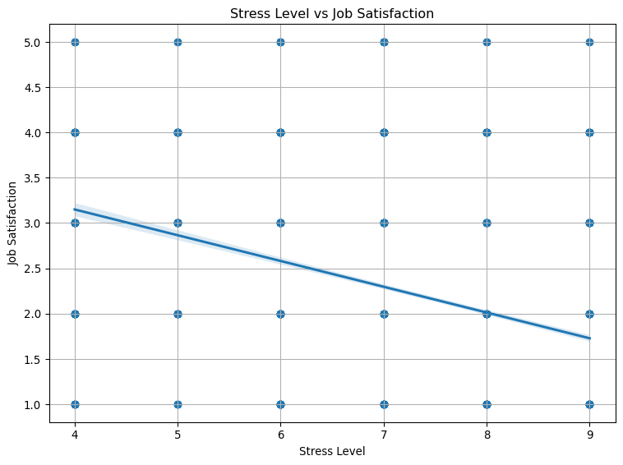
Stress Level vs Job Satisfaction

Slide 7
Mental Health Absences by Access to EAPs
Unable to display output for mime type(s): text/html
Unable to display output for mime type(s): text/html

Slide 8
Job Satisfaction by Employee Type
Unable to display output for mime type(s): text/html

Slide 9
Spearman Rank Correlation: Stress vs Job Satisfaction
Spearman correlation: -0.366, p-value: 0.0000

Slide 10
Chi-Square Test: Department vs Burnout Frequency
Chi-Square Test Results Chi2 Statistic: 144.41, p-value: 0.0000, Degrees of freedom: 18 There is a statistically significant association between Department and Burnout Frequency.

Slide 11
Recommendations
Implement stress management and resilience training programs.
Improve access to Employee Assistance Programs (EAPs).
Tailor interventions for departments with high burnout rates.
Regularly monitor mental health indicators across roles and departments.
Encourage open dialogue and mental health support in the workplace.

