Slide 1
Computational Complexity for Social Choice Theorists
Jörg Rothe
COMSOC 2008, Liverpool, UK

Slide 2
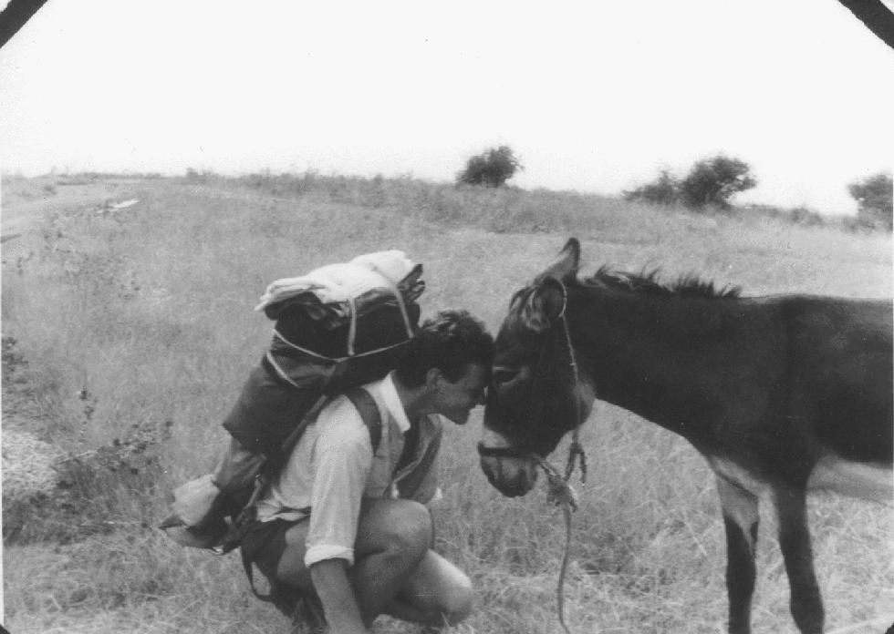
Everything you Always Wanted to Know about Complexity Theory but Were Afraid to Ask
Question: What do you do in complexity theory?
Answers:
Struggling with intractable problems.

Slide 3
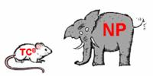
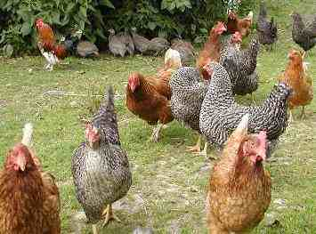
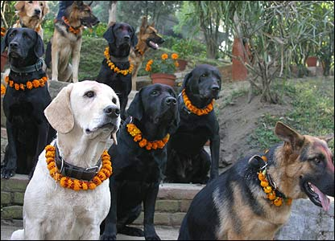
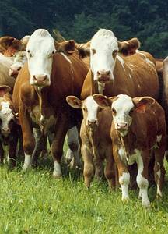
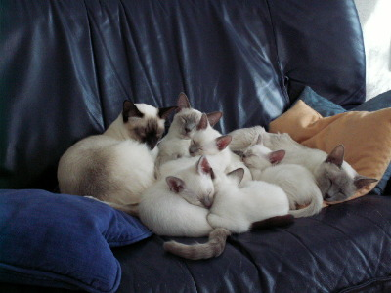
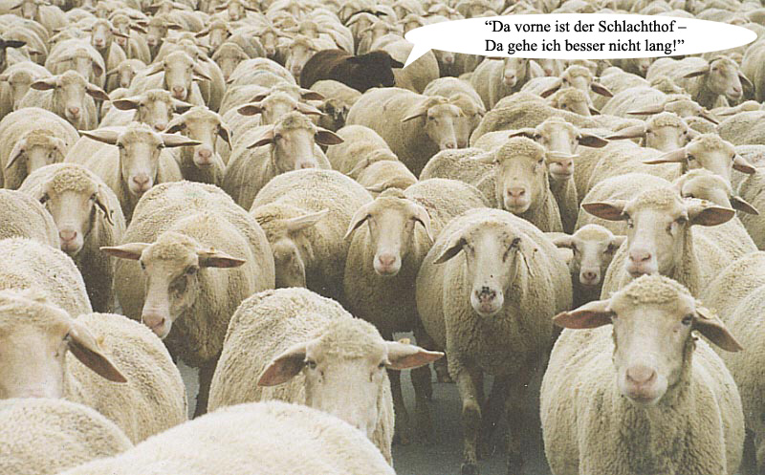
Everything you Always Wanted to Know about Complexity Theory but Were Afraid to Ask
Question: What do you do in complexity theory?
Scott Aaronson‘s Zoo of Complexity Classes
CHICKENS
DOGS
Answers:
Struggling with intractable problems.
Collecting them in complexity classes and making up funny names for those.
SHEEP
CATS
CATTLE

Slide 4

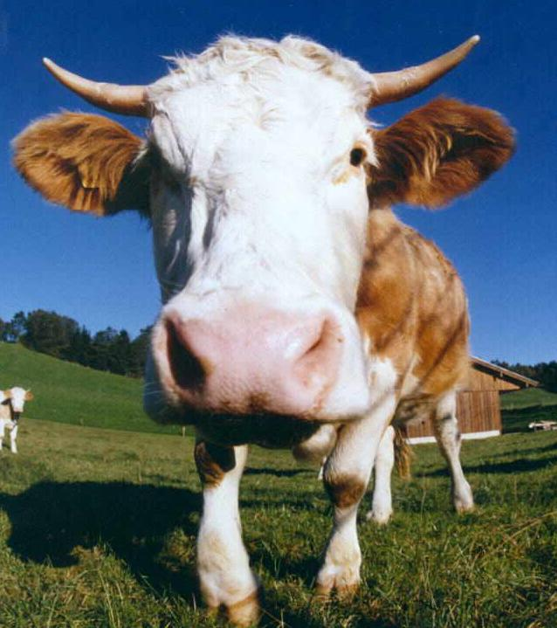

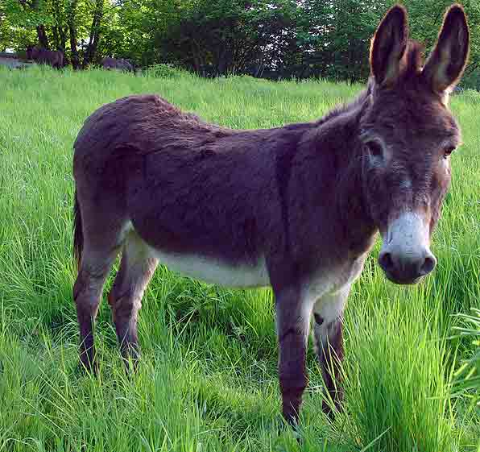
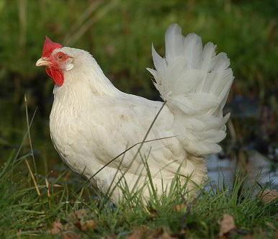
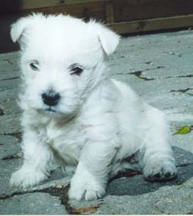
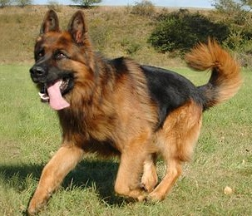
Everything you Always Wanted to Know about Complexity Theory but Were Afraid to Ask
Question: What do you do in complexity theory?
Answers:
Struggling with intractable problems.
Collecting them in complexity classes and making up funny names for those.
Comparing the complexity of problems via reducibilities to find the „hardest“ problems in the class: Completeness.
Pm
Pm
Polynomial-time Many-One Reducibility:
A B ⇔ (∃f∈FP)(∀x∈Σ*)[x∈A ⇔ f(x)∈B].
B is hard for class C if (∀A∈C)[A B].
B is C-complete if B is in C and is hard for C .
Pm
Pm
Pm

Slide 5
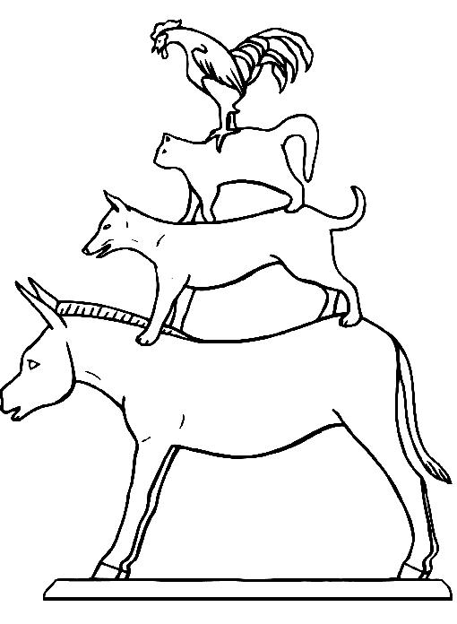
Everything you Always Wanted to Know about Complexity Theory but Were Afraid to Ask
Question: What else do you do in complexity theory?
Answers:
Struggling with intractable problems.
Collecting them in complexity classes and making up funny names for those.
Comparing the complexity of problems via reducibilities to find the „hardest“ problems in the class: Completeness.
Studying hierarchies of complexity classes, such as
  the Polynomial Hierarchy,
  the Boolean Hierarchy over NP, etc.

Slide 6
„Computer Science is not about computers,
any more than astronomy is about telescopes.“
Edsger Dijkstra
Outline
Everything You Always Wanted to Know about...
Some Problems from Social Choice Theory
  Voting Problems: Winner Determination, Manipulation, Control, ...
  Power-Index Comparison and Weighted Voting Games
  Multiagent Resource Allocation
Foundations of Complexity Theory
Problems Complete for NP
Parallel Access to NP and the Polynomial Hierarchy
Probabilistic Polynomial Time and Power Indices
DP and the Boolean Hierarchy over NP

Slide 7
Voting Problems:
How to Recruit a new Faculty Member
Candidates: A, B, C, D, E, F, G, H, I, J, K
Preferences of the Recruiting Committee:
J < A < B < E < D < F < G < H < K < I < C
I < J < A < D < E < F < G < B < C < K < H
A < B < F < G < H < K < I < C < J < E < D
E < G < F < B < J < I < H < C < A < D < K
C < A < F < E < B < K < H < G < I < D < J
C < A < F < E < B < K < H < G < I < D < J
H < G < K < I < C < B < A < F < J < E < D
D < I < E < A < B < H < F < G < C < J < K
F < G < D < I < E < B < H < A < C < K < J
D
Cycle
K J
Make the List ... by the Plurality Rule:
Rank 1: J
Rank 2: D and K (aequo loco)
Rank 3: C and H (aequo loco)
Make the List ... by Borda‘s Rule:
Rank 1: K (63 points)
Rank 2: J (60 points)
Rank 3: D (56 points)
Make the List ... by the Majority Rule:
Rank 1: D and J and K (aequo loco)
Since: D defeats J by 5:4 votes,
J defeats K by 5:4 votes,
K defeats D by 5:4 votes.
Condorcet‘s Paradoxon

Slide 8
Voting Problems:
Winner Determination, Manipulation, Control, Bribery
Winner Determination:
How hard is it to determine the winners of a given election?
For most election systems, it is easy to determine the winners,
but for some it is hard (Carroll, Kemeny, and Young elections).
Manipulation:
How hard is it, computationally, to manipulate the result of
an election by strategic voting?
The Gibbard-Satterthwaite Theorem says: Manipulation is
unavoidable in principle.
Control:
How hard is it, computationally, for an evil chair to influence
the outcome of an election via procedural changes?
Bribery:
How hard is it, computationally, for an external agent to bribe
certain voters in order to change an election‘s outcome?

Slide 9
Voting Problems:
Winner Determination, Manipulation, Control, Bribery
Winner Determination: Hardness is undesirable!
How hard is it to determine the winners of a given election?
For most election systems, it is easy to determine the winners,
but for some it is hard (Carroll, Kemeny, and Young elections).
Manipulation: Hardness provides protection!
How hard is it, computationally, to manipulate the result of
an election by strategic voting?
The Gibbard-Satterthwaite Theorem says: Manipulation is
unavoidable in principle.
Please attend the
afternoon session tomorrow
to learn more about
bribery and control.
Control: Hardness provides protection!
How hard is it, computationally, for an evil chair to influence
the outcome of an election via procedural changes?
Bribery: Hardness provides protection!
How hard is it, computationally, for an external agent to bribe
certain voters in order to change an election‘s outcome?

Slide 10








Power-Index Comparison and
Weighted Voting Games
Harvard University
Money University
Where will I have more (local) power?
20
papers
20
papers
50
papers
$2M
$5M
$2M
Aha! Clearly, I will have more (local) power at Money University!
But how else can I justify this choice?
4 papers
$10M

Slide 11
Power-Index Comparison and
Weighted Voting Games
Weighted Voting Games:
Alice
3
Alice
3
Alice
3
Bob
3
Bob
3
Bob
3
Carol
4
Carol
4
Alice
2
Bob
2
Carol
6
Equal power
No power
Total power
Power Index idea:
How “often” is the given player critical to the winning side?
Power indices (e.g., Shapley-Shubik and Banzhaf) formally capture this idea. How hard is it to
  compute a power index for a given weighted voting game?
  compare the power index of two given weighted voting games?

Slide 12
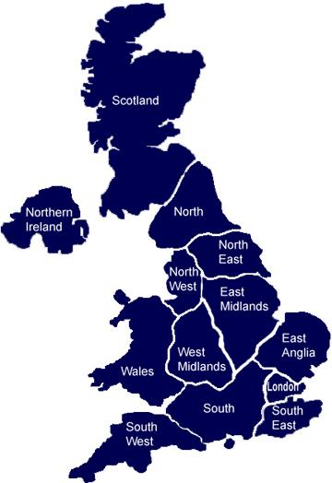
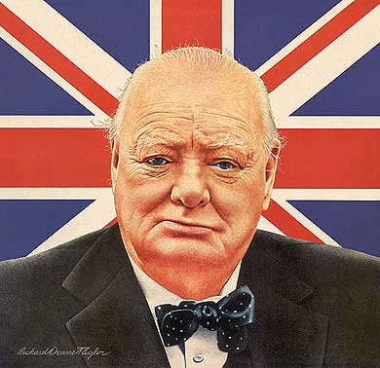
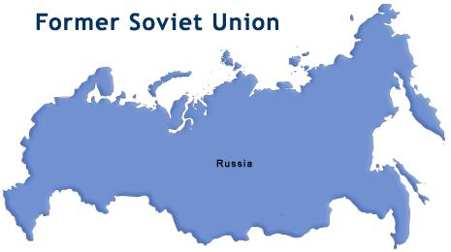
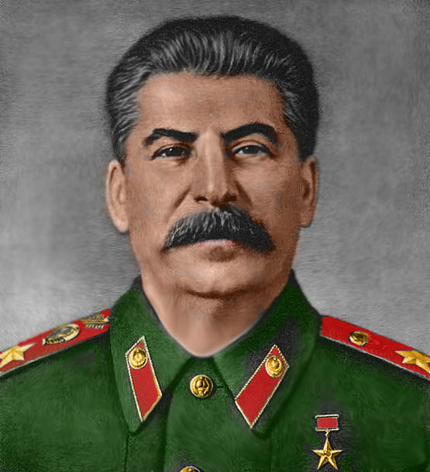
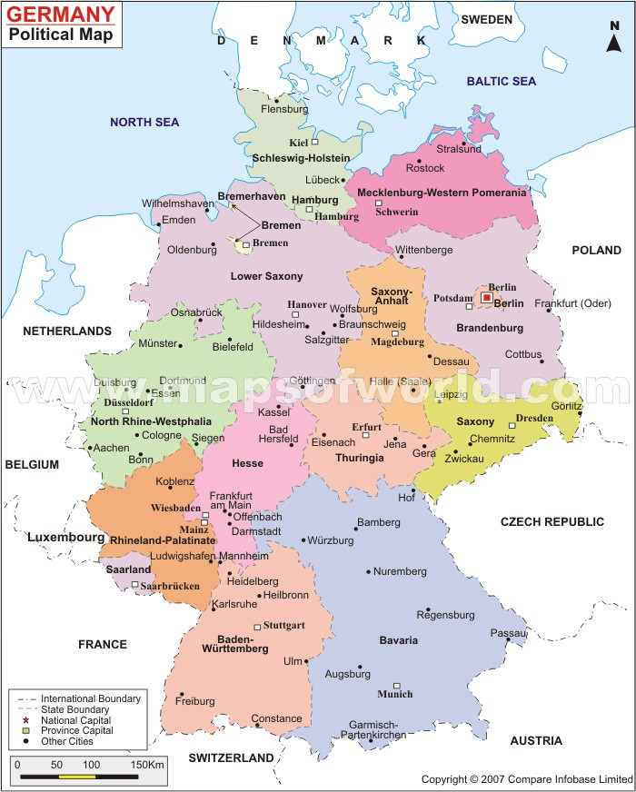
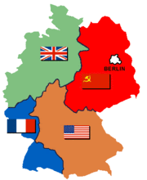
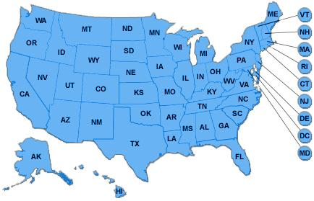
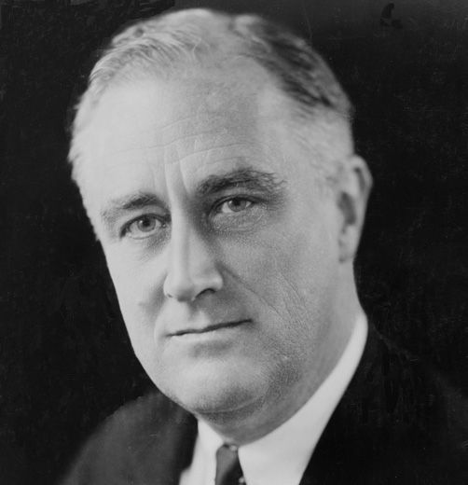
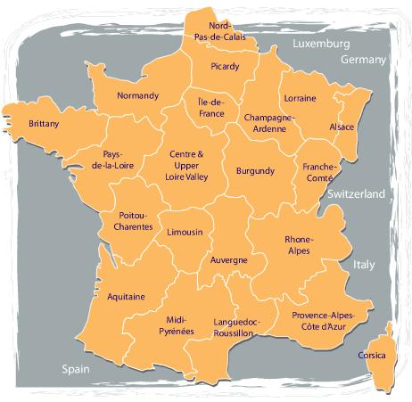
Multiagent Resource Allocation after World War II
Set of Agents: the Allies of World War II
Set of Resources: Germany‘s Federal States

Slide 13


Multiagent Resource Allocation
Set of Agents: A = {1, 2, ..., n}
Set of Resources: R = { }
Each agent a has
  a preference over allocations
  a utility function that assigns values to bundles of resources.
Each resource is indivisible and nonsharable.
An allocation is a mapping P from A to bundles of resources. Useful properties:
  Envy-freeness
  Pareto optimality
Given agents A, resources R, and utility functions U, how hard is it to
  to maximize (utilitarian) social welfare?
  to determine if a given allocation is Pareto-optimal?
  to determine if a given allocation is envy-free?

Slide 14
„Computer Science is not about computers,
any more than astronomy is about telescopes.“
Edsger Dijkstra
Outline
Everything You Always Wanted to Know about...
Some Problems from Social Choice Theory
  Voting Problems: Winner Determination, Manipulation, Control, ...
  Power-Index Comparison and Weighted Voting Games
  Multiagent Resource Allocation
Foundations of Complexity Theory
Problems Complete for NP
Parallel Access to NP and the Polynomial Hierarchy
Probabilistic Polynomial Time and Power Indices
DP and the Boolean Hierarchy over NP

Slide 15
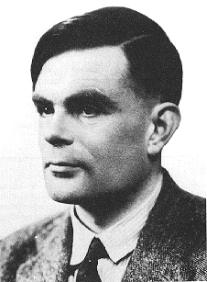
Foundations of Complexity Theory
1912 - 1954
A problem‘s computational complexity is determined by:
computational model
  Turing machine
  Boolean circuit
  ...
computational paradigm
  Deterministic TM
  Nondeterministic TM
  Probabilistic TM
  Alternating TM
  ...
complexity measure
(a.k.a. resource) used
  computation time
  space (memory)
  ... (see Blum‘s axioms)
Alan Turing
Broke the Enigma-Code
Invented the Turing machine

Slide 16

What is a Turing machine?
Turing machines:
capture everything computable
are a simple, abstract model of a computer/algorithm
form the theoretical basis of computer science
facilitate the complexity analysis
How to get a problem into the computer?
Which problems are not solvable on a computer?
The (deterministic, worst-case) complexity measure Time of a Turing machine M gives, as a function of the input size n, the maximum number of steps M needs on inputs of size n.
The (deterministic, worst-case) complexity measure Space of a Turing machine M gives, as a function of the input size n, the maximum number of tape cells M needs on inputs of size n.
Compare with Impossibility Theorems from Social Choice:
Arrow: No election system satisfying a certain small set of
„fairness“ conditions can be nondictatorial.
Gibbard-Satterthwaite:
Manipulation is unavoidable in principle.

Slide 17
„Computer Science is not about computers,
any more than astronomy is about telescopes.“
Edsger Dijkstra
Outline
Everything You Always Wanted to Know about...
Some Problems from Social Choice Theory
  Voting Problems: Winner Determination, Manipulation, Control, ...
  Power-Index Comparison and Weighted Voting Games
  Multiagent Resource Allocation
Foundations of Complexity Theory
Problems Complete for NP
Parallel Access to NP and the Polynomial Hierarchy
Probabilistic Polynomial Time and Power Indices
DP and the Boolean Hierarchy over NP

Slide 18

Nondeterministic
Polynomial Time
Complexity classes collect all problems solvable on a Turing machine of a certain type within a certain amount of resources
P is the class of polynomial-time („efficiently“) solvable problems
NP is the class of problems with efficiently checkable solutions
Central open question in computer science:
P = NP ?
One of the standard NP-complete problems: Traveling Sales Person
  TSP belongs to NP (upper bound)
  TSP is one of the „hardest“ problems in NP, i.e., every problem in NP efficiently reduces to TSP (lower bound)
x ∈ L
A R A

Slide 19
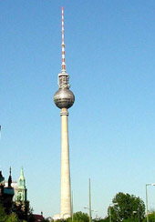



The Traveling Salesperson Problem
919
538
575
Berlin
Düsseldorf
London
338
508
871
For n cities:
(n - 1)! / 2 tours
For n = 1000:
2x10 tours
There are about
10 atoms in the universe
Tour 1: D-B-L-P-D = 2340
Tour 2: D-P-B-L-D = 2836
2564
Paris
Tour 3: D-L-P-B-D = 2322 is optimal.
77

Slide 20
Voting Problems: Manipulation
Candidates: A, B, C, D, E, F, G, H, I, J, K
Preference profile: Multiset of voters‘ preferences
J < A < B < E < D < F < G < H < K < I < C
I < J < A < D < E < F < G < B < C < K < H
A < B < F < G < H < K < I < C < J < E < D
E < G < F < B < J < I < H < C < A < D < K
C < A < F < E < B < K < H < G < I < D < J
C < A < F < E < B < K < H < G < I < D < J
H < G < K < I < C < B < A < F < J < E < D
D < I < E < A < B < H < F < G < C < J < K
F < G < D < I < E < B < H < A < C < K < J
Preference relation:
strict,
transitive,
complete.
Manipulation: Strategic voters misrepresent their preferences to change the election‘s outcome, either to
make their favorite candidate win (constructive case) or to
prevent a despised candidate‘s victory (destructive case).

Slide 21
Election Systems that are NP-hard to Manipulate
Gibbard-Satterthwaite: Manipulation is unavoidable in principle.
Manipulation Problem
Instance: (C,c,V), where C is a set of candidates,
V is the voters‘ preference profile over C,
c a designated candidate in C.
Question: Does there exist a preference order making c a winner?
J. Bartholdi, C. Tovey & M. Trick (SCW 1989):
For Second-Order Copeland, the winner problem is efficiently
solvable, but the manipulation problem is NP-complete.
V. Conitzer, T. Sandholm & J. Lang (J.ACM 2007):
Studied coalitional manipulation by weighted voters
Characterized the exact number of candidates for which manipulation becomes NP-hard for plurality, Borda, STV, Copeland, maximin, veto, and other protocols
Considered both constructive and destructive manipulation

Slide 22
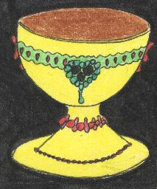
Election Systems that are NP-hard to Manipulate
E. Hemaspaandra & L. Hemaspaandra (JCSS 2007):
Provided the first dichotomy result for voting systems:
an easy-to-check condition („diversity of dislike“) that separates
  Scoring protocols that are NP-hard to manipulate from
  Scoring protocols that are easy to manipulate.
P. Faliszewski, E. Hemaspaandra & H. Schnoor (AAMAS 2008):
Established NP-hardness results for coalitional manipulation both for
weighted and unweighted voters within (various) Copeland elections.
Holy Grail
C. Dwork, R. Kumar, M. Naor & D. Sivakumar (WWW 2001):
„Rank Aggregation Methods for the Web“:
Kemeny SCF is suitable to prevent „manipulation of website rankings“ by search engines.
Efficient heuristic: „Local Kemenization“.

Slide 23
„Computer Science is not about computers,
any more than astronomy is about telescopes.“
Edsger Dijkstra
Outline
Everything You Always Wanted to Know about...
Some Problems from Social Choice Theory
  Voting Problems: Winner Determination, Manipulation, Control, ...
  Power-Index Comparison and Weighted Voting Games
  Multiagent Resource Allocation
Foundations of Complexity Theory
Problems Complete for NP
Parallel Access to NP and the Polynomial Hierarchy
Probabilistic Polynomial Time and Power Indices
DP and the Boolean Hierarchy over NP

Slide 24
The Condorcet Principle
Majority Rule:
Candidate A defeats candidate B if A gets more votes than B.
A Condorcet candidate defeats every other candidate according to the majority rule.
A
Cycle
B C
Example 1
Voter 1: A < B < C
Voter 2: A < C < B
Voter 3: B < C < A
C defeats A and B by 2:1 and thus is a Condorcet candidate.
Example 2
Voter 1: A < B < C
Voter 2: C < A < B
Voter 3: B < C < A
There‘s NO Condorcet winner!
Condorcet‘s Paradox
Condorcet Principle
An election system should respect the notion of Condorcet winner.

Slide 25
Condorcet SCFs...
... respect the Condorcet Principle by choosing the Condorcet Candidate whenever one exists.
Lewis Carroll‘s Voting System (1876):
The winner is whoever becomes a Condorcet candidate by a minimum number of sequential switches of adjacent candidates in the voters‘ preference profile.
H. P. Young‘s Voting System (1977):
The winner is whoever becomes a Condorcet candidate by removing a minimum number of voters from the preference profile.
J. G. Kemeny‘s Voting System (1959):
The winner is the candidate ranked first place in the „Consensus Ranking,“ a preference order that minimizes the sum of the distances to the voters‘ preferences in the profile.
...

Slide 26
Carroll Elections
The Carroll score of a candidate C is the smallest number of
sequential switches of adjacent candidates in the preference
profile of the voters that make C a Condorcet candidate.
Carroll winner is whoever has the lowest Carroll score.
Example: Carroll score
Voter 1: A < B < C
Voter 2: A < C < B
Voter 3: C < A < B
Voter 4: C < B < A
B defeats A and C by 3:1 and so is a Condorcet candidate
Example: Carroll score
Voter 1: A < B < C
Voter 2: A < B < C
Voter 3: C < A < B
Voter 4: C < B < A
C ties A and B (2:2) and thus is no Condorcet candidate
Example: Carroll score
Voter 1: A < B < C
Voter 2: A < B < C
Voter 3: C < A < B
Voter 4: B < C < A
C defeats B (3:1), ties A (2:2): No Condorcet candidate
Example: Carroll score
Voter 1: A < B < C
Voter 2: A < B < C
Voter 3: C < A < B
Voter 4: B < A < C
C defeats A and B by 3:1 and so is a Condorcet candidate
Score(B) = 0
Score(C) = 3
Score(A) = 3
For this preference profile P, the Carroll SCF gives:
A = C < B

Slide 27
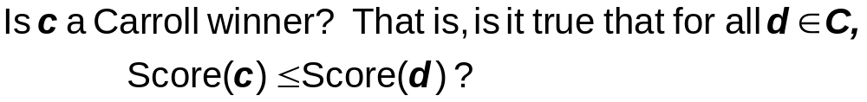

Problems for Carroll Elections
Carroll Winner
Instance: A Carroll triple (C,c,V), where
C Set of Candidates,
V Preference profile of voters over C,
c a designated candidate in C.
Question:
Carroll Ranking
Instance: A Carroll triple (C,c,V) and another candidate d in C.
Question:
Carroll Score
Instance: A Carroll triple (C,c,V) and a positive integer k.
Question:

Slide 28

Results for Carroll Election Problems
J. Bartholdi, C. Tovey & M. Trick (SCW 1989):
Carroll Score and Kemeny Score are NP-complete.
Carroll Winner and Kemeny Winner are NP-hard.
E. Hemaspaandra, L. Hemaspaandra & J. Rothe (J.ACM 1997):
Carroll Winner and Carroll Ranking are complete for
P : „parallel access to NP.“
Question:
Can we do better?
NP
||
J. Rothe, H. Spakowski & J. Vogel (TOCS 2003):
Young Winner and Young Ranking are P -complete.
NP
||
E. Hemaspaandra, H. Spakowski & J. Vogel (TCS 2005):
Kemeny Winner and Kemeny Ranking are P -complete.
NP
||

Slide 29


The Polynomial Hierarchy
Defining the Polynomial Hierarchy:
Level 0: P (deterministic polynomial time)
Level 1 has two classes:
  NP (nondeterministic polynomial time)
  coNP (the class of complements of problems in NP)
Level 2 has two classes:
  (nondeterministic polynomial time)
  (the class of complements of problems in )
NP
NP
coNP
NP
NP
NP
Level k has two classes:
  NP with a stack of k-1 NP oracle computations
  coNP with a stack of k-1 NP oracle computations
PH is the union of all these levels.
The levels of the PH capture the idea of a bounded number of alternating polynomially length-bounded and quantors.

Slide 30
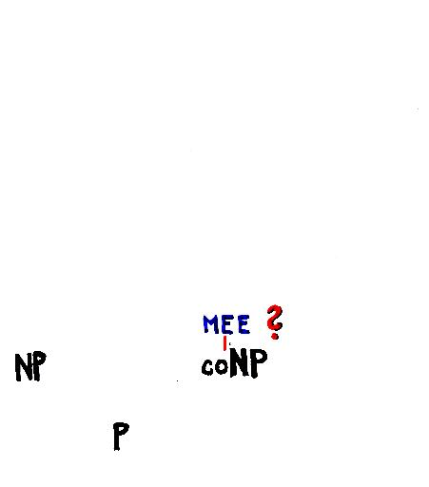
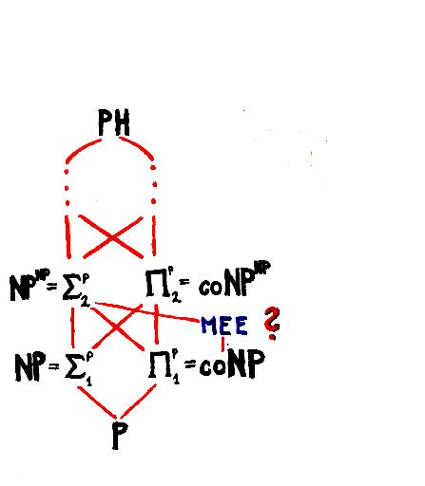
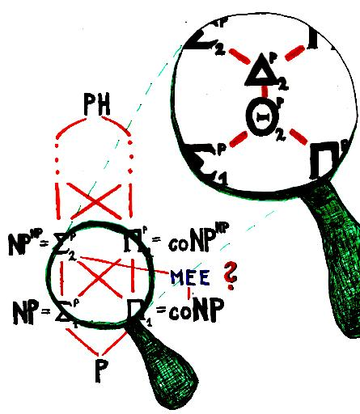
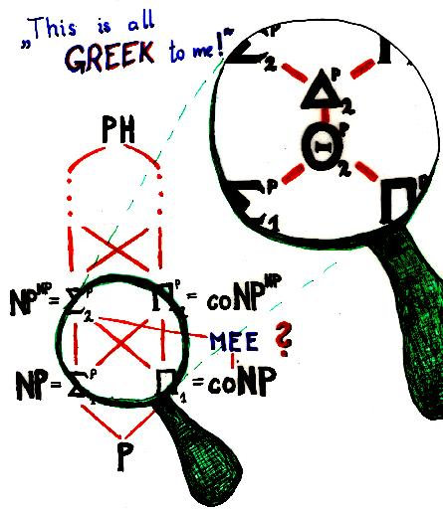
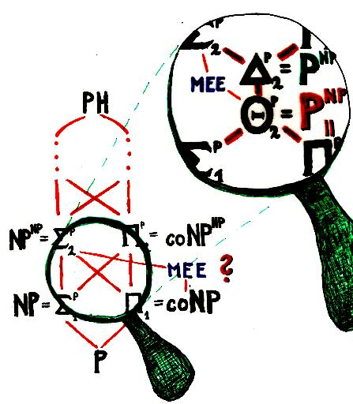
The Polynomial Hierarchy

Slide 31
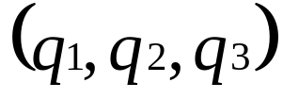
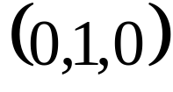




Parallel and Sequential Access to NP
NP oracle
Parallel Access to an NP oracle:
NP
P
||
is the closure of NP under pol-time
truth-table reductions
Query list
Answer list
Accept
Sequential Access to an NP oracle:
Queries may depend on answers to previous
queries, which results in a query tree
More powerful class
NP
P
is the closure of NP under
pol-time Turing reductions

Slide 32




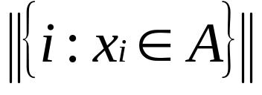
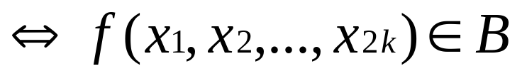
Proof Sketch for Carroll Winner:
Wagner‘s Tool
E. Hemaspaandra, L. Hemaspaandra & J. Rothe (J.ACM 1997):
Carroll Winner and Carroll Ranking are complete for
P : „parallel access to NP.“
NP
||
NP
Lemma 1 (Wagner‘s Tool for P -hardness)
||
Let A be some NP-complete problem, and let B be any set. If there is a polynomial-time computable function such that, for all k and all strings satisfying that
we have
is odd
then B is P -hard.
NP
||

Slide 33









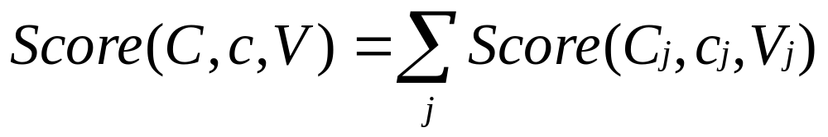
Proof Sketch for Carroll Winner:
Controlled Reduction and Summing Elections
Lemma 2 (Controlled Reduction to Carroll Score)
There is a polynomial-time computable function that reduces the NP-complete problem 3-Dimensional Matching to Carroll Score such that, for all ,
has an odd number of voters.
If 3-Dimensional Matching then .
If 3-Dimensional Matching then .
Lemma 3 (Summation of Carroll Scores)
There is a polynomial-time computable function such that for all k and all Carroll triples
each having an odd number of voters, it holds that
is a Carroll triple
with an odd number of voters, and
.

Slide 34







Proof Sketch for Carroll Winner:
Two-Election Ranking and Merging Elections
Lemma 4 (Two-Election Ranking)
The problem Two-Election Ranking:
is complete for parallel access to NP.
Instance: A pair of Carroll triples, and ,
with and each having an odd number of voters.
Question: Is it true that ?
Lemma 5 (Merging Elections)
There is a polynomial-time computable function such that for all Carroll triples and with and each having an odd number of voters, it holds that
is a Carroll triple,
,
, and
for each .

Slide 35
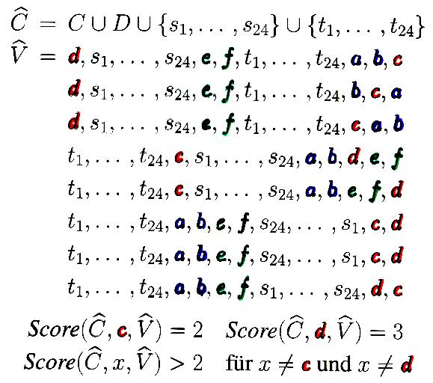
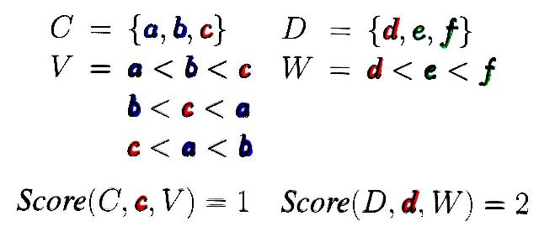
Example of one Construction: Merging Elections

Slide 36
Proof Sketch for Carroll Winner:
Overview
Easy upper bound argument
E. Hemaspaandra, L. Hemaspaandra & J. Rothe (J.ACM 1997):
Carroll Winner is complete for P : „parallel access to NP.“
NP
||
Lemma 5
(Merging Elections)
Lemma 4
(Two-Election Ranking)
Lower bound argument
Via Lemma 1 (Wagner‘s
Tool for P -hardness)
NP
||
Lemma 2 (Controlled
Reduction to Carroll Score)
Lemma 3 (Summation
of Carroll Scores)

Slide 37
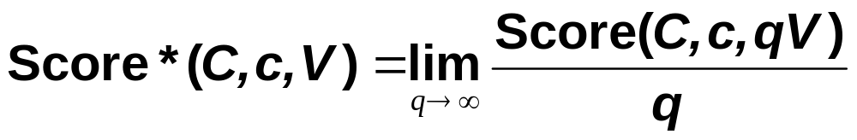
Homogeneous Voting Systems
P. Fishburn showed that:
neither the Carroll SCF (Counterexample with 7 voters and 8 candidates)
nor the Young SCF (Counterexample with 37 voters and 5 candidates)
is homogeneous... BUT they can be made homogeneous by:
J. Rothe, H. Spakowski & J. Vogel (TOCS, 2002):
In the homogeneous case, Carroll*Winner and Carroll*Ranking are efficiently solvable by a linear program.

Slide 38
„Computer Science is not about computers,
any more than astronomy is about telescopes.“
Edsger Dijkstra
Outline
Everything You Always Wanted to Know about...
Some Problems from Social Choice Theory
  Voting Problems: Winner Determination, Manipulation, Control, ...
  Power-Index Comparison and Weighted Voting Games
  Multiagent Resource Allocation
Foundations of Complexity Theory
Problems Complete for NP
Parallel Access to NP and the Polynomial Hierarchy
Probabilistic Polynomial Time and Power Indices
DP and the Boolean Hierarchy over NP

Slide 39
Power Indices –
Banzhaf [1965] and Shapley-Shubik [1954]
Voting game: G = (w₁, …, w_{n}; q). Our notation:
N = {1, …, n} : set of players
w₁, …, w_{n} : weights of players
q : quota value.
3 3 4 q = 6
Banzhaf*(G,i) = how many of the 2^{n-1} subsets of N – {i} have total weight < q but ≥ q-w_{i}?
Banzhaf(G,i) = Banzhaf*(G,i)/2^{n-1}
(Probability that a randomly chosen coalition of players in N – {i} is not successful but player i will put them over the top.)
SS*(G,i) = in how many of the n! permutations of N is i pivotal, i.e., the players before it sum to less than q but player i puts them over the top.
SS(G,i) = SS*(G,i)/n!

Slide 40
Complexity Classes:
PP [Simon/Gill, 1970s] and #P [Valiant, 1979]
#P (Counting NP):
f ∈ #P if there is a nondeterministic polynomial-time Turing machine M such that
#P: standard “counting” version of NP.
PP (Probabilistic Polynomial Time):
L ∈ PP if there is a probabilistic polynomial-time Turing machine that has acceptance probability greater than 50% precisely on the strings in L.
(Or… “on most paths.”)
( ∀x∈Σ*)[ f(x) = number of accepting paths of M on input x].
x ∉ L
x ∈ L
x
M f(x) = 3
R R A
A R A
A A A
Known Results about PP:
NP ⊆ PP
PH ⊆ P^{PP} [Toda, 1991]
P^{PP} = P^{#P} [BBS, 1986]
P^{NP} ⊆ PP [BHW, 1991]
P^{PP} = PP [FR, 1996]
Known Results on PP:
NP ⊆ PP
PH ⊆ P^{PP} [Toda, 1991]
P^{PP} = P^{#P} [BBS, 1986]
P^{NP} ⊆ PP [BHW, 1991]
P^{PP} ⊆ PP [BRS, 1992]
||
||

Slide 41

“Hardest” Problems for Classes: Completeness
#P-completeness:
#P-complete?
Multiple notions!
PP-completeness:
Polynomial-time Many-One Reducibility:
A B ⇔ (∃f∈FP)(∀x∈Σ*)[x∈A ⇔ f(x)∈B].
B is hard for class C if (∀A∈C)[A B].
B is C-complete if B is in C and is hard for C .
Pm
Pm
Complete, yes. But how complete?
f
A
B
f

Slide 42
“Hardest” Problems for Function Classes: Completeness
Definition:
[Krentel, 1988] A function f:Σ*→N metric reduces to a function g:Σ*→N if there exist two FP functions, φ and ψ, such that
(∀x∈Σ*)[ f(x) = ψ( x, g( φ(x) ) ) ].
[Zankó, 1991] A function f:Σ*→N many-one reduces to a function g:Σ*→N if there exist two FP functions, φ and ψ, such that
(∀x∈Σ*)[ f(x) = ψ( g( φ(x) ) ) ].
[Simon, 1975] A function f:Σ*→N parsimoniously reduces to a function g:Σ*→N if there exists an FP function φ such that
(∀x∈Σ*)[ f(x) = g(φ(x)) ].
x
φ(x)
g
ψ
f(x)
φ(x)
g
ψ
f(x)
φ(x)
g
f(x)

Slide 43
“Hardest” Problems for Function Classes: Completeness
Dunno ’bout you, but I’m completely lost!
Reductions for function classes
  parsimonious
  many-one
  metric.
Each defines a completeness notion: f is #P-foo-complete if
  f ∈ #P, and
  each #P function foo-reduces to f.
Examples:
  #SAT is #P-parsimonious-complete [L. Valiant, 1979].
  SS* is #P-metric-complete [X. Deng & C.Papadimitriou, 1994].
#P-metric-complete
#P-many-one-complete
#P-parsimonious-complete

Slide 44
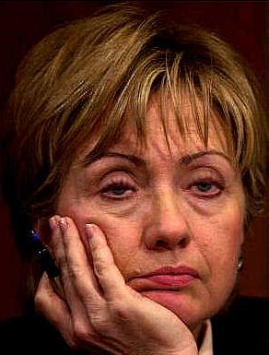
Results for Computing Power Indices
Prasad & Kelly (1990)+Hunt, Marathe, Radhakrishnan & Stearns (1998):
Banzhaf* is #P-parsimonious-complete.
X. Deng & C. Papadimitriou (1994):
SS* is #P-metric-complete.
No, We Can‘t!
P. Faliszewski & L. Hemaspaandra (2008):
SS* is #P-many-one-complete.
SS* is not #P-parsimonious-complete.
P. Faliszewski & L. Hemaspaandra (2008):
SS* is #P-many-one-complete.
No, We Can‘t!
Aha… that complete is SS* for #P!
Question:
Can we do better?
(Can we improve this to #P-many-one-completeness?)
Question:
Can we do better?
(Can we improve this to #P-parsimonious-completeness?)
#P-metric-complete
#P-many-one-complete
SS*
#P-parsimonious-complete

Slide 45
Power-Index Comparison is PP-Complete
Harvard University
Money University
Where will I have more (local) power?
20
papers
20
papers
50
papers
$2M
$5M
$2M
Aha! Clearly, I will have more (local) power at Money University!
But how else can I justify this choice?
4 papers
$10M
Recall: Voting game G = (w₁, …, w_{n}; q).

Slide 46
Power-Index Comparison is PP-Complete
PowerCompare-PI
(where PI is either Banzhaf* or SS*)
Instance: Two voting games, G = (w₁, …, w_{n}; q) and G’ = (w’₁, …, w’_{n}; q’),
and an integer i, 1 ≤ i ≤ n.
Question: Is it true that PI( G, i ) > PI( G’, i )?
P. Faliszewski & L. Hemaspaandra (2008):
PowerCompare-Banzhaf* is PP-complete.
PowerCompare-SS* is PP-complete.
Proof Idea
PowerCompare-Banzhaf* is PP-complete: follows from
  Prasad & Kelly‘s result that Banzhaf* is #P-parsimonious-complete and
  the fact that if f is any #P-parsimonious-complete function then the set Compare-f = { (x,y) | x,y∈Σ* and f(x) > f(y)} is PP-complete.
PowerCompare-SS* is PP-complete: needs different arguments, since SS* is not #P-parsimonious-complete.

Slide 47

Further Results on Weighted Voting Games
E. Elkind, L. Goldberg, P. Goldberg & M. Wooldridge (2007):
Studied the complexity of other aspects of weighted voting games:
  The core
  The least core
  The nucleolus
Notions that help finding
coalitions that are stable
and have fair imputations
Provided:
  Polynomial-time algorithms
  NP-hardness results
  Pseudopolynomial-time algorithms
  Approximation algorithms
If we are done with weighted voting now, we could start cutting a cake!

Slide 48
„Computer Science is not about computers,
any more than astronomy is about telescopes.“
Edsger Dijkstra
Outline
Everything You Always Wanted to Know about...
Some Problems from Social Choice Theory
  Voting Problems: Winner Determination, Manipulation, Control, ...
  Power-Index Comparison and Weighted Voting Games
  Multiagent Resource Allocation
Foundations of Complexity Theory
Problems Complete for NP
Parallel Access to NP and the Polynomial Hierarchy
Probabilistic Polynomial Time and Power Indices
DP and the Boolean Hierarchy over NP

Slide 49
Multiagent Resource Allocation
Set of Agents: A = {1, 2, ..., n}
Set of Resources: R = { }
Each agent a has
  a preference over allocations
  a utility function that assigns values to bundles of resources.
Each resource is indivisible and nonsharable.
An allocation is a mapping P from A to bundles of resources. Useful properties:
  Envy-freeness
  Pareto optimality

Slide 50

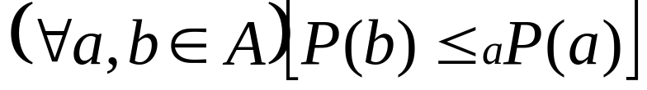

Multiagent Resource Allocation
Set of Agents: A = {1, 2, ..., n}
Set of Resources: R = { }
Each agent a has
  a preference over allocations
  a utility function that assigns values to bundles of resources.
Each resource is indivisible and nonsharable.
An allocation is a mapping P from A to bundles of resources. Useful properties:
  Envy-freeness
  Pareto optimality
An allocation is envy-free if every agent is at least as happy with its share as with any of the other agents‘ shares.
Formally:
An allocation is Pareto optimal if it is not Pareto-dominated by any other allocation. That is, for no allocation does it hold that

Slide 51


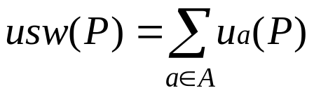



Some Complexity Results in
Multiagent Resource Allocation
Definition: Let be a given resource allocation setting, and let be a given allocation. The utilitarian social welfare of
is defined as the sum of individual utilities:
Welfare Opimization
Instance: Resource allocation setting and a rational .
Question: Does there exist an allocation such that
?
Welfare Improvement
Instance: Resource allocation setting and an allocation .
Question: Does there exist another allocation such that
?
Y. Chevaleyre, U. Endriss, S. Estivie & N. Maudet (2004) and
P. Dunne, M. Wooldridge & M Laurence (2005):
Welfare Opimization and Welfare Improvement are NP-complete.

Slide 52
Some Complexity Results in
Multiagent Resource Allocation
Pareto Optimality
Instance: Resource allocation setting and an allocation .
Question: Is Pareto optimal?
Envy-Freeness
Instance: Resource allocation setting .
Question: Does there exist an envy-free allocation?
Y. Chevaleyre, U. Endriss, S. Estivie & N. Maudet (2004) and
P. Dunne, M. Wooldridge & M Laurence (2005):
Pareto Optimality is coNP-complete.
S. Bouveret & J. Lang (2005):
Envy-Freeness is NP-complete.
For problems that combine Pareto Optimality and Envy-Freeness
they prove complexity results ranging from NP-completeness up to completeness for the second level of the PH.

Slide 53


A Conjecture from the MARA Survey by Chevaleyre et al.
Exact Welfare Optimization
Instance: Resource allocation setting and a rational .
Question: Is the maximum utilitarian social welfare exactly equal to , i.e., is it true that
?
Chevaleyre, Dunne, Endriss, Lang, Lemaitre, Maudet,
Padget, Phelps, Rodriguez-Aguilar & Sousa (2005):
Conjecture: Exact Welfare Optimization is DP-complete.
Examples of DP-complete problems from graph theory:
Exact-4-Color: Given a graph, is its
chromatic number exactly 4?
Rothe (2003): Exact-4-Color is DP-complete.
Exact-4-Color
Exact-4-Color

Slide 54
A Conjecture from the MARA Survey by Chevaleyre et al.
Exact Welfare Optimization
Instance: Resource allocation setting and a rational .
Question: Is the maximum utilitarian social welfare exactly equal to , i.e., is it true that
?
Chevaleyre, Dunne, Endriss, Lang, Lemaitre, Maudet,
Padget, Phelps, Rodriguez-Aguilar & Sousa (2005):
Conjecture: Exact Welfare Optimization is DP-complete.
Examples of DP-complete problems from graph theory:
Exact-4-Color: Given a graph, is its
chromatic number exactly 4?
Rothe (2003): Exact-4-Color is DP-complete.
Min-3-Uncolor: Given a graph, decide
if it is not 3-colorable but removing even
just one vertex makes it 3-colorable?
Cai & Meyer (1987): Min-3-Uncolor is DP-complete.
Min-3-Uncolor
Min-3-Uncolor

Slide 55
A Conjecture from the MARA Survey by Chevaleyre et al.
Exact Welfare Optimization
Instance: Resource allocation setting and a rational .
Question: Is the maximum utilitarian social welfare exactly equal to , i.e., is it true that
?
Chevaleyre, Dunne, Endriss, Lang, Lemaitre, Maudet,
Padget, Phelps, Rodriguez-Aguilar & Sousa (2005):
Conjecture: Exact Welfare Optimization is DP-complete.
Examples of DP-complete problems from graph theory:
Exact-4-Color: Given a graph, is its
chromatic number exactly 4?
Rothe (2003): Exact-4-Color is DP-complete.
Min-3-Uncolor: Given a graph, decide
if it is not 3-colorable but removing even
just one vertex makes it 3-colorable?
Cai & Meyer (1987): Min-3-Uncolor is DP-complete.
Min-3-Uncolor

Slide 56
The Boolean Hierarchy over NP
Defining the Boolean Hierarchy over NP:
Level 0: P (deterministic polynomial time)
Level 1 has two classes:
  NP (nondeterministic polynomial time)
  coNP (the class of complements of problems in NP)
Hey! That reminds me of the polynomial hierarchy!
But what is DP?
Desparate Prayers?
It seems to me that DP is full of
Difficult Problems.
Level 2 has two classes:
  DP = { A-B : A, B ∈ NP } (Difference-NP)
  coDP (the class of complements of problems in DP)
Level k has two classes:
  BH(k) = { L : L is the nested difference of k NP sets }
  coBH(k)
BH is the union of all these levels.
The levels of the BH capture the idea of
„hardware over NP.“

Slide 57
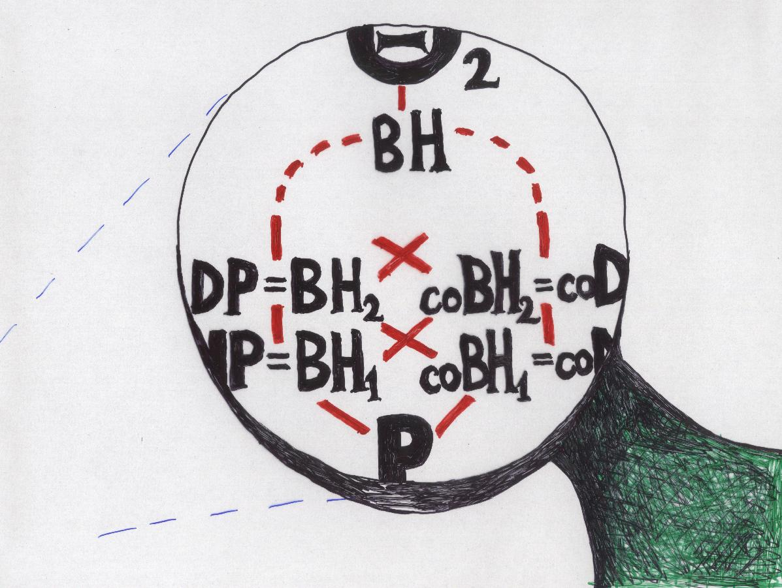
The Boolean Hierarchy over NP

Slide 58
Summary: A Landscape of Complexity Classes
So what do you do in complexity theory? I can’t remember… It was so complicated…
Studying hierarchies:
Pareto Optimal
Envy-Freeness
PSPACE
  Boolean Hierarchy
P^{PP}=P^{#P}
  Polynomial Hierarchy
PH
Probabilistic and
counting classes
NP^{NP}
NP^{NP}
coNP^{NP}
PP=P^{PP}
PP=P^{PP}
Proving problems
complete for
complexity classes
||
||
P^{NP}
PowerCompare-
  Banzhaf*
  SS*
P^{NP}
P^{NP}
Min-3-Uncolor
Exact-4-Color
Exact Welfare Optimization ???
||
||
Carroll Winner
Young Winner
Kemeny Winner
BH
BH
DP
DP
DP
coDP
coDP
Carroll Score
Manipulation for some voting systems
Envy-Freeness
Welfare Optimization
Welfare Improvement
NP
NP
NP
coNP
coNP
coNP
Pareto Optimization
P
P

Slide 59


Any Literature Recommendations?
What if I can read only German?

Slide 60
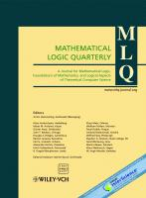
... and a Call for Papers
„Logic and Complexity within Computational Social Choice“
To appear as a special issue of Mathematical Logic Quarterly
Edited by Paul Goldberg and Jörg Rothe
Deadline: September 15, 2008

Slide 61
Thank you!
I hope they won’t ask any questions!

