Slide 1
Manipulation
Toby Walsh
NICTA and UNSW

Slide 2
Manipulation
Constructive
  Can we change result so a given candidate wins
Destructive
  Can we change result so a given candidate does not win

Slide 3
Manipulation
Means to manipulate
  Our vote
  A coalition of voters
  Other voters
    Bribery
  Chair person
    Agenda
    Adding/deleting candidates
    Adding/deleting votes
    ..

Slide 4
An example
Suppose Florida would vote as follows
  49%: Bush>Gore>Nader
  20%: Gore>Nader>Bush
  20%: Gore>Bush>Nader
  11%: Nader>Gore>Bush
Bush wins a plurality vote
  Gore is the Condorcet winner (pairwise winner)
  Nader’s supporters can “manipulate” vote and get a “better” result by voting for Gore

Slide 5
Gibbard-Satterthwaite
All “reasonable” voting rules are manipulable under weak assumptions
  One of social choice’s most fundamental results
  Only limited ways to escape GS
    Restrict how people can vote
    Ensure it is (computationally) difficult to manipulate result
    …

Slide 6
Gibbard-Satterthwaite
Assumptions
  2 or more agents
  3 or more candidates
  Voting rule is onto
    Every candidate is able to win
  Voting rule is strategy-proof
    Voting insincerely does not help
    More precisely, an agent does not improve the result by mis-reporting their preferences

Slide 7
Gibbard-Satterthwaite
Assumptions
  2 or more agents
  3 or more candidates
  Voting rule is onto
  Voting rule is strategy-proof
Conclusion
  Voting rule is dictatorial
    One agent dictates the result

Slide 8
Circumventing Gibbard Sattertwhaite
Limit candidates
  With 2 candidates, plurality is strategy-proof and lacks a dictator
Restrict vote
  For example, only permit single peaked votes
  Then “median” rule is
    Onto
    Strategy-proof
    Non-dictatorial

Slide 9
Other types of manipulation
Control: adding a new candidate
  Borda rule and following votes
    4 agents: A>X>B>C
    3 agents: C>A>X>B
    6 agents: B>C>A>X
    Borda scores: A/24, B/22, C/21, X/11
  It was an advantage for A’s supporters to introduce X into ballot
    Borda scores without X: A/11, B/16, C/12

Slide 10
Other types of manipulation
Control: deleting a candidate
  Borda rule and following votes
    4 agents: A>X>B>C
    3 agents: C>A>X>B
    6 agents: B>C>A>X
    Borda scores: A/24, B/22, C/21, X/11
  It was an advantage for B’s supporters to force/persuade X to drop ou of ballot
    Borda scores without X: A/11, B/16, C/12

Slide 11
Manipulating agenda
Suppose we have a Condorcet cycle:
  Agent1: A>B>C
  Agent2: B>C>A
  Agent3: C>A>B
By choosing agenda, Chair can make anyone win
  A win: play B against C, winner plays A
  B win: play C against A, winner plays B
  C win: play A against B, winner plays C

Slide 12
Computational hardness as a barrier
A successful manipulation is a way of misreporting one’s preferences that leads to a better result for oneself
Gibbard-Satterthwaite only tells us that for successful manipulations exist
  It does not tell us what these manipulations are
Do voting rules exist for which manipulations are computationally hard to find?

Slide 13
A formal computational problem
The simplest version of the manipulation problem:
CONSTRUCTIVE-MANIPULATION:
  We are given a voting rule R, the (unweighted) votes of the other voters, and a candidate p.
  We are asked if we can cast our (single) vote to make p win.
E.g. for the Borda rule:
  Voter 1 votes A > B > C
  Voter 2 votes B > A > C
  Voter 3 votes C > A > B
Borda scores are now: A: 4, B: 3, C: 2
Can we make B win with our single vote?
Answer: YES. Vote B > C > A (Borda scores: A: 4, B: 5, C: 3)

Slide 14
Constructive manipulation
Sometimes (as here) consider manipulation by one voter
  If this is computationally hard, then manipulation with more voters is also
Sometimes consider manipulation by coalition of voters
  More likely to be able to change result!
  More relevant to small committees than general elections?

Slide 15
Bad news: plurality is easy to manipulate by coalition (or single voter)
If want p to win, the best thing to do is vote for p
  If they then win, we have manipulated vote
  If they do not win, there is no manipulation
Hence, we can decide if plurality can be manipulated in polynomial time

Slide 16
Bad news: Borda is easy to manipulate
Greedy algorithm which finds a manipulation (if one exists)
  Place p at top of your vote
  (Repeat) Check every other candidate to see if they can placed next in order without defeating p. If so, place them next otherwise declare no manipulation exists
Hence, we can decide if Borda can be manipulated in polynomial time

Slide 17
Good news: there exist rules which are hard
Theorem. CONSTRUCTIVE-MANIPULATION is NP-complete for the second-order Copeland rule. [Bartholdi, Tovey, Trick 1989]
  Second order Copeland = score is sum of Copeland scores of alternatives it defeats
Theorem. CONSTRUCTIVE-MANIPULATION is NP-complete for the STV rule. [Bartholdi, Orlin 1991]
Most other rules are easy to manipulate (in P)

Slide 18
“Tweaking” voting rules to make them hard
It would be nice to be able to tweak rules:
  Change the rule slightly so that
    Hardness of manipulation is increased (significantly)
    Many of the original rule’s properties still hold
It would also be nice to have a single,universal tweak for all (or many) rules
One such tweak: add a preround [Conitzer & Sandholm IJCAI 03]

Slide 19
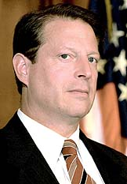
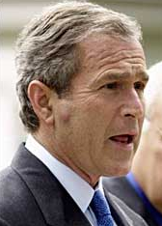

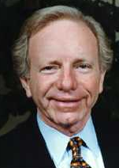
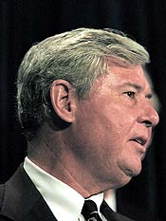
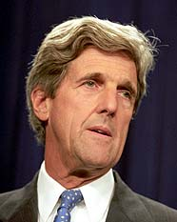
Adding a preround
A preround proceeds as follows:
  Pair the candidates
  Each candidate faces its opponent in a pairwise election
  The winners proceed to the original rule
Original rule

Slide 20
Preround example (with Borda)
  STEP 1:
  A. Collect votes and
  B. Match candidates
  (no order required)
  Voter 1: A>B>C>D>E>F
  Voter 2: D>E>F>A>B>C
  Voter 3: F>D>B>E>C>A
  Match A with B
  Match C with F
  Match D with E
  A vs B: A ranked higher by 1,2
  C vs F: F ranked higher by 2,3
  D vs E: D ranked higher by all
  STEP 2:
  Determine winners of preround
  STEP 3:
  Infer votes on remaining candidates
  Voter 1: A>D>F
  Voter 2: D>F>A
  Voter 3: F>D>A
  STEP 4:
  Execute original rule
  (Borda)
  A gets 2 points
  F gets 3 points
  D gets 4 points and wins!

Slide 21


Matching or vote collection first?
Match then collect
“A vs C,
B vs D.”
“A vs C,
B vs D.”
“D > C > B > A”
Collect then match (randomly)
“A vs C,
B vs D.”
“A > C > D > B”

Slide 22
Could also interleave…
Elicitor alternates between:
  (Randomly) announcing part of the matching
  Eliciting part of each voter’s vote
“A vs F”
“B vs E”
“C > D”
“A > E”
…
…

Slide 23
How hard is manipulation when a preround is added?
Manipulation hardness differs depending on the order/interleaving of preround matching and vote collection:
Theorem. NP-hard if preround matching is done first
Theorem. #P-hard if vote collection is done first
Theorem. PSPACE-hard if the two are interleaved (for a complicated interleaving protocol)
In each case, the tweak introduces the hardness for any rule satisfying certain sufficient conditions
  All of Plurality, Borda, Maximin, STV satisfy the conditions in all cases, so they are hard to manipulate with the preround

Slide 24
What if there are few candidates?
The previous results rely on the number of candidates (m) being unbounded
There is a recursive algorithm for manipulating STV with O(1.62^{m}) calls (and usually much fewer)
E.g. 20 candidates: 1.62²⁰ = 15500
Sometimes the candidate space is much larger
  Voting over allocations of goods/tasks
  California governor elections
But what if it is not?
  A typical election for a representative will only have a few

Slide 25
Manipulation with few candidates
Ideally, would like hardness results for constant number of candidates
But then manipulator can simply evaluate each possible vote
  assuming the others’ votes are known
Even for coalitions of manipulators, there are only polynomially many effectively different votes
However, if we place weights on votes, complexity may return…
  Weighted case informs case where uncertainty about votes
Unbounded #candidates
Constant #candidates
Unweighted
voters
Weighted
voters
Unweighted
voters
Weighted
voters
Individual
manipulation
Can be
hard
Can be
hard
easy
easy
Coalitional
manipulation
Can be
hard
Can be
hard
Potentially
hard
easy

Slide 26
Constructive manipulation with weighted votes
We are given weights and votes of the others
And we are given the weights of a coalition of voters who want to manipulate result
Can the coalition make their preferred candidate p win?
  E.g. Borda example:
  Voter 1 (weight 4): A>B>C, voter 2 (weight 7): B>A>C
  Manipulators: one with weight 4, one with weight 9
  Can we make C win?
  Yes! Solution: weight 4 voter votes C>B>A, weight 9 voter votes C>A>B
    Borda scores: A: 24, B: 22, C: 26

Slide 27
Inverse plurality is NP-hard to manipulate with 3 or more candidates
In NP since we can just give the manipulation
To show NP-hard, we give a simple reduction of PARTITION
  Given m integers ki with sum 2K, is there a partition with sum K?
  Reduce to manipulate election so p wins against a or b
Assume one agent with weight 2K-1 has vetoed p
Each of the votes of the m manipulators has weight 2ki
  their combined weight is 4K
The only way for p to win is if the manipulators can veto a with 2K weight, and b with 2K weight
But this solves the PARTITION problem

Slide 28
Why are many rules easy to manipulate?
Most rules are computationally easy to run
  Hence it is easy to check whether a given vector of votes for the manipulators is successful
The best strategy for the manipulators is often to vote identically
If this is the case then the voting rule is easy to manipulate when the number of candidates is fixed
  Simply check all possible orderings of the candidates (constant)

Slide 29
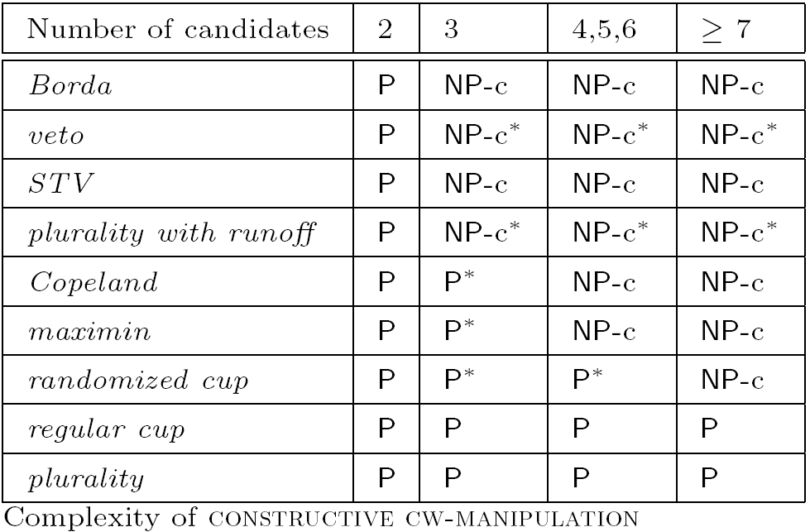
Results for constructive manipulation

Slide 30
Destructive manipulation with weighted votes
Exactly the same, except:
Instead of a preferred candidate
We now have a hated candidate
Our goal is to make sure that the hated candidate does not win (whoever else wins)
  Destructive manipulation can be easy even though constructive manipuation is hard
  If destructive manipulation is hard then so is constructive manipulation
  Reverse does not hold
    E.g. Borda is polynomial to manipulate desctructively but NP-hard constructively for 3 or more candidates

Slide 31
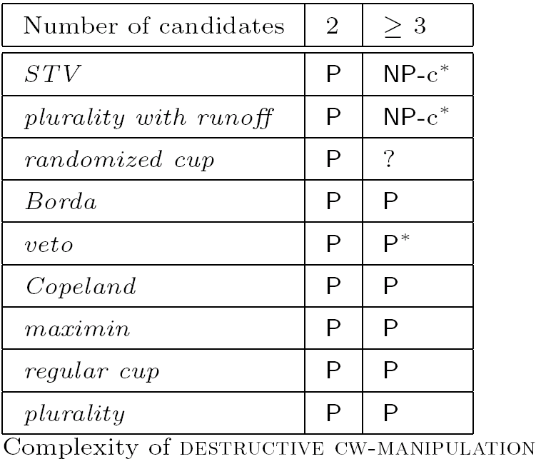
Results for destructive manipulation

Slide 32
Uncertainty about votes
Suppose we have some probability distribution over votes
Weighted manipulation informs us about complexity of reasoning about such uncertainty
  Thm: Constructive manipulation with weighted votes is NP-hard implies computing probability of candidate winning given uncertain votes is NP-hard

Slide 33
Preference elicitation
Also closely related to manipulation
Elicitation is time consuming, costly, difficult, …
  Famous 7 questions!
Want to terminate elicitation as soon as winner fixed
  May be before all votes are collected
  Obama must now win however remaining states and the super-delegates vote

Slide 34
Possible and necessary winners
Necessary winner
  However remaining votes are cast, they must win
  Obama is not yet a necessary winner
Possible winner
  There is a way for remaining votes to be cast so that they win
  Clinton is still a possible winner

Slide 35
Possible and necessary winners
Closely connected to manipulation
  p is possible winner iff there is a constructive manipulation for p
    Clinton is a possible winner and so can still manipulate a future in which she wins!
  p is a necessary winner iff there is not a destructive manipulation for p
    Once Obama wins Pensylvania and is a necessary winner, there is no way for the vote to be manipulated destructively so he is not chosen

Slide 36
Possible and necessary winners
Closely connected to preference elicitation
  Elicitation can only be terminated iff possible winners = necessary winner
  Deciding elicitation is over is in P => computing possible (and necessary) winners is also

Slide 37
Possible and necessary Condorcet winner
Condorcet winner
  Beats all others in pairwise contests
Possible Condorcet winner
  Some way to complete votes so Condorcet winner
Necessary Condorcet winner
  Condorcet winner however votes completed

Slide 38
Possible and necessary Condorcet winner
Polynomial to compute
  Even if votes are weighted and large number of candidates
  To find necessary Condorcet winner, see if one candidate has at least half votes against every other candidate
  To find possible Condorcet winners, put each candidate at top of incomplete votes
  Hence can decide in polynomial time when to terminate preference elicitation when electing Condorcet winner

Slide 39
Possible and necessary Condorcet winner
Polynomial to compute
  Even if votes are weighted and large number of candidates
  To find necessary Condorcet winner, see if one candidate has at least half votes against every other candidate
  To find possible Condorcet winners, put each candidate at top of incomplete votes
  Good news as many authorities have argued that Condorcet winners should be elected when they exist

Slide 40
Manipulating Condorcet winner
Polynomial to decide if coalition of voters can manipulate Condorcet winner
  Each member of coalition just puts desired candidate top of their vote!
  Bad news: we don’t want voting to be (easy to be) manipulable
  Slightly good news: Condorcet consistent rules can still be hard to manipulate (e.g. 2nd order Copeland) but only in what they do when there is no Condorcet winner

Slide 41
Computing possible & necessary winners
Consider specific voting rules
Unweighted votes
Arbitrary number of candidates
  For STV, computing possible winners is NP-hard, and necessary winners is coNP-hard
  Even NP-hard to approximate set of possible winners within constant factor in size
  Many other rules easy!

Slide 42
Computing possible & necessary winners
Weighted votes
Fixed number of candidates
  NP-hard for Borda, veto, STV with 3 or more votes
  NP-hard for Copeland & Simpson with 4 or more candidates
  …

Slide 43
Manipulating (individual) preferences
Previously, we considered manipulating whole votes
What if only certain preferences can be changed?
  Final order must be transitive!
  Certain preferences cannot be changed
    E.g. I am willing for you to bribe me to vote for Clinton in front of Obama, but I will not put a Republican in front of a Democrat however much you pay me
  Makes manipulation more subtle and computationally challenging

Slide 44
Cup rule
Easy to manipulate by coalition
  Constructively or destructively
  Weighted or unweighted votes
  Introduce randomness (and 7 candidates) to make it NP-hard
NP-hard to manipulate individual preferences
  3 or more candidates, weighted votes

Slide 45
Cup rule
Easy to manipulate by coalition
  For simplicity, consider balanced tree and p is leftmost leaf
  In each subtree, to make p win, must be a winner of left subtree, and beat one of winners of right subtree
    Then coalition put all candidates in left subtree above those in right
  Simple recursive algorithm (remember depth is log of candidates) is polynomial

Slide 46
Cup rule
NP-hard to manipulate individual preferences
  Reduction from number partitioning
  Bag of n numbers k_{i} with sum 2k
  Cup in which A plays B and winner then plays C
  Can we make C win?
    1 vote of weight 1: C > B > A
    1 vote of weight 2k-1: C > A > B
    1 vote of weight 2k-1: B > C > A
    n partially specified votes of weight 2k_{i}: A > C
      Possible completions are A > C > B, A > B > C or B > A > C
  A>C in final result by 1 vote
    So B must beat A and C beat B for C to be able to win
    Half weight of unspecified votes: B>A>C, rest: A>C>B

Slide 47
Manipulation with single peaked votes
What if we restrict or know votes have some structure?
  E.g. single peakedness prevents some rules from being manipulated
With single peaked votes, necessary and possible Condorcet winners are polynomial
  Find leftmost & rightmost possible winner
  If they’re the same, this is necessary winner
  Possible winners are all candidates between leftmost and rightmost possible winners

Slide 48
Manipulation with single peaked votes
Possible and necessary winners for STV
  Remains NP-hard with just 3 candidates and weighted votes
Constructive and destructive manipulation of STV
  Remains NP-hard with just 3 candidates and weighted votes

Slide 49
Pre-rounds
Plurality rule
  Polynomial to decide when to terminate elicitation (good)
  Polynomial to manipulate (bad)
Pre-round then plurality
  Remains polynomial to decide when to terminate elicitation (good)
  Becomes NP-hard to manipulate (good)
  Illustrates tension between complexity of manipulation and deciding the termination of preference elicitation

Slide 50
More recent topics
Multi-winner elections
  Committees, …
Other types of manipulation
  Adding/deleting candidates
  Choosing the agenda
  Bribery
  ..
Average-case complexity
  Voting rules that are hard on average

Slide 51
Conclusions
Voting rules are manipulable in general
  GS: 2 voters, 3 or more candidates, …
Two fixes
  Restrict votes (e.g. single peaked preferences)
  Choose rule that is computationally hard to manipulate
Complexity of manipulation
  Depends on number of candidates, weights, voting rule, pre-round, …

