Slide 1
Not Everyone Likes Mushrooms:
Fair Division and Degrees of Guaranteed Envy-Freeness*
Second GASICS Meeting
Computational Foundations of Social Choice
Aachen, October 2009
Claudia Lindner
Heinrich-Heine-Universität Düsseldorf
*To be presented at WINE’09
C. Lindner and J. Rothe: Degrees of Guaranteed Envy-Freeness in Finite Bounded Cake-Cutting Protocols

Slide 2
Overview
Motivation
Preliminaries and Notation
Degree of Guaranteed Envy-Freeness (DGEF)
DGEF-Survey: Finite Bounded Proportional Protocols
DGEF-Enhancement: A New Proportional Protocol
Summary
Fair Division and the Degrees of Guaranteed Envy-Freeness

Slide 3


Motivation
Fair allocation of one infinitely divisible resource
Fairness? ⇨ Envy-freeness
Cake-cutting protocols: continuous vs. finite
⇨ finite bounded vs. unbounded
Envy-Freeness & Finite Boundedness & n>3?
Approximating fairness
  Minimum-envy measured by value difference [LMMS04]
  Approximately fair pieces [EP06]
  Minimum-envy defined by most-envious player [BJK07]
  …
    Degree of guaranteed envy-freeness
Fair Division and the Degrees of Guaranteed Envy-Freeness

Slide 4

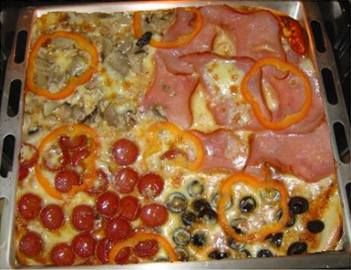










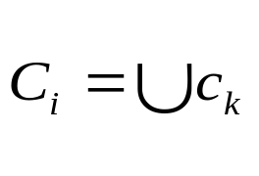
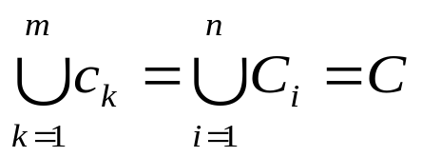


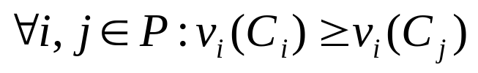
Preliminaries and Notation
Resource ℝ
Players with
Pieces : ∅ ; ∅,
Portions : ∅ ; ∅,
and
Player ‘s valuation function ℝ
Fairness criteria
  Proportional:
  Envy-free:
Fair Division and the Degrees of Guaranteed Envy-Freeness

Slide 5



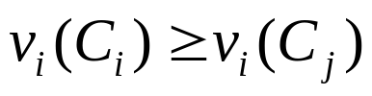
Degree of Guaranteed Envy-Freeness I
Envy-free-relation (EFR)
Binary relation from player to player
for , , such that:
Case-enforced EFRs ≙ EFRs of a given case
Guaranteed EFRs ≙ EFRs of the worst case
Fair Division and the Degrees of Guaranteed Envy-Freeness

Slide 6

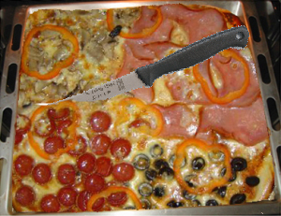










Degree of Guaranteed Envy-Freeness II
Given: Heterogeneous resource ,
Players and
Rules: Halve in size.
Assign to and to .
⇨ G-EFR: 1
Worst case: identical valuation functions
Player : and
Player : and
Best case: matching valuation functions
Player : and
Player : and
⇨ 1 CE-EFR
⇨ 2 CE-EFR
Fair Division and the Degrees of Guaranteed Envy-Freeness

Slide 7
Degree of Guaranteed Envy-Freeness III
  Proof Omitted, see [LR09].
Degree of guaranteed envy-freeness (DGEF)
Number of guaranteed envy-free-relations
≙
Maximum number of EFRs in every division
Proposition
Let d(n) be the degree of guaranteed envy-freeness of a proportional cake-cutting protocol for n ≥ 2 players. It holds that n ≤ d(n) ≤ n(n−1).
Fair Division and the Degrees of Guaranteed Envy-Freeness

Slide 8
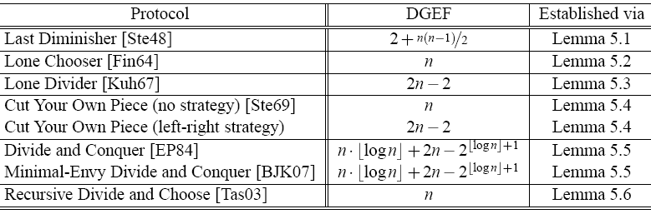
DGEF-Survey of Finite Bounded Proportional Cake-Cutting Protocols
  Proof Omitted, see [LR09].
Theorem
For n ≥ 3 players, the proportional cake-cutting protocols listed in Table 1 have a DGEF as shown in the same table.
Table 1: DGEF of selected finite bounded cake-cutting protocols [LR09]
Fair Division and the Degrees of Guaranteed Envy-Freeness

Slide 9

Enhancing the DGEF:
A New Proportional Protocol I
Significant DGEF-differences of existing finite bounded proportional cake-cutting protocols
Old focus: proportionality & finite boundedness
New focus: proportionality & finite boundedness & maximized degree of guaranteed envy-freeness
Based on Last Diminisher:
  piece of minimal size valued 1/n
  + Parallelization
Fair Division and the Degrees of Guaranteed Envy-Freeness

Slide 10


Enhancing the DGEF:
A New Proportional Protocol II
  Proof Omitted, see [LR09].
  ⇨ Improvement over Last Diminisher:
Proposition
For n ≥ 5, the protocol has a DGEF of .
Fair Division and the Degrees of Guaranteed Envy-Freeness

Slide 11
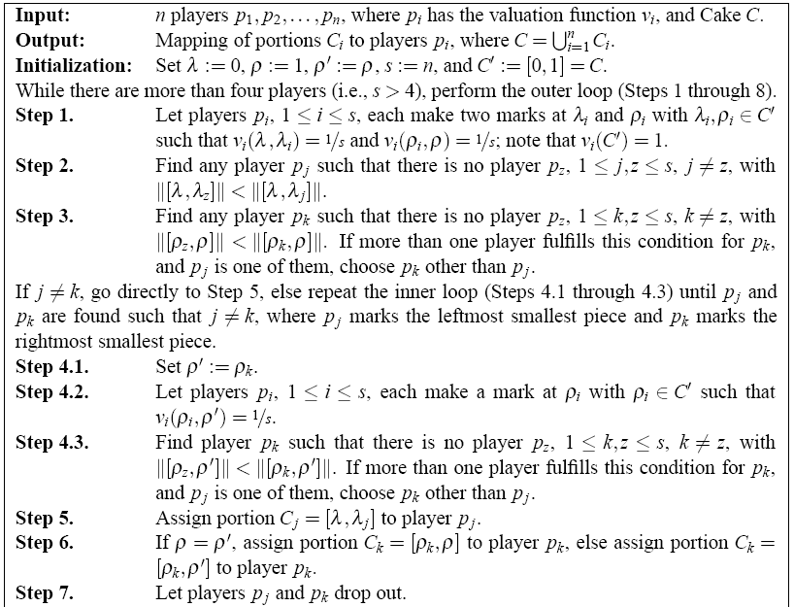
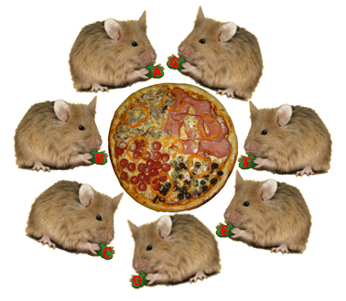
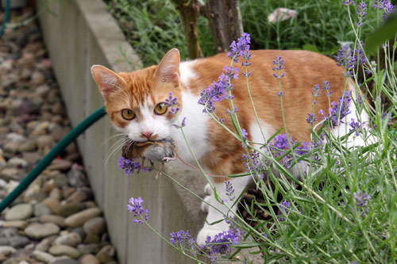
Enhancing the DGEF:
A New Proportional Protocol III
Seven players A, B, …, G and one pizza
Everybody is happy! Well, let’s say somebody…
0
1
A D C B E G F
A F C B E D G
D
D C B E F
D
F C B E D
F D B C E
C
B
Selfridge–Conway [Str80]
F
B
C C
A
D
C
F
B
E
G
…
Fair Division and the Degrees of Guaranteed Envy-Freeness

Slide 12
Summary and Perspectives
Problem: Envy-Freeness & Finite Boundedness & n>3
⇨ DGEF: Compromise between envy-freeness and finite boundedness – in design stage
State of affairs: survey of existing finite bounded proportional cake-cutting protocols
Enhancing DGEF: A new finite-bounded proportional cake-cutting protocol
⇨ Improvement:
Scope: Increasing the DGEF while ensuring finite boundedness
Fair Division and the Degrees of Guaranteed Envy-Freeness

Slide 13
Questions???
THANK YOU
Fair Division and the Degrees of Guaranteed Envy-Freeness

Slide 14
References I
[LR09] C. Lindner and J. Rothe. Degrees of Guaranteed Envy-Freeness in Finite Bounded Cake-Cutting Protocols. Technical Report arXiv:0902.0620v5 [cs.GT], ACM Computing Research Repository (CoRR), 37 pages, October 2009.
[BJK07] S. Brams, M. Jones, and C. Klamler. Divide-and-Conquer: A proportional, minimal-envy cake-cutting procedure. In S. Brams, K. Pruhs, and G. Woeginger, editors, Dagstuhl Seminar 07261: “Fair Division”. Dagstuhl Seminar Proceedings, November 2007.
[BT96] S. Brams and A. Taylor. Fair Division: From Cake-Cutting to Dispute Resolution. Cambridge University Press, 1996.
[EP84] S. Even and A. Paz. A note on cake cutting. Discrete Applied Mathematics, 7:285–296, 1984.
Fair Division and the Degrees of Guaranteed Envy-Freeness

Slide 15
References II
[EP06] J. Edmonds and K. Pruhs. Cake cutting really is not a piece of cake. In Proceedings of the 17th Annual ACM-SIAM Symposium on Discrete Algorithms, pages 271–278. ACM, 2006.
[Fin64] A. Fink. A note on the fair division problem. Mathematics Magazine, 37(5):341–342, 1964.
[Kuh67] H. Kuhn. On games of fair division. In M. Shubik, editor, Essays in Mathematical Economics in Honor of Oskar Morgenstern. Princeton University Press, 1967.
[LMMS04] R. Lipton, E. Markakis, E. Mossel, and A. Saberi. On approximately fair allocations of indivisible goods. In Proceedings of the 5th ACM conference on Electronic Commerce, pages 125–131. ACM, 2004.
Fair Division and the Degrees of Guaranteed Envy-Freeness

Slide 16
References III
[RW98] J. Robertson and W. Webb. Cake-Cutting Algorithms: Be Fair If You Can. A K Peters, 1998.
[Ste48] H. Steinhaus. The problem of fair division. Econometrica, 16:101–104, 1948.
[Ste69] H. Steinhaus. Mathematical Snapshots. Oxford University Press, New York, 3rd edition, 1969.
[Str80] W. Stromquist. How to cut a cake fairly. The American Mathematical Monthly, 87(8):640–644, 1980.
[Tas03] A. Tasnádi. A new proportional procedure for the n-person cake-cutting problem. Economics Bulletin, 4(33):1–3, 2003.
Fair Division and the Degrees of Guaranteed Envy-Freeness

Slide 17

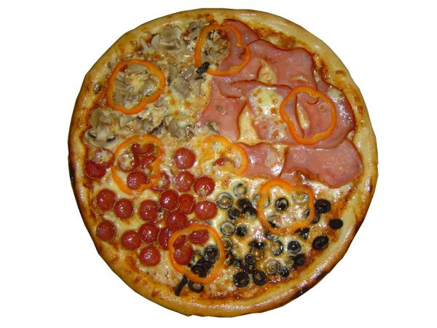
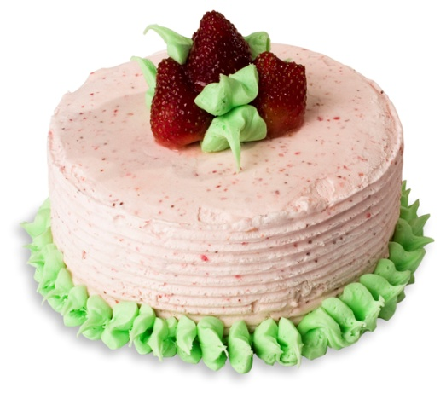
What is it all about?
Multiagent systems
Fair division
Cake-cutting
Fair Division and the Degrees of Guaranteed Envy-Freeness

Slide 18

Preliminaries and Notation II
Fairness criteria
  Simple fair (proportional):
  Strong fair:
  Envy-free:
Envy-free-relation (EFR)
Binary relation between players and for all ,
, such that:
  Intransitive
  One-way or two-way
⇨ proportional
Fair Division and the Degrees of Guaranteed Envy-Freeness

Slide 19












Degrees of Guaranteed Envy-Freeness
Upper and Lower Bound
: ⇨ proportionality ≙ envy-freeness
:
  ⇨ “Anybody with everybody”
  ⇨ “Everybody hates somebody’s piece”
  and for all
  and with
Proposition
Let d(n) be the degree of guaranteed envy-freeness of a proportional cake-cutting protocol for n ≥ 2 players. It holds that n ≤ d(n) ≤ n(n−1).
Fair Division and the Degrees of Guaranteed Envy-Freeness

Slide 20



Enhancing the DGEF:
A New Proportional Protocol III
Per outer loop with players
  Player to be guaranteed EFRs to players
Proposition
For n ≥ 3, the protocol has a DGEF of .
0
1
A D C B E G F
A
Fair Division and the Degrees of Guaranteed Envy-Freeness

Slide 21
Enhancing the DGEF:
A New Proportional Protocol III
Proposition
For n ≥ 3, the protocol has a DGEF of .
0
T
1
A D C B E G F
A F C B E D G
A D C B E G F
A F C B E D G
D
D C B E F
D
F C B E D
F D B C E
A
D
E
G
A
G
Fair Division and the Degrees of Guaranteed Envy-Freeness

Slide 22

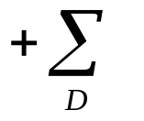



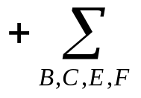









Enhancing the DGEF:
A New Proportional Protocol III
Proposition
0
1
For n ≥ 3, the protocol has a DGEF of .
A D C B E G F
A F C B E D G
D
D
D C B E F
F C B E D
F E B C D
E B C F D
B | C | E | F
A
D
G
Fair Division and the Degrees of Guaranteed Envy-Freeness
Fair Division and the Degrees of Guaranteed Envy-Freeness

Slide 23







Enhancing the DGEF:
A New Proportional Protocol III
Per outer loop with players
  Player to be guaranteed EFRs to players
  Player to be guaranteed EFRs to players
⇨ iterations, i.e.,
  even:
  odd:
⇨
Proposition
For n ≥ 3, the protocol has a DGEF of .
Fair Division and the Degrees of Guaranteed Envy-Freeness

