Slide 1
Not Everyone Likes Mushrooms:
Fair Division and Degrees of Guaranteed Envy-Freeness*
Claudia Lindner and Jörg Rothe
Heinrich-Heine-Universität Düsseldorf
Modelling Interaction, Dialog, Social Choice, and Vagueness
Amsterdam, March 2010
*C. Lindner and J. Rothe: Degrees of Guaranteed Envy-Freeness in Finite Bounded Cake-Cutting Protocols (WINE 2009)

Slide 2
Overview
Motivation
Preliminaries and Notation
Degree of Guaranteed Envy-Freeness (DGEF)
DGEF-Survey: Finite Bounded Proportional Protocols
DGEF-Enhancement: A New Proportional Protocol
Summary
Fair Division and the Degrees of Guaranteed Envy-Freeness

Slide 3


Motivation
Fair allocation of one infinitely divisible resource
Fairness? ⇨ Envy-freeness
Cake-cutting protocols: continuous vs. finite
⇨ finite bounded vs. unbounded
Envy-Freeness & Finite Boundedness & n>3?
Approximating fairness
  Minimum-envy measured by value difference [LMMS04]
  Approximately fair pieces [EP06]
  Minimum-envy defined by most-envious player [BJK07]
  …
    Degree of guaranteed envy-freeness
Fair Division and the Degrees of Guaranteed Envy-Freeness

Slide 4

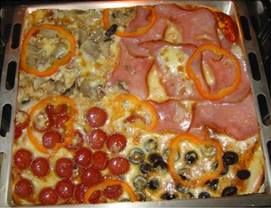










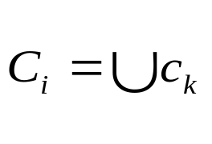
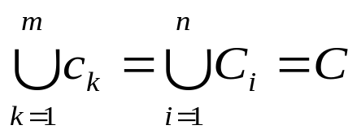

Preliminaries and Notation I
Resource ℝ
Players with
Pieces : ∅ ; ∅,
Portions : ∅ ; ∅,
and
Player ‘s valuation function
  Normalization
  Positivity
  Additivity
  Divisibility
Fair Division and Degrees of Guaranteed Envy-Freeness

Slide 5


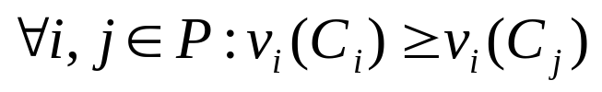



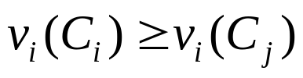
Preliminaries and Notation II
Fairness criteria
  Simple fair (proportional):
  Strong fair:
  Envy-free:
Envy-free-relation (EFR)
Binary relation from player to player for ,
, such that:
Case-enforced EFRs ≙ EFRs of a given case
Guaranteed EFRs ≙ EFRs of the worst case
⇨ proportional
Fair Division and the Degrees of Guaranteed Envy-Freeness

Slide 6

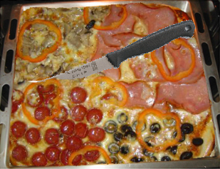










Degrees of Guaranteed Envy-Freeness
Example
Given: Heterogeneous resource ,
Players and
Rules: Halve in size.
chooses and gets .
⇨ G-EFR: 1
Worst case: identical valuation functions
Player : and
Player : and
Best case: complementing valuation functions
Player : and
Player : and
⇨ 1 CE-EFR
⇨ 2 CE-EFR
Fair Division and the Degrees of Guaranteed Envy-Freeness

Slide 7
Degrees of Guaranteed Envy-Freeness
Definition
Degree of guaranteed envy-freeness (DGEF)
Number of guaranteed envy-free-relations
≙
Maximum number of EFRs in every division
Fair Division and Degrees of Guaranteed Envy-Freeness

Slide 8












Degrees of Guaranteed Envy-Freeness
Upper and Lower Bound
: ⇨ proportionality ≙ envy-freeness
:
  ⇨ “Everyone with everyone else”
  ⇨ “Everyone hates someone’s piece”
  and for all
  and with
Proposition
Let d(n) be the degree of guaranteed envy-freeness of a proportional cake-cutting protocol for n ≥ 2 players. It holds that n ≤ d(n) ≤ n(n−1).
Fair Division and Degrees of Guaranteed Envy-Freeness

Slide 9
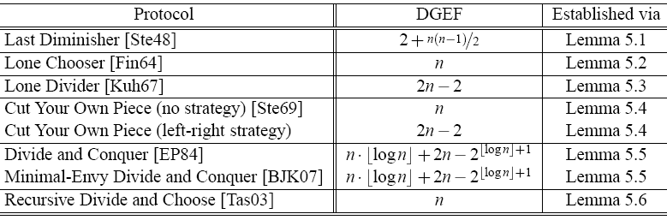
DGEF-Survey of Finite Bounded Proportional Cake-Cutting Protocols
  Proof Omitted, see [LR09].
Theorem
For n ≥ 3 players, the proportional cake-cutting protocols listed in Table 1 have a DGEF as shown in the same table.
Table 1: DGEF of selected finite bounded cake-cutting protocols [LR09]
Fair Division and the Degrees of Guaranteed Envy-Freeness

Slide 10

Enhancing the DGEF:
A New Proportional Protocol I
Significant DGEF-differences of existing finite bounded proportional cake-cutting protocols
Old focus: proportionality & finite boundedness
New focus: proportionality & finite boundedness & maximized degree of guaranteed envy-freeness
Based on Last Diminisher:
  piece of minimal size valued 1/n
  + Parallelization
Properties (n ≥ 3): enhanced DGEF, finite bounded, proportional, strategy-proof & strong fair-adjustable
Fair Division and the Degrees of Guaranteed Envy-Freeness

Slide 11


Enhancing the DGEF:
A New Proportional Protocol II
  Proof Omitted, see [LR09].
  ⇨ Improvement over Last Diminisher:
Proposition
For n ≥ 5, the protocol has a DGEF of .
Fair Division and the Degrees of Guaranteed Envy-Freeness

Slide 12
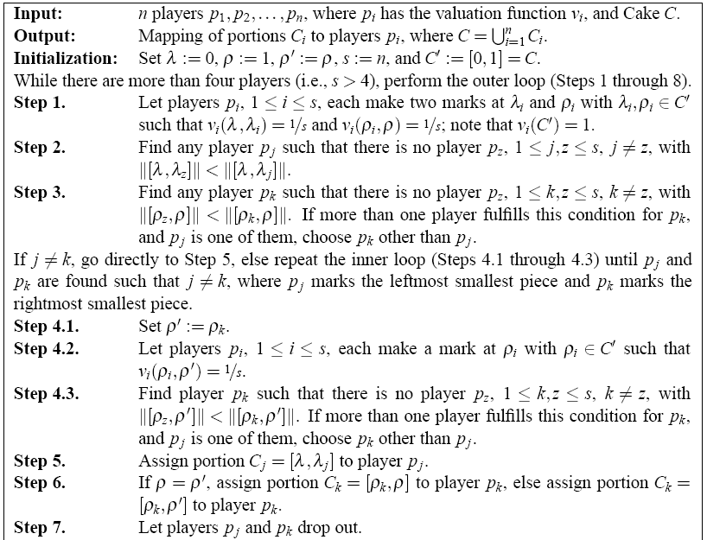
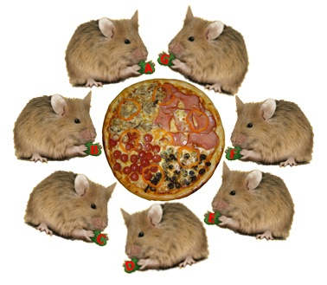
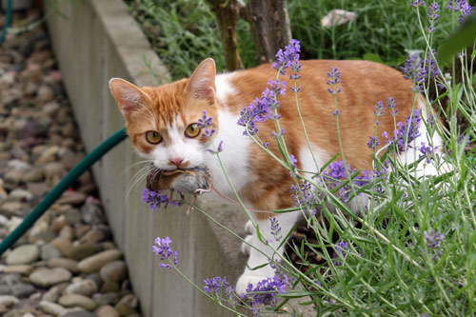
Enhancing the DGEF:
A New Proportional Protocol II
Seven players A, B, …, G and one pizza
Everybody is happy! Well, let’s say somebody…
0
1
A D C B E G F
A F C B E D G
D
D C B E F
D
F C B E D
F D B C E
C
B
Selfridge–Conway [Str80]
F
B
C C
A
D
C
F
B
E
G
…
Fair Division and Degrees of Guaranteed Envy-Freeness

Slide 13
Summary and Perspectives
Problem: Envy-Freeness & Finite Boundedness & n>3
⇨ DGEF: Compromise between envy-freeness and finite boundedness – in design stage
State of affairs: survey of existing finite bounded proportional cake-cutting protocols
Enhancing DGEF: A new finite-bounded proportional cake-cutting protocol
⇨ Improvement:
Scope: Increasing the DGEF while ensuring finite boundedness; balancing the DGEF
Fair Division and the Degrees of Guaranteed Envy-Freeness

Slide 14

Third International Workshop on Computational Social Choice
Düsseldorf, Germany, September 13–16, 2010
Important Dates
Paper submission deadline: May 15, 2010
Notification of authors: June 20, 2010
Camera-ready copies due: July 15, 2010
Early registration deadline: July 15, 2010
Tutorial day: September 13, 2010
Workshop dates: September 14–16, 2010
Fair Division and the Degrees of Guaranteed Envy-Freeness

Slide 15
Questions???
THANK YOU
Fair Division and the Degrees of Guaranteed Envy-Freeness

Slide 16
References I
[LR09] C. Lindner and J. Rothe. Degrees of Guaranteed Envy-Freeness in Finite Bounded Cake-Cutting Protocols. In Proceedings of the 5th Workshop on Internet & Network Economics (WINE 2009), pages 149-159, December 2009.
[BJK07] S. Brams, M. Jones, and C. Klamler. Divide-and-Conquer: A proportional, minimal-envy cake-cutting procedure. In S. Brams, K. Pruhs, and G. Woeginger, editors, Dagstuhl Seminar 07261: “Fair Division”. Dagstuhl Seminar Proceedings, November 2007.
[BT96] S. Brams and A. Taylor. Fair Division: From Cake-Cutting to Dispute Resolution. Cambridge University Press, 1996.
[EP84] S. Even and A. Paz. A note on cake cutting. Discrete Applied Mathematics, 7:285–296, 1984.
Fair Division and the Degrees of Guaranteed Envy-Freeness

Slide 17
References II
[EP06] J. Edmonds and K. Pruhs. Cake cutting really is not a piece of cake. In Proceedings of the 17th Annual ACM-SIAM Symposium on Discrete Algorithms, pages 271–278. ACM, 2006.
[Fin64] A. Fink. A note on the fair division problem. Mathematics Magazine, 37(5):341–342, 1964.
[Kuh67] H. Kuhn. On games of fair division. In M. Shubik, editor, Essays in Mathematical Economics in Honor of Oskar Morgenstern. Princeton University Press, 1967.
[LMMS04] R. Lipton, E. Markakis, E. Mossel, and A. Saberi. On approximately fair allocations of indivisible goods. In Proceedings of the 5th ACM conference on Electronic Commerce, pages 125–131. ACM, 2004.
Fair Division and the Degrees of Guaranteed Envy-Freeness

Slide 18
References III
[RW98] J. Robertson and W. Webb. Cake-Cutting Algorithms: Be Fair If You Can. A K Peters, 1998.
[Ste48] H. Steinhaus. The problem of fair division. Econometrica, 16:101–104, 1948.
[Ste69] H. Steinhaus. Mathematical Snapshots. Oxford University Press, New York, 3rd edition, 1969.
[Str80] W. Stromquist. How to cut a cake fairly. The American Mathematical Monthly, 87(8):640–644, 1980.
[Tas03] A. Tasnádi. A new proportional procedure for the n-person cake-cutting problem. Economics Bulletin, 4(33):1–3, 2003.
Fair Division and the Degrees of Guaranteed Envy-Freeness

