Slide 1
Employee Salary Prediction using Machine Learning
CAPSTONE PROJECT
Presented By:
Alins Binu
Amal Jyothi College of Engineering
Computer Science and Engineering

Slide 2
OUTLINE
Problem Statement
System Development Approach
Algorithm & Deployment
Result
Conclusion
Future Scope
References

Slide 3
PROBLEM STATEMENT
This project aims to predict whether an employee earns more than 50K per year based on demographic and work-related attributes. It addresses the need for automated salary class prediction using historical data. The model uses the UCI Adult dataset and applies machine learning algorithms for classification. By analyzing factors like age, education, hours worked, and more, it classifies income as >50K or <=50K. This can help HR professionals and analysts in quick salary segmentation.

Slide 4
SYSTEM APPROACH
System Requirements:
Platform: Google Colab / Jupyter Notebook
Python 3.8+
RAM: 4 GB minimum
Compatible with Windows/Linux/macOS
Libraries Required:
pandas, numpy — data manipulation
matplotlib, seaborn — visualization
scikit-learn — machine learning (KNN model)
joblib — model saving/loading
streamlit — frontend web app
pyngrok — public hosting for the app via Colab

Slide 5
ALGORITHM & DEPLOYMENT
Data collection from UCI Adult dataset (CSV format). Data preprocessing (cleaning missing values, encoding). Feature selection and splitting data into train/test. Model training using algorithms like KNN. Model evaluation using accuracy and metrics. Model saved using joblib and deployed using Streamlit. Shared via Ngrok for external access.

Slide 6
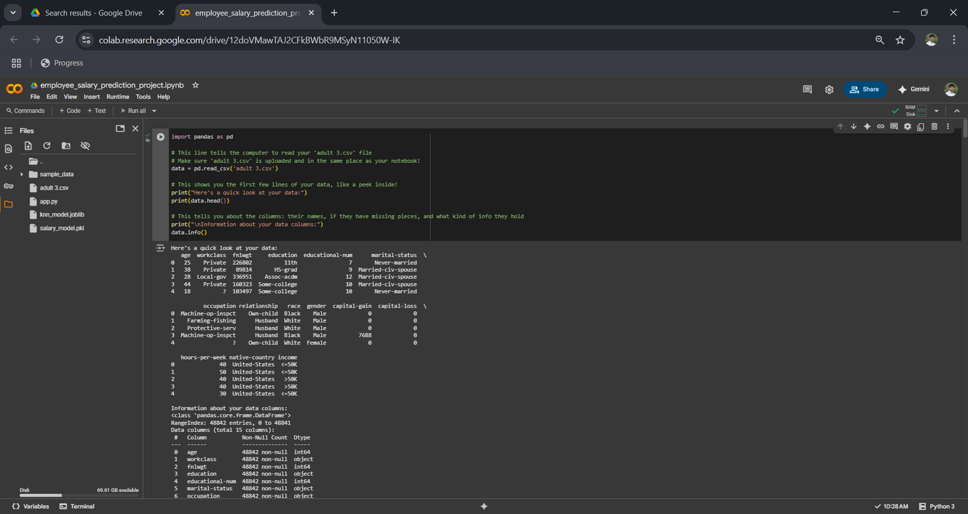
RESULT
Program Introduction

Slide 7
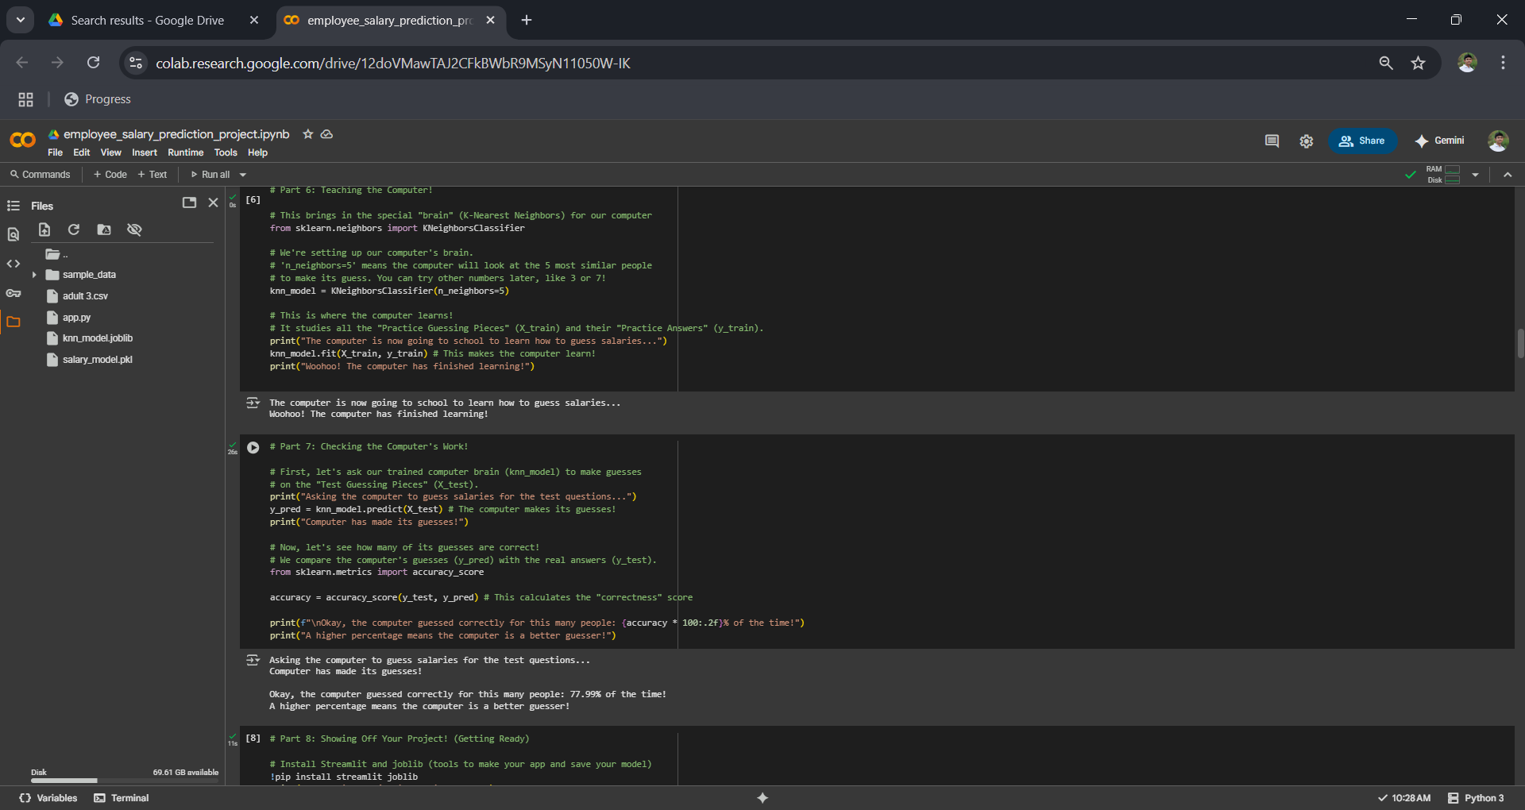
Accuracy Test

Slide 8
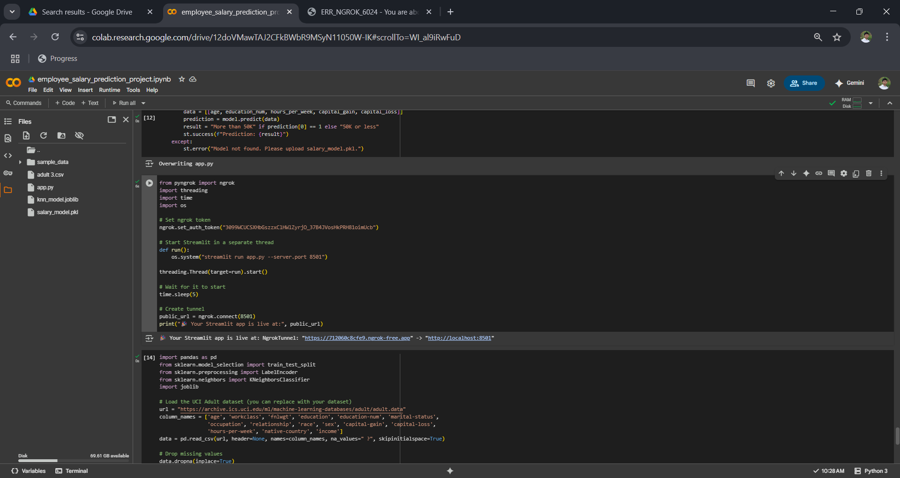
App Creation

Slide 9
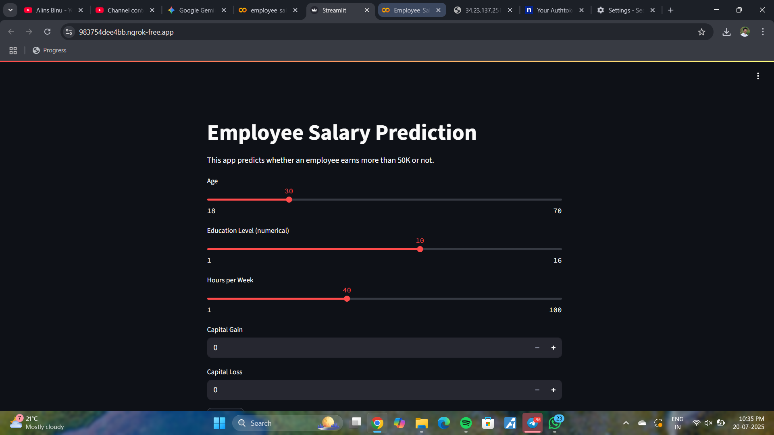
Employee Salary Prediction App

Slide 10
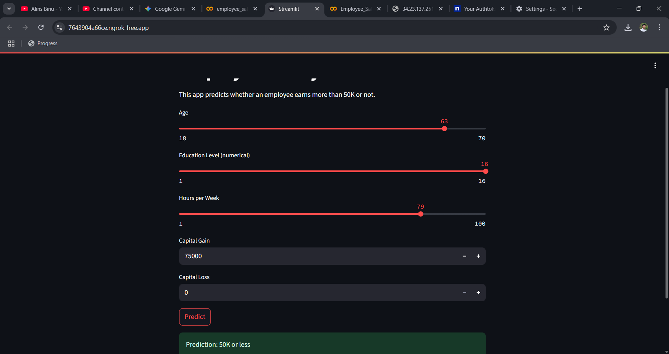
Employee Salary Prediction Test

Slide 11
GITHUB LINK
https://github.com/AlinsBinuP/Employee-Salary-Prediction.git

Slide 12
CONCLUSION
The project successfully demonstrates a machine learning model that can predict employee salary class. The Streamlit app offers an interactive and user-friendly interface. Challenges included handling categorical variables and model deployment. Future improvements could involve testing more algorithms and integrating with a web dashboard.

Slide 13
Future scope
1. Use of advanced algorithms like XGBoost or Neural Networks. 2. Integration with a company’s HR system. 3. Support for real-time batch predictions. 4. Improved UI with analytics dashboard.

Slide 14

REFERENCES
UCI Machine Learning Repository Adult Income Dataset https://archive.ics.uci.edu/ml/datasets/adult
Scikit-learn Documentation https://scikit-learn.org/stable/documentation.html
Streamlit Documentation https://docs.streamlit.io/
Pandas Documentation https://pandas.pydata.org/docs/
Google Colab Used as the development environment https://colab.research.google.com

Slide 15
THANK YOU

