Slide 1

FOR BETTERMENT OF YOUR LIFE

Slide 2
PROJECT TEAM
MD. ALINUR HOSSAIN
ID:20-41855-1
MD. JIDAN RAHMAN
ID:20-41860-1
SAAD MUHAMMOD BIJOY
ID:20-41880-1

Slide 3
AGENDA
01
Introduction
02
Market and audience of this project
03
Objectives of this project
04
Purpose and functionality

Slide 4
INTRODUCTION
Appointment
Emergency Service
01
Get appointment for your health issue from specialized doctor.
02
Get 24/7 emergency ambulance service.
Healthcare Tips
Donation
Order Medicine
03
04
Donate blood and funds for those who are in need of better life.
05
Get any prescribed medicine via trusted sources.
Get healthcare tips based on your BMI.

Slide 5




Market and Audience
1
2
3
4
5
This system is for those people who want proper medical care for themselves to lead a better and healthy life.
Easy to find doctors appointment.
Easy to use emergency ambulance service.
Easy to find prescribed medicines by staying at home
Giving healthcare tips everyday.
Easy to find blood in crucial moment.

Slide 6
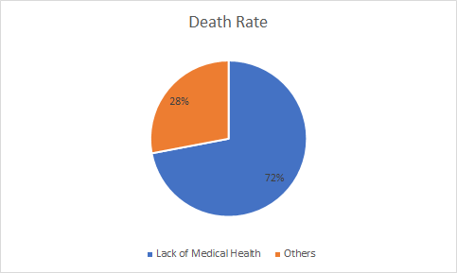
Objective
Helping People
We provide Civic Care System for the betterment of the people. Most of the people of Bangladesh are illiterate. That’s why they don’t have any idea about medicines and medical care. Every year 13 out of 18 people die due to a lack of medical help. In the cities, emergency
services are very hard to get. Many times they can’t reach the emergency places at the
exact time. Many hospitals are giving wrong medication and treatments to the patient and
they are unknown about this. Peoples are having wrong treatment and service every day.
This kind of problem lets people danger their lives. So this problem is so important to
consider.

Slide 7
Purpose
The goal of this software is to give
the people proper medical service.
Most of the people are deprived of
proper medical care for their health
issues. This software helps them to
find the perfect medical service for
them. Because this software is giving all the service in one place. So, it will help all the people who are in need of emergency services in their crucial
time.

Slide 8
Thank you

